Slide 1
Governance reforms and the dynamics of accountability in public services
Katarzyna Lakoma, Dr Peter Eckersley, Prof Peter Murphy
Nottingham Trent University
UKAPA Conference, Birmingham
12-13 September 2024

Slide 2
Accountability of public services
In the public sector, accountability concerns the relationships between public managers, politicians, and citizens (Mulgan 2000).
Public services have been subjected to various governance reforms that invariably promise improved accountability (Dubnick and Yang 2011).
Governance reforms often resulted in multiple accountability demands and shifts in the pattern of accountabilities (Byrkjeflot et al. 2014, Grubnic and Cooper 2019, Hansen et al. 2019, Lakoma 2024).
The nature and form of accountability in the public sector has been changing and has been portrayed as extremely complex (Bovens et al. 2014, Murphy et al. 2019), making public services tangled in a web of different, and often conflicting forms of accountability (Piatak et al. 2018, Aleksovska and Schillemans 2022, Lee 2022).
Notes:
As part of these arrangements, public services take responsibility for their actions and report on them to key stakeholders at various hierarchical levels (Bovens 2007).
Previous studies have sought to investigate the implications of governance reforms on accountability within public sector settings. For example, in welfare, hospitals and migration, local health and social care, in the higher education sector, and in Fire and Rescue Services. They all found changes in accountability arrangements following governance reforms that resulted in greater complexity and multiplicity of accountability types, in with the argument that governance reforms ultimately redefine accountability dynamics (Dubnick 2011).
At times, these reforms have made things more complicated (Haveri 2006).

Slide 3
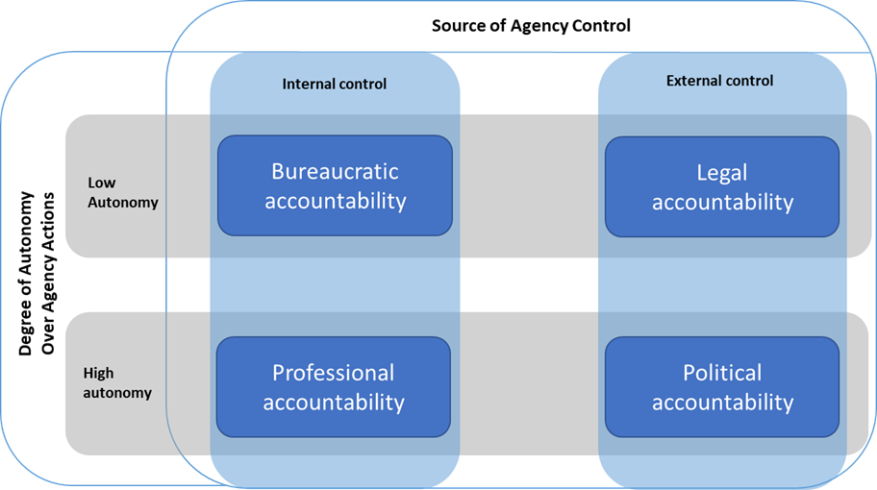
Theoretical perspectives on accountability
Romzek and Dubnick identified four types of accountability: bureaucratic, political, legal, and professional (1987) based on two dimensions – the source of control and the degree of control.
Figure 1: Accountability typology identified by Romzek and Dubnick (1987) and later refined by Romzek (2000)
Notes:
Accountability is being held answerable for one’s actions.
Public services are involved in many accountability relationships.
The source of control identifies whether the ability to define and control expectations is held by some specified entity inside or outside the agency, whereas the degree of autonomy explains the level of autonomy that the agency is given over defining those expectations.

Slide 4
Accountability typology
Type of accountability | Authors | Relationship | Characteristics | Mechanisms
Bureaucratic (Administrative, Managerial, Hierarchical) | Romzek and Dubnick (1987), O’Laughlin (1990), Sinclair (1995), Page (2006), Bovens (2007), Willems and Van Dooren (2011), Lindberg (2013) | Superior – subordinate | Hierarchic, obedience to organisational directives, efficiency | Supervision, rules, regulations
Legal (Judicial) | Romzek and Dubnick (1987), O’Laughlin (1990), Page (2006), Bovens (2007), Willems and Van Dooren (2011), Lindberg (2013) | Policy maker - implementer | Rule of law | Courts, formal judicial trials, and procedures
Professional | Romzek and Dubnick (1987), O’Laughlin (1990), Sinclair (1995), Page (2006), Bovens (2007), Lindberg (2013) | Layperson – expert | Expertise | Expert scrutiny, peer review, standards, values
Political | Romzek and Dubnick (1987), O’Laughlin (1990), Sinclair (1995), Page (2006), Bovens (2007), Willems and Van Dooren (2011), Lindberg (2013) | Constituent – elected representative | External, democratic | Voice, elections, budget control
Table 1: Classifications of accountability (Source: Authors)
Notes:
Over the following years, scholars have, however, attempted to revise the Romzek and Dubnick typology. This is because some believed that the framework missed important accountability types. We believe that introducing new accountability types into Romzek and Dubnick’s conceptualisation may further complicate the already complex nature of accountability rather than help to broaden our understanding of the phenomenon (Dubnick and Yang 2011).
Finding an ideal balance between different forms of accountability remains highly contested in the literature on public sector accountability (Romzek and Dubnick 1987, Kim 2005).

Slide 5
Governance reforms
An underlying rationale for many New Public Management and post-New Public Management reforms has been a desire to improve public services’ accountability, even though this has not necessarily been achieved (Pollitt 2000, Heinrich 2002).
The experience of public management reforms suggests that governance reforms seem to be aimed at certain forms of accountability (Romzek 2000).
They often redefine the forms of accountability inherent in existing governance structures and create new accountability dynamics.
Notes:
Achieving effective accountability (challenge and scrutiny) in the public sector is difficult because of the complexity and ambiguity of their governance arrangements.
Governments in most Western countries have been experiencing increasing pressures to improve public services, which has often led them to introduce governance reforms

Slide 6
Research gap
It remains unclear why and how governments, who ultimately direct and control public services, might seek to improve the accountability of public services through governance reforms in the first place, and how these reforms change existing accountability dynamics within a public service.
Our literature review reveals that governments introduce reforms to try to change the focus of accountability in the public sector following perceived accountability deficits in an attempt to depoliticise an issue and avoid the blame for potentially unpopular decisions (Burnham 2001, Flinders and Buller 2006).
Notes:
Research to date has largely been descriptive when discussing the driving forces behind accountability changes during public reforms (e.g., Byrkjeflot et al. 2014) and have focused on the outcomes of reforms in terms of a broad range of accountability types and relationships (e.g., Christensen and Lægreid 2015).

Slide 7
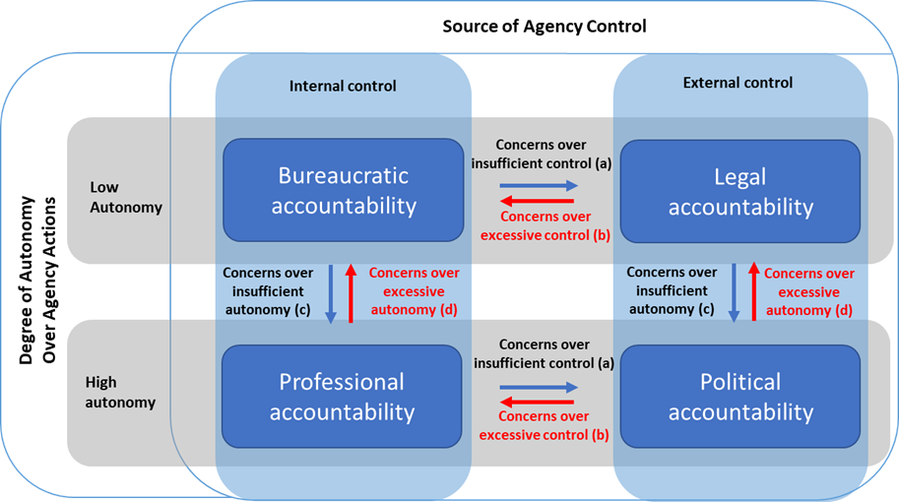
Towards a conceptualisation
Figure 2: Accountability typology identified by Romzek and Dubnick (1987) and later refined by Romzek (2000)
Figure 3: Analytical framework
Source: Authors and adapted from Romzek and Dubnick (1987), Romzek (2000)
Introducing dynamism
Notes:
We now explain how deliberately changing existing accountability dynamics within public services may have consequences for all types of accountability. To do this, we developed an analytical framework (Figure 2) that draws on the prominent accountability typology by Romzek and Dubnick (1987). The conceptualisation uses the two dimensions ‘the source of agency control’ and ‘the degree of autonomy over agency actions’ to explain how accountability dynamics change following governance reforms.
how structures influence the types of accountabilities that may be predominant in governance contexts.
We introduce dynamism into their framework by asking why governments might introduce reforms to try to change the focus of accountability and set out how such reforms may have (unintended) consequences for the other types of accountability.
we propose that they also mean that the focus of accountability shifts from one type to another. We explain why this might happen by drawing on the two dimensions - ‘the source of agency control’ and ‘the degree of autonomy over agency actions’ (Romzek 2000).

Slide 8
Government concern | Governance reforms results in accountability shift | Initial focus of accountability (dimensions) | Expected focus of accountability (dimensions)
a. Insufficient control of an agency | From: Bureaucratic accountability To: Legal accountability | Internal control, low autonomy | External control, low autonomy
 | From: Professional accountability To: Political accountability | Internal control, high autonomy | External control, high autonomy
b. Excessive control of an agency | From: Legal accountability To: Bureaucratic accountability | External control, low autonomy | Internal control, low autonomy
 | From: Political accountability To: Professional accountability | External control, high autonomy | Internal control, high autonomy
c. Insufficient autonomy of an agency | From: Bureaucratic accountability To: Professional accountability | Internal control, low autonomy | Internal control, high autonomy
 | From: Legal accountability To Political accountability | External control, low autonomy | External control, high autonomy
d. Excessive autonomy of an agency | From: Professional accountability To: Bureaucratic accountability | Internal control, high autonomy | Internal control, low autonomy
 | From: Political accountability To: Legal accountability | External control, high autonomy | External control, low autonomy

Slide 9
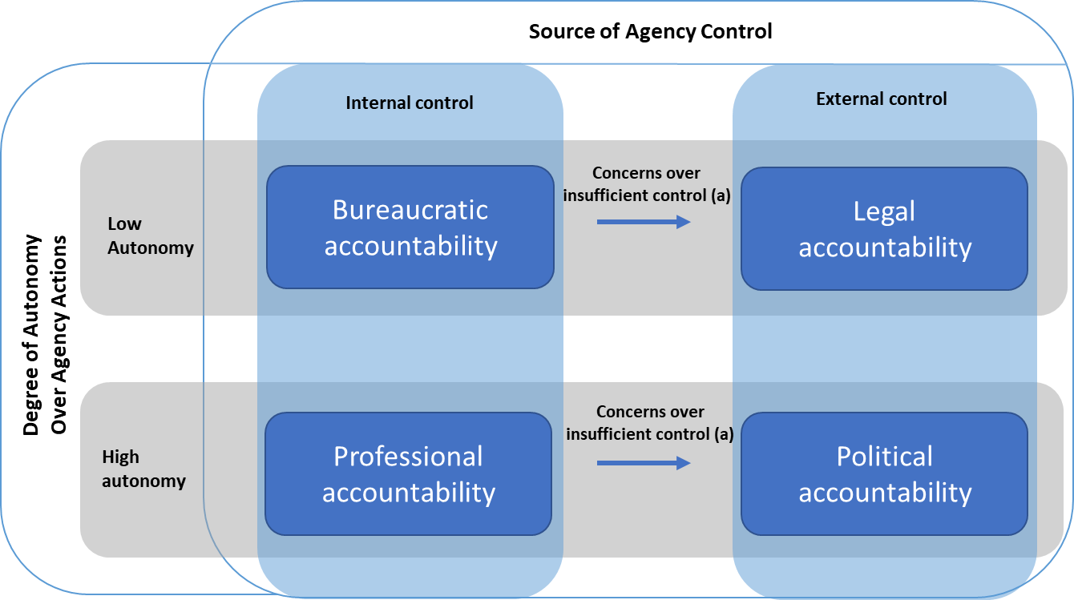
Government concern | Governance reforms results in accountability shift | Initial focus of accountability (dimensions) | Expected focus of accountability (dimensions)
a. Insufficient control of an agency | From: Bureaucratic accountability To: Legal accountability | Internal control, low autonomy | External control, low autonomy
 | From: Professional accountability To: Political accountability | Internal control, high autonomy | External control, high autonomy
Notes:
If a government feels that it has insufficient control of an agency, it may introduce a reform to try to increase it, thereby resulting in a shift to more legal accountability versus bureaucratic accountability and/or more political accountability versus professional accountability, depending on the degree of autonomy.
• Shift away from bureaucratic accountability towards legal accountability
This can happen when government feels that it has insufficient control of public services and wishes to move towards stricter oversight through new legislation, in which external bodies can impose legal sanctions and assert obligations on public services (external control), whilst maintaining low autonomy of public services.
• Shift away from professional accountability towards political accountability
This can happen when government feels that it has relied too much on internal, expert knowledge and wishes to move towards more democratic form of accountability – political accountability, in which ministers and elected politicians oversee decision-making and are politically accountable to citizens (external control), whilst maintaining high autonomy of public services.

Slide 10
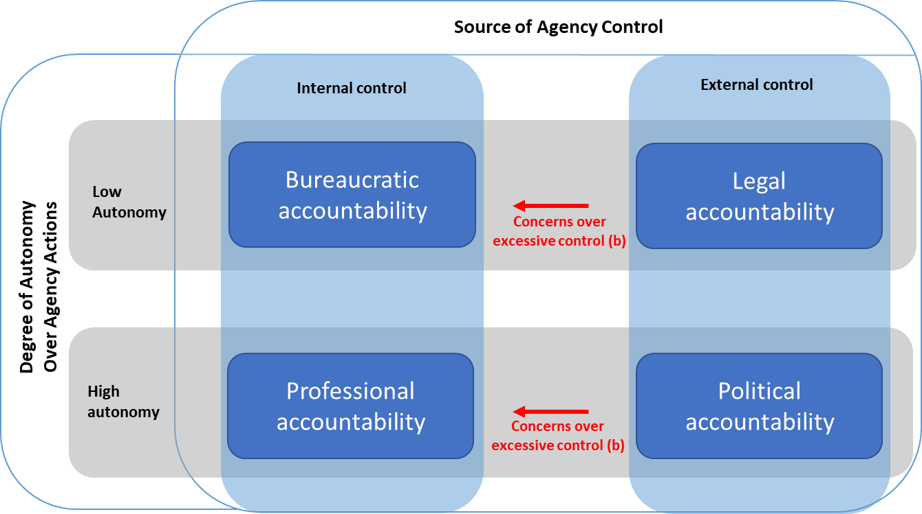
Government concern | Governance reforms results in accountability shift | Initial focus of accountability (dimensions) | Expected focus of accountability (dimensions)
b. Excessive control of an agency | From: Legal accountability To: Bureaucratic accountability | External control, low autonomy | Internal control, low autonomy
 | From: Political accountability To: Professional accountability | External control, high autonomy | Internal control, high autonomy
Notes:
Concerns over excessive external control of an agency (i.e., governments feel they need to exercise more internal control)
If a government is concerned that external bodies exert too much control over a public service, it may pull a lever to try to reduce this, which could result in a shift to more bureaucratic accountability versus legal accountability and/or more professional accountability versus political accountability, depending on the degree of autonomy.
Shift away from legal accountability towards bureaucratic accountability
This can happen when government feels that it has relied too much on external oversight of public services and wishes to move towards more bureaucratic accountability to rely on supervisory control within services (internal control), whilst maintaining low autonomy of public services.
Shift away from political accountability towards professional accountability
This can happen when government feels that it has relied too much on external control of public services through ministers and politicians and wishes to move towards more professional accountability to rely on expert knowledge (internal control), whilst maintaining high autonomy of public services.

Slide 11
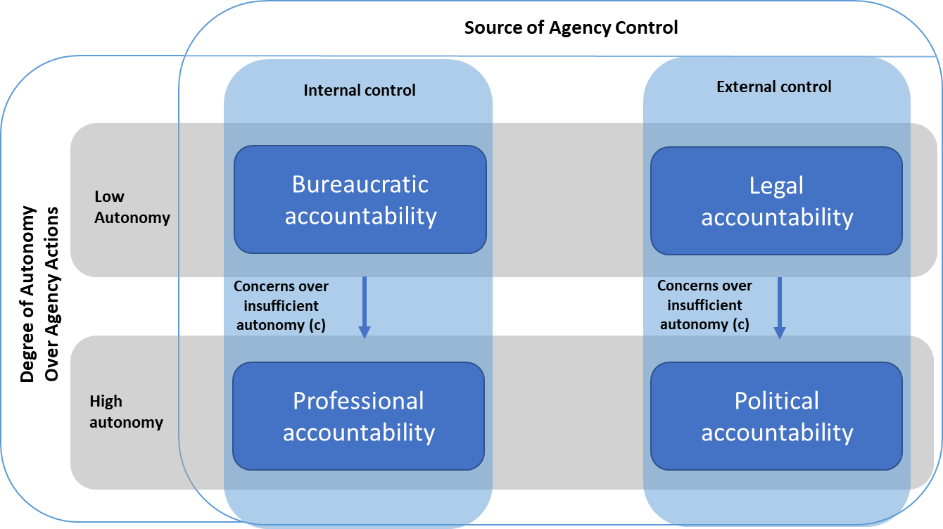
Government concern | Governance reforms results in accountability shift | Initial focus of accountability (dimensions) | Expected focus of accountability (dimensions)
c. Insufficient autonomy of an agency | From: Bureaucratic accountability To: Professional accountability | Internal control, low autonomy | Internal control, high autonomy
 | From: Legal accountability To Political accountability | External control, low autonomy | External control, high autonomy
Notes:
Concerns over insufficient autonomy of an agency (i.e., governments feel they need to increase the agency’s autonomy)
If a government is concerned that a public service has insufficient autonomy over its actions, ministers may seek to reduce their level of scrutiny over the service by introducing reforms that result in a shift to either more professional accountability versus bureaucratic accountability and/or more political accountability versus legal accountability, depending on the source of control.
Shift away from bureaucratic accountability towards professional accountability
This can happen when government feels that public services have insufficient autonomy over their actions by relying on supervisory control within services and wishes to rely on more professional accountability and expert knowledge. This would give public services more discretion over their decisions (high autonomy), whilst maintaining internal control of public services.
Shift away from legal accountability towards political accountability
This can happen when government feels that public services have insufficient autonomy over their actions and there is excessive external oversight. In such a situation, it might wish to move towards more political accountability, in which ministers and elected politicians, as well as other stakeholders, including citizens, are in charge of decision-making (high autonomy), whilst maintaining external control of public services.

Slide 12
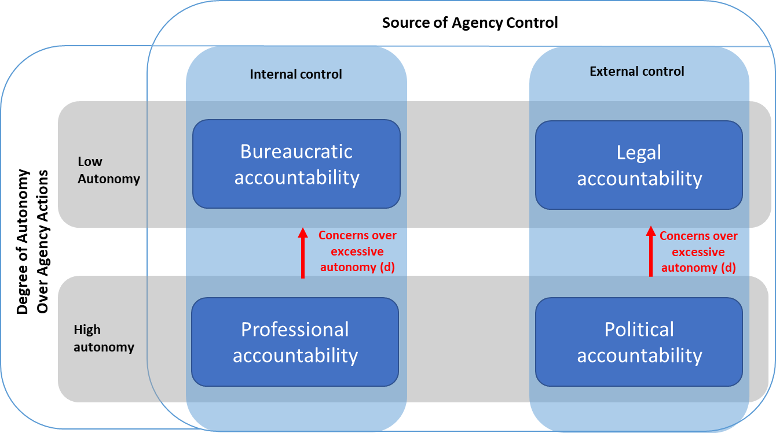
Government concern | Governance reforms results in accountability shift | Initial focus of accountability (dimensions) | Expected focus of accountability (dimensions)
d. Excessive autonomy of an agency | From: Professional accountability To: Bureaucratic accountability | Internal control, high autonomy | Internal control, low autonomy
 | From: Political accountability To: Legal accountability | External control, high autonomy | External control, low autonomy
Notes:
Concerns over excessive autonomy of an agency (i.e. governments feel they need to decrease the agency’s autonomy)
If a government feels that a public service has too much autonomy, it may seek to limit the service’s freedom and increase the level of scrutiny provided by governing bodies and other monitoring agencies. This would result in a shift towards either more bureaucratic accountability versus professional accountability and/or more legal accountability versus political accountability, depending on the source of control.
Shift away from professional accountability to bureaucratic accountability
This can happen when government feels that it has relied too much on professional expertise and wishes to move towards more bureaucratic accountability to rely on supervisory control within services (low autonomy), whilst maintaining internal control of public services.
Shift away from political accountability to legal accountability
This can happen when government feels that ministers or citizens can exercise too much discretion and it therefore wishes to move towards stricter oversight through external bodies that can impose legal sanctions and assert obligations on public services (low autonomy), whilst maintaining external control of public services.

Slide 13
Discussion and conclusions
Our analysis complements and extends the studies of Romzek and Dubnick (1987) and Romzek (2000) because it illustrates real-life accountability dynamics that result from governance reforms.
We explain why governments might seek to improve the accountability of public services through governance reforms, and how these reforms change existing accountability dynamics within a public service.
Governments either extend or reduce control over public services, and/or increase or decrease the service’s autonomy, generally in response to perceived accountability deficits following sudden shocks (e.g. failures, scandals, emergencies, crises).
Governments avoid blame and introduce reforms that shift the accountability focus to other actors (Flinders and Buller 2006).
As such, they change the balance of different types of accountabilities in public services.
Notes:
We draw on the concept of blame avoidance and argue that governments shift their focus of accountability following previously perceived accountability issues
other actors (ranging from local authorities, arm’s-length public agencies to courts, citizens and experts).
We argue that governments routinely shift the focus of accountability to a variety of actors, ranging from local authorities, arm’s-length public agencies to courts, citizens and experts. Flinders and Buller (2006) suggest that with increasingly complex governance structures in the public sector, the more actors involved in the governance structures, the more blame shifting opportunities exist for governments

Slide 14
Thank you
Questions? Comments?
katarzyna.lakoma@ntu.ac.uk

