Slide 1

Reclaiming the Political agenda: a call for action?
Spatialisation, Political Action and Youth Work Methodology:
Parallel or Nexus, is convergence possible?

Slide 2
What?…Focus
Presented through the lens of a pracademic network that has created the space 'for' and 'of' convergence, enabling opportunities to reclaim the political.
Thus, enabling youth work educators' vehicles to continue as agents of social change.
ntu.ac.uk

Slide 3
Why?…Rationale & Purpose
The vehicle and lens of the pracademic network is fostered in a ‘collegiate approach, interpreting community and partnership' in the wider sense as the bases for inclusive engagement between stakeholders.
The value-based methodology of practice is embedded within the fabric of the network throughout.
This enables a horizontal-focused 'space and place' for academics and practitioners to explore challenges in a respectful, facilitative, 'support and challenge'; that creates an develops collective transformational change.
ntu.ac.uk

Slide 4
How?…Context for today
Exploratory Presentation
Participatory Exercise (through the convergence of the P.E.S.T and S.W.O.T analysis tools to identity external and internal factors.)
ntu.ac.uk

Slide 5
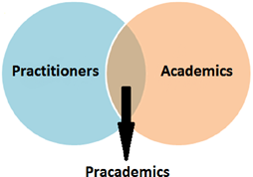
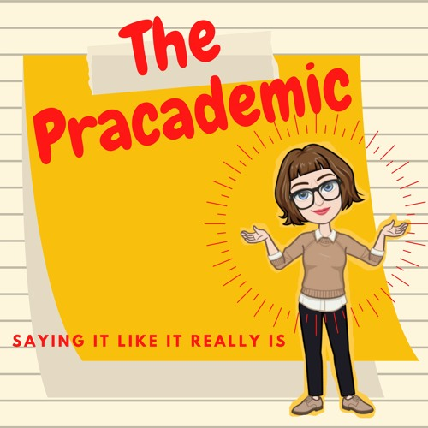
But First…Positionality
"I'm a Pracademic"
Lecturers with first-hand practitioner experience, or pracademics (Panda, 2014), are widely considered to have authority about their subject, whether they realise it or not. They have invested a significant part of their working life into their career to date.
(Stirk, 2023, p. 40)
ntu.ac.uk

Slide 6
Other definitions…Positionality
...pracademic is collaborative and research-oriented characterizing relationships between academics who are interested in practice concerns and practitioners who are reflexive and seek to implement based on research.
(Powell et al, 2018, p. 64)
...a single person who is engaged as a practitioner and a researcher. This pracademic approach to discovery and translation requires facilitators with unique professional characteristics
(Powell et al, 2018, p. 64)
...the collaborator serving as a translator between the research community and the practitioner.
(Powell et al, 2018, p. 65)
ntu.ac.uk

Slide 7
Other definitions…Positionality
...Pracademia allows theoretically enriched knowledge to positively impact on practice (Eacott 2022) and the conversion of theory into reality (Wilson 2015).
(Douglas, Achilleos, Washbrook & Robbins, 2023, p. 5)
'Metaphors for pracademic and pracademia...'
The bridge...not just active in both domains, but in multiple spaces and memberships
The Möbius strip...connected identities informing both spaces
Dismantling the wheel...disassembling the traditional to 'co-create a collective space' .
(Holweck, Netolicky & Campbell, 2022, p. 10)
ntu.ac.uk

Slide 8
Spatialisation notions of phenomena, processes and material things within youth work practice and HEI environments.
Agency, change, development…
New knowledge, deeper learning, new perspectives…
Voluntary engagement, activity, AOP…
Modular delivery, curriculum, assessments…
Places and spaces, trusted adults, resources…
Learning spaces, knowledge experts, reading materials…
...the process of causing something to occupy space or assume some of the properties of space.
(Collins, 2024)
The concept of socio-spatial work leads to the general aim of social development in spatial settings (Homfeldt & Reutlinger, 2009)
(Spatscheck, 2019, p. 12)
ntu.ac.uk

Slide 9
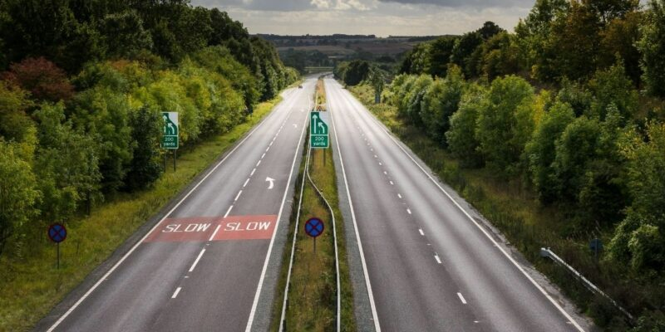
Posits these currently exist in parallel within the neo-liberal context.
Deficit-focused, tokenistic, contain & control…
Marketisation, ideology of knowledge, labour market driven…
Targeted intervention, limited/no resources, predetermined needs…
Consumerism, required assets, assessment driven…
Perceptions of young people, adults as state interveners, limited access…
Collecting rooms, topic producers, protected assets…
ntu.ac.uk

Slide 10
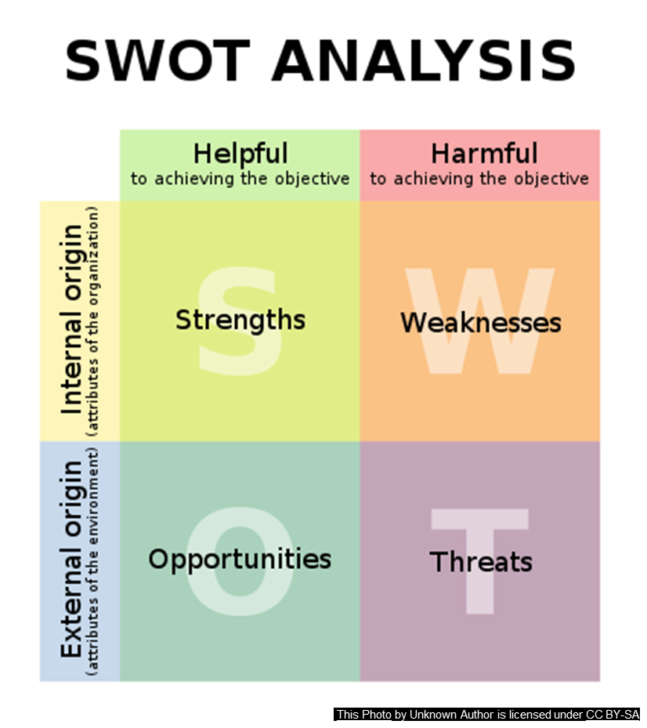
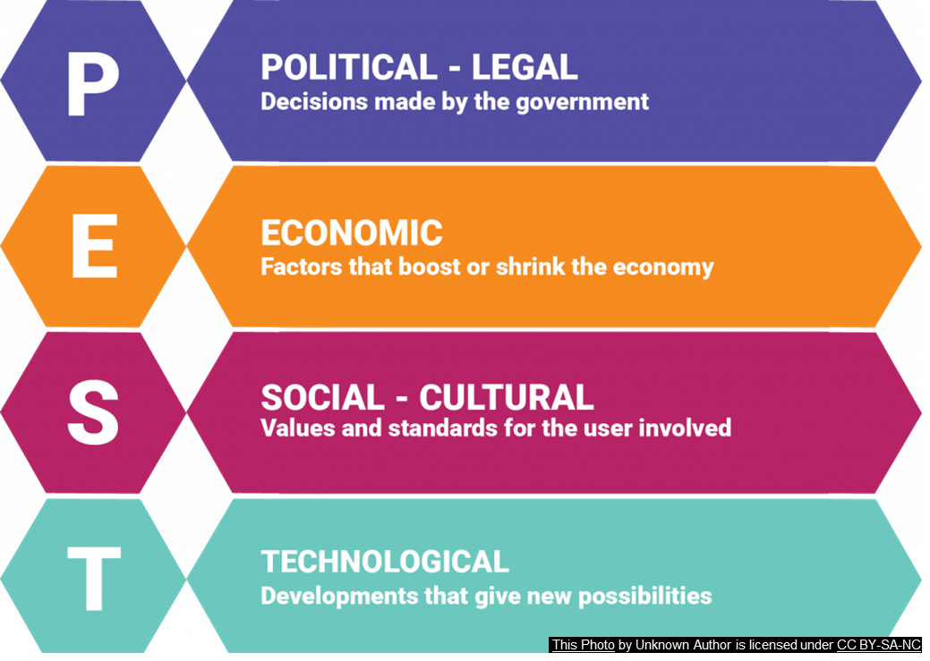
Practice the Practice...Participatory Exercise
PART 1: P.E.S.T
through the convergence of the P.E.S.T and S.W.O.T analysis tools to identity external and internal factors.
www.ntu.ac.uk

Slide 11

Parallel or Nexus, is convergence possible?
...morality may be thought of as a set of normative constraints on attitudes and actions that stem from the fact that we inhabit a common world together with other agents...it may be thought of as a normative nexus that links us individually with each of the persons who might potentially be affected by what we do.
(Wallace, 2019, p. 1)
...an effective academic–practitioner relationship forged to foster and disseminate high-quality research and strengthen nonprofit management education, community service, voluntary action, and philanthropic studies.
(Powell et al, 2018, p. 65)
...a connection or series of connections within a particular situation or system.
(Collins, 2024)
ntu.ac.uk

Slide 12

Pracademic Network…Nexus possibilities
Increased sector voice (practice and teaching & learning)
Collective approach in supporting issues raised
Increased pool of knowledge, skills and expertise
Issues for young people (NTU, 2024)
Youth Professional Practitioner Network
ntu.ac.uk

Slide 13

Pracademic Network…Nexus convergence
…the ability to be ‘problem-posing and solving’, solution focused, imaginative and creative, empathic and understanding, developing opportunities and possibilities, offering alternative suggestions, facilitating shared dialogue etc…to engage with the prescribed challenges faced but creating solutions and practices within the constraining framework of the institution… the willingness to challenge and critique where there exists some form of injustice or ‘control and contain’ infrastructure exists.
(Jones, 2022, p. 3)
www.ntu.ac.uk

Slide 14
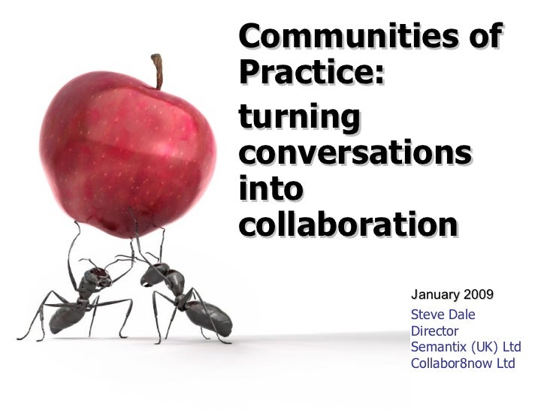
Pracademic Network…Nexus convergence
...a possible ‘community of practice’ can be considered to have been formed.
“…learning is formed from a combination of community, identity, meaning and practice.” (Ord, 2016, p. 220)
This Photo by Unknown Author is licensed under CC BY-SA
www.ntu.ac.uk

Slide 15
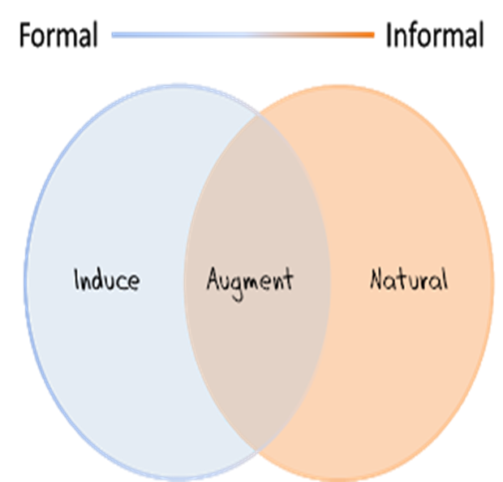
Pracademic Network…Nexus convergence
…[it is often] a spontaneous process of helping people to learn. It works through conversation, and the exploration and enlargement of experience. Its purpose, we suggest, is to cultivate communities, associations and relationships that make for human flourishing
(Jeffs and Smith; 1997, 2005, 2011)
www.ntu.ac.uk

Slide 16
Pracademic Network…Nexus convergence
…as posed by Freire, he notes that ‘informal education is a dialogical (or conversational) rather than a curricula form…’ and that such ‘dialogue involves respect’…
(Smith; 1997, 2002)
www.ntu.ac.uk

Slide 17
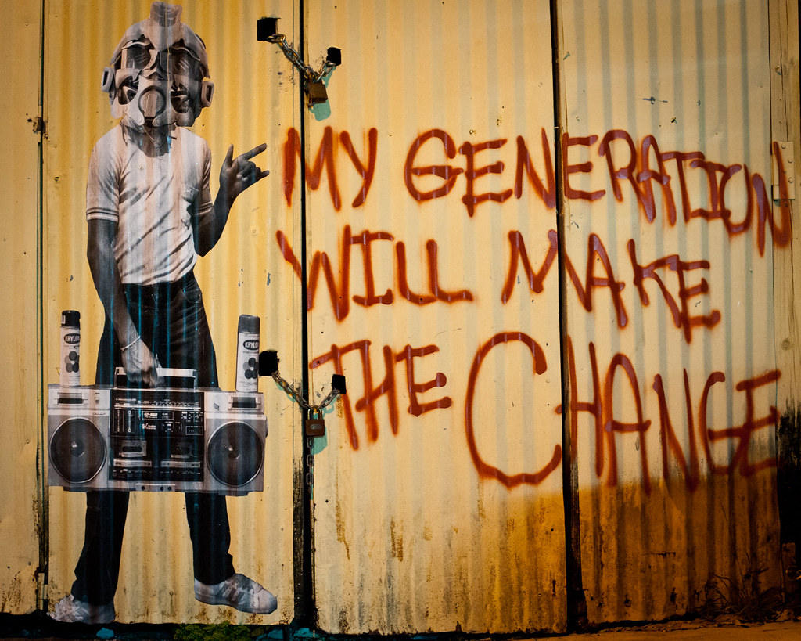
'Vehicles' to continue as agents of social change…Reclaim the Political
In contrast to the unified, centralized movements of the past, Black Lives Matter and #EndSARS fight localized battles and have wide-ranging agendas. These require flexibility and democracy in mobilization that an overly rigid organizational structure would hamper. In other words, demonstrators are connected by a common goal, but tailor demands to best fit their community’s needs and situations — and the movements are organized to do so.
(Sharma, 2021)
www.ntu.ac.uk

Slide 18
Practice the Practice...Participatory Exercise
PART 2: S.W.O.T
through the convergence of the P.E.S.T and S.W.O.T analysis tools to identity external and internal factors.
www.ntu.ac.uk

Slide 19


'Hit from both sides'…'Pracademic double-whammy'
Maintaining the 3 Metaphors for pracademic and pracademia...
The Bridge, The Möbius Strip & Dismantling the wheel
(Holweck, Netolicky & Campbell, 2022, p. 10)
www.ntu.ac.uk

Slide 20
Practice the Practice...Participatory Exercise
PART 3: NEXT STEPS – Call for Action
through the convergence of the P.E.S.T and S.W.O.T analysis tools to identity external and internal factors.
www.ntu.ac.uk

Slide 21

References…
Collins Dictionary (2024) https://www.collinsdictionary.com/
Douglas, H., Achilleos, J., Washbrook, Y. And Robbins, M. Pracademia—Role Modelling HyFlex Digital Pedagogies in Youth Work Education. JAYS (2024). https://doi.org/10.1007/s43151-024-00128-z
Freire, P. (1997) Pedagogy of the Oppressed. London: Penguin Books.
Hollweck, T., Netolicky, D.M. and Campbell, P. (2022), "Defining and exploring pracademia: identity, community, and engagement", Journal of Professional Capital and Community, Vol. 7 No. 1, pp. 6-25. https://doi.org/10.1108/JPCC-05-2021-0026
Jeffs, T. and Smith, M. (2005) Informal education: conversation, democracy and learning. Nottingham: Educational Heretics Press.
Jones, I.D,; Brady, G. (2022) Informal Education Pedagogy Transcendence from the ‘Academy’ to Society in the Current and Post COVID Environment. International Journal of Education Sciences. Special Issue, Educating Informal Educators, 12, 37. https://doi.org/10.3390/educsci12010037
Ord, J. (2016) Youth Work Process, Product and Practice: Creating an Authentic Curriculum in Working with Young People, 2nd ed. Oxon: Routledge.
Powell, E., Winfield, G., Schatteman, A.M. and Trusty, K., 2018. Collaboration Between Practitioners and Academics: Defining the Pracademic Experience. The Journal of Nonprofit Education and Leadership, 8(1),. https://doi.org/10.18666/JNEL-2018-V8-I1-8295
Sharma, M. (2021) Young People, Protest, and Policy: A 21st Century Model of Social Change. Youth & Policy, Young People, Protest, and Policy: A 21st Century Model of Social Change – Youth & Policy (youthandpolicy.org)
Smith, M.K. (1997/2002) Paulo Freire and Informal Education. The Encyclopaedia of Pedagogy and Informal Education. Available online: https://infed.org/mobi/paulo-freire-dialogue-praxis-and-education
Christian Spatscheck (2019) Spatial approaches to social work – theoretical foundations and implications for practice and research, European Journal of Social Work, 22:5, 845-859, DOI: 10.1080/13691457.2018.1550387
Stirk, M. (2023). The Pracademic: Where Practice Meets Theory. The Value of Practitioner Experience when Teaching and Researching in a Higher Education Environment. In: Dickinson, J., Griffiths, TL. (eds) Professional Development for Practitioners in Academia. Knowledge Studies in Higher Education, vol 13. Springer, Cham. https://doi.org/10.1007/978-3-031-33746-8_4
Wallace, R. J. (2019). The Moral Nexus. Princeton University Press. https://doi.org/10.2307/j.ctv3znwhn
www.ntu.ac.uk

