Slide 1
FRS governance: the current state-of- play and HMICFRS Inspection Programme 2025-2027
fireKnowledge
Webinar
Good governance in fire
and rescue: it’s everyone’s
business
Professor Pete Murphy
Nottingham Trent University

Slide 2
Governance, Accountability and Transparency
Higher standards of Governance, Accountability and Transparency are required in democratic administrations when operating in the public interest and spending the public’s money.
Governance, Leadership, Management are overlapping concepts (as are Strategic and Operational Governance) and they are the core concepts in public policy, public service delivery and public assurance.
Accountability in the Public Sector is Complex - it works at both individual and systemic levels and has multiple dimensions e.g., types (political, legal, bureaucratic, professional) directions (vertical, horizontal, diagonal) and temporal (retrospective and prospective).

Slide 3
Good Governance is essential, but it is not a panacea.
Good Governance is an integral part of a cluster of mutually supporting attributes that underpin successful organisations, it is only one part.
These include:
Organisational Culture,
Leadership, throughout all levels (particularly in FRS circumstances)
Strategy and strategic oversight,
Efficient and effective Collaborations and Partnerships
Operational Issues and service delivery
These are all interrelated and based on mutual respect trust and reciprocity.
The key to good organisations is how they deal with relationships

Slide 4
Some basic underpinnings from research
Good governance is like leadership it is everybody's business not just the Senior Leadership Teams.
The purpose of good governance is more than just establishing constitutional arrangements, administrative structures and delegated powers.
The purpose of good governance as shown by CIPFAs Framework is to improve outcomes delivered to the public. (an example from Nottingham City Council)

Slide 5
Learning from other sector governance arrangements
There is no one definitive framework, but the most relevant ones are:
The CIPFA/IFCA Framework
The Local Government Framework
The NHS Framework
The Police Leadership and Standards Framework
The NFCC Project and Corporate Governance
Academics find students benefit most when students compare all these frameworks and see the differences and the reasons for differences

Slide 6
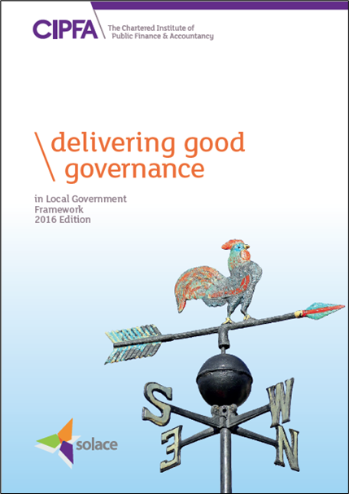
The model of ‘good governance’ in the public sector?
Based on the International Framework Good Governance in the Public Sector (IFCA 2014)
“Delivering Good Governance in Local Government” Framework. (Solace/CIPFA 2016)
A set of principles that should underpin an authority’s:
• Planning, priorities, and objectives
• Decision making
• Policies & procedures
• Culture, values, ways of working

Slide 7
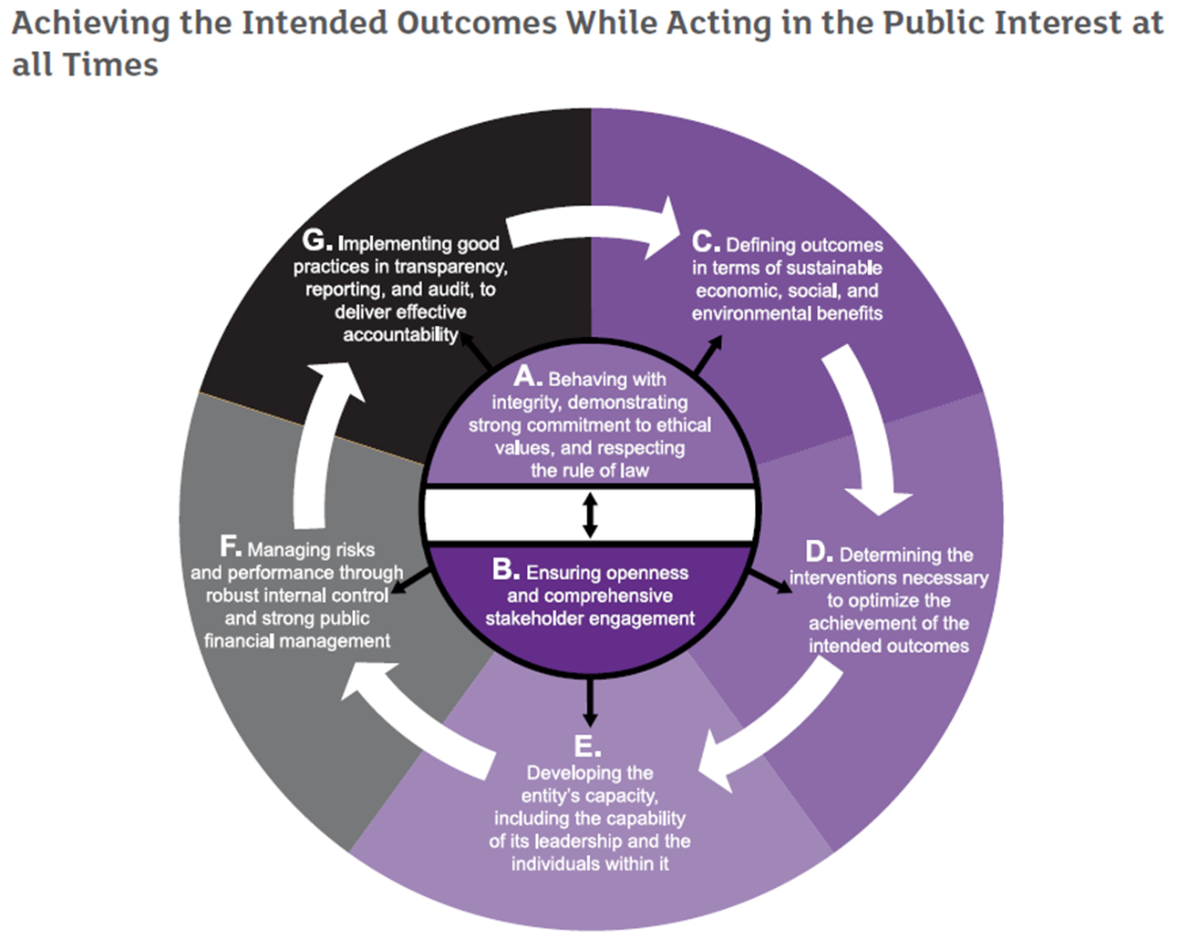
Delivering Good Governance in Local Government, Framework
Definition: Governance comprises the arrangements put in place to ensure that the intended outcomes for stakeholders are defined and achieved.

Slide 8
The origins of Fire Service Governance Local Government
In 1947 the national fire service was transformed into a Local government service (counties and boroughs) and after Local Government Reorganisation in 1974 became the responsibility of County and “upper tier” LAs.
Thus 1947-2001 both Police and FRS were governed by the committee system of LAs which is essentially an indirectly elected stakeholder model of governance.
The Local Government Act 2000 introduced Overview and Scrutiny System which was mandatory for all but smallest district councils.

Slide 9
FRS Governance in the UK Single National Services
Northern Ireland
NI Office and (intermittently) devolved to Stormont; Non-Departmental Public Body; NIFRS Board - the Chair and 10 NEDs appointed by Ministers (4 District Councillors 6 lay members) plus the CFO.
Local authorities much weaker in NI so little robust local scrutiny and no dedicated Inspectorate. Annual financial audits only.
Scotland
Ministers set objectives and expectations in Fire and Rescue Framework 2022 relationships in a Governance and Accountability Framework 2024
SFRS Board a Chair and 14 Non-Executive members appointed by Scottish Ministers with (annual report to parliament).
HM Fire Service Inspectorate (service delivery, local delivery, thematic focussed inspections Dispute determinations (non-domestic). Audit Scotland – annual Audit reports and National reports (2012, 2015, 2018).

Slide 10
FRS Governance Wales & England Multiple Local Services
Wales
3 FRS based on the ‘combined authority’ model’ of governance and Welsh Government provide policy, guidance, objectives and priorities in the FRS national framework 2016
Chief F&R Adviser (and Deputy), undertakes thematic reviews. From 2024 Intervention powers and appointed 4 independent commissioners SWFRS
Audit Wales – annual Audit reports and (positive) national reports in 2012, 2015, 2018.
England
Home Office; 44 FRS with indirectly elected FRAs on Single County, Combined Authority, and Metropolitan FRA (3 models), and directly elected Mayoral, and Fire Police & Crime Commissioners models (2 models).
Policy, delivery and assurance in National Frameworks (latest 2018). HMICFRS undertakes service and thematic inspections and reviews.
Government has Intervention powers since 1999. Annual Audits and NAO reports. External Audit currently acknowledged as “unfit for purpose” (Redmond 2020)

Slide 11
HMICFRS Inspection Programme 2025-2027.
Aspects of Performance previously outside of their evaluations
The impact of FRA governance, oversight and scrutiny of FRS – “we will not inspect governance in the FRA …. only the impact of FRA governance.
Leadership at all levels in FRS.
FRSs’ work to improve community resilience.
We have also identified opportunities to better show the context within which FRSs are operating

Slide 12
FRAs and Community Risk Management Plans
CRMP must identify and assess all foreseeable risks to fire and rescue affecting communities.
HMICFRS will use the plan as a source of information for:
Assessing risk and vulnerability in respect of each service;
Identify the factors that affect public safety; and
How FRS will use prevention, protection and response activities to mitigate risk to communities.

Slide 13
Integrating them into the reports
In the assessment of effectiveness, we will also examine how FRS’s work with local communities to make them more resilience
In the assessment of efficiency, we will combine how FRS uses its resources to manage current risks and how it is planning to manage future risks (so as to concentrate more on outcomes for communities and the workforce).
In people we will add a new section to reports after ‘overall summary’ where we set out the most important findings on the services leadership

Slide 14
Overview and Scrutiny
Overview and Scrutiny model of executive governance derived from parliamentary model (but more extensive) introduced in 2000 Local Government Act 2000 to replace internal scrutiny the committee system
Localism Act 2011 gave option of reverting to committee system which generated concerns over the effectiveness of scrutiny
In 2017 the DCLG Select Committee Inquiry found “the most significant factor in determining whether or not scrutiny committees are effective is the organisational culture of a particular authority” The will as well as the wherewithal?
FRS External Scrutiny by HMICFRS, Auditors and Courts.
PCCs and FPCCs consistently acknowledged to have relatively poor internal scrutiny.

Slide 15
The (under) use of Independent Non-Executive Directors (NEDS)
Use of NEDs adopted from private sector governance model.
2017 Select Committee used evidence from within LAs.
Central Government departments and Non-Departmental Public Bodies adopted NEDs in 2000s
Most evidence available on local public services is from NHS trusts and from Education (primary secondary tertiary and HEIs)
Pre-2012 Health & Social Care Act appears the most effective model (Board is made up of Executive Team and expert NEDS with independent chair)
In non-PFCC authority, PCC or Mayor can attend or nominate a delegate onto the scrutiny panel/committee (Lakoma 2024).

Slide 16
Big take-out messages
The lesson for individual FRA and FRSs
In practice it is all about mutually respectful and supportive relationships and ultimately it is about trust
The real question for the sector
How do you facilitate good governance and good scrutiny both internal and external?

Slide 17
Thank you for listening.

