Slide 1
Lessons from REF 2021 and preparations for REF 2029
Pete Murphy (peter.murphy@ntu.ac.uk)
Nottingham Business School
UoA Panel 17 Business and Management REF2021

Slide 2
What is the Research Excellence Framework?
The Research Excellence Framework (REF) is the UK’s system for assessing the quality of research in UK higher education institutions. Iterations of the REF, variously titled, have been in operation for the last three decades, with the most recent exercise undertaken in 2021 and the next in 2029. The REF has three main purposes:
To provide accountability for public investment in research and produce evidence of the benefits of this investment.
To provide benchmarking information and establish reputational yardsticks, for use within the HE sector and for public information.
To inform the selective allocation of funding for research (circa £2bn pa).
www.ntu.ac.uk

Slide 3
REF 2029 – what we know
There will be a REF! latest information is at https://www.ref.ac.uk/
Delayed by a year, with submissions to be made in Autumn 2028 and results in December 2029.
Three discrete submission elements will remain (outputs (60%), impact (25%), environment (15%) in REF 2021 with some changes:
Contribution to knowledge and understanding (50% weighting) replaces the outputs element. It will largely be based on assessment of research outputs but will also include evidence of broader contributions to the advancement of the discipline.
Engagement and impact (25% weighting) replaces the impact element. It is similar to the impact element of REF 2014 and will consist of impact case studies and an accompanying statement.
People, culture and environment (25% weighting) replaces the environment element and will be expanded to include research culture.
Weightings are all still indicative and subject to confirmation.
www.ntu.ac.uk

Slide 4
REF 2029 – more of what we know
Volume (how much stuff we have to submit) will be based on the average number of staff affiliated with each unit of assessment over two years (2025/6 and 2026/7) as indicated through institutional HESA returns.
Currently, there is no minimum or maximum number of outputs any individual can contribute, though there has been pushback against removing an upper limit. Academic staff on any pathway, technical, research-only staff etc can contribute outputs. Outputs authored solely by doctoral candidates will still be ineligible.
The minimum number of impact case studies required per unit of assessment will drop to one, and there will be a removal of the need for case studies to be underpinned by outputs of at least 2* quality.
Open Access requirements will still exclude longform outputs (books and book chapters) but these will be included in the next REF. Deposit requirements shift from date of acceptance to date of publication for outputs published from 1 January 2026 onwards.
www.ntu.ac.uk

Slide 5
REF 2029 – what we don’t know
The final rules. Policy module to be issued in Autumn/Winter 2024/2025 (including on staff and output eligibility, and codes of practice), draft guidance and consultation in Summer/Autumn 2025, and final guidance published in Winter 2025/2026.
PCE – consultation to determine indicators against which PCE will be measured concluded in autumn 2024. Pilot panels in eight units of assessment have been established to assesses submissions from participating institutions. NTU is participating in pilots in two units of assessment. The outcomes of the pilot will be used to inform the final approach to assessing PCE.
www.ntu.ac.uk

Slide 6
REF panel membership
The call is now open to join REF 2029 panels, with opportunities to join sub-panels as a member (deadline 28 April), chair and deputy chair (deadline 6 February) and others. More details are available here: https://engagementhub.ukri.org/re-ref/7add9cfc/consultation/
Unlike in previous REFs, where nominations had to be made through learned societies and sector bodies, REF 2029 will utilise a self-nomination process. The intention of this is to ‘enhance transparency, broaden the pool of potential applicants, and ensure that the panels reflect the diversity of expertise within each discipline.’
Colleagues wishing to apply are firstly asked to confirm with their line manager that they can be released for the required amount of time to execute the role of sub-panel member and, secondly, inform the Secretary to the NTU REF Planning Group (Anton Muszanskyj) once an application has been submitted.
Applications are encouraged from suitably qualified colleagues, though support for these will need to be balanced with potential volumes of interest and associated resourcing implications for departments and schools.
www.ntu.ac.uk

Slide 7
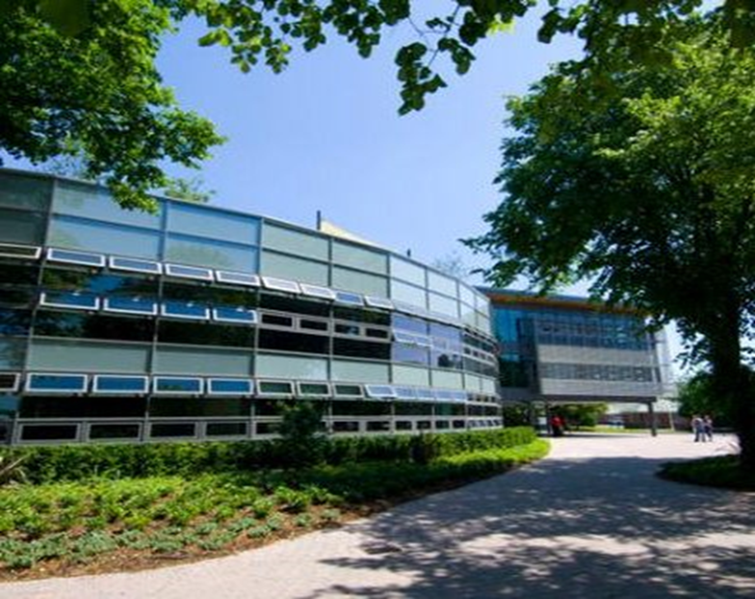
Edge Hill University Business School NBS preparations for the Research Excellence Framework 2021
Professor Pete Murphy
Nottingham Business School

Slide 8
NBS Strategic Leadership Team for Research & REF 2021
Chair of RSG and ADR - Professor Murphy
Vice Chair of RSG (Dean of NBS) - Professor Yazdani
UoA Outputs Assurance Team - Professor Ackrill (.2 FTE)
Associate Professor Ramanathan (.2 FTE)
Associate Professor Thompson (.2 FTE)
Associate Professor Abdo (.2 FTE)
Associate Professor King (.2 FTE)
Coordinator - Research Environment (.2 FTE) - Professor Clark
Coordinator – ECRs Development (.2 FTE) - Prof Collins
Coordinator - Impact Case Studies (.2 FTE) – Murphy

Slide 9
NBS Research Objectives
A sustainable step change in the quality and quantity of research and its outputs and impacts (Overall Objective)
1. Long term: Achieve and retain international accreditations (EPAC, AACSB, EQUIS, AMBA)
2. Medium term: 2021REF
65-85 individuals submitting individual REF outputs 162.5 – 200 plus contingency
6-8 Impact Case Studies
Improved Research Environment
3. Build research infrastructure and sustainability and prepare for next REF

Slide 10
Drivers and processes for delivery
Contractual arrangement and benchmarks (T&R, T&S, T&P)
NTU-wide Annual REF Planning Review Process
Individual Outputs – internal and External Peer Review Process
Impact Case Studies – bi-annual review and external support
Research Environment reviews
NBS - co-ordinated through Research Strategy Group (monthly)
Annual Individual Research Review for allocating research hours
Impact Case Study support Network
Development initiatives – funding, support, visiting scholars

Slide 11
NBS Delivering/assuring individual outputs Six-monthly tranches of outputs
Stage 1
Internal review of individual outputs
1 within the same department 1 from another department
Stage 2
External Peer Assessment
2 or 3 peers off authorised list
Stage 3
Moderation within School
If quality is 3 or 4* add to university database

Slide 12
Delivering and assuring impact case studies (Six-monthly reviews with support from RAND)
Reviewed at School, College and University levels – internal and external support available at School, College and University levels
(increasingly bespoke as case matures).
Review of the case
Summary of nature of Impact
Strategy for academic underpinning
Strategy for non-academic impact
Risk register; risk review and mitigation strategy
Plan B
Road Map or Plan of Action or Benefits Realisation Strategy

Slide 13
Delivering and assuring an Improved Research Environment
Less clear than other two parts
Wider scholastic contributions - Conferences, panels, seminars, editorials, reviewing
PhD and Doctorate performance metrics
Research Infrastructure – Category ‘A’ and Category ‘C’ staff
Development of Early Career Researchers – accommodation; support; financial and academic investment
Interdisciplinary and International developments.

Slide 14
REF2021 ambitions and preparations
2014
24 FTE submitted at 2.5 GPA (180 FTE faculty) (= 48th)
3 Impact Case Studies (Rated 3*/4*) (=18th)
Research Environment (=92nd)
2021 (Objectives)
60-80 FTEs submitted at 3.0 GPA (2020 FTE faculty)
Case Studies 6-7 Impact (Rated 3*/4*)
Research Environment (50th)
2021 Result
57.50 at 2.9
5 Impact Case Studies
Research Environment (5
REF Result 2021

Slide 15
What happened
14 out of 16 units over-achieved with a GPA of 3.0+ for individual outputs - the 2 largest submissions (UoAs A4 and C17) where the exception).
NBS Impact Case Studies significantly underperformed expectations (Rewritten in Feb/March 2021 by Pro-VC Research)
Environment GPA of 2.5 was 3rd lowest of NTUs 14 UoAs
Resulted in a fundamental review and early changes at the centre and in UoAs.

Slide 16
What has happened – structures and processes
Review of REF2021 decisions to include
Only staff in post on census date (no previous colleagues)
Only Staff that were on the T&R pathway
Only PRJAs as part of output submission.
The central infrastructure and quality assurance was considerably strengthened particularly support for ICS and Knowledge Exchange generally
Smaller UoAs consistently received greater support and attention than they had done previously - There was a strong early preference for smaller UoA submissions – since weakened

Slide 17
REF Planning at NTU
Planning for REF 2029 began the moment the submission to REF 2021 was made moved to a continuous REF cycle.
It is overseen by the REF Planning Group, which reports to the University Executive Team, and is chaired by the (new) Pro Vice-Chancellor – Research & International. The Vice-Chancellor is a member. Schools are represented through Associate Deans for Research, with HR, Research Strategy and Operations, Research Culture and Environment, and former REF 2021 sub-panel members also included.
Support from RAND, external reviewers and external consultants deemed disappointing and/or poor vfm.
It meets periodically (typically around 3 times per year) to discuss developments and monitor progress. The autumn meeting is used for a detailed review of all parts of all units of assessment under development.
The focus and cadence of meetings will reflect each phase of the REF cycle (currently middle phase).
www.ntu.ac.uk

Slide 18
REF Planning Timeline – review of Units of Assessment (UoAs) and outputs (subject to change).
Full UoA review by REF Planning Group (Autumn 25)
Full UoA review by REF Planning Group (Autumn 26)
Full UoA review by REF Planning Group (Autumn 27)
Reviews of UoAs by REF Planning Group focusing on specific elements as required
Submission Deadline (Autumn 28)
Tranche 9 output review (Apr 25)
Tranche 10 output review (Oct 25)
Tranche 11 output review (Apr 26)
Tranche 12 output review (Oct 26)
Tranche 13 output review (Apr 27)
Tranche 14 output review (Oct 27)
Tranche 15 output review (Apr 28)
Review of outputs as needed for REF purposes
Submissions approved by REF Planning Group
www.ntu.ac.uk

Slide 19
Planning for contribution to knowledge and understanding
A revised institutional output review process was instigated in 2021 to generate assessments and scoring of outputs produced by NTU researchers.
Scores generated can be used to support various institutional processes, not just REF preparations.
Outputs are reviewed on a biannual basis, and the process is managed by internal panels aligned with REF units of assessment.
External review of some internally-rated outputs, predominantly at boundaries where there was notable attrition between predicted and actual scores in REF 2021. Scores can be adjusted, but only for REF purposes.
www.ntu.ac.uk

Slide 20
NBS Delivering/assuring individual outputs Six-monthly tranches of outputs
Stage 1
Internal review of individual all types of outputs
1 within the same department 1 from another department (within NBS)
Stage 2
External Peer Assessment
2 or 3 peers off authorised list but only 3* and 2/3* boundary - we don’t’ review 4* or 1/2*
Stage 3
Moderation within School
If quality is 3* solid or 4* add to university database

Slide 21
Planning for impact and engagement: strategy, culture, and environment
REF have reintroduced an Impact (and Engagement) Statement, worth 20-50% of UoA impact submission.
NTU new Research Impact Culture Framework is being implemented.
Strengthened Infrastructure and Support: Research Impact Champions/Network, Institute for Knowledge Exchange Practice, Nottingham Civic Exchange, marketing, library/open research…
www.ntu.ac.uk

Slide 22
Planning for impact and engagement: Impact Case Study (ICS) Support
ICS, acknowledged/formally listed centrally - ICS candidates (and future REFS)
Reduction to 1 ICS for small units is ‘big’ for NTU (10 out of our 14 are small).
Continued investment in impact ICS through a new NTU Impact Accelerator Fund (40 out of 85) ICSs supported to date.
Impact activities include IP commercialisation, policy, public engagement etc.
Annual ICS reviews (June-Sept) continued from REF2021.
Regular workshops and writing retreats 2hours, ½, 1, 3, and 5, day duration.
1:1s with strengthened support team (both ICS and KE teams).
www.ntu.ac.uk

Slide 23
Planning for people, culture and environment
Annual data harvest at individual, school/unit of assessment and institutional level.
Active participation in REF PCE consultations and pilots.
Begin to ‘put the jigsaw together’ for institutional and unit of assessment level people, culture and environment statements.
NBS in a week position within NTU given our past performance
www.ntu.ac.uk

Slide 24
Current Progress (Sept 2024)
C17 had Headcount 61 and FTE of 55.65 (June figures); prior to MARS Scheme
Outputs (GPA 3.25) we had 159 3* and 31 4*; Total 190
Impact Case Studies require by current position 4 but expect to need 5/6. In September those acknowledge in development were reduced from 12 to 10 with 5 GGreen and 5 Amber.
PCE: Grant Income (July 2024) £2.6m; PGR numbers static average 15; Networks and esteem-based relationships (and KTPs) internally rated good.
EDI an identified weakness - appraisal and improvement to every part of process and revamped Athena Swan aspirations (Traditional good EDI position in past REFs had declined significantly in 2020/2021).

Slide 25
Thank you for listening
Happy to take any questions

