Slide 1
NBS Showcase #NBSBright: NBS students as business consultants
Dr Amanda Thompson, Head of Personalisation and Experiential Learning
Dr David Candon, Senior Lecturer, Department of Economics

Slide 2
Personalisation and Experiential learning (PEL) at NBS
NBS is known as a leader among business schools in the field of personalisation and experiential learning. We enable our students to live, thrive and succeed in a connected and evolving world by developing their capabilities through high-impact experiential and personalised learning
The PEL team have been instrumental in designing a credit-bearing thread of personal and professional development modules which is core for all students:
Level 4 – Personal and Academic Development
Level 5 – Applied Professional Development
Level 6 – Developing Professional Impact
Tailored versions of these modules exist to ensure content/material is discipline specific
PD modules are a key vehicle within NBS for embedding work/work-like experience within the curriculum
In addition, all students are mentored to select relevant CPD to complement their personal development journey and support their career aspirations

Slide 3
What is #NBSBright?
A summatively assessed live group consultancy experience for final year undergraduate NBS students
Embedded within the core, final year UG personal development module - Developing Professional Impact (DPI), weighted 40% of the module
Runs at scale – 1500+ students per annum
The initiative enables organisations from a wide range of sectors to tap into the talent and creative thinking of Business School students to help solve contemporary business challenges
Culminates with students presenting their findings and recommendations to the client (face to face), under assessment conditions

Slide 4
Benefits of #NBSBright
Students gain real-life consultancy experience to support their employability
The project enhances students’ skill sets in project management, analysis, research, teamworking and communication
The experience is work-like, with ample proximity and authenticity
Participating organisations gain a fresh perspective on the issues they face, for free, and with minimal time commitment
Exposes businesses to ‘soon to be’ graduates, can be an opportunity for talent spotting

Slide 5
Challenges associated with #NBSBright
Sourcing suitable real business challenges for teams of students to tackle
Preparing students to interact with clients
The logistics of arranging c.300 presentations in a short timescale
Managing client and student expectations
Gathering and collating feedback
YOY improvements

Slide 6
Sourcing clients
Target 1 challenge per 2 seminar groups – c. 40 challenges per annum, model has some flexibility within to adapt for fewer than/more than scenarios
Creation of a series of off-the-shelf challenges businesses can select from which we can be assured convert well into a project brief for the students
We retain an option for clients to create their own brief, but the off-the-shelf challenges have significantly reduced the amount of bespoke brief writing for academics
Creation of a landing page and application portal on the NTU website dedicated to #NBSBright
The portal and website enables BDO and academic colleagues to provide a link to prospective organisations and create posts on LinkedIn and other platforms about the opportunity to generate interest among their wider networks
Long lead time - commence campaign early (May), allowing 5 months to secure sufficient challenges

Slide 7
Managing the client experience
Being very up-front about the level of organisational input from the outset (on website & application portal)
Input minimal so as not to deter organisations from participating
1 x 60-90 mins Teams call in Oct, half a day (am or pm) on campus in Nov to listen to presentations from all the groups who worked on the organisation’s challenge
Regular email communications with clients at each stage of the process
Managed via an NBS projects email address which several colleagues access – ensures speedy response to client queries
Once the initiative is underway the seminar tutor acts as the main point of contact to set up the Oct Teams meeting

Slide 8
Preparing students to interact with clients
Series of supporting seminars throughout the consultancy experience, from first distribution of the challenge brief through to the final presentation
Questions vetting by seminar tutor before the Teams call (Oct)
Advice on greeting etiquette, networking and dress expectations prior to the live in-person presentations
Opportunity for a practice presentation to module teaching staff built into seminar time
Seminar tutor present at the presentations to facilitate interaction between clients and groups

Slide 9
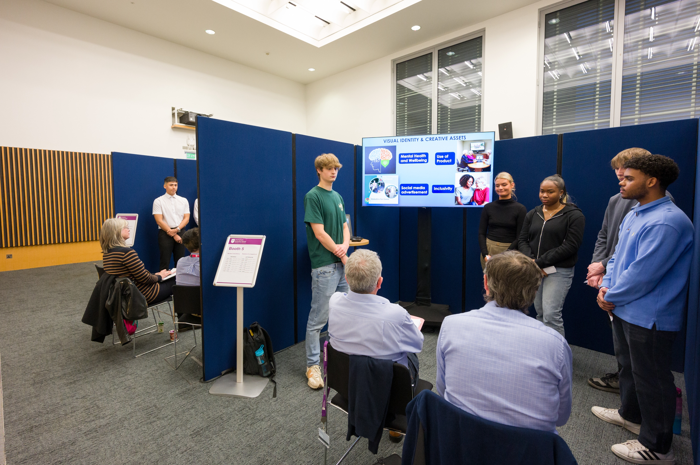
Assessed presentations
Contingency for absent/delayed clients
Use of alumni
Self-contained space for event
Breakout space for ‘am clients and ‘pm clients
Layout in screened off ‘booths’ to minimise sound disruption and allow privacy
Running order for each booth posted on the screen
Preloaded presentations to enable quick turnaround between presentations (synchronised prior submission date for presentations)
Simple criteria and easy to use proforma

Slide 11
I didn't really set any expectations; however, I was quite blown away with what was presented. I was already motivated and excited by what I think C'RIBBE's potential is, but the students collectively added so much more than I thought was possible. It has really opened my mind to the huge possibilities that can be had if efforts are put in the right direction (James Douglas, C’RIBBE)

