Slide 1
The influence of the Global Financial Crisis and COVID-19 pandemic on the profitability and risk of U.S. banks
DR. Thao Nguyen
Dr. CHRIS STEWART
14-01-2025

Slide 2
Outline of the presentation
Objectives
Literature review
Methodology
Results
Conclusions

Slide 3
1. Objectives
We examine the effect of crises on bank profitability and bank risk across 50 U.S. states and the District of Columbia from 1991 to 2022.
We use aggregated annual data
The pandemic caused recessions around the world and lead to the sharpest economic descent in U.S. recorded history. The Covid-19 outbreak also triggered the most rapid and comprehensive set of policy responses ever
The Global Financial Crisis (GFC) of 2007–2009 and the Covid-19 pandemic in 2020 have a significant negative impact on bank profitability.
The Covid-19 pandemic dummy variable in 2021 had a significant and positive impact on bank profits.

Slide 4
2. Literature review
Policymakers learned several lessons from the 2007–2009 Global Financial Crisis (GFC) and the GFC changed the goals of bank regulation. Before the GFC the main goals were largely micro-prudential in nature, aiming to promote the safety and soundness of individual financial institutions. After the GFC, policymakers increasingly adopted a macro-prudential approach, recognizing that, in the presence of fire-sale and credit-crunch externalities, they must take steps to promote the soundness and stability of the whole financial system (Hanson et al., 2011 and Blank et al., 2020).
Some economies such as China, Brazil and Vietnam were not as drastically affected by the GFC as other countries because free international capital mobility was limited for these nations, or the financial market did not attract much foreign capital in the first place. In contrast, the Covid-19 pandemic dramatically affected all nations as countries could not close borders for too long. While research on the impacts of the Covid-19 pandemic on banking and financial systems are increasing the final effect of this crisis is still unknown (Goodell, 2020; Berger and Demirguc-Kunt, 2021; Berger et al. 2021)

Slide 5
3. Methodology
We consider short run dynamic models of bank profitability (equation 1) and bank risk (equation 2) and include a lagged dependent variable to allow for possible dynamics (McMillan and McMillan, 2012; Apergis, 2014; Tran et al., 2016; Koutoupis and Malisiovas, 2021).
(1)
(2)
where, $Π_{i,t}$denotes bank profitability and $Ω_{i,t}$is bank risk. $X_{i,t−1 }$ is a vector of bank-specific characteristics lagged by one year including the logarithm of firm total assets (LNTA), equity-to-assets (EOA), loan-to-assets (LOA), deposit-to-assets (DOA), and the ratio of salaries over assets (OCTA). $Y_{i,t−1 }$is a state characteristic vector lagged by one year that includes state GDP growth (SGDPG), regional inflation (RCPIG), state housing price index (SHPIC), and state unemployment rate (SUR). ${Crises}_{i,t}$ denote the independent variable capturing the GFC and the pandemic and $ε_{i,t} (µ_{i,t})$ is the random error.

Slide 6
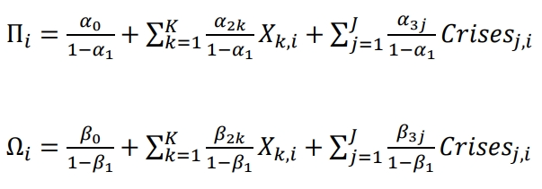
3. Methodology
To facilitate a valid comparison of the covariates’ coefficients across different measures of the dependent variable and different samples we derive the respective static long run solutions.

Slide 7
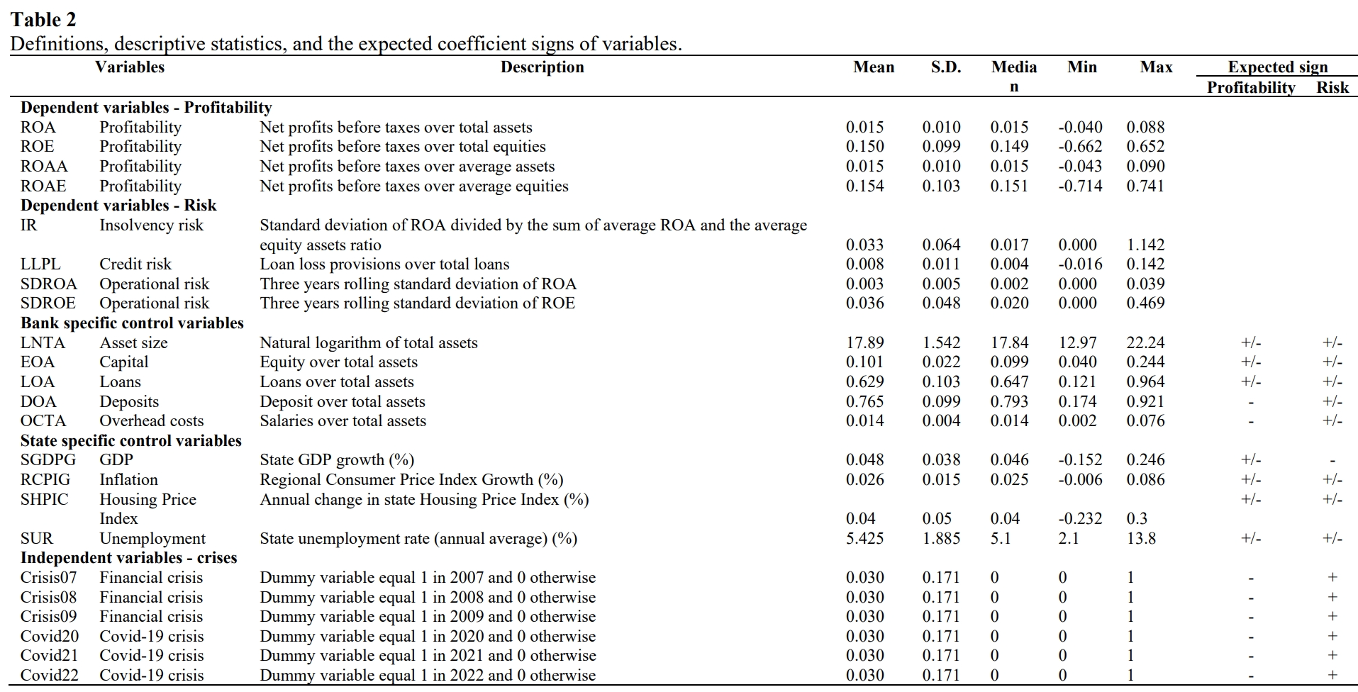

Slide 8
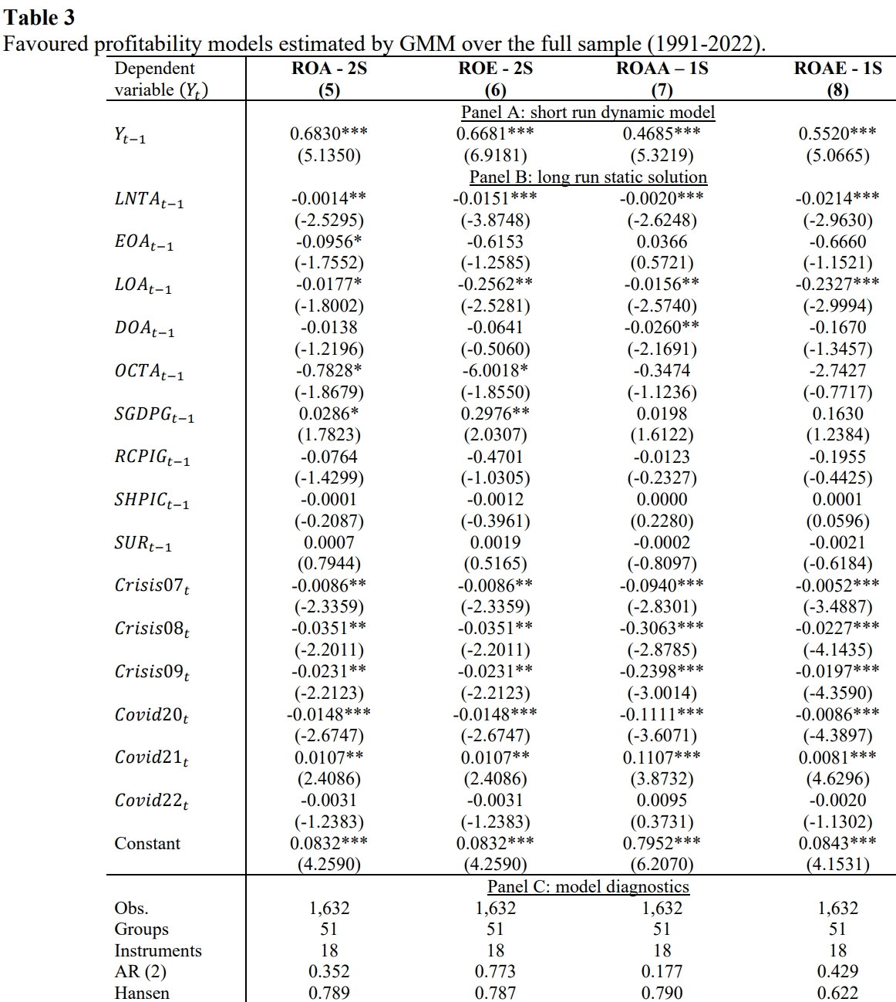
4. Results

Slide 9
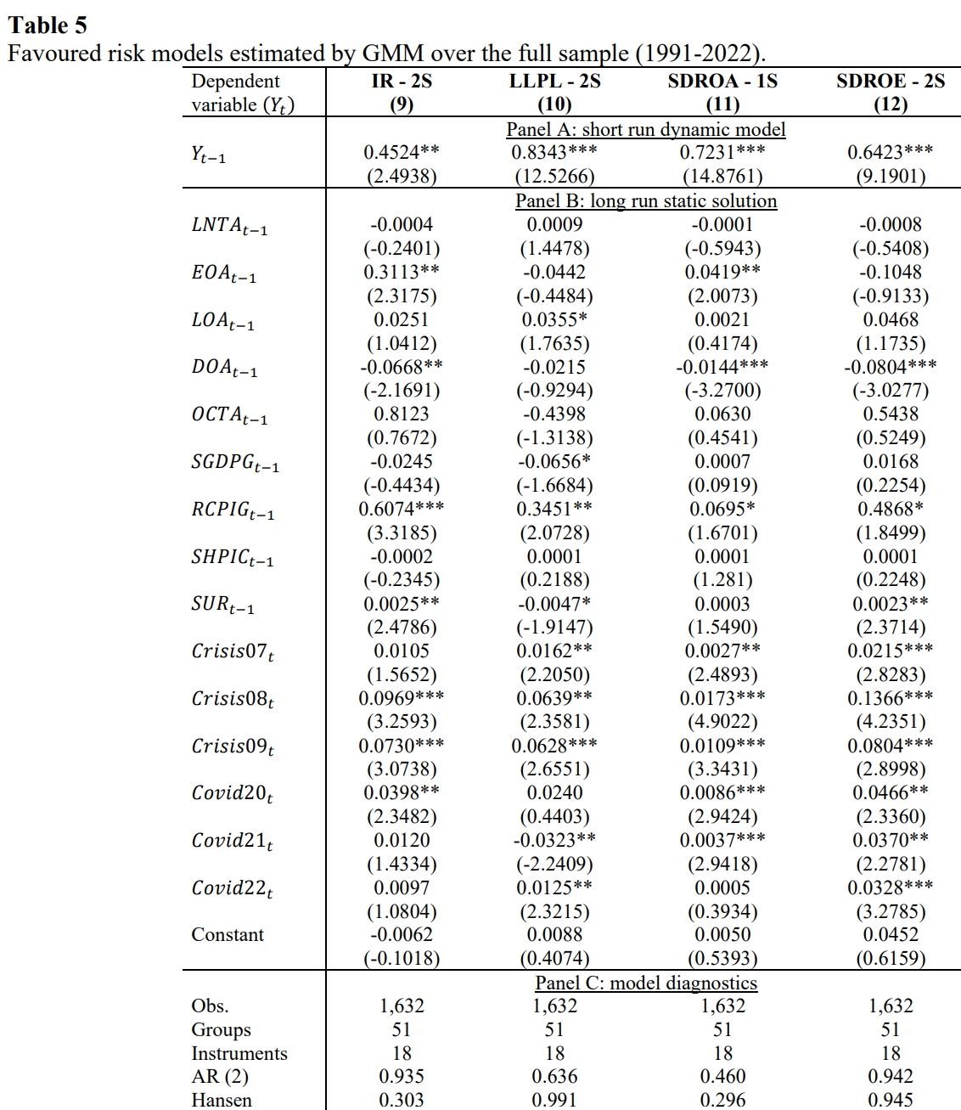

Slide 10
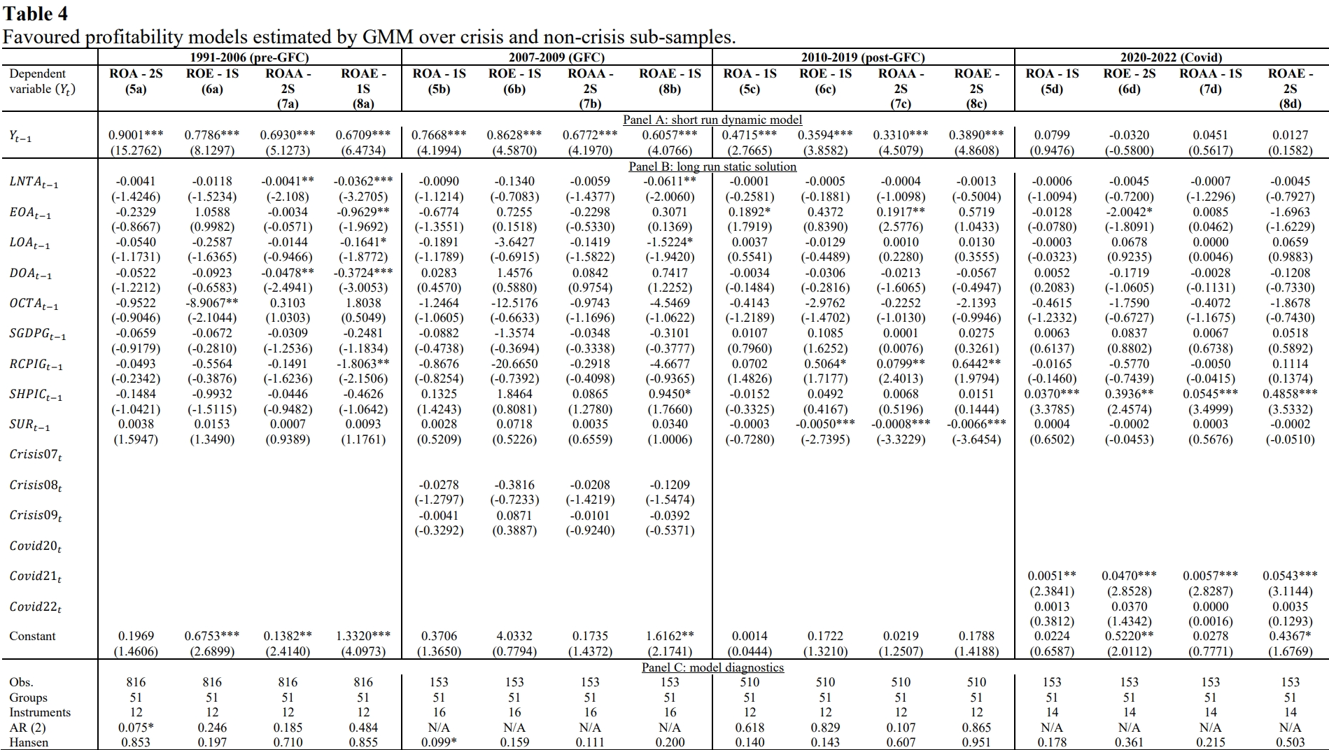

Slide 11
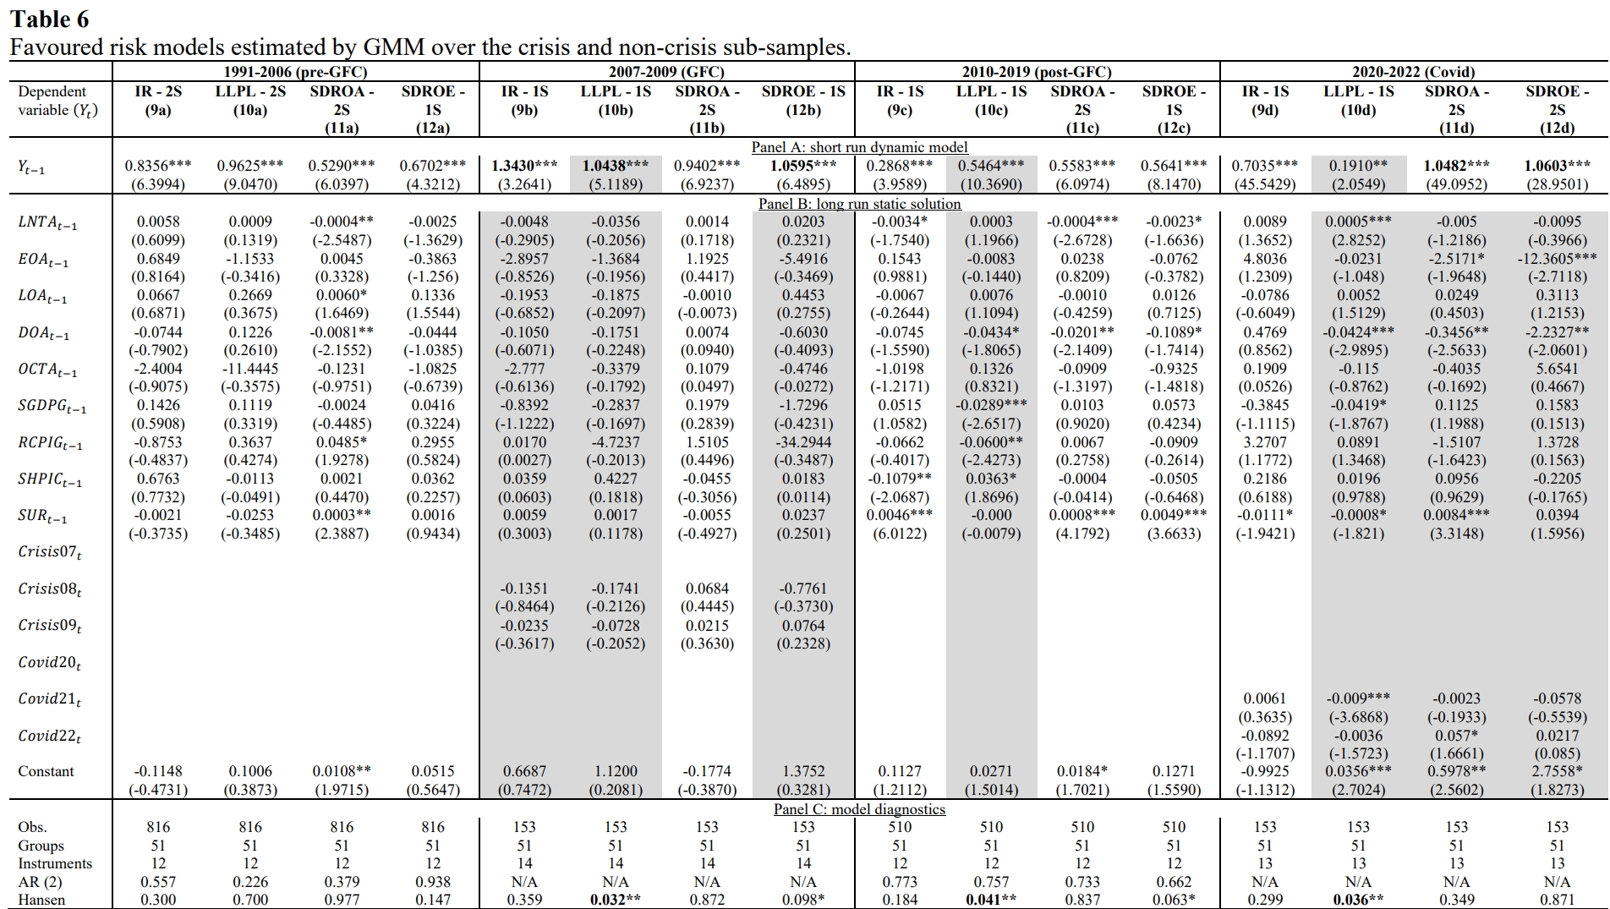

Slide 12
5. Findings and Conclusions
The coefficients on all three GFC dummy variables are significant and negative in all the full sample profitability models suggesting theoretically plausible downward shifts in profitability between 2007 and 2009 with the main downturn occurring in 2008. However, the Covid-19 crisis dummy variables only suggest a significant downward shift in profits in 2020. In 2021 there is a significant upward autonomous shift in profits and no significant shift in 2022.
The full sample risk regressions virtually all suggest autonomous upward shifts in risk in 2007, 2008 and 2009 in line with the expected adverse effect of the GFC on bank risk. However, while there is general evidence of autonomous upward shifts in risk in 2020, 2021 and 2022 it is not as clear cut for the Covid-19 period as it is for the GFC. Further, the magnitudes of the dummy variables’ coefficients indicate that the upward shifts in bank risk caused by the GFC were greater than those resulting from the Covid-19 crises.

Slide 13
5. Findings and Conclusions
With the mass rollout of vaccinations, lockdowns have substantially reduced since 2022 and the adverse impacts of Covid-19 are declining. At the same time the demand for goods, most notably energy, have risen at a faster pace than supply could match causing worldwide inflationary pressures. Supply constraints of energy and the acceleration of inflation were exacerbated with the starting of the war between Russia and Ukraine in early 2022. Hence, the economic environment immediately post-2022 may also be regarded as a crisis period and care needs to be taken when using models of bank profit/risk identified for past periods to make (policy) recommendations for the (immediate) future.
There is clear heterogeneity across the sub-periods and measures of profit/risk in terms of which non-crisis variables are significant and the persistence of profit/risk. Our results suggest that profit/risk are determined by theory-based variables more in non-crisis than crisis periods. Further, profits are less persistent after the GFC suggesting the U.S. banking system became more competitive after this time while risk is generally much more persistent during crisis periods than non-crisis periods.

Slide 14
5. Findings and Conclusions
Our findings indicate the need for responses and action plans from the Federal Reserve to mitigate different types of financial risks that could be presented by evolving idiosyncratic crisis in the near future, which, hence, affects financial stability
If the economy does recover more quickly than expected from the emerging energy and inflationary pressures, bank profitability should be able to recover post-Covid-19. However, if these issues drag on longer than expected, bank profitability will be drastically affected without intervention from the governments. Specifically, the Federal Reserve’s raising of interest rates from late 2022 throughout 2023 is a policy aimed at reducing regional inflation which should also help bank profitability.

Slide 15
Thank you for your attention!

