Slide 1
The effect of uncertainty on bank risk in Europe
DR. FReeman Owusu
DR. Albert Acheampong
DR. Thao Nguyen
DR. Emmanuel Joel Aikins Abakah
13-14/01/2025

Slide 2
Outline of the presentation
Objectives
Literature review
Methodology
Results
Conclusions

Slide 3
1. Objectives
We examine the impact of the COVID-19 pandemic and the Russia-Ukraine war on bank risk in Europe.
Using an annual dataset of 145 banks from 2005 to 2022, the analysis identifies a significant and positive relationship between both events and accounting-based bank risk measures.
The global banking sector came under intense pressure during the COVID-19 pandemic due to extended lockdowns, loan payment deferments and increased economic uncertainty. The Russia-Ukraine war (R-UWAR) introduced a new wave of uncertainty that triggered geopolitical tensions, energy supply disruptions, and inflationary pressures which further amplified the risks faced by banks.
The result is confirmed by propensity score matching, entropy balancing, lag analysis

Slide 4
2. Literature review
Worldwide economies and financial systems have been profoundly and unprecedentedly impacted by the COVID-19 pandemic, which emerged as a global health crisis. During this crisis, the banking sector, essential for both the stability of financial systems and the expansion of economies, faced significant challenges. Researchers have focused on understanding the pandemic's implications on banking systems, particularly in the context of risk management (Goodell, 2020; Berger et al., 2021).
The war in Ukraine, marked by geopolitical tensions and economic sanctions, has caused significant disruptions to global financial systems (Caldara and Iacoviello, 2022). The financial repercussions of this conflict are especially likely to affect European banks due to their geographical proximity and economic ties to the region.
H1: The COVID-19 pandemic increases the risk of European banks.
H2: The Ukraine-Russia War increases the risk of European banks.

Slide 5
3. Methodology
We utilize annual EU bank data for each state spanning from 2005 to 2022. We consider models of bank risk
where, $Π_{i,t}$is bank risk. $X_{i,t−1 }$ and $Y_{i,t−1 }$are vectors of bank and country. ${Crises}_{i,t}$ denote the independent variable capturing the COVID-19 pandemic and the Russia-Ukraine war. $ε_{i,t} (µ_{i,t})$ is the random error. The definition and descriptive statistics of these variables are provided in Table 2. Pearson correlation matrix is reported in Table 3. All crisis variables are expected to be positively related to bank risk (Apergis, 2014; Vu et al., 2023).

Slide 7
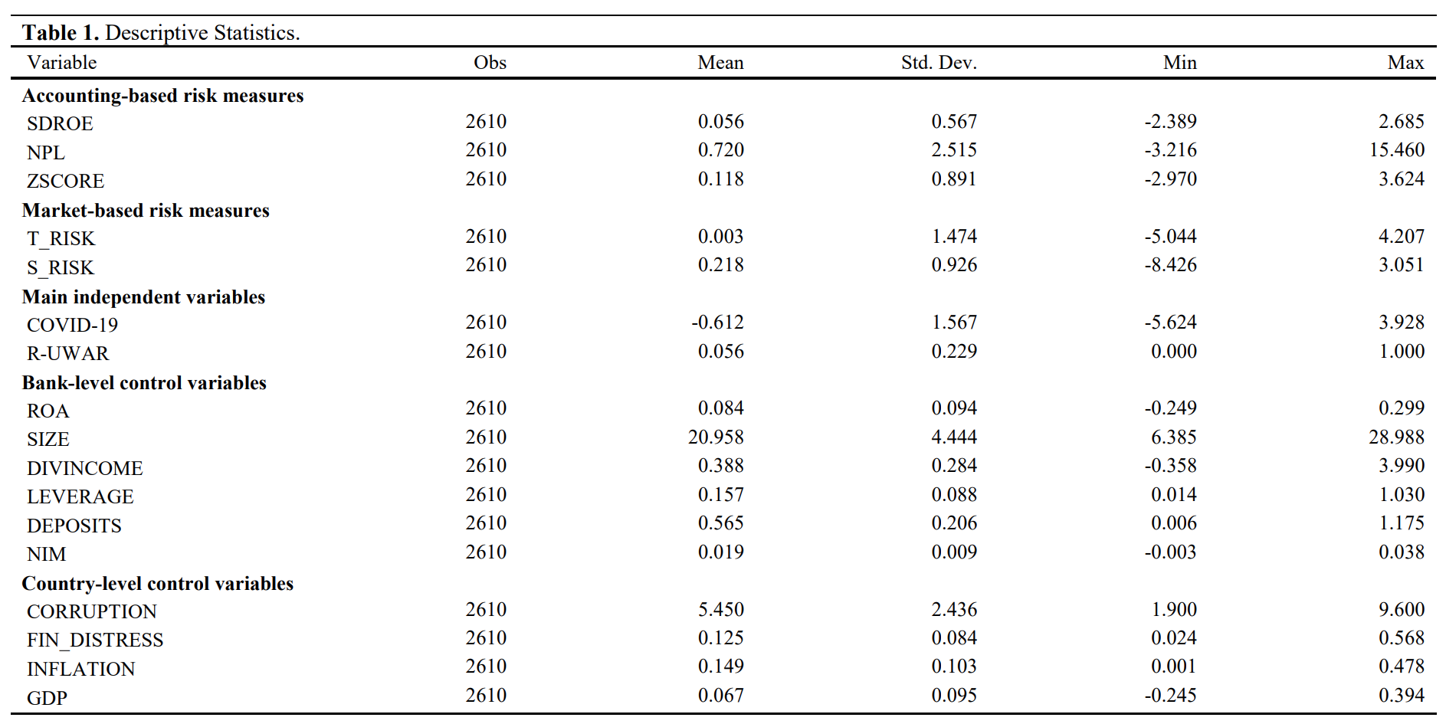

Slide 8
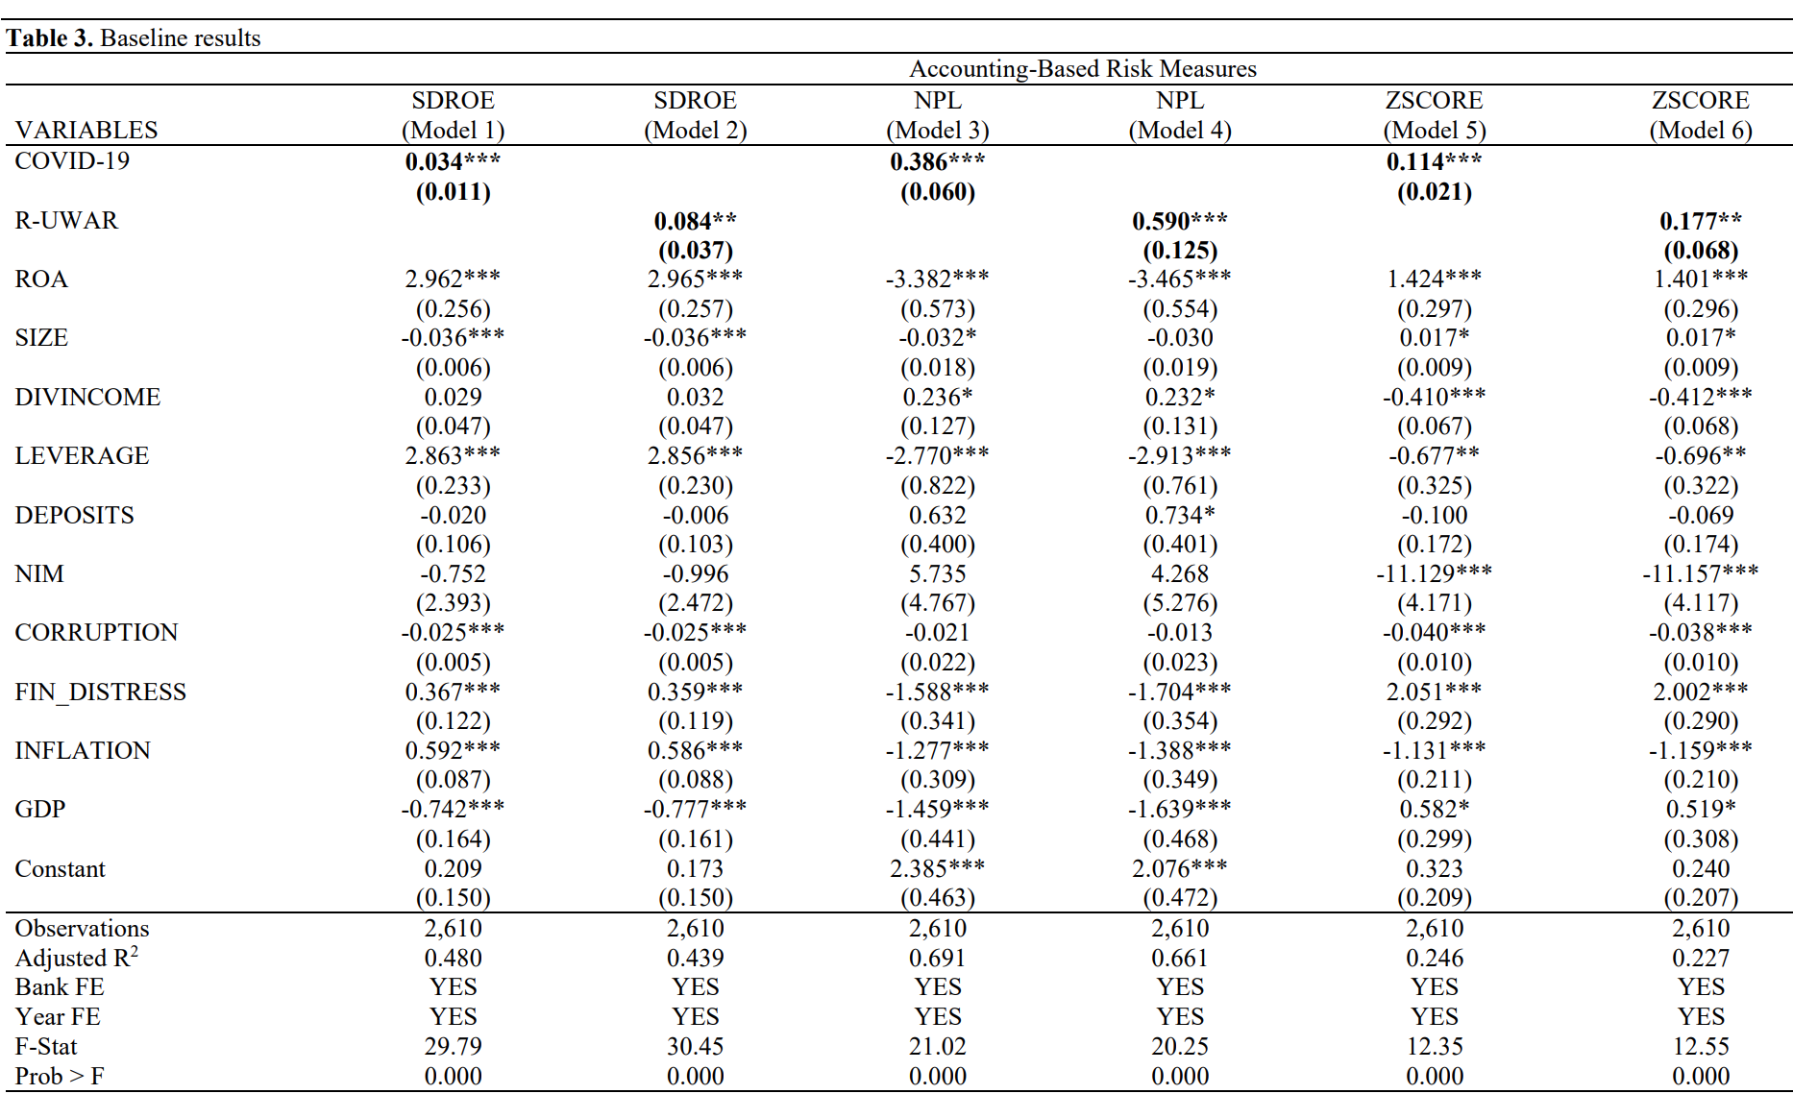

Slide 9
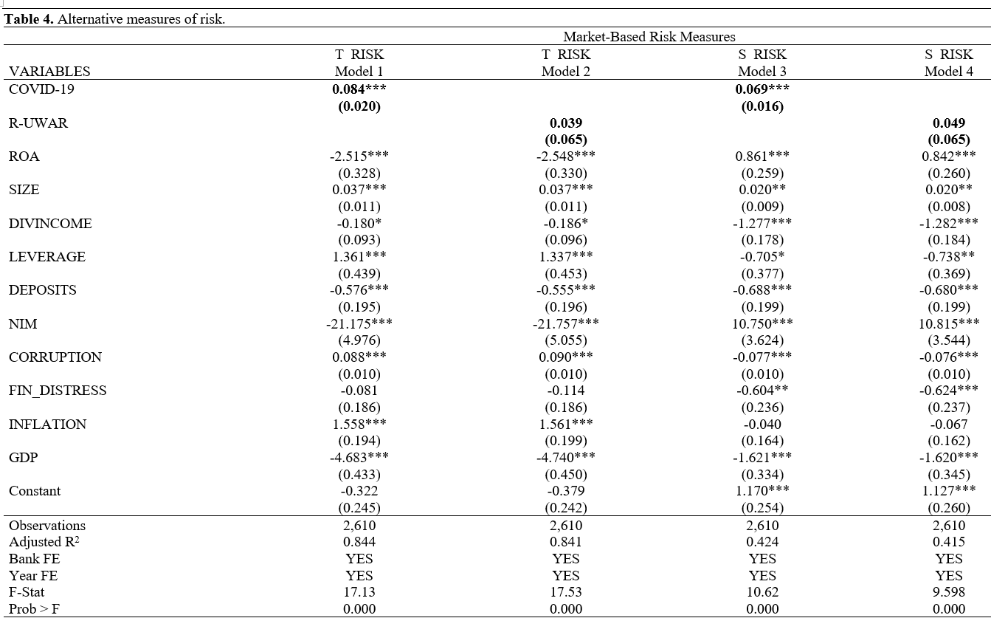

Slide 10
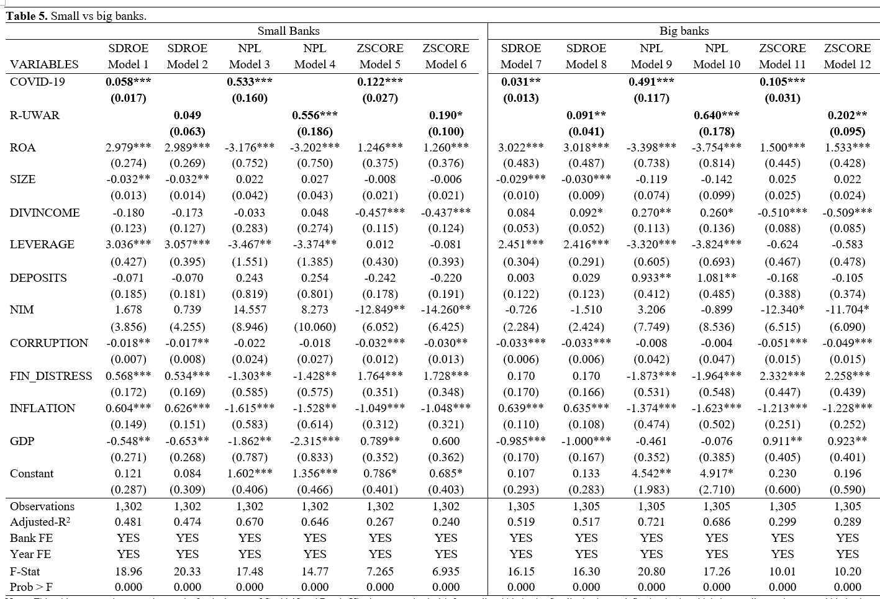

Slide 11
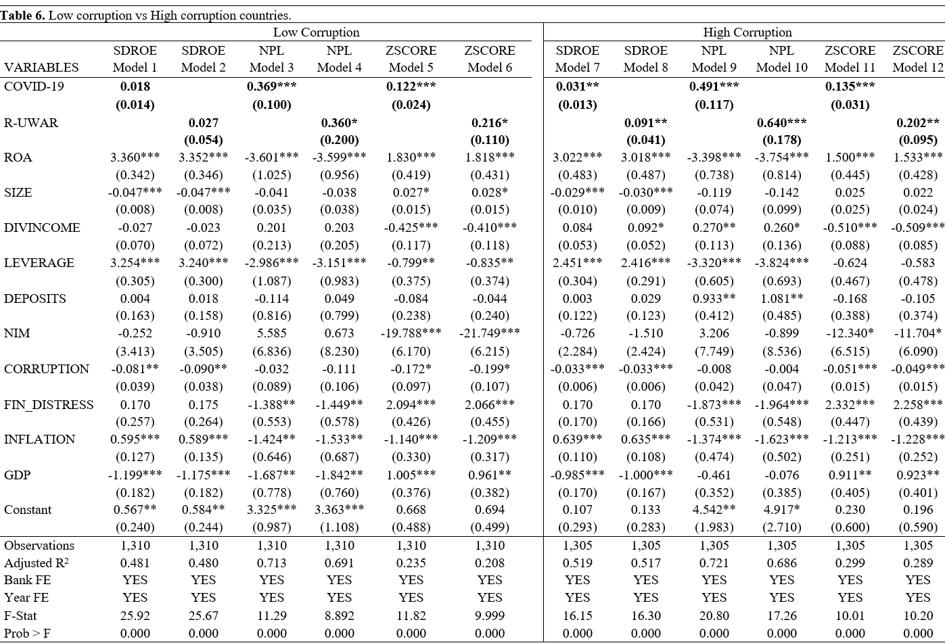

Slide 12
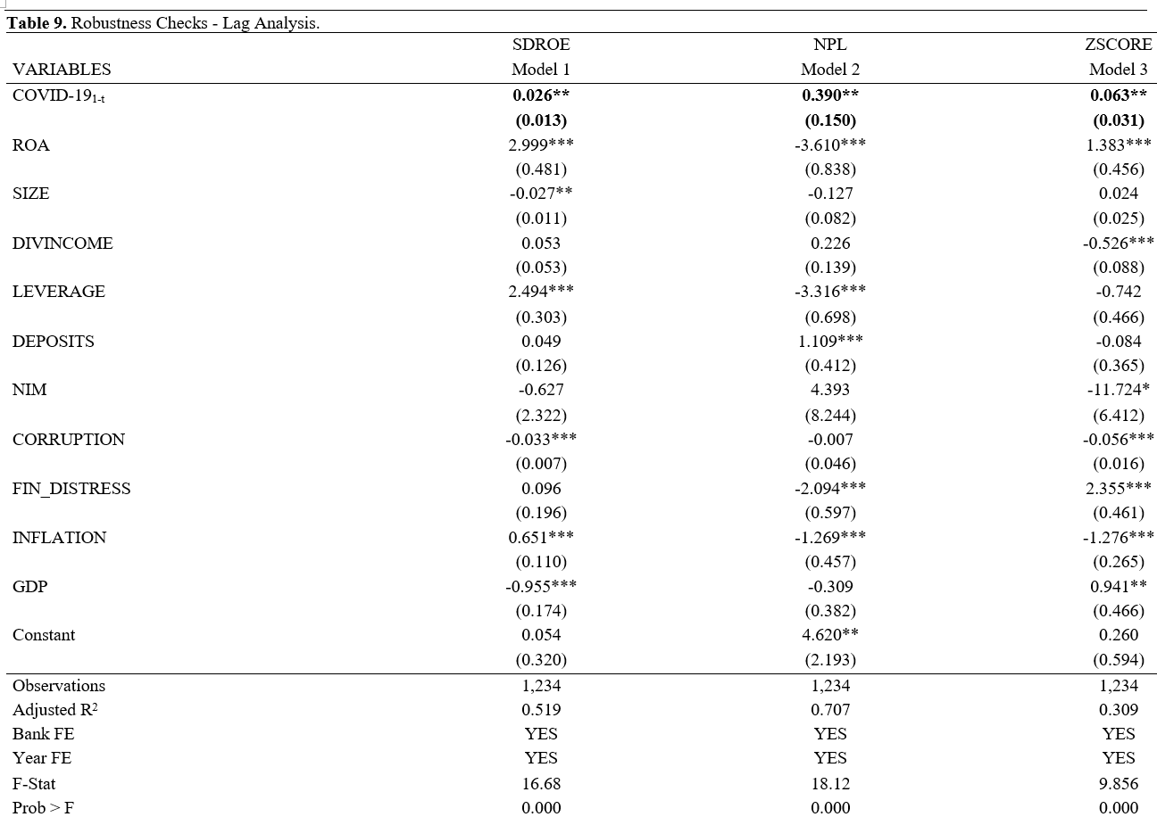

Slide 13
5. Findings and Conclusions
Our analysis, which encompasses 145 banks over the period from 2005 to 2022, reveals significant insights into the differential impacts of these crises on various bank risk types. Our findings indicate that both COVID-19 pandemic and R-UWAR have significant and positive effects on accounting-based risk measures.
However, in terms of market-based risk measures, we find that only COVID-19 has significant and positive effects on them. R-UWAR does not exhibit a significant relationship with market-based risk measures, a nuance that indicates the unique economic repercussions of this geopolitical conflict
We also document that effects of COVID-19 pandemic on accounting-based risk measures are more pronounced for small banks than their big counterparts.
Whilst COVID-19 has a more pronounced impact on banks from high corruption countries than those from low corruption countries, the effect of R-UWAR based on the corruption levels is less clear.

Slide 14
5. Findings and Conclusions
Policies aimed at mitigating the effects of crises should be tailored, taking into account various factors including specific bank characteristics, bank types, and country-specific traits like corruption indexes. Lastly, assessing bank risk measures should involve consideration of the types of risks that directly or indirectly impact the banking system.
Future research could build upon this study by examining the long-term impacts of these crises on bank stability and exploring the effectiveness of different risk mitigation strategies across various contexts. Additionally, further studies could investigate the role of regulatory frameworks in enhancing the resilience of banking systems to such multifaceted risks, providing deeper insights for policymakers and financial institutions aiming to fortify the global financial landscape against future crises.

Slide 15
Thank you for your attention!

