Slide 1
The future of on-campus teaching and learning in mathematics
Laurence Shaw (School of Science & Technology)
Charlotte Marshall (Centre for Academic Development & Quality)
Laurence.shaw@ntu.ac.uk

Slide 2
Overview
Context
Discussion

Slide 3
Context

Slide 4
Why this topic?
Post-92 vs Russell Group: How relevant are my experiences to yours?
All large, on-campus universities in similar cities
You are starting to fish in our pond (international shortfall)
Looked for common ground with colleagues at University of Nottingham
Looked for commonality in our universities’ policies

Slide 5
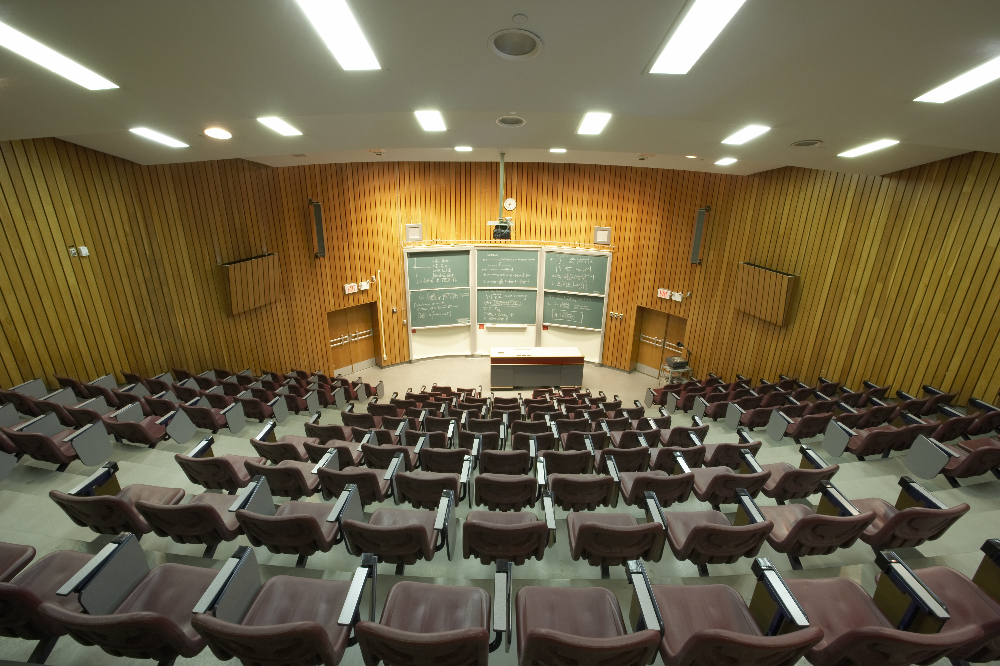
Our Experience (NTU Physics & Maths)
Attendance has plummeted since Covid
Students who do attend seem less engaged, sometimes to the point of being disruptive
Are you seeing something similar?
Why do we care given our universities’ current strategies…

Slide 6
University Policies
“We will create increased student choice and flexible learning through combinations of face-to-face, online and blended learning at greater scale.” UoM, Our Future
“Combine the best of in person and interactive online learning methods to provide more flexibility in how and when students want to study, embrace the future demand from students wanting to learn at their own pace, and open up learning opportunities to a broader range of students” UoL, Liverpool 2031: Our Strategic Ambition
“We will weave face-to-face and digital provision seamlessly into all our programmes so students can plot their own routes through our courses” NTU, University, Reimagined

Slide 7
The UK HE Mathematics Landscape
 | Distance Option Courses | On-Campus Universities
Mathematics Undergraduate Students 2022/23 | 3845 (11%) | 30495 (89%)
Data from HESA (Higher Education Statistics Agency)
Open university is the biggest single provider but on-campus still very much the go-to option
Key point: the specialist distance option exists

Slide 8
My Assumption(s)
All students coming to our universities to study mathematics have made a conscious decision to undertake an on-campus, in-person degree.
Therefore, the vast majority must have intended to study on campus and attend in-person.
Some may end up remote for reasons beyond their control and we should cater for them. The rest want (or at least wanted) an in-person experience.
Do students expect that attending will be advantageous?

Slide 9
We should be providing an experience that encourages students to come to campus whilst ensuring that those who must work remotely are able to engage fully in their course, without negative impact
Anon member of management at NTU (Oct 2020)

Slide 10
Question Time

Slide 11
Is my assumption reasonable?
If yes, what is keeping them away?
If not, why have they come to our institutions?
How do we get them back?
What should be the advantage(s) of coming to campus and attending classes in-person if you have the choice?

Slide 12
Attendance vs Engagement
Would you rather?
100% attendance with mostly blank expressions and no interaction
70% attendance but a minority of disengaged students at the back
40% attendance but everyone there is fully engaged and involved

Slide 13
You are lecturing to a group of 1st year students. This is the first time you have taught this group, and you are unfamiliar to them. The number of students in the room is lower than you expected. One student arrives and tells you they need to leave but would you still mark them as present as they don’t want to get a bad reputation.
What would you do if…

Slide 14
You are delivering a lecture to a group of 40-50 students. Whilst it is clear that the majority are engaged with the content,there are 3 or 4 of the group that are wearing headphones. It is as if they are saying they are in the room, but they don’t care about the content. You’re frustrated by their apathy and are worried that other students might start to follow their lead.
What would you do if…

Slide 15
Final Thoughts
Hard to write this slide in advance…
Think about why your students are on your course
Do you need individual, departmental, or university level intervention
Get in touch if you fancy investigating further

Slide 16
References
Higher Education Statistics Agency (HESA) (2024) Where do HE students study? https://www.hesa.ac.uk/data-and-analysis/students/where-study
University of Manchester (2023) Our Future www.manchester.ac.uk/strategic-plan.
University of Liverpool (2023) Liverpool 2031: Our Strategic Ambition https://strategy.liverpool.ac.uk/
Nottingham Trent University (2020) University, reimagined https://www.ntu.ac.uk/about-us/strategy/university-reimagined

