Slide 1
The role of Audit and Inspections in Fire and Rescue Services in the UK
International Research Society for Public Management Conference Bologna, Italy 7th-9th April 2025
P33 Panel: Emergency Services
Pete Murphy, Katarzyna Lakoma and Peter Eckersley

Slide 2
Purpose of the paper
Examine how the external audit and inspection of FRS in England has evolved in terms of their purposes and objectives within the services’ assurance regime.
Assess the extent of assurance that the service’s performance regime provides to the public, to key stakeholders and partners, and to the government.
Identify potential improvements in both audit and inspections within the assurance regime.

Slide 3
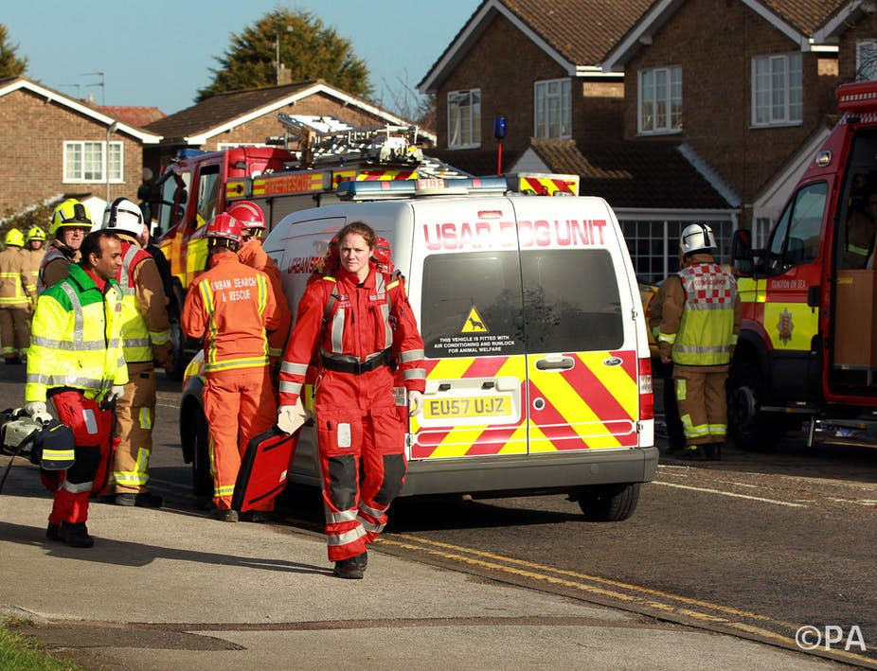
Background and Context
In the UK, FRS have recently been subjected to long-term policies of financial austerity and de-regulation as well as they have experienced significant changes in external audit and inspection.
FRS attracted widespread and significant criticism following major disasters (Grenfell Tower Fire, Manchester Arena Terrorist Attack), and widescale emergencies (COVID-19 pandemic) - all followed by statutory public inquiries.
Government, opposition and the sector have acknowledged significant inadequacies of both Local Public Audit and external inspection of FRS.

Slide 4
Literature review
Little academic literature, and specifically little public management literature, has looked at audit and inspection of FRS.
We therefore draw on archival sources and official secondary literature, such as government legislation, ministerial statements, parliamentary committees, and other publicly available reports.
In the UK, both local public audit (1844) and external inspections and inspectorates (1833), have long history back to mid-19th century including multiple roles for different types of inspectorates.
This paper relates solely to performance inspections and inspectorates that are part of the performance management and public assurance regime. They play a key role in ensuring accountability and transparency in accordance with the FRS assurance framework.

Slide 5
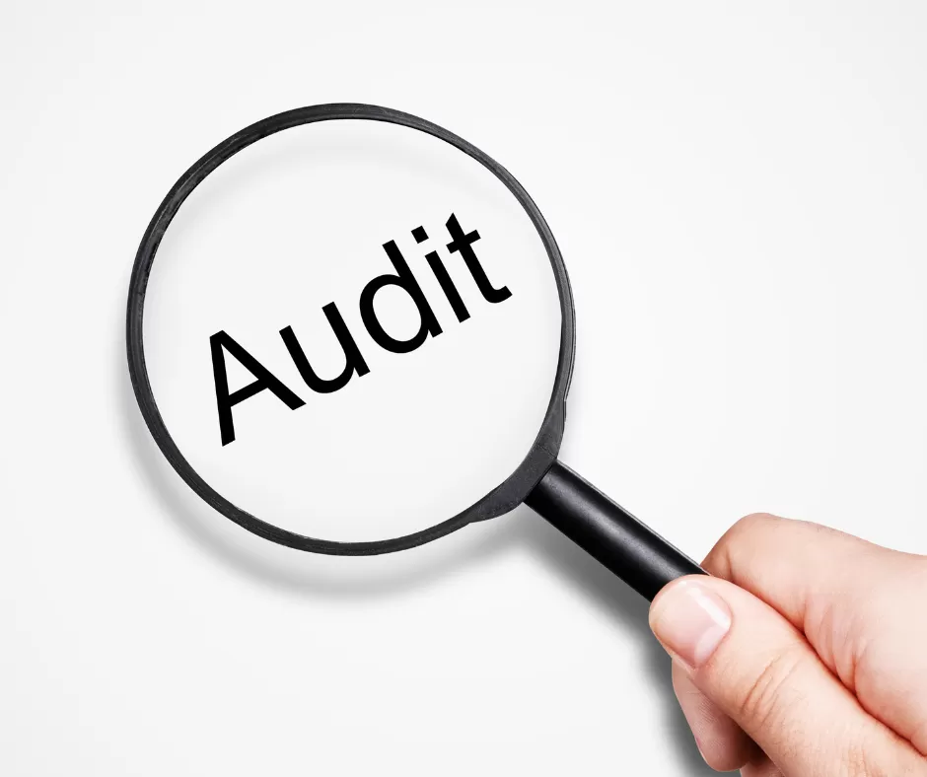
Recent history – Local Public Audit in the UK
Comparison of audit systems in local governments (Manes Rossi et al. 2021)
1868-1983. District Audit was a wholly public audit system
1983-2015. Audit Commission and mixed public/private audit
2015-2025. Private firms undertook all local public audits
2015-2025. Scotland, Wales and N. Ireland retained Public Audit

Slide 6
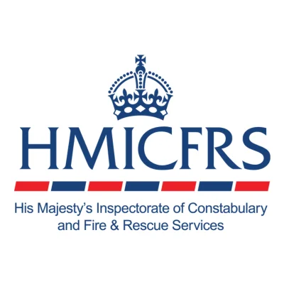
Recent history – FRS Inspection in UK
1983–2010. The Audit Commission meant a step change in the quantity and quality of the data, and intelligence in the 'evidence base’ available for performance management.
2004-2010. Service, corporate, and financial inspections for FRS were brought together under an “Inspection for Improvement” regime (including short- medium- and long-term assessments.
2010-2018. Sector led peer review system led to no service inspectorate for FRS and only sporadic corporate inspections (Essex, Avon).
2018-2023. HMICFRS reinstated service inspections with occasional corporate interventions (London FB, West Midlands, South Wales FRS (HMICFRS 2023)).
2023-2025. HMICFRS’ reports of Corporate Issues (Organisational Culture and Misconduct)

Slide 7
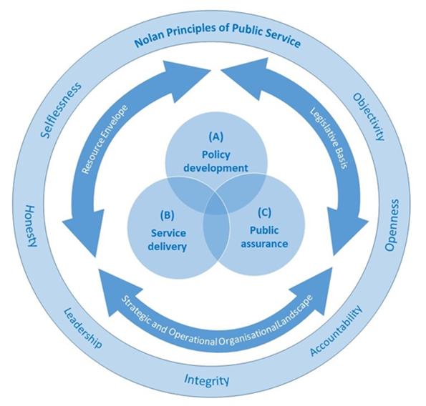
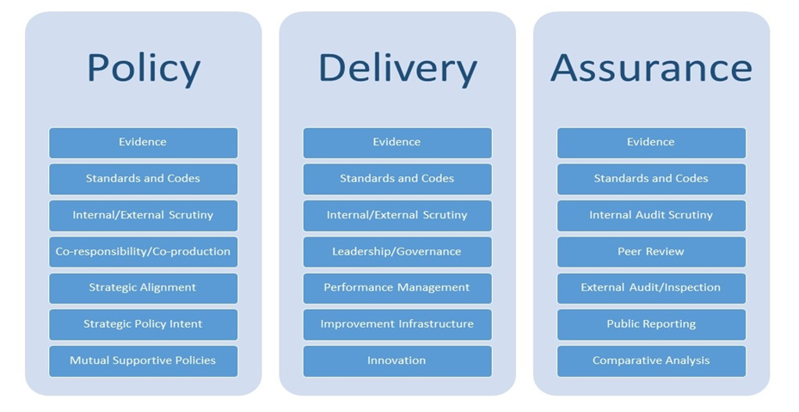
Methods: we used 3 analytical models
Figure 1a. National Frameworks: A generic model
(Source: Murphy & Lakoma 2018)
Figure 1b. The three core domains of policy, delivery and assurance.
(Source: Murphy & Lakoma 2018)

Slide 8
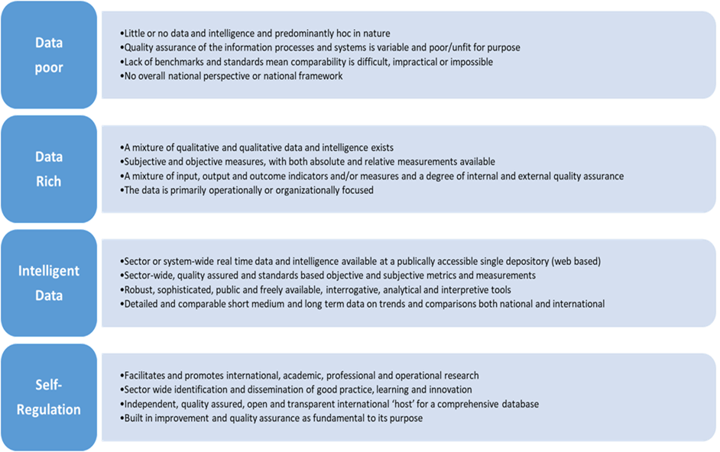
Methods: we used 3 analytical models
Figure 2. The performance management data environment model (Source: Murphy & Greenhalgh 2013)

Slide 9
Methods: we used 3 analytical models
Comparative Judgement and Public Reporting
Assessment of Strategic and Operational Performance
Assessment of Financial Performance and Resource Assurance and Resilience
Assessment of Improvement Innovation and Systemic Contribution
Assessment of individual and collective performance of Collaborations and Partnerships
Figure 3. A simple generic model for standalone Corporate Inspections
(Source: Murphy & Jones 2016)

Slide 10
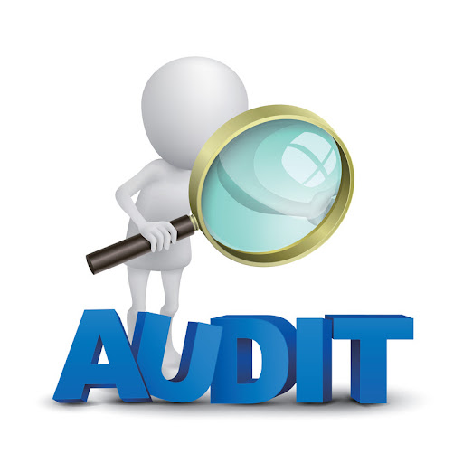
Findings – Local Public Audit
Since 2019 and the Redmond Review, five governments (May, Johnson, Truss, Sunak and Starmer) have known: Local Public Audit is not fit for purpose.
In September 2023, record backlogs.
Since the election, the sector has to an extent reduced the backlog of audit opinions and can envisage “a pathway to timely audits”.
In December 2024, the current government proposed the creation of a Local Audit Office (LAO), with 5 strategic responsibilities (MHCLG 2024).
Coordinating the system,
Contract management,
Ownership of the Code of Audit Practice, and
Quality oversight and assurance, and
Public reporting

Slide 11
Findings – External Inspection
Since 2018, regular service inspections of individual FRS, supplemented by thematic/spotlight inspections.
Because of scandals, there have been Corporate/Best Value inspections in the London Fire Brigade (Afzal 2022), South Wales FRS (Morris 2023), and for both the Fire Service and the Authority in West Midlands (2024).
Reports of widespread bullying, harassment, misogyny, discrimination and misconduct have fuelled concerns over the organizational culture and standards of leadership and governance in FRS (HMICFRS 2023, 2024).
In response, HMICFRS has made incremental changes in its inspection of the impact of governance, leadership and community engagement, but “will continue to focus on the operational service”.

Slide 12
Conclusions and Recommendations
The legal framework, resources available, and the strategic and operational organisation landscape in England continue to powerfully influence and shape policy, delivery and assurance.
The current regime, while improved by institutional change, policy developments and assurance improvements since the 2017 Act, is still not as robust, efficient or effective as it has been in the past or should be (even allowing for the long-term restrictions on resources caused primarily by exogenous causes).
While the Local Public Audit is likely to change (adopting many of the recommendations in the Redmond Review) the ‘resource envelop’ available to the sector and FRS is unlikely to expand.
Government responsibility will move from Home Office to MHCLG, and a new national framework will replace the 2018 framework - this requires only secondary legislation and government guidance.

Slide 13
Examples of our detailed recommendations
LAO to be responsible for performance standards with professional standards remaining with Standards Board
Single accessible public repository for performance data and to be in LAO
Embed a small number of performance KPIs into the Local Public Audit
Use of resources assessment should be part of inspection methodology
Regular service inspection should include corporate issues (leadership, governance, financial, and culture elements)
Separate inspectorates for Fire and Rescue from Police
Strengthen Prevention, Protection, Collaboration with the NHS and community engagement in the new national Framework.

Slide 14
Thank you for listening
Questions or comments.
peter.murphy@ntu.ac.uk
katarzyna.lakoma.@ntu.ac.uk
peter.eckersley@ntu.ac.uk

