Slide 1
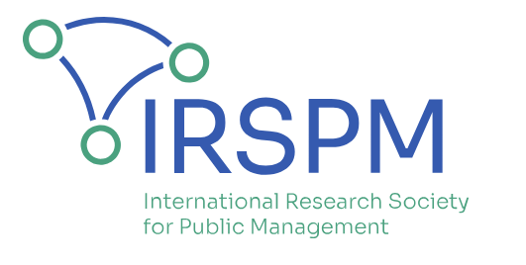
Challenges and Opportunities of Artificial Intelligence in Public Sector Auditing: a Systematic Literature Review
Paola Riva
(Politecnico di Milano, Italy)
(Presenter’s contacts: paola.riva@polimi.it)
Bernard Kofi Dom
(Nottingham Trent University, UK)
P01.8: Accounting and Accountability SIG
IRSPM Conference 2025
Bologna, Italy
7th – 9th April, 2025

Slide 2
Background
AI: Artificial Intelligence
Positive
Negative
AI has evolved as a ‘buzzword’, making it difficult to have a common definition across multiple disciplines (Samoili et al., 2021)
Increasing debate on how AI influences organisations across different disciplines including public sector (e.g., Zuiderwijk et al., 2021; Wirtz et al., 2019; Agarwal, 2018) and audit (e.g., Ferry et al., 2022; Bandy, 2021)
Using blockchain has shown to enhance auditors in guaranteeing data security and in generating trust amongst public sector organizations (Han et al., 2023)
Renowned accounting firms use AI-sophisticated templates to enhance their integrated audit automation systems also used for public sector auditing (Zhang et al., 2020)
FRC (2018) established that independent opinions are trusted when AI is employed for auditing financial records, boosting accountability and transparency.
The use of AI in public sector presents different layers of challenges, which, if not well managed, are expected to disrupt effective decision-making, accounting, accountability and audit (Agostino et al., 2023)
Public sector audit is increasingly under scrutiny for lack of transparency (Ferry & Midgley, 2024) and the use of AI poses some risks, e.g., potential biases (Patel and Uddin, 2022) and privacy concerns (Busuioc, 2021)
Practice shows real-life examples of how AI influences public sector audit, e.g.:
fraud detection, e.g., UK’s HM Revenue and Customs for detection of fraudulent activities
identification of inconsistencies and potential errors in financial reports, e.g., AI tool used by the US Social Security Administration to support judges review decisions
wrongful convictions due to over-reliance on AI without human oversight in public financial systems, i.e., UK Post Office Horizon Scandal, with the AI-powered Horizon software falsely flagged financial discrepancies
→ anecdotal and sparce knowledge on how AI use influences Public Sector Audit calls for a systematization
Notes:
UK post office Horizon Scandal: wrongful prosecution of over 900 sub-postmasters who were falsely accused of theft, fraud, and false accounting, stemming from issues arising from the Horizon accounting software developed by Fujitsu

Slide 3
Methodology_{_1}
What is known about how AI use influences public sector audit?
Systematic literature review (Kitchenham, 2004)
Contribute rejuvenate systematization of knowledge in public sector (George et al., 2023):
‘purpose’ of research: analyse in depth what has been written and which are the future challenges that academia needs to face in connection to the use of AI for public sector audit
‘object’ of research: relationship between AI use and public sector audit, to better understand how the use of AI is transforming traditional public sector audit practices
‘community’ targeted: audit experts, i.e.
Scholars, interested in the research gaps and the opportunity for future research developments
Practitioners, interested in examples of top-notch use of AI in public sector audit, challenges and opportunities so-far recognized and discussed.
‘subject’ of the research: (human) authors, i.e., researchers with interest and expertise in Public Administration, Accounting and AI, with experience in conducting topical rigorous research to identify emerging gaps and analyse use cases.
‘practice’ to support the review: coding scheme coupled with the Preferred Reporting Items for Systematic Reviews and Meta-Analyses (PRISMA) approach (Liberati et al., 2009)
Notes:
Particularly well-suited methodology for the purpose of this research paper

Slide 4
Methodology_{_2}
TITLE-ABS ("Artificial Intelligence" AND ("Audit*"))
AND SUBJAREA (BUSI)
AND DOCTYPE ("ar" OR "re" OR "ch" )
(TI OR AB = ("Artificial Intelligence" AND "Audit*")
AND (WC = (Business) OR (Business, Finance))
AND (DT = (Article) OR (Book Chapter))
What is known about how AI use influences public sector audit?
PRISMA
(Liberati et al., 2009)
from Scopus database
(n = 232)
from Web of Science database
(n = 86)
Identify
Duplicated records
(e’ = 70)
Non-duplicated records
screened in Title, Abstract, and Source
(n’ = 248)
Records non-relevant
for study purpose
(e’’ = 45)
Screen
Reports sought for
full-text reports
(n’’=203)
Reports not retrieved
(e’’’ = 65)
Reports elected for
full-text screening
(n’’’ = 138)
Elect
Records non-relevant
for study purpose
(e’’ = 9)
Reports included
(N = 129)
Review
Notes:
+ exclusion criteria…
We followed the 4 phases of the PRISMA approach, namely:
1. (identification)
First, we identified potentially relevant records from the two most famous databases for academic research, namely Scopus and Web of Science, searching for the basic and simple yet focused combination of the keywords “Artificial Intelligence” and “Audit”. We decided to avoid imposing the use of additional generic keywords to refer to public administration or public sector, as “public sector” or “public administration”, to avoid excluding relevant sectorial research within the public administration discipline, such as research focused on education, healthcare, or cultural institutions.
Since the targeted community of the research is the one of audit experts, we considered results in fields connected to this discipline area, therefore in Scopus the subject area “Business, Management and Accounting” also addressed as “BUSI” and in Web of Science the categories “Business”, “Business Finance”, “Management”.
Among these results, we selected document of types “article”, “review” and “book chapter”, to consider contributions undergone through recognized peer-to-peer procedures and practice-oriented research outlets. This resulted in the identification of 168 unique records from the two databases.
This process resulted in 232 records from Scopus and 86 records on Web of Science, out of which 248 (170) did non contain duplicates.
2. (screening)
Then both the authors independently screened the records for content relevance considering mainly the fields of title, abstract and source. Multiple meetings have been dedicated to the resolution of conflicts on screening results.
[The main reasons for exclusions…]
3. (elect)
Third, out of the (138 = 82%) records sought for full-text reports, we elected and read in full-text 138 reports. These papers have been read by both authors in search for content-relevance, resulting in the exclusion of 9 additional reports upon dedicated meetings among the authors devoted to the resolution of conflicts on the analysed reports.
4. (review)
Four and final step, we recognize 129 reports to be relevant to be included in the narrative review described in the following, where we clarify the benefits and barriers of the use of AI for public sector auditing purposes as currently recognized in literature.

Slide 5
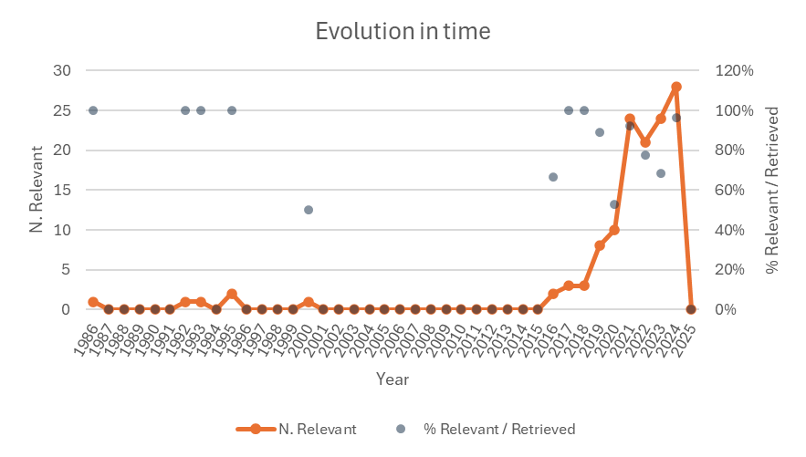
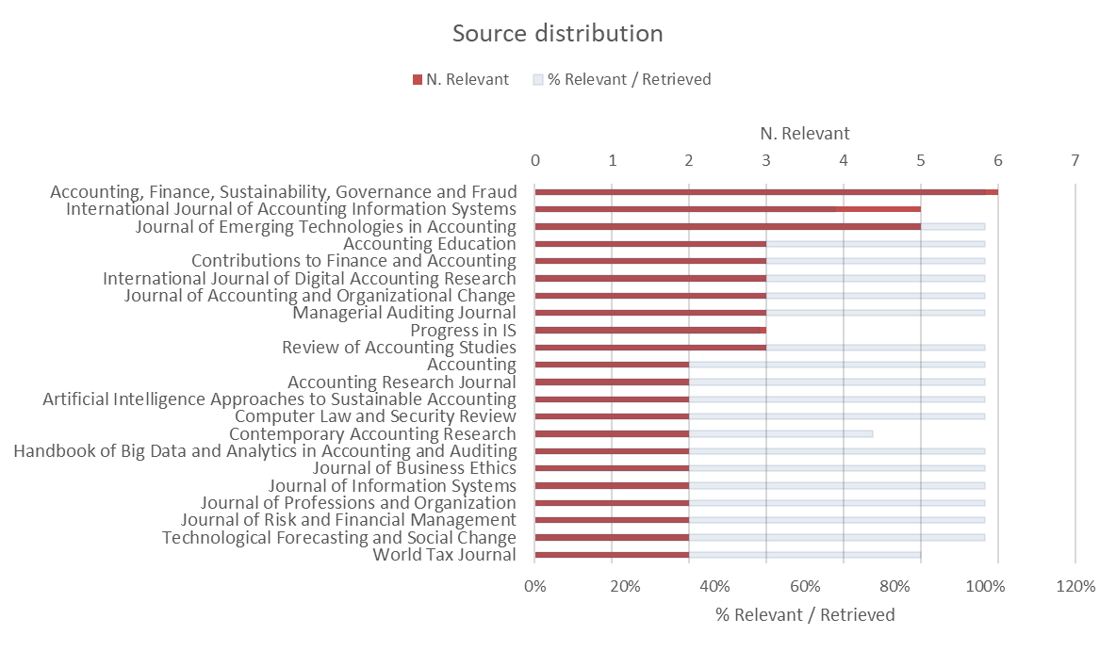
Findings_{_1}
What is known about how AI use influences public sector audit?
Notes:
Growing attention since 2016, with a rapid increase in steepness since 2018 – with a spike between 20-21
In terms of sources, among the sources for which we found the highest number of relevant papers we have mostly Accounting-relavant journals e.g. … but also relevant sources for Information System, Computer Security, Business Ethics, and Organization.

Slide 6
Findings_{_2}
… more specific on public sector
What is known about how AI use influences public sector audit?
As a Phenomenon:
changing the role of auditors, the skills required, and the potential for job displacement (e.g., Almufadda & Almezeini, 2022; Nguyen et al., 2024; Tiberius & Hirth, 2019) and the need to integrate AI in curricula to effectively prepare the auditors of the future (e.g., Baldwin-Morgan, 1995; Dalwai et al., 2022; Holmes & Douglass, 2022; Nouraldeen, 2023)
ethical implications, risks, biases, and governance issues (e.g., Lehner et al., 2022; Grove et al., 2018; Laine et al., 2024; Kunz & Wirtz, 2024; Çetin Kumkumoğlu & Kemal Kumkumoğlu, 2023; Cecere et al., 2024; Munoko et al., 2020)
intersection of AI with other emerging technologies like blockchain, big data analytics, and robotic process automation (e.g., Abu et al., 2024; Han et al., 2023; Atayah & Alshater, 2021; Gotthardt et al., 2020; Zemánková, 2019; Mugwira, 2022; Kahyaoglu & Aksoy, 2021; Taneja & Arora, 2021; Arslan, 2024; Butijn, 2023; Maharajan et al., 2023)
factors influencing the adoption, implementation, and use (e.g., Rahayu, 2021; Albawwat & Frijat, 2021; Seethamraju & Hecimovic, 2023; Noordin et al., 2022; Khuong et al., 2023; Thottoli, 2024; Anh et al., 2024)
As a Resource:
effects on quality, efficiency, accuracy, effectiveness and transparency of processes, among which financial reporting (e.g, Estep et al., 2024; Fedyk et al., 2022; Melnychenko, 2020; Silva et al., 2024; Hu et al., 2023; Koreff et al., 2023; Commerford et al., 2022; Al-Sayyed et al., 2021; Khan et al., 2021; Puthukulam et al., 2021; Al-Around, 2020; Raschke et al., 2018)
use of explainable AI (XAI) techniques to favour transparency and interpretability of results (e.g., Lee, 2022; Tsakalakis et al., 2021; Zhang et al., 2022; Monteiro & Reynoso-Meza, 2023)
for specific purposes, e.g., detect fraud, assess risks, and improve internal controls (e.g., Hajek & Henriques, 2017; Li & Vasarhelyi, 2018; Malik, 2020; Kahyaoglu & Aksoy, 2021; Boer et al., 2023; Crawford & Nilsson, 2023), audit government agencies, public assets, and ensure accountability in the public sector (e.g., Koreff et al., 2023), and use by tax administrations to improve efficiency, transparency, and combat tax evasion (e.g., Rahayu, 2021).
Notes:
AI is not only a phenomenon that public sector auditing has to interact with, but is also discussed as a resource for Public Sector Auditing, with …
Somehow literature literature specifically on public sector, while various conversation remain general, for both public and private

Slide 7
Findings_{_3}
What is known about how AI use influences public sector audit?
Benefits
Long-term cost-saving opportunities (Gotthardt et al., 2020)
Reduced anomalies to ensure quality independent opinions (Meyer, 2019; Almufadda and Almezeini, 2022)
Improved efficiency and effectiveness (Thottoli, 2024; Noordin, 2022; Almufadda and Almezeini, 2022)
Barriers
Cost of investment (Gotthardt et al., 2020; Almufadda and Almezeini, 2022)
AI is high-risk & low-reward (Boillet, 2018; Kruskopf et al., 2019)
Expertise & technical know-how (Thottoli, 2024)
Fast-evolving nature of tech (Damerji and Salimi, 2021; Holmes and Douglass, 2022)
Knowledge in accounting is necessary (Damerji and Salimi, 2021; Kavanagh and Drennan (2008)

Slide 8
Discussion & Conclusion
Governance Culture & AI Adoption
AI’s role in public sector audit is influenced by governance culture, regulatory frameworks, and institutional trust
Big Four firms act as key players in shaping AI norms, but transparency in AI-driven public sector audits remains limited
Awareness of Benefits & Risks
AI enhances public sector audits by means of efficiency and effectiveness, but risks include bias, explainability issues, and over-reliance on algorithms.
Public sector stakeholders require greater awareness of failures and successes of AI use for public audit to balance automation with professional judgment
Revised Curriculum & Training
Public sector audit curricula must integrate AI-related aspects as ethics, algorithmic accountability, and technical competencies which sectorial risks and benefits connected to public sector
Upskilling public sector auditors to critically evaluate AI-driven insights to face public sector challenges, e.g., public value delivery
Will AI Replace Public Sector Audit Practice?
AI is used as trust-enhancing tool to support and augment, rather than substitute, the role of public sector auditors, as human oversight remains essential to face professional scepticism and complex judgment
Essential elements for the future: development of hybrid governance models; regulatory oversight ensuring ethical AI deployment; stronger training and revised educational frameworks; continuous human judgment in AI-assisted practices; specific empirical research on AI use in public sector audit.
Notes:
Considerations about governance culture; awareness of benefits & risks, …
Call for more focus on AI use as a specific «Resource» for Public Sector Audit

Slide 9
References_{_1}
Abu Huson, Y., Sierra-García, L., & Garcia-Benau, M. A. (2024). A bibliometric review of information technology, artificial intelligence, and blockchain on auditing. Total Quality Management & Business Excellence, 35(1-2), 91-113.
Agarwal, P. K. 2018. “Public Administration Challenges in the World of AI and Bots.” Public Administration Review 78(6):917–21. doi: 10.1111/puar.12979.
Agostino, D., Bracci, E., Cruz, I., Jorge, S., Cardoso, R. L., & Lourenço, R. (2023). Debate: Data science challenges to financial information in the public sector. Public Money & Management, 1-4.
Albawwat, I., & Frijat, Y. (2021). An analysis of auditors’ perceptions towards artificial intelligence and its contribution to audit quality. Accounting, 7(4), 755-762.
Almufadda, G., & Almezeini, N. A. (2022). Artificial intelligence applications in the auditing profession: a literature review. Journal of Emerging Technologies in Accounting, 19(2), 29-42.
Al-Aroud, S. F. (2020). The impact of artificial intelligence technologies on audit evidence. Academy of Accounting and Financial Studies Journal, 24, 1-11.
Al-Sayyed, S., Al-Aroud, S., & Zayed, L. (2021). The effect of artificial intelligence technologies on audit evidence. Accounting, 7(2), 281-288.
Anh, N. T. M., Hoa, L. T. K., Thao, L. P., Nhi, D. A., Long, N. T., Truc, N. T., & Ngoc Xuan, V. (2024). The effect of technology readiness on adopting artificial intelligence in accounting and auditing in Vietnam. Journal of Risk and Financial Management, 17(1), 27.
Arslan, M. (2024). Digitalisation in Accounting: Is It a Risk or an Opportunity?. In Impact of Digitalization on Reporting, Tax Avoidance, Accounting, and Green Finance (pp. 112-133). IGI Global.
Atayah, O. F., & Alshater, M. M. (2021). Audit and tax in the context of emerging technologies: A retrospective analysis, current trends, and future opportunities. International Journal of Digital Accounting Research, 21.
Baldwin-Morgan, A. A. (1995). Integrating artificial intelligence into the accounting curriculum. Accounting education, 4(3), 217-229.
Bandy, Jack. 2021. “Problematic Machine Behavior: A Systematic Literature Review of Algorithm Audits.” Proceedings of the ACM on Human-Computer Interaction 5(CSCW1):74:1-74:34. doi: 10.1145/3449148.
Boer, A., de Beer, L., & van Praat, F. (2023). Algorithm assurance: Auditing applications of artificial intelligence. Advanced Digital Auditing, 149.
Busuioc, Madalina. 2021. “Accountable Artificial Intelligence: Holding Algorithms to Account.” Public Administration Review 81(5):825–36. doi: 10.1111/puar.13293.

Slide 10
References_{_2}
Butijn, B. J. (2023). Introduction to Advanced Information Technology. Advanced Digital Auditing, 15.
Cecere, G., Jean, C., Le Guel, F., & Manant, M. (2024). Artificial intelligence and algorithmic bias? Field tests on social network with teens. Technological Forecasting and Social Change, 201, 123204.
Çetin Kumkumoğlu, S., & Kemal Kumkumoğlu, A. (2023). Rethinking Non-discrimination Law in the Age of Artificial Intelligence. In Algorithmic Discrimination and Ethical Perspective of Artificial Intelligence (pp. 33-53). Singapore: Springer Nature Singapore.
Commerford, B. P., Dennis, S. A., Joe, J. R., & Ulla, J. W. (2022). Man versus machine: Complex estimates and auditor reliance on artificial intelligence. Journal of Accounting Research, 60(1), 171-201.
Crawford, J., & Nilsson, F. (2023). Integrating ESG risks into control and reporting: Evidence from practice in Sweden. In Handbook of Big Data and Analytics in Accounting and Auditing (pp. 255-277). Singapore: Springer Nature Singapore.
Dalwai, T. A. R., Madbouly, A., & Mohammadi, S. S. (2022). An investigation of artificial intelligence application in auditing. In Artificial intelligence and COVID effect on accounting (pp. 101-114). Singapore: Springer Nature Singapore.
Estep, C., Griffith, E. E., & MacKenzie, N. L. (2024). How do financial executives respond to the use of artificial intelligence in financial reporting and auditing?. Review of Accounting Studies, 29(3), 2798-2831.
Fedyk, A., Hodson, J., Khimich, N., & Fedyk, T. (2022). Is artificial intelligence improving the audit process?. Review of Accounting Studies, 27(3), 938-985.
Ferry, L., & Midgley, H. (2024). Are public sector accounts trusted? Exploring the verdict of the Public Administration and Constitutional Affairs Committee in the United Kingdom. Public Administration, 102(4), 1450-1467.
Ferry, L., Radcliffe, V. S., & Steccolini, I. (2022). The future of public audit. Financial Accountability & Management, 38(3), 325-336.
FRC. (2018). Blockchain and the future of corporate reporting How does it measure up? Financial Reporting Council. Available at. https://www.frc.org.uk/getattachment/58866565-ab3b-44d3-93e1-1ef7158968d5/Blockchain-and-the-future-of-corporate-reporting-how-does-it-measure-up-(June-2018).pdf (Accessed: 21 December 2023).
George, B., Andersen, L. B., Hall, J. L., & Pandey, S. K. (2023). Writing impactful reviews to rejuvenate public administration: A framework and recommendations. Public administration review, 83(6), 1517-1527.
Gotthardt, M., Koivulaakso, D., Paksoy, O., Saramo, C., Martikainen, M., & Lehner, O. (2020). Current state and challenges in the implementation of smart robotic process automation in accounting and auditing. ACRN Journal of Finance and Risk Perspectives.

Slide 11
References_{_3}
Grove, H., Clouse, M., Schaffner, L., & Xu, T. (2018). Monitoring AI progress for corporate governance.
Hajek, P., & Henriques, R. (2017). Mining corporate annual reports for intelligent detection of financial statement fraud–A comparative study of machine learning methods. Knowledge-Based Systems, 128, 139-152.
Han, H., Shiwakoti, R. K., Jarvis, R., Mordi, C., & Botchie, D. (2023). Accounting and auditing with blockchain technology and artificial Intelligence: A literature review. International Journal of Accounting Information Systems, 48, 100598.
Holmes, A. F., & Douglass, A. (2022). Artificial intelligence: Reshaping the accounting profession and the disruption to accounting education. Journal of Emerging Technologies in Accounting, 19(1), 53-68.
Hu, K. H., Chen, F. H., Hsu, M. F., & Tzeng, G. H. (2023). Governance of artificial intelligence applications in a business audit via a fusion fuzzy multiple rule-based decision-making model. Financial Innovation, 9(1), 117.
Kahyaoglu, S. B., & Aksoy, T. (2021). Artificial intelligence in internal audit and risk assessment. In Financial ecosystem and strategy in the digital era: Global approaches and new opportunities (pp. 179-192). Cham: Springer International Publishing.
Khan, R., Adi, E., & Hussain, O. (2021). AI-based audit of fuzzy front end innovation using ISO56002. Managerial Auditing Journal, 36(4), 564-590.
Khuong, N. V., Anh, L. H. T., Ha, L. T. N., Cuong, L. V., Ngan, N. P. T., Thu, H. T. M., & Minh, L. K. (2023). Factors Affecting Decision to Adopt Artificial Intelligence During COVID-19 Pandemic Period: Evidence from PLS-SEM and fsQCA. Vision, 09722629221149847.
Kitchenham, B. (2004). Procedures for performing systematic reviews. Keele, UK, Keele University, 33(2004), 1-26. ISSN:1353-7776
Koreff, J., Baudot, L., & Sutton, S. G. (2023). Exploring the impact of technology dominance on audit professionalism through data analytic-driven healthcare audits. Journal of Information Systems, 37(3), 59-80.
Kunz, W. H., & Wirtz, J. (2024). Corporate digital responsibility (CDR) in the age of AI: implications for interactive marketing. Journal of Research in Interactive Marketing, 18(1), 31-37.
Laine, J., Minkkinen, M., & Mäntymäki, M. (2024). Ethics-based AI auditing: A systematic literature review on conceptualizations of ethical principles and knowledge contributions to stakeholders. Information & Management, 103969.
Lee, S. C. (2022). A black box approach to auditing algorithms. Issues In Information Systems, 23(2).

Slide 12
References_{_4}
Lehner, O. M., Ittonen, K., Silvola, H., Ström, E., & Wührleitner, A. (2022). Artificial intelligence based decision-making in accounting and auditing: ethical challenges and normative thinking. Accounting, Auditing & Accountability Journal, 35(9), 109-135.
Li, Q., & Vasarhelyi, M. (2018). Developing a cognitive assistant for the audit plan brainstorming session. The International Journal of Digital Accounting Research, 18(January), 119-140.
Liberati, A., Altman, D. G., Tetzlaff, J., Mulrow, C., Gøtzsche, P. C., Ioannidis, J. P. A., … Moher, D. (2009). The PRISMA statement for reporting systematic reviews and Meta-analyses of studies that evaluate health care interventions: Explanation and elaboration. PLoS Medicine, 6(7), Article e1000100. https://doi.org/10.1371/journal.pmed.1000100
Maharajan, K., Kumar, A. S., El Emary, I. M., Sharma, P., Latip, R., Mishra, N., ... & Sharma, M. (2023). Blockchain methods and data-driven decision making with autonomous transportation. In Effective AI, Blockchain, and E-Governance Applications for Knowledge Discovery and Management (pp. 176-194). IGI Global.
Malik, S. (2020). The changing face of regulatory, compliance and audit. The AI Book: The Artificial Intelligence Handbook for Investors, Entrepreneurs and FinTech Visionaries, 223-224.
Melnychenko, O. (2020). Assessment of financial security of an enterprise on the basis of behavioral economics. Bulletin Of The Cherkasy Bohdan Khmelnytsky National University. Economic Sciences, 44-59.
Monteiro, W. R., & Reynoso-Meza, G. (2023). A multi-objective optimization design to generate surrogate machine learning models in explainable artificial intelligence applications. EURO Journal on Decision Processes, 11, 100040.
Mugwira, T. (2022). Internet Related Technologies in the auditing profession: A WOS bibliometric review of the past three decades and conceptual structure mapping: Tecnologías relacionadas con Internet en la profesión de auditor: Una revisión bibliométrica de la WOS de las últimas tres décadas y un mapa de la estructura conceptual. Revista de Contabilidad-Spanish Accounting Review, 25(2), 201-216.
Munoko, I., Brown-Liburd, H. L., & Vasarhelyi, M. (2020). The ethical implications of using artificial intelligence in auditing. Journal of business ethics, 167(2), 209-234.
Nguyen, P. T., Kend, M., & Le, D. Q. (2024). Digital transformation in Vietnam: the impacts on external auditors and their practices. Pacific Accounting Review, 36(1), 144-160.

Slide 13
References_{_5}
Noordin, N. A., Hussainey, K., & Hayek, A. F. (2022). The use of artificial intelligence and audit quality: An analysis from the perspectives of external auditors in the UAE. Journal of Risk and Financial Management, 15(8), 339.
Nouraldeen, R. M. (2023). The impact of technology readiness and use perceptions on students’ adoption of artificial intelligence: the moderating role of gender. Development and Learning in Organizations: An International Journal, 37(3), 7-10.
Patel, P., & Uddin, M. N. (2022). AI for algorithmic auditing: mitigating bias and improving fairness in big data systems. International Journal of Social Analytics, 7(12), 39-48.
Puthukulam, G., Ravikumar, A., Sharma, R. V. K., & Meesaala, K. M. (2021). Auditors’ perception on the impact of artificial intelligence on professional skepticism and judgment in Oman. Universal Journal of Accounting and Finance, 9(5), 1184-1190.
Rahayu, S. K. (2021). Utilization of artificial intelligence in tax audit in Indonesia. Management and Accounting Review (MAR), 20(3), 135-157.
Raschke, R. L., Saiewitz, A., Kachroo, P., & Lennard, J. B. (2018). AI-enhanced audit inquiry: A research note. Journal of Emerging Technologies in Accounting, 15(2), 111-116.
Samoili, S., López Cobo, M., Delipetrev, B. (2021). AI watch, defining artificial intelligence 2.0 : towards an operational definition and taxonomy for the AI landscape, Publications Office of the European Union. European Commission, Joint Research Centre. https://data.europa.eu/doi/10.2760/019901
Seethamraju, R., & Hecimovic, A. (2023). Adoption of artificial intelligence in auditing: An exploratory study. Australian Journal of Management, 48(4), 780-800.
Silva, L., Serra, S., & Barbosa, E. (2024). Influence of artificial intelligence on auditing: Perception of audit professionals. In Artificial Intelligence Approaches to Sustainable Accounting (pp. 149-167). IGI Global.
Taneja, E., & Arora, S. (2021). Impact of AI and Block Chain on Accounts, Finance, Valuations and Auditing—Indian Perspective. Ethics and Sustainability in Accounting and Finance, Volume III, 205-214.
Tiberius, V., & Hirth, S. (2019). Impacts of digitization on auditing: A Delphi study for Germany. Journal of International Accounting, Auditing and Taxation, 37, 100288.
Thottoli, M. M. (2024). Leveraging information communication technology (ICT) and artificial intelligence (AI) to enhance auditing practices. Accounting Research Journal, 37(2), 134-150.

Slide 14
References_{_6}
Tsakalakis, N., Stalla-Bourdillon, S., Carmichael, L., Huynh, T. D., Moreau, L., & Helal, A. (2021). The dual function of explanations: Why it is useful to compute explanations. Computer Law & Security Review, 41, 105527.
Wirtz, Bernd W., and Wilhelm M. Müller. 2019. “An Integrated Artificial Intelligence Framework for Public Management.” Public Management Review 21(7):1076–1100. doi: 10.1080/14719037.2018.1549268.
Zemánková, A. (2019). Artificial intelligence and blockchain in audit and accounting: Literature review. wseas Transactions on Business and Economics, 16(1), 568-581.
Zhang, Y., Xiong, F., Xie, Y., Fan, X., & Gu, H. (2020). The impact of artificial intelligence and blockchain on the accounting profession. IEEE Access, 8, 110461-110477.
Zhang, C. A., Cho, S., & Vasarhelyi, M. (2022). Explainable artificial intelligence (XAI) in auditing. International Journal of Accounting Information Systems, 46, 100572.
Zuiderwijk, Anneke, Yu-Che Chen, and Fadi Salem. 2021. “Implications of the Use of Artificial Intelligence in Public Governance: A Systematic Literature Review and a Research Agenda.” Government Information Quarterly 38(3):101577. doi: 10.1016/j.giq.2021.101577.
UK’s HMRC: https://www.gov.uk/government/organisations/hm-revenue-customs
AI at SSA (US): https://www.ssa.gov/ai/

Slide 15
Challenges and Opportunities of Artificial Intelligence in Public Sector Auditing: a Systematic Literature Review
Paola Riva
(Politecnico di Milano, Italy)
(Presenter’s contacts: paola.riva@polimi.it)
Bernard Kofi Dom
(Nottingham Trent University, UK)
P01.8: Accounting and Accountability SIG
IRSPM Conference 2025
Bologna, Italy
7th – 9th April, 2025

