Slide 1
The Grenfell Tower Fire - Who’s to blame? A case of Proactive and Reactive Accountability
IRSPM Conference 2025, Bologna, Italy
P33 Strengthening Civic Engagement, Citizen Interactions and Social Capital in relation to Emergency Services: Issues, Challenges and Opportunities
Dr Katarzyna Lakoma, Prof Peter Murphy, Dr Peter Eckersley

Slide 2
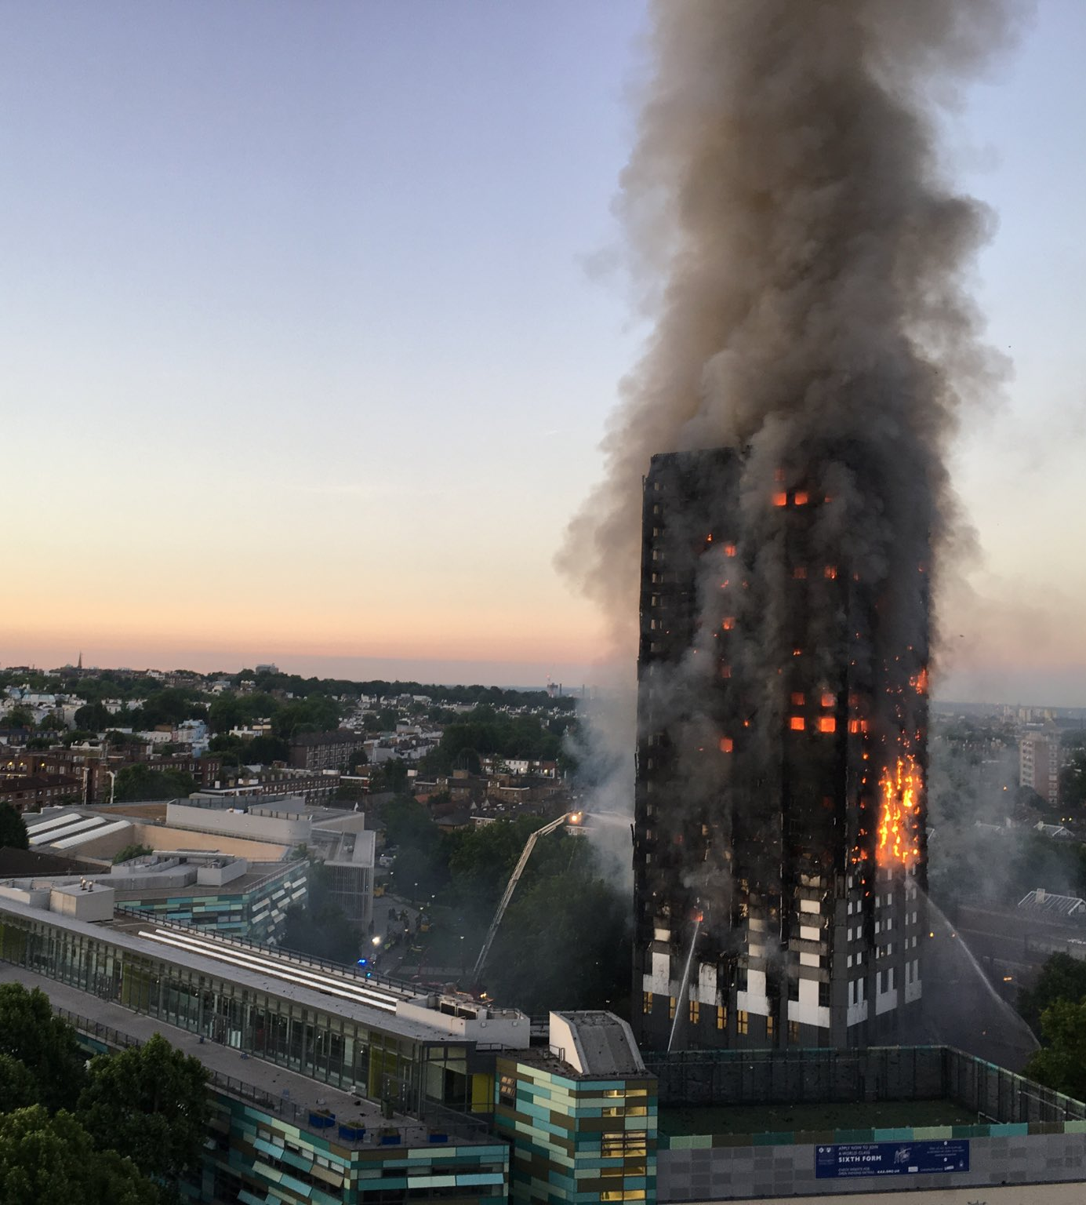
The Grenfell Tower Fire North Kensington, London 14 June 2017
One of the deadliest structural fires in the UK
The fire started by an electrical fault in a fridge on the 4th floor of the 24-storey building
72 people died, 70 injured and 223 escaped

Slide 3
Accountability - Who’s to blame?
Accountability - a principal-agent relationship between the agent and the principal, who can hold the agent to account for its behaviour and activity (Mulgan 2000).
Accountability is often framed as a response to failure (Hood 2010), where individuals or institutions are expected to be held responsible for their actions or negligence.
Accountability as a mechanism and as a virtue (Bovens 2010) :
Accountability as a mechanism - justifying past actions and decisions (ex-post),
Accountability as a virtue – a set of normative standards for the evaluations of public officials (ex-ante)
Recent studies in public administration have started to emphasise a more prospective approach to accountability, facilitating learning and improvement (Bovens et al. 2008, Visser 2016, Murphy et al. 2019)

Slide 4
Crises and disasters
Crises and disasters reveal gaps in accountability arrangements and trigger intense scrutiny and demands for greater accountability (Boin et al. 2010, Christensen et al. 2018, Cooper and Lapsley 2021, Ferry et al. 2024).
The role of accountability throughout the entire crisis cycle (pre-crisis, crisis, post-crisis) has remained relatively underexplored.
Accountability research primarily focuses on post-crisis evaluations (Romzek and Dubnick 1987, Koppell 2005, Boin et al. 2010, Cooper and Lapsley 2021).
However, there is a growing need to examine accountability in crisis research as a proactive mechanism for crisis prevention, preparedness, and risk mitigation.

Slide 5
Research objective
To understand the holistic nature of accountability in the crisis management cycle.
We draw on previous studies that introduce the concepts of proactive and reactive accountability (Kearns 1994, Novelli et al. 2024):
Proactive accountability – assigning responsibilities before an event
Reactive accountability – assigning blame after an event
RQ: How do proactive and reactive accountability mechanisms interact across the crisis management cycle?

Slide 6
Methods
A qualitative case study
Three-phases of crisis management (pre-crisis, crisis, and post-crisis)
Public Inquiry reports:
Phase 1 Report - the events of the 14th of June 2017 and includes the causes of the fire, the London Fire Brigade’s response, and how the fire spread through the building.
Phase 2 Report - the causes of the fire, including the building's structural flaws, regulatory failures, and the roles of contractors and regulatory bodies in the refurbishment of the Grenfell Tower.
Understanding how accountability mechanisms (proactive and reactive) played out before (pre-crisis), during (crisis), and after the crisis (post-crisis).

Slide 7
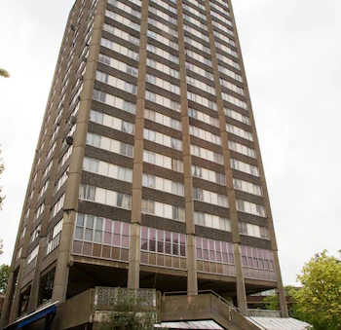
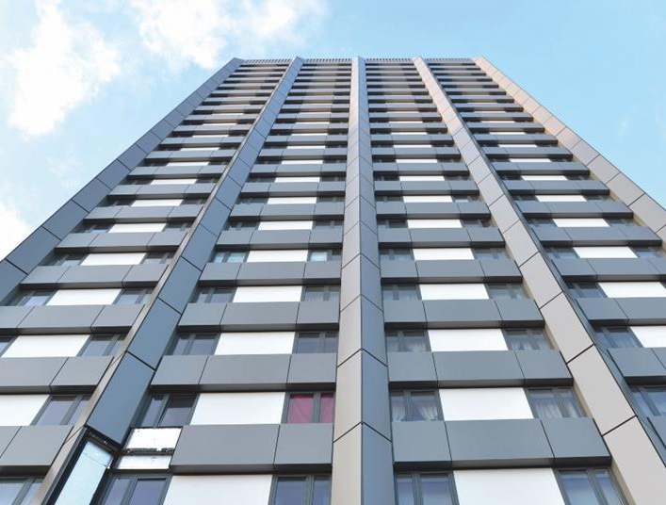
Findings: Pre-crisis
Flammable materials
Installation of highly flammable cladding (Reynobond 55 PE) and combustible insulation (Celotex RS5000 and Kingspan K15) during Grenfell Tower refurbishment in 2016, approved by Studio E (the architect), and ultimately by the Tenant Management Organisation (TMO).
Outdated and incomplete fire risk assessments failed to account for the changes to the building's design
Resident unaware of the potential fire hazard in their building
Regulators were dishonest in ensuring the safety of the materials used in the construction and alteration of high-rise buildings:
Local Authority Building Control (LABC), the British Board of Agrément (BBA), the Building Research Establishment (BRE), and the National House Building Council (NHBC)
Government’s awareness of cladding risks

Slide 8
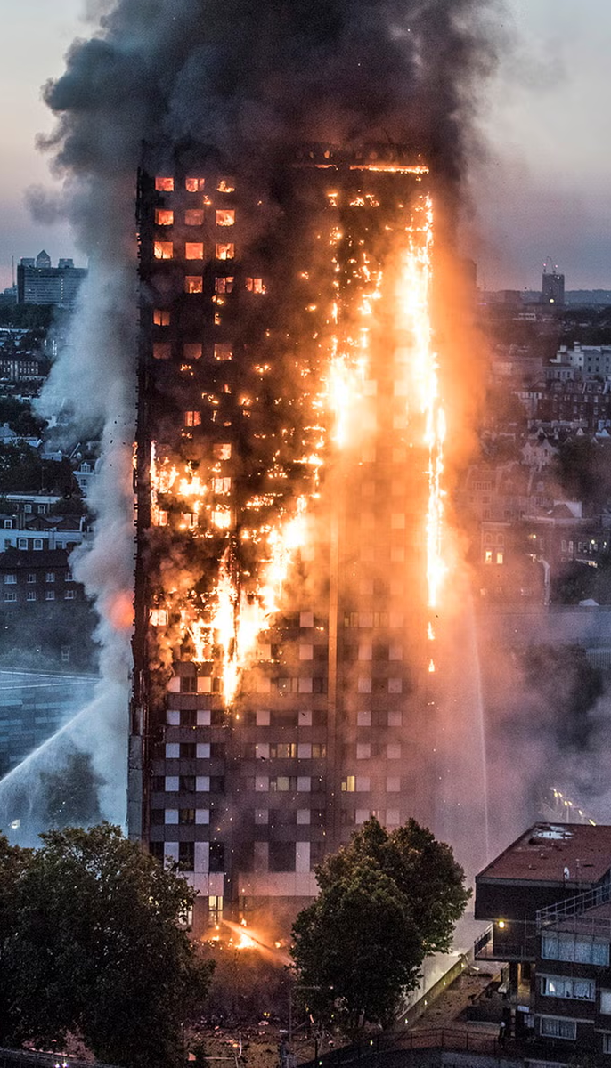
Findings: Crisis – the fire
Initial ‘stay put’ advice allowed the flames to spread rapidly across multiple floors
Chaotic and inadequately coordinated emergency services response
RBKC (the local authority) did not have an effective plan to deal with the displacement of a large number of people from their homes
No effective system in place for communicating with the public, leaving many survivors, residents and relatives unaware of available resources and next steps
Residents of the Grenfell Tower were excluded from the discussions related to support and recovery

Slide 9
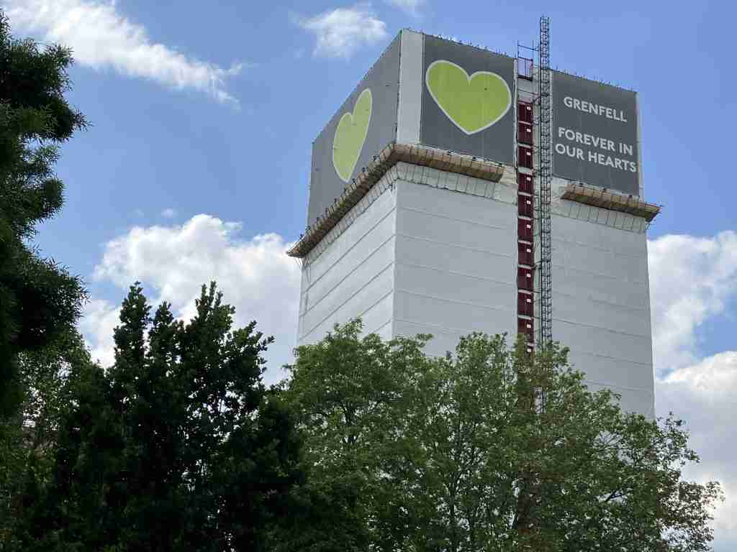
Findings: Post-crisis
A public inquiry to find and ultimately hold responsible individuals or organisations to account.
The UK government has introduced a range of new reforms and regulations to prevent future high-rise fires:
The Building Safety Act 2022 to enhance safety standards.
Establishing a single construction regulator.
Further recommendations:
Enhanced training for firefighters, particularly in high-rise buildings, and a review of evacuation strategies in high-rises
Greater coordination and collaboration between emergency services and local authorities

Slide 10
Proactive and Reactive Accountability
Table 1. Proactive accountability and reactive accountability in crisis management (Source: Authors)
 | Focus | Timing | Mechanisms | Goal
Proactive accountability | Assigning specific responsibilities to actors | Before a crisis | Risk assessments, contingency planning, learning from past events | Reducing risks
Reactive accountability | Assigning blame to responsible actors | After a crisis | Public inquiries, legal actions, evaluations, criminal prosecutions | Ensuring justice
Both proactive and reactive accountability processes played out different roles across all phases of the crisis
They serve distinctive, yet complementary roles in crisis management, as they inform emergency preparedness and effective response and recovery throughout the crisis cycle.

Slide 11
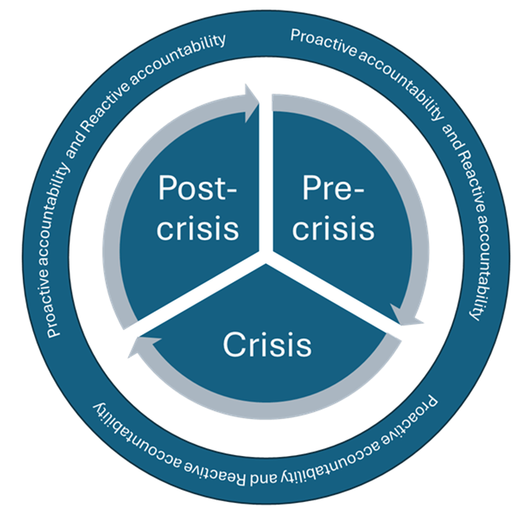
The interplay of proactive and reactive accountability
Both forms of accountability are intertwined throughout the crisis management cycle and failures in one form of accountability may influence the other.
Proactive accountability mechanisms can prevent the need for extensive reactive accountability measures, and similarly, reactive accountability measures might help identify inadequacies in proactive accountability mechanisms to improve future responses.
Figure 1. The interplay of proactive and reactive accountability mechanisms/processes across the crisis management cycle (Authors’ interpretation).

Slide 12
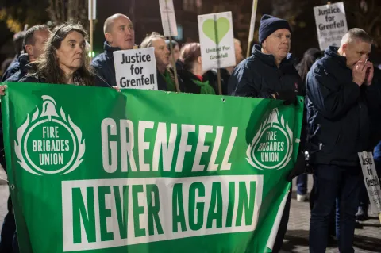
Conclusions
We contribute to the literature on accountability in crisis research, by arguing that accountability in crisis management can act as both proactive and reactive mechanisms (Bovens et al. 2008, Novelli et al. 2024).
Our conceptualisation helps to develop more comprehensive crisis management strategies, which will ensure that not only crises can be better prevented but also that responses to crises can be improved when crises unfold.
We hope that our findings will help improve regulatory and policy reforms, support the ongoing pursuit of justice for Grenfell victims, inform future crisis management strategies in similar situations.

Slide 13
Thank you
katarzyna.lakoma@ntu.ac.uk
peter.murphy@ntu.ac.uk
peter.eckersley@ntu.ac.uk

