Slide 1
Psychology in everyday life: Using psychology to make a difference
Professor Julie Hulme
Professor of Psychology Education

Slide 2
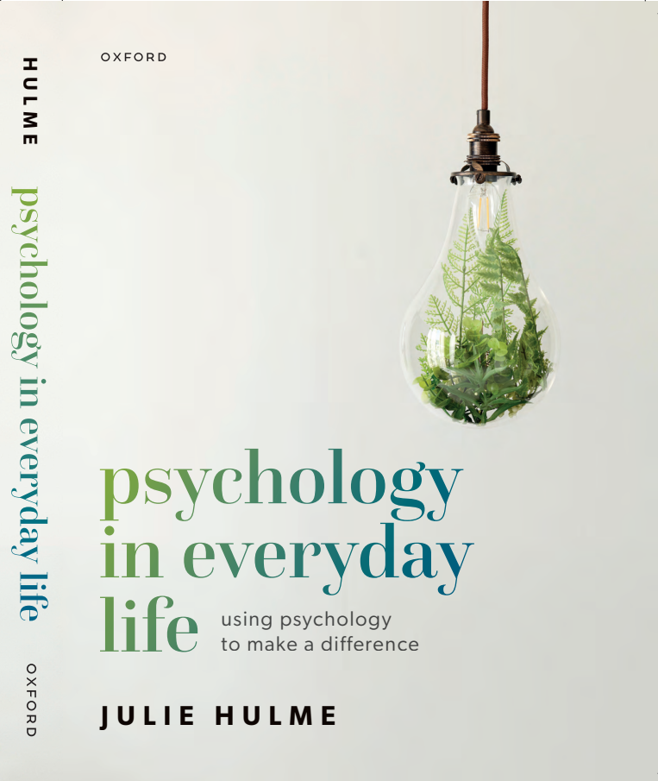
Outline
Understandings of psychology – what do we all mean?
Psychology as a toolkit:
To meet our personal goals
To meet our work goals
To meet our community goals
Giving psychology away – what will you do with it?
www.ntu.ac.uk
Notes:
This is an in person event where we will hear from Professor Julie Hulme who will introduce her book 'The Psychology in Everyday Life'.
Abstract: Why do so many people choose to study psychology? And what's the point of doing so? In this talk, and in her new book of the same name, Julie will lead us on an exploration of some of the most important ways in which psychology can contribute to students' (and everyone's) personal, work, and community lives. We will reflect on what we want to achieve in our lives, and touch on some of the core psychological knowledge and skills that can be applied to meeting our goals. From improving our own health and wellbeing, to gaining and enjoying meaningful employment, and generally making the world a better and more inclusive place for ourselves and those around us, Julie hopes to inspire you to find your own way to make a difference.

Slide 3
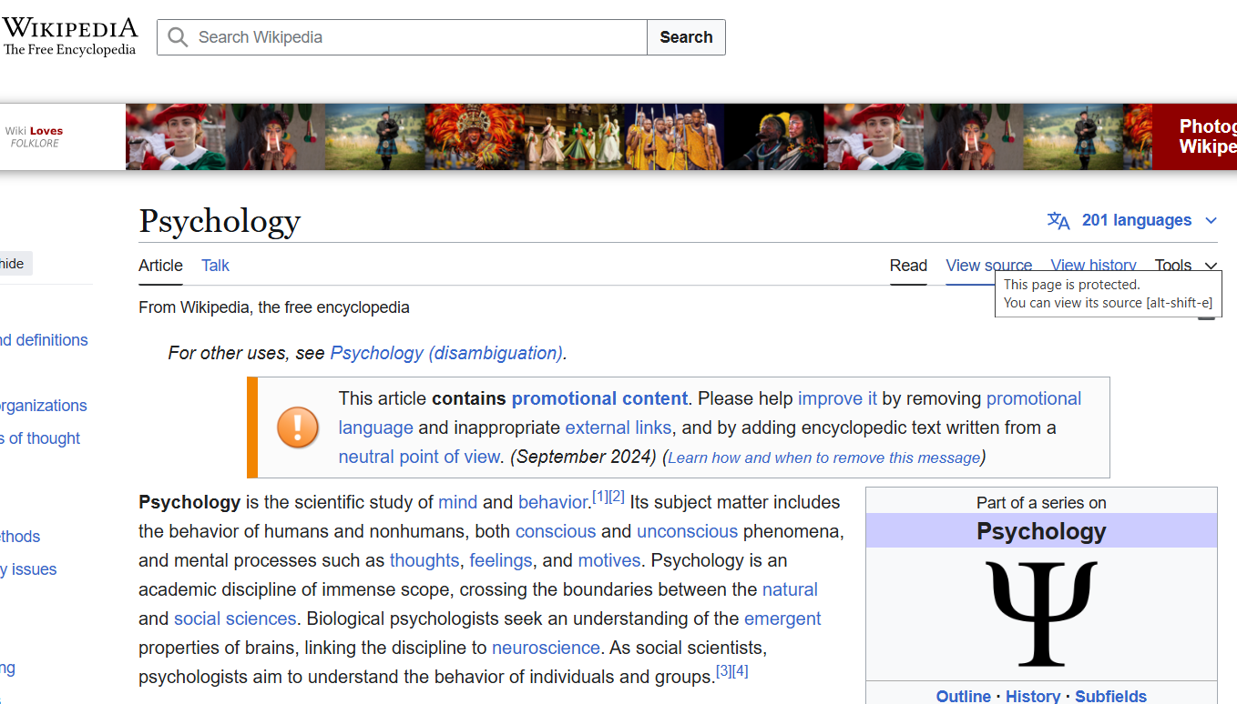
What do we mean by ‘psychology’?
(What does it mean to YOU?)
Freud?
The science of brain and behaviour?
Understanding the human mind?
Experimental design and statistics?
Analysis of talk and text?
Lots of theory?
???
www.ntu.ac.uk

Slide 4
The nature of psychology
Bringing psychology to life…or life to psychology?
“Psychology is an unusual discipline, drawing on natural sciences, social sciences and philosophy (Quality Assurance Agency, 2016). It encompasses all aspects of what it is to be human, covering biology and neuropsychology, social interaction and cultural context, cognitive processing, development from pre-birth to death, all of the things that humans share in common, and all of the ways in which we are diverse. As such, it touches on the life experiences of each and every one of us, and at the same time requires us to study those experiences within an academic context.”
Hulme & Kitching (2017)

Slide 5
Psychological literacy
Psychological literacy: “the intentional application of psychological knowledge, skills, values and attitudes to achieve personal, work and community (local to global) goals”
(Nolan et al., 2025, p. 12)
International Collaboration on Undergraduate Psychology Outcomes

Slide 6
International Competences for Undergraduate Psychology
What can psychology graduates DO?
Nolan et al. (2025, p4)

Slide 7
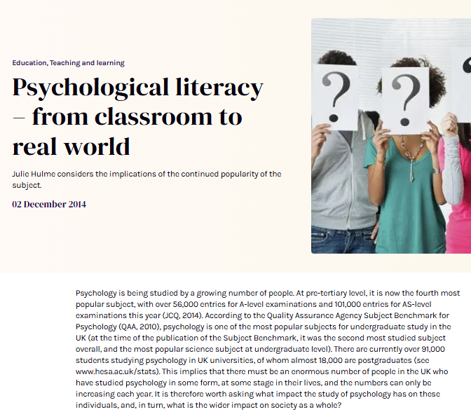
Teaching and learning psychological literacy
Bringing psychology to life…
Recognise and teach applications, not only theory
Align intended learning outcomes with practical opportunities in class and assessments
Model psychologically literate practices – ethics, inclusion, problem solving
(Hulme, 2014; Hulme & Cranney, 2022).
What can we do, rather than what do we know?

Slide 8
Psychology in everyday life
Personal, work, and community (local to global) goals
Hulme et al., 2015; Hulme, 2025

Slide 9
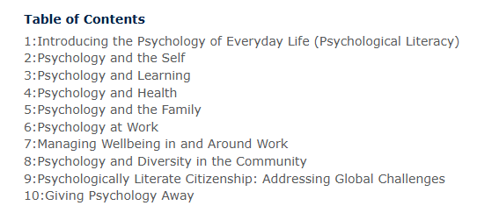
Table of contents
(And what you’ll find inside)

Slide 10
Dipping into a few examples…
Chapter 3: Learning
What motivates your learning?
Overcoming difficult content
What constitutes effective learning? How can we learn ‘better’?
Different approaches for different tasks?
What techniques do you use when reading or revising? Do they work?

Slide 11
Dipping into a few examples
Chapter 5: Psychology and family
What do traditional psychology textbooks tell us about psychology in family life?
Is it ok to do things differently?
What happens through the life span and how can we get through changes?

Slide 12
Dipping into a few examples
Chapter 7: Work and wellbeing
What is work-life balance, and how can I achieve it?
Leading and following as psychological skills
Serious leisure??

Slide 13
Dipping into a few examples…
Chapter 8: Diversity in the community
Which communities do you belong to?
What do we mean by cultural responsiveness, and how do we get better at it?

Slide 14
“Giving psychology away”
Miller (1969) – Psychology as a means of promoting human welfare. American Psychologist, 24(12): 1063-1075.
“The most urgent problems of our world today are the problems we have made for ourselves” (p. 1063).
Around 10-15% of psychology graduates go into psychology professions – the rest follow different and interesting pathways! But psychology can still be useful to them (Hulme, 2014) – and to their communities.
Banyard & Hulme (2015), Cranney et al. (2022) – why isn’t psychology already making a difference to the world around us?
What kind of gift are we giving? And how are we ensuring that those who study psychology know how to (safely and ethically) give it away?

Slide 15
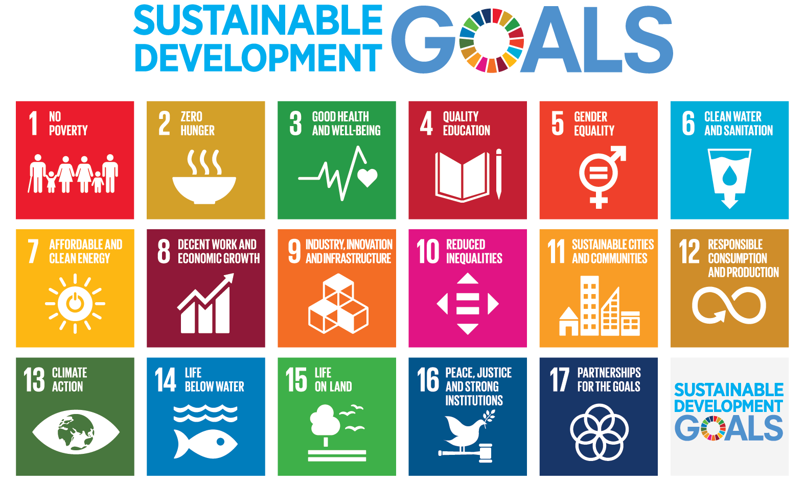
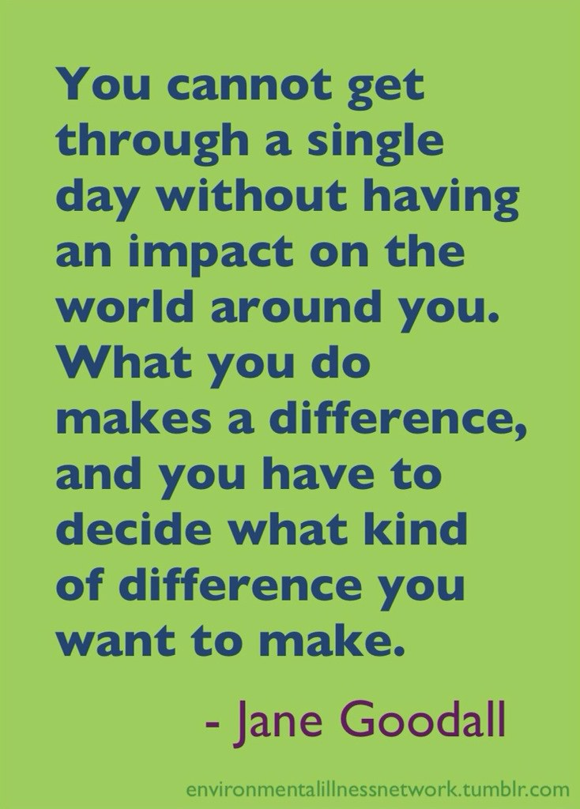
Using psychology to make a difference

Slide 16
Some questions and discussion?
Hulme, J.A. (2025). Psychology in everyday life: Using psychology to make a difference. Oxford University Press.

