Slide 1
Shining a spotlight on scholarship: Building and developing your profile in an education-focused career in psychology
Prof Julie Hulme (she/her)
Julie.Hulme@ntu.ac.uk; @JulieHulme-Psyc.bsky.social
Notes:
Shining a spotlight on scholarship: building and developing your profile in an education-focused career.
up, please do invite them! I've scheduled a 90 minute session to ensure we have plenty of time for discussion, but please don't be put off if you can only attend for part of it.

Slide 2
Outline
Education-focused careers
Overview - areas of interest
BOGOF – an example of how it has worked for me

Slide 3
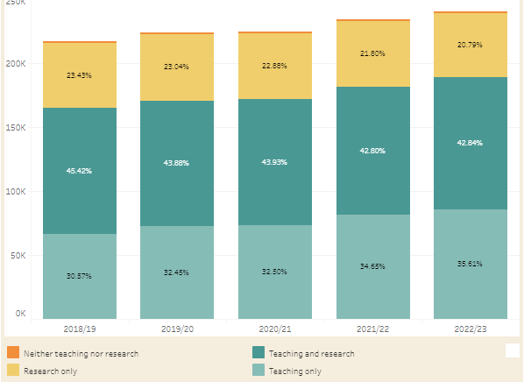
Academic staff in UK universities (HESA)
WonkHE: https://wonkhe.com/wonk-corner/hesa-spring-2024-staff-in-outline/
“Teaching only”
30.57
32.45
32.50
34.65
35.61
Notes:
240k academic staff – 35% are teaching only = 84,000 people
“A further 36% of academic staff were on teaching only contracts. This percentage has steadily increased year-on-year since 2015/16, when it was 26%.” – has risen year on year since 2012.

Slide 4
Teaching “only”?
How many people do you know who “only” teach?
E.g.
  NTU – Teaching and practice/Teaching and scholarship
  Keele – Education and scholarship
  Lincoln – Teaching, scholarship & professional practice
  Manchester – Teaching and scholarship
There’s nearly always an “and” – even if it isn’t written in a contract

Slide 5
Example – Teaching Fellow / Senior Teaching Fellow roles
My two “teaching only” experiences
TF: 2002-2004 – Teaching and Psychology-specific student support provision
STF: 2015-2016 – Teaching and transform all of our learning and teaching provision to improve the student experience and be Director of Education and please develop staff and take on some uni-level roles?
What is your ‘and’?

Slide 6
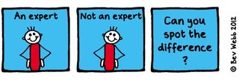
The ‘and’ is often where expertise lies…

Slide 7
Leading effective educational change requires educational expertise (e.g. Nelson and Campbell, 2017; Fung, 2017; Gorard, 2020), and educational expertise is more likely to be located in those who choose to study it than it is in traditional discipline-specific researchers. Thus education-focused academics are frequently “positive disruptors” (Akerman, 2020).
Hulme (2022)

Slide 8
So what is scholarship?
Trigwell (2013) – scholarship (of teaching and learning / SoTL) has many (contested) definitions and many purposes. Generally:
Improving and enhancing teaching, learning, assessment, and more
Evaluating and determining ‘quality’
Evidence-based and systematic

Slide 9
Scholarship means “going meta”
IMPACT
Hutchings and Shulman (1999): “A scholarship of teaching is not synonymous with excellent teaching. It requires a kind of ‘going meta’, in which faculty frame and systematically investigate questions related to student learning—the conditions under which it occurs, what it looks like, how to deepen it, and so forth—and do so with an eye not only to improving their own classroom but to advancing practice beyond it.”
Shulman (1999): “An act of intelligence or artistic creation becomes scholarship when it possesses at least three attributes: it becomes public, it becomes an object of critical review and evaluation by members of one’s community, and members of one’s community begin to use, build upon, and develop those acts of mind and creation”

Slide 10
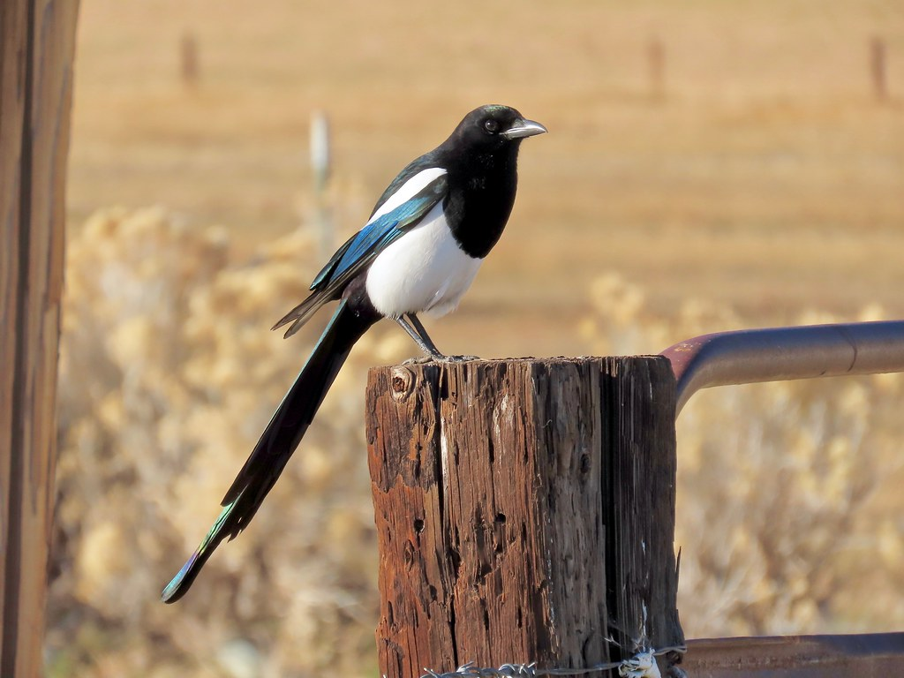
My areas of interest – the academic magpie!
Psychological literacy (and psychology education more broadly)
Inclusive education – across disciplines
Supporting reward and recognition for education-focused colleagues
With interests around transitions into/through university, feedback on assessment, decolonising curricula…

Slide 11
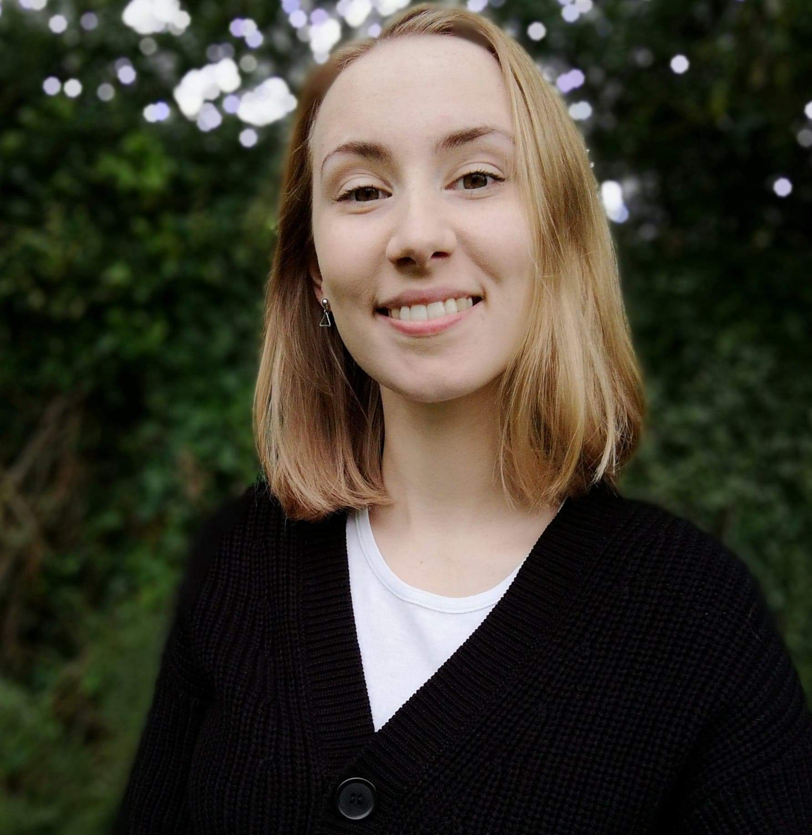
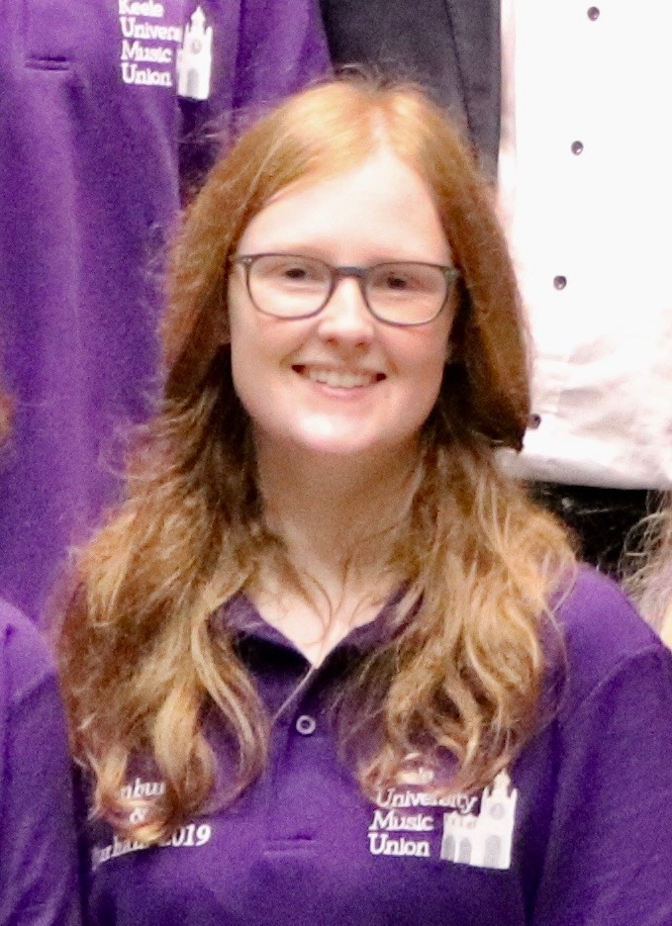
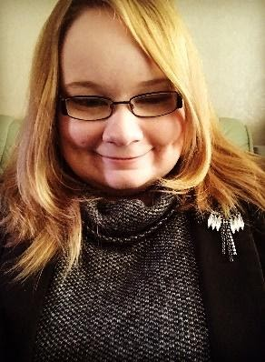
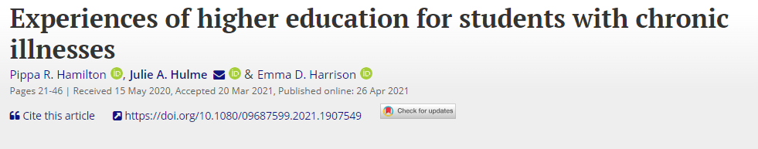
Inclusive education – how to grow a BOGOF system!
Teaching disabled (and other marginalised) students – allyship
Students wanting to understand their own university experience from a psychological perspective
Final year project supervision – and eventually a whole lab on MS Teams
Output 1: Co-authored paper with Pippa Hamilton on experiences of UK HE students with chronic illness – more journal articles in prep
Pippa Hamilton
Emma Crabb
Stacey Lyons

Slide 12
That one output and the lab collectively became very productive:
Hamilton, P., Hulme, J.A. & Harrison, E.D. (2023 – online 2021). Experiences of higher education students with chronic illnesses. Disability and Society. DOI: 10.1080/09687599.2021.1907549.
Hulme, J.A., Hamilton, P., Lyons, S., Crabb, E., Cascone, C., Davis, S., Fahey, C., Holland, B., Hussain, M., & Knight, E. (2023). Students as researchers: Amplifying disabled student voices. In: Disability Evidence Review with TASO. https://taso.org.uk/wp-content/uploads/Uni-Lincoln-Disability-Evidence-Review-with-TASO.pdf
Hulme, J.A. & Lyons, S.M. (2023). Disability across disciplines: Exploring lived experiences of disabled students through psychological and disability studies theoretical lenses. NTU Theory Aloud Seminar Series.
Hulme, J.A. (2022). Amplifying disabled students’ voices. ANTF blog, 25/03/2022. https://ntf-association.com/amplifying-disabled-student-voices/
Hulme, J.A. (2021): Inclusive learning: Engaging student voices. GlobalMindED expert talk, 28th May 2021. Available to view at: https://youtu.be/p-SmwpbPtuU (from 27 minutes).
Lyons, S.M. & Hulme, J.A. (June, 2021). Why are so many students locked out of their education? WonkHE (18/06/2021). https://wonkhe.com/blogs/why-are-so-many-students-locked-out-of-their-education/
Hulme, J.A. (September, 2021). Social identity and disability in the classroom. Changing States of Mind podcast. https://changingstatesofmind.libsyn.com/social-identity-and-disability-in-the-classroom-with-dr-julie-hulme
Hulme, J.A. (2021). There’s no such thing as the student voice: Listening to the throng. HigherPsychEd, August 2021.
And a whole new project – Autistic Voices in Geosciences – coming soon…!

Slide 13
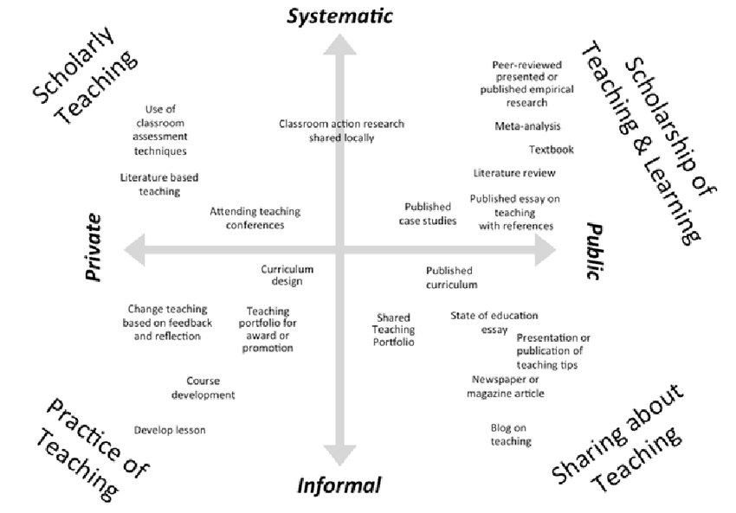
Kern et al (2015)
Dimensions of activity relating to teaching (DART)

Slide 14
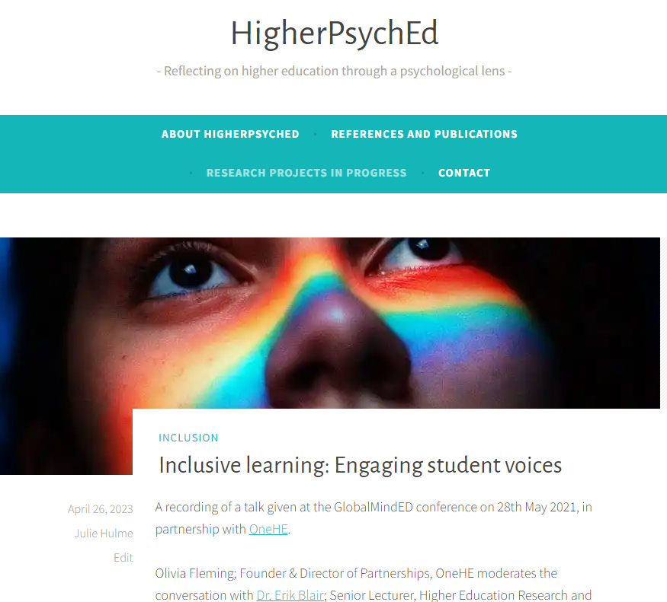
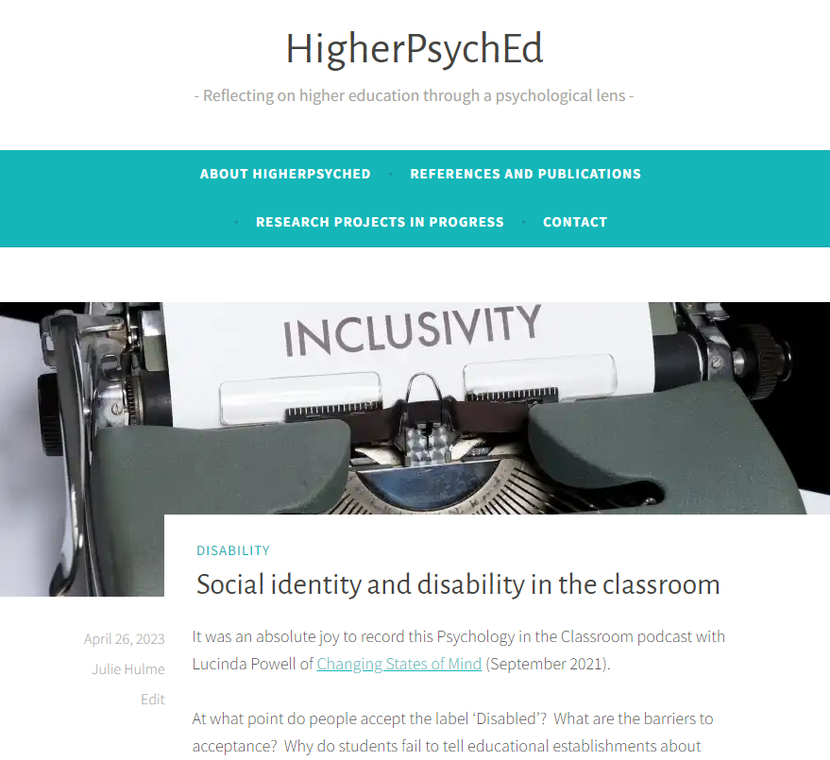

Slide 15

The BOGOF model of scholarship
Scholarship – the evidence that underpins the decisions you make (that achieves teaching success)
Scholarship – the products or resources you produce that deliver teaching, can be turned into OER
Scholarship – the evaluation of the design, the development, the delivery, the products, the outcomes, the formal outputs…
Scholarship as an act of generosity (Martinovic et al., 2022)
Where’s your BOGOF opportunity?

Slide 16

Reward and recognition
Promotion?
(Inter)National invitations?
AFHEA, FHEA, SFHEA, PFHEA
National Teaching Fellowship, CATE award?
BPS DART-P HEPTOTY award?
What works for you?
Narrative that pulls together evidence of your reach, impact, value.
A claim of expertise
Who are you? What are you known for? What do you want to achieve?

Slide 17
There are relatively few teaching-focussed staff in more senior positions who can review, mentor and support teaching staff; act as role models for junior staff who are seeking to develop a teaching/education career (Fung and Gordon, 2016); help individuals to collate a mix of quantitative and qualitative evidence that provides a clear sense of their teaching achievements”
(McHanwell & Robson, 2018)
Networking and peer support – finding your tribe

Slide 18
Networks
T-FΨN (Teaching-Focused University Network - Psychology)
Profs in Prep – email me on Julie.Hulme@ntu.ac.uk
UK Teaching-Focused Higher Education Network – sign up to our JISCmail list, HETEACHINGNETWORK@JISCMAIL.AC.UK, via https://jiscmail.ac.uk
National Teaching Repository
BPS DART-P
Start your own?
Networks enable you to collaborate, disseminate your work (reach), to see it being implemented and evaluated (impact), open up new opportunities, raise your profile, provide a pool of peer reviewers, referees and assessors.

Slide 19
What difference will you make, and how can you plan to achieve it?
Where (topics?) can you build your expertise?
What actions can you take to increase your success in doing impactful and visible scholarship?
Who can help?
Some other thoughts? – over to you
What next?

