Slide 1
Shining a spotlight on scholarship: building and developing your profile in an education-focused career
Professor Julie Hulme
Julie.Hulme@ntu.ac.uk
@JulieH_Psyc
Notes:
Title:
Shining a spotlight on scholarship: building and developing your profile in an education-focused career
Abstract:
The number and proportion of academics employed on education-focused career pathways has grown considerably in recent years (HESA, 2023), but the nature of their role and their contributions to universities above and beyond teaching and educational leadership can be misunderstood and sometimes undervalued. In this talk, Julie will share her own scholarship journey and her national work in supporting education-focused professorial promotions. She'll lead us through exploring the nature of scholarship, the diverse ways in which scholarship can be 'done' and disseminated, and discussing what it means to develop a meaningful academic career and expertise to professorial level while on an education-focused career pathway. There will be plenty of opportunities for discussion and questions throughout.
Bio:
Julie is Professor in Psychology Education at Nottingham Trent University. She is a Chartered Psychologist, Principal Fellow of the HEA, and a National Teaching Fellow, and applies psychological theory and research methods to better understand and enhance learning and teaching in higher education. As an education-focused academic, Julie is committed to developing understanding and support for other academics on diverse career paths, and set up the successful Profs in Prep network in 2018 to facilitate change across the sector. Julie describes herself as a 'positive disruptor'; she challenges inequity in higher education, champions inclusion, and is always willing to question the status quo.

Slide 2
Outline
Sector context – who and where are the ‘education-focused’ staff? What do we do?
Education focus as expertise – scholarship as a specialism
Profile building – from classroom to global reach and impact!
Discussion and questions

Slide 3
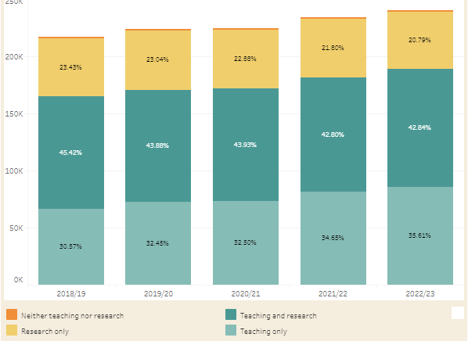
Academic staff in UK universities (HESA)
WonkHE: https://wonkhe.com/wonk-corner/hesa-spring-2024-staff-in-outline/
“Teaching only”
30.57
32.45
32.50
34.65
35.61
Notes:
240k academic staff – 35% are teaching only = 84,000 people
“A further 36% of academic staff were on teaching only contracts. This percentage has steadily increased year-on-year since 2015/16, when it was 26%.” – has risen year on year since 2012.

Slide 4
How does it look at Cardiff Uni? (2022-23)
1050 teaching only = 30.79% (cf 65.61% sector)
985 research only
1375 teaching and research
3410 total academic staff
https://www.hesa.ac.uk/data-and-analysis/staff/employment-conditions

Slide 5
Intersections?
Demographics
Some evidence that certain groups are over-represented amongst education-focused staff – but this is not part of the HESA open data set, and seems to vary from university to university:
Female
Parents/carers
Part-time employment
Disabled
Racially minoritized groups
Why?

Slide 6
Teaching “only”?
Lies, damn lies, and statistics
How many people do you know who “only” teach?
What are the expectations of education-focused staff at Cardiff?
E.g.
NTU – Teaching and scholarship/Teaching and practice
Keele – Education and scholarship
Lincoln – Teaching, scholarship & professional practice
Manchester – Teaching and scholarship
There’s nearly always an “and” – even if it isn’t written in a contract

Slide 7
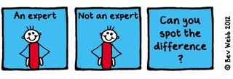
Example – Teaching Fellow / Senior Teaching Fellow roles
My two “teaching only” experiences
TF: 2002-2004 – Teaching and Psychology-specific student support provision
STF: 2015-2016 – Teaching and transform all of our learning and teaching provision to improve the student experience and be Director of Education and please develop staff and take on some uni-level roles?
What is your ‘and’?

Slide 8
Leading effective educational change requires educational expertise (e.g. Nelson and Campbell, 2017; Fung, 2017; Gorard, 2020), and educational expertise is more likely to be located in those who choose to study it than it is in traditional discipline-specific researchers. Thus education-focused academics are frequently “positive disruptors” (Akerman, 2020).
Hulme (2022)

Slide 9
The BOGOF model of scholarship
Scholarship – the evidence that underpins the decisions you make (that achieves the T success)
Scholarship – the products/resources you produce that deliver the T
Scholarship – the evaluation of the design, the development, the delivery, the products, the T, the outcomes…
Where’s your BOGOF opportunity?

Slide 10
Psychological literacy – the ability to apply psychology to achieve goals in personal, professional, and community (local to global) life
I wanted to use my knowledge and skills in psychology to improve the lives of my students and my colleagues. I also wanted to progress in my career!
See Hulme & Cranney (2022)

Slide 11
So what is scholarship?
Boyer (1990)

Slide 12
So what is scholarship?
Trigwell (2013) – scholarship (of teaching and learning / SoTL) has many (contested) definitions and many purposes. Generally:
Improving and enhancing teaching, learning, assessment, and more
Evaluating and determining ‘quality’
Evidence-based and systematic
In a pracademic context – how do you teach students to become professional practitioners who are ‘work ready’?

Slide 13
Scholarship means “going meta”
Hutchings and Shulman (1999): “A scholarship of teaching is not synonymous with excellent teaching. It requires a kind of ‘going meta’, in which faculty frame and systematically investigate questions related to student learning—the conditions under which it occurs, what it looks like, how to deepen it, and so forth—and do so with an eye not only to improving their own classroom but to advancing practice beyond it.”
Shulman (1999): “An act of intelligence or artistic creation becomes scholarship when it possesses at least three attributes: it becomes public, it becomes an object of critical review and evaluation by members of one’s community, and members of one’s community begin to use, build upon, and develop those acts of mind and creation”

Slide 14
Going meta!
Who can see your work?
How do they find it?
Who are your stakeholders? Who cares?
Who is using your work?
What is the reach, impact, and value?
What is the potential for reach, impact, value?

Slide 15
Kern et al (2015) Dimensions of activity relating to teaching (DART)
Where are you?

Slide 16
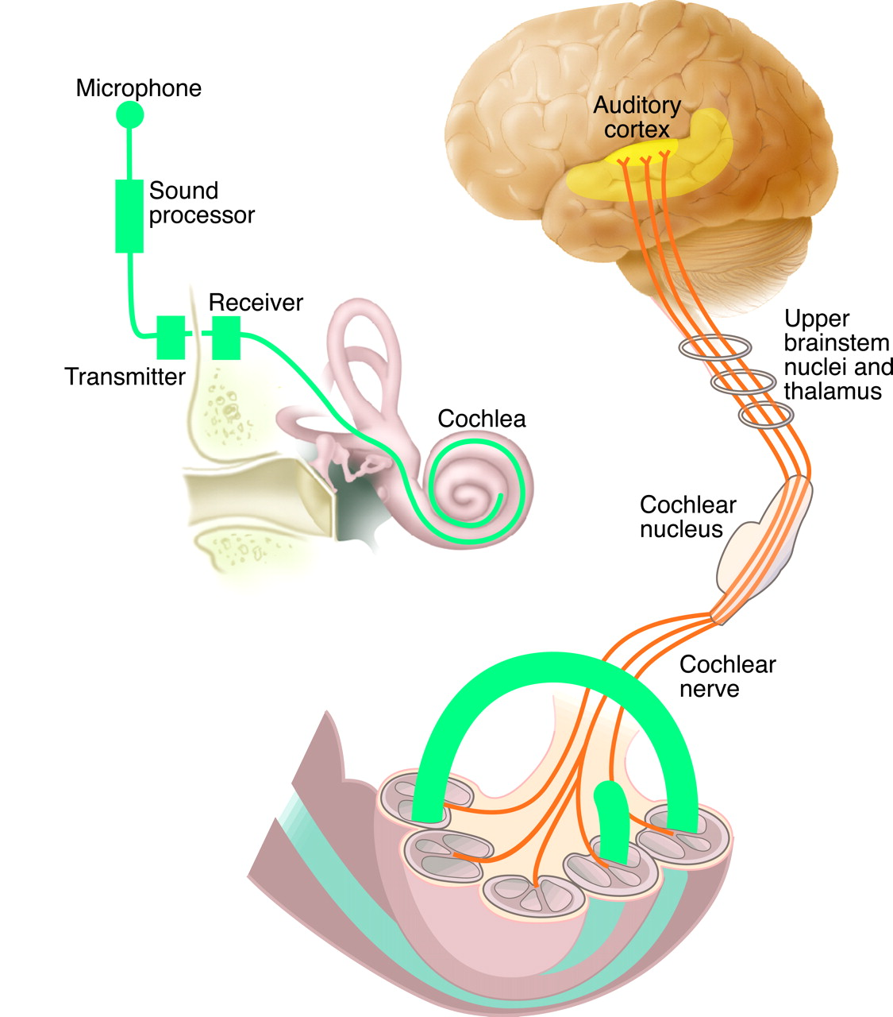
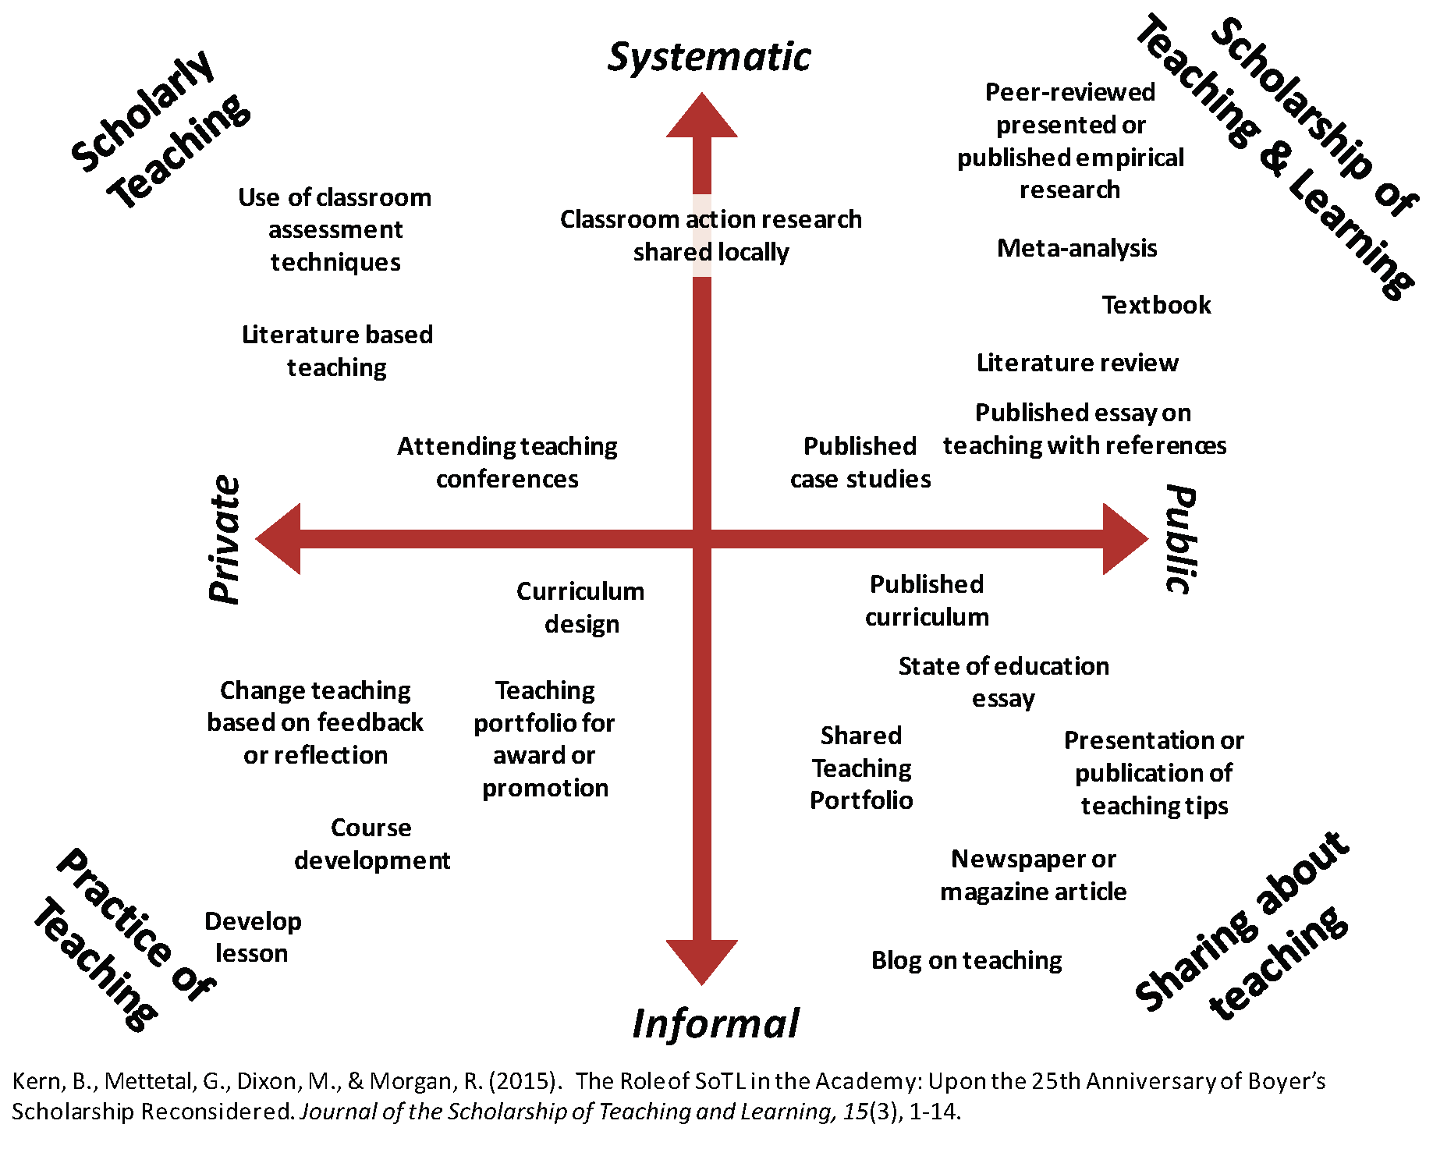
My scholarship journey
Scholarship of scholarship!
Disabled students as researchers
Journal articles
Profs in Prep network and more
Assessment and feedback research
Psychological literacy
Blog
Advance HE resources
Scholarly teaching
Open educational resources

Slide 17
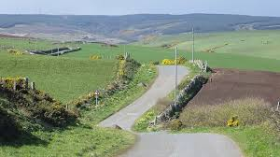
Purposeful planning for impact
How do you find the ‘BOGOF’ deal?
Topical issue - who shares the problem?
Resources – funding? time? students as researchers? collaborative networks?
Stakeholders – internal and external
Plan evaluation from the start – who has the skills?
Disseminate how? where?
How to assess reach, impact, value?

Slide 18
Reward and recognition
Promotion?
(Inter)National invitations?
AFHEA, FHEA, SFHEA, PFHEA
National Teaching Fellowship, CATE award?
BPS fellowship? DART-P Higher Education Psychology Teacher of the Year?
What works for you?
Narrative that pulls together evidence of your reach, impact, value.
A claim of expertise
Who are you? What are you known for? What do you want to achieve?

Slide 19
There are relatively few teaching-focussed staff in more senior positions who can review, mentor and support teaching staff; act as role models for junior staff who are seeking to develop a teaching/education career (Fung and Gordon, 2016); help individuals to collate a mix of quantitative and qualitative evidence that provides a clear sense of their teaching achievements”
(McHanwell & Robson, 2018)
Networking and peer support – finding your tribe

Slide 20
Networks
Profs in Prep – email me on Julie.Hulme@ntu.ac.uk
UK Teaching-Focused Higher Education Network – sign up to our JISCmail list, HETEACHINGNETWORK@JISCMAIL.AC.UK, via https://jiscmail.ac.uk
BPS Division of Academics, Researchers and Teachers in Psychology (DART-P)
ISSOTL https://issotl.com/
Cardiff Learning and Teaching Academy?
National Teaching Repository
Start your own?

Slide 21
Reflections and discussion
What actions can you take to increase your success in doing impactful and visible scholarship?
Where can positive disruption be useful in all this? (and who can influence?)
Some other thoughts?
What next?

