Slide 1
Engaging students with Psychology: Active, inspirational learning for diverse students
Prof Julie Hulme (she/her)
Julie.Hulme@ntu.ac.uk; @JulieH_Psyc
Notes:
The workshop intends to meet the following objectives:
To engage staff in active learning experiences, modelling practice, and equipping them to increase their use of active learning in their own teaching delivery;
To introduce staff to the concept of psychological literacy, in the context of the forthcoming QAA Subject Benchmark Statement for Psychology, and to initiate planning to embed student skills and competences related to psychological literacy in their teaching and assessment (with a view to supporting student wellbeing, employability and global citizenship);
To reflect on the diversity of student needs within the student body at Worcester, and to equip staff with strategies to work to further develop inclusive teaching practices;
To actively plan individual learning and teaching activities, and initiate discussion about departmental learning and teaching strategies from 2023-24.

Slide 2
Outline
Warm up
Context
Opportunities – psychology and psychological literacy
Inclusive education
Practical strategies
Putting ideas into action – what’s next?

Slide 3
Warm up
Why did you choose to study psychology?
Why do you choose to teach psychology?
What’s the most rewarding aspect of your job?
Share your thoughts on your table and then summarise for the larger group

Slide 4
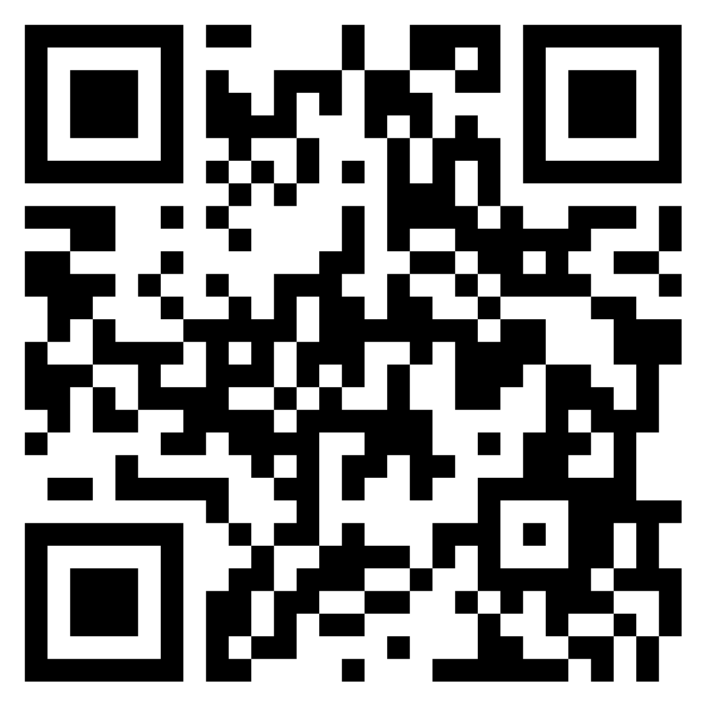
https://bit.ly/3CByS3j
Continuing the discussion…
What is university education for?
What is the value of studying psychology?
What is great/unique about Worcester psychology graduates?
(How do you know?)

Slide 5
Why do students choose to study psychology?
Augar report – subject of little value.
Graduate Outcomes data – relatively low levels of ‘graduate employment’ compared to other subjects. BPS graduate survey – psychology graduates ‘catch up’ on employability within 5 years.
Around 10-15% of students become psychologists – what about the rest? Health and social care, education, housing, human resources, charitable work…
Recent debates around “quality of work” not only income and status – e.g. how does work impact on wellbeing?
Bromnick & Horowitz (2013) – to “make a difference” – it’s not about status or income, but about helping people.

Slide 6
What is higher education for?
“Formal education systems tend to emphasize the acquisition of knowledge to the detriment of other types of learning, but it is vital now to conceive education in a more encompassing fashion.” (Learning: The Treasure Within, UNESCO, 1996)
“The aim of education is not only to prepare students for productive careers, but also to enable them to live lives of dignity and purpose; not only to generate new knowledge, but to help shape a citizenry that can promote the public good. Thus, higher education’s vision must be widened if the nation is to be rescued from the problems that threaten to diminish permanently the quality of life.”
(Boyer, 1990, p77-78).

Slide 7
Does psychology education achieve these purposes?
What do you think studying a psychology degree does to help students to:
Live lives of dignity and purpose?
Generate knowledge?
Serve humanity?
Does your psychology programme promote these aims?

Slide 8
Psychology for a changing world – what is changing?
Technology including AI
Student expectations and preparation for HE
Increased student diversity
Employment landscape and nature of jobs
Student numbers and graduate numbers
Global issues – climate change, health inequalities, cost of living crisis, etc
The QAA subject benchmark statement for Psychology
…?

Slide 9
How does HE teaching change?
The status quo bias: ‘If it ain’t broke, don’t fix it’ – our cognitive preference for keeping things the same.
Fraser (2016): “It’s always been taught like this”.
It doesn’t change very much…unless we decide to change it.
Hulme & Winstone (2017) – change is driven by needs to be inclusive, preparing graduates, changing world, student engagement. It can feel risky…but there are ways of managing risks.

Slide 10
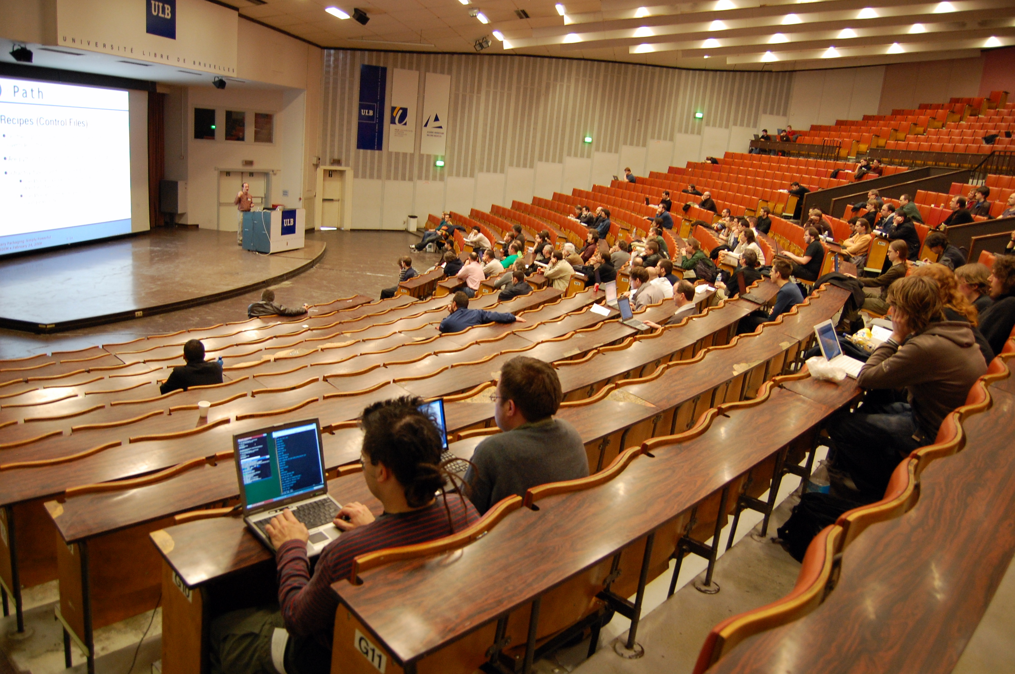
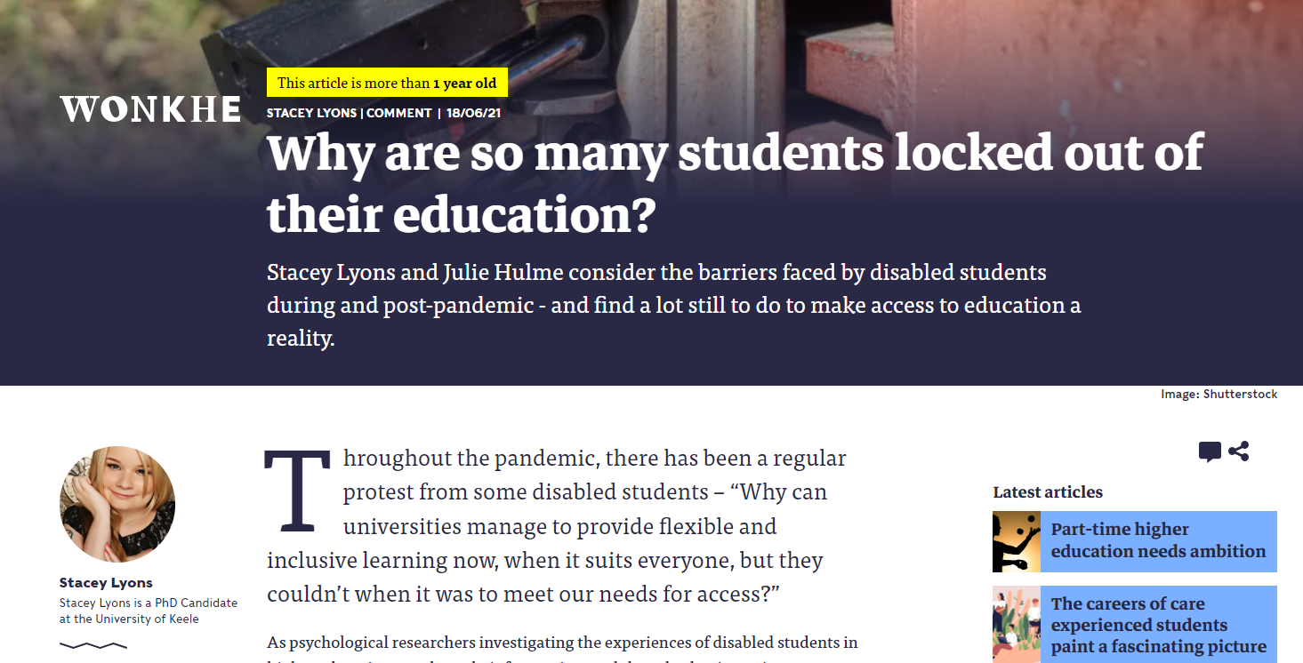
Is it broke…?
Awarding gaps, attendance and engagement, employability…
Future proofing?
If it’s broke (even a little bit), can we fix it?

Slide 11
Psychological literacy
“The general capacity to adaptively and intentionally apply psychology to meet personal, professional and societal needs”
(Cranney et al, 2012).

Slide 12
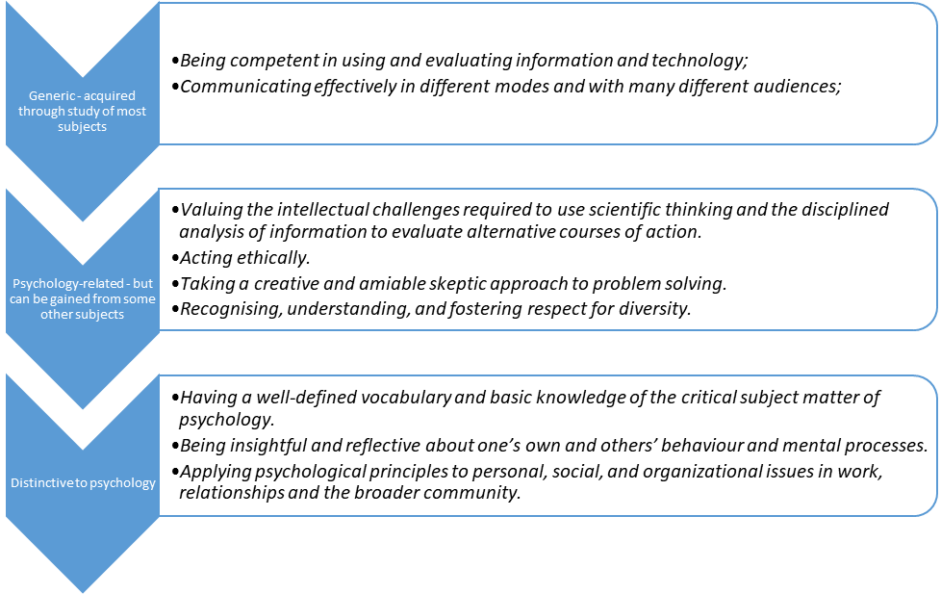
Hulme (in prep, based on McGovern et al., 2011)

Slide 13
New draft QAA subject benchmark for Psychology
Subject to change…has been through consultation
Psychological literacy features strongly
New emphases:
Sustainability
Diversity and inclusion
Employability and entrepreneurship
Accessibility
Draft also includes slightly different content – lifespan development and community psychology are proposed as core

Slide 14
Draft subject benchmark – purpose of studying psychology
Psychology is a broad-based discipline that encompasses a range of empirical approaches and methods of enquiry that aim to understand the mind, brain, experience, behaviour and contexts of humans and animals. The antecedents of psychology can be found in physics, biology and philosophy, but its methods of enquiry have developed not only from these disciplines but also from the humanities and other natural, social and mathematical sciences. These origins, often referred to as ‘global north’, have narrowed the lens of the discipline and restricted wider focus on the diversity of the human experience. This has had the effect of amplifying the experiences of some, while marginalising, misunderstanding and mischaracterising others. The purpose of psychology is to be an inclusive, empirically based and reflective discipline that fosters the development of local and global psychological literacy to address human, social, economic and environmental challenges, as well as building a knowledge and understanding of the fundamental premises of psychology. This Subject Benchmark Statement outlines a roadmap for psychology that is underpinned by a commitment to inclusion, ethical practice and integrity in addressing the questions and challenges facing society.

Slide 15
Implications
“Promoting psychological literacy entails reorienting what and how we teach students in a way that emphasizes Psychology’s relevance”.
Dunn et al. (2011)
“We must both (a) recognise the relevance of psychology to students’ personal lives, and (b) facilitate their self-awareness of the ways in which this personal meaning can impact on their ability to evaluate evidence and to make informed decisions.”
Hulme & Cranney (2022)
Hulme, J.A. & Cranney, J. (2022). Psychological literacy and learning for life. In: J. Zumbach, D. Bernstein, S. Narciss & G. Marsico (Eds). International handbook of psychology learning and teaching. Cham: Springer. DOI: 10.1007/978-3-030-26248-8_42-1.

Slide 16
Implications
We need to:
Teach applications alongside theoretical psychology
Constructively align our teaching
Model psychological literacy
Hulme (2014). Psychological literacy – from classroom to real world. The Psychologist, 27 (12): 932-935.

Slide 17
Constructive alignment
Biggs, 1996

Slide 18
Problem-based learning activity
In groups of four to eight:
Choose a core module (this might inform the group you choose to work with).
Choose one of the four new SBS features – sustainability, diversity and inclusion, employability and entrepreneurship, accessibility.
What “problems” can you identify? Brainstorm and choose one.
What do you need to know in order to solve one “problem”?
Allocate tasks, find info to fill the gaps, then synthesise your findings.
Propose a solution – what might learning outcomes, activities, assessment look like with this in mind?
Feedback to main group.
Worcester Psychology

Slide 19
Reflections on PBL
How did you find this (brief) experience of PBL?
How do you think your students might find it?
Advantages and disadvantages?
Worcester Psychology

Slide 20
My reflections on PBL from teaching practice
It sometimes frightens teaching staff! – what if it doesn’t work, what if students don’t learn ‘the content’?
Students find it challenging at first – why aren’t you telling me things?…
But then find it highly engaging and rewarding, and module evaluations climb
Diverse perspectives contribute to learning, and students form effective, supportive teams
It’s a safe way to learn from mistakes and gain feedback prior to assessment
It builds problem solving skills and creativity for employability
Worcester Psychology

Slide 21
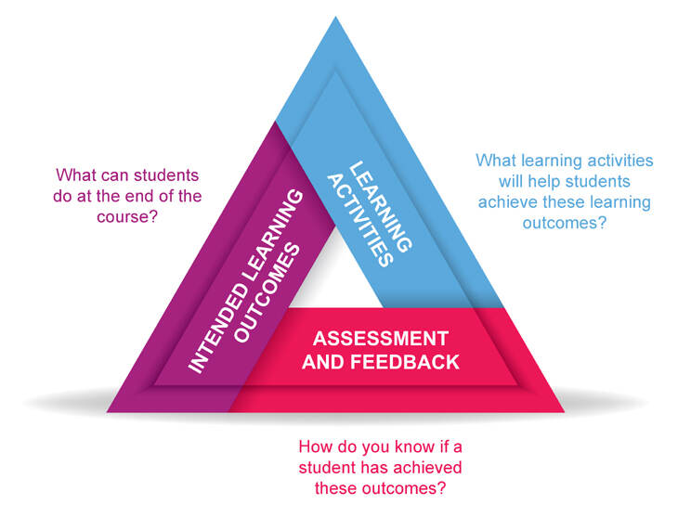
How does this fit with constructive alignment?
Learning outcome: Colleagues will be able to apply the principles of problem-based learning to their own teaching.
Learning and teaching activity: Engage in PBL and see how it works – gain familiarity with a ‘real’ PBL activity as a learner. (Fraser, 2016 – “they teach how they were taught”).
‘Assessment’: formative: feedback solutions to the group; summative: can you apply it in your own class?

Slide 22
Authentic assessment
“Authentic assessment means that: (a) tasks must appropriately reflect the competency that needs to be assessed, (b) the content of an assessment involves authentic tasks that represent real-life problems of the knowledge domain assessed, and (c) the thinking that experts use to solve the problem in real life are also required by the assessment task”
Gulikers et al. (2004).
See also Sambell & Brown (2021-) for case studies

Slide 23
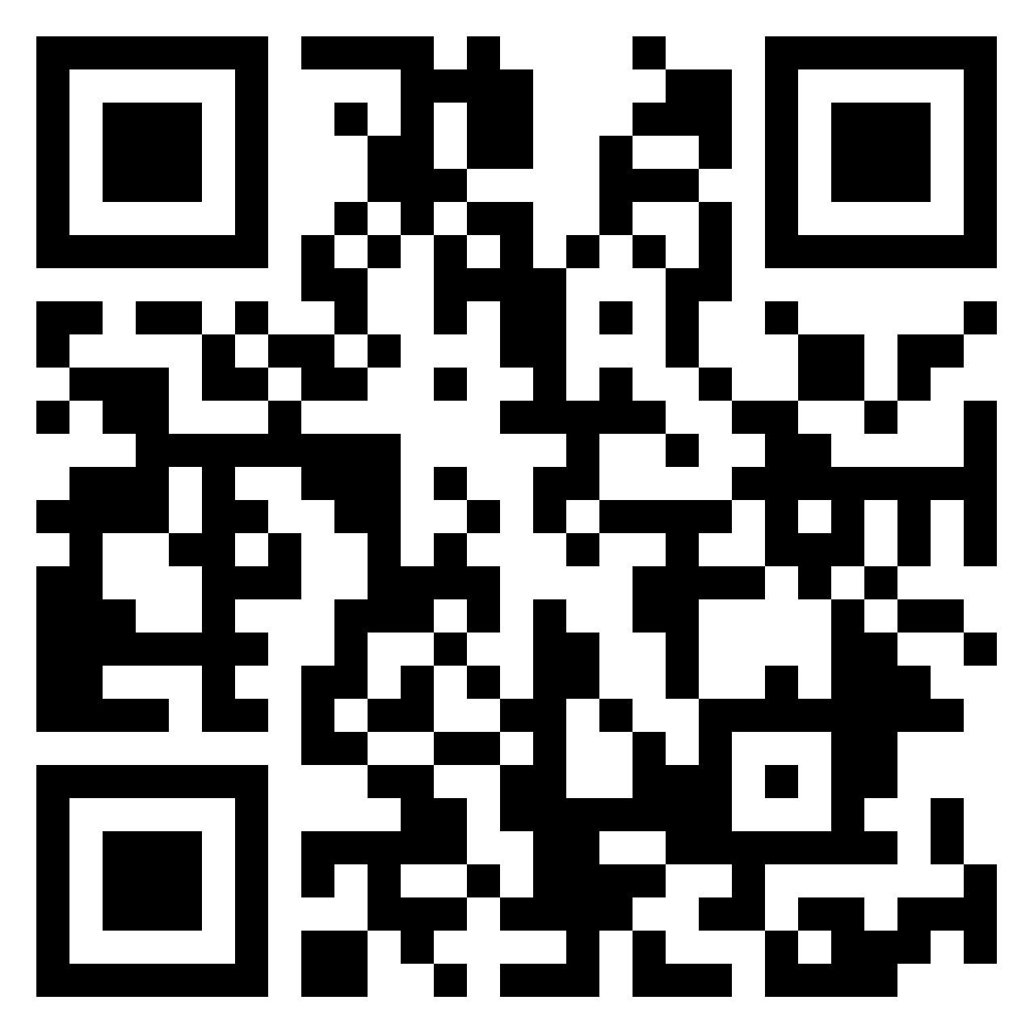
What opportunities can we see to further developing psychological literacy in our teaching?
For students?
For us?
For the department/university?
For society/employers?
https://bit.ly/3CjJ9Rp

Slide 24
Inclusive learning and teaching
Hockings (2010):‘the ways in which pedagogy, curricula and assessment are designed and delivered to engage students in learning that is meaningful, relevant and accessible to all. It embraces a view of the individual and individual difference as the source of diversity that can enrich the lives and learning of others’ (p.1).
If we are modelling psychological literacy to our students, they can see us ‘recognising, understanding and fostering respect for diversity’ through our teaching – informed by psychology in our approach.

Slide 25
The sector perspective
Largely ignores intersectionality
Assumes homogeneity of demographic groups
Problematises diversity – “attainment gaps” (awarding gaps)
Focuses on metrics – not belonging, inclusion, experience, community, learning

Slide 26
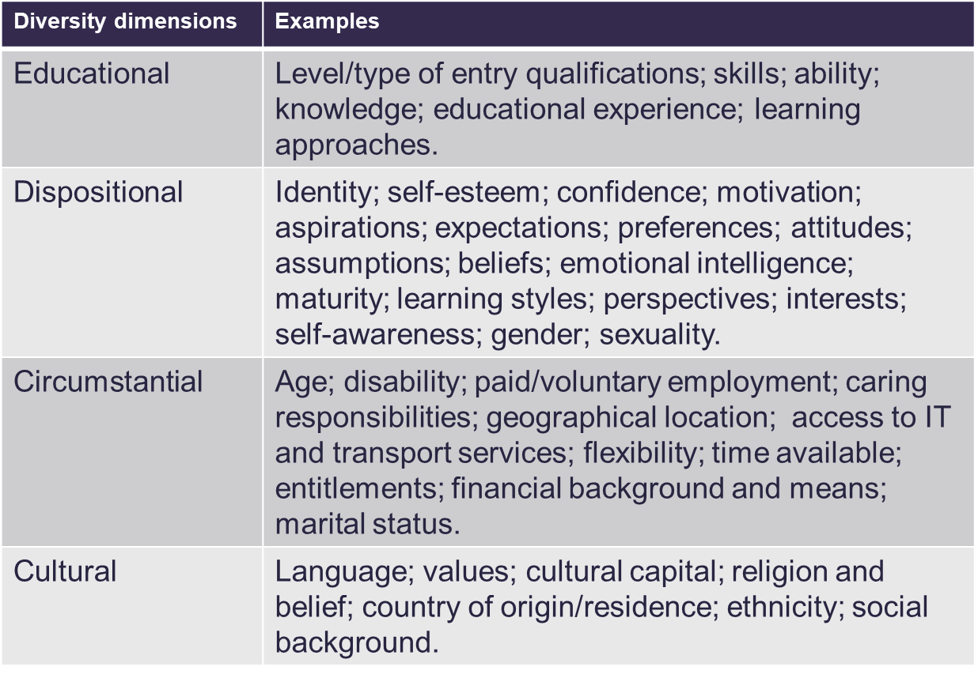
What is the “problem”? (Thomas & May, 2010)

Slide 27
The importance of student voiceS
Students do not have only one voice – we do not hear all of their voices through our student voice representatives.
A learning community (Lave and Wenger, 1991) with active learning enables all students to share ideas, resources, experiences – gives everyone a voice and we can all learn from each other (staff included!).

Slide 28
Importance of belonging
Sense of belonging is correlated with academic engagement, attainment, and course completion (e.g. Thomas, 2102; 2019)
And with mental wellbeing (Meehan & Howells, 2018).
Notes:
Diversity of who I am – age, gender, ethnicity, culture, religion, health/disability, mental health, socioeconomic factors, educational background, family support, peer influences….LOTS!
Awarding gaps (not attainment gaps)

Slide 29
Who are your students?
What content are you teaching them?
How do you make your content meaningful and relevant to them?
How do you show that their (diverse) contributions are valued?
Where do they see ‘people like them’? (including their future ‘possible selves’?)

Slide 30
Example – attachment theory
What do students learn (hidden curriculum) when they study attachment theory?
Mother as primary caregiver, heteronormative families, binary gender, fully abled.

Slide 31
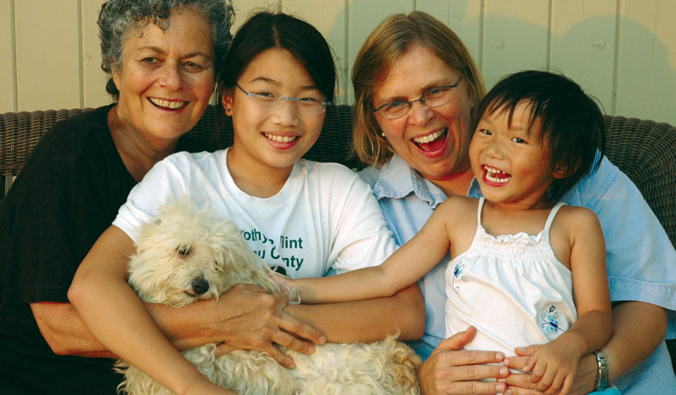
Search for ‘family’ on Google Images – what do you see?
Search for ‘non-traditional family’ on Google images – what do you see?
Thinking back to who your students are – do they include care-experienced students, adopted students, parents, non-binary students?
Golombok (2015) Modern Families. Cambridge University Press.

Slide 32
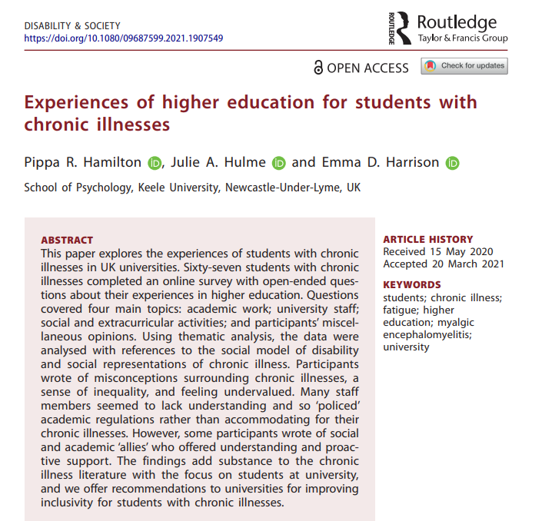
Example – disability and mental ill health
From the curriculum:
Medical models prevail – broken, ‘abnormal’ or at least ‘atypical’
Focus on ‘what I can’t do’
‘Fascinating’ case studies – exoticism, ‘other’
In contrast to social models – society is excluding me, “I can”.

Slide 33
Practical opportunities for inclusion and growing belonging – also promote psychological literacy
Group learning as a way to build student relationships and to enable diverse voices to be heard (eg Psychology in Education) (Hulme & Cranney, 2021).
Flipped classrooms and interactive methods.
Students as researchers and students as co-creators.
Ensuring accessibility. Alt-Text? Recordings? Transcripts? Extra materials in different formats for independent study? Choice in assessment?
What examples can you share of ways in which you or others ensure you hear diverse student voices, and build inclusion and belonging?
What ‘others’ or excludes you and your students?

Slide 34
Managing the risks of innovation
Evidence-based approaches to innovation – pedagogic/SOTL literature, evaluation, networks
Ethical and values-based innovation – students as co-creators, duty of care, contingency plans
Professional competence – continuing professional development, scholarship, peer observation. Academics as professional learners. Delay innovation?

Slide 35
Provocation:
We must innovate to create psychology education that is truly inclusive, and prepares students to thrive and make a difference in an uncertain future. We have a responsibility to empower our students with psychological literacy.
See also: Cranney et al. (2022)

Slide 36
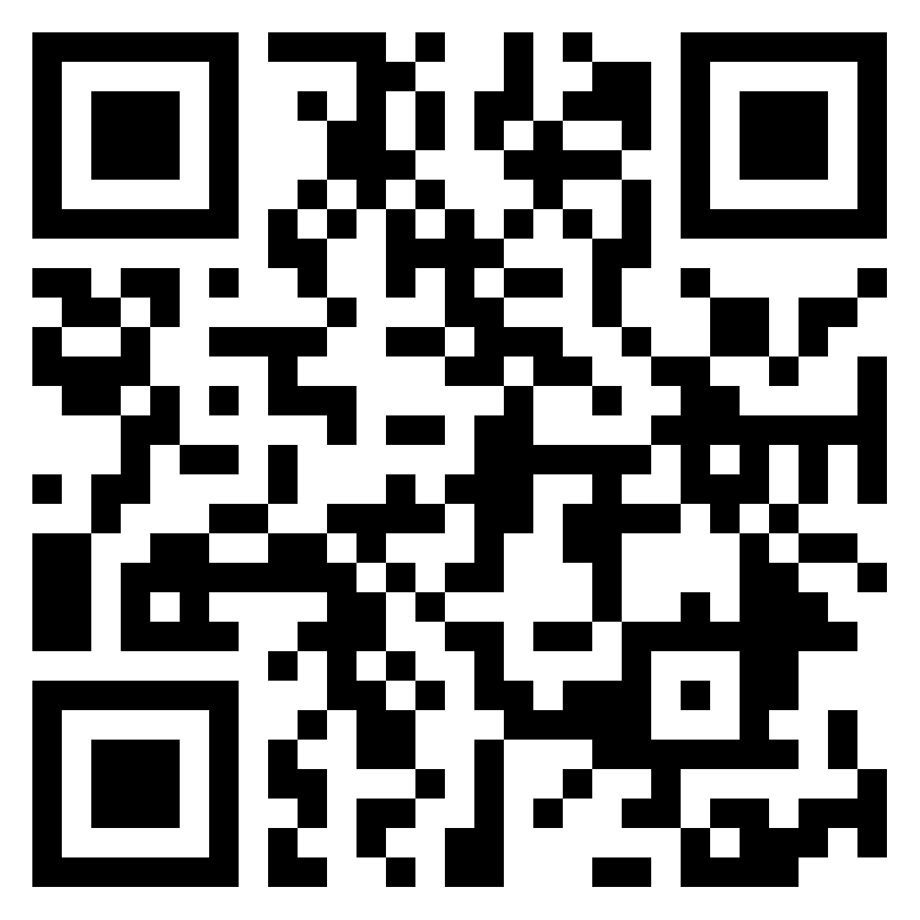
Actions?
What were the main learning points for you today?
What are the good practices you can see in Psychology at Worcester?
What needs to improve?
What are you going to do (individually and as a department) – and how?
How committed are you?
Take notes on Padlet, and report back.
https://bit.ly/43rEkBB

