Slide 1
Belonging, being, and becoming: Exploring possible selves through the transitions into, through, and beyond higher education
Prof Julie Hulme (she/her)
Julie.Hulme@ntu.ac.uk; @JulieH_Psyc
Notes:
Suggested title: Belonging, being, and becoming: Exploring possible selves through the transitions into, through, and beyond higher education.
Suggested abstract:
Most students start university during their 'emerging adulthood' developmental stage, a time when they are exploring who they are, and who they want to be. The changed lifestyle and new social groups that they encounter on the transition to university can open up new reflections on their current identity, and on who they might become in the future. Applying the theoretical perspectives of social identity theory and possible selves theory, Julie will introduce us to new ways of motivating students and thinking about graduate employability through facilitating students to explore new possible selves within the classroom and curriculum.
Time
Duration
(mins)
Task
Speaker
HKT
GMT
1600 - 1603
0900 - 0903
3
Introduction
MC (Mia Leung & Elizabeth Wong)
1603 - 1607
0903 - 0907
4
Presentation of Appreciation Certificates
Prof. Cecilia Chan -> by Dr. Benjamin Chan
Prof. Julie Hulme -> by Dr. Benjamin Chan
Group Photo
MC (Elizabeth Wong)
Dean with Cecilia → Julie (individually)
Dean with Cecilia & Julie; joined by Doug & Kathy
1607 - 1610
0907 - 0910
3
Introduction to Speaker
MC (Elizabeth Wong )
1610 - 1640
0910 - 0940
30
Keynote 1: “Accrediting competency for future readiness”.
Prof. Cecilia Chan
1640 - 1643
0940 - 0943
3
Introduction to Speaker
MC (Mia Leung)
1643 - 1713
0943 - 1013
30
Keynote 2: “Belonging, being, and becoming: Exploring possible selves through the transitions into, through, and beyond higher education.”
Prof. Julie Hulme (30 mins)
1713 - 1715
1013 - 1015
2
Introduction to Q&A Session
MC (Mia Leung )
1715 - 1730
1015 - 1030
15
Q&A
Dr. Kathleen Chim
Dr. Doug Cole
1730 - 1731
1030 - 1031
1
Introduction to Closing Remark guest
MC (Mia Leung)
1731 - 1736
1031 - 1037
6
Closing Speech
Prof. Ricky Kwok
1736 - 1738
1037 - 1038
1
Closing
MC (Elizabeth Wong)
1738 - 1740
1038 - 1040
2
Buffer
up, please do invite them! I've scheduled a 90 minute session to ensure we have plenty of time for discussion, but please don't be put off if you can only attend for part of it.

Slide 2
Outline
Transitions research
Being, belonging, becoming in the context of transitions
Who might I become? – possible selves
Including diverse possible selves – disability research
Practical approaches to developing opportunities around possible selves

Slide 3
Transitions in context
Transitions as change…a journey?
Often focus on initial start at university – but we also experience transitions between levels (years) and again at graduation
Framed as a challenge – leaving home, changes in teaching and learning environment, independent living, social group changes, expectation vs reality ‘gap’
Focus on deficits – the unprepared student, the ‘misfit’, lacking skills.

Slide 4
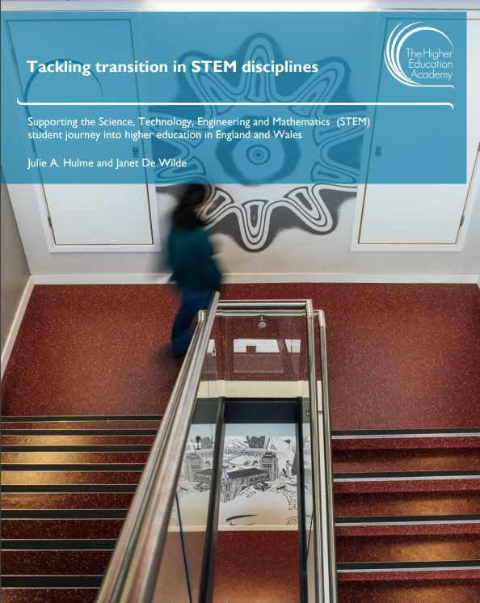
Tackling transitions in STEM disciplines
Hulme & De Wilde (2014) – tackling transitions in STEM disciplines
Workshop series – 381 participants including students, teachers, university staff +
Skills and knowledge gaps – especially “Thinking like a…” – pre-uni qualifications as “poor” preparation
Lack of explicit signposting (making the unknown known) about different expectations
Anonymity and class sizes
Tension between sectors – different teaching styles, lack of understanding and co-operation – resources and research
Students keen to engage and support

Slide 5
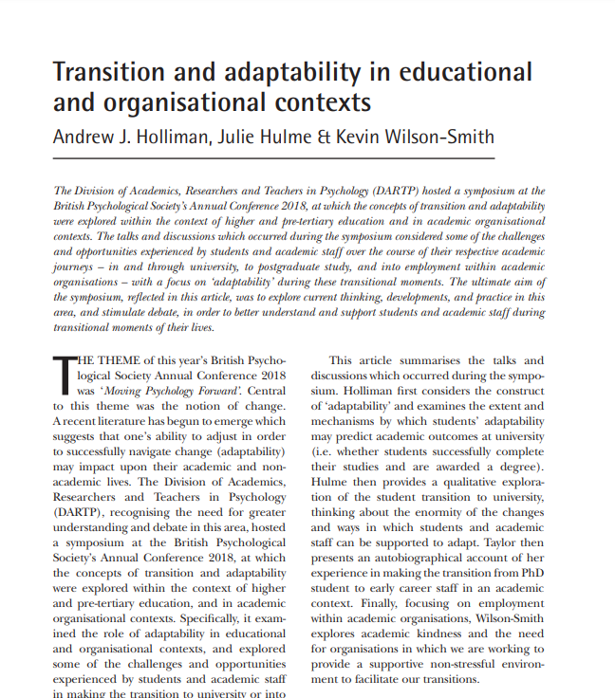
Transitions in context – social support
Holliman, Hulme & Wilson-Smith (2019) – a series of short reflections on transitions research from different perspectives:
Adaptability can be developed and predicts engagement and success
Transitions as a challenging time in a novel environment for which one must be prepared
Autoethnographic account of transition to PhD/ECR – importance of social support
Academic kindness – for students and staff – in the face of competition, reward and recognition
Social support as a buffer – for all transitions

Slide 6
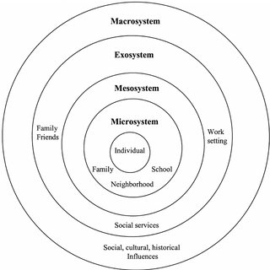
Transitions in a social context
Gale & Parker (2014): “taken-for-granted notions of transition…and…the normative and the universal discourses of transition do not capture the diversity of student lives, their experiences of university, or of universities themselves”
(Bronfenbrenner, 1992 – ecological systems theory)

Slide 7
Transitions as transformative
“…transitions can lead to profound change and be an impetus for new learning, or they can be unsettling, difficult and unproductive. Yet, while certain transitions are unsettling and difficult for some people, risk, challenge and even difficulty might also be important factors in successful transitions for others.” (Ecclestone, Biesta, & Hughes, 2010, p. 2)
Transition as navigating threshold concepts, liminality, transformation (Meyer & Land, 2010)

Slide 8
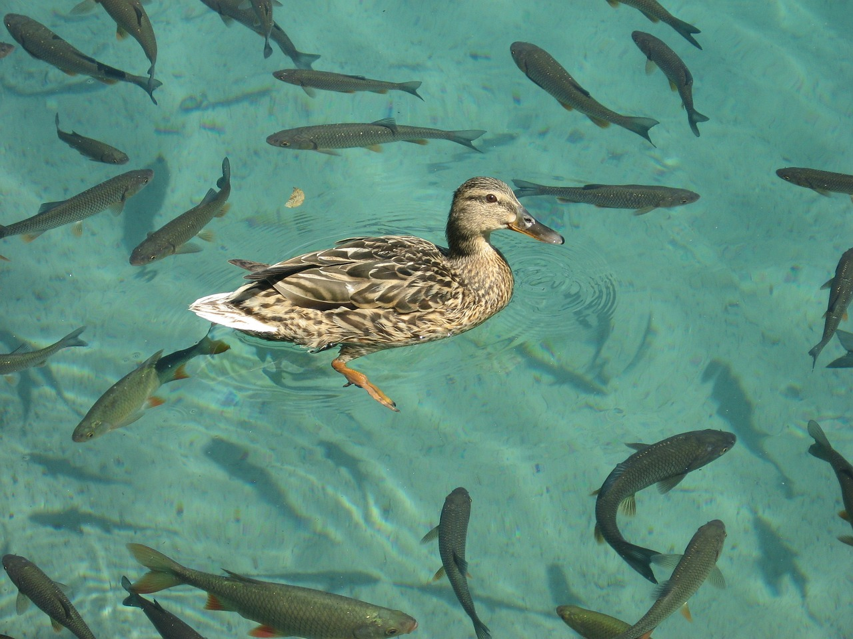
Transition for diverse students: Ducks to water or fish out of water?
Assumptions that low SES, minoritised groups, first in family might find transitions harder
Knowledge ‘about’ vs knowledge ‘of’ university – knowledge ‘of’ is missing for all
Predictive value? – but not certainties. Unable to target students – all may be at risk?
Do students experience transitions into, through, and out of university like “ducks to water” or like “fish out of water”?

Slide 9
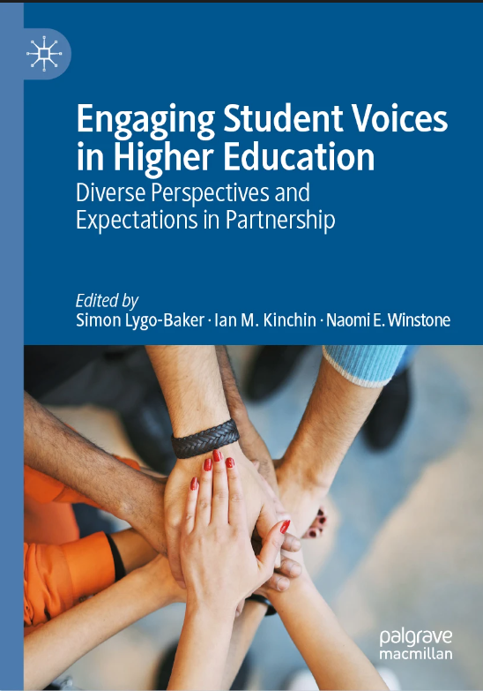
Winstone and Hulme (2019): How do diverse students experience transitions?
“Problematisation” of transitions is not helpful – can be challenging, but can be exciting/transformational. Or both!
Need to capture student experience, rather than make assumptions.
What can we learn from students themselves about how to facilitate successful transitions?
Survey – Likert scale responses and open questions

Slide 10
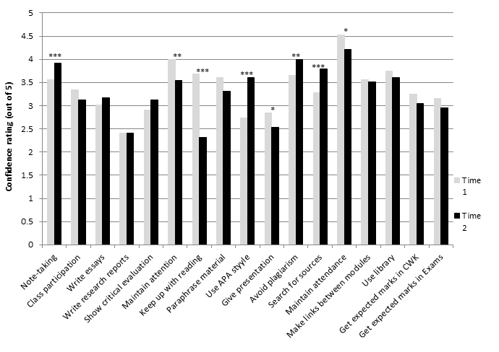
Student skills perceptions
Mean confidence ratings across academic skills at Time 1 (start of year 1) and Time 2 (end of year 1).
Paired t-tests: * p < .05 ** p < .01 *** p < .001
N = 91
Confidence for some skills increases, for other decreases – expectation-reality gap

Slide 11
Students’ experiences of transitions from school to sixth form and then to university
Shift to more independent learning
Increased workload
Increased difficulty/higher level of academic work
BUT note in the UK, students often have the same friendship group and sometimes the same teachers when making this transition
Recognised that skills acquired during this transition were helpful in the transition to university

Slide 12
Implications
Reflections on historical personal transition experiences may be more helpful than a homogenous ‘institutional’ perspective
Students are able to share stories with each other – mentoring is one mechanism that can be successful, or narrative testimonials
Students as partners in facilitating transitions – researchers, mentors, story-tellers
Transitions through education as a continuing process that we can all learn from
Systemic and social identity approaches to develop social support

Slide 13
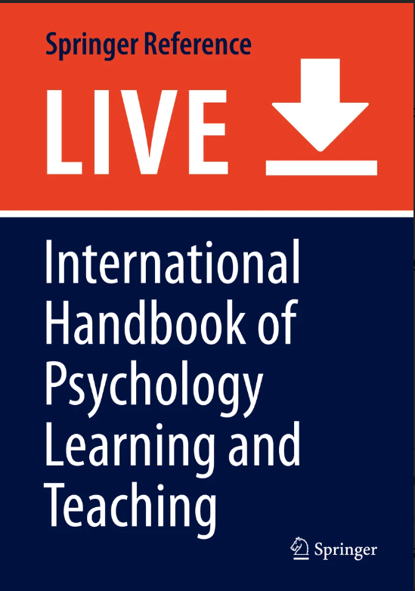
Reflections – how do we enable peer support?
Importance of curriculum
Group work early in the degree programme (Hulme & Cranney, 2021) to form peer relationships
Meaningful, personally relevant material – students can bring lived experience to the classroom and contribute knowledge from diverse backgrounds – e.g. Psychology in Education module. Scaffolded and subsequently formalised – but everyone can bring a perspective, socially valued.

Slide 14
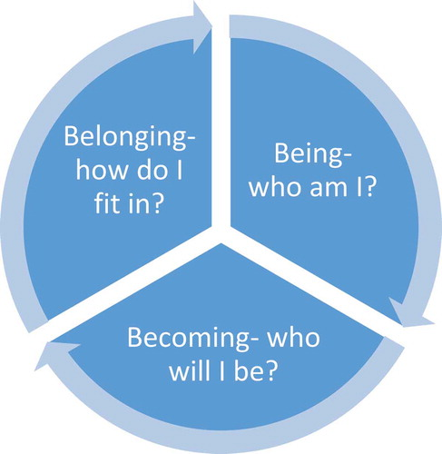
Social identity: Being, Belonging, Becoming
Kift (2004): Complex interaction of environment, social and cognitive attributes – social connectedness.
Thomas (2012): Psychological and sociological aspects and a feeling of a sense of purpose – linked to subject and career aspirations.
Soria and Stubblefield (2015) – self-awareness of strengths and capabilities, supported by the curriculum.
From: Meehan & Howells (2018).

Slide 15
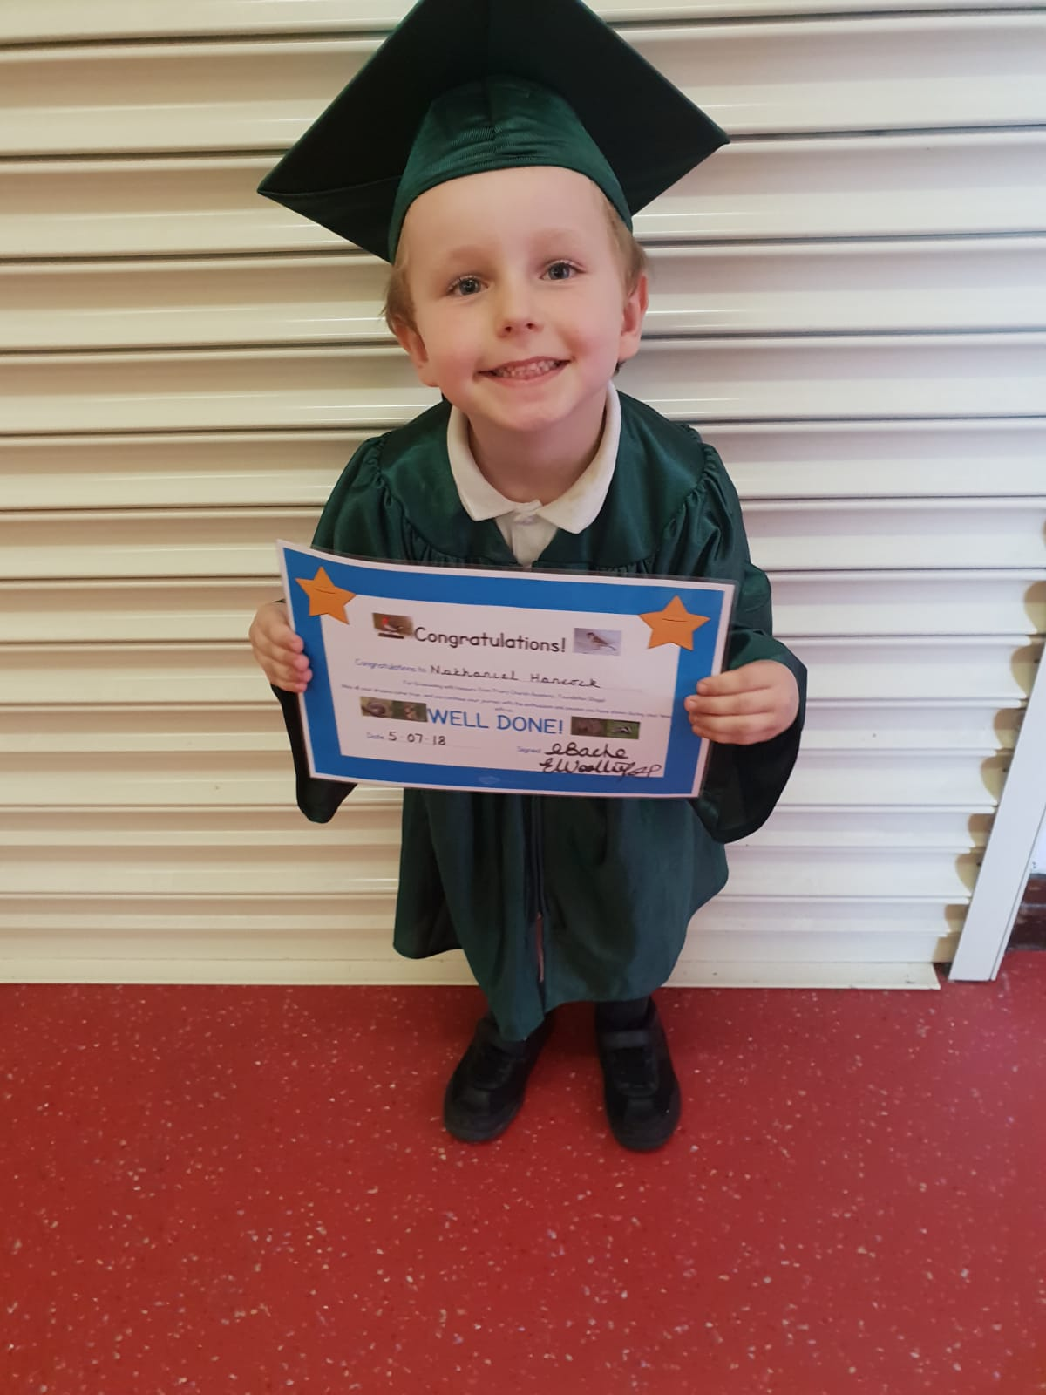
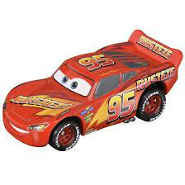
Becoming: Who will I be?
Markus & Nurius (1986): “Possible selves represent individuals’ ideas of what they might become, what they would like to become, what they are afraid of becoming, and thus provide a conceptual link between cognition and motivation”
“What do you want to be when you grow up?”
Our possible selves are constrained by our social environment.
Role models, cultural context, self-knowledge (accurate or not)

Slide 16
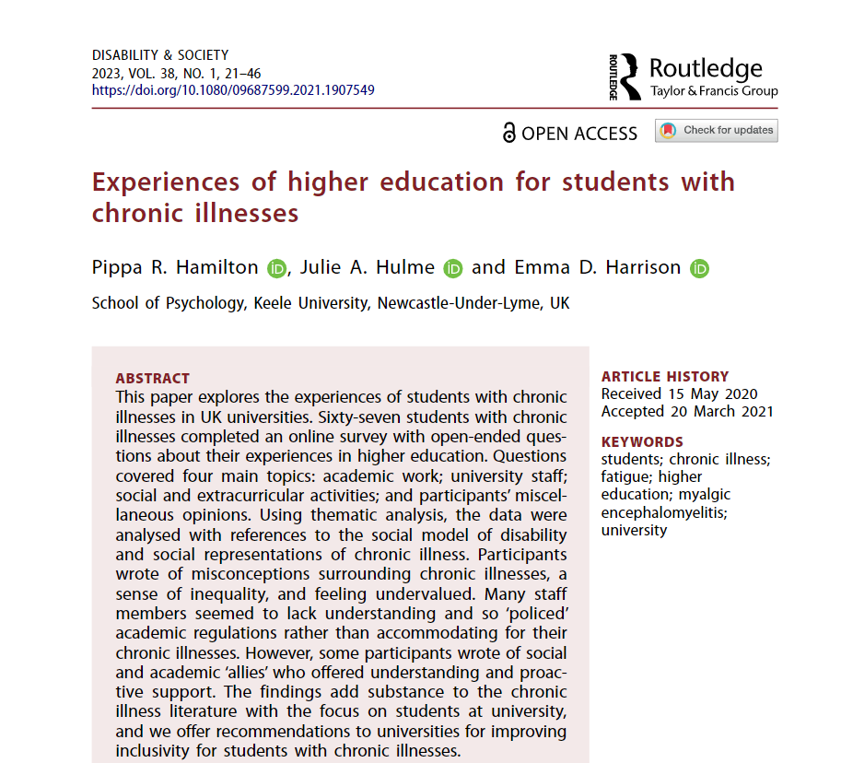
Employability, possible selves, and higher education: Disabled students
How do we provide students with role models for their possible selves?
What messages do we send students about what is possible and what is not?
Hamilton, Hulme, & Harrison (2021)
“I feel as though I am looked at as less than the other students even if this isn’t true… Only 3% of qualified English lawyers have a disability as the profession is so inaccessible so that is also over my head.”
“…At interview I was told ‘we don't want to give a place to someone with your type of disability because you might not be able to do the work post qualification’”

Slide 17
Implications
Reflect on who students ‘meet’ in the curriculum – work experience, teaching staff, engaged employers, peers, more advanced students, authors of books and journal articles:
Diversity needs to be visibly represented if we want students to be empowered to aspire to ambitious possible selves
Students need safe opportunities to try out their skills and their ‘fit’ with different careers – authentic assessment, employment-relevant teaching, error-friendly learning, reflection.
How can we empower our students to truly appreciate their own potential, and motivate them to work towards a positive future?

