Slide 1
Psychological literacy in the UK: Outcomes and pedagogy
Professor Julie Hulme (she/her):
Julie.Hulme@ntu.ac.uk; @JulieH_Psyc
https://higherpsyched.home.blog/
Note: most references on slides are hyperlinked for your convenience

Slide 2
Outline
What do we mean by psychological literacy?
Developments in the UK
Implications for teaching – pedagogic frailty and resilience
Provocation

Slide 3
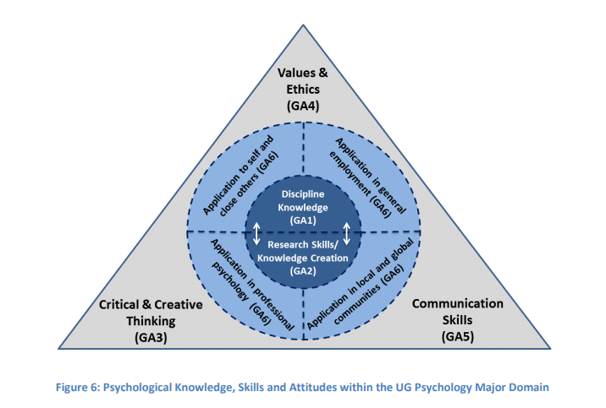
What do we mean by psychological literacy?
Contested definitions and understandings (Newell, 2020)
“The general capacity to adaptively and intentionally apply psychology to meet personal, professional and societal needs” (Cranney et al, 2012).

Slide 4

Psychological literacy in the UK – a brief history
2011 – Trapp et al, Future of Undergraduate Psychology (UK) Report
2013 – AdvanceHE report on employability; introductory guide to psychological literacy; compendium of case studies.
2016 – revised QAA subject benchmark and BPS accreditation criteria introduce psychological literacy into UK standards for the first time
2021 – Harris et al. (2021) – students unaware of term, but value and are developing the attributes associated with psychological literacy
2023 – new QAA subject benchmark is coming out soon! – strong emphasis on psychological literacy

Slide 5
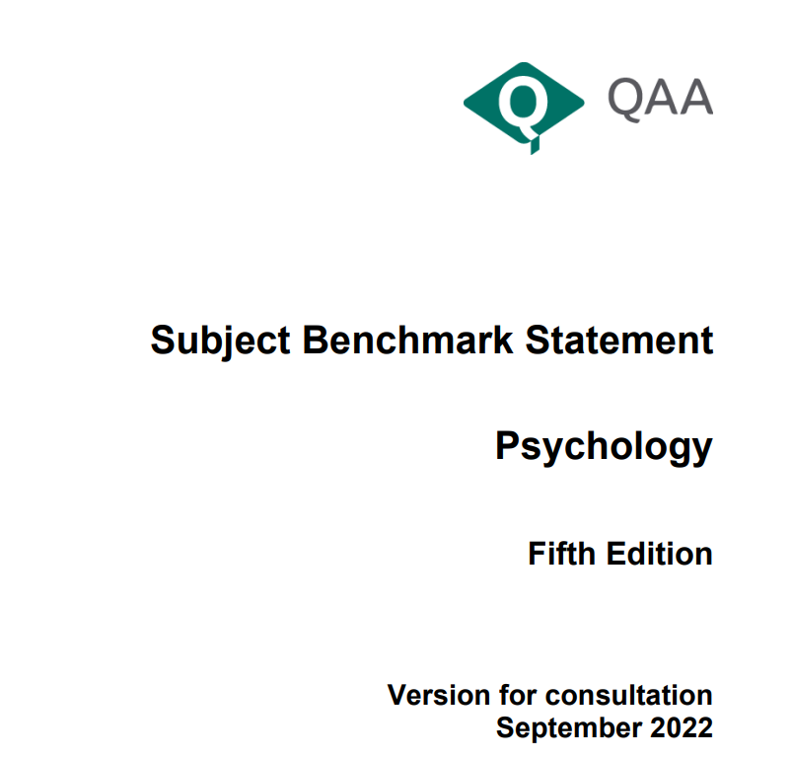
Key changes from the previous Subject Benchmark Statement include a revised structure for the Statement which includes the introduction of cross-cutting themes of: ­
equality, diversity and inclusion ­
education for sustainable development ­
employability, entrepreneurship and enterprise education
a comprehensive review updating the context and purposes of Psychology, including course design and content in order to inform and underpin the revised benchmark standards.

Slide 6
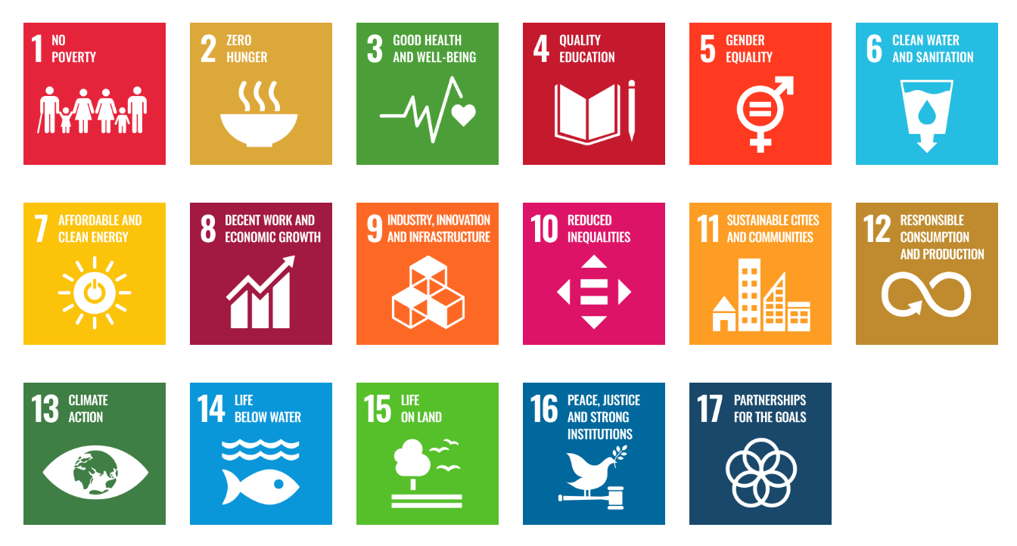
Personal – mental health and wellbeing; self-awareness; reflection; accessibility; inclusion; belonging.
Professional – employability and entrepreneurship; psychology and non-psychology career pathways; work experience; employer engagement.
Societal – community psychology, decolonial perspectives, sustainable development goals, structural inequalities.
THE 17 GOALS | Sustainable Development (un.org)

Slide 7
What is higher education for?
“The aim of education is not only to prepare students for productive careers, but also to enable them to live lives of dignity and purpose; not only to generate new knowledge, but to help shape a citizenry that can promote the public good. Thus, higher education’s vision must be widened if the nation is to be rescued from the problems that threaten to diminish permanently the quality of life.”
(Boyer, 1990, p77-78).

Slide 8

Implications for psychology educators (Hulme & Cranney, 2021; Hulme, 2014)
Curriculum development and constructive alignment – learning outcomes, teaching and learning activities, assessment that scaffold learning towards psychological literacy.
Professional development needs – especially for academics who have followed traditional psychology education pathways to date.
Role modelling psychological literacy in our practice with students.

Slide 9

Overcoming ‘pedagogic frailty’ (Hulme & Winstone, 2017)
Evidence-based approaches to innovation – pedagogic/SOTL literature, evaluation, networks – scientist-educators.
Ethical and values-based innovation – students as co-creators, duty of care, contingency plans
Professional competence – continuing professional development, scholarship, peer observation. Academics as professional learners!

Slide 10

Provocation:
We must innovate to create psychology education that is truly inclusive, and prepares students to thrive and make a difference in an uncertain future. We have a responsibility to empower our students with psychological literacy.
See also: Cranney et al. (2022)

