Slide 1
Buy one get one free: getting maximum value, impact, and profile out of your teaching and SoTL ideas
Prof Julie Hulme (she/her)
Julie.Hulme@ntu.ac.uk; @JulieH_Psyc
Notes:
Julie: Buy One Get One Free - getting maximum value, impact and profile out of your teaching and SoTL ideas
up, please do invite them! I've scheduled a 90 minute session to ensure we have plenty of time for discussion, but please don't be put off if you can only attend for part of it.

Slide 2
Outline
Overview - areas of interest
BOGOF – an example of how it has worked for me

Slide 3
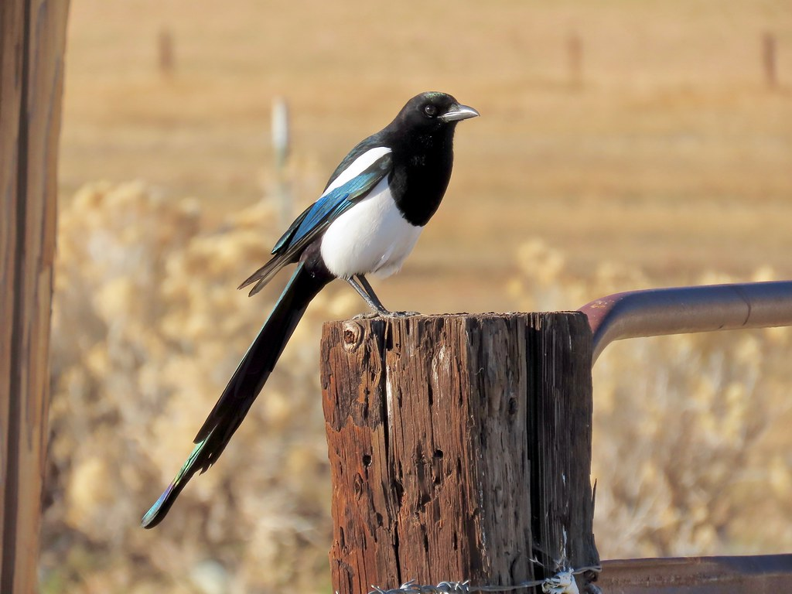
Areas of interest
Psychological literacy (and psychology education more broadly)
Inclusive education – across disciplines
Supporting reward and recognition for education-focused colleagues
With interests around transitions into/through university, feedback on assessment, decolonising curricula…

Slide 4
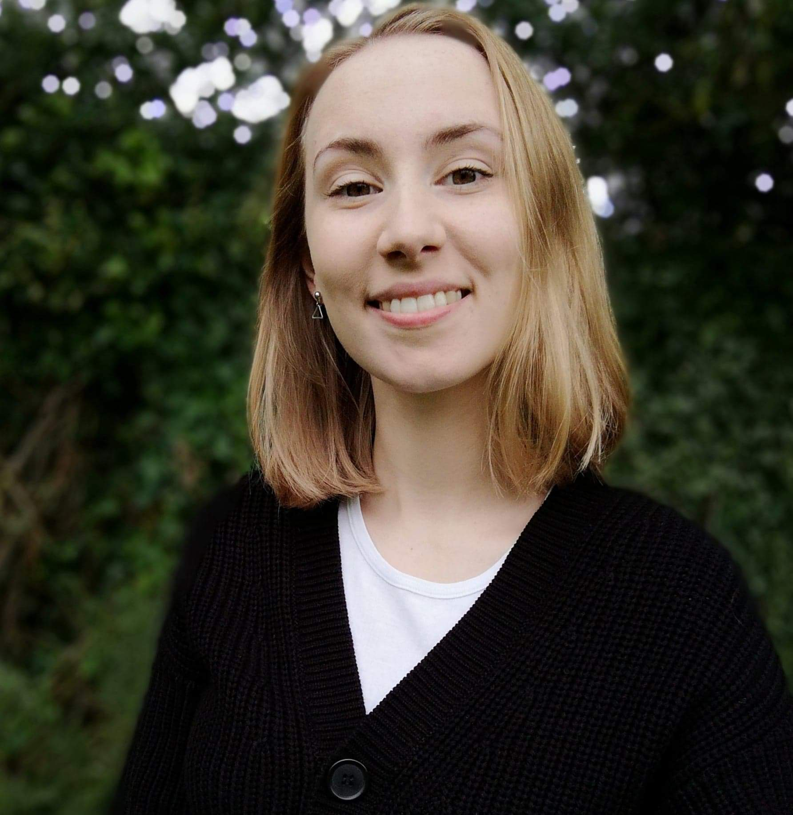
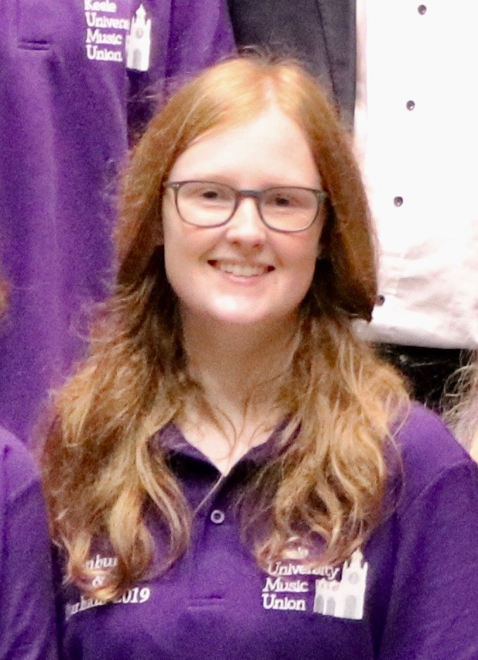
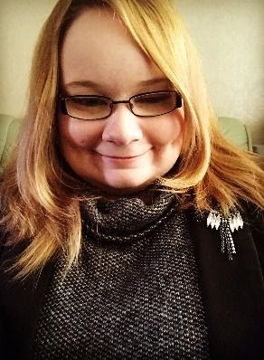
Inclusive education – how to grow a BOGOF system!
Teaching disabled (and other marginalised) students – allyship
Students wanting to understand their own university experience from a psychological perspective
Final year project supervision – and eventually a whole lab on MS Teams
Output 1: Co-authored paper with Pippa Hamilton on experiences of UK HE students with chronic illness – more journal articles in prep
Pippa Hamilton
Emma Crabb
Stacey Lyons

Slide 5
That one output and the lab collectively became very productive:
Hamilton, P., Hulme, J.A. & Harrison, E.D. (2023 – online 2021). Experiences of higher education students with chronic illnesses. Disability and Society. DOI: 10.1080/09687599.2021.1907549.
Hulme, J.A., Hamilton, P., Lyons, S., Crabb, E., Cascone, C., Davis, S., Fahey, C., Holland, B., Hussain, M., & Knight, E. (2023). Students as researchers: Amplifying disabled student voices. In: Disability Evidence Review with TASO. https://taso.org.uk/wp-content/uploads/Uni-Lincoln-Disability-Evidence-Review-with-TASO.pdf
Hulme, J.A. & Lyons, S.M. (2023). Disability across disciplines: Exploring lived experiences of disabled students through psychological and disability studies theoretical lenses. NTU Theory Aloud Seminar Series.
Hulme, J.A. (2022). Amplifying disabled students’ voices. ANTF blog, 25/03/2022. https://ntf-association.com/amplifying-disabled-student-voices/
Hulme, J.A. (2021): Inclusive learning: Engaging student voices. GlobalMindED expert talk, 28th May 2021. Available to view at: https://youtu.be/p-SmwpbPtuU (from 27 minutes).
Lyons, S.M. & Hulme, J.A. (June, 2021). Why are so many students locked out of their education? WonkHE (18/06/2021). https://wonkhe.com/blogs/why-are-so-many-students-locked-out-of-their-education/
Hulme, J.A. (September, 2021). Social identity and disability in the classroom. Changing States of Mind podcast. https://changingstatesofmind.libsyn.com/social-identity-and-disability-in-the-classroom-with-dr-julie-hulme
Hulme, J.A. (2021). There’s no such thing as the student voice: Listening to the throng. HigherPsychEd, August 2021.
And a whole new project – Autistic Voices in Geosciences – coming soon…!

Slide 6
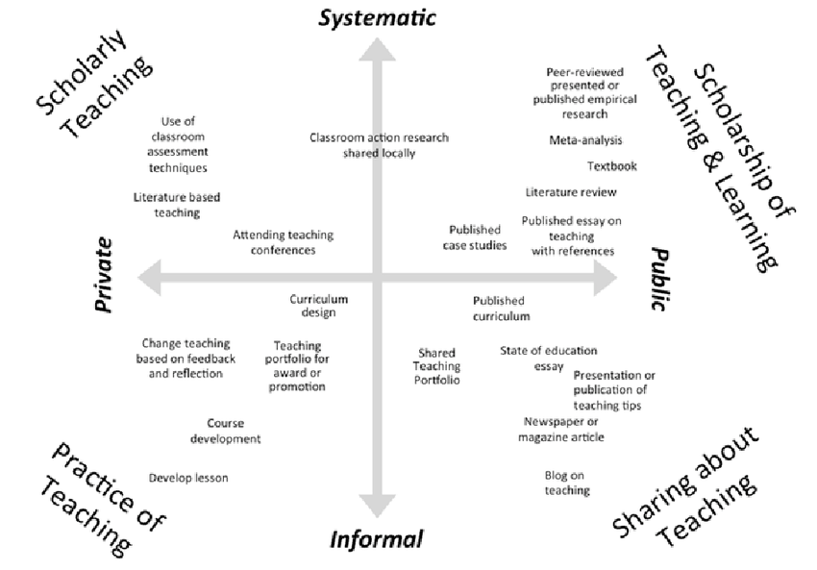
Kern et al (2015)
Dimensions of activity relating to teaching (DART)

Slide 7
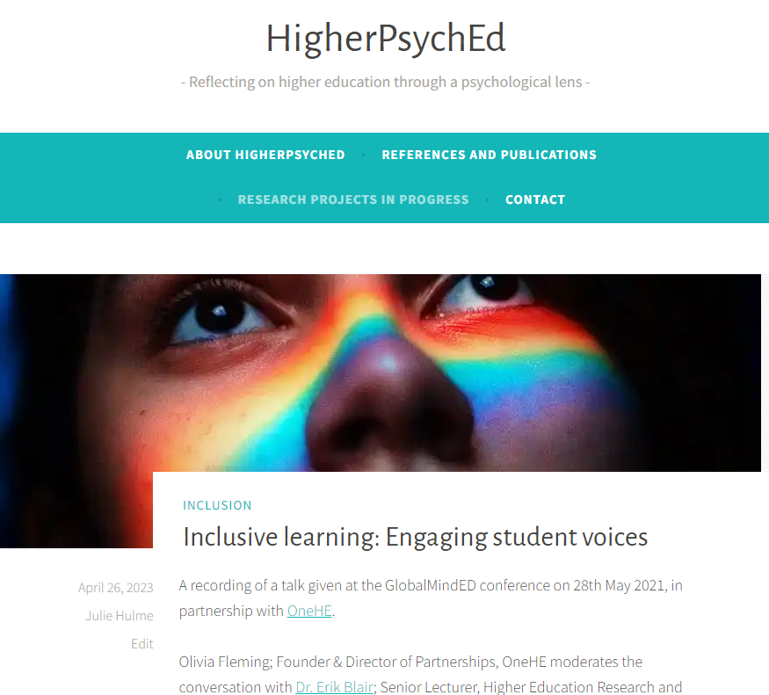
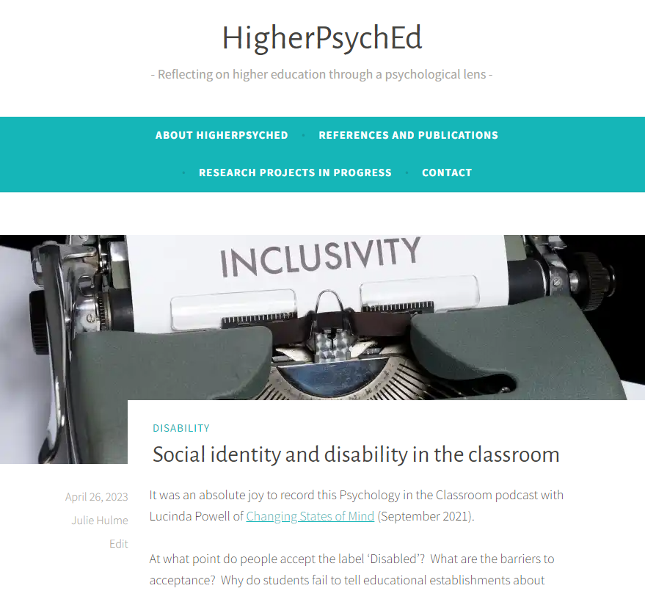

Slide 8
The BOGOF model of scholarship
Scholarship – the evidence that underpins the decisions you make (that achieves teaching success)
Scholarship – the products or resources you produce that deliver teaching, can be turned into OER
Scholarship – the evaluation of the design, the development, the delivery, the products, the outcomes, the formal outputs…
Where’s your BOGOF opportunity?

