Slide 1
Developing and progressing an education-focused career in psychology
Professor Julie Hulme (she/her)
Julie.Hulme@ntu.ac.uk
Bsky: @JulieHulme-psyc.bsky.social
X: @JulieH_Psyc
Notes:
Title: Developing and progressing an education-focused career in psychology
Abstract: Getting promoted in higher education is hard, and getting promoted in the context of an education-focused career is even harder! In this talk, and the subsequent workshop, we will explore how we can turn our teaching into outputs, and use the impact from those to evidence impact for reward and recognition. Julie will take us on a journey using her own career development as a stimulus, and will support us in reflecting on where we are now, identifying our own expertise, and planning what we might want to do next. As an added bonus, she'll also help us to think about the ways we can do all of that while still having a life outside of the job!
Bio: Julie Hulme is a Professor of Psychology Education at Nottingham Trent University, where she is proudly employed on the 'Teaching and Scholarship' career pathway. A former Chair and current member of DART-P, she is a Chartered Psychologist, Principal Fellow of the HEA, and a National Teaching Fellow. She enjoys applying her psychological skills and knowledge to making a difference in higher education, particularly around inclusion, and has a national reputation for championing education-focused academic careers. A self-described "positive disruptor", Julie is always willing to challenge the status quo.
14:00
Keynote 2: Professor Julie Hulme – Developing and progressing an education-focused career in psychology
Abstract: Getting promoted in higher education is hard, and getting promoted in the context of an education-focused career is even harder! In this talk, and the subsequent workshop, we will explore how we can turn our teaching into outputs, and use the impact from those to evidence impact for reward and recognition. Julie will take us on a journey using her own career development as a stimulus, and will support us in reflecting on where we are now, identifying our own expertise, and planning what we might want to do next. As an added bonus, she'll also help us to think about the ways we can do all of that while still having a life outside of the job!
14:45
Break
15:00
Workshop led by Professor Julie Hulme: Developing and progressing an education-focused career in psychology
16:00
Reflection and close

Slide 2
Outline
Education-focused academics
Finding your own expertise
Building a reputation for ‘making a difference’ – impact and profile
Pathways to reward and recognition
Call to action – we’re in it together!

Slide 3
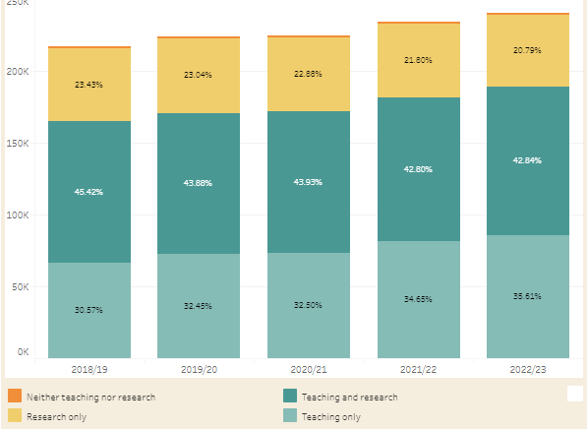
Academic staff in UK universities (HESA)
WonkHE: https://wonkhe.com/wonk-corner/hesa-spring-2024-staff-in-outline/
“Teaching only”
30.57
32.45
32.50
34.65
35.61
Notes:
240k academic staff – 35% are teaching only = 84,000 people
“A further 36% of academic staff were on teaching only contracts. This percentage has steadily increased year-on-year since 2015/16, when it was 26%.” – has risen year on year since 2012.

Slide 4
Teaching “only”?
How many people do you know who “only” teach?
E.g.
NTU – Teaching and practice/Teaching and scholarship
Keele – Education and scholarship
Lincoln – Teaching, scholarship & professional practice
Manchester – Teaching and scholarship
There’s nearly always an “and” – even if it isn’t written in a contract

Slide 5
Example – Teaching Fellow / Senior Teaching Fellow roles
My two “teaching only” experiences
TF: 2002-2004 – Teaching and Psychology-specific student support provision
STF: 2015-2016 – Teaching and transform all of our learning and teaching provision to improve the student experience and be Director of Education and please develop staff and take on some uni-level roles?
What is your ‘and’?

Slide 6
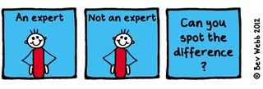
The ‘and’ is often where expertise lies…

Slide 7
Leading effective educational change requires educational expertise (e.g. Nelson and Campbell, 2017; Fung, 2017; Gorard, 2020), and educational expertise is more likely to be located in those who choose to study it than it is in traditional discipline-specific researchers. Thus education-focused academics are frequently “positive disruptors” (Akerman, 2020).
Hulme (2022)

Slide 8
So what is scholarship?
Trigwell (2013) – scholarship (of teaching and learning / SoTL) has many (contested) definitions and many purposes. Generally:
Improving and enhancing teaching, learning, assessment, and more
Evaluating and determining ‘quality’
Evidence-based and systematic

Slide 9
The BOGOF model of scholarship – what are you already doing that can gain more benefits?
Scholarship – the evidence that underpins the decisions you make (that achieves the T success)
Scholarship – the products/resources you produce that deliver the T
Scholarship – the evaluation of the design, the development, the delivery, the products, the T, the outcomes…
https://higherpsyched.home.blog/2024/11/17/the-buy-one-get-one-free-bogof-model-of-scholarship-in-higher-education/
Where’s your BOGOF opportunity?

Slide 10
Thinking about BOGOF scholarship
Finding your own expertise – or turning your teaching into outputs
What are the ‘big questions’ for you at the moment?
What are the problems? (or what can improve?)
How do you find or develop solutions?
How do you know if your solution works?

Slide 11
Scholarship means “going meta”
IMPACT
Hutchings and Shulman (1999): “A scholarship of teaching is not synonymous with excellent teaching. It requires a kind of ‘going meta’, in which faculty frame and systematically investigate questions related to student learning—the conditions under which it occurs, what it looks like, how to deepen it, and so forth—and do so with an eye not only to improving their own classroom but to advancing practice beyond it.”
Shulman (1999): “An act of intelligence or artistic creation becomes scholarship when it possesses at least three attributes: it becomes public, it becomes an object of critical review and evaluation by members of one’s community, and members of one’s community begin to use, build upon, and develop those acts of mind and creation”

Slide 12
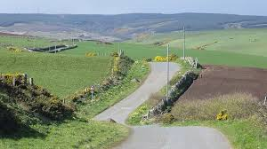
Purposeful planning for impact
How do you find the ‘BOGOF’ deal?
Topical issue - who shares the problem?
Resources – funding? time? students as researchers? collaborative networks?
Stakeholders – internal and external
Plan evaluation from the start – who has the skills?
Disseminate how? where?
How to assess reach, impact, value?

Slide 13
Reward and recognition
Promotion?
(Inter)National invitations?
AFHEA, FHEA, SFHEA, PFHEA
National Teaching Fellowship, CATE award?
BPS DART-P HEPTOTY award?
What works for you?
Narrative that pulls together evidence of your reach, impact, value.
A claim of expertise
Who are you? What are you known for? What do you want to achieve?

Slide 14
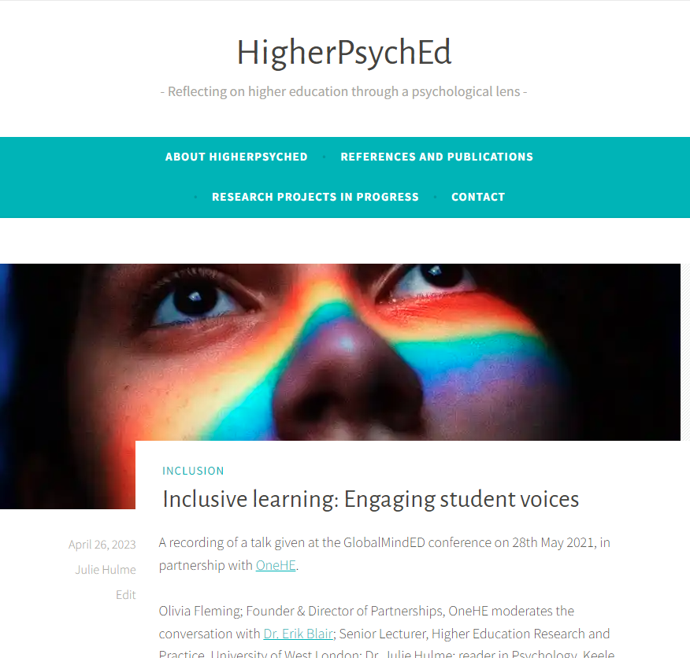
More BOGOF thinking
Hamilton, P., Hulme, J.A. & Harrison, E.D. (2023 – online 2021). Experiences of higher education students with chronic illnesses. Disability and Society. DOI: 10.1080/09687599.2021.1907549
Hulme, J.A., Hamilton, P., Lyons, S., Crabb, E., Cascone, C., Davis, S., Fahey, C., Holland, B., Hussain, M., & Knight, E. (2023). Students as researchers: Amplifying disabled student voices. In: Disability Evidence Review with TASO. https://taso.org.uk/wp-content/uploads/Uni-Lincoln-Disability-Evidence-Review-with-TASO.pdf
Hulme, J.A. (2022). Amplifying disabled students voices. ANTF blog, 25/03/2022. https://ntf-association.com/amplifying-disabled-student-voices/
Hulme, J.A. (September, 2021). Social identity and disability in the classroom. Changing States of Mind podcast. https://changingstatesofmind.libsyn.com/social-identity-and-disability-in-the-classroom-with-dr-julie-hulme.
Lyons, S.M. & Hulme, J.A. (June, 2021). Why are so many students locked out of their education? WonkHE (18/06/2021). https://wonkhe.com/blogs/why-are-so-many-students-locked-out-of-their-education/
Hulme, J.A., McDermott, H. & Kent, A. (2022). Truly inclusive education: Teaching qualitative methods in psychology to enhance inclusion in the higher education psychology curriculum. QMiP Bulletin, 34, 22-29.

Slide 15
There are relatively few teaching-focussed staff in more senior positions who can review, mentor and support teaching staff; act as role models for junior staff who are seeking to develop a teaching/education career (Fung and Gordon, 2016); help individuals to collate a mix of quantitative and qualitative evidence that provides a clear sense of their teaching achievements”
(McHanwell & Robson, 2018)
Networking and peer support – finding your tribe

Slide 16
Networks
Profs in Prep – email me on Julie.Hulme@ntu.ac.uk
UK Teaching-Focused Higher Education Network – sign up to our JISCmail list, HETEACHINGNETWORK@JISCMAIL.AC.UK, via https://jiscmail.ac.uk
National Teaching Repository
T-FΨN (Teaching-Focused University Network - Psychology)
Start your own?
Networks enable you to disseminate your work (reach), to see it being implemented and evaluated (impact), open up new opportunities, raise your profile, provide a pool of peer reviewers, referees and assessors.

Slide 17
What difference will you make, and how can you plan to achieve it?
Where (topics?) can you build your expertise?
What actions can you take to increase your success in doing impactful and visible scholarship?
Where can positive disruption be useful in all this?
Who can help?
Some other thoughts? – over to you
What next?

Slide 18
Break…

Slide 19
Workshop: Exploring the DARSHE (Descriptions of activity related to scholarship of higher education)
Gann, R.J. & Hulme, J.A. (under review). Scholarship reimagined: Creating the DARSHE, an inclusive and flexible model for scholarship in higher education. Higher Education.

Slide 24
Your turn!

Slide 25
Where are your strengths?
Where can you grow?
Where can you collaborate?
How can you develop reach, impact, value?
What do you still need to know?

