Slide 1
Shining a spotlight on scholarship: Building and developing your profile in an education-focused career
Prof Julie Hulme (she/her)
Julie.Hulme@ntu.ac.uk; @JulieH_Psyc
Notes:
Bio:
Julie is Professor in Psychology Education at Nottingham Trent University. She is a Chartered Psychologist, Principal Fellow of the HEA, and a National Teaching Fellow, and applies psychological theory and research methods to better understand and enhance learning and teaching in higher education. Julie describes herself as a 'positive disruptor'; she challenges inequity in higher education, champions inclusion, and is always willing to question the status quo. Julie is committed to developing understanding and support for other academics on diverse career paths, and is a strong advocate for education-focused staff career progression.
Title:
Shining a spotlight on scholarship: building and developing your profile in an education-focused career
Abstract:
The number and proportion of academics employed on education-focused career pathways has grown considerably in recent years (HESA, 2023), but the nature of their role and their contributions to universities above and beyond teaching and educational leadership can be misunderstood and sometimes undervalued. In this talk, Julie will share her own scholarship journey and her national work in supporting education-focused professorial promotions. She'll lead us through exploring the nature of scholarship, the diverse ways in which scholarship can be 'done' and disseminated, and discussing what it means to develop a meaningful academic career and expertise to professorial level while on an education-focused career pathway. She'll also get us thinking about how all of this can be done while still having a life beyond the job!
up, please do invite them! I've scheduled a 90 minute session to ensure we have plenty of time for discussion, but please don't be put off if you can only attend for part of it.

Slide 2
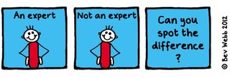
Outline
Education-focused academics
Finding your own expertise
Going meta
Building a reputation and developing your impact and profile
Reward and recognition
Collective action – how can we help each other?

Slide 3
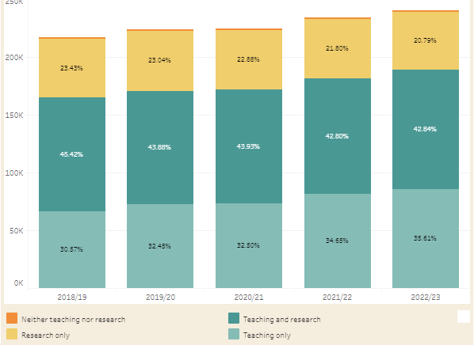
Academic staff in UK universities (HESA)
WonkHE: https://wonkhe.com/wonk-corner/hesa-spring-2024-staff-in-outline/
“Teaching only”
30.57
32.45
32.50
34.65
35.61
Notes:
240k academic staff – 35% are teaching only = 84,000 people
“A further 36% of academic staff were on teaching only contracts. This percentage has steadily increased year-on-year since 2015/16, when it was 26%.” – has risen year on year since 2012.

Slide 4
Teaching “only”?
How many people do you know who “only” teach?
E.g.
  NTU – Teaching and practice/Teaching and scholarship
  Keele – Education and scholarship
  Lincoln – Teaching, scholarship & professional practice
  Manchester – Teaching and scholarship
  Beds - Teaching and Student Academic Experience
There’s nearly always an “and” – even if it isn’t written in a contract

Slide 5
Example – Teaching Fellow / Senior Teaching Fellow roles
My two “teaching only” experiences
TF: 2002-2004 – Teaching and Psychology-specific student support provision
STF: 2015-2016 – Teaching and transform all of our learning and teaching provision to improve the student experience and be Director of Education and please develop staff and take on some uni-level roles?
What is your ‘and’?

Slide 6
Scholarship expertise
Trigwell (2013) – scholarship and SoTL have many (contested) definitions and many purposes. Generally:
Improving and enhancing teaching, learning, assessment, and more, in higher education
Evaluating and determining ‘quality’
Evidence-based and systematic

Slide 7

Practitioner (pracademic) expertise
Practitioner-academics and academic identities
A ‘revolving door’ between practice and academia? – with tensions around shifting identities and transitions (Dickinson et al., 2020 – ‘fragile academic selves’).
Imposter syndrome – ‘not a real academic’? – in a higher education sector where research is often prized (e.g. Hulme, 2022).
BUT support students to be ‘knowledge-able’ rather than knowledgeable; networks and employer engagement that contribute to curricula; industry-university partnerships (Dickinson et al., 2020).
Need to maintain currency in practice area while also developing in academic role.

Slide 8
The ‘and’ is often where expertise lies…

Slide 9
Leading effective educational change requires educational expertise (e.g. Nelson and Campbell, 2017; Fung, 2017; Gorard, 2020), and educational expertise is more likely to be located in those who choose to study it than it is in traditional discipline-specific researchers. Thus education-focused academics are frequently “positive disruptors” (Akerman, 2020).
Hulme (2022)

Slide 10

The BOGOF model of scholarship – what are you already doing that can gain more benefits?
Scholarship – the evidence that underpins the decisions you make (that achieves the T success)
Scholarship – the products/resources you produce that deliver the T
Scholarship – the evaluation of the design, the development, the delivery, the products, the T, the outcomes…
Where’s your BOGOF opportunity?

Slide 11
Thinking about BOGOF scholarship
Finding your own expertise – or turning your teaching into outputs
What are the ‘big questions’ for you at the moment?
What are the problems? (or what can improve?)
How do you find or develop solutions?
How do you know if your solution works?

Slide 12
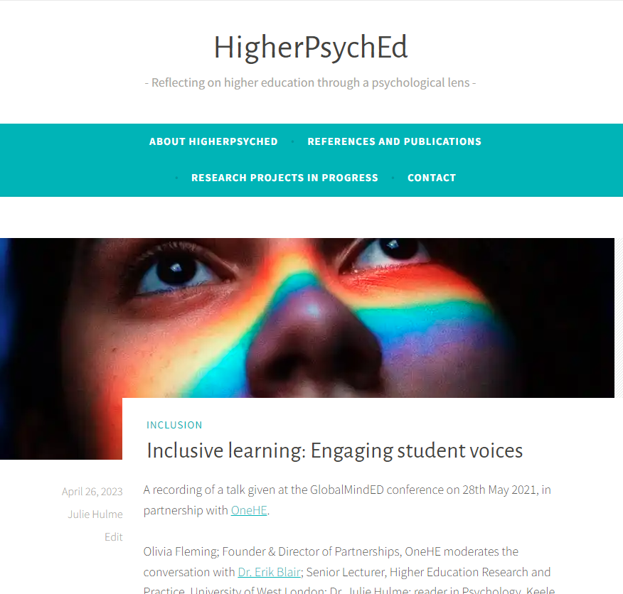
More BOGOF thinking
Hamilton, P., Hulme, J.A. & Harrison, E.D. (2023 – online 2021). Experiences of higher education students with chronic illnesses. Disability and Society. DOI: 10.1080/09687599.2021.1907549
Hulme, J.A., Hamilton, P., Lyons, S., Crabb, E., Cascone, C., Davis, S., Fahey, C., Holland, B., Hussain, M., & Knight, E. (2023). Students as researchers: Amplifying disabled student voices. In: Disability Evidence Review with TASO. https://taso.org.uk/wp-content/uploads/Uni-Lincoln-Disability-Evidence-Review-with-TASO.pdf
Hulme, J.A. (2022). Amplifying disabled students voices. ANTF blog, 25/03/2022. https://ntf-association.com/amplifying-disabled-student-voices/
Hulme, J.A. (September, 2021). Social identity and disability in the classroom. Changing States of Mind podcast. https://changingstatesofmind.libsyn.com/social-identity-and-disability-in-the-classroom-with-dr-julie-hulme.
Lyons, S.M. & Hulme, J.A. (June, 2021). Why are so many students locked out of their education? WonkHE (18/06/2021). https://wonkhe.com/blogs/why-are-so-many-students-locked-out-of-their-education/
Hulme, J.A., McDermott, H. & Kent, A. (2022). Truly inclusive education: Teaching qualitative methods in psychology to enhance inclusion in the higher education psychology curriculum. QMiP Bulletin, 34, 22-29.

Slide 13
IMPACT
Going meta!
Hutchings and Shulman (1999): “A scholarship of teaching is not synonymous with excellent teaching. It requires a kind of ‘going meta’, in which faculty frame and systematically investigate questions related to student learning—the conditions under which it occurs, what it looks like, how to deepen it, and so forth—and do so with an eye not only to improving their own classroom but to advancing practice beyond it.”
Shulman (1999): “An act of intelligence or artistic creation becomes scholarship when it possesses at least three attributes: it becomes public, it becomes an object of critical review and evaluation by members of one’s community, and members of one’s community begin to use, build upon, and develop those acts of mind and creation”

Slide 14

Going meta!
Who can see your work?
How do they find it?
Who are your stakeholders? Who cares?
Who is using your work?
What is the reach, impact, and value?
What is the potential for reach, impact, value?

Slide 15
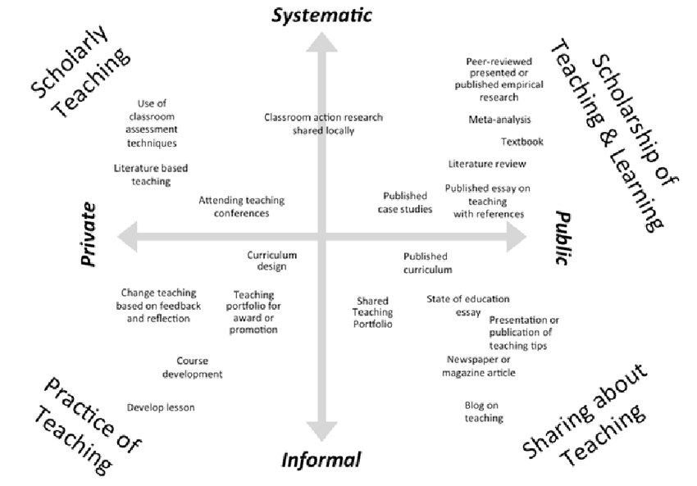
Kern et al (2015) Dimensions of activity relating to teaching (DART)
Where are you?

Slide 16
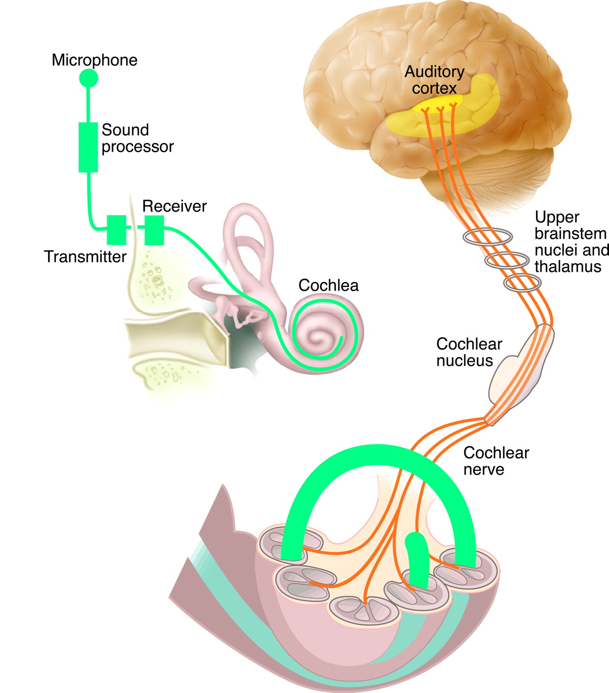
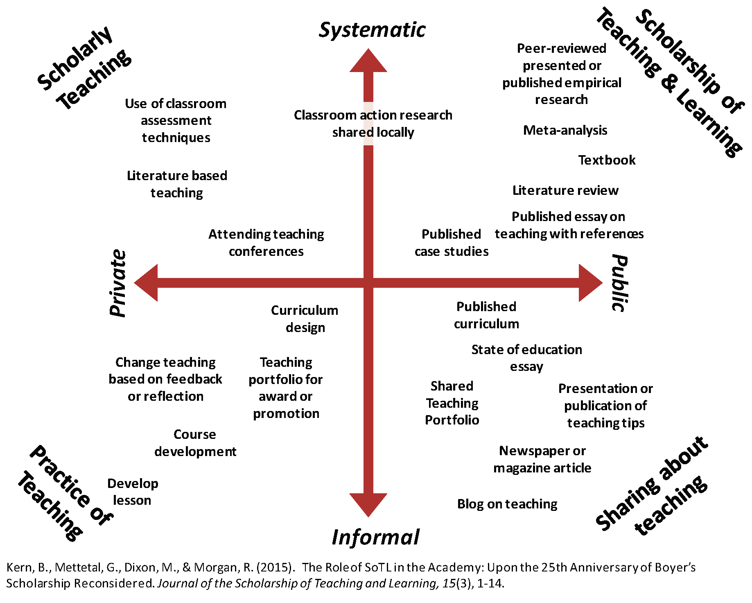



My scholarship journey
Scholarship of scholarship!
Disabled students as researchers
Journal articles
Profs in Prep network and more
Assessment and feedback research
Psychological literacy
Blog
Advance HE resources
Scholarly teaching
Open educational resources

Slide 17
Purposeful planning for impact
How do you find the ‘BOGOF’ deal?
Topical issue - who shares the problem?
Resources – funding? time? students as researchers? collaborative networks?
Stakeholders – internal and external
Plan collaboration and evaluation from the start – who has the skills?
Disseminate how? where?
How do you get the BOGOF outputs?
How to assess reach, impact, value?

Slide 18
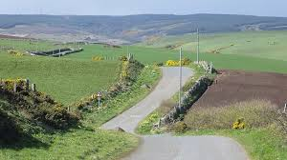
Reward and recognition
Promotion?
AFHEA/FHEA/SFHEA/PFHEA?
National Teaching Fellowship, CATE award?
Fellowship of or awards from your professional body?
What’s appropriate in your world?
Need for a clear narrative; evidence of reach, impact, value.
A claim of expertise.
Who are you? What are you known for? What do you want to achieve?

Slide 19

Building (Y)OUR scholarship profile and making impact visible

Slide 20
There are relatively few teaching-focussed staff in more senior positions who can review, mentor and support teaching staff; act as role models for junior staff who are seeking to develop a teaching/education career (Fung and Gordon, 2016); help individuals to collate a mix of quantitative and qualitative evidence that provides a clear sense of their teaching achievements”
(McHanwell & Robson, 2018)
Networking and peer support – finding your tribe

Slide 21
Networks and resources
Profs in Prep – email me on Julie.Hulme@ntu.ac.uk
UK Teaching-Focused Higher Education Network – sign up to our JISCmail list, HETEACHINGNETWORK@JISCMAIL.AC.UK, via https://jiscmail.ac.uk
National Teaching Repository
Scholarship spotlight – under construction!
Start your own?
Networks enable you to disseminate your work (reach), to see it being implemented and evaluated (impact), open up new opportunities, raise your profile, provide a pool of peer reviewers, referees and assessors. And COLLABORATORS!!

Slide 22
Reflections and discussion
Where is your ‘and’? – what is your expertise?
How can you make your scholarship more visible?
What is your impact – where do you make a difference?
What can we do collectively?
What next?

