Slide 1
Transitions and belonging in higher education: duck to water, or fish out of water?
Professor Julie Hulme
Julie.Hulme@ntu.ac.uk; @JulieH_Psyc
Notes:
Title: Transitions and belonging in higher education: duck to water, or fish out of water?
Abstract: The transition to university is often described as a challenging or difficult time, with the literature focusing on the transitional experience as a single episode, and often drawing generalised conclusions about specific 'disadvantaged' groups. In this talk, I will draw upon my own research to reflect on the diversity of transitional experiences, and explore whether it is helpful to 'problematise' transitions, or to consider them as a normal part of the student (and human) life experience. We will explore some practical implications of the findings to reflect on ways in which we can help diverse students to successfully navigate transitions, and to develop a sense of belonging and social support at university.

Slide 2
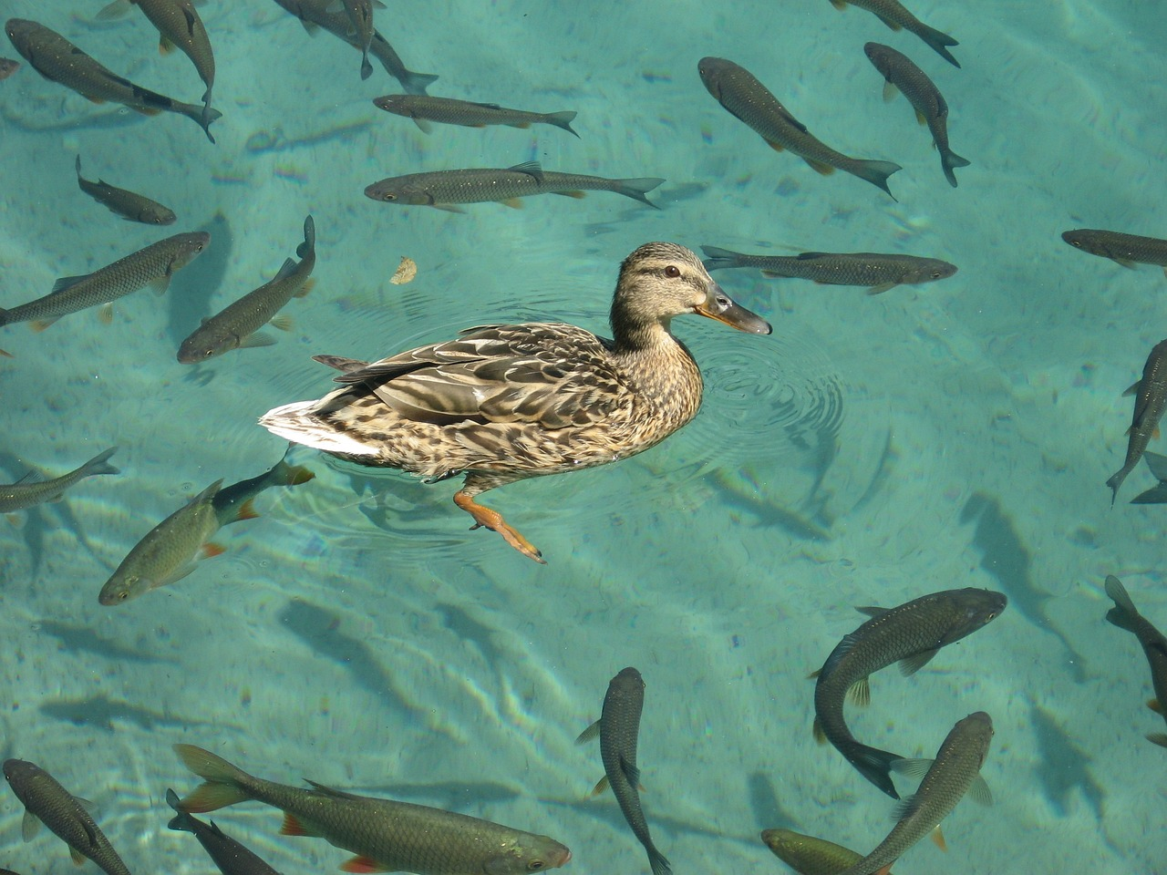
Outline
Problematising transition
Ditching the deficit
The ‘student identity’ and a sense of belonging
Strategies for developing a sense of belonging and social support
Notes:
Abstract: The transition to university is often described as a challenging or difficult time, with the literature focusing on the transitional experience as a single episode, and often drawing generalised conclusions about specific 'disadvantaged' groups. In this talk, I will draw upon my own research to reflect on the diversity of transitional experiences, and explore whether it is helpful to 'problematise' transitions, or to consider them as a normal part of the student (and human) life experience. We will explore some practical implications of the findings to reflect on ways in which we can help diverse students to successfully navigate transitions, and to develop a sense of belonging and social support at university.

Slide 3
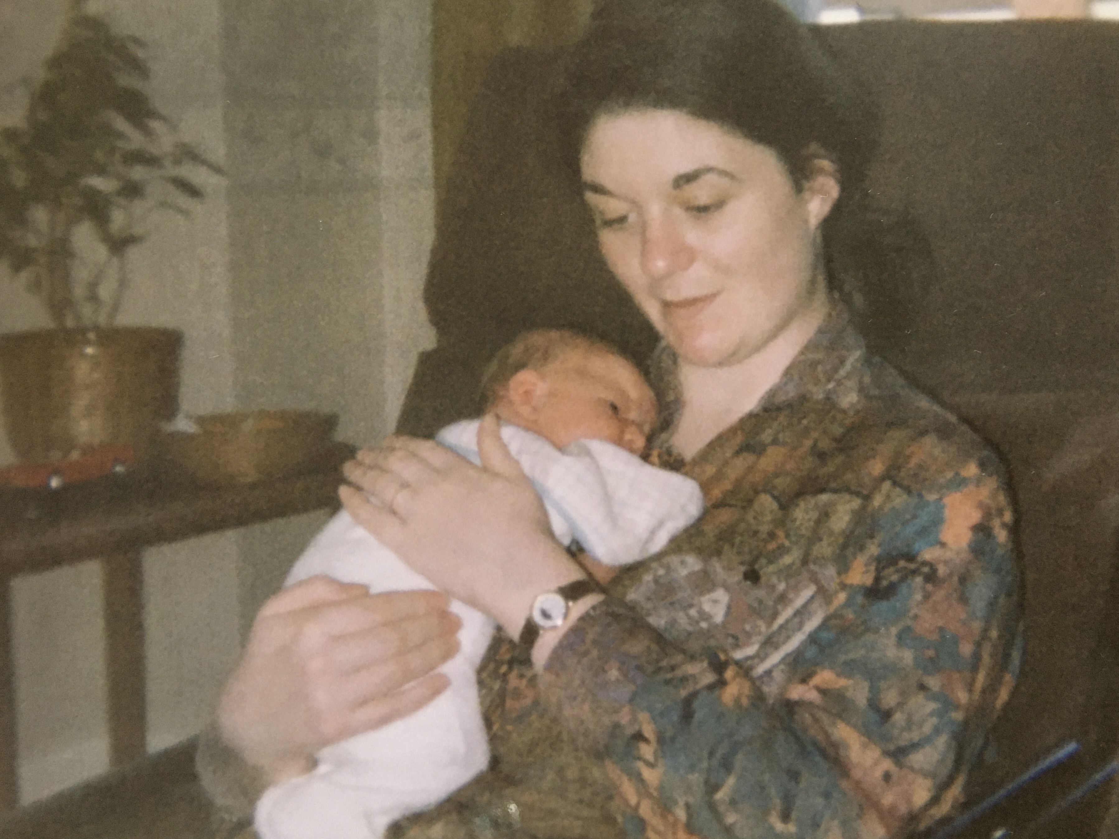
Think back…
How was your transition to university?
What thoughts and emotions do you remember from that time?
What behaviours do you remember?

Slide 4
What do we mean by transitions?
Transition as change…a journey?
Often framed as a challenge – shift in identity, social support, independent living, changes in teaching and learning environment/activities, expectation vs reality ‘gap’

Slide 5

Tackling transitions in STEM
Hulme & De Wilde (2014) – tackling transitions in STEM
381 participants (lecturers, teachers, students, others) in workshops – thematic analysis
Skills and knowledge gaps – especially “Thinking like a…” – pre-uni qualifications as “poor” preparation
Lack of explicit signposting (making the unknown known) about different expectations
Anonymity and class sizes
Tension between sectors – different teaching styles, lack of understanding and co-operation – resources and research
Focus on deficits…

Slide 6

Transition as transformative – a reflective conversation at a conference
“…transitions can lead to profound change and be an impetus for new learning, or they can be unsettling, difficult and unproductive. Yet, while certain transitions are unsettling and difficult for some people, risk, challenge and even difficulty might also be important factors in successful transitions for others.” (Ecclestone, Biesta, & Hughes, 2010, p. 2)
Transition as navigating threshold concepts, liminality, transformation (Meyer & Land, 2010)

Slide 7

Transition for diverse students
Assumptions that low SES, minority groups, disabled students, first in family, etc might find transitions harder
Knowledge ‘about’ vs knowledge ‘of’ university – knowledge ‘of’ is missing for all
Predictive value? – but not certainties. Unable to target students – all may be at risk?
Gale & Parker (2014): “taken-for-granted notions of transition” and “…the normative and the universal discourses of transition do not capture the diversity of student lives, their experiences of university, or of universities themselves”

Slide 8
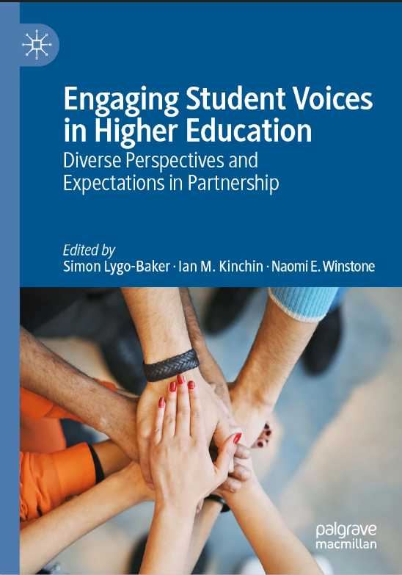
How do diverse students experience transitions? Winstone and Hulme (2019))
“Problematisation” of transitions is not helpful – can be challenging, but can be exciting/transformational. Or both!
Need to capture student experience, rather than make assumptions.
What can we learn from students themselves about how to facilitate successful transitions?
Survey – Likert scale responses and open questions

Slide 9
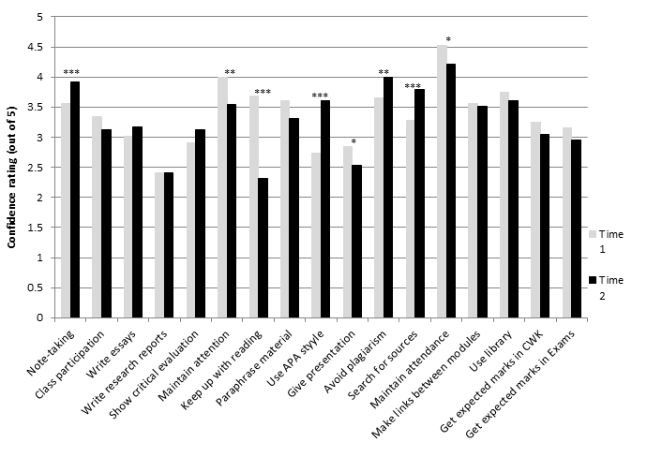
Student skills perceptions
Mean confidence ratings across academic skills at Time 1 (start of year 1) and Time 2 (end of year 1).
Paired t-tests: * p < .05 ** p < .01 *** p < .001
N = 91
Confidence for some skills increases, for other decreases – expectation-reality gap

Slide 10
Students’ experiences of transitions
Students also rated experience of transition from GCSE (age 16) to A level – significant correlation with rating of transition from A level to University
“How has your experience of the A level to university transition been similar to your experience of the GCSE to A level transition?”
“What did you learn from the GCSE to A level transition that has helped you make the transition to university?”.

Slide 11
Similarities between successive transitions
Shift to more independent learning
Increased workload
Increased difficulty/higher level of academic work
BUT note in the UK, students often have the same friendship group and often the same teachers when making transition to Level 3.
Appreciating their own skills acquired during previous transitions was reassuring and helpful.
Recognised that transition can be difficult, but they have successfully navigated transitions before, and will do again.

Slide 12
Dealing with ducks and fish
Reflections on historical personal transition experiences may be more helpful than a homogenous ‘institutional’ perspective
Students are able to share stories with each other – mentoring and narrative testimonials
Students as partners in facilitating transitions – mentors and story-tellers
Transitions through education as a continuing process that we can all learn from

Slide 13
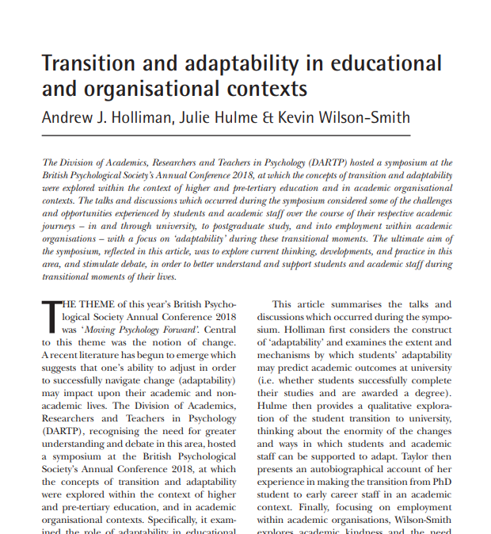
Adaptability, kindness, and supporting fish out of water
Holliman, Hulme & Wilson-Smith (2019) – a series of short reflections on transitions research from different perspectives:
  Adaptability can be developed and predicts engagement and success
  Transitions as a challenging time in a novel environment for which one must be prepared
  Autoethnographic account of transition to PhD/ECR – importance of social support
  Academic kindness – for students and staff – in the face of competition, reward and recognition
Social support as a buffer – for all transitions

Slide 14
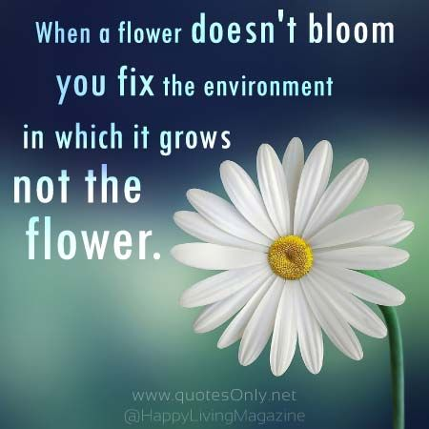
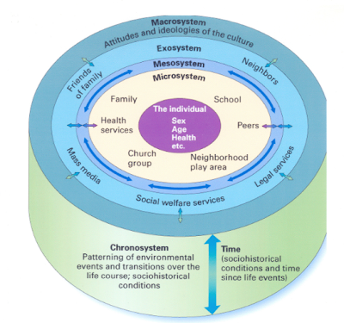
Individuals in a social context
‘Resilience’ as systemic – state not trait (Bronfenbrenner, 1992 – bioecological model)

Slide 15
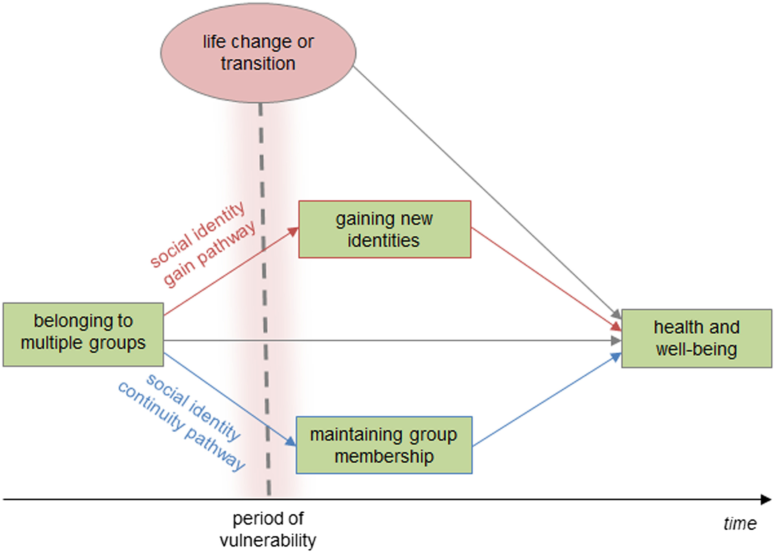
Social identity model of identity change (SIMIC)
Ng et al. (2018). ‘How can you make friends if you don’t know who you are?’ A qualitative examination of international students’ experience informed by the Social Identity Model of Identity Change. Community and Applied Psychology, 28, 3, 169-187. https://doi.org/10.1002/casp.2349
Notes:
This paper explores the contribution of social identity change to international students' health and well-being. International students typically face a range of challenges from the time they leave their home country, including the need to adapt both to a new culture and norms and to a new educational landscape. Previous research informed by the Social Identity Model of Identity Change (SIMIC) suggests that during such life transitions, an individual's group memberships and associated social identities can provide a buffer against the threats to well-being that such transitions present. To examine the relevance of SIMIC for the transitions that international students' experience, semistructured interviews were conducted with 15 international students attending an Australian university. Thematic analysis provided support for the relevance of SIMIC's social identity gain and social identity maintenance pathways in the transition and revealed a number of associated factors that acted as either facilitators (e.g., a host family that supported community integration) or barriers (e.g., experiencing culture shock) to social identity change. These findings present the first qualitative support for SIMIC within an international student population and help to flesh out the specific ways in which social identity processes contribute to both positive and negative health and well-being outcomes.

Slide 16
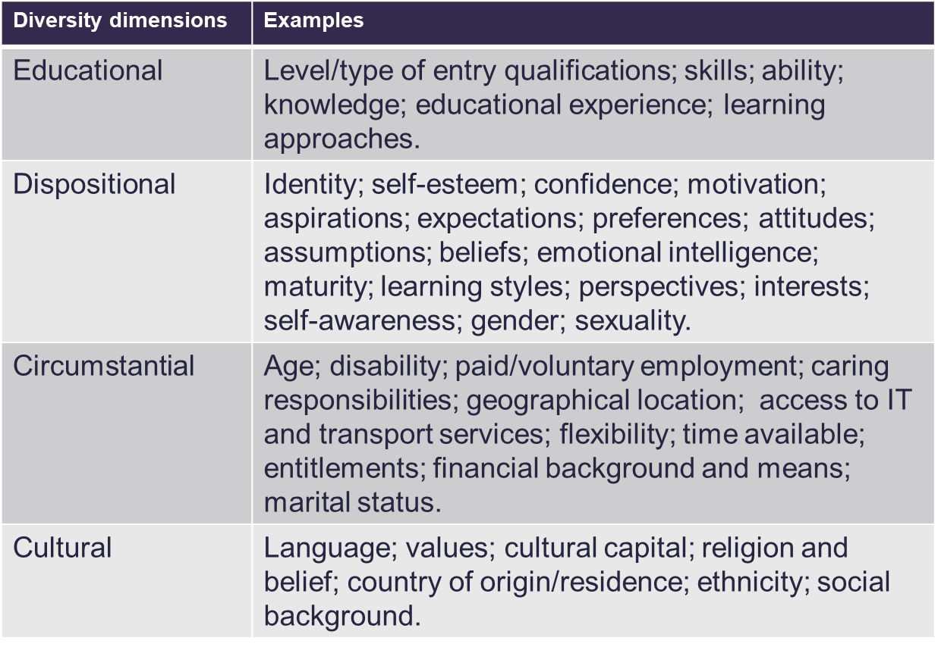
Sources of diversity – and social identity
Thomas and May (2010).

Slide 17
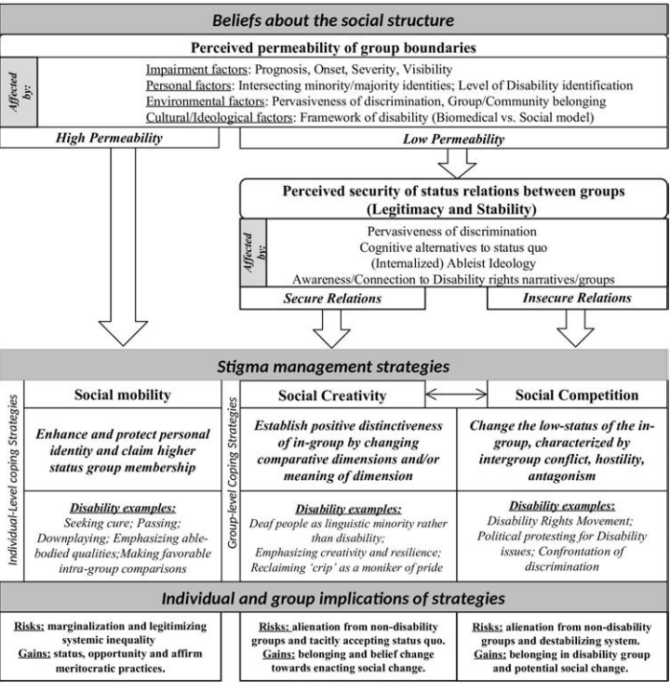
Social identity and disability
Dirth & Branscombe (2018). The social identity approach to disability: Bridging disability studies and psychological science. Psychological Bulletin, 144, 12, 1300-1324. https://doi.org/10.1037/bul0000156
Notes:
Although mainstream psychology has received numerous critiques for its traditional approaches to disability-related research, proposals for alternative theory that can encompass the social, cultural, political, and historical features of disability are lacking. The social identity approach (SIA) offers a rich framework from which to ask research questions about the experience of disability in accordance with the critical insights found in disability studies (DS), the source for many of the most compelling critiques of disability psychology research. We review existing research considering the complementary social identity (Tajfel & Turner, 1979) and self-categorization (Turner, Hogg, Reicher, & Wetherell, 1987) theories to support our contention that the disability social category is a significant driving force in the psychological experience of disability and to demonstrate the theoretical utility of the SIA. We suggest that a bridge between the critical epistemological perspectives found in disability studies and the methodological rigor and theoretical breadth and parsimony of a social identity approach is essential for examining the social psychological experience of disability in the 21st century. To conclude we explore the emergent possibilities for research in psychological science that can follow from a social identity approach to disability.

Slide 18
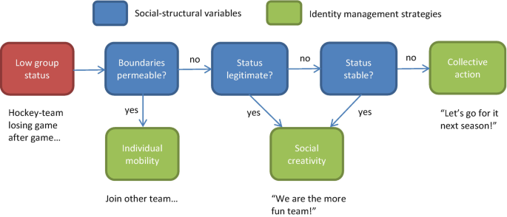
Scheepers and Ellemers (2019) – is the social hierarchy permeable, legitimate, stable?

Slide 19
“I have been open about it, but I always worry about the stigma and can tell when someone is a non-believer of ME. I've managed to educate some about it, and they've seen me suffer with it so I hope that'll help their knowledge.”
“I only told them through necessity due to it affecting my studies, otherwise I would not disclose it due to stigma over the illness”
“I feel hesitant about sharing my illness with people, because I do not want to be viewed as a disabled person. I also do not want to face the judgment of being a person with a chronic illness while also trying to be a nurse. I fear that people will think I am physically unsafe to be caring for other people. I think that people become uncomfortable when I tell them.”
Data extracts from Hamilton, Hulme, & Harrison (2023)
“I'd worry they'd view me different, or they'd think I was lying. I don't want to be treated any different.”

Slide 20

Reflections: how do we enable peer support?
Importance of curriculum.
Group work early in the degree programme (Hulme & Cranney, 2021) to form peer relationships (possibly individually assessed).
Meaningful, personally relevant material – students can bring lived experience to the classroom and contribute knowledge from diverse backgrounds. Scaffolded and subsequently formalised – but everyone can bring a perspective, socially valued.

Slide 21
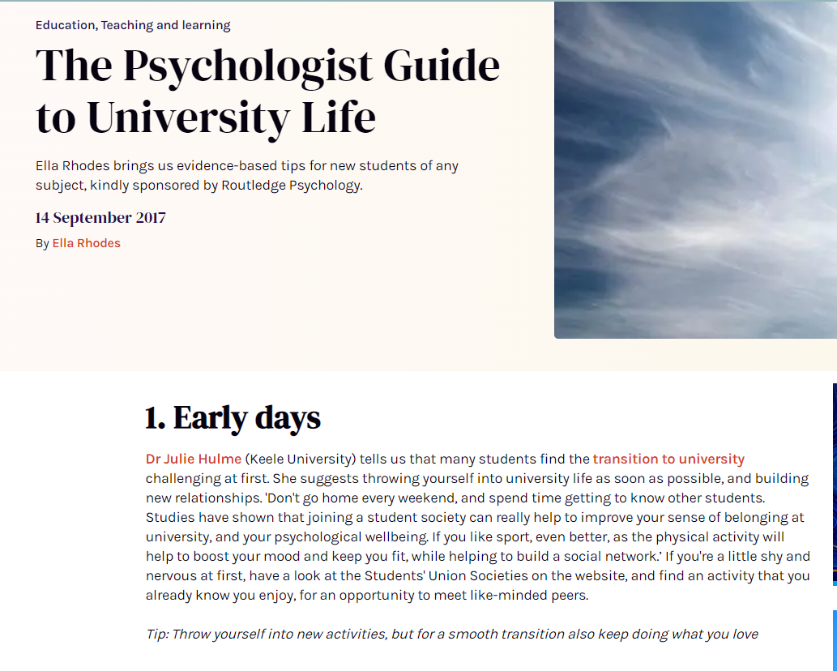
Reflections: importance of student-led groups
https://www.bps.org.uk/psychologist/psychologist-guide-university-life

Slide 22


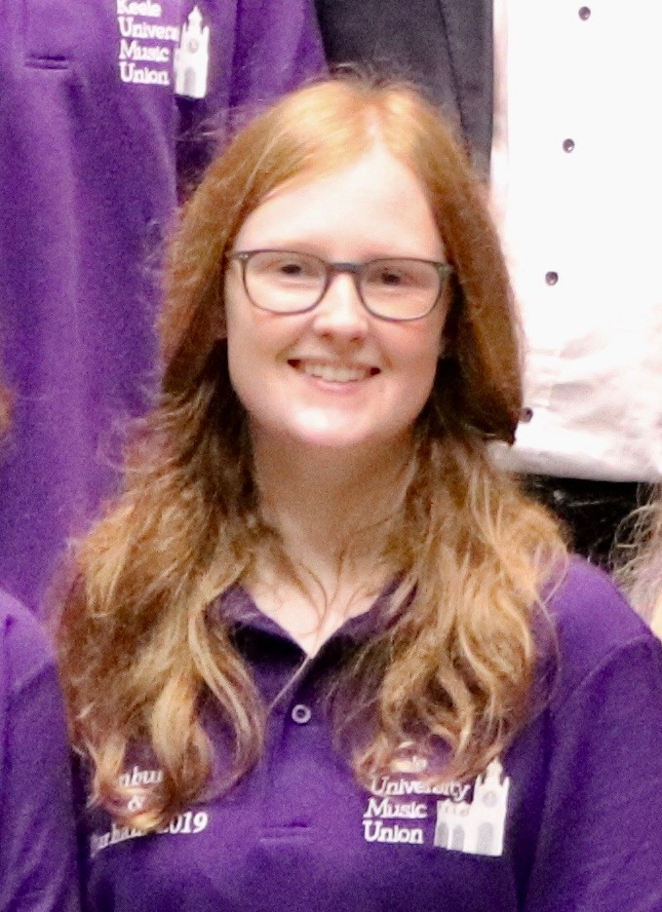

Students as researchers
Students can offer unique insight into student experience – and have access to communities that we cannot always access ourselves.
Learning from, and informing policy and practice with, our students – empowering them to represent their communities and amplifying their voices.
Community of practice (Lave & Wenger, 1991).
Hamilton, Hulme & Harrison (2023) Experiences of higher education for students with chronic illnesses. Disability & Society. DOI: 10.1080/09687599.2021.1907549 + in prep
Crabb (in prep). The relationship between social camouflaging behaviours, mental wellbeing and the university experience of female autistic students.
Keeling Ball (unpublished dissertation, 2021). Experiences of blended learning amongst students with learning difficulties during the COVID-19 pandemic.
Lyons, S.M. & Hulme, J.A. (2021). Why are so many students locked out of their education? WonkHE.
https://taso.org.uk/wp-content/uploads/Uni-Lincoln-Disability-Evidence-Review-with-TASO.pdf

Slide 23
Further reflections on diversity and transitions
“Each student enters university with a specific and complex profile which entails specific adaptation to the academic world” (De Clercq, Galand, & Frenay, 2017).
Stepping away from labels and assumptions – moving towards “intellectual streaking”? (Bearman & Molloy, 2017) – to allow student to identify with people who meet their needs, rather than the needs we assume they might have?
Opportunities for students to share *their* perspectives – active learning, critical thinking, decolonising, students as partners, students as researchers. Experts by experience.

Slide 24
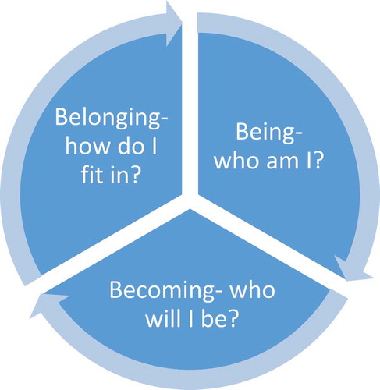
Kift (2004): Complex interaction of environment, social and cognitive attributes – social connectedness.
Thomas (2012): Psychological and sociological aspects and a feeling of a sense of purpose – linked to subject and career aspirations.
Soria and Stubblefield (2015) – self-awareness of strengths and capabilities, supported by the curriculum.
From: Meehan & Howells (2018).

Slide 25
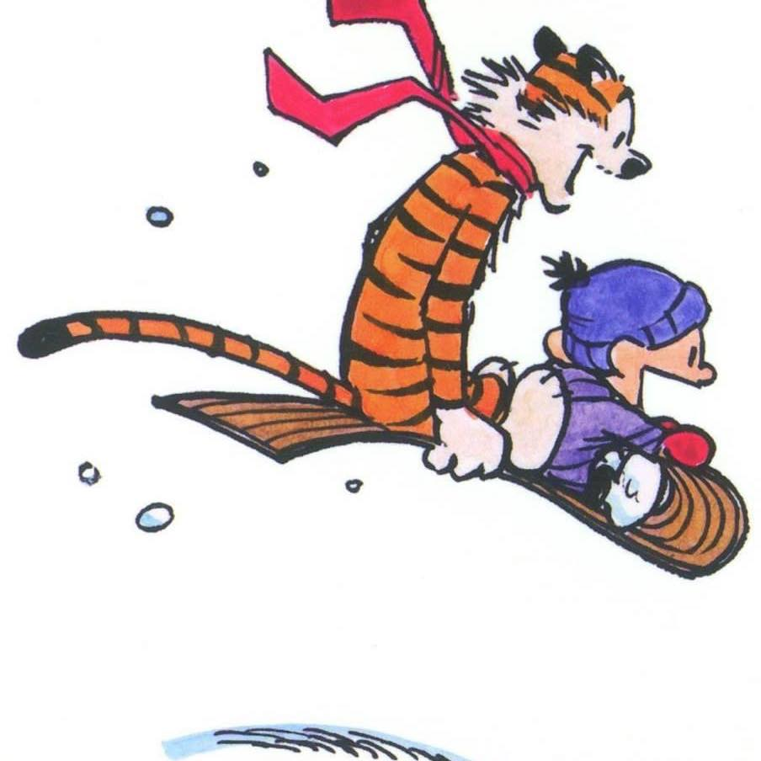
Closing thoughts
Hockings (2010) on inclusive education:‘the ways in which pedagogy, curricula and assessment are designed and delivered to engage students in learning that is meaningful, relevant and accessible to all. It embraces a view of the individual and individual difference as the source of diversity that can enrich the lives and learning of others’ (p.1).
Transitions as an ongoing aspect of our lives – a normal feature of being human.
Transitions are ‘healthier’ when we can find others with shared (emerging or pre-existing) identities in supportive social groups.
Implications for teaching at Westminster? Implications for your own transitions at work?
Calvin and Hobbes, 1995: “Let’s go exploring!”

