Slide 1
Making a difference in higher education: pracademic pathways to impact
Professor Julie Hulme (she/her)
Julie.Hulme@ntu.ac.uk
@JulieH_Psyc
Notes:
Within the HE sector, the role of the education-focused academic and their contribution to the wider sector – beyond teaching and educational leadership – can be misunderstood and sometimes undervalued. In this talk, Julie will share her own scholarship journey and her national work in supporting education-focused promotions. She'll lead us through exploring the ways in which we can turn our teaching into outputs, the diverse ways in which we can make a difference in and beyond higher education, and discussing what it means to develop a meaningful academic career as a pracademic (a practitioner who brings experience from work into the university). We'll close with a call to action: What difference will you make, and how can you plan to achieve it?

Slide 2
Outline
Education-focused academics
What’s a pracademic? And what are the issues?
Finding your own expertise
Building a reputation for ‘making a difference’ – impact and profile
Pathways to reward and recognition
Call to action – we’re in it together!

Slide 3
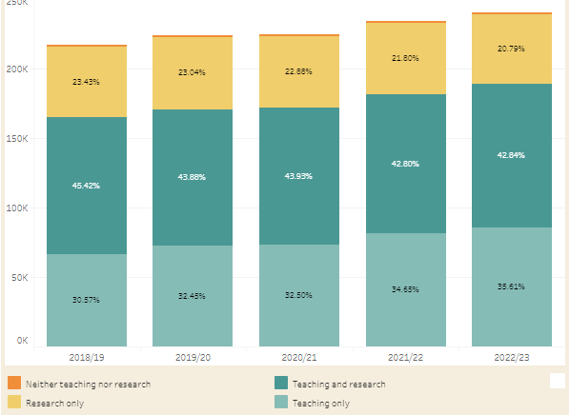
Academic staff in UK universities (HESA)
WonkHE: https://wonkhe.com/wonk-corner/hesa-spring-2024-staff-in-outline/
“Teaching only”
30.57
32.45
32.50
34.65
35.61
Notes:
240k academic staff – 35% are teaching only = 84,000 people
“A further 36% of academic staff were on teaching only contracts. This percentage has steadily increased year-on-year since 2015/16, when it was 26%.” – has risen year on year since 2012.

Slide 4
Teaching “only”?
How many people do you know who “only” teach?
E.g.
NTU – Teaching and practice/Teaching and scholarship
Keele – Education and scholarship
Lincoln – Teaching, scholarship & professional practice
Manchester – Teaching and scholarship
There’s nearly always an “and” – even if it isn’t written in a contract

Slide 5
Example – Teaching Fellow / Senior Teaching Fellow roles
My two “teaching only” experiences
TF: 2002-2004 – Teaching and Psychology-specific student support provision
STF: 2015-2016 – Teaching and transform all of our learning and teaching provision to improve the student experience and be Director of Education and please develop staff and take on some uni-level roles?
What is your ‘and’?

Slide 6
Pracademics
Practitioner-academics and academic identities
A ‘revolving door’ between practice and academia? – with tensions around shifting identities and transitions (Dickinson et al., 2020 – ‘fragile academic selves’).
Imposter syndrome – ‘not a real academic’? – in a higher education sector where research is often prized (e.g. Hulme, 2022).
BUT support students to be ‘knowledge-able’ rather than knowledgeable; networks and employer engagement that contribute to curricula; industry-university partnerships (Dickinson et al., 2020).
Need to maintain currency in practice area while also developing in academic role.

Slide 7
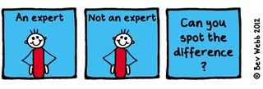
The ‘and’ is often where expertise lies…

Slide 8
Leading effective educational change requires educational expertise (e.g. Nelson and Campbell, 2017; Fung, 2017; Gorard, 2020), and educational expertise is more likely to be located in those who choose to study it than it is in traditional discipline-specific researchers. Thus education-focused academics are frequently “positive disruptors” (Akerman, 2020).
Hulme (2022)

Slide 9
So what is scholarship?
Trigwell (2013) – scholarship (of teaching and learning / SoTL) has many (contested) definitions and many purposes. Generally:
Improving and enhancing teaching, learning, assessment, and more
Evaluating and determining ‘quality’
Evidence-based and systematic

Slide 10
The BOGOF model of scholarship – what are you already doing that can gain more benefits?
Scholarship – the evidence that underpins the decisions you make (that achieves the T success)
Scholarship – the products/resources you produce that deliver the T
Scholarship – the evaluation of the design, the development, the delivery, the products, the T, the outcomes…
Where’s your BOGOF opportunity?

Slide 11
Thinking about BOGOF scholarship
Finding your own expertise – or turning your teaching into outputs
What are the ‘big questions’ for you at the moment?
What are the problems? (or what can improve?)
How do you find or develop solutions?
How do you know if your solution works?

Slide 12
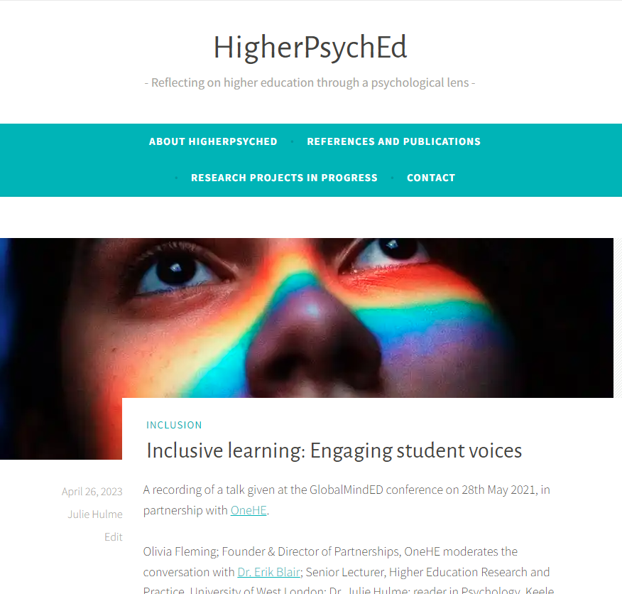
More BOGOF thinking
Hamilton, P., Hulme, J.A. & Harrison, E.D. (2023 – online 2021). Experiences of higher education students with chronic illnesses. Disability and Society. DOI: 10.1080/09687599.2021.1907549
Hulme, J.A., Hamilton, P., Lyons, S., Crabb, E., Cascone, C., Davis, S., Fahey, C., Holland, B., Hussain, M., & Knight, E. (2023). Students as researchers: Amplifying disabled student voices. In: Disability Evidence Review with TASO. https://taso.org.uk/wp-content/uploads/Uni-Lincoln-Disability-Evidence-Review-with-TASO.pdf
Hulme, J.A. (2022). Amplifying disabled students voices. ANTF blog, 25/03/2022. https://ntf-association.com/amplifying-disabled-student-voices/
Hulme, J.A. (September, 2021). Social identity and disability in the classroom. Changing States of Mind podcast. https://changingstatesofmind.libsyn.com/social-identity-and-disability-in-the-classroom-with-dr-julie-hulme.
Lyons, S.M. & Hulme, J.A. (June, 2021). Why are so many students locked out of their education? WonkHE (18/06/2021). https://wonkhe.com/blogs/why-are-so-many-students-locked-out-of-their-education/
Hulme, J.A., McDermott, H. & Kent, A. (2022). Truly inclusive education: Teaching qualitative methods in psychology to enhance inclusion in the higher education psychology curriculum. QMiP Bulletin, 34, 22-29.

Slide 13
Scholarship means “going meta”
IMPACT
Hutchings and Shulman (1999): “A scholarship of teaching is not synonymous with excellent teaching. It requires a kind of ‘going meta’, in which faculty frame and systematically investigate questions related to student learning—the conditions under which it occurs, what it looks like, how to deepen it, and so forth—and do so with an eye not only to improving their own classroom but to advancing practice beyond it.”
Shulman (1999): “An act of intelligence or artistic creation becomes scholarship when it possesses at least three attributes: it becomes public, it becomes an object of critical review and evaluation by members of one’s community, and members of one’s community begin to use, build upon, and develop those acts of mind and creation”

Slide 14
Going meta!
Who can see your work?
How do they find it?
Who are your stakeholders? Who cares?
Who is using your work?
What is the reach, impact, and value?
What is the potential for reach, impact, value?

Slide 15
Kern et al (2015) Dimensions of activity relating to teaching (DART)
Where are you?

Slide 16
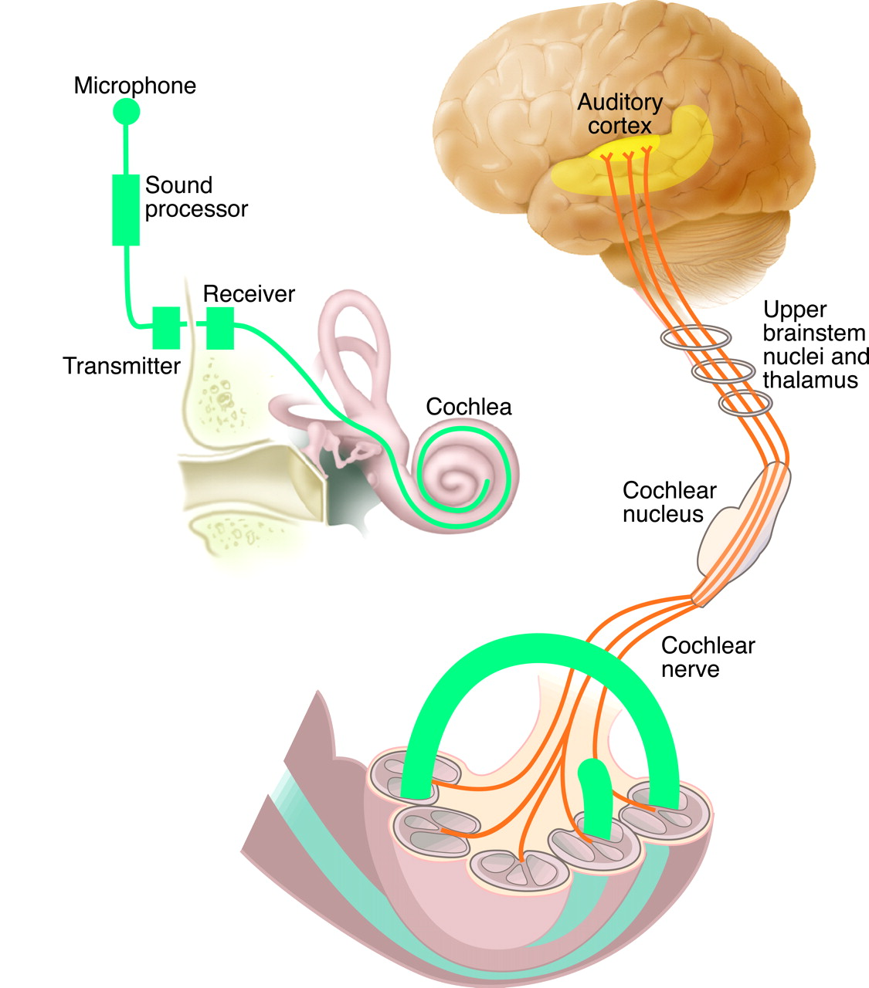
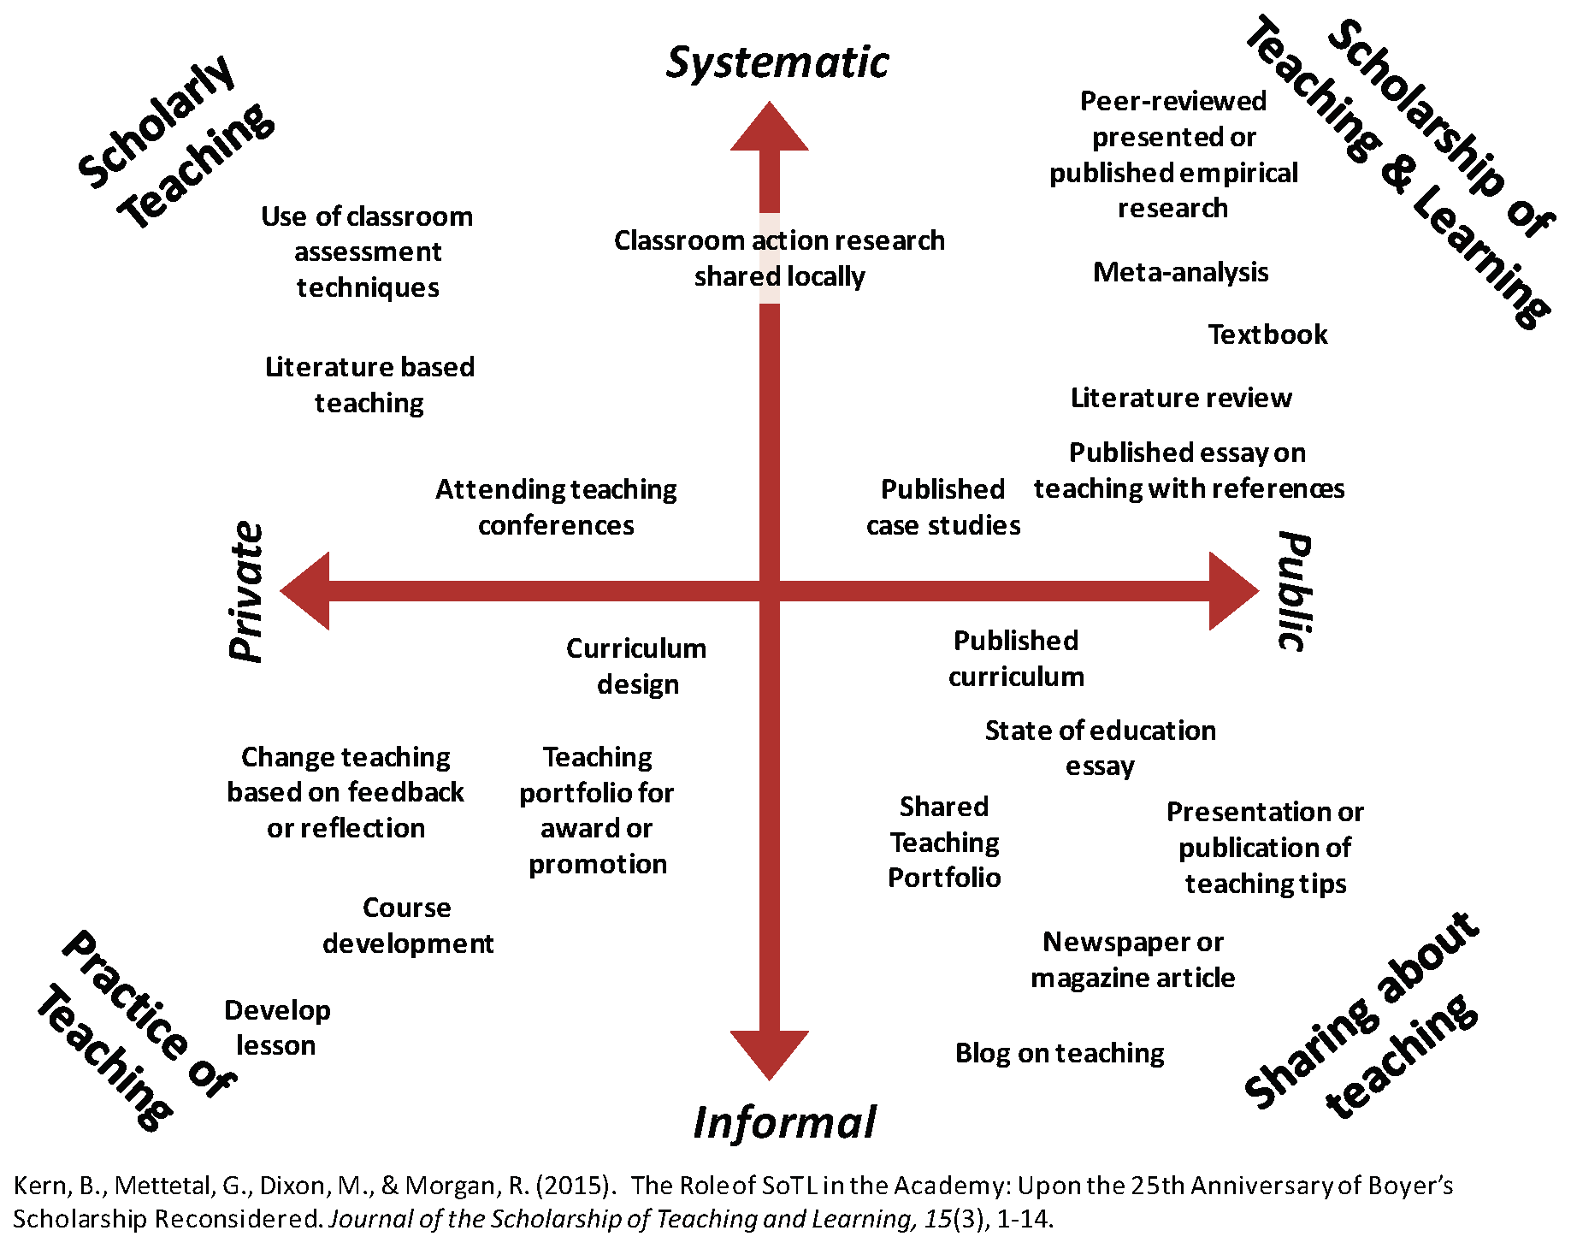
My scholarship journey
Scholarship of scholarship!
Disabled students as researchers
Journal articles
Profs in Prep network and more
Assessment and feedback research
Psychological literacy
Blog
Advance HE resources
Scholarly teaching
Open educational resources

Slide 17
A few examples from legal education
NTU’s Nottingham Law School – NLS Legal – ‘the only UK Law School with an on-campus teaching law firm’
Keele’s CLOCK – ‘community legal outreach collaboration Keele’
Fay, M., & Skipper, Y. (2022). “I was able to ask for help when I became stressed rather than sitting alone and struggling”: psychology and law students’ views of the impact of identity and community on mental wellbeing. The Law Teacher, 56(1), 20–36. https://doi.org/10.1080/03069400.2021.2020507
Duffin, M., Daramy, F.K. (2024). Creating a culturally sensitive law curriculum. In: Thomas, D.S., Quinlan, K.M. (eds) Culturally Sensitive Curricula Scales. Palgrave Studies in Race, Inequality and Social Justice in Education. Palgrave Macmillan. https://doi.org/10.1007/978-3-031-57688-1_7

Slide 18
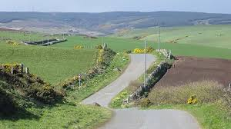
Purposeful planning for impact
How do you find the ‘BOGOF’ deal?
Topical issue - who shares the problem?
Resources – funding? time? students as researchers? collaborative networks?
Stakeholders – internal and external
Plan evaluation from the start – who has the skills?
Disseminate how? where?
How to assess reach, impact, value?

Slide 19
Reward and recognition
Promotion?
(Inter)National invitations?
AFHEA, FHEA, SFHEA, PFHEA
National Teaching Fellowship, CATE award?
Law Society prizes and awards – eg Law Teacher of the Year award?
What works for you?
Narrative that pulls together evidence of your reach, impact, value.
A claim of expertise
Who are you? What are you known for? What do you want to achieve?

Slide 20
Building (Y)OUR scholarship profile and making impact visible

Slide 21
There are relatively few teaching-focussed staff in more senior positions who can review, mentor and support teaching staff; act as role models for junior staff who are seeking to develop a teaching/education career (Fung and Gordon, 2016); help individuals to collate a mix of quantitative and qualitative evidence that provides a clear sense of their teaching achievements”
(McHanwell & Robson, 2018)
Networking and peer support – finding your tribe

Slide 22
Networks
Profs in Prep – email me on Julie.Hulme@ntu.ac.uk
UK Teaching-Focused Higher Education Network – sign up to our JISCmail list, HETEACHINGNETWORK@JISCMAIL.AC.UK, via https://jiscmail.ac.uk
National Teaching Repository
Start your own?
Networks enable you to disseminate your work (reach), to see it being implemented and evaluated (impact), open up new opportunities, raise your profile, provide a pool of peer reviewers, referees and assessors.

Slide 23
What difference will you make, and how can you plan to achieve it?
Where (topics?) can you build your expertise?
What actions can you take to increase your success in doing impactful and visible scholarship?
Where can positive disruption be useful in all this?
Who can help?
Some other thoughts? – over to you
What next?

