Slide 2
Daring to innovate: Inclusion, engagement, and active learning in the context of large diverse classes
Professor Julie Hulme (she/her) NTF PFHEA CPsychol AFBPsS
Julie.Hulme@ntu.ac.uk; @JulieH_Psyc
Notes:
Bio:
Julie is Professor in Psychology Education at Nottingham Trent University. She is a Chartered Psychologist, Principal Fellow of the HEA, and a National Teaching Fellow, and applies psychological theory and research methods to better understand and enhance learning and teaching in higher education. Julie describes herself as a 'positive disruptor'; she challenges inequity in higher education, champions inclusion, and is always willing to question the status quo. Julie is committed to developing understanding and support for other academics on diverse career paths, and is a strong advocate for education-focused staff career progression.
Title:
Daring to innovate: Inclusion, engagement, and active learning in the context of large diverse classes.
Abstract:
As student numbers grow and students themselves become more diverse, the idea of engaging and including students as individuals can seem like a bit of a pipe dream - but is it? Julie will share a mix of practical tips and findings from her own research to inspire us to innovate with confidence, whilst making sure we bring our students with us. Come with questions!

Slide 3
Outline
Warm up
Innovative teaching
Inclusive education
Practical strategies
Putting ideas into action – what’s next?

Slide 4
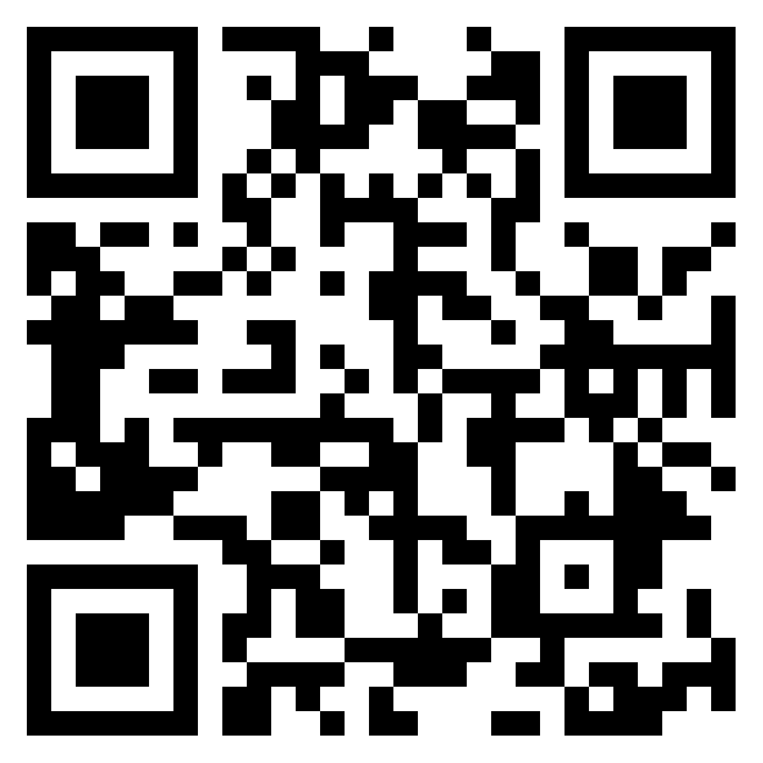
https://bit.ly/45cjdF2
Warming up the discussion…
What is university education for?
What’s changing about teaching your subject?
Who are your students? In what ways are they diverse?

Slide 5
Higher Education for a changing world – what is changing? (my thoughts)
Technology including AI
Student expectations and preparation for HE
Increased student diversity
Employment landscape and nature of jobs
Student numbers and graduate numbers
Global issues – climate change, health inequalities, cost of living crisis, etc
The QAA subject benchmark statements for many subjects now include sustainability, inclusion/diversity, employability/entrepreneurship, accessibility
The area/region in which we live and work?
…?

Slide 6
What is higher education for?
“Formal education systems tend to emphasize the acquisition of knowledge to the detriment of other types of learning, but it is vital now to conceive education in a more encompassing fashion.” (Learning: The Treasure Within, UNESCO, 1996)
“The aim of education is not only to prepare students for productive careers, but also to enable them to live lives of dignity and purpose; not only to generate new knowledge, but to help shape a citizenry that can promote the public good. Thus, higher education’s vision must be widened if the nation is to be rescued from the problems that threaten to diminish permanently the quality of life.”
(Boyer, 1990, p77-78).

Slide 7
Implications
We need to:
Teach applications alongside theory that enable students to meet their personal, professional, and societal goals
Constructively align our teaching
Model ways of thinking and working in our disciplines through our teaching
Hulme (2014). Psychological literacy – from classroom to real world. The Psychologist, 27 (12): 932-935.

Slide 8
Constructive alignment
What do you intend your students to learn?
What do they practice?
What do you assess? (both the task and the criteria)
Biggs, 1996

Slide 9
Authentic assessment
“Authentic assessment means that: (a) tasks must appropriately reflect the competency that needs to be assessed, (b) the content of an assessment involves authentic tasks that represent real-life problems of the knowledge domain assessed, and (c) the thinking that experts use to solve the problem in real life are also required by the assessment task”
Gulikers et al. (2004).
See also Sambell & Brown (2021-) for case studies

Slide 10
How does HE teaching change?
The status quo bias: “If it ain’t broke, don’t fix it” – our cognitive preference for keeping things the same.
Fraser (2016): “It’s always been taught like this”.
It doesn’t change very much…unless we decide to change it.
Is it broke?

Slide 11
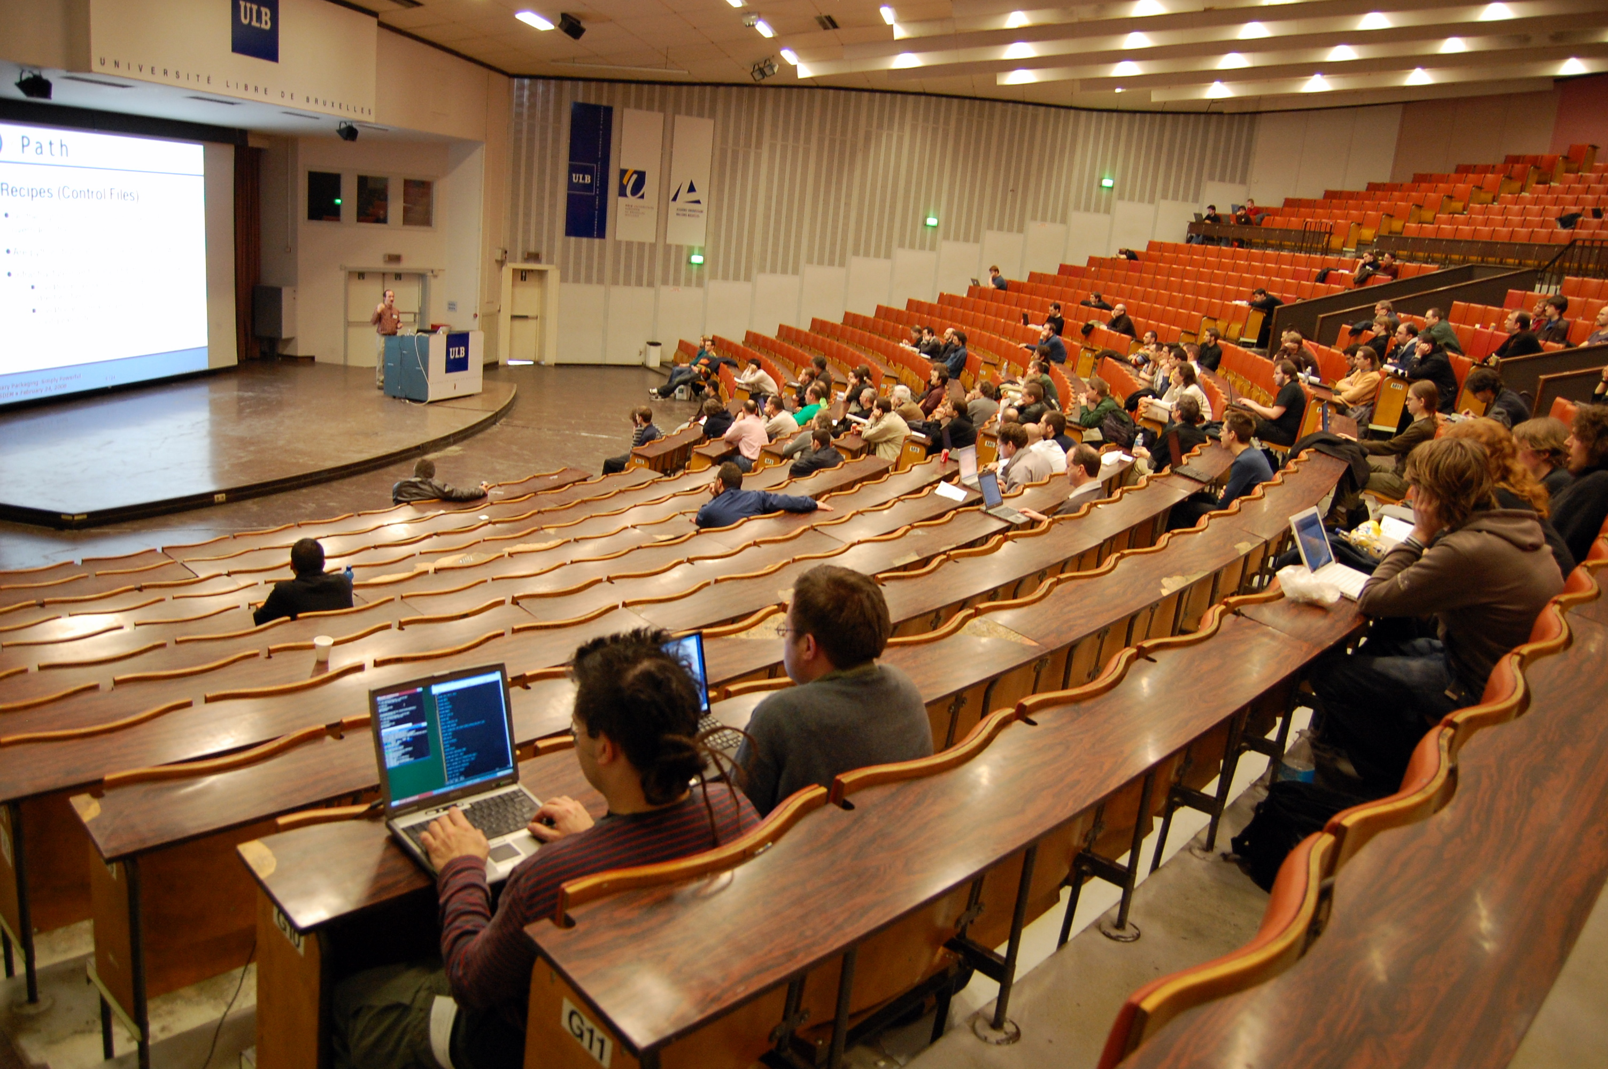
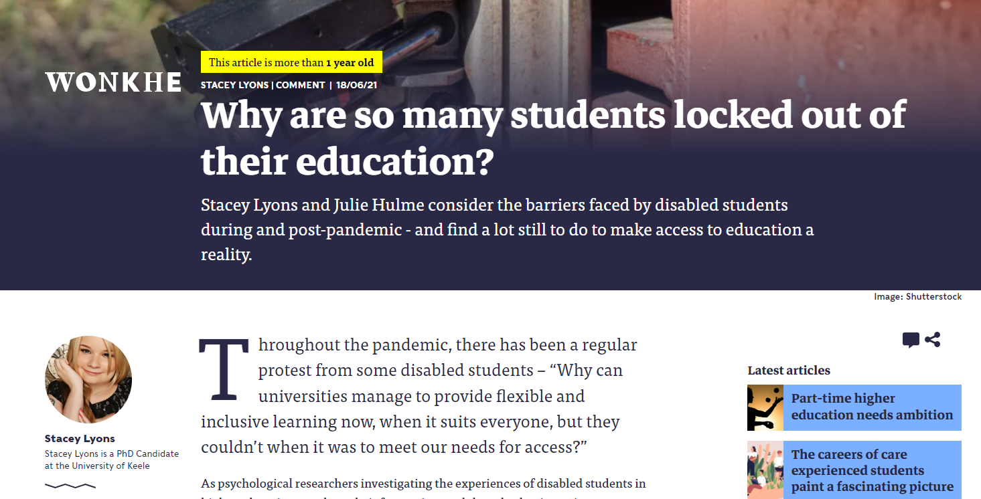
Is it broke…?
Awarding gaps, attendance and engagement, employability…
Future proofing?
If it’s broke (even a little bit), can we fix it?

Slide 12
Hulme & Winstone (2017) – change is driven by needs to be inclusive, preparing graduates, changing world, student engagement. It can feel risky…but there are ways of managing risks.
I think if you accept the risk that’s implicit in innovation, then it can’t be a negative experience because you have to accept that there may be cases when it doesn’t work when the students don’t benefit how you wanted them to, when the workload associated with your new efficient time saving technology doesn't pay off, you know all of those things (Eva, senior academic)
People are saying well I don't want to take a risk with my teaching because the students might give me bad feedback or it might might change the NSS results…I was reading something, can't remember where now, that was saying actually sometimes it’s riskier not to change…and if you're doing something and getting bad feedback it’s probably probably if you do something different that’ll be a bit better than carrying on as you are (Hannah, academic developer)
What are the risks?
Students may fail to learn – student attainment, progression
Risk for student evaluations and promotion prospects for the individual
Time and resource cost
BUT failure to innovate might also be risky – students who are not prepared for the modern world?

Slide 13
the economics taught before the crisis couldn’t explain the crisis…what’s happened to economics teaching in university uh since, pretty much nothing with some exceptions, so I think if we do need innovation what we need what if there is to be widespread innovation what we really need is innovation in in what it is we’re teaching…uh making students aware that if you’re going to learn these theories learning what the down sides of the theories are, understand what the limitations are (Richard, senior academic)
you have a, you may have the most wonderful innovation and it could already be implemented and bringing about positive outcomes for developing capacity across the whole organisation you get a change of leadership a new VC or PVC whatever comes in and says nah, don’t want it, it’s gone…so the politics and the academic arrogance and the egos in university are a hindrance (Mary, academic developer)
it’s like a kind of again that kind of learning by trial and error kind of approach…you’re going to have a structure where people are in some sense rewarded or looked up to or encouraged to innovate, it’s important that as long as as long as they’re not just being ridiculous it’s important to allow failure…cause if you don’t allow failure you’ll never get significant innovation because most people will be too scared to do it (John, senior academic with leadership role)
What are the barriers and enablers? (Hulme & Winstone, 2017)
Discipline drivers
Institutional culture and context
Reward and recognition

Slide 14
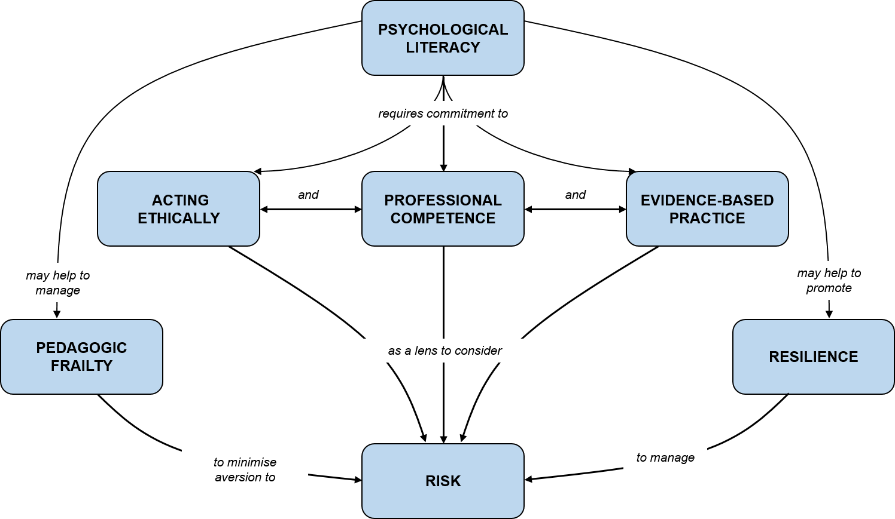
Developing your own innovations (Hulme & Winstone, 2017) – managing the risks
Evidence-based approaches to innovation – pedagogic/SOTL literature, evaluation, networks
Ethical and values-based innovation – students as co-creators, duty of care, contingency plans
Professional competence – continuing professional development, scholarship, peer observation. Academics as professional learners! Delay innovation?
And from the recent research – the university needs to be systemically supportive…

Slide 15
Inclusive learning and teaching
Hockings (2010):‘the ways in which pedagogy, curricula and assessment are designed and delivered to engage students in learning that is meaningful, relevant and accessible to all. It embraces a view of the individual and individual difference as the source of diversity that can enrich the lives and learning of others’ (p.1).

Slide 16
The sector perspective
Largely ignores intersectionality
Assumes homogeneity of demographic groups
Problematises diversity – “attainment gaps” (awarding gaps)
Focuses on metrics – not belonging, inclusion, experience, community, learning

Slide 17
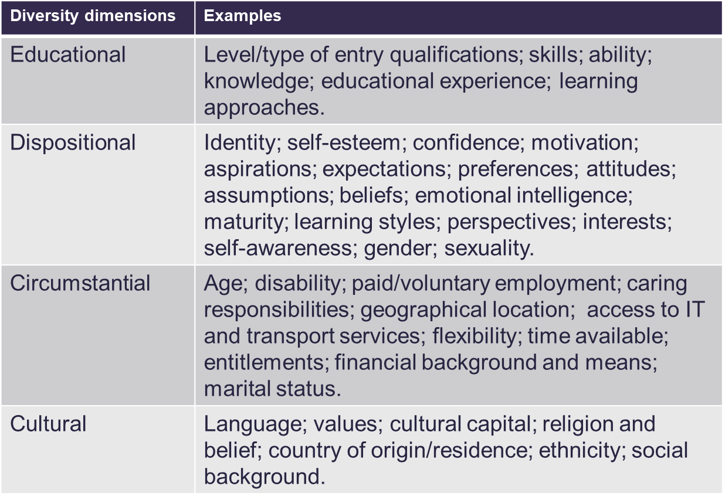
What is the “problem”? (Thomas & May, 2010)

Slide 18
The importance of student voiceS
Students do not have only one voice – we do not hear all of their voices through our student voice representatives.
A learning community (Lave and Wenger, 1991) with active learning enables all students to share ideas, resources, experiences – gives everyone a voice and we can all learn from each other (staff included!).
No such thing as the student voice…

Slide 19
Importance of belonging
Sense of belonging is correlated with academic engagement, attainment, and course completion (e.g. Thomas, 2012; 2019)
And with mental wellbeing (Meehan & Howells, 2018).

Slide 20
Who are your students?
What are you teaching them?
How do you make your content meaningful and relevant to them?
How do you show that their (diverse) perspectives and contributions are valued?
Where do they see ‘people like them’? (including their future ‘possible selves’?)

Slide 21
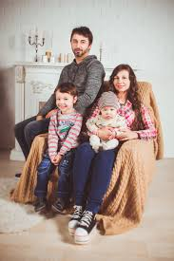
Example – attachment theory (psychology)
What do students learn (hidden curriculum) when they study attachment theory?
Mother as primary caregiver, usually White, heteronormative families, binary gender, fully abled.

Slide 22
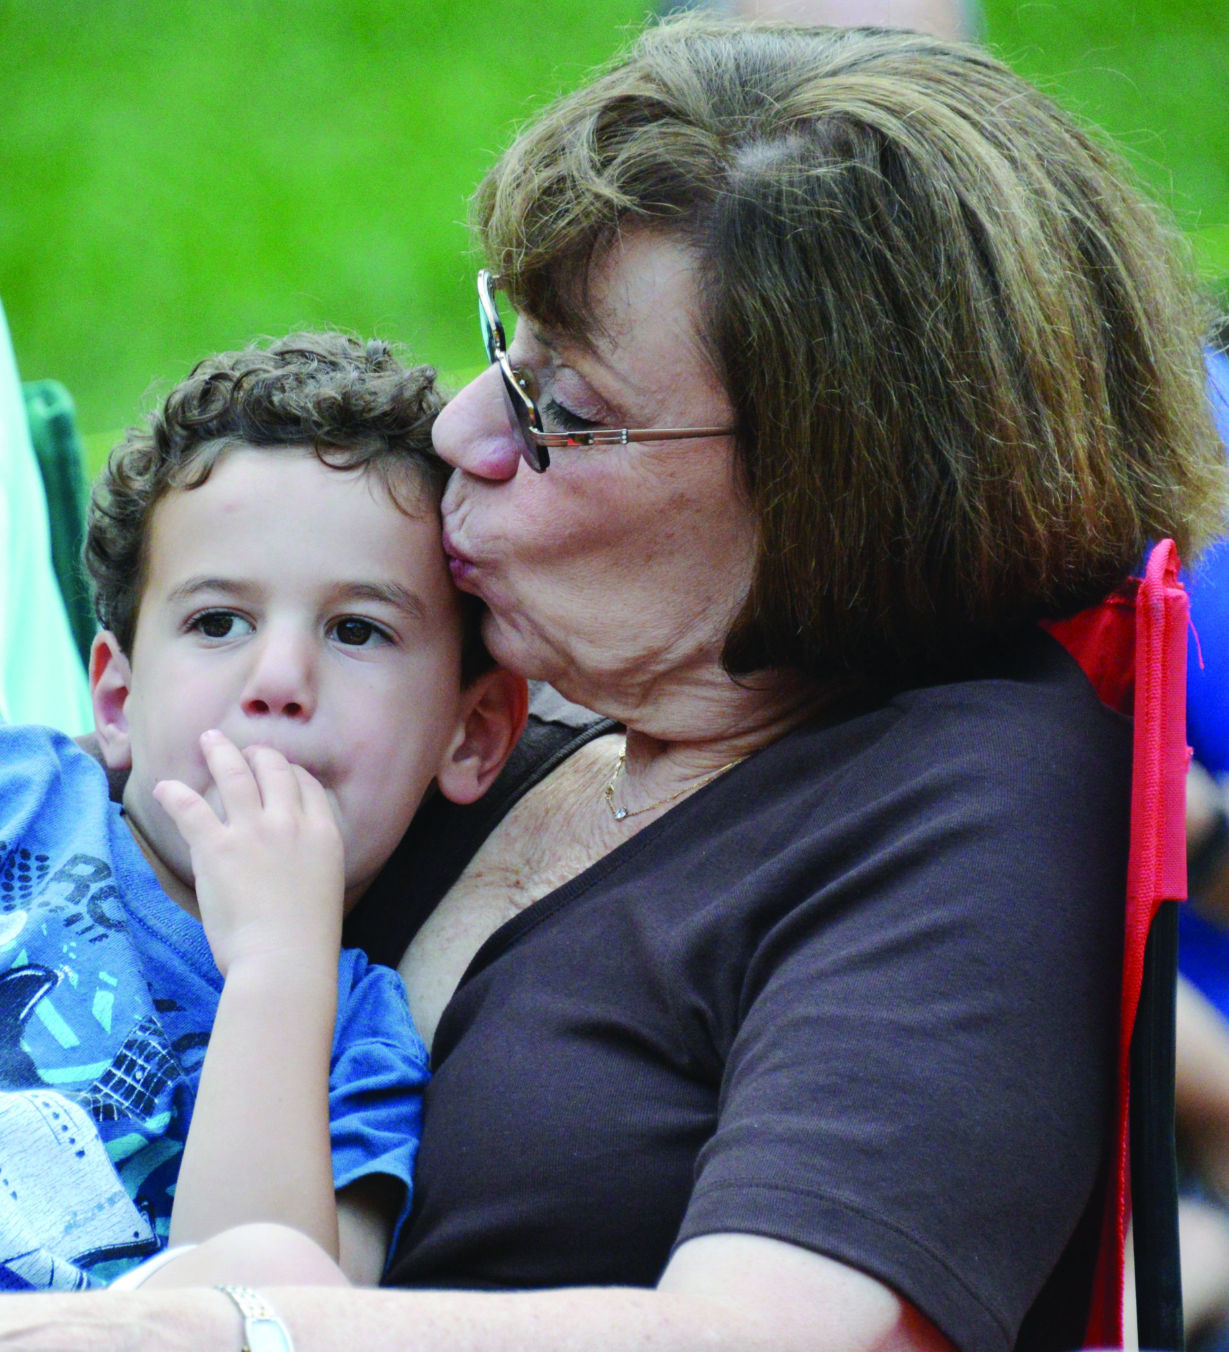
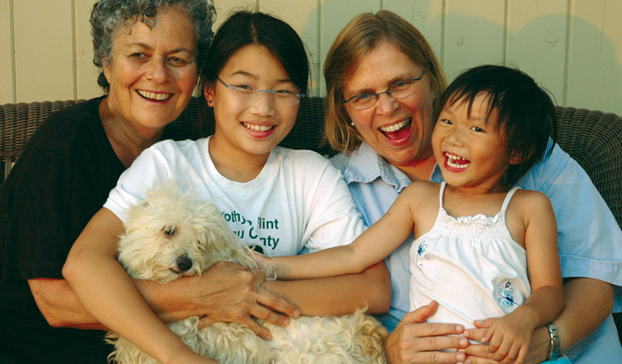
Search for ‘family’ on Google Images – what do you see?
Search for ‘non-traditional family’ on Google images – what do you see?
Thinking back to who your students are – do they include care-experienced students, adopted students, parents, non-binary students?
Golombok (2015) Modern Families. Cambridge University Press.

Slide 23
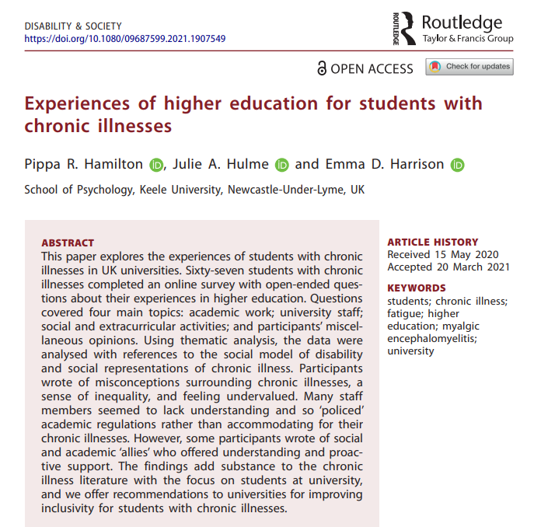
Example – disability and mental ill health
From the psychology curriculum:
Medical models prevail – broken, ‘abnormal’ or at least ‘atypical’
Focus on ‘what I can’t do’
‘Fascinating’ case studies – exoticism, ‘other’
In contrast to social models – society is excluding me, “I can”.

Slide 24
Practical opportunities for inclusion and growing belonging – also promote psychological literacy
Group learning as a way to build student relationships and to enable diverse voices to be heard (eg Psychology in Education) (Hulme & Cranney, 2021).
Flipped classrooms and interactive methods.
Students as researchers and students as co-creators.
Ensuring accessibility. Alt-Text? Recordings? Transcripts? Extra materials in different formats for independent study? Choice in assessment?
What examples can you share of ways in which you or others ensure you hear diverse student voices, and build inclusion and belonging?
What ‘others’ or excludes you and your students?
Hulme, J.A., *Hamilton, P., *Lyons, S., *Crabb, E., *Cascone, C., *Davis, S., *Fahey, C., *Holland, B., *Hussain, M., and *Knight, E. (2023). Students as researchers: Amplifying disabled student voices. In: Disability Evidence Review with TASO. https://taso.org.uk/wp-content/uploads/Uni-Lincoln-Disability-Evidence-Review-with-TASO.pdf

Slide 25
Provocation:
We must innovate to create university education that is truly inclusive, preparing students to thrive and make a difference in an uncertain future. We have a responsibility to empower our students.
See also: Cranney et al. (2022)

Slide 26
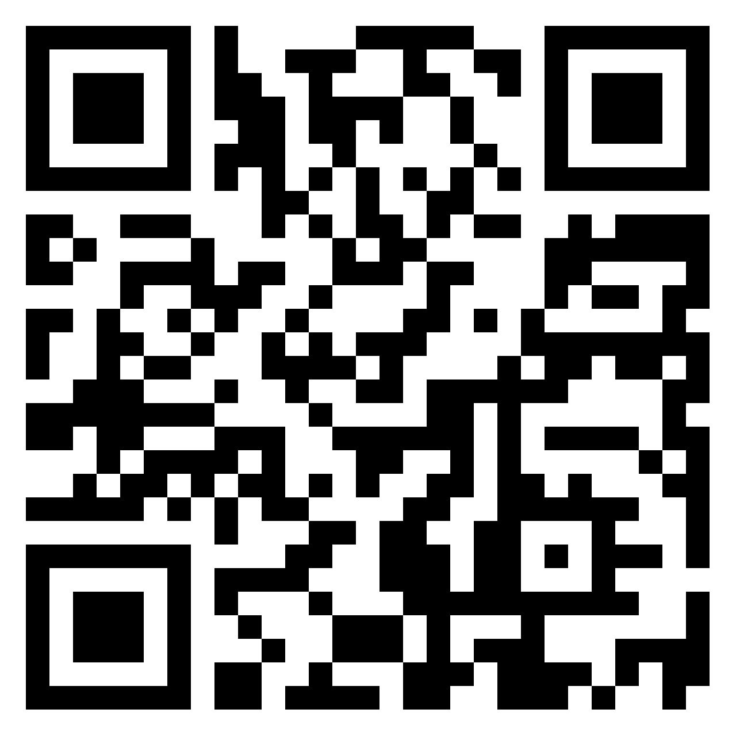
Actions?
What will you take away with you from this talk?
What are the good practices you can see at Falmouth?
What needs to improve?
What are you going to do (individually and in your team or department) – and how?
What more do you need to know? (Who can help?)
Finally – you might want to help my learning – there’s no such thing as the audience voice…
https://bit.ly/3X24CtJ

