Slide 1
Psychology? It’s a Mickey Mouse™ subject…is it?
Prof Julie Hulme (she/her)
Julie.Hulme@ntu.ac.uk; @JulieH_Psyc
Notes:
Title: Psychology? It's a Mickey Mouse subject...is it?
Abstract: Growing numbers of students are taking psychology at A level or equivalent, and at university in the UK. At the same time, there has been a persistent political discourse about the lack of value of psychology as a subject (for example, in the Augar Report), partly based on employability metrics from universities. Julie will share with us why psychology is one of the most valuable subjects that students can learn, because it enables them to meet their personal, professional, and community goals through a concept known as psychological literacy. Equip yourself with answers for questioning students, sceptical parents, and any politicians you happen to bump into - and find out more about the competences that you and your students can put to use to make a difference in the world around you.
Bio: Julie Hulme is Professor of Psychology Education at Nottingham Trent University. A National Teaching Fellow and Chartered Psychologist, Julie has an international reputation for her work on psychological literacy, and enjoys applying her own psychological knowledge and skills to creating inclusive learning opportunities for students. A long-time friend of the ATP, Julie is a former Further Education teacher, and Past Chair of the BPS Division of Academics, Researchers, and Teachers in Psychology. She believes passionately that transformative education should be available to all.
Find out more at https://www.ntu.ac.uk/staff-profiles/social-sciences/julie-hulme, and follow Julie on X @JulieH_Psyc.

Slide 2
Outline
Why did YOU choose psychology?
The political discourse
A Mickey Mouse subject?
Well…that depends!
Plenary discussion/questions
2

Slide 3
Warm up
Why did you choose to study psychology? (if you did)
Why do you choose to teach psychology?
Share your thoughts…

Slide 4
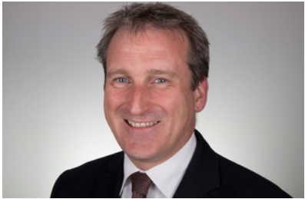
Political discourse
If a student did not repay their student loan within five years of graduation, the degree they studied was economically without value, and higher education providers should “drop or revamp” such courses (2019)

Slide 5
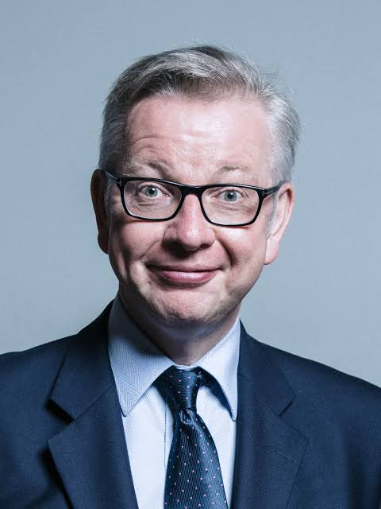
“It’s not history…”
(Well ok, he didn’t say this, or at least not in public…but I knew some of you would be disappointed if he didn’t feature somewhere in this talk)

Slide 6
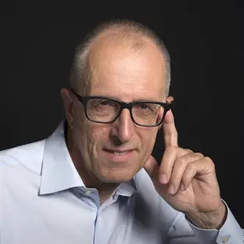
Psychology offers a poor lifetime economic return for its students, BUT acknowledgement that (2019):
“…successful outcomes for both students and society are about more than pay. Higher levels of education are associated with wider participation in politics and civic affairs, and better physical and mental health. We also understand the social value of some lower-earning professions such as nursing and social care, and the cultural value of studying the Arts and Humanities. The earnings data enable us to make economically defined value calculations, not value judgements. Assessing this wider value is very difficult, but government should continue to work to ensure that wider considerations are taken into account in its policy and funding decisions”

Slide 7
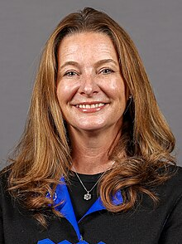
“Students and taxpayers rightly expect value for money and a good return on the significant financial investment they make in higher education” – announcing a “crackdown on rip-off degrees” in 2023

Slide 8
The term ‘Mickey Mouse Degree’ was originally coined in 2003 by the then Minister for Education, Margaret Hodge, as part of a discussion paper on the expansion of HE. She referred to a Mickey Mouse degree course as one where the content is not as rigorous as one would expect, and where the degree itself does not have huge relevance in the labour market and . . . simply stacking up numbers on Mickey Mouse courses is not acceptable.

Slide 9
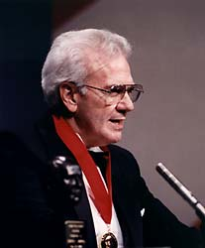
What is education for? Your thoughts?
Boyer (1990): “The aim of education is not only to prepare students for productive careers, but also to enable them to live lives of dignity and purpose; not only to generate new knowledge, but to help shape a citizenry that can promote the public good.”

Slide 10
Why do students choose to study psychology?
Graduate Outcomes data – relatively low levels of ‘graduate employment’ compared to other subjects.
BPS graduate survey – psychology graduates ‘catch up’ on employability within 5 years.
Around 10-15% of students become psychologists – what about the rest? Health and social care, education, housing, human resources, charitable work…
Recent debates around “quality of work” not only income and status – e.g. how does work impact on wellbeing?
Bromnick & Horowitz (2013) – to “make a difference” – it’s not about status or income, but about helping people.

Slide 11
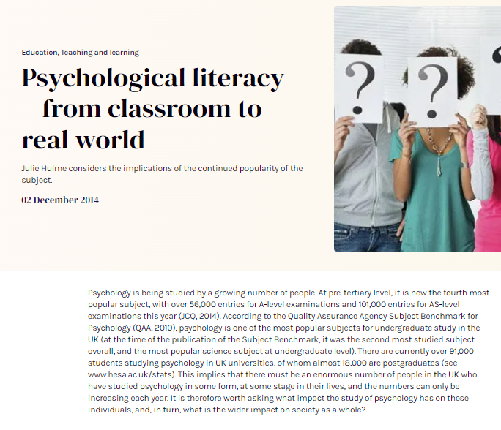
So what do students actually get from studying psychology?
Psychological literacy:
“intentional values-driven application of psychology to achieve personal, professional, and community goals.” (Nolan et al., 2024).

Slide 12
ICUPO
Overall, 118 people from 41 countries took part – including from global majority countries
What competences do students gain from studying psychology at undergraduate level?
27+ national frameworks – including UK
Consensus seeking and iterative stakeholder consultation
We’re nearly there…final consultation is happening at the International Congress of Psychology in Prague, 21-26 July 2024
Meet the ICUP (international competences for undergraduate psychology) framework – offers guidance to people planning and designing curricula in psychology.

Slide 13
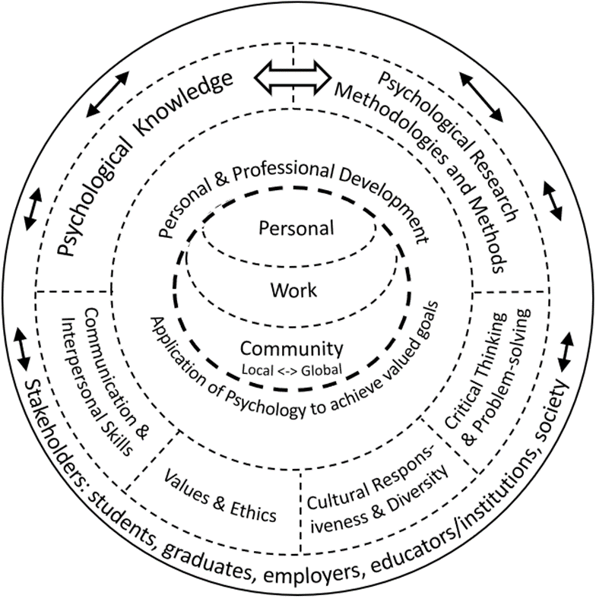
ICUP – what students gain from studying psychology
Psychological Knowledge
Psychological Research Methods & Methodologies
Psychology-relevant
Values & Ethics
Critical Thinking & Problem Solving
Cultural responsiveness & Diversity
Communication & Interpersonal Skills
Personal & Professional Development

Slide 14
Psychological Knowledge
Evaluate the fundamental concepts, theories, principles, methodologies and methods of psychology, including acknowledgement of multiple ways of knowing (e.g., Western, Non-Western, Indigenous).
Critically reflect on the history and current context of the discipline of psychology and its philosophical, social-cultural, historical, and geopolitical influences.
Identify the distinctive contribution of the discipline of psychology in relation to other disciplines to understanding the self, others, and contemporary contexts.
QAA SBS 2.2: Courses are designed to provide an understanding of both historical and contemporary psychological theories and research, and to prepare students for the application of psychological knowledge and skills to future issues. Historical and contemporary viewpoints will be integrated throughout the design of a course and represent culturally diverse perspectives.

Slide 15
Psychological Research Methodologies & Methods
Evaluate the benefits and limitations of the different methodologies, paradigms and core methods of psychological research.
Identify and formulate research questions; select appropriate and rigorous methods; gather and analyse data; interpret and evaluate findings relevant to the methods used, and communicate all aspects of this research process.
Evaluate the integrity of psychological research in terms of ethical considerations, the influence of personal and social-cultural factors, and the cultural and social appropriateness and impact of the research.
QAA SBS 3.6, 3.7, 3.8, 3.9, 3.10, 3.11 – quantitative and qualitative research methods, data collection, ethics and social responsibility, reporting…

Slide 16
Psychology-relevant Values & Ethics
QAA SBS 2.5: At the core of the discipline is ethical understanding and ethical behaviour and this
is often at the heart of course design. For example, there will be a range of activities that will facilitate the comprehensive application of ethics in research, professional practice and
everyday conduct. Students will be able to apply this to their own ethical behaviour as well as critically evaluating the ethical behaviour of others.
Demonstrate ongoing reflexivity regarding personal values and biases and their developmental, social-cultural and contextual influences.
Evaluate the ethical and legal principles and values of professional codes of conduct relevant to psychological research and practice.
Evaluate complex moral and ethical dilemmas and apply psychology-informed ethical decision-making in diverse cultural contexts.

Slide 17
Psychology-relevant Cultural Responsiveness & Diversity
Demonstrate reflexivity regarding the impact of one’s own and others’ historical, social-cultural, and geopolitical contexts and roots in understanding self and others – on an ongoing basis.
Demonstrate cultural responsiveness and humility, that is, behaviour that is respectful, compassionate, culturally appropriate, and sensitive in relation to individuals, groups, and communities from diverse cultural and personal backgrounds.
Propose, implement and/or evaluate interventions based on psychological science to meet the needs of diverse cultural groups including historically marginalised groups.
QAA SBS 1.20 (and EDI section generally): Psychology degree programmes create an inclusive and supportive learning environment that encourages openness and values diversity - for example, regarding differing cultural backgrounds. Course content emphasises critical thinking, ethics, evidence-based decision making, and collaboration across interdisciplinary fields. Programme objectives foster self-awareness, emotional intelligence, and communicative effectiveness, ultimately preparing individuals to become informed citizens who engage thoughtfully with society at large.

Slide 18
Psychology-relevant Critical Thinking & Problem Solving
QAA SBS 3.16 (subject specific skills): integrate ideas and findings across multiple perspectives and approaches in psychology and apply psychological knowledge ethically, professionally and safely to real-world problems; apply critical-thinking skills to address complex problems to identifying creative and innovative solutions
Evaluate claims by considering source credibility and validity, the potential for bias, and evidence of multiple perspectives.
Apply problem-solving to generate ideas to address psychological challenges.
Form and justify judgements and decisions based on psychological knowledge, skills and values.
Propose, implement, and/or evaluate interventions to promote critical thinking and creative problem-solving.

Slide 19
Psychology-relevant Communication & Interpersonal Skills
Demonstrate foundational communication and collaboration skills using a variety of formats to communicate psychological principles and research findings to diverse audiences.
Demonstrate teamwork skills that promote understanding, inclusivity, and cooperation among team members.
Demonstrate appropriate and ethical use of digital technology to facilitate communication and collaboration using a variety of communicative formats.
QAA SBS 3.17 (transferable skills): communicate effectively using a range of verbal and/or non-verbal methods; interact professionally with others, respond inclusively in a manner sensitive to the needs and expectations of a diverse range of audiences; demonstrate digital literacy through the use of online databases and analytic software, and digital approaches to personal and professional development

Slide 20
Psychology-relevant Personal & Professional Development
Demonstrate ongoing reflexivity regarding one’s competences, values, and interactions with others to enhance self-care and the self-regulation of thoughts, feelings, and behaviours.
Seeks advice appropriately from experts/mentors/supervisors when experiencing limitations in judgment or competence.
Identify one’s career aspirations and requirements and implement a career development plan.
Propose, implement and/or evaluate interventions to address psychological challenges in workplace contexts.
Propose, implement, and/or evaluate interventions to meet the psychological needs of communities (local to global), with reference to the United Nations (UN) Sustainable Development Goals (SDGs), such as eliminating racism and human habitat destruction.
QAA SBS Sections 1.28-1.32 (sustainability); sections 1.33-1.35 (enterprise and entrepreneurship),

Slide 21
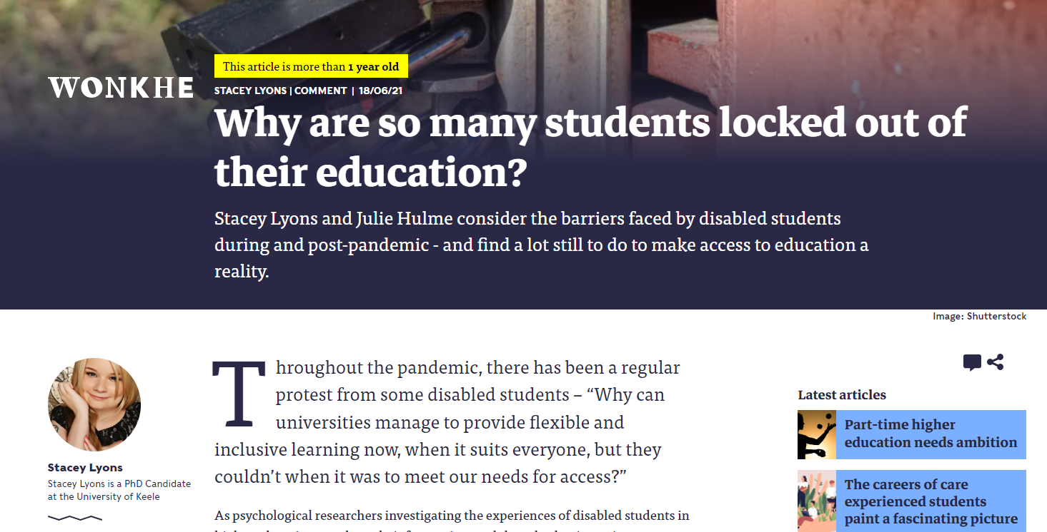
Psychology in schools and colleges isn’t the same as undergraduate psychology – but students are gaining the same skills and knowledge at an entry level.
“We must both (a) recognise the relevance of psychology to students’ personal lives, and (b) facilitate their self-awareness of the ways in which this personal meaning can impact on their ability to evaluate evidence and to make informed decisions.” Hulme & Cranney (2022)
This also means recognising the diversity in our classrooms and looking for ways for all of our students to “feel seen”…

Slide 22
Example – attachment theory
Do a Google search – “family” – what comes up?
What do students learn (hidden curriculum) when they study attachment theory?
Mother as primary caregiver, heteronormative families, binary gender, fully abled.

Slide 23
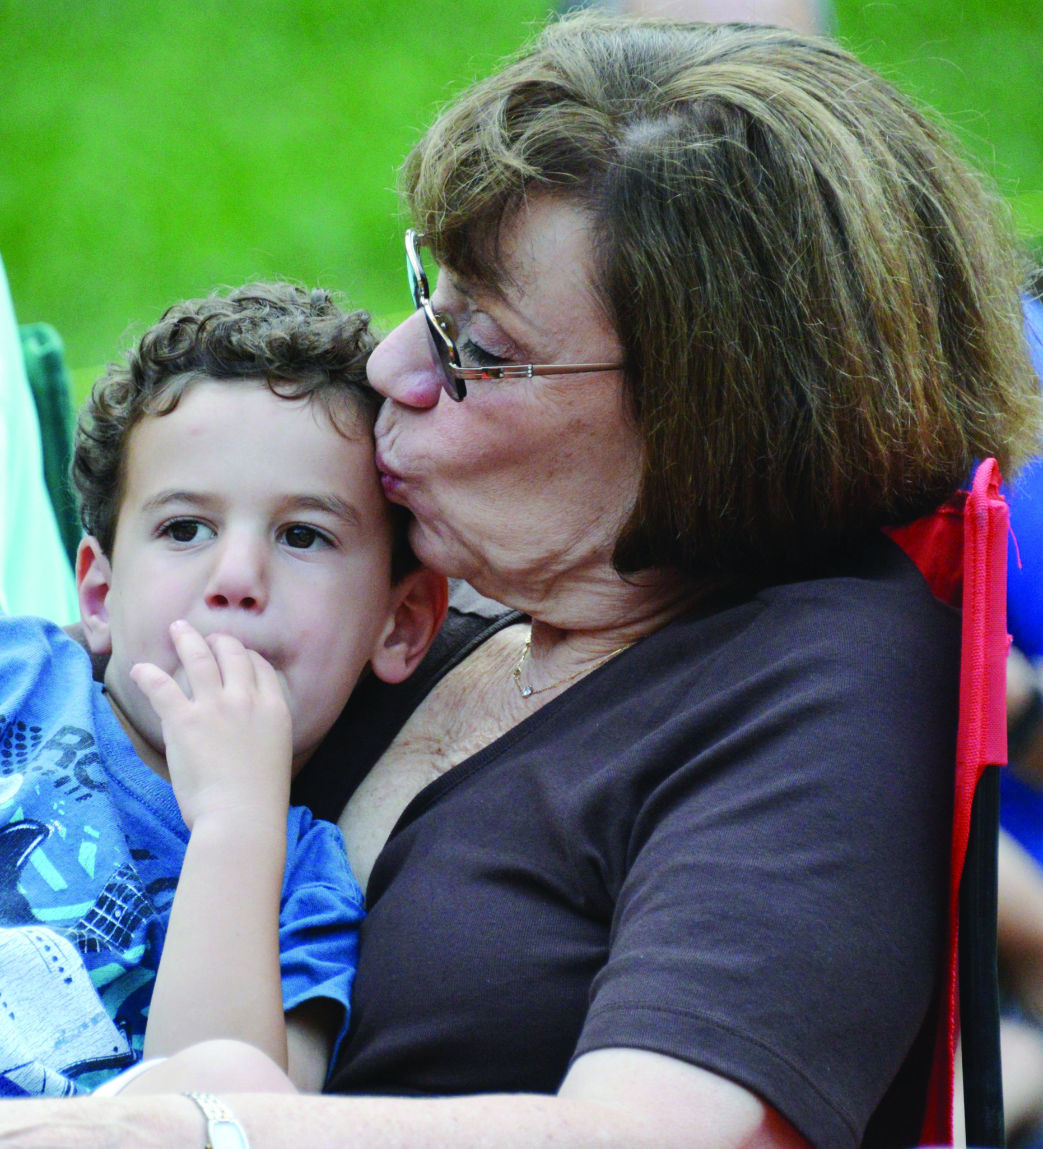
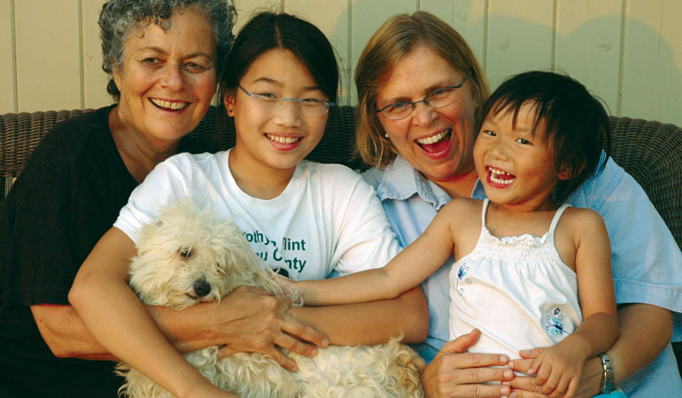
Now search for ‘non-traditional family’ on Google images – what do you see?
What message are we sending if you have to search for ‘non-traditional’ to find yourself?
Thinking back to who your students are – do they include care-experienced students, adopted students, parents, non-binary students?
Golombok (2015) Modern Families. Cambridge University Press.

Slide 24
The impact of global anxiety and the climate emergency in therapeutic relationships with specific reference to the fire- fighting community
Our Beneficiaries are usually the first to arrive on a scene to rescue people from catastrophic climate events such as flooding, wildfires and storm damage caused by high winds. Last summer the UK burned with many wildfires putting strain on already stretched resources and physical strain on firefighters wearing breathing apparatus for protracted periods of time. We are aware that neither the trauma of the events themselves nor the impact of the climatic events are being brought into the therapy room. This absence is surprising. Reviewing the psychological literature, consider:
Identifying why the climate emergency is absent from the therapy room with specific reference to the fire- fighting community.
Consider how the Charity can promote engagement with our community and seek their views on climate change and its impact.
Consider the influence of compassion fatigue on the fire-fighting community and identify how this impacts their engagement with the climate emergency and global anxiety.
Suggest how our service provision could develop to better support groups of Beneficiaries and individuals to manage their feelings around climate change and its impact on their operational roles.
Can students really do all this? (Can I?!!)
Yes!
Like all skills, it takes practice to be psychologically literate. But here’s an example of a Psychology Applied Work Scenario that our NTU psychology students solve for an employer, charity, or community organisation.

Slide 25
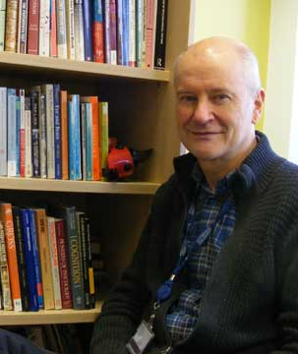
“I can imagine nothing that we could do that would be more relevant to human welfare, and nothing that could pose a greater challenge to the next generation of psychologists than to discover how best to give psychology away” (Miller, 1969).
“Today’s students must prepare themselves for a world in which knowledge is accumulating at a rapidly accelerating rate and in which old problems such as poverty, racism and pollution join new problems such as global terrorism, a health crisis…, and the growing gap between the poor and the very rich. All of these problems require psychological skills, knowledge and values for their solution (Halpern, 2010: 162).
“If psychology chooses to follow Miller’s vision and seek to give psychology away then we can enhance public understandings of the subject and challenge the misconceptions that take hold. Psychology may not have developed transformational theories or products but it still has the potential to be revolutionary and change our perceptions of who we are and who we can be. One way to further this is through promoting and supporting psychological literacy. Our impact then will not be measured by academic output and conference presentations but by our effect on public perceptions of what is humanly possible.” (Banyard & Hulme, 2015)
“Giving psychology away”

Slide 26
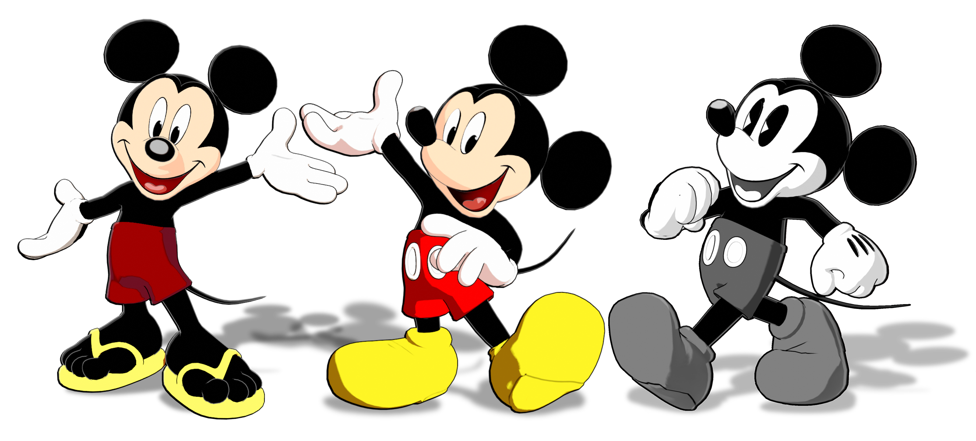
Introducing the Mouse himself…
1928 – present time
Revenue of more than $52 billion (hard to calculate)
But more importantly has put a smile on uncountable numbers of children’s and adults’ faces…including those who are very ill and/or traumatised…

Slide 27
So what do you think? Is psychology a Mickey Mouse subject?
Are you up for the challenge of making sure it is?
Over to you…
27

