Slide 1
Welcome!
Professors in Preparation
#ProfsInPrep #ANTF2023
Professor Julie Hulme
Nottingham Trent University
@JulieH_Psyc
Join #ProfsInPrep by emailing Julie for a link to our Facebook community
Julie.Hulme@ntu.ac.uk

Slide 2
Why #ProfsInPrep?
“There are relatively few teaching-focussed staff in more senior positions who can review, mentor and support teaching staff; act as role models for junior staff who are seeking to develop a teaching/education career (Fung and Gordon, 2016); help individuals to collate a mix of quantitative and qualitative evidence that provides a clear sense of their teaching achievements”
(McHanwell & Robson, 2018)
Notes:
Getting promoted on teaching/professional practice routes is challenging not only because criteria can be difficult to interpret, but also because relatively few people have pioneered the journey – so review, mentor, support is harder to find than it might be for those on more traditional research-focused career paths. We set up profs in prep initially as a way of providing peer mentoring, following discussions on both the NTF and PFHEA mail lists which suggested this was a common challenge for many in the communities. Many people were unsure how to evidence their achievements for professorial promotions, and felt that they needed support in demonstrating that they could meet promotion criteria. We set out to gather information about what sorts of evidence promotions panels are looking for, and ways in which others had been successful. In doing so, we created a community of around 150 (and growing) aspiring profs, some of whom have now achieved prof status (Debbie included!). In addition, we gained a lot of support from ANTF and have gathered a supportive community of L&T/professional practice profs, who are acting as mentors, giving talks (Pint Size Profs resources), and generally helping to develop our practice. Ultimately, we hope that profs in prep will grow the number of people in these senior roles, creating a much larger community to support those coming through on these pathways – a community built on academic kindness and peer support. Note the logo – both people are climbing the ladder together – we’re a network that is creating knowledge together, not hierarchical.

Slide 3
Aims of #ProfsInPrep
To provide a supportive network of colleagues – peers and profs
To facilitate reflection on our own development, progression and aspirations, and help us to reach our goals
To create a ‘pipeline’ community
Events – sharing experience, expertise and support for aspiring profs
Notes:
Hopefully largely self-explanatory – note that the pipeline implies people who are promoted continue the work to support those coming along the path!
Events – we are keen to grow our team of facilitators – currently Julie and Debbie, Harriet has recently started to work with us, there’s room for more, and we can support this. We also need sponsoring institutions! Events are free to attend, sponsoring institution provides travel expenses for facilitators, free room/AV, and catering.

Slide 4
Today’s aims
Working with diverse university criteria – what are they looking for?
Reflecting on your narrative
Evidencing your achievements
Overcoming ‘imposter syndrome’ and building confidence to apply for senior university appointments
How to use the professors in preparation (PiP) network to gain peer support and mentoring.

Slide 5
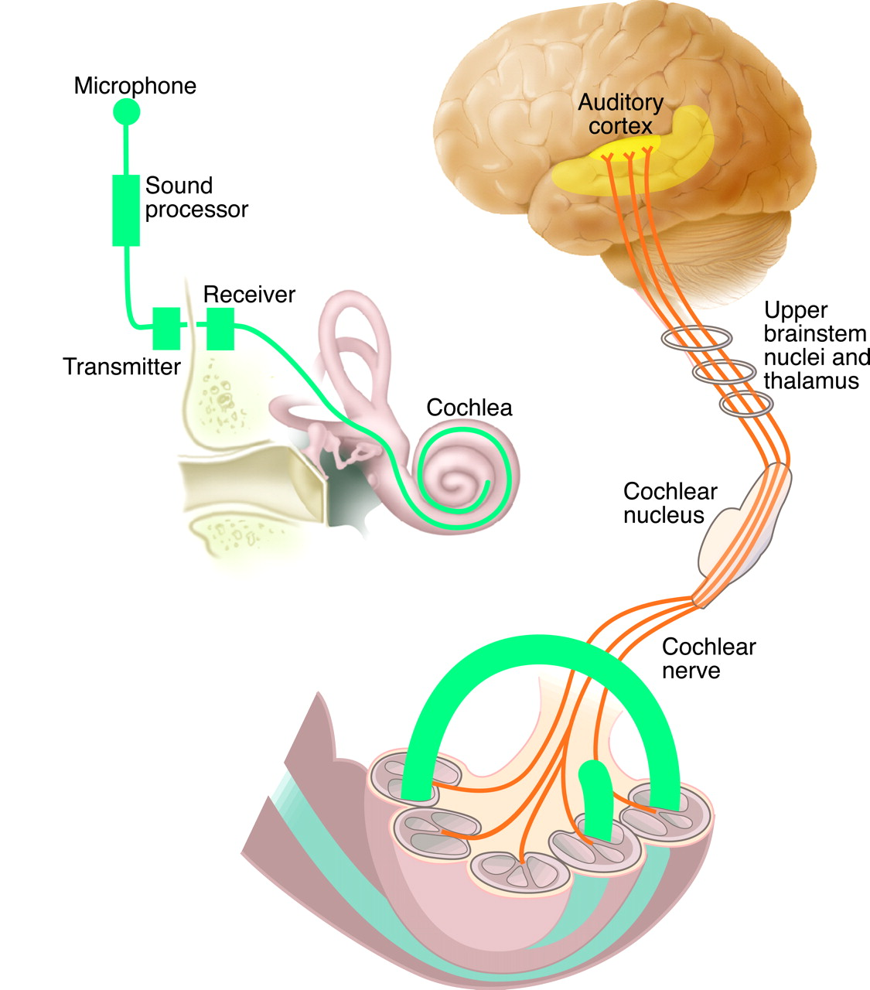
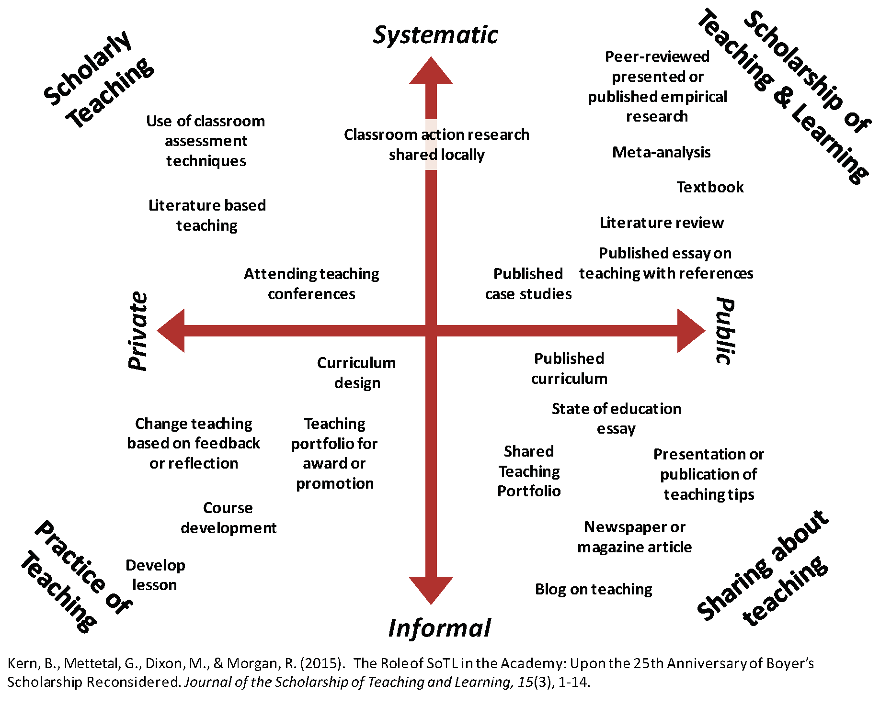
Pint-Size Prof Hulme: A scholar’s journey

Slide 6
“What will you profess in?”
Spend two minutes thinking about your professional journey so far, and how you can best present yourself as an aspiring professor (or other senior university role)
Share with the people on your table

Slide 7
Capturing evidence…
It can help to make a case if you generate a narrative…
A shop window display
“What will you profess in?” – or what is your USP?
Coherent theme, bringing together different strands of activity
Not everything you ever did!

Slide 8
Capturing evidence
Common themes across most universities, for senior roles, regardless of criterion area – think about:
REACH - institutional, national, international, discipline?
IMPACT – what difference did it make? (income, resources, student experience, influence others’ practices, influence practitioner education, pedagogic research, others?)
LEADERSHIP - mentoring, programmes, management, professional bodies?
VALUE – how do you know that the changes you bring are beneficial?

Slide 9
Evidence
Choose one significant achievement that fits with your narrative.
What does leadership look like?
Who did you reach?
What was the impact? – what difference did you make?
What was the value? – who benefitted and how?
Reflect – there’s no I in team…but what was your individual contribution?
Reflect – where are the gaps, and how can you fill them?

Slide 10
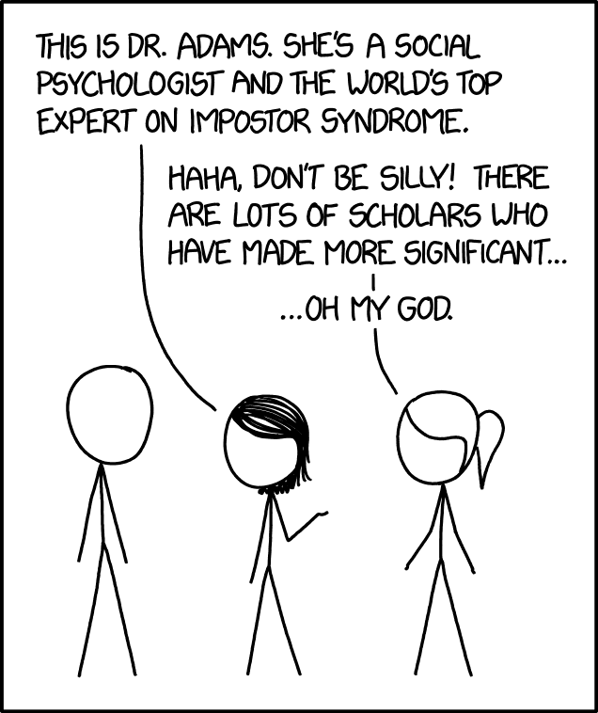
Imposterism
What can we do about it?

Slide 11
Networking
Why?
Helps you to disseminate your work, ensure you have reach and impact
Opens up opportunities – and allows you to pass on those that don’t fit with your personal strategy (to others’ benefit)
Broadens your knowledge of the sector – new perspectives, creativity, leadership
Seek feedback from future you(s)
Finding referees and assessors
Who is your tribe?

Slide 12
Plenary
Where do we need support?
Can we help each other?
Role of mentors – peer and professorial
Importance of networks – join us on Facebook (Julie.Hulme@ntu.ac.uk)
What will you do next?

