Slide 1
Disability across disciplines: Exploring lived experiences of disabled students through psychological and disability studies theoretical lenses
Professor Julie Hulme (she/her): Julie.Hulme@ntu.ac.uk; @JulieH_Psyc
Stacey Lyons (she/her): PhD candidate, Keele University
Note: most references on slides are hyperlinked for your convenience
Notes:
In the second seminar of Theory Aloud in the second half of 2022-2023, Prof Julie Hulme will present ‘Disability across disciplines: Exploring lived experiences of disabled students through psychological and disability studies theoretical lenses’.
The seminar series is supported by the S3 Methods Hub.
Disability across disciplines: Exploring lived experiences of disabled students through psychological and disability studies theoretical lenses
Disabled students are less likely to participate in higher education, less likely to complete their studies, and less likely to be awarded high class degrees. Working alongside disabled student researchers, Julie's work has explored disabled university students experiences of university, in order to explain why these disadvantages occur, and to inform policy and practice to improve university experience and success for disabled students. The research has drawn on theories of disability, focusing particularly on a critical social model of disability, alongside psychological theories (social identity theory, social representations theory, ecological systems theory), and some educationally-focused previous research, to understand and identify barriers to engagement, accessibility, and belonging, among disabled students, as well as reflections on steps that individual academics and institutions can take to promote inclusion. In this session, we will reflect on the utility of such interdisciplinary research, and the value of theory for understanding the lived experiences of marginalised students.

Slide 2
Outline
Why disabled students?
Models of disability
Bronfenbrenner’s ecological systems theory
Social representations theory
Social identity theory
What have we learned?

Slide 3
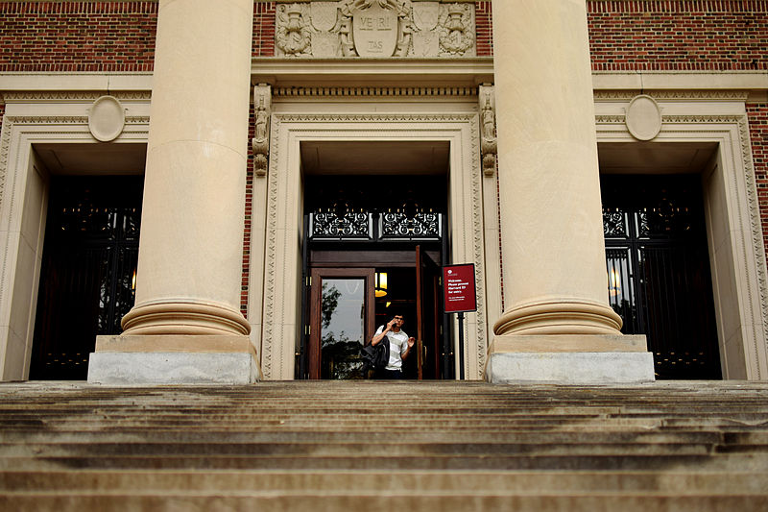
Why disabled students*?
Disability – a physical or mental impairment that has a ‘substantial’ or ‘long-term’ negative effect on their ‘normal’ daily functions (Equality Act, 2010)
Historically marginalised, excluded from universities, ‘objects of study’ (Hodkinson, 2016; Dolmage, 2017) – Disabled Students Allowance introduced in 1993.
Number of disabled students in HE increasing (around 14% DSA) BUT still under-represented, take longer to complete, more likely to drop out, and awarding gap (HESA, 2021).
What are the reasons for disadvantage? How to improve?
* Note use of identity-first rather than person-first language, throughout this talk
Widener Library, Harvard University

Slide 4
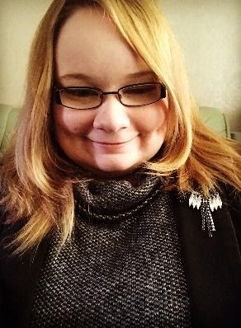
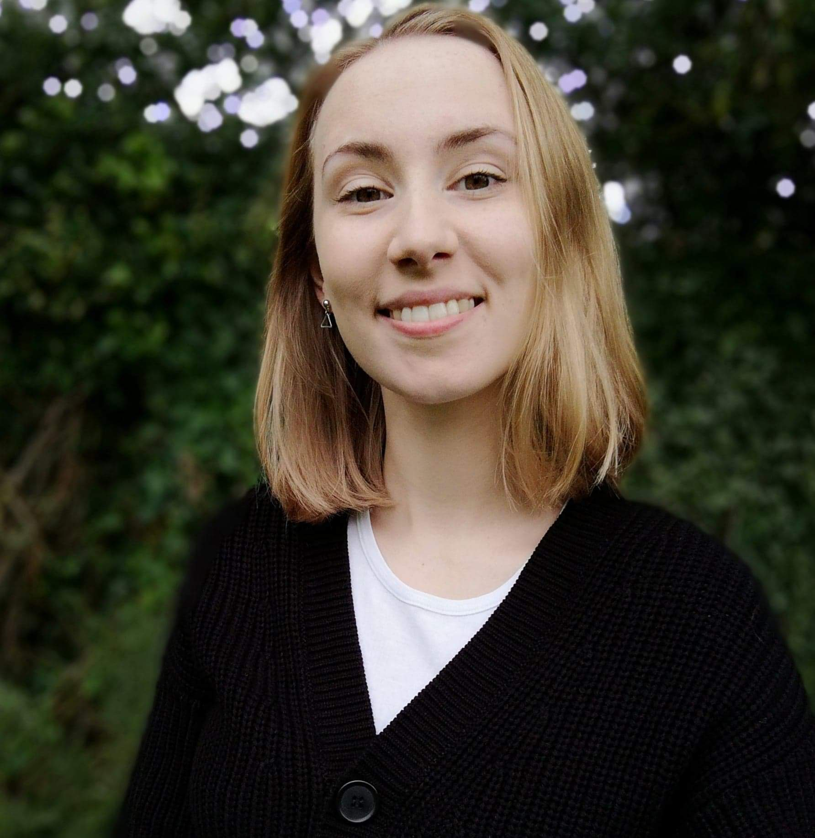
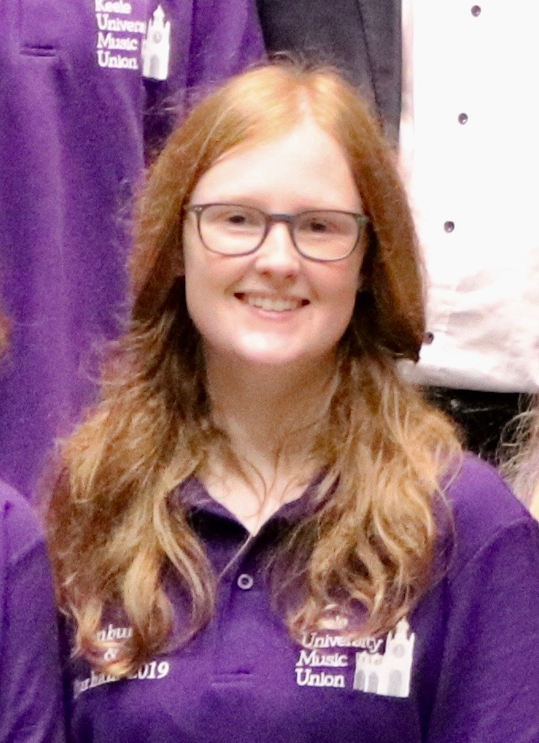
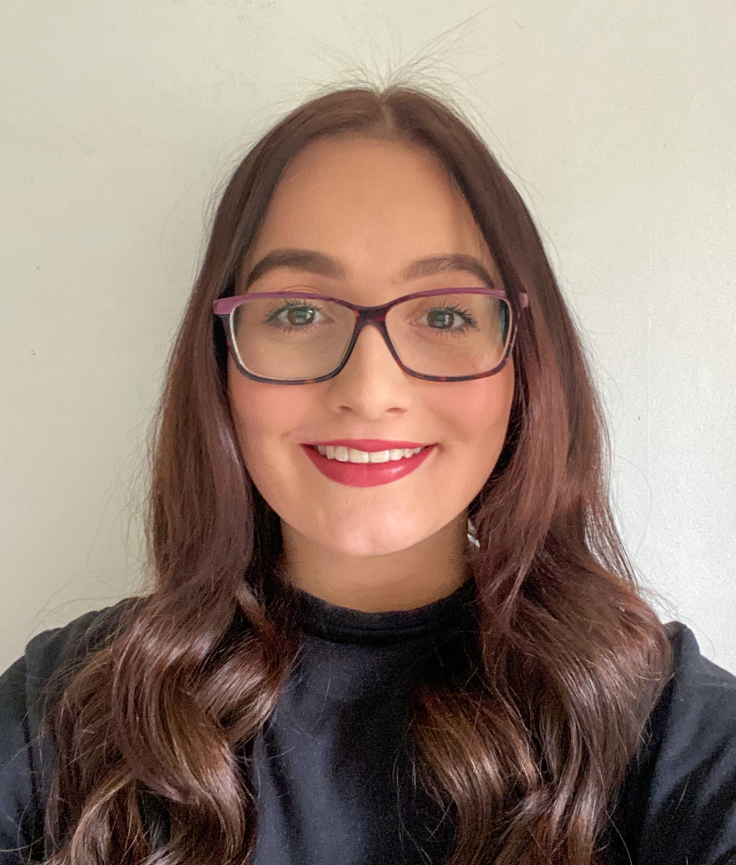
Why disabled students?
‘Disabled students’ – a diverse group
What are disabled students’ experiences? NOT ‘objects of study’!
Students as researchers – a learning community, with lived experience of disability, long-term illness, and/or neurodivergence
Stacey Lyons
Pippa Hamilton
Emma Crabb
Cleo Keeling Ball

Slide 5
Models of disability
Medical model – individual impairment (Retief & Letšosa, 2018)
Social model – society fails to be accessible (Oliver, 1983, 1990; Brown & Leigh, 2020)
Affirmative model – stereotypical societal views are disabling, disabled individuals are autonomous & have rights (Swain & French, 2020)
Critical social model – recognises social barriers and effects of disability/illness (Kruse & Oswal, 2018)
What do students themselves think?

Slide 6
“This makes lectures…where there isn't a place to put my computer very difficult as I'm usually hunched over or in an unsupportive seat. Lab stools are probably the worst as there is no back rest and I frequently can't do anything else for the rest of the day after a lab due to being in so much pain”
“The pain I’m in constantly makes it hard to focus on uni work, I also have cognitive dysfunction which affects being able to read and study.”
“CFS involves a lot of planning by considering the "payback cost" where I have to make a decision between carrying out one task and being unable to carry out another.”
“I miss a large amount of class - last term I missed all of the seminars and lectures for one of my modules bar the first week, and I was able to utilise lecture capture to have the content from the lecture available”
Data extracts from Hamilton, Hulme, & Harrison (2021) study

Slide 7
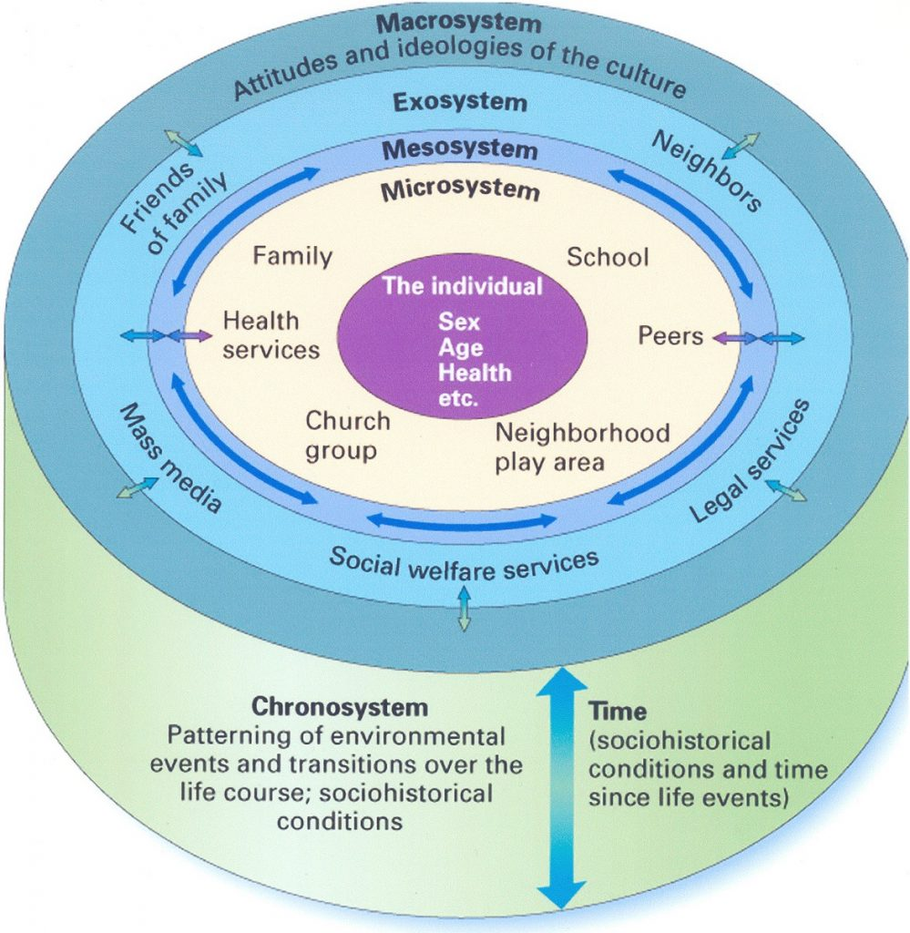
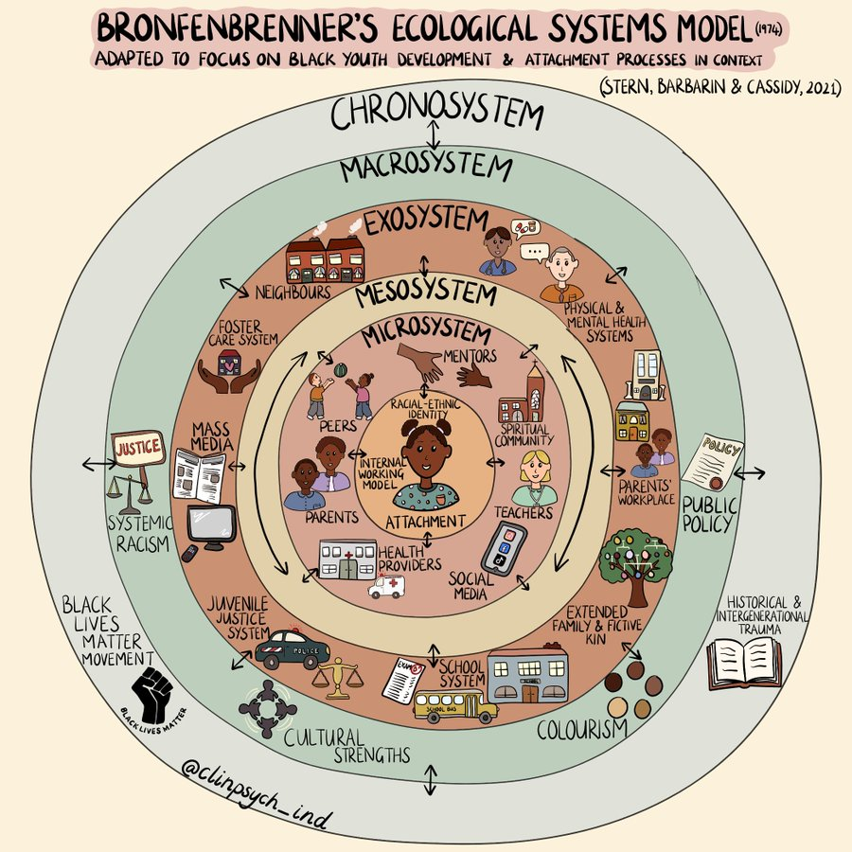
Bronfenbrenner’s Bioecological Model, 1995 (based on his Ecological Systems Theory, 1974)

Slide 8
RAP = Reasonable Adjustments Plan
“Nightmare. Was given audio note taking software for my phone to record lectures, so that it synced with the lecture slides. Lecturers reduced numbers of slides so it meant my slides had audio that didn’t match up, so had no notes that were meaningful. One lecturer ignored my RAP for the whole of the first semester and I got ill because of it. I went to see her manager who was just as helpful as the lecturer was. As part of my RAP, adjustments made were that they should make sure I understood the assignment set, when I asked for this, I was told by lecturer that she couldn’t tell me. On going to see her manager about this lecturer not explaining things that I needed explaining in accordance with my RAP, he said, “well it’s level 4 education and as you go up a level, it means you have to do it yourself more.” Completely missing the point that it was about a disability related problem why I needed things explaining. The lack of support by lecturers was astounding and as a result, I would not recommend anyone with a chronic illness to go to my university because they are likely to relapse.”
Data extracts from Hamilton, Hulme, & Harrison (2021) study

Slide 9
“It took me 10 years of suffering just to get a diagnosis, and it’s often something people don’t think is real or I’m just exaggerating because “everyone gets exhausted” - especially when studying. I think some lecturers are probably going to be easier to tell than others, as I am doing a healthcare course and have heard a couple of them mention dealing with patients with chronic illness before. It’s an illness that most people do not understand very well, and it’s hard to explain just how debilitating it is.”
Social representations theory (Moscovici, 2001)
“Reality” is a social construction and different groups have different understandings of the same reality
What does ‘disability’ mean to you?
Data extracts from Hamilton, Hulme, & Harrison (2021) study
“Some tutors didn’t understand and I think thought I was lazy or lying. Others were very supportive but still firm and I often felt doubted. I don’t think anyone truly believed I would finish either my BA or MA. Having a supportive university doctors surgery helped because they wrote very supportive letters for when I had to speak to tutors about my health. I often felt silly or like I was bothering people talking about it and there doesn’t seem like there is a direct platform to have these type of discussions so it often ekes out a bit at a time and I don’t think it’s easy with an invisible illness for tutors to understand the full picture.”

Slide 10
Social identity theory (Tajfel & Turner, 1979; Hogg, 2016; Haslam et al, 2021)
We understand ourselves through our social interactions with others – ‘in-groups’ and ‘out-groups’.
As members of multiple groups, there can be conflicts between group identities.
What are the characteristics of ‘students’?
What are the characteristics of ‘disabled people’?
How connected can someone feel to both groups, and what are the implications?

Slide 11
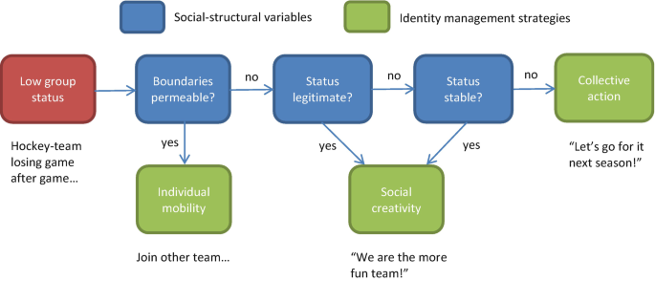
Identity management
Scheepers & Ellemers (2019) – is the social hierarchy permeable, legitimate, and stable?

Slide 12
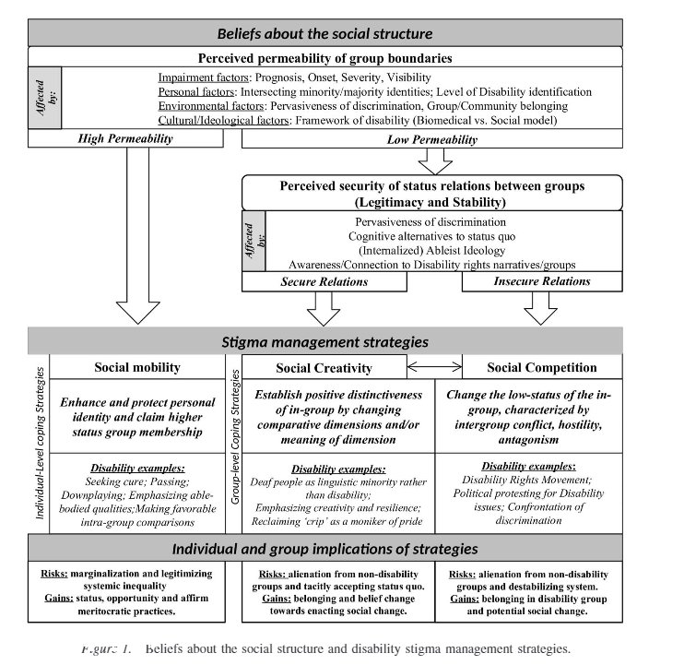
Identity management – disability (Dirth & Branscombe, 2018)

Slide 13
“I have been open about it, but I always worry about the stigma and can tell when someone is a non-believer of ME. I've managed to educate some about it, and they've seen me suffer with it so I hope that'll help their knowledge.”
“I only told them through necessity due to it affecting my studies, otherwise I would not disclose it due to stigma over the illness”
“I feel hesitant about sharing my illness with people, because I do not want to be viewed as a disabled person. I also do not want to face the judgment of being a person with a chronic illness while also trying to be a nurse. I fear that people will think I am physically unsafe to be caring for other people. I think that people become uncomfortable when I tell them.”
Data extracts from Hamilton, Hulme, & Harrison (2021) study
“I'd worry they'd view me different, or they'd think I was lying. I don't want to be treated any different.”

Slide 14
Over to Stacey!

Slide 15
What have we learned?
Disability is complex, as is our sense of identity. Theoretically, multiple perspectives can help to understand students’ experiences of disability – interdisciplinary approaches are needed to synthesise theory across fields of study.
Discrimination and stigma in higher education are still very real and systemic, and impact on students’ ability to disclose, access support, and so on opportunities for success in higher education.
A need to listen to students, to recognise individual needs and strengths, to trust them as the experts in their own experience.
What do you want to bring to this discussion?

Slide 16
Additional (hyperlinked) resources
Lyons & Hulme (2021). Why are so many students locked out of their education? WonkHE.
Hamilton, Hulme, & Harrison (2021). Experiences of higher education for students with chronic illnesses. Disability & Society.
Hulme (2021). Inclusive learning: Engaging student voices. GlobalMindED expert talk, 28th May 2021 – YouTube video, from 27 minutes.
Hulme (2021). Social identity and disability in the classroom. Changing States of Mind podcast.

