Slide 1
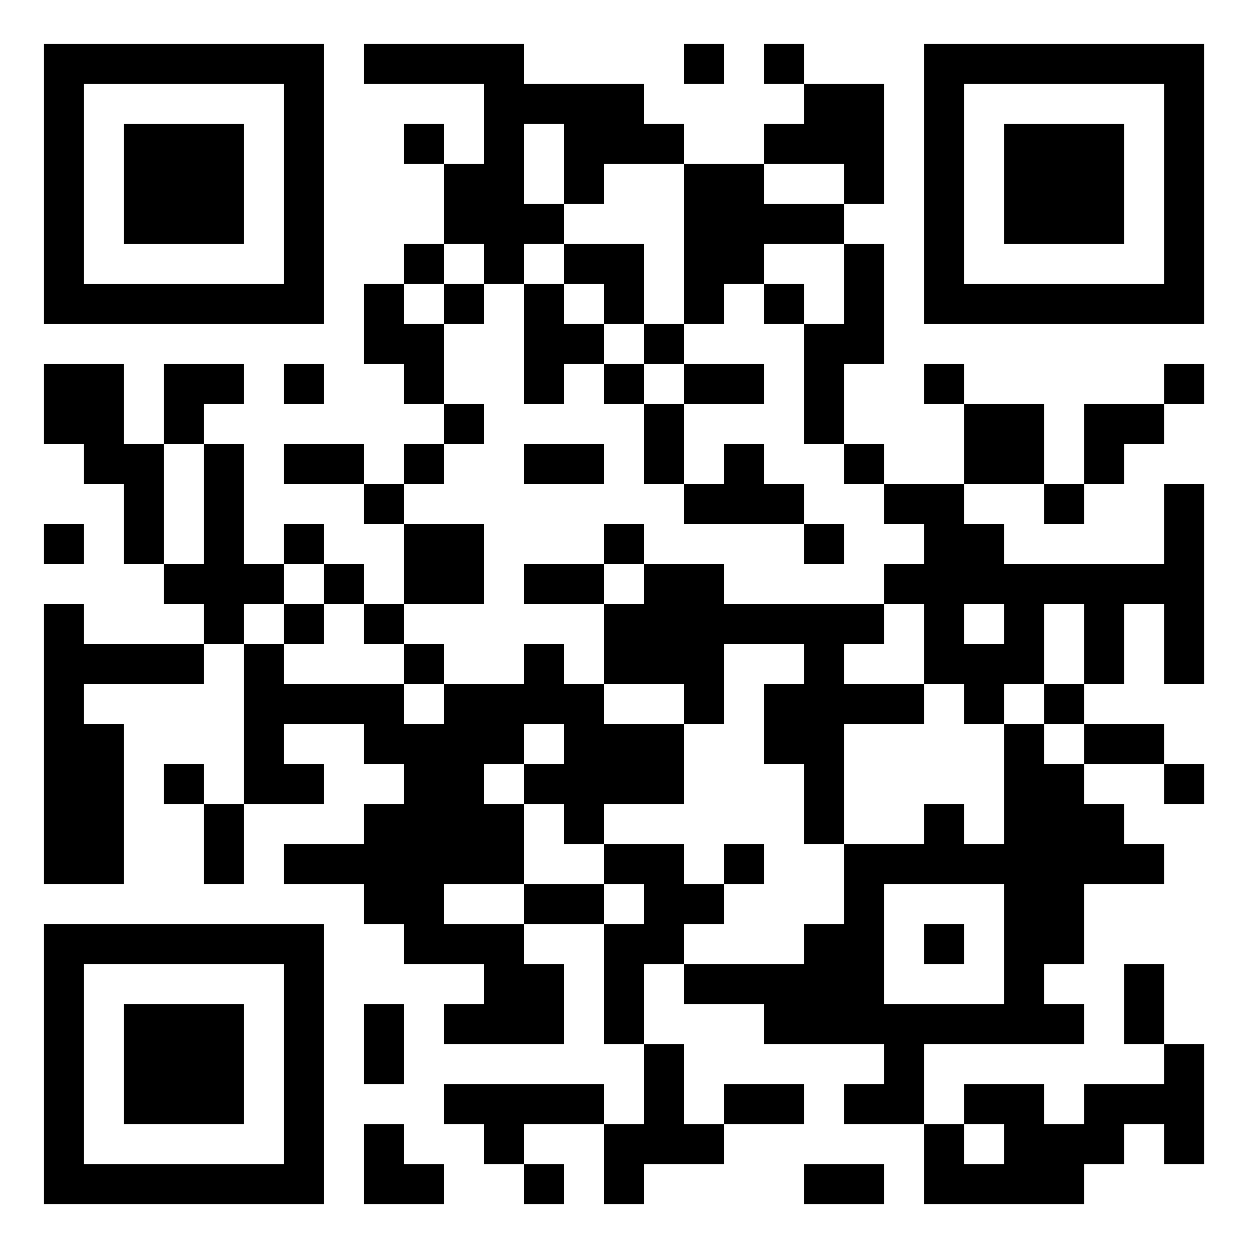
Psychology for a changing world: opportunities from psychological literacy
Professor Julie Hulme
Julie.Hulme@ntu.ac.uk
@JulieH_Psyc
https://bit.ly/3iCvnD5
Notes:
Title: Psychology for a changing world: Opportunities from psychological literacy
Abstract:
Studying psychology has the potential to transform student lives, equipping them to apply their psychological skills and knowledge to meet their personal, professional, and societal goals. Recent changes to higher education, and the forthcoming new QAA subject benchmark statements, highlight the importance of developing students’ confidence in independent learning and problem solving, through raising their awareness of the skills that they acquire through a psychology degree, helping them to apply these skills, and enabling them to articulate them to others. In this talk, Julie will explore the implications of these changes for our teaching and assessment practices, and will draw on educational and psychological theories and evidence, as well as practical examples from her own teaching and scholarship, to reflect on ways in which we can practically enable students and graduates to become confident independent learners, future-proof and highly employable, and able to make a difference to their communities as global citizens.

Slide 2
Outline
What is changing?
What is higher education for?
Introduction to psychological literacy
Teaching for psychological literacy
Reflections, questions, discussion

Slide 3
A changing world - what is changing?
Technology including AI
Student expectations and preparation for HE
Increased student diversity
Employment landscape and nature of jobs
Student numbers and graduate numbers
Global issues – climate change, health inequalities, cost of living crisis, etc
The QAA subject benchmark statement for Psychology!
…?

Slide 4
What is HE for?
Formal education systems tend to emphasize the acquisition of knowledge to the detriment of other types of learning, but it is vital now to conceive education in a more encompassing fashion.”
(Learning: The Treasure Within, UNESCO, 1996)
The aim of education is not only to prepare students for productive careers, but also to enable them to live lives of dignity and purpose; not only to generate new knowledge, but to help shape a citizenry that can promote the public good. Thus, higher education’s vision must be widened if the nation is to be rescued from the problems that threaten to diminish permanently the quality of life.”
(Boyer, 1990).

Slide 5
Does psychology education achieve these purposes?
What do you think studying a psychology degree does to help students to:
Live lives of dignity and purpose?
Generate knowledge?
Serve humanity?
Does your psychology programme promote these aims?

Slide 6
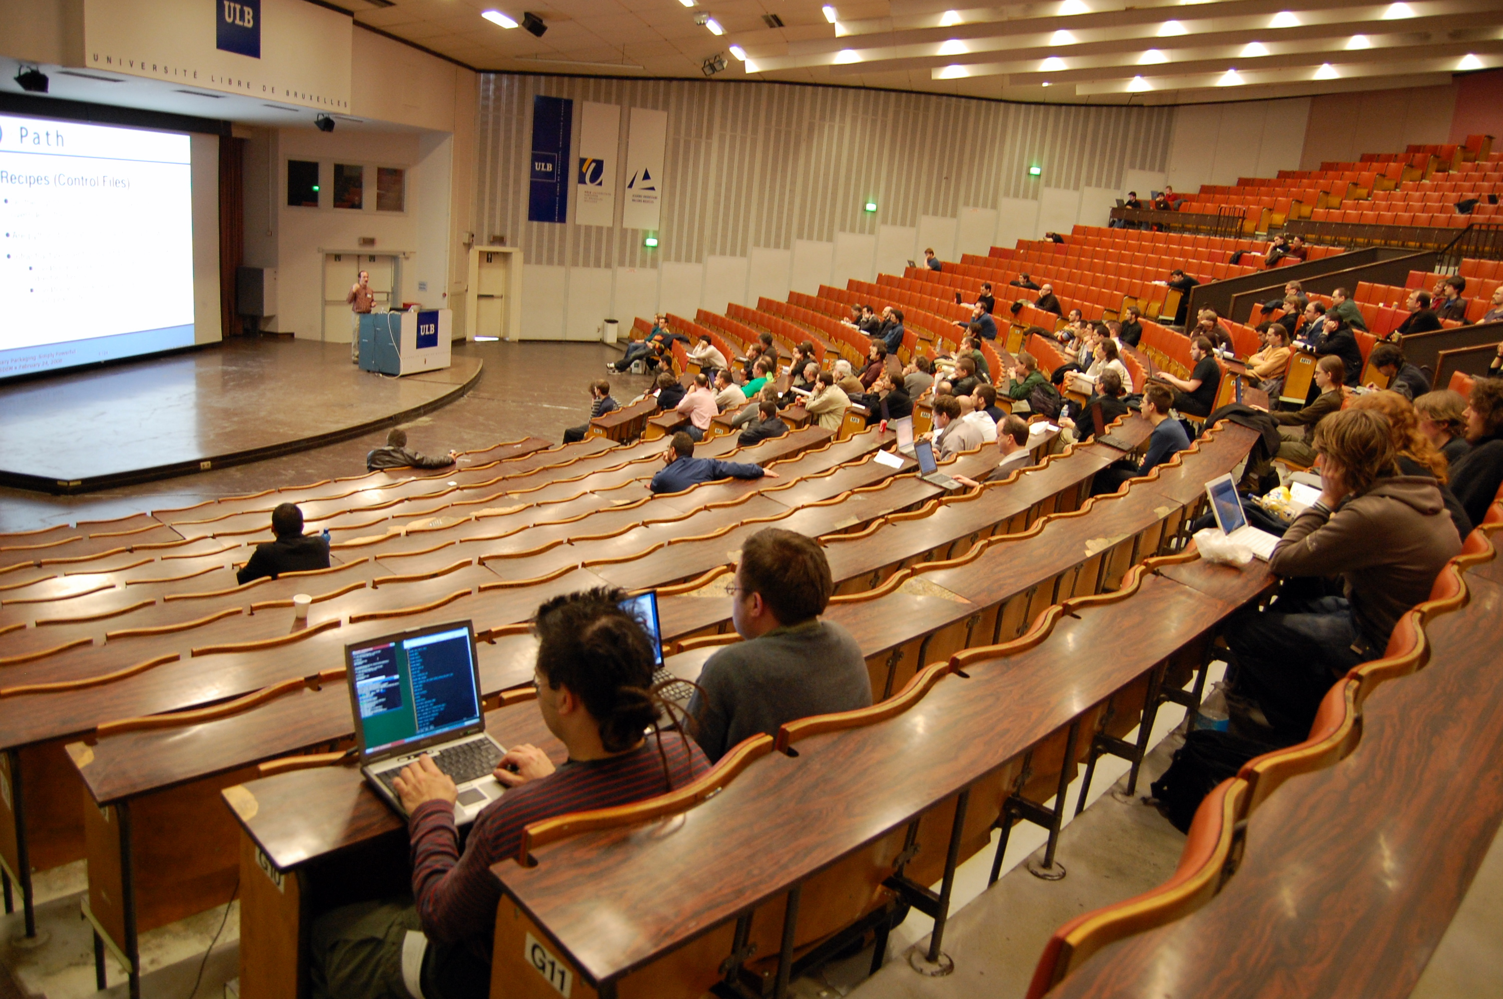
How does HE teaching evolve?
Fraser (2016): “It’s always been taught like this”.
“Certainly their strength is in their knowledge of the content. They don’t feel competent or strong or well versed in the pedagogy at all. They tend to operate in the way they were taught” (Fraser, 2016).
The status quo bias: ‘If it ain’t broke, don’t fix it’ – our cognitive preference for keeping things the same.

Slide 7
It’s broke!
Student engagement and attendance
Employer concerns about student career readiness (given that only around 10-15% of our students go on to psychology careers)
Awarding gaps
We need to fix it!

Slide 8
Psychological literacy
“The general capacity to adaptively and intentionally apply psychology to meet personal, professional and societal needs”
(Cranney et al, 2012).

Slide 9
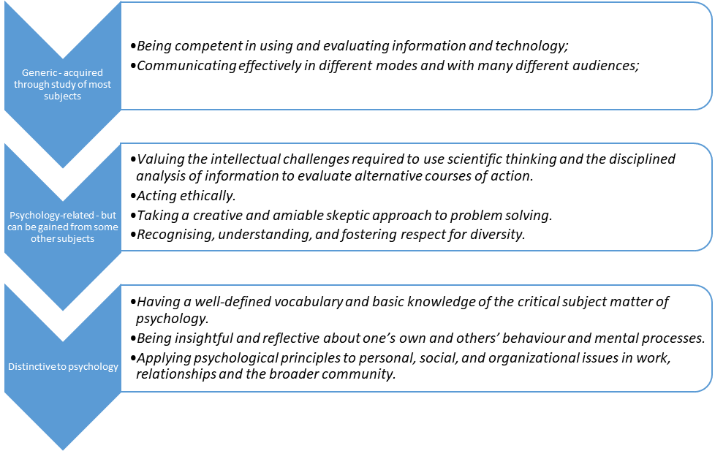
Hulme (in prep, based on McGovern et al., 2011)

Slide 10
New draft QAA subject benchmark for Psychology
Subject to change…has been through consultation
Psychological literacy features strongly
New emphases:
Sustainability
Diversity and inclusion
Employability and entrepreneurship
Accessibility
Draft also includes slightly different content – lifespan development and community psychology are core

Slide 11
Draft subject benchmark – purpose of studying psychology
Psychology is a broad-based discipline that encompasses a range of empirical approaches and methods of enquiry that aim to understand the mind, brain, experience, behaviour and contexts of humans and animals. The antecedents of psychology can be found in physics, biology and philosophy, but its methods of enquiry have developed not only from these disciplines but also from the humanities and other natural, social and mathematical sciences. These origins, often referred to as ‘global north’, have narrowed the lens of the discipline and restricted wider focus on the diversity of the human experience. This has had the effect of amplifying the experiences of some, while marginalising, misunderstanding and mischaracterising others. The purpose of psychology is to be an inclusive, empirically based and reflective discipline that fosters the development of local and global psychological literacy to address human, social, economic and environmental challenges, as well as building a knowledge and understanding of the fundamental premises of psychology. This Subject Benchmark Statement outlines a roadmap for psychology that is underpinned by a commitment to inclusion, ethical practice and integrity in addressing the questions and challenges facing society.

Slide 12
Implications
“Promoting psychological literacy entails reorienting what and how we teach students in a way that emphasizes Psychology’s relevance”.
Dunn et al. (2011)
“We must both (a) recognise the relevance of psychology to students’ personal lives, and (b) facilitate their self-awareness of the ways in which this personal meaning can impact on their ability to evaluate evidence and to make informed decisions.”
Hulme & Cranney (2022)
Hulme, J.A. & Cranney, J. (2022). Psychological literacy and learning for life. In: J. Zumbach, D. Bernstein, S. Narciss & G. Marsico (Eds). International handbook of psychology learning and teaching. Cham: Springer. DOI: 10.1007/978-3-030-26248-8_42-1.

Slide 13
Implications
We need to:
Teach applications alongside theoretical psychology
Constructively align our teaching
Model psychological literacy
Hulme (2014). Psychological literacy – from classroom to real world. The Psychologist, 27 (12): 932-935.

Slide 14
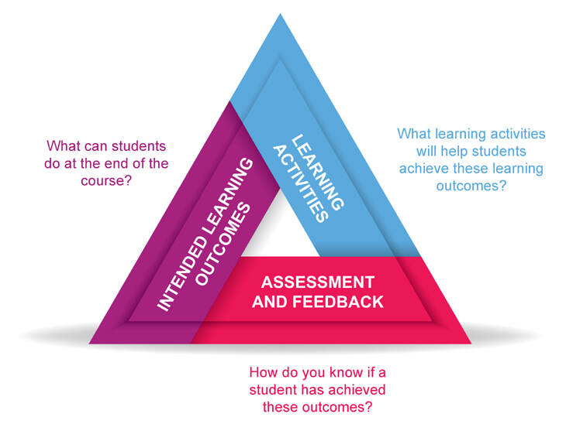
Constructive alignment
Biggs, 1996

Slide 15
Learning outcomes – Making a Difference
Communicate information and arguments effectively to both academic and non-academic audiences;
Apply psychological theories and findings to “real world” situations
3. Evaluate existing theories in psychology
4. Identify and select appropriate and relevant information from the research literature;
5. Design a “real world” intervention grounded in psychological theories and findings.
Hulme, J.A., Stanyard, R., Kent, A. & Skipper, Y. (2019). Making a difference with psychology. In: P. Kahn and L. Anderson (Eds). Developing your teaching towards excellence. Second Edition. Oxon: Routledge. pp 39-40.
Hulme, J.A. & Cranney, J. (2022). , Psychological literacy and learning for life. In: J. Zumbach, D. Bernstein, S. Narciss & G. Marsico (Eds). International handbook of psychology learning and teaching. Cham: Springer. DOI: 10.1007/978-3-030-26248-8_42-1.

Slide 16
Learning activities
Learning and teaching activities give students an opportunity to practice the skills we’ve identified – learning outcomes and literacies.
Our educational practices need to model how a ‘psychologically literate’ person operates:
“Let’s find out together”
“Thinking like a psychologist”
Intellectual streaking (Bearman & Molloy, 2017)

Slide 17
Practice and modelling
Often highly interactive, peer learning and scaffolding
Start where the students are – meaningful, relevant (Jones, 2009)
Start with the ‘problem’ and then apply theory to work towards a solution – what happens in the world?
Engaging students in interactive sessions helps us to hear diverse student voices – inclusion and decolonisation – and to recognise them in our teaching (Hulme, 2021).
Making a difference:
Some traditional lecturing – but usually incorporating interactive elements
Small group work (even within large classes)
Problem-based learning

Slide 18
Assessment
“Authentic assessment means that: (a) tasks must appropriately reflect the competency that needs to be assessed, (b) the content of an assessment involves authentic tasks that represent real-life problems of the knowledge domain assessed, and (c) the thinking that experts use to solve the problem in real life are also required by the assessment task”
Gulikers et al. (2004).
See Sambell & Brown (2021-) for case studies

Slide 19
Assessment – Making a Difference
Students are self-employed psychology consultants, responding to an invitation to tender from an organisation or business (choice of three). They are seeking to solve a problem.
They write a Project Proposal Outline for the company, in language suitable for a lay audience (eg Chief Exec).
They write a Research-Informed Rationale suitable for a psychologist employed by the organisation.
3000 words.
Organisations that have informed assessments include Shelter, Appetite Stoke, Police, Army, Higher Education Academy, Keele University’s student marketing team, various other universities, retail village. Can be anonymised, or can bring in speakers.

Slide 20
Constructively aligned? (Making a Difference)
Learning outcome | Learning and teaching activities | Assessment component
Communicate information and arguments effectively to both academic and non-academic audiences | Group work Formative presentations | Project proposal outline (lay) and research-informed rationale (psychologist)
Apply psychological theories and findings to “real world” situations | Group work Problem-based learning | Community/employer-derived problem scenarios Project proposal and research-informed rationale
Evaluate existing theories in psychology | Lectures and interactions Problem-based learning | Research-informed rationale
Identify and select appropriate and relevant information from the research literature | Lectures and interactions Problem-based learning | Research-informed rationale
Design a real world intervention grounded in psychological theories and findings. | Problem-based learning | Project proposal and research-informed rationale

Slide 21
Psychologically literate citizenship
Having studied a psychology degree at Durham, are your graduates ready to make the world a better place?
“Today’s students must prepare themselves for a world in which knowledge is accumulating at a rapidly accelerating rate and in which old problems such as poverty, racism, and pollution join new problems such as global terrorism, a health crisis…, and the growing gap between the poor and the very rich. All of these problems require psychological skills, knowledge and values for their solution.”
(Halpern, 2010)

Slide 22
Challenges and critique
Do students need skills or content? Can we do both?
Does it scale up?
Getting student buy in?
Do we make students believe they are fully skilled before they are truly ready to take on these challenges? (Banyard & Hulme, 2015).
Aspirational? (Newstead, 2015; Murdoch, 2016)
Culturally loaded and values-laden? (Hulme & Cranney, 2022).

Slide 23
What do YOU think? What’s next for you and for Durham Psychology?
Opportunity for questions, discussion, reflections and provocation!
Note that slides will be available to anyone who wants them (hyperlinked references).
A final reference: Cranney, J., Dunn, D.S., Hulme, J.A., Nolan, S.A., Morris, S. & Norris, K. (2022). Psychological literacy and undergraduate psychology education: An international provocation. Frontiers in Education, 7, 790600. DOI: 10.3389/feduc.2022.790600.

