Slide 1
Developing scholarship: practical steps to making a difference
Professor Julie Hulme
Julie.Hulme@ntu.ac.uk
@JulieH_Psyc

Slide 2
Outline
Introductions and context
What is good scholarship?
Practical steps to developing your scholarship – capacity, reach, impact
Reflections and discussion
This afternoon – action planning!

Slide 3
Who am I?
PhD in Auditory Neuroscience
Early career - teaching fellow in Psychology, FE, Open University
Why do some students find university easier than others?
L/SL in Psychology – the ‘BOGOF’ deal
Higher Education Academy and other reputational stories
Now – combining reflections, interventions, educational research, knowledge exchange to ‘make a difference’ to students and colleagues

Slide 4
Scholarship – an expert focus on teaching and learning
Trigwell (2013) – scholarship and SoTL have many definitions and many purposes. Generally:
Improving and enhancing teaching, learning, assessment, and more
Evaluating and determining ‘quality’
Evidence-based

Slide 5
Target of scholarship?
Example – critical evaluation resource
What are the ‘big questions’ for you at the moment?
What are the problems?
What do you want to improve or build upon?

Slide 6
Moving beyond learning and teaching – going meta
Hutchings and Shulman (1999): “A scholarship of teaching is not synonymous with excellent teaching. It requires a kind of ‘going meta’, in which faculty frame and systematically investigate questions related to student learning—the conditions under which it occurs, what it looks like, how to deepen it, and so forth—and do so with an eye not only to improving their own classroom but to advancing practice beyond it.”
Shulman (1999): “An act of intelligence or artistic creation becomes scholarship when it possesses at least three attributes: it becomes public, it becomes an object of critical review and evaluation by members of one’s community, and members of one’s community begin to use, build upon, and develop those acts of mind and creation”

Slide 7
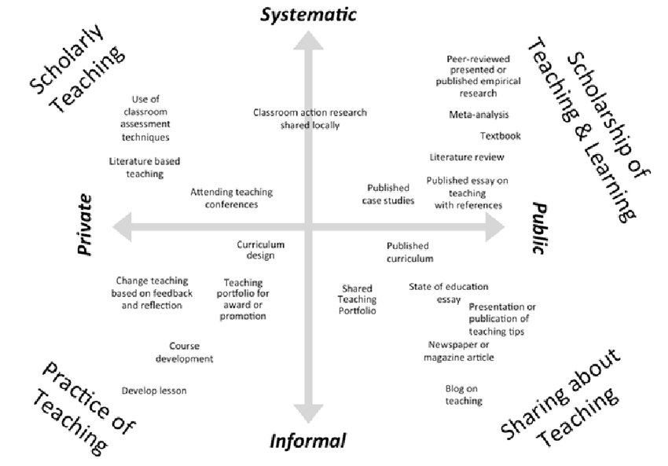
Kern et al (2015) Dimensions of activity relating to teaching (DART)

Slide 8
Examples
Shift to online learning (covid pandemic) and reaching potential project
HigherPsychEd blog
Psychological literacy – international provocation to enhance psychology education – personal, professional and societal/community goals
Disabled students research and WonkHE article
Innovative teaching project

Slide 9
What scholarship are you doing now?
Systematic or informal?
Public or private?
How public? – micro, meso, macro (my students, my institution, the world!)
Hulme (2022) – scholarship activities and educational activities to “positively disrupt” and transform higher education

Slide 10
Planning impactful scholarship
Topical issue - who shares the problem?
How do you find the ‘BOGOF’ deal?
Resources – funding? time? students as researchers? collaborative networks?
Stakeholders – internal and external
Plan evaluation from the start – who has the skills?
Disseminate how? where?
How to assess reach, impact, value?

Slide 11
SWOT – personal reflection
STRENGTHS | WEAKNESSES
OPPORTUNITIES | THREATS

Slide 12
SWOT – personal reflection (me)
STRENGTHS Psychology research methods for evaluation High profile, network, strong reputation enables reach and credibility Large student numbers (co-researchers and participants) | WEAKNESSES Tendency to over-commit – don’t always have time for planning and can have too many projects underway at one time Quantitative/statistical skills for mixed methods evaluation
OPPORTUNITIES Completion of incomplete projects – relatively quick, high quality outputs New role and responsibilities – new collaborators, possible new areas | THREATS New role and responsibilities distract from scholarship PhD studentships nearing completion reduces capacity Lack of focus through variety of projects – potential to lose ‘distinctiveness’ in specific areas
What advice can you give me?
Your colleagues?

Slide 13
Reflections and discussion
What are your own development (or other) needs?
How can working with others help to increase strengths and opportunities? How can working with others help to alleviate weaknesses and threats?
What actions can you take to increase your success in doing impactful scholarship?
What next?

