Slide 1
If it ain’t broke…: Reasons, risks, and resilience in innovative teaching
Professor Julie Hulme (she/her)
julie.hulme@ntu.ac.uk; @JulieH_Psyc
Notes:
Higher education can transform students’ lives and future lives, and bring (often intangible) benefits to wider society. However, it can be argued that higher education teaching has changed relatively little for centuries. In this talk, Julie will explore why innovation matters, including ideas around student inclusion, engagement, and future-proofing graduates for uncertain times. She will discuss her research findings around why academics innovate (or not), the perceived risks of innovation, and ways in which you can manage the risks to bring an innovative sparkle to your own teaching. Drawing on psychology and the theory of pedagogic frailty and resilience, this talk aims to inspire you to reflect on your tried and tested teaching methods, and to try something new!

Slide 2
Outline
What do we mean by innovation?
Why is innovation important?
Pedagogic frailty and pedagogic resilience – theoretical context
Preliminary findings from research
Discussion and questions

Slide 3
What do we mean by innovation?
Jot down your thoughts in the chat – what does innovation mean to YOU?
Do you think of yourself as an innovative teacher?
Is innovation important to you? Why or why not?

Slide 4
What do we mean by innovation?
“…a process in which new ideas are generated, created, developed, applied, promoted, realised, and modified by teachers to benefit students” (Thurling, 2015, adapted)
“...a planned or deliberate process of introducing change directed towards (but not necessarily achieving) improvements or solving some perceived problem” (Hannan & Silver, 2000, HE specific)
Notes:
Pop your responses to these questions in the chat if you like – what do you like or dislike about these definitions?

Slide 5
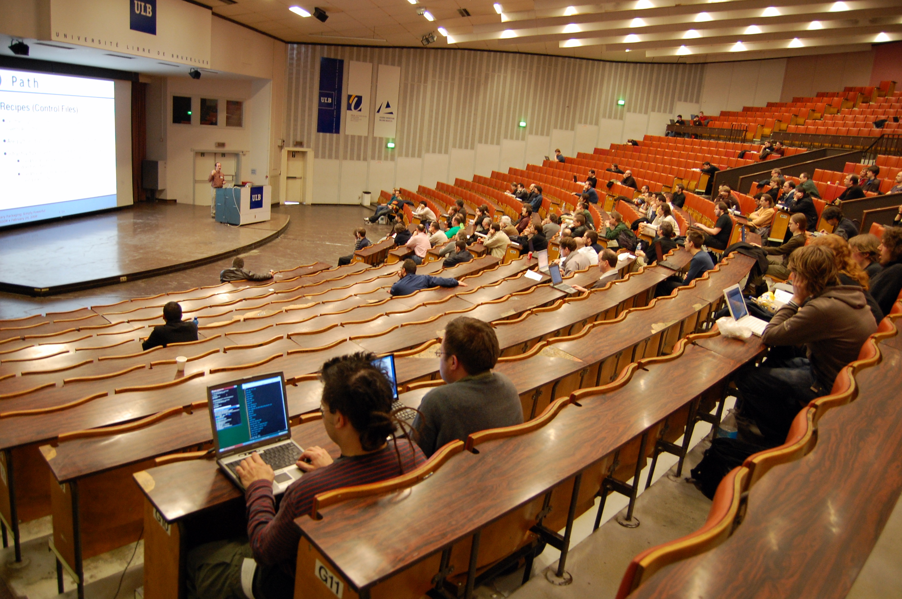
How does HE teaching evolve?
Fraser (2016, p151): “It’s always been taught like this”.
The status quo bias: ‘If it ain’t broke, don’t fix it’ – our cognitive preference for keeping things the same.
Notes:
It doesn’t evolve!
And it’s broke.
Student engagement/attendance – students have changed and are changing.
Student employability – future proofing – employers say that students aren’t ready for graduate careers – and graduate careers are changing.
Awarding gaps – and other indicators of diversity – we are letting down diverse students – from racialised groups, from non-traditional backgrounds, disabled students, autistic students, mental health challenges, employed students, commuter students…cost of living crisis!

Slide 6
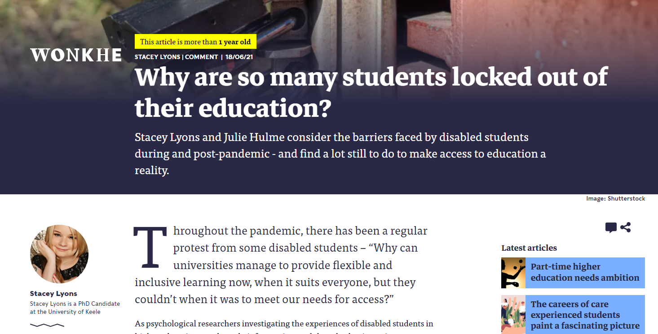
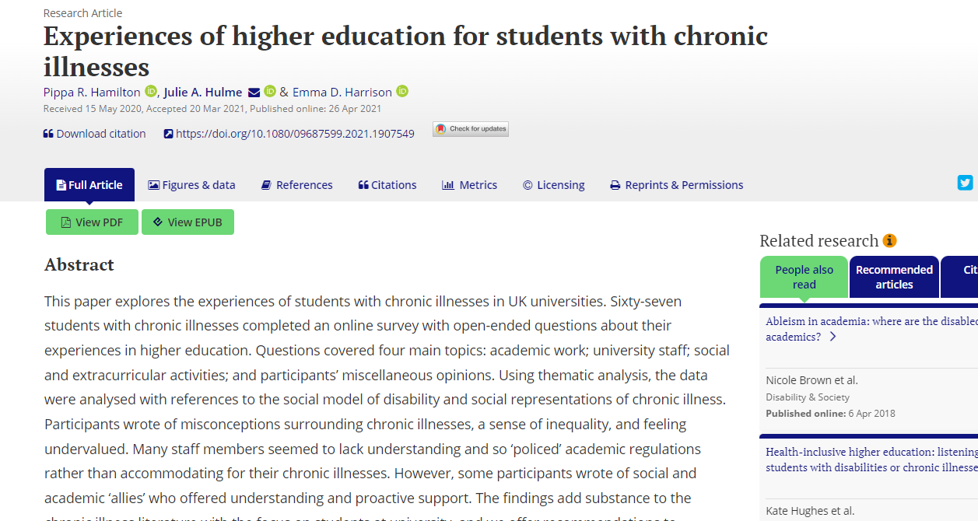

Slide 7
What is higher education for?
“Formal education systems tend to emphasize the acquisition of knowledge to the detriment of other types of learning, but it is vital now to conceive education in a more encompassing fashion.” (Learning: The Treasure Within, UNESCO, 1996)
“The aim of education is not only to prepare students for productive careers, but also to enable them to live lives of dignity and purpose; not only to generate new knowledge, but to help shape a citizenry that can promote the public good. Thus, higher education’s vision must be widened if the nation is to be rescued from the problems that threaten to diminish permanently the quality of life.”
(Boyer, 1990, p77-78).
Notes:
Note that both of these quotes are from around 30 years ago – and yet our model of higher education hasn’t changed…what does it mean to widen the vision of HE? Many unis claim to reward innovation in teaching – and yet even post-pandemic, many academics are returning to the old normal. Why? What helps us to innovate, and what prevents it?

Slide 8
Introducing pedagogic frailty (Kinchin et al., 2016)
Frailty as a “vulnerability to adverse actions”
Pedagogic frailty results in a “conservative approach to teaching” and “feelings of helplessness”
“Certainly their strength is in their knowledge of the content. They don’t feel competent or strong or well versed in the pedagogy at all. They tend to operate in the way they were taught” (Fraser, 2016).
In contrast – pedagogic resilience…

Slide 9
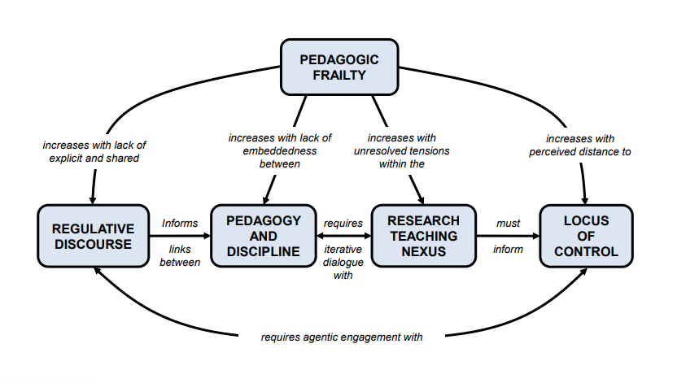
Notes:
From Hulme and Winstone 2017 KMEL: The model of pedagogic frailty presented by Kinchin et al. (2016) captures the challenges faced by the educator in contemporary HE. Drawn from a clinical analogy, the concept of pedagogic frailty represents the stress that can arise from constant change within HE. Within the model, four key factors are seen to underpin the development of the frailty syndrome: a focus on instructional, rather than regulative discourse; a lack of synergy between pedagogy and discipline; unresolved tension in the research-teaching nexus, and perceived externality of the locus of control. The result of these challenges, according to Kinchin et al., is the adoption of a ‘safe and sustainable pedagogic approach’ (p. 2). In this paper, we continue the clinical analogy to interrogate this key ‘symptom’ of pedagogic frailty, risk aversion, within the context of psychology education.

Slide 10

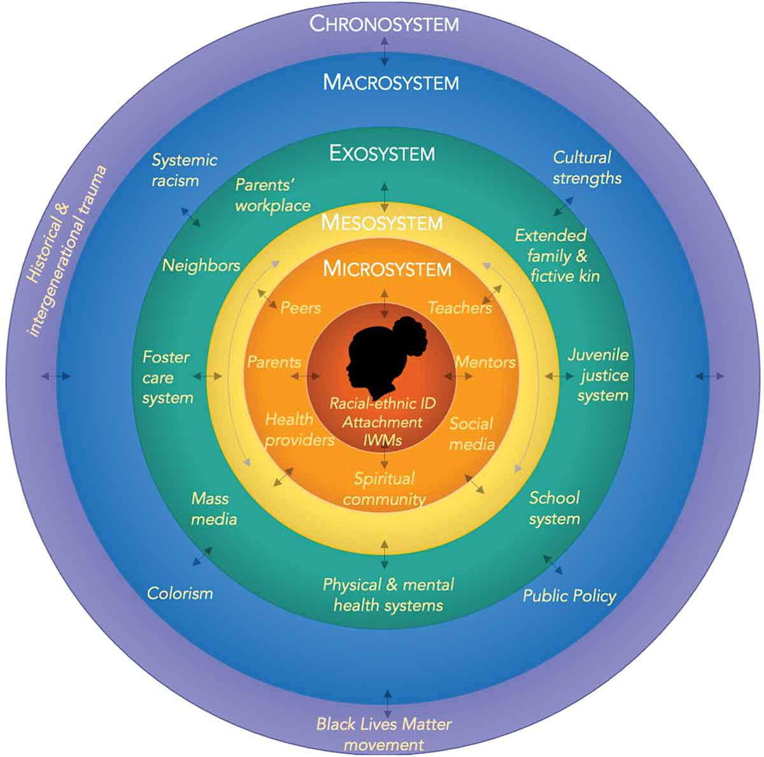
Hulme & Winstone, 2017 proposed ‘frailty’ as state not trait – environmental factors and changes over time.
Funding from OneHE to investigate what factors really influence whether or not someone innovates
Interviewed 21 academics, academic developers, leaders – from early career to professors, in diverse roles, mostly from the UK (about 32 hours of [mostly open] data)
What does innovation mean to you?
What helps, what hinders?
What are the positives and negatives?
Bronfenbrenner (1992) – ecological systems theory

Slide 11
What is innovation?
…any innovation has to be around enhancing the student experience so thereby enabling the students to to achieve erm as best they can. So sometimes innovation can be er led not necessarily with that ideology erm but for me it’s always around ok well what improving what we do for the students in the long term rather than necessarily tinkering around the edges and playing for playing’s sake that might improve it but understanding what those improvements might be and that the student experience for me is the core bit and what they get out in the long term (Irene, lecturer)
I was shortlisted this year as Times Higher most innovative teacher of the year and I go I have no idea what’s innovative about what I do… (Beth, senior academic)
I see it as probably doing doing something differently. I used to think of it in terms of creating something new but you, most of the innovations are just doing something differently for the better, it’s about improvement (Matthew, academic leader)
solving some perceived problem…sort of implies you’re starting from a deficit…whereas actually the bigger the you know the kind of innovation we should be aiming for in higher education is we shouldn’t be starting from a deficit at all, we should be starting from something that’s very good and turning into excellent (Eva, senior academic)

Slide 12
…turning things on their head um and trying to think of different ways of how you can engage the students with the material that you’re trying to trying to teach them (Eleanor, new lecturer)
in any um, organisation sector service, any sort of thing I can’t think of the right word, you should always be looking at how are we doing what ways can we improve um because the world's changing students are changing (Hannah, academic developer)
…we got brilliant students who do really really well and then they get to their final year and they really struggle to write a dissertation, and I’m sat there thinking, well for two years you’ve been telling them that economics is about doing learning sets and algebra and stuff like this, now you’re saying, go away and look at the real world…where's the preparation and training? (Richard, senior academic)
when I talk to students yes all students like it they all think it does, you know, wonderful things for their study skills for many of them it probably doesn't, but then you talk to a student who is um partially deaf and they they say they just couldn’t study without it (Eva, senior academic)
…actually if you were in the same job teaching similar stuff for a long period of time then it can get quite boring doing the same things so actually we could think about the role of innovation in terms of keeping uh keeping your interest in as educator (Beth, senior academic)
Why innovate? (Hulme & Winstone, 2017)
Student engagement
Changing world
Future proof graduates and employability
Inclusion

Slide 13
I think if you accept the risk that’s implicit in innovation, then it can’t be a negative experience because you have to accept that there may be cases when it doesn’t work when the students don’t benefit how you wanted them to, when the workload associated with your new efficient time saving technology doesn't pay off, you know all of those things (Eva, senior academic)
People are saying well I don't want to take a risk with my teaching because the students might give me bad feedback or it might might change the NSS results…I was reading something, can't remember where now, that was saying actually sometimes it’s riskier not to change…and if you're doing something and getting bad feedback it’s probably probably if you do something different that’ll be a bit better than carrying on as you are (Hannah, academic developer)
What are the risks? (Hulme & Winstone, 2017)
Students may fail to learn – student attainment, progression
Risk for student evaluations and promotion prospects for the individual
Time and resource cost
BUT failure to innovate might also be risky – students who are not prepared for the modern world?

Slide 14
the economics taught before the crisis couldn’t explain the crisis…what’s happened to economics teaching in university uh since, pretty much nothing with some exceptions, so I think if we do need innovation what we need what if there is to be wide spread innovation what we really need is innovation in in what it is we’re teaching…uh making students aware that if you’re going to learn these theories learning what the down sides of the theories are, understand what the limitations are (Richard, senior academic)
you have a, you may have the most wonderful innovation and it could already be implemented and bringing about positive outcomes for developing capacity across the whole organisation you get a change of leadership a new VC or PVC whatever comes in and says nah, don’t want it, it’s gone…so the politics and the academic arrogance and the egos in university are a hindrance (Mary, academic developer)
there is a sense that this type of institution the very specialist industry focus institution who are located along with industry, so you know our [place] location is an important part of because, that's where the UK […] industry is based (Tom, academic leader)
What are the barriers and enablers? (Hulme & Winstone, 2017)
Discipline drivers
Institutional culture and context
Reward and recognition

Slide 15
More barriers and enablers
there are climates and cultures where people are flexible and say, yeah we all make mistakes let's see what we can do with this (Joanne, mid-career academic)
well for example we have things which we introduced which work quite well which include a very early assessment for first year students which isn’t very highly weighted and the university‘s new assessment policy says we can’t have low weighted assessments they’ve all got to be at least 20% of a module whereas ours is 10% which might you know…Policies which have good intentions but which end up being quite restrictive (Tim, academic leader)
What you could do is say to your team ok you own the programme, you you you know you’ve decided why you’re doing this programme and the purpose of it, so as long as you’re not changing that you can do whatever you like within it. It doesn’t feel like that’s what we’re doing, what we do is you know we’ve got this very regimented form of module structure and programme structure that any minute changes erm have to go through some form of committee structure which therefore in some ways stifles that process, and again going back to why do people not do it, because they’ll say well I’ll have to do a module change form, and I’ll probably need to go through that and then someone’s going to ask me how many words is that and how many lectures and what number of hours are going to fit into this module…I want to try something out…instead of having a one hour lecture and a two hour seminar I want to go to the park with the…students, and have a whole day there and we’re going to try some things out. You know the systems aren’t set up for any of that sort of playfulness, to try and think about we want to understand something in a slightly different way.

Slide 16
it’s like a kind of again that kind of learning by trial and error kind of approach…you’re going to have a structure where people are in some sense rewarded or looked up to or encouraged to innovate, it’s important that as long as as long as they’re not just being ridiculous it’s important to allow failure…cause if you don’t allow failure you’ll never get significant innovation because most people will be too scared to do it (John, senior academic with leadership role)
there’s a definite need just for staff support for erm for to give to go back somewhat to the start of this conversation to give teachers the confidence to do things differently, to give them confidence to to fail if things don’t work out well (Matthew, senior academic with leadership role)
I think what helps is erm within a university always having the support of your line managers, your senior management team, and executive or whoever’s holding the purse strings, or whoever is leading the university erm in terms of how able we are to erm try these innovations in the first place and/or try and roll them out whether it’s across a department or an institution or more broadly (Rebecca, mid-career academic)
Notes:
Innovation means being given room to “fail” and make mistakes, and needs encouragement

Slide 17
I think innovation shouldn’t be a a cliff edge, you know sometimes it is sometimes you have this magic moment where you think I’m gonna do this, and you do it and it works and that’s great, but more often than not you you might take an initial pretty big leap and then you have these iterative steps afterwards these kind of baby steps to perfecting the things that you started (Eva, senior academic)
and then of course if you know hopefully you will also want to evaluate it and perhaps refine and hone it (Hannah, academic developer)
So innovation sometimes can be erm gentle tweaks gentle improvements erm that you have that the students feedback on and you just adapt your practice but sometimes it can be much bigger than that but that for me that should always be evidence informed, the problem is that that evidence has to come from somebody trying it initially (Irene, lecturer)
actually maybe introduced an innovation successfully and right through to fruition and by fruition I mean by getting evaluation of the impact along the way, cause that's another thing we do very badly, we can have as much innovation as we like but we need to be able to prove its effectiveness its impact (Mary, academic developer)
Notes:
Innovation is often done in small iterative steps – not all at once
Evidence-based – from your own evaluations or from other people’s disseminated practice

Slide 18
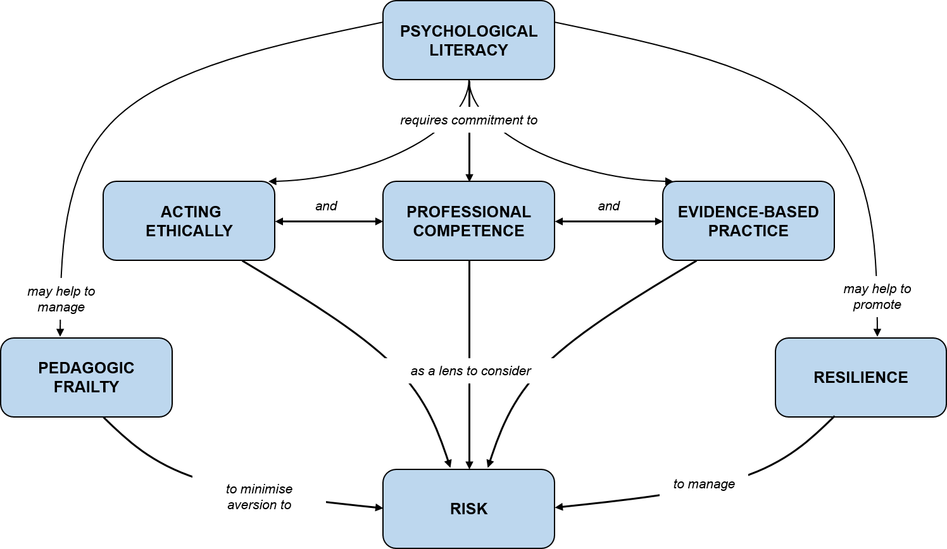
Developing your own innovations (Hulme & Winstone, 2017)
Evidence-based approaches to innovation – pedagogic/SOTL literature, evaluation, networks
Ethical and values-based innovation – students as co-creators, duty of care, contingency plans
Professional competence – continuing professional development, scholarship, peer observation. Academics as professional learners! Delay innovation?

Slide 19
Concluding thoughts
How can we develop our own confidence around innovation?
How can we influence our institutional environments to facilitate innovation?
To what extent does your discipline encourage innovative teaching or keeping ‘safe’? Can we influence that?
What’s next for you?

