Slide 1
Psychology for all: including diverse student perspectives in psychology teaching and learning
Professor Julie Hulme
julie.hulme@ntu.ac.uk; @JulieH_Psyc
Notes:
Thanks to Nicola
Note pronouns
Note changes to QAA subject benchmark – EDI and decol, accessibility, sustainability, employability and entrepreneurship – opportunities around transition to university (refer to Lucy’s policy update)
Looking at core studies/key studies gives a good opportunity to address some of the issues I’ll raise

Slide 2
Importance of belonging
Sense of belonging is correlated with academic engagement, attainment, and course completion (e.g. Thomas, 2102; 2019)
And with mental wellbeing (Meehan & Howells, 2018).
Notes:
Diversity of who I am – age, gender, ethnicity, culture, religion, health/disability, mental health, socioeconomic factors, educational background, family support, peer influences….LOTS!
Awarding gaps (not attainment gaps)

Slide 3
What is belonging?
Kift (2004): Complex interaction of environment, social and cognitive attributes – social connectedness.
Thomas (2012): Psychological and sociological aspects and a feeling of a sense of purpose – linked to subject and career aspirations.
Soria and Stubblefield (2015) – self-awareness of strengths and capabilities, supported by the curriculum.

Slide 4
Inclusive learning:
“…the ways in which pedagogy, curricula and assessment are designed and delivered to engage students in learning that is meaningful, relevant and accessible to all. It embraces a view of the individual and individual difference as the source of diversity that can enrich the lives and learning of others.”
Hockings (2010, p1)

Slide 5
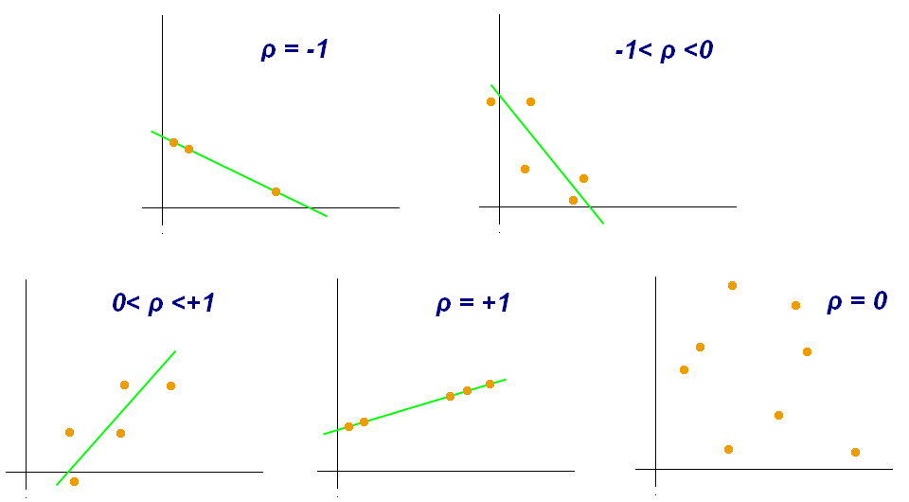
Who am I? What do I know from the psychology curriculum?
Research and researchers – who are they, where do they come from, and what is their cultural background? Role models?
Research conducted on WEIRD participants (Western, educated, industrial, rich, democratic societies) (Henrich et al., 2010)
Eugenics and intelligence theories (Turiel, 2020).
Muller-Lyer illusion
Spearman and Pearson

Slide 6
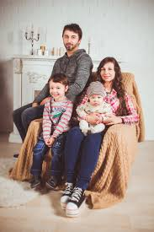
Who am I? What do I know from the psychology curriculum?
Family
Attachment theory – focus on mother as primary caregiver
Heteronormative and binary gender
Recognition of family diversity (Golombok, 2015).

Slide 7
Who am I? What do I know from the psychology curriculum?
Ethnicity and culture
Exoticisation and othering (e.g. hunter-gatherers, trepanning)
Importance of community-based research methods (Scrine et al., 2022) – in contrast
Notes:
Nothing about us without us and emancipatory research

Slide 8
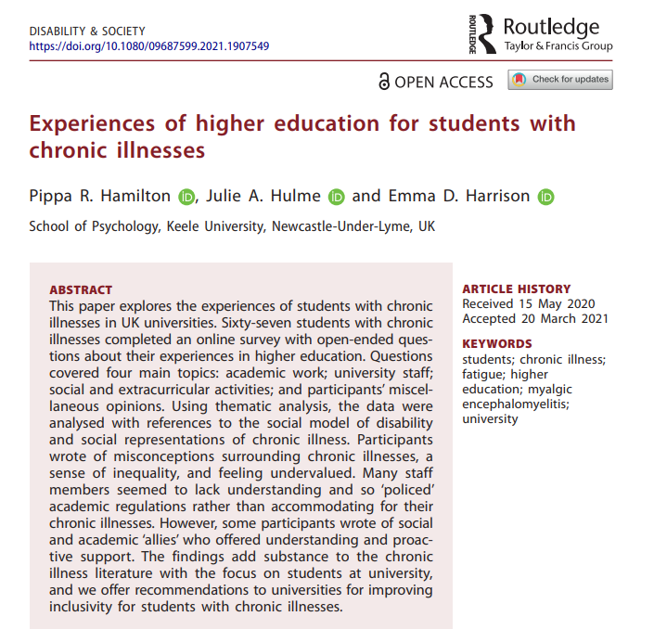
Who am I? What do I know from the psychology curriculum?
Mental health and medical model
Intellectual disability
Disability more generally
Social models of disability and mental ill health - in contrast
Notes:
Autism

Slide 9
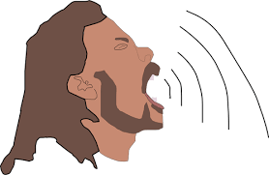
“ Although a man may lose a sense of his own importance when he is a mere unit among a busy throng, all utterly regardless of him, it by no means follows that he can dispossess himself, with equal facility, of a very strong sense of the importance and magnitude of his cares.”
Charles Dickens: The Life and Adventures of Nicholas Nickleby

