Slide 1
What the English Devolution White Paper might mean for the region?
Pete Murphy
Peter. Murphy@ntu.ac.uk

Slide 2
Overview
Constitutional autonomy and partnership based on elected mayors
Devolution of powers & Representation in Westminster.
Integrated Funding Settlements
Universal coverage of Strategic Authorities (1.5m population).
Local Gov-organisation – universal unitary authorities 0.5m population.
Over the long-term - Align public service boundaries with Strategic Authority boundaries.

Slide 3
Devolution Framework
Requires primary legislation - and will be in a Devolution Bill this year
A single “mutually agreed” outcomes framework (similar to Scotland’s for individual authorities)
Mayors taking PCC/PFCC role across two or more areas (subject to boundaries aligning)
but
Monitored over a Spending Review period (usually 3 Years).

Slide 4
Elected Mayors and the ‘escalator’ The strategy has push and pull elements
Pull
Foundation Strategic Authorities (18 new responsibilities and powers)
Mayoral Strategic Authorities (47)
Established Mayoral Strategic Authorities (57)
Push
The fallback –is mandatory ministerial powers

Slide 5
…and back to sub-regionalism: Devo coverage December 2024

Slide 6
Figure 2: Streamlining government

Slide 7
Local Government Reorganisation
A note of caution from past reorganizations

Slide 8
Councils in Central Government Intervention Process and those receiving exceptional financial support
Birmingham (Int & EFS)
Bradford (EFS)
Cheshire East (EFS)
Croydon (Int & EFS)
Cumberland (EFS)
Eastbourne (EFS)
Havering (EFS)
Medway (EFS)
Middlesborough (EFS)
North Northants (EFS)
Nottingham (Int & EFS)
Plymouth (EFS)
Slough (Int & EFS)
Somerset (EFS)
Southampton(EFS)
Stoke (EFS)
Thurrock (Int & EFS)
West Northants (EFS)
Woking (EFS)

Slide 9
Local Government Reorganization in the East Midlands NB. Reorganisations to be implemented in 2027 and 2028.

Slide 10
The East Midlands Combined County Authority Police and Fire Responsibilities?

Slide 11
Derby, Derbyshire
& 9 Districts
Nottingham, Nottinghamshire
& 7 Districts

Slide 12
Leicester, Leicestershire Rutland & 7 Districts

Slide 13
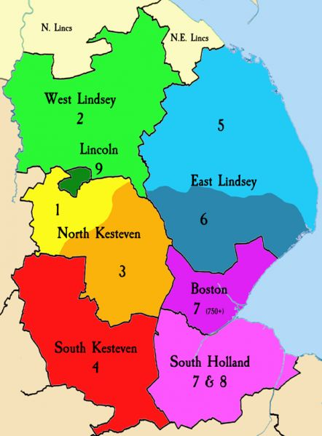
Lincolnshire CC
North Lincolnshire UA
North-East Lincolnshire UA
and
9 District Councils
Greater Lincolnshire Mayoral Election in May 2025

Slide 14
Northamptonshire’s 2 Unitary Councils and the Milton Keynes & South Midlands Issue
West Northamptonshire
North Northamptonshire

Slide 15
18 councils have requested an election delay in 2025. (Government will only postpone elections where there is a clear commitment to the aims of the reorganisation, and where councils had offered "genuine proposals for change).
• Derbyshire CC
• Devon CC
• East Sussex CC
• West Sussex CC
• Essex CC
• Gloucestershire CC
• Hampshire CC
• Kent CC
Leicestershire CC
• Lincolnshire CC
• Norfolk CC
• Oxfordshire CC
• Suffolk CC
• Surrey CC
• Warwickshire CC
• Worcestershire CC
Thurrock UA (see Essex)
Isle of Wight UA (Hampshire)

