Slide 1
Documenting trauma: The experiences of war survivors in Krusha e Madhe, Kosova
Dr Blerina Këllezi &
Aurora Guxholli, Gazmend Bajri, Dr Tadeusz Jones, Dr Ardiana Shala
Research funded by: NTU QR Kickstarter fund, NTU Safety and Security Theme, The British Academy and the British Psychological Society

Slide 3
Trauma and social psychology
Trauma is a collective experience, before, during and after
It is shaped by our identities (ethnic, religious, gender identities)
Identities determine:
who is target of violence/increased risks of distress (Muldoon et al., 2021)
meaning given to the experience (turning them into more positive or double negative & more threating (Kellezi & Reicher, 2009; 2012; 2014)
quantity and quality of support (+expectations) (Haslam et al 2012) and meaningfulness of trauma support (Kellezi et al., 2019)
coping and collective efficacy (Haslam & Reicher, 2006)
justice needs and processes (criminal, historical, reparation, administrative and transitional constitutionalism)

Slide 4
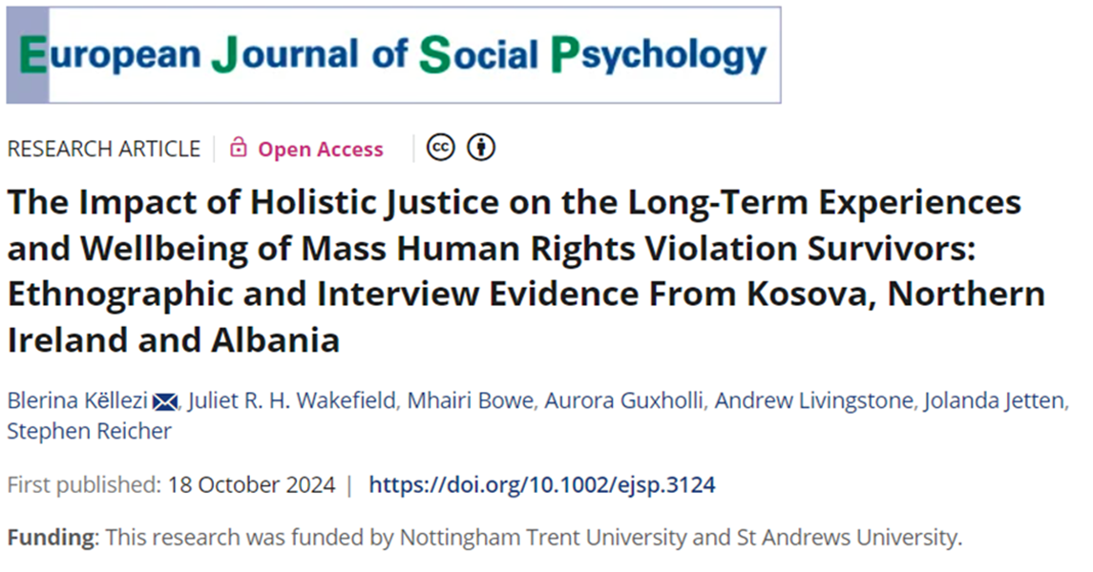
Importance of holistic justice!
Transitional justice
Social Justice
Socio-political, judicial & economic processes aimed at redressing the impact of MHRVs and preventing future conflict (Teitel, 2000).
Social structures: distributive, procedural and interactional justice (Jost & Kay, 2010)

Slide 5
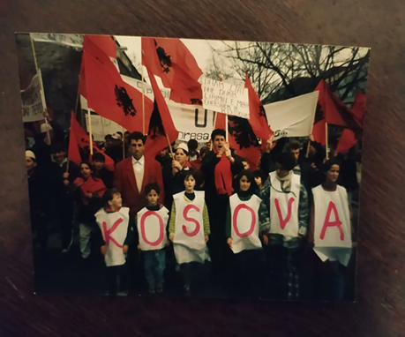
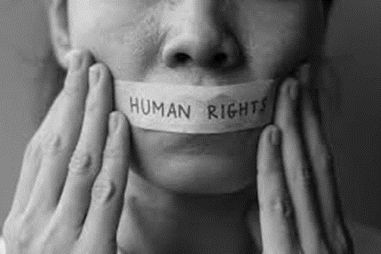
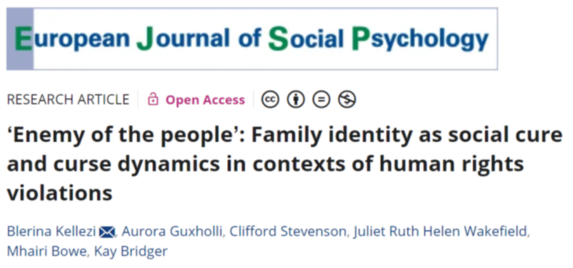
Sharing stories
Benefits: prepare next generation, to make sense/process trauma, uncertainty reduction, continuity, resilience‐building, collective self‐esteem, to create shared bonds, and support.
Duty: Sharing it is a duty and to achieve justice (transitional and social) and to support democratic societies. Often non-vengeful
Harms: shared emotional pain, passing on responsibility for justice, undermine relationship with nation
Decisions not to share:
To protect children
To avoid intergroup conflict
Mindful in stories that are norm-violation (stigma, GBV, painful, or norm-affirming (pride, survival)

Slide 6
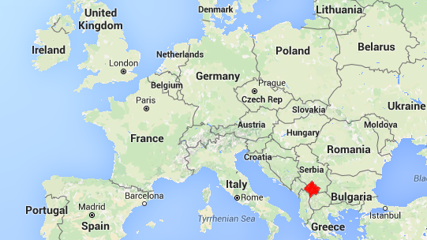
Krusha e Madhe
Kosova

Slide 7
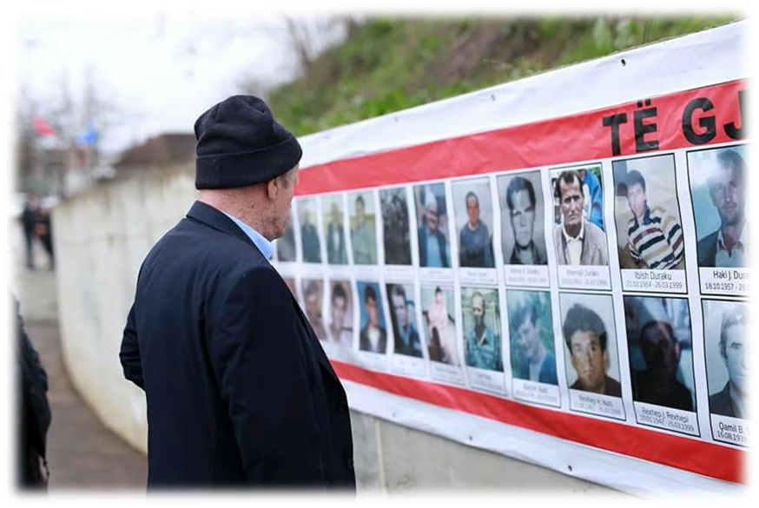
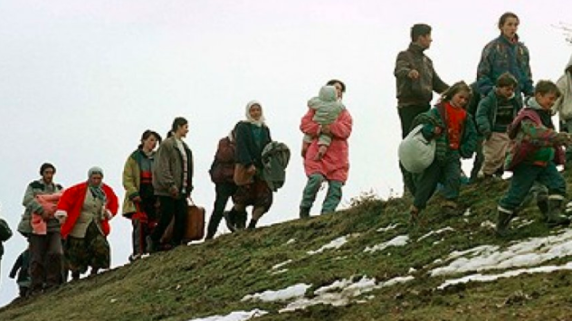
Why Krusha e Madhe?
One of the most affected
25-26th of March 1999: men/boys separated from women/girls
Many of the men killed/missing
Women, children and older people forced to walk to the border
https://www.youtube.com/watch?v=NfAAPhXOCck

Slide 8
The impact of taking part in the documentary
Important to remember for young generation: ‘It is very important to tell the story so young children don’t forget, pass it to next generation. My son and grandson will know about the war’
Important to avoid history repeating itself
A form of justice: ‘Great documentary. This will serve to not lose our testimonies. To show Europe what the Serbs did.‘
Need to write and document what has happened- many witnesses are dying.
Talking part in the interview is very psychologically demanding.

