Slide 1
UFHRD 2025 Conference Workshop
AI-Powered Literature Review
Welcome to the workshop
AI-Powered Literature Review

Slide 2
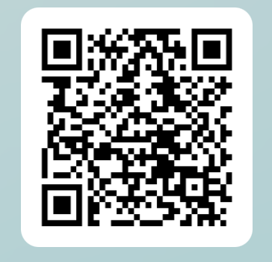
UFHRD 2025 Conference Workshop
AI-Powered Literature Review:
Unlock the Power of AI to Supercharge Your Research
https://forms.office.com/e/pNUC5eA78R?origin=lprLink
Dr Fotios Mitsakis
Senior Lecturer / Deputy Chair UFHRD Doctoral Symposium
Nottingham Business School, Nottingham Trent University

Slide 3
Variety of traditional & AI tools Use them wisely & ethically

Slide 4
AI Tools
Transforms information into mind maps, quadrants and timelines - visualises information
AI tool helping you discover, evaluate, and understand research on any topic.
Helps find relevant papers to your topic - add 1 or 2 key ones and then automatically searches for similar focused papers
Impress your audience with your songwriting skills

Slide 5
AI Tools
Provides summaries, Q&As, insights and mind maps of lengthy videos
Lecture.new (records lecture and generates notes and slides)
Amongst other things - statistical analysis yet statistical error subject to different results based on prompt (GhatPDF – Summarise PDFs)
Summarises YouTube videos
Summarises papers, extracts data, and synthesises your findings

Slide 6
AI Tools
Record and create your clone who speaks 60 languages
Proofreader ensures compliance with AMA and APA style guides.
Text to speech
Creates outlines for research topics (and not only.
Writes meeting notes
Literature review / AI detector/paraphraser / pdf to video / citation generation / slides generation etc.)

Slide 7
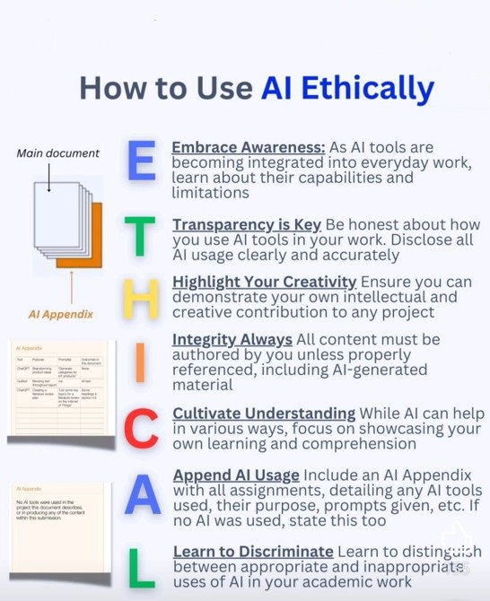
Ethical use of AI tools

Slide 8
Let’s play with
https://www.typeset.io

Slide 9
To use SciSpace, visit: https://www.typeset.io
Try the following special discounts:
🔥Use “Vugar40” or “FRED40” and get a 40 % Discount for the Annual Membership Plan
🔥Use “Vugar20” and get a 20 % Discount on Monthly Plan

Slide 10
Short tutorials:
https://www.youtube.com/watch?v=cZjaHI8RnWY
Scispace | AI for Researchers – YouTube
CoPilot - Best AI Research Assistant from SciSpace | CoPilot - Summarize Research Article
SciSpace AI Literature Review Workspace - Find and survey relevant papers in minutes
Introducing SciSpace's AI-powered literature review

Slide 11
Blog Posts:
With massive datasets and cutting-edge NLP techniques, a team of ML researchers at SciSpace is building next-generation tools for scientists and publishers
Can SciSpace Break Barriers In Scientific Research And Collaboration To Solve The World’s Problems?

Slide 12
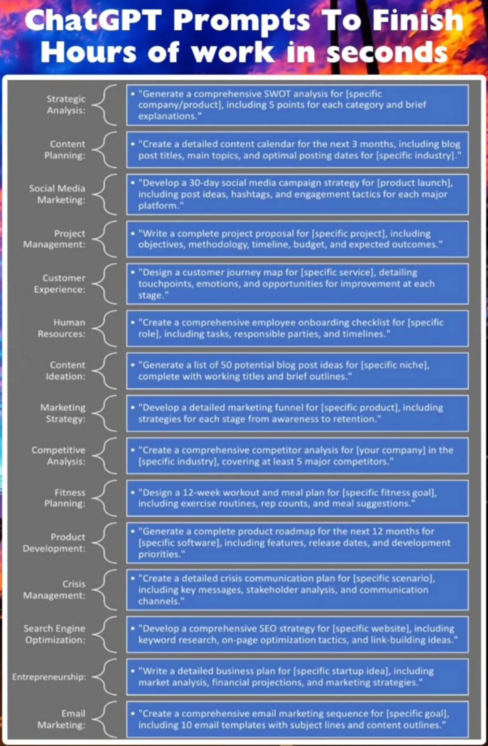
Play with Ai ChatGPT Prompts to play with

Slide 13
Play with Ai Prompts - Optimise your LinkedIn Profile with AI
✳️ Prompt 1: Crafting an Attention-Grabbing Headline Suggest an impactful LinkedIn headline that showcases my unique blend of skills, experiences, and career goals tailored for [Target Job Title/Industry]. ✳️ Prompt 2: Crafting a Compelling "About" Summary Create an engaging "About" summary highlighting my professional journey, key accomplishments, and future aspirations in [Industry/Field]. Make it compelling for potential [employers or clients]. Here’s my resume: [Paste Resume]. ✳️ Prompt 3: Revamping the Experience Section Provide compelling bullet points that effectively communicate my responsibilities, achievements, and impact for each role, aligning with the requirements of [Target Job Title/Industry]. Here’s my resume: [Paste Resume]. ✳️ Prompt 4: Curating a Skill-Endorsement Strategy Identify the most relevant and in-demand skills for [Target Job Title/Industry] and create a strategy for showcasing and obtaining endorsements for those skills on my LinkedIn profile.

Slide 14
Play with Ai Prompts - Optimise your LinkedIn Profile with AI
✳️ Prompt 5: Leveraging Industry-Specific Keywords Research and provide a list of the most relevant keywords and phrases for [Target Job Title/Industry] that I should strategically incorporate into my LinkedIn profile to improve visibility and searchability. ✳️ Prompt 6: Building a Targeted Professional Network Develop a plan for expanding my LinkedIn network by identifying key individuals, companies, or groups within [Industry/Field] that I should connect with to foster valuable professional relationships. ✳️ Prompt 7: Soliciting Compelling Recommendations Provide guidance on how to effectively request and obtain high-quality recommendations from colleagues, managers, or clients that highlight my strengths and achievements relevant to [Target Job Title/Industry]. ✳️ Prompt 8: Creating Thought-Provoking Content Suggest topics and formats for LinkedIn posts or articles that can establish my expertise and thought leadership in [Industry/Field], fostering engagement and visibility. ✳️ Prompt 9: Joining Relevant LinkedIn Groups Research and identify the most active and influential LinkedIn groups related to [Industry/Field] and provide strategies for meaningful participation and networking within those groups. ✳️ Prompt 10: Maintaining a Professional Online Presence Outline a checklist of essential elements (e.g., profile photo, current job details, skills, recommendations) that I should regularly review and update on my LinkedIn profile to maintain a polished and up-to-date professional presence.

Slide 15
Play with Ai Prompts - Write a compelling Cover Letter with AI
✴️ Prompt 1: Irresistible Opening Hook Create 3 attention-grabbing opening sentences for my [Job Title] cover letter at [Company Name]. Each should highlight a unique selling point. Rank them by impact. Suggest how to expand the best one into a full paragraph. My resume: [Paste Resume]. Job description: [Paste Job Description]. ✴️ Prompt 2: Value Proposition Statement Write a compelling paragraph highlighting my unique value for the [Job Title] role. Focus on solving a key challenge mentioned in the job description. Include a specific achievement as evidence. Limit to 75 words. My resume: [Paste Resume]. Job description: [Paste Job Description]. ✴️ Prompt 3: Skills-Job Alignment Showcase Identify the top 3 required skills for [Job Title]. For each, write a concise statement demonstrating my proficiency. Include a brief, relevant example. Present in a table format with 'Skill', 'Proficiency Statement', and 'Example'. My resume: [Paste Resume]. Job description: [Paste Job Description].

Slide 16
✴️ Prompt 4: Achievement Story Optimizer Select my most impressive achievement relevant to [Job Title]. Create a concise story using the STAR method. Emphasize the result and its relevance to the target role. Provide a "before/after" version, showing how to transform a basic achievement statement into a compelling STAR story. Keep it under 100 words. My resume: [Paste Resume]. Job description: [Paste Job Description]. ✴️ Prompt 5: Career Transition Justification Write a compelling paragraph explaining my transition from [Current Field] to [Target Field] for the [Job Title] role. Highlight transferable skills and demonstrate enthusiasm for the new field. Provide two versions: one emphasizing skills continuity, another focusing on fresh perspective. Keep it under 75 words. My resume: [Paste Resume]. Job description: [Paste Job Description]. ✴️ Prompt 6: Continuous Learning Enthusiasm Create a paragraph showcasing my commitment to ongoing learning for the [Job Title] role. Mention a recent relevant skill I've acquired and how it applies to the position. Include a future learning goal aligned with the company's objectives. Limit to 50 words. My resume: [Paste Resume]. Job description: [Paste Job Description]. ✴️ Prompt 7: Industry Passion Articulator Write a paragraph expressing my passion for the [Industry] and how it aligns with [Company Name]'s mission. Reference a recent industry development or company achievement. Connect this to my career aspirations. Keep it under 75 words. My resume: [Paste Resume]. Job description: [Paste Job Description].
Play with Ai Prompts - Write a compelling Cover Letter with AI

