Slide 1
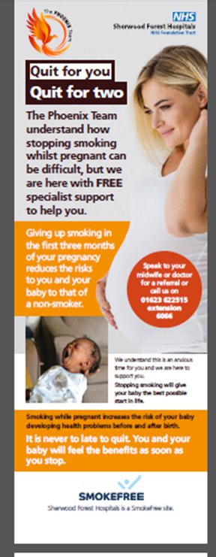
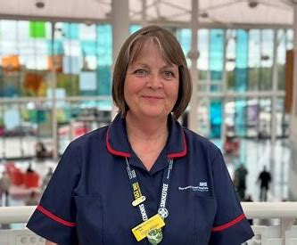
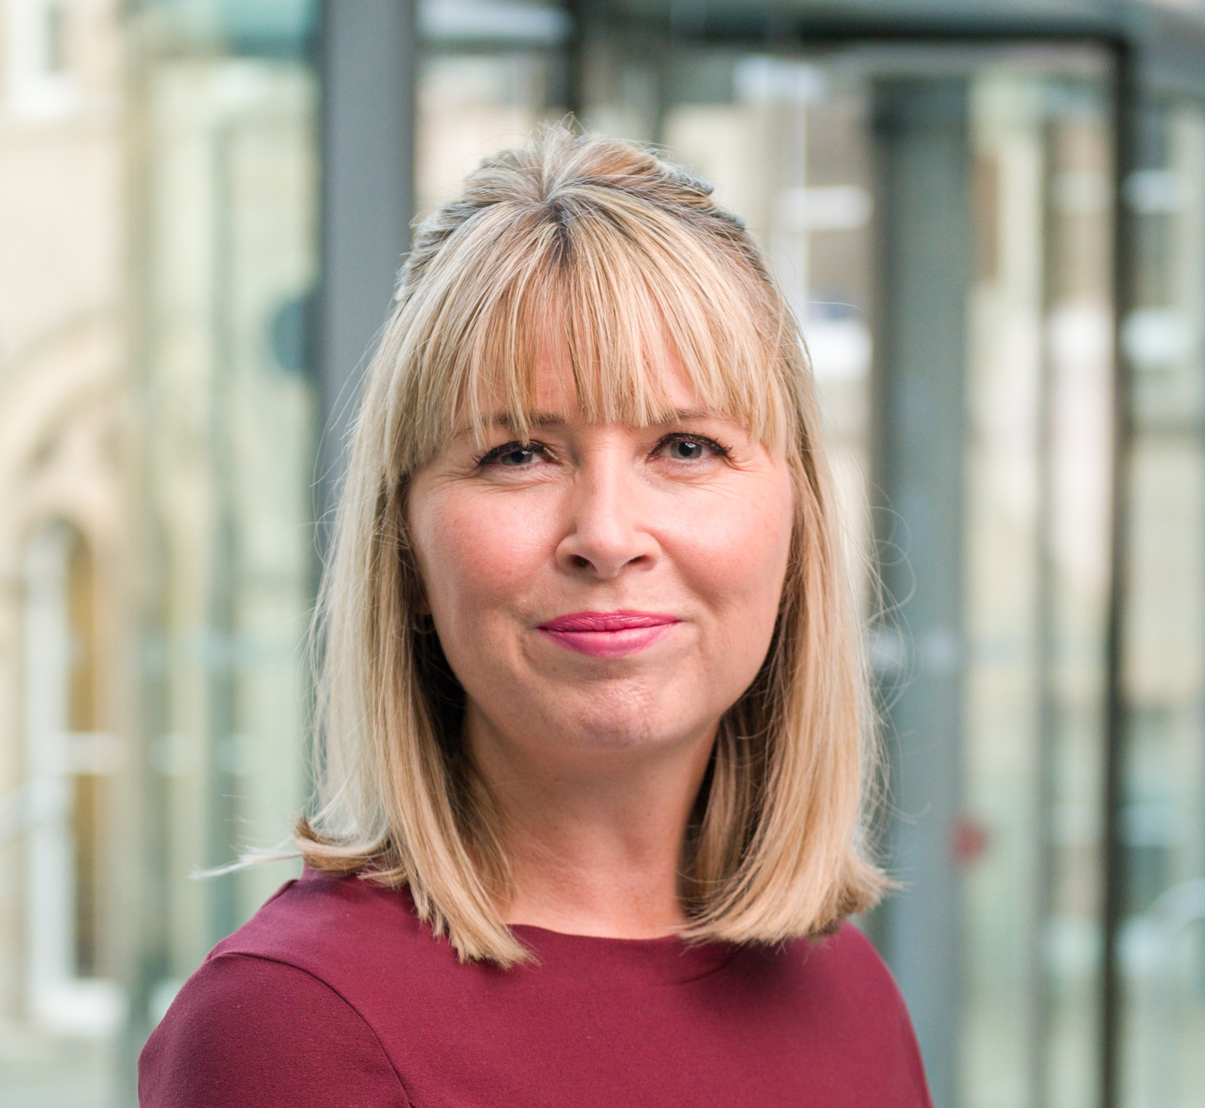
The Project Team
Evaluating an Incentive Scheme to Support Smoking Cessation during Pregnancy at Sherwood Forest Hospitals NHS Foundation Trust
Seamus Allison
Claire Allison
Karla Padley
Bilal Akbar

Slide 2
Why is this important?
Smoking is the single greatest risk factor in avoidable deaths in Western Europe
Smoking tobacco continues to be one of England's biggest causes of health, social and economic inequalities, affecting smokers and those around them
Smoking reduces expected lifespan and is the main causative factor of premature death by numerous cancers and other life-limiting diseases
Two out of three smokers will die due to a smoking-related illness or live with a serious disease contributing to increased healthcare and reduced economic activity
Smoking is the leading modifiable risk factor for poor pregnancy outcomes, including miscarriage, stillbirth, and preterm birth, a leading cause of death, disability and disease among new-borns, and low birth weight
Smoking triples the risk of sudden infant death and may result in life-long risk factors for children born to people who smoke during pregnancy and is a cause of child morbidity
The adverse impact of smoking during pregnancy continues throughout the life of the person born to a smoking mother including resulting in lower educational attainment
Smoking disproportionately affects those who are more socio-economically deprived (a typical smoker spends £175,000 on smoking across their lifespan)
Supporting those who smoke during pregnancy to quit can break the generational cycle of poor health, deprivation, poor educational outcomes, and mental health concerns
Pregnancy is recognised as a time associated with motivation for behaviour change
Therefore, because of all the above, smoking during pregnancy is a key target for the NHS.
“The specialist Phoenix Team recognises that smoking in pregnancy is the result of addiction to nicotine, which requires treatment, so they provide free, friendly support that is tailored to each individual - without judgement or pressure”. (The Trust’s Tobacco Dependence Maternity Lead)

Slide 3
The clinical team activities
The academic team activities
Sherwood Forest Hospitals NHS Foundation Trust was running a programme to support pregnant people set a smoking quit date
A lead clinician and two Smoking Dependence Advisors were employed
Funding was provided by the East Midland’s Local Maternity and Neonatal System (LMNS)
This included funding for an incentive scheme offering Love2Shop vouchers worth £400 paid in increasing increments as smoke-free behaviour was maintained
The clinical team created a “brand” presence, the Phoenix Team, with promotional materials and staff badges
The Phoenix Team provided support and encouragement using the Motivational Interviewing technique to help women set their own pace/objectives
An NBS research team was appointed to conduct the evaluation of the programme (a requirement of the funding)
Funding: £2000 from NBS + £2000 from the Trust
Funded a research assistant
Conducted 13 semi-structured interviews with pregnant people who had set a quit date and maintained this
We were interested in their experiences and perception of both the support they received and the incentive scheme
Resulted in 75,000 words of incredible richness
Conducted initial thematic review to highlight key themes
In parallel we reviewed the Trust’s operational data to check impact of the scheme on quit rates and other behavioural indicators
Combined the data and analysis to produce a management report for the Trust
The desired behaviour change was to set a quit date.

Slide 4
The key themes
Themes | Research findings (selection)
Support received from the Phoenix team | "I do give full credit to the Phoenix team because I honestly think I would still be smoking if it wasn't for them." "The whole team is just really friendly and supportive and go above and beyond, more than what they need to"
Overcoming stigmatisation and judgement | "I have got this little toddler in the pushchair, and I'm pregnant, and I'm getting stared at because I'm having a fag.... It was very stressful and quite upsetting…” "I just felt like they [the Phoenix team] did not judge anything."
Empowerment | "…dignified…rather than coming out of an appointment, feeling like a scumbag, you go out feeling empowered that you are going to be able to do this because they have made you feel like you are not a bad person."
Acknowledgement of healthy results | "I feel amazing all around. Like I feel like I have got loads more energy." "I do feel like it's not only benefited my health but also my children."
Financial incentives | "I saved my vouchers for the breast pump; it's like made it achievable cause, like, I hit those targets."
Relationship building | "…it was like going and seeing a friend; it was lovely." "…they are very interested in how you get on as a whole."

Slide 5
Impact
Clinical outcomes
During the period of the incentive scheme numbers setting quit dates more than doubled
Quitters appear to achieve maternity outcomes very similar to non-smokers
This includes behaviours such as breastfeeding
On average it takes 3 weeks for people to commit to a quit date (some quitters take up to 8 weeks)
88% of participants were smoke-free at birth
83% of participants were still smoke-free 6 weeks postnatal
18% of homes became entirely smoke-free (82% still had others in the home who smoked)
In the first year of service (to Feb 2023) there were 101 smoke-free births rising to 210 by Nov 2023
The smoking rate has declined: 18% (20/21), 16% (21/22), 14% (22/23), 12% (23/24 run rate)
A one percentage point reduction in the smoking rate equates to an annual saving to the Trust of around £100,000
The service has been given permanent funding
 | Non smokers n=25 | Incentive Scheme quit n=17 ^{* x1 exclusion very prem birth} | Smokers throughout pregnancy n=25
Altered fetal movement (% of cohort with at least one episode) | 36% | 35% | 48%
Antenatal appointments (average) | 13 | 13 | 16
Gestation at birth (weeks) | 39.8 | 38.5* n=16 | 38.6
Birth weight (average) | 3.4kg | 3.5kg* n=16 | 2.8kg
Breastfeeding initiation rate (%) | 76% | 69%* n=16 | 28%
An unexpected result

Slide 6
We feel these two comments highlight the profound personal impact smoking and the Phoenix Team has had on participants’ lives.
Impact
Interviewees reported significant emotional responses to the support given by the Phoenix Team and were universal in their praise
It was felt that the team made an important contribution to participants'’ ability to set a quit date and achieve their quit objectives
Phoenix Team worked to reduce barriers to engagement with the service. This was both emotional, not being judgemental and tangible, collecting them from a maternity appointment (this also acted to reduce procrastination, often due to anxiety either because of personality or perceived stigmatisation)
Several interviewees acknowledged that quitting alongside a significant other supported their own quitting and maintenance efforts.
From...
“…coming out of an appointment, feeling like a scumbag…”.
…to
“All my dreams I had 15 years ago is (sic) all coming into place now instead”.

Slide 7
Publications:
Practice paper in the European Journal of Marketing (3*)
Paper forthcoming in the British Journal of Midwifery
Management report for the Trust
2 x posters prepared for the Tobacco Dependency Conference Sept. 2023 – won best in conference
Presentation to the Midlands LMNS
Research outputs planned:
Considerable academic potential for analysis of the 75,000 words from the interviews
This will be added to by a further 15 interviews recently completed.
Top Tips:
Respect the needs of the practice client
Do what is right for their needs and then look for publication opportunities
Be prepared for them to wonder why some things take so long in academia
Look for ways to deliver value to them
You might need to look for publication opportunities beyond the usual academic journals

