Slide 1
Disability and Inclusion Support and Academic Colleagues – working together to improve equity and enhance the experiences of disabled students at NTU
Dr Gary McGladdery – Head of Disability and Inclusion
Prof Julie Hulme – Professor of Psychology Education
www.ntu.ac.uk

Slide 2
Outline
What do we know about disabled students at NTU and across the sector?
The importance of the social model of disability
How do disabled students experience higher education? – some insights from qualitative research
What are your experiences?
What can we – as colleagues – practically do to be inclusive of disabled students?

Slide 3
Facts and Figures
NTU had 9,220 disabled students enrolled in the 2023/24 Academic year (HESA).
This is a 4% increase on the previous academic year where the corresponding figure was 8,870 and a 33% increase on the figure for 2021/22 which was 7,195.
That equates to 23.9% of our overall student population (compared to sector average of 17.7% in 2023/24).
Sector wide, 40% of complaints relate to disability (Office for the Independent Adjudicator) – a legal and financial mine field!

Slide 4
What do we mean by “disabled”?
Equality Act 2010 - a physical or mental impairment that has a substantial and long-term negative effect on a person's ability to carry out normal day-to-day activities. This means the impairment must last, or be expected to last, for at least 12 months, and the effect must be more than minor or trivial.
Universities have a legal obligation to make ‘anticipatory adjustments’ – if we have reason to believe that learning is or will be inaccessible to a student, due to a disability, we must take action to create accessible learning.
We are one of 22 providers to sign up to The Disabled Student Commitment | Advance HE – we are committed to providing inclusive education.

Slide 5
Models of disability
Medical model of disability – focuses on disability as an impairment of the person, “what someone cannot do”
Social model of disability – focuses on the environment, “how does the environment (including the sociocultural world) stop someone from doing something?”
UK legislation guides us to social models, but practice is often medical model informed – e.g. requirement for medical evidence before we will make ‘reasonable adjustments’.
E.g. Andrews et al. (2022): https://doi.org/10.1016/j.dhjo.2022.101328

Slide 6
Social model of disability

Slide 7
Inclusive practice
'An approach to teaching that recognises the diversity of students, enabling all students to access course content, fully participate in learning activities and demonstrate their knowledge and strengths at assessment. Inclusive practice values the diversity of the student body as a resource that enhances the learning experience' (Equality Challenge Unit, 2014).
‘The ways in which pedagogy, curricula and assessment are designed and delivered to engage students in learning that is meaningful, relevant and accessible to all. It embraces a view of the individual and individual difference as the source of diversity that can enrich the lives and learning of others’ (Hockings, 2010, p.1)

Slide 8
Reasonable Adjustments vs Inclusive Practice
Reasonable Adjustments
Inclusive Practice
Often reactive and support Disabled Students only - aimed at removing specific barriers.
A reflection of the barriers that need to be removed due to the nature of someone’s disability – more medical model influenced.
Most reasonable adjustments conveyed through the Access Statements.
Often ad hoc for specific adjustments such as alternative assessment.
Often time costly and resource heavy!
All students access the adjustment and all benefit.
Less focus on disability specific adjustments
Supports the Social Model of Disability
Reasonable adjustments are more focused on supporting students with specific needs (not necessarily medical diagnosis).
Can be easier to administrate and so less costly!
Waterfield, J. and West, B. (2006) Inclusive Assessment in Higher Education: A Resource for Change. Staff Student Partnership for Assessment Change and Evaluation (SPACE) University of Plymouth: Plymouth.

Slide 9
Examples of inclusive practice at NTU
Ensuring building access at the design stage (changing places in PG Centre)
Wide use of lecture capture to support notetaking/revision for all students
Notes online in advance to support preparation and understanding of topic.
Accessible and inclusive reading lists which are accessible to screen reading technology and reflect a global academic outlook.
Built in alternatives to some assessment types.
Different modes of presentation (to group, small group, 1-1 Tutor, online or video)
Assessment Good Practice Guide (Presented to ASQC in May 2025)
Highlights range of assessment methods that could be used.
See also Universal Design for Learning: https://www.cast.org/what-we-do/universal-design-for-learning/

Slide 10
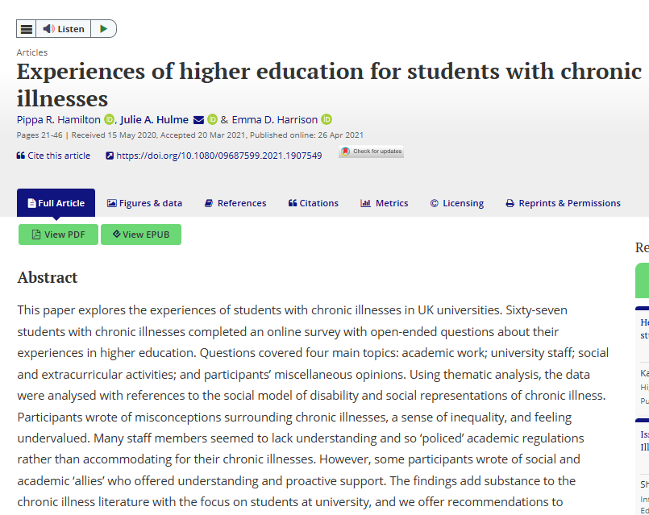
Why does it matter? What is it to do with me?
Natasha Abrahart case – we have a duty of care for our students, and universities are being held to account. Inclusion is everyone’s job – it’s not just a problem for disability services to solve.
Disabled students are less likely to participate in higher education, less likely to complete a degree (withdrawal or failure), and likely to achieve lower grades than their fully abled peers.
Let’s hear from students (and reflect on what we can do)…
Hamilton, Harrison, & Hulme (2023): https://doi.org/10.1080/09687599.2021.1907549

Slide 11
I find that when I am more unwell, it’s easier to go to some seminars than others, depending on the style of teaching.
Last term I had one module which focused a lot on group work and individual participation in class, which I found very difficult as I was struggling to keep up with the reading and being able to form coherent points - often I knew what I was trying to say, but I was misunderstood by the lecturer - or had misunderstood the question - and ultimately found it too difficult to attend those seminar sessions. (The room was also quite inaccessible which made me uncomfortable too)
Equally though, my other module had a planned set of questions, I didn’t feel as pressured to talk in class & when I did, the lecturer seemed more willing to give me more time to get my point out and was better at understanding what I was trying to say.
In previous years, when parts of the course has had films shown in class, there has rarely been subtitles, and so I have had to leave & find it on my own time to watch where I am able to use subtitles. (in retrospect, I did not ask for subtitles & do not know the reaction. I require them as I struggle with processing just audio, especially in films.)
What would inclusive teaching look like in these classes?

Slide 12
I manage my coursework by looking at it as soon as I get given it. I work bit by bit each week, which feels like the work is taking forever to complete, but it is the only way I can manage. I once had 2 assignments due at roughly the same time and I had to ask for an extension because the physical and mental exertion, as well as attending lectures & seminars became too much to juggle. A positive about my chronic illness has been improved time management by starting very early. A negative would be how I feel left out that others can finish an assignment in a few days or even an all nighter but I have to plan months in advance.
What can we do to make learning and assessments more inclusive for this student?

Slide 13
I don’t struggle with writing essays...I get 2:1s or firsts…However, were I not chronically ill, I do think I would easily be getting high firsts. My cognitive function issues make it hard for me to form sentences and find words, so once I have completed an essay to the best of my ability, my sister reads through it & is able to offer suggestions…Without that, I doubt I would be scoring as highly.
Exams I find very difficult. I have accommodations (extra time, rest breaks, separate room) but they do not help with the difficulties I have with memory. I struggle to remember anything I have learnt - occasionally I am able to remember concepts, but usually without any context. For example, memory issues meant that in my first year exam for an American History course, I forgot the names of the sides fighting in the civil war. I only was able to recall one of the sides as it was in a later question.
I am concerned about upcoming exams, as I don’t know how I am going to manage them. They are both at 9am & I am rarely able to be awake before 10am. I think this will affect my performance in them, which is stressful. I often am unable to complete the reading for seminars, and I struggle to prepare fully for essays with reading books outside of the suggested options (which will impact my final mark). [This is due to fatigue, pain and/or cognitive issues.] I find it very hard.
Can we create structures and ways of working that support students like this? Are closed-book timetabled exams essential to assess the learning outcomes?

Slide 14
My disability adviser is really understanding and does his best to put support in place.
Sadly, I’ve had some poor experiences. I was threatened with refused credit as I had missed a French oral exam due to a flare - I was expressly told that I could not resit it despite my tutor being happy to reschedule.
My GP surgery charges me £20 for each letter so I couldn’t afford to get a sick note. The university had a letter from the consultant neurologist confirming my symptoms but I had to have my flatmate write a letter saying I was ill. It was pretty stressful, unnecessary and I ended up with a pretty bad flare from the stress.
Is medical evidence necessary for an incident like this?

Slide 15
But them’s the rules!!
(No, not really…)
If a student gives us reason to believe they may be disabled, we have a responsibility to support.
A referral to Disability and Inclusion services is just one step.
We are empowered to make good decisions and to be proactive.
Students shouldn’t need to repeat themselves, or provide evidence more than once, and we should be aware of intersectionality.
Medical evidence is needed for Disabled Students’ Allowance (££) – not for ‘reasonable adjustments’ and definitely not for us to plan inclusive education.

Slide 16
Are there times when I can say no?
TL;DR – yes, but they’re quite specific, and you should seek advice
If students are required to demonstrate a competence – e.g. dose calculation in medicine or nursing – then we don’t have to adjust the assessment.
But only a legal process can determine whether something is really a competence…
Reflect on whether you can assess learning outcomes in other ways (e.g. can students record a video presentation or present 1-2-1, rather than present in class?).
Even better – offer choice designed into the assessment.

Slide 17
What if I’m just not sure?
Ask for help!
Disability and Inclusion Services at NTU are here to help academic colleagues as well as the students.
As a general rule of thumb – trust your students to tell you the truth (they often under-report rather than over-report disability).

Slide 18
What are you thinking or wondering?
It’s your turn to ask questions or offer ideas.
We’d love to know what you might do differently as a result of attending this session.
Thank you!

Slide 19
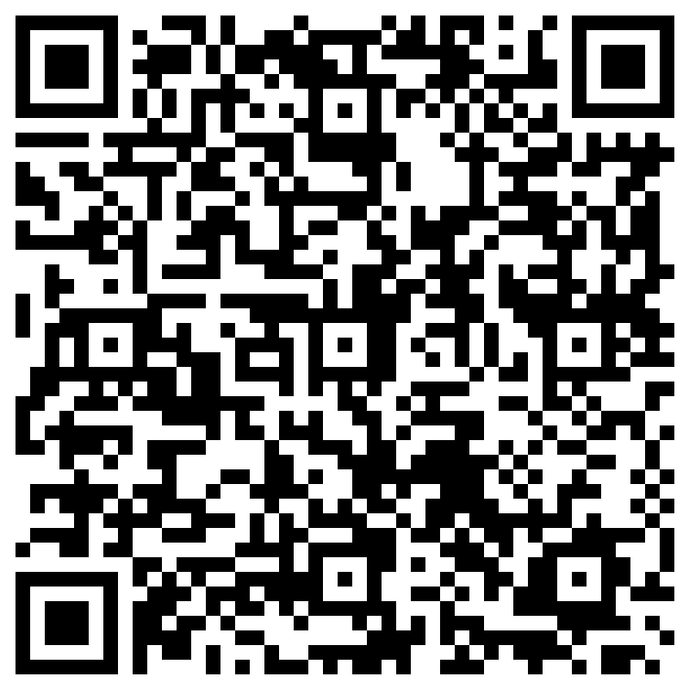
CADQ Staff Voice:
Professional Development Priorities
Your opportunity to shape the development of TILT L&T offers

