Slide 1
Developing cultural responsiveness in a global collaborative education project
Professor Julie Hulme (she/her)
Julie.Hulme@ntu.ac.uk
Bsky: @JulieHulme-psyc.bsky.social
Notes:
Abstract: Cultural responsiveness is an essential competence to develop when working as part of a diverse global team. In this talk, we'll hear how one large, diverse team of global educators set out to develop their own cultural responsiveness, and reflect on how similar approaches might benefit NTU.

Slide 2
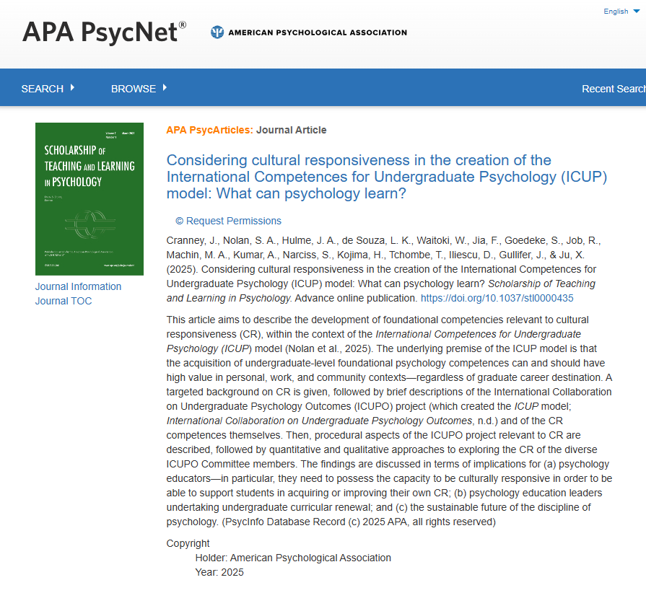
Outline and introduction
An introduction to ICUPO and the ICUP model
Why cultural responsiveness? How does it differ from intercultural competence? (or other models).
How did we develop CR?
Did we increase our own CR?
What can we do in our practice at NTU to develop CR in ourselves and our students?
Cranney, J., Nolan, S. A., Hulme, J. A., et al. (2025). Considering cultural responsiveness in the creation of the International Competences for Undergraduate Psychology (ICUP) model: What can psychology learn? Scholarship of Teaching and Learning in Psychology. Advance online publication. https://doi.org/10.1037/stl0000435

Slide 3
International Collaboration on Undergraduate Psychology Outcomes - ICUPO
Arose following a provocation paper:
Cranney, J., Dunn, D.S., Hulme, J.A., Nolan, S.A., Morris, S. & Norris, K. (2022). Psychological literacy and undergraduate psychology education: An international provocation. Frontiers in Education, 7, 790600. DOI: 10.3389/feduc.2022.790600.
Globally, psychology graduates differ in their career destinations – e.g. UK, 10-15% enter psychology professions; Brazil, 85%.
What is the intrinsic value of a psychology undergraduate degree? What competences do psychology undergraduates acquire?
ICUPO committee – 19 leading psychology educators, 15 countries PLUS IRGUPO (International Reference Group…) – 103 stakeholders across 39 countries PLUS student researchers. Two + years…40+ national frameworks…and finally a consensus.
icupo.org

Slide 4
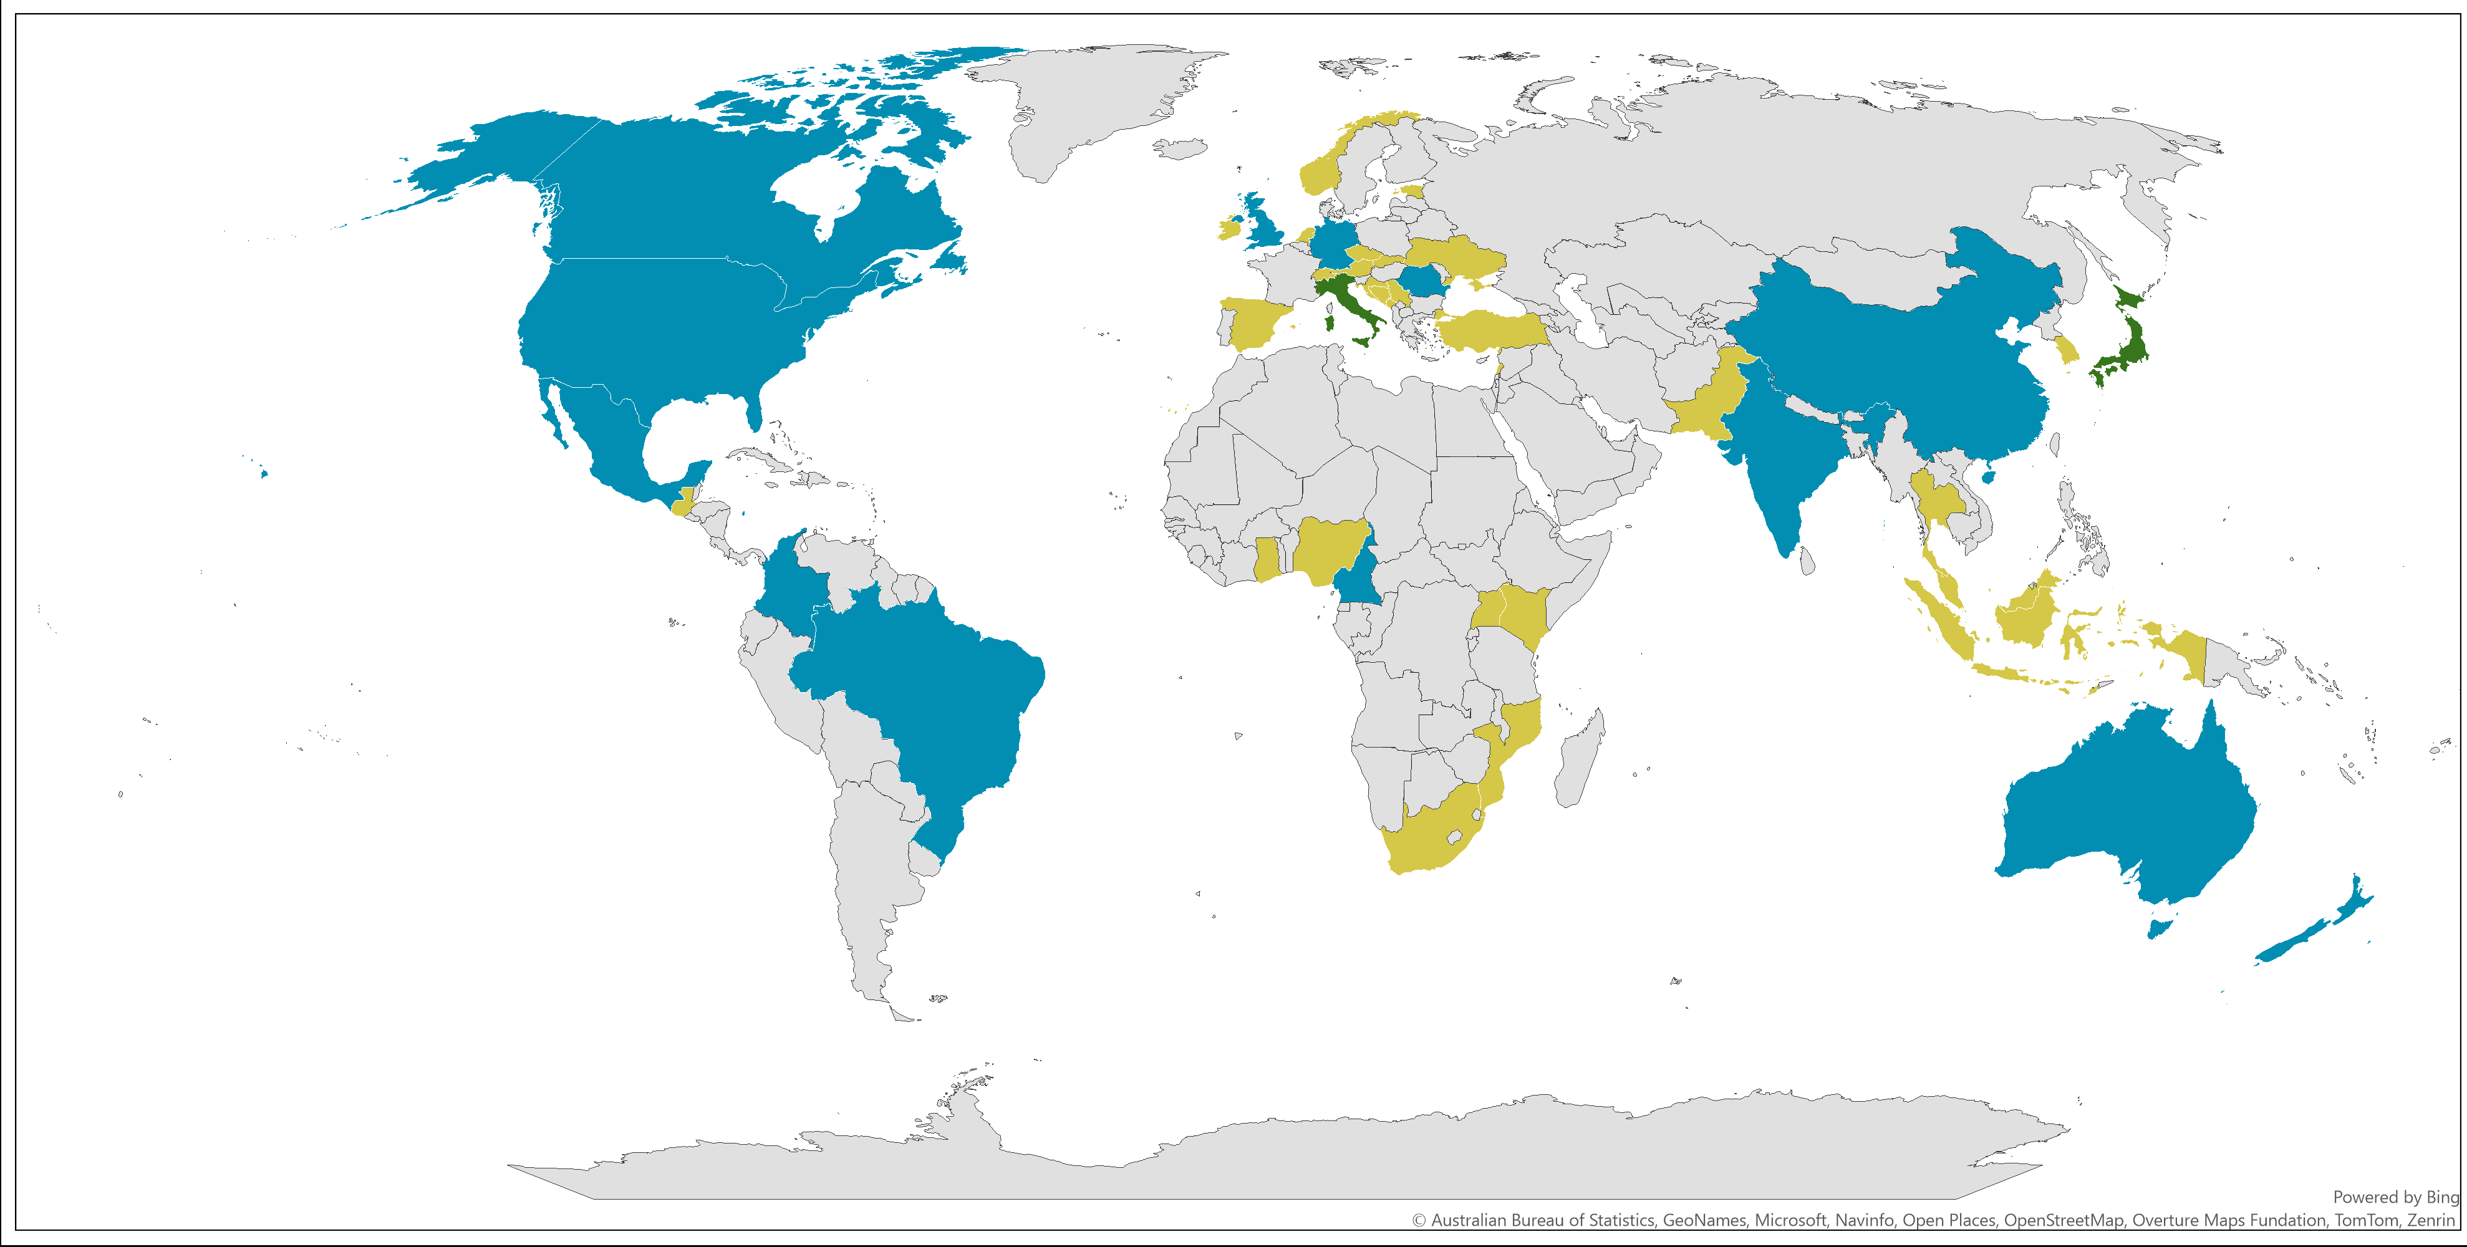
ICUPO and IRGUPO distribution
 | Both
 | IRGUPO
 | ICUPO

Slide 5
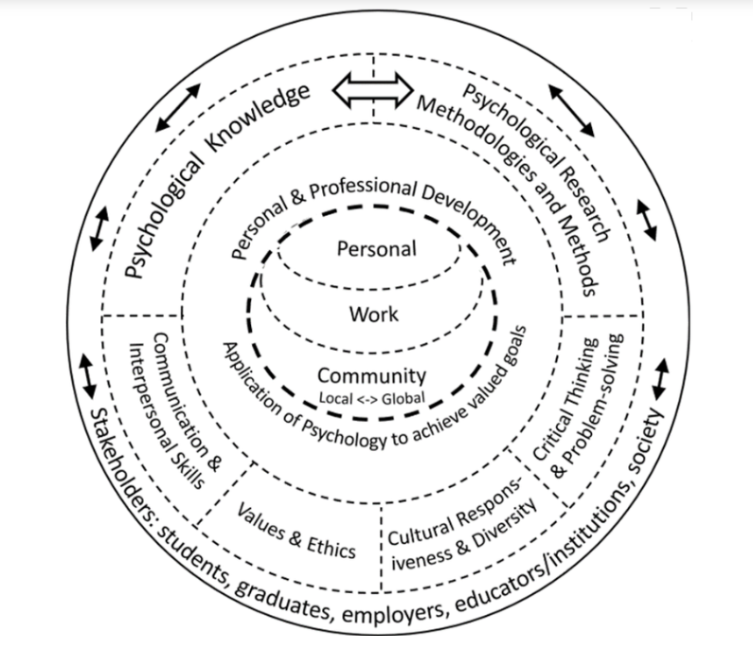
International Competences for Undergraduate Psychology (ICUP model)
Figure 1.International Competences for Undergraduate Psychology (ICUP) Model. This socio-ecologically framed figure emphasizes (a) the broad ecosystem in which the ICUP competences are situated, and (b) the wide range of stakeholders, given that graduates of undergraduate programs in many countries go on to a wide range of careers. There are two core competence categories, Psychological Knowledge (1) and Psychological Research Methodologies & Methods (2). There are also five psychology-relevant competence categories (Values & Ethics (3); Cultural Responsiveness & Diversity (4); Critical Thinking & Problem-solving (5); Communication & Interpersonal Skills (6); Personal & Professional Development (7). All seven competence categories interact with each other. Numbering is primarily for convenience in referring to competence statements. In this figure, psychology-relevant Personal and Professional Development is in the center, emphasising the importance of students’ current and future lives and goals.
This placement also represents a socio-ecological perspective (Bronfenbrenner, 1979, 2005; Bronfenbrenner & Ceci, 1994). From “International Collaboration on Undergraduate Psychology Outcomes (ICUPO): Figures and Tables””, by S. A. Nolan et al., 2025b (https://osf.io/6y38x/). Copyright 2025 by the International Collaboration for Undergraduate Psychology Outcomes Committee; permission to use Figure 1 granted on 13 January 2025.
CR
ICUP preprint available: https://osf.io/6vz8s

Slide 6
Why cultural responsiveness (CR)?
The capacity to sensitively interact with people from different cultures (Deardorff, 2010, Arasaratnam-Smith, 2017)
Often known as ‘intercultural competence’ – but this has been criticised in recent work with Indigenous and First People communities (e.g. Comeaux, 2023, emphasis on intersectionality not only ethnicity).
CR is: “transformative, incorporating knowledge, especially self-knowledge, behaviour, and action…[and is] about listening more and talking less and working collaboratively…” (Smith et al., 2022, p.2).
Within ICUPO – a broad understanding of culture, inclusive of intersecting identities related to sex, gender, sexual orientation, ethnicity, ability/disability, neurodiversity, religion, and more consistent with the Central Vancouver Island Multicultural Society (CVIMS, 2021).
“Cultural responsiveness involves adopting an ongoing reflexive approach to understanding and addressing the psychological needs and well-being of diverse populations, including by actively seeking knowledge about cultural groups – their histories, traditions, customs, systemic influences, and unique challenges.” (Nolan et al., 2024b, p.11)

Slide 7
Why and how did we develop CR in our group?
We quickly realised we had cultural assumptions about psychology, about higher education, and how we see and exist within the world.
ICUPO Committee – 17 people, 11 self-identified as having White ancestry, 10 identified as women. Seven were from colonised nations, 3 were from First Peoples ancestry, and three were from colonising nations. Three people were from the Global South (now 5 among 19).
Integrated reflexivity – an attitude of learning from diverse others, and recognition of our own biases.
Positionality exercises – led by Indigenous member, based on Working to End Racial Oppression resources.
Emphasis of Banks’ (2014) Transformative Approach to Multicultural Curriculum Reform – Know, Care, Act. Examples – slow down, monitor chat.
Prioritise minoritised voices, collective agenda setting and a ‘Three Minute Thesis’ opportunity at the end of every meeting.
Allyship! – drawing on privileged status to ensure minoritised voices were heard.

Slide 8
Did we increase our own CR? (part 1)
Quantitative measures – Cultural Competence Self-Assessment scale (CCSA – CVIMS, 2021) and the Multicultural Attitude Scale Questionnaire (MASQUE – Monroe & Pearson, 2006, includes Know, Care, Act measures).
Small sample size, but high reliability.
Higher scores on Know subscales than on Act subscales – as expected.
There was generally high CR at the start of the project AND most members demonstrated an increase in CR during the project.
Cautious optimism!

Slide 9
Did we increase our own CR? Part 2
Qualitative analysis of positionality statements – reflexive thematic analysis (Braun & Clarke, 2022).
Constructed four themes:
Challenge as a stimulus for growth
Discomfort when making errors, being challenged by others, and generally reflecting on engagement in a diverse social environment. Structural processes supported this.
“those uncomfortable and/or ‘aha’ moments… whereby I realised that I had made an incorrect assumption about the way that they think, feel or behave, because that assumption was based on my, rather than their, cultural norms”.
Being able to “forgive myself, as long as I learned for future interactions.”

Slide 10
Did we increase our own CR? Part 2
2. Never-ending journey
Regardless of the starting point (novice/expert), everyone recognised development through the project, and that this process of growth and understanding would likely continue throughout life.
“I have always believed that I was culturally responsive and acted to ensure that my colleagues, students, and friends were respected and safe when interacting with me. However, I am beginning to understand more about the dynamics of working in a very culturally diverse group… asking myself if I have sufficient evidence to support my self-beliefs and if I am open to changing them!”
“I now know more about what I don’t know as well as what I do know…”

Slide 11
Did we increase our own CR? Part 2
3. The work of cultural responsiveness
Becoming culturally responsive entails complex cognitive and emotional challenges which require considerable self-awareness, inclusive behaviours, learning, sensitive challenges, and difficult communication, sometimes in another language.
“being culturally responsive does take self-motivated effort, and my energy is limited.”
4. Transformations through CR – personal, curricular, student-related
We were personally transformed – and took this to our teaching practices. In developing our students, we dream of a more inclusive, culturally safe society, where diversity is valued, and curricula are decolonised.
“Teaching psychology in [nation] has many challenges, especially that the country is very multicultural…We largely teach western models and texts, but sometimes that limits us from taking into consideration cultural differences.”

Slide 12
Our overarching conclusion
“The future success of the ICUP Model, in terms of its use in curriculum creation/revision, is likely dependent on the growth of CR within the discipline of psychology, as instantiated by the CR of its leaders, especially its educational leaders. That development is critical to the global sustainability of the discipline and practice of psychology” (Cranney et al., 2025).

Slide 13
Our conclusions and some implications across disciplines in S3/NTU
It is possible to deliberately and consciously incorporate activities that support the development of CR into the ‘business’ of higher education. Where do we or can we encourage positionality and the privileging of minoritised voices in our meetings and decision-making processes? What about in our classes?
Diversity among groups of educators helps to stimulate growth and reflection. Recruitment practices that positively promote diversity benefit everyone.
Ongoing professional development for educators that incorporates skills in reflection and positionality exercises can help develop CR. Can this be emphasised in our staff development offer?
There is value in recognising cultural difference within the discipline. How do we find out about curricula in other cultures than our own?
What we know (or don’t know) influences how and what we teach. Where do we have opportunities to reflect on what is effective in teaching our students CR?

Slide 14
You have been introduced by a friend to one of their friends, Bindi, an Aboriginal woman who has recently moved down to the city from a remote area. You are trying to engage her in conversation, but finding this very difficult as she looks away whenever your eyes meet.
Attempt to speak to her a couple of times, but if she doesn't want to talk then leave her alone.
B. Do your best to make her feel comfortable with the tone of your voice and manner of speaking. Adopt non-threatening body language and make soft eye contact with her whenever you have the opportunity.
C. Ask her if eye contact is uncomfortable for her and if she would prefer that you look away too.
D. Adapt to her needs in order to ensure she's comfortable.
E. Ask about her people and if she would like to share a little of her beliefs and values. Give her some time to get to know you.
Thanks to Prof Tony Machin (University of Southern Queensland) for this example

Slide 15
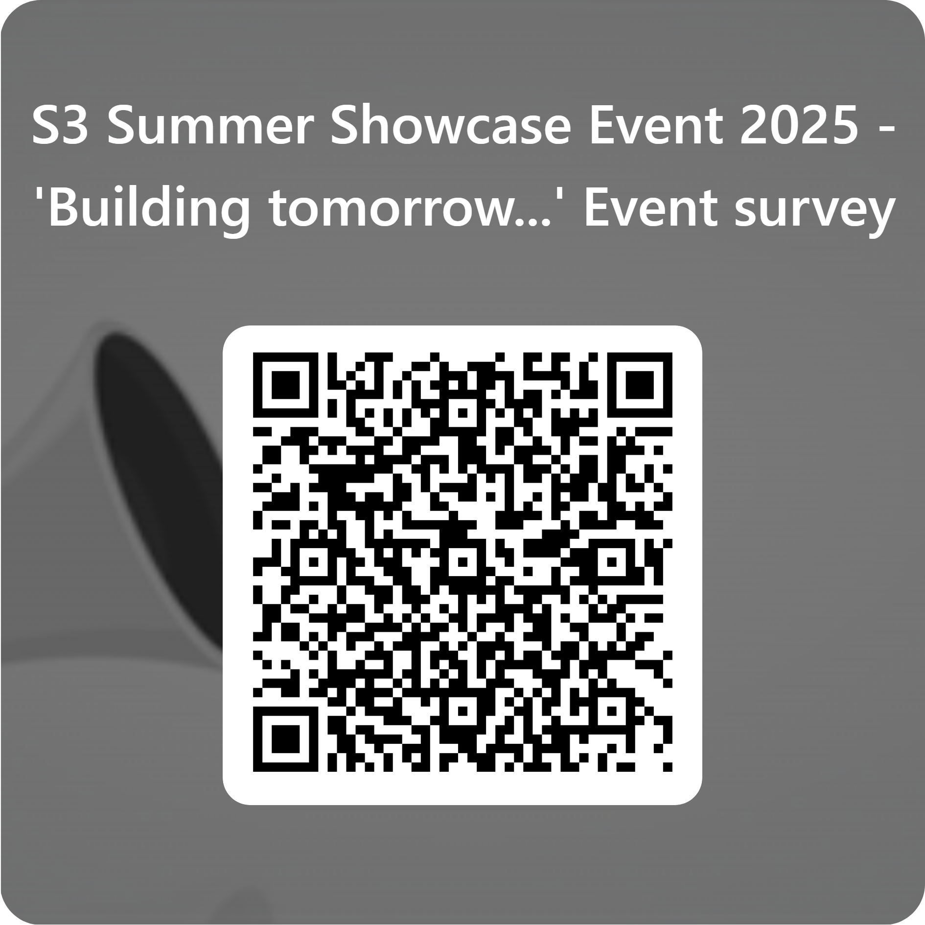
S3 School Summer Showcase
Thank you for attending the S3 School Showcase 2025.
We hope you have enjoyed these sessions.
Please remember to register your feedback at the end of the event:
https://forms.office.com/e/qk1AbCMsEV

