Slide 1
Approaches to scholarship within the Social Sciences, Arts, and Humanities
School of Social Sciences Scholarship Forum
Panel chair: Professor Rose Gann, rose.gann@ntu.ac.uk
Panel:
Dr Chris Rolph, chris.rolph@ntu.ac.uk
Dr Lia Blaj-Ward – apologies, lia.blaj-ward@ntu.ac.uk
Dr Iain Wilson, iain.wilson@ntu.ac.uk
Dr Ricky Gee, ricky.gee@ntu.ac.uk
Professor Julie Hulme, julie.hulme@ntu.ac.uk
Notes:
S3 Summer Showcase: 09/10 June 2025
S3 scholarship forum proposal:
Type of Contribution: Main Programme Presentation
Title: Approaches to scholarship within the Social Sciences, Arts and Humanities
Outline of content: This panel of 4/5 staff from across the School of Social Sciences and the School of Arts and Humanities provides 4 (5-8 minutes) short insights into a scholarship project or approach to scholarship to showcase the variety of ways in scholarship is practiced and understood within both Schools and how this has been beneficial to students and staff alike. Indicative panel running order: 1. Prof Julie Hulme & Dr Ricky Gee, 2. Lia Blaj-Ward. 3. Iain Wilson. 4. Chris Rolph
50-word summary for the programme: This panel of 4/5 staff from Social Sciences and Arts and Humanities provides insights into several scholarship projects to showcase the variety of ways in which scholarship is practiced and understood within both Schools and to examine how scholarship is beneficial for students and/or for staff expertise.
How the proposal links with the school mission statement and showcase theme: This proposal celebrates innovations in scholarship across Social Sciences, Arts and Humanities and supports the School of Social Sciences’ long term scholarship objective to demonstrate scholarship impact and bring about positive change to enrich the student learning experience as well as staff expertise.

Slide 2
Scholarship Case Study – Chris Rolph
2019
“any work that aims to understand or enhance an aspect of higher education. It is shared publicly, it can be evaluated, and it is implemented by other people.”
2016
2022
2024

Slide 3
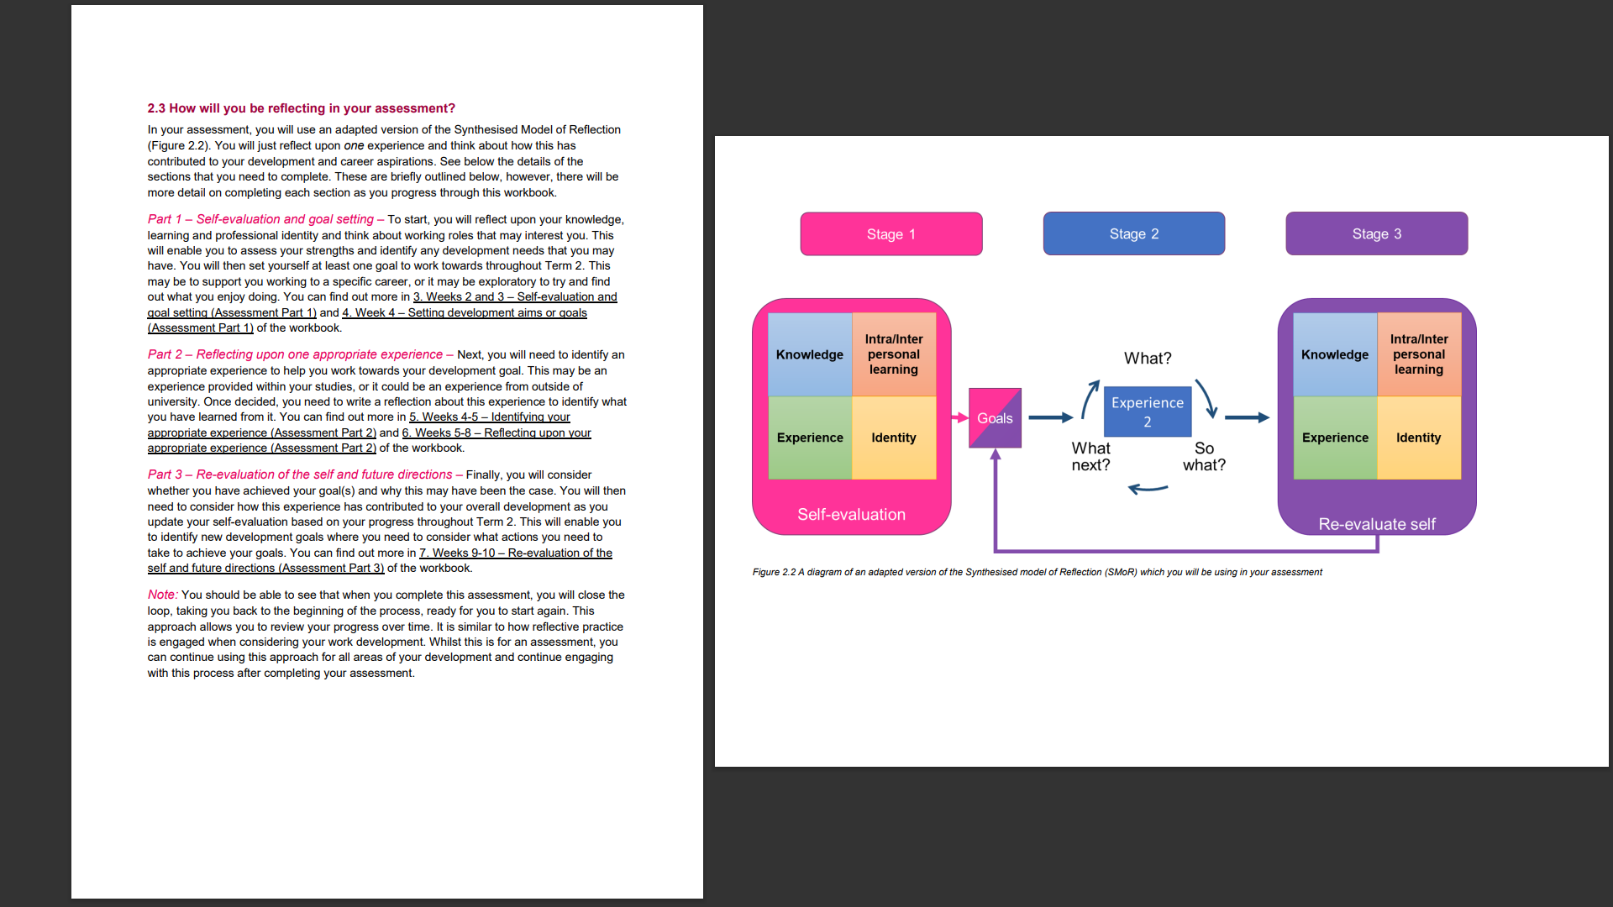
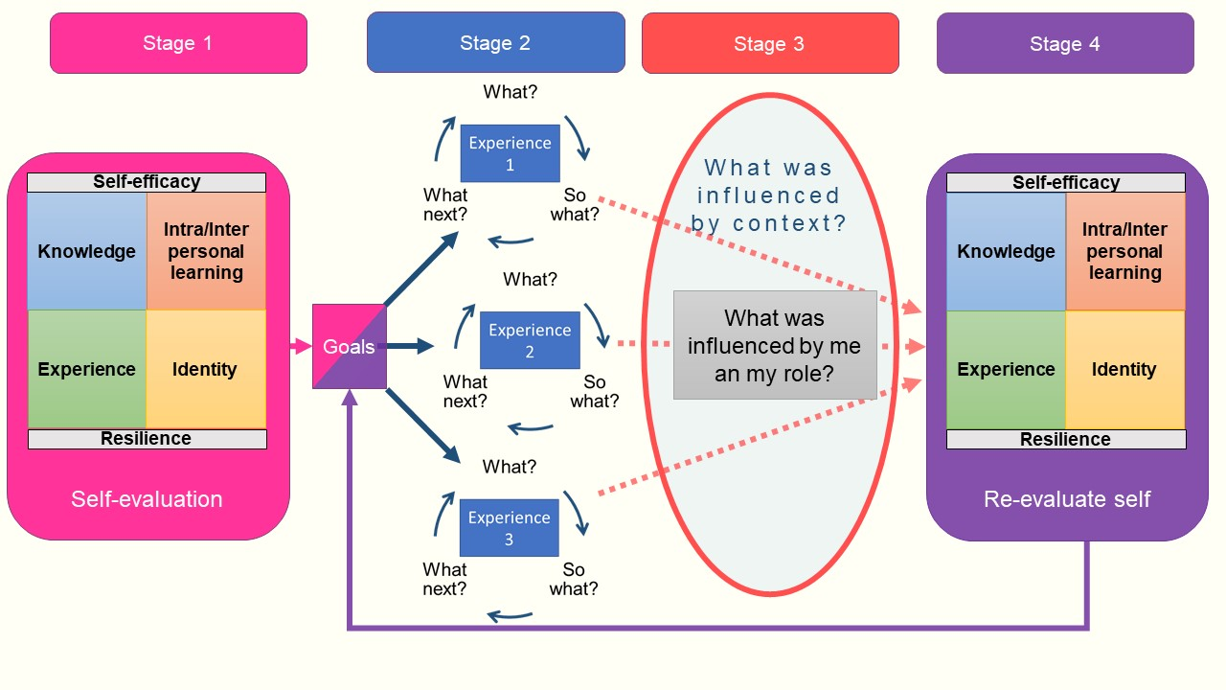
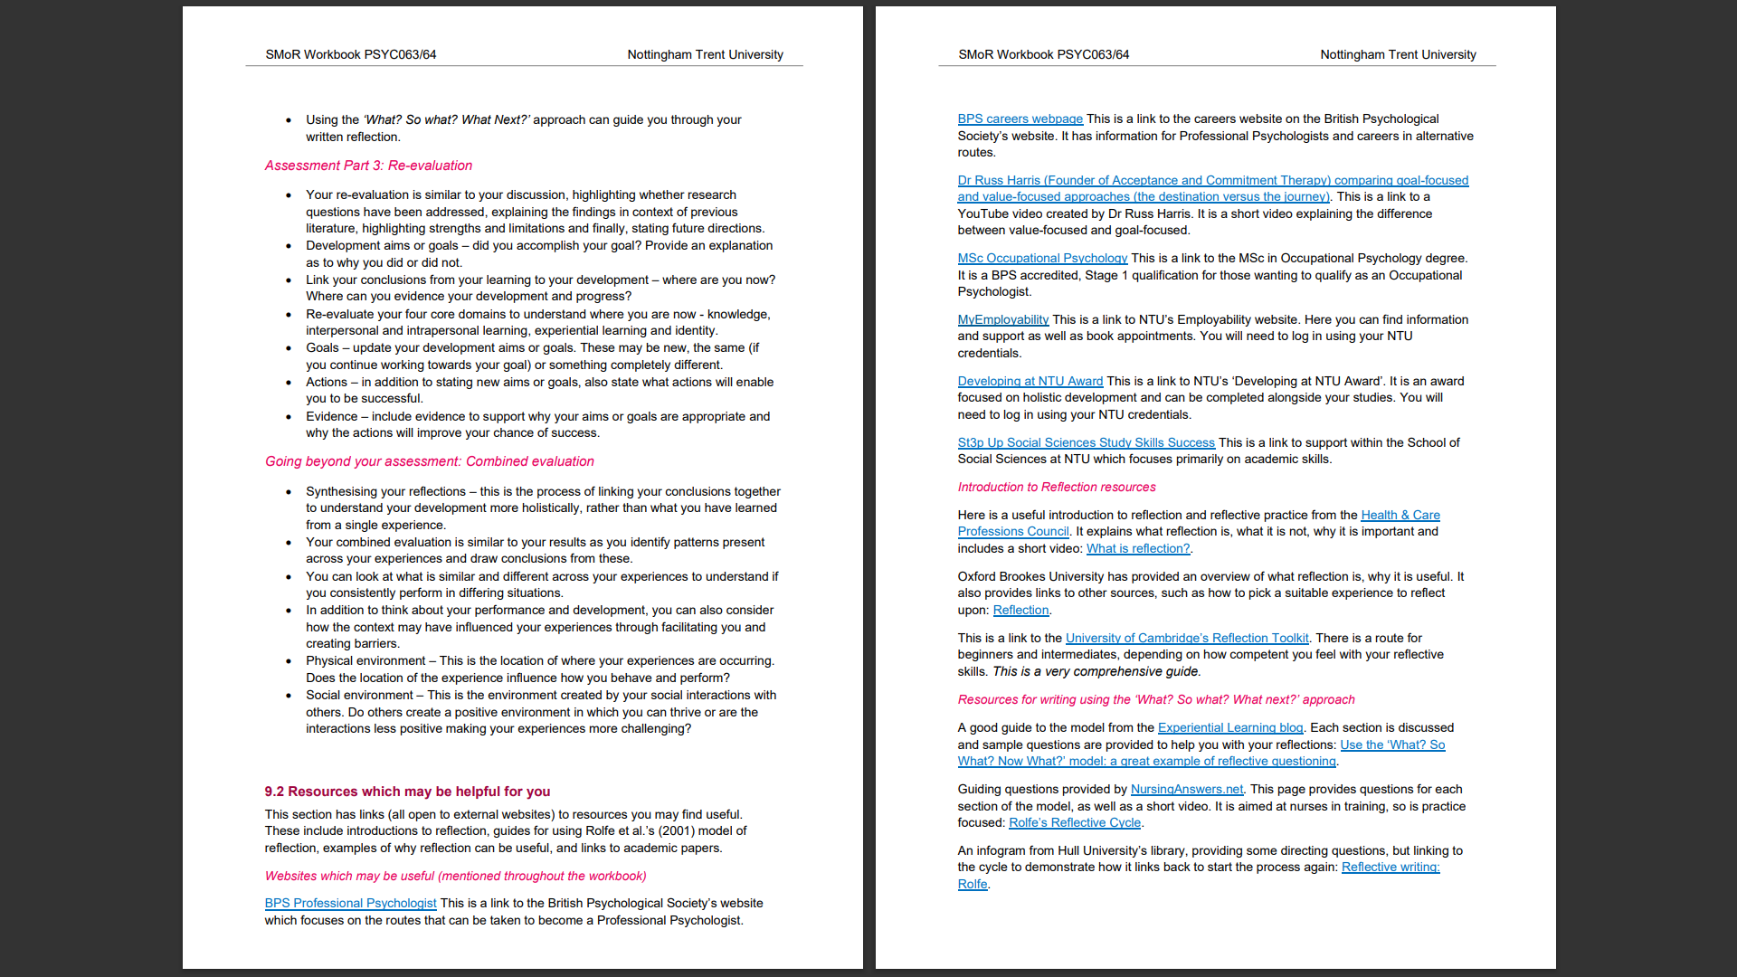
Iain Wilson PhD C.Psycol SFHEA (iain.Wilson@ntu.ac.uk)

Slide 4
Career development stories and identity for marginalised education-focused academics
Dr Ricky Gee
Prof Julie Hulme (she/her)
With thanks to NTU Psychology for seedcorn funding.
With thanks to Owen Wilkinson for research assistant support.
Notes:
.

Slide 5
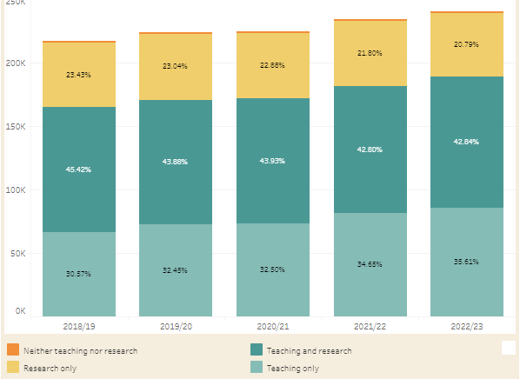
Introduction
Both numbers and proportions of education-focused academics (EFA; e.g. Teaching and Scholarship pathway at NTU) have increased across the sector since 2012 (approx. 250,000 now).
There are multiple reports of stigmatisation among this group relative to those classified as active researchers, e.g. Hulme (2022). Promotion is known to be highly challenging.
People with marginalised characteristics are over-represented in this group.
How do marginalised EFAs experience their academic careers? How can this be explained in terms of career development theory (e.g. Oldridge & Gee, 2023) and/or social identity theory (Tajfel & Turner, 1979)?
WonkHE: https://wonkhe.com/wonk-corner/hesa-spring-2024-staff-in-outline/

Slide 6
Methods
Both researchers identify as marginalised EFAs themselves, in different ways.
Participants = 11 EFAs who were employed in UK higher education institutions in 2024 as Senior Lecturers, Principal Lecturers, Associate Professors/Readers. All self-identified as marginalised in some way, e.g. ethnicity, gender/sexuality, disability, socioeconomic background.
Semi-structured interviews (60-90 minutes) conducted over MS Teams, recorded and transcribed.
Reflexive thematic analysis (Braun & Clarke, 2022).

Slide 7
Results (preliminary themes)
Origins in happenstance – EFAs accidentally/opportunistically found themselves taking a teaching-focused job early in their career, enjoyed it and realised they were good at it – so agentically chose to continue. It becomes part of their identity. This sometimes also ties in with lack of ability to move, and so reduced opportunities to leave.
Jack/y of all trades – often had to take on lots of different teaching roles, fill the gaps – and so see themselves as flexible and versatile, but can also sometimes miss identifying their specialism and expertise.
Emotional labour – minoritised EFAs frequently spoke of being involved in EDI work, supporting others, especially those who are also minoritised, and other EFAs. They want to change culture and create parity of esteem, but this can be emotionally burdensome.
Economy of care – they talk about having encountered barriers and blockages, but finding a sponsor who helped them to develop and progress. They are now ‘paying it forward’.

Slide 8
Implications
EFA expertise is can be under-appreciated both by universities and sometimes by EFAs themselves. Intersectionality of marginalised identity with EFA status. Universities can recognise educational contributions more, and consider providing additional support (mentoring, coaching) for marginalised EFAs.
Importance of recognising that the decision to become an EFA may at first be opportunistic, but for many, it becomes a central feature of professional identity, and an expression of a commitment to social justice. EFAs are agentically following a vocation, not stuck in a career that they perceive as ‘a road to nowhere’ – we need to support development and progression, not try and persuade them to become researchers!
Marginalised EFAs as ‘positive disruptors’ (Hulme, 2022) who care, and who take responsibility for equity, inclusion, organisational culture. Universities must ensure that this good will is both valued and not taken for granted – monitor and provide support for compassion fatigue, recognise the costs. Processes that recognise and reward citizenship and collegiality (as per Hulme et al., 2025).

Slide 9
Thank you!
Conclusion:
Scholarship can look different for different individuals and in different contexts.
Please share your questions, thoughts, comments – we all learn from discussing with each other!
“any work that aims to understand or enhance an aspect of higher education. It is shared publicly, it can be evaluated, and it is implemented by other people.”

