Slide 1
Introducing the DARSHE*: A tool to build and develop scholarship in higher education *Descriptions of activity related to scholarship of higher education
Rose.Gann@ntu.ac.uk
Julie.Hulme@ntu.ac.uk
Gann, R.J. & Hulme, J.A. (under review). Scholarship reimagined: Creating the DARSHE, an inclusive and flexible model for scholarship in higher education. Higher Education.

Slide 2
Outline
11am Welcome and introductions
11.30am Introducing the DARSHE – exploring conceptualisations of scholarship and the development of the DARSHE in response
1pm Lunch and networking
2pm Exploring the DARSHE for scholarship development – for individuals, for groups, for staff development – for you!
3.45pm Closing remarks
4pm Optional refreshments and networking available until 5pm – or take a snack with you

Slide 3
Housekeeping
We are not expecting a fire alarm test today; if you hear the alarm, please follow NTU staff to the meeting point. (Use stairs or Lift F for those with mobility impairments).
Tea and coffee are available at the stations outside this room all day
Toilets
Chatham House rules
Meet the team! – come to us with any queries or concerns.

Slide 4
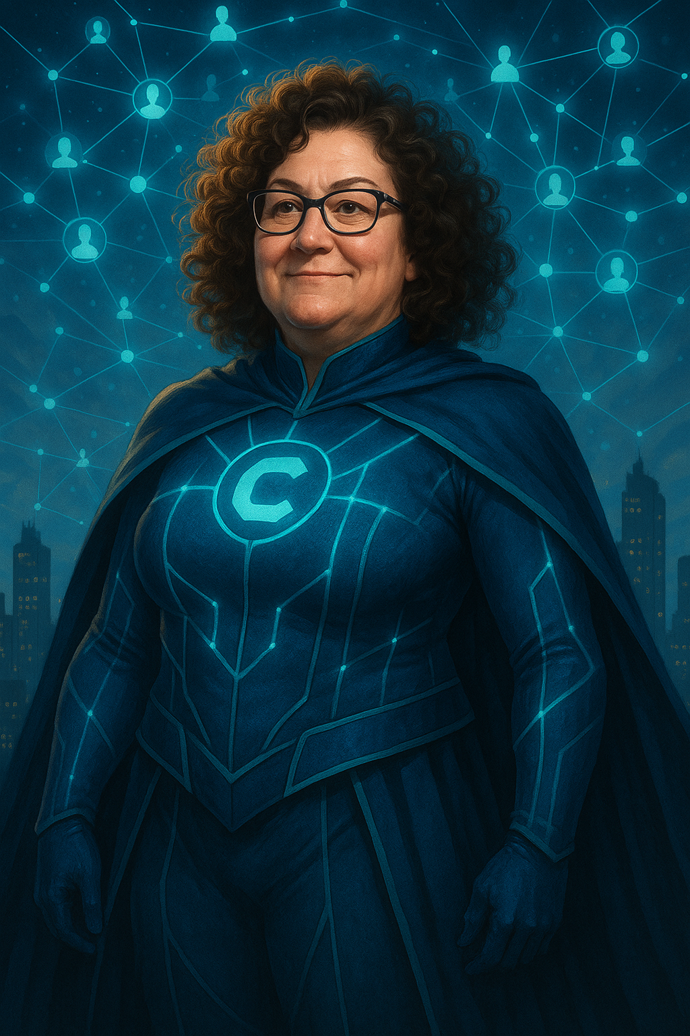
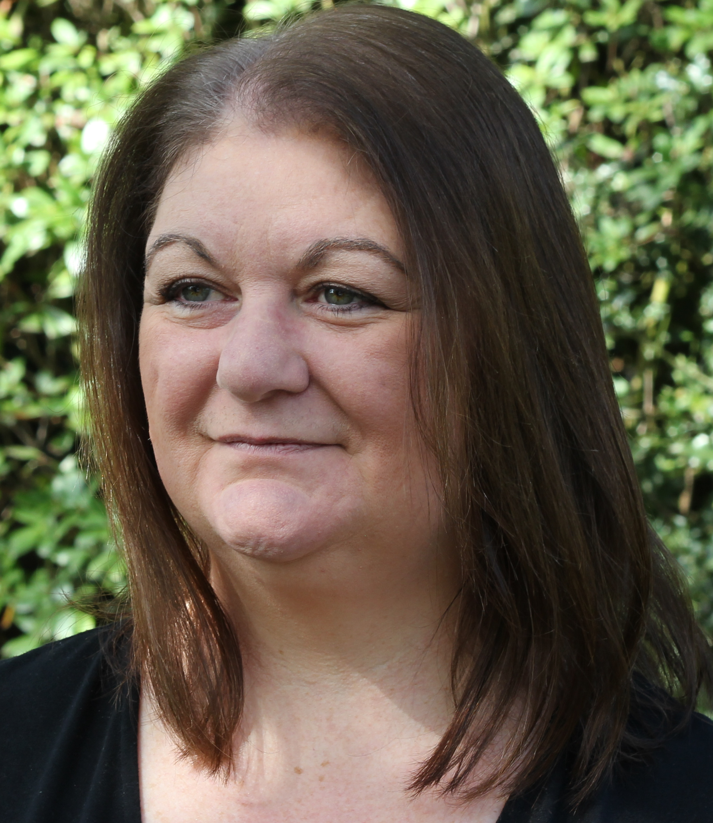
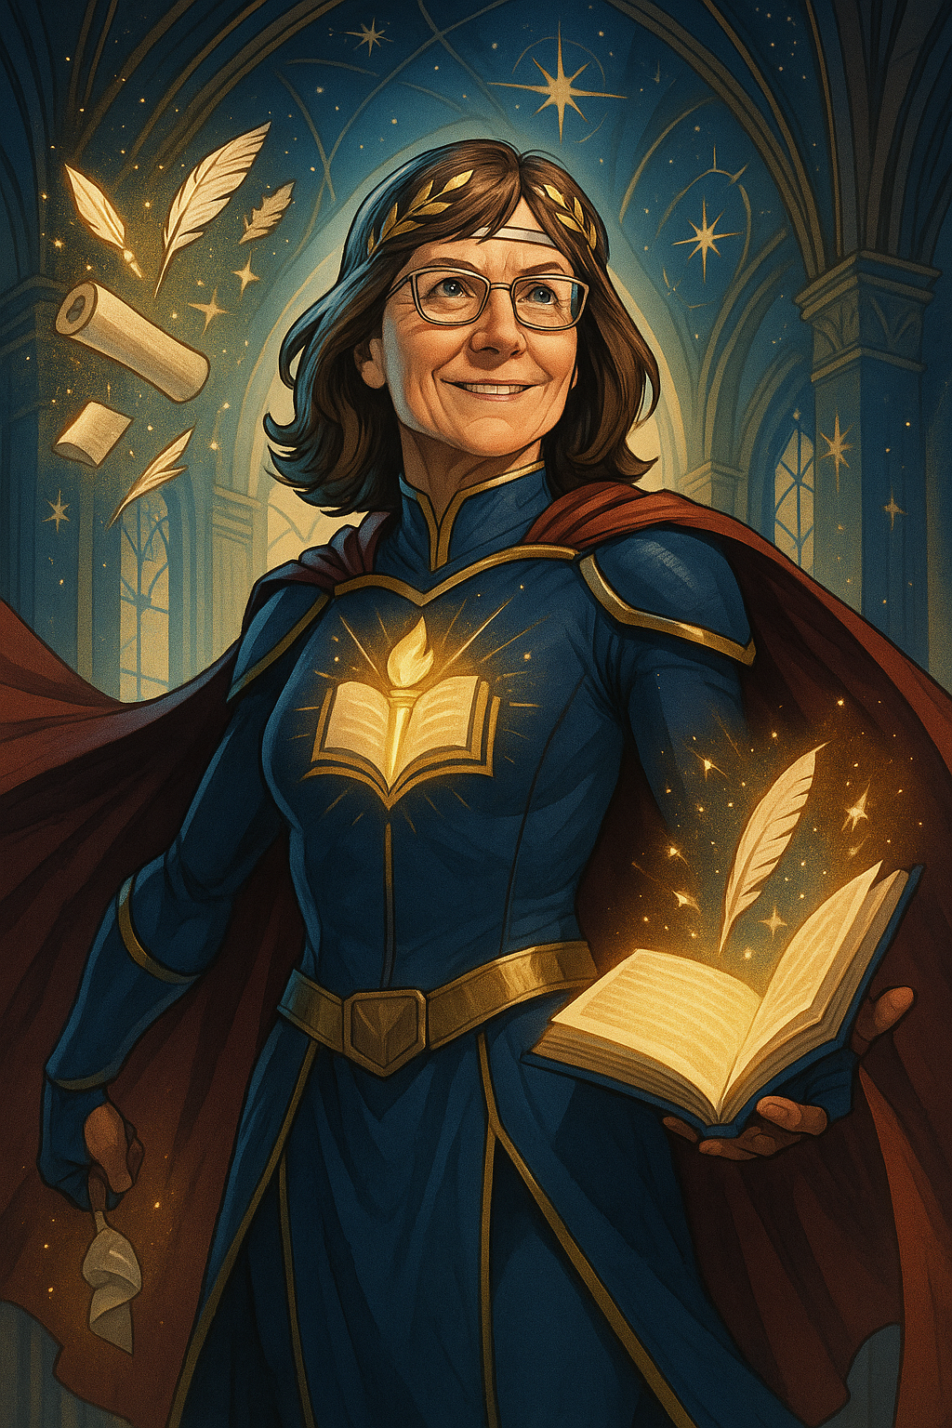
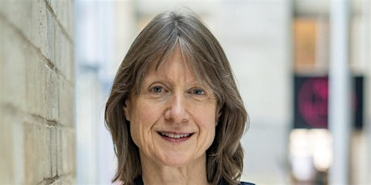
Who are you?
Mix of people with things in common! Academic and educational developers, expert scholars, people leading scholarship activity, key sector bodies, people just getting started in scholarship…
Introduce yourself - what do you like to be called?
Which university do you work at, and what is your job there?
Is there something you’d like your colleagues to know about you?
Why are you interested in scholarship?
What is your scholarship superpower?

Slide 5
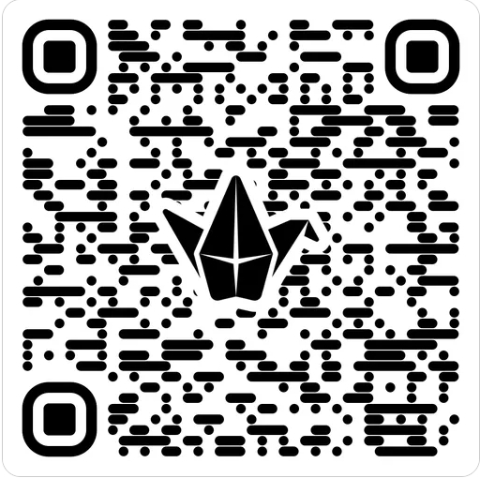
Background to the DARSHE – do we really need another conceptualisation of scholarship?
2022 – the Mapping Scholarship project at NTU
School of Social Sciences, around 80 academics across disciplines engaged with a structured discussion – what does scholarship mean to you?
Padlet and discussion in groups – we’re going to ask you to have a go!
Kern et al (2015) DART model as well as other models resonated with our colleagues BUT they also identified some concerns about it.
http://bit.ly/4ksFoNX

Slide 6
Contested definitions of scholarship
There are lots of models (more than we’ve presented), and there is a lot of confusion in the sector about what we mean by scholarship.
Research, PedR, SoTL, SoTL PedR…so many things!
Rather than trying to argue about which is best, what we accept as scholarship, or following a research model, we wanted to create an inclusive model that would accept different approaches and provide a tool for growth and development.
Synthesis of existing models to encourage consensus and inclusion – what are you doing already, and how can you develop scholarship from it?
We recognised DART as a way in – and built from there. We drew on our lived experience, knowledge of the literature, and voices from Mapping Scholarship.
Iterative process – feedback from ANTF2024 and then confirmation from ANTF2025.

Slide 7
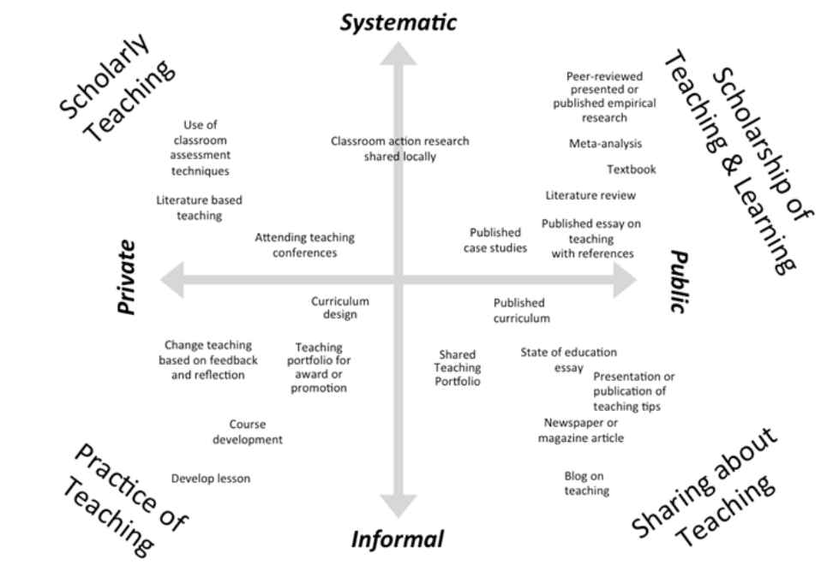

Slide 8
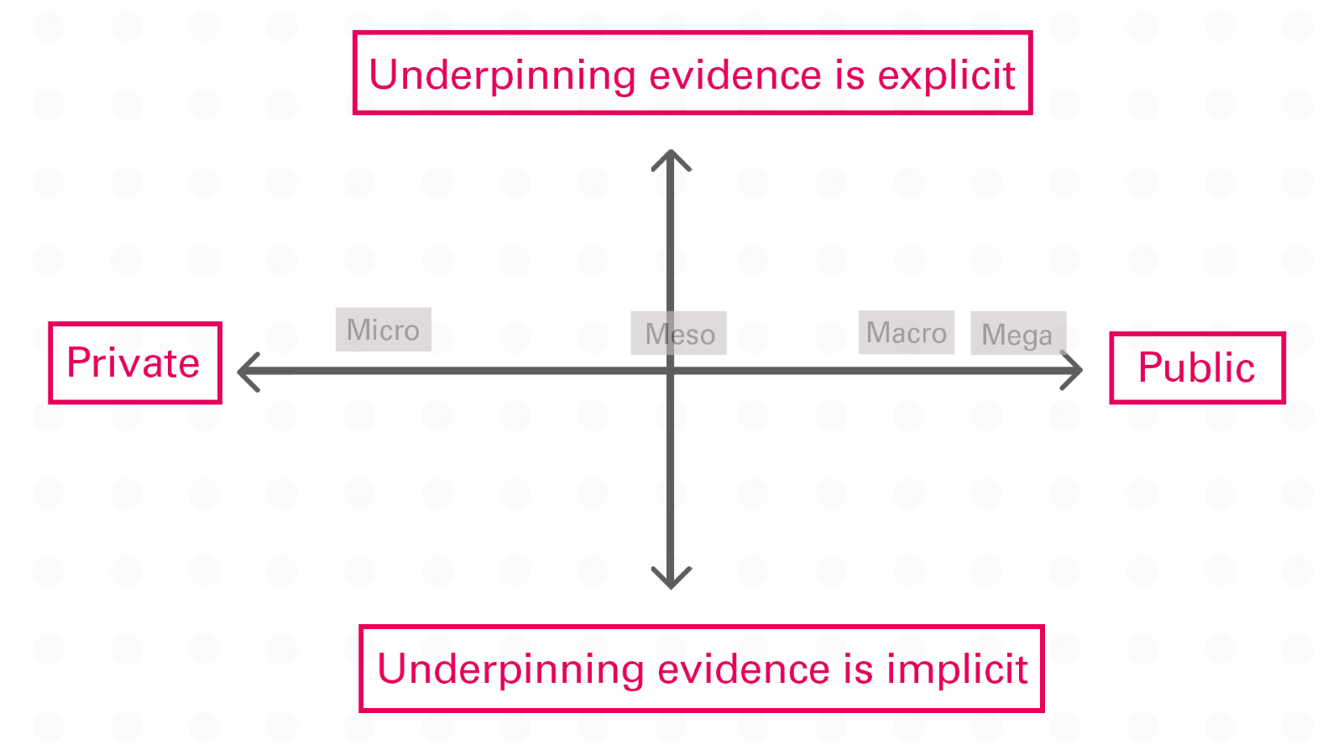

Slide 9
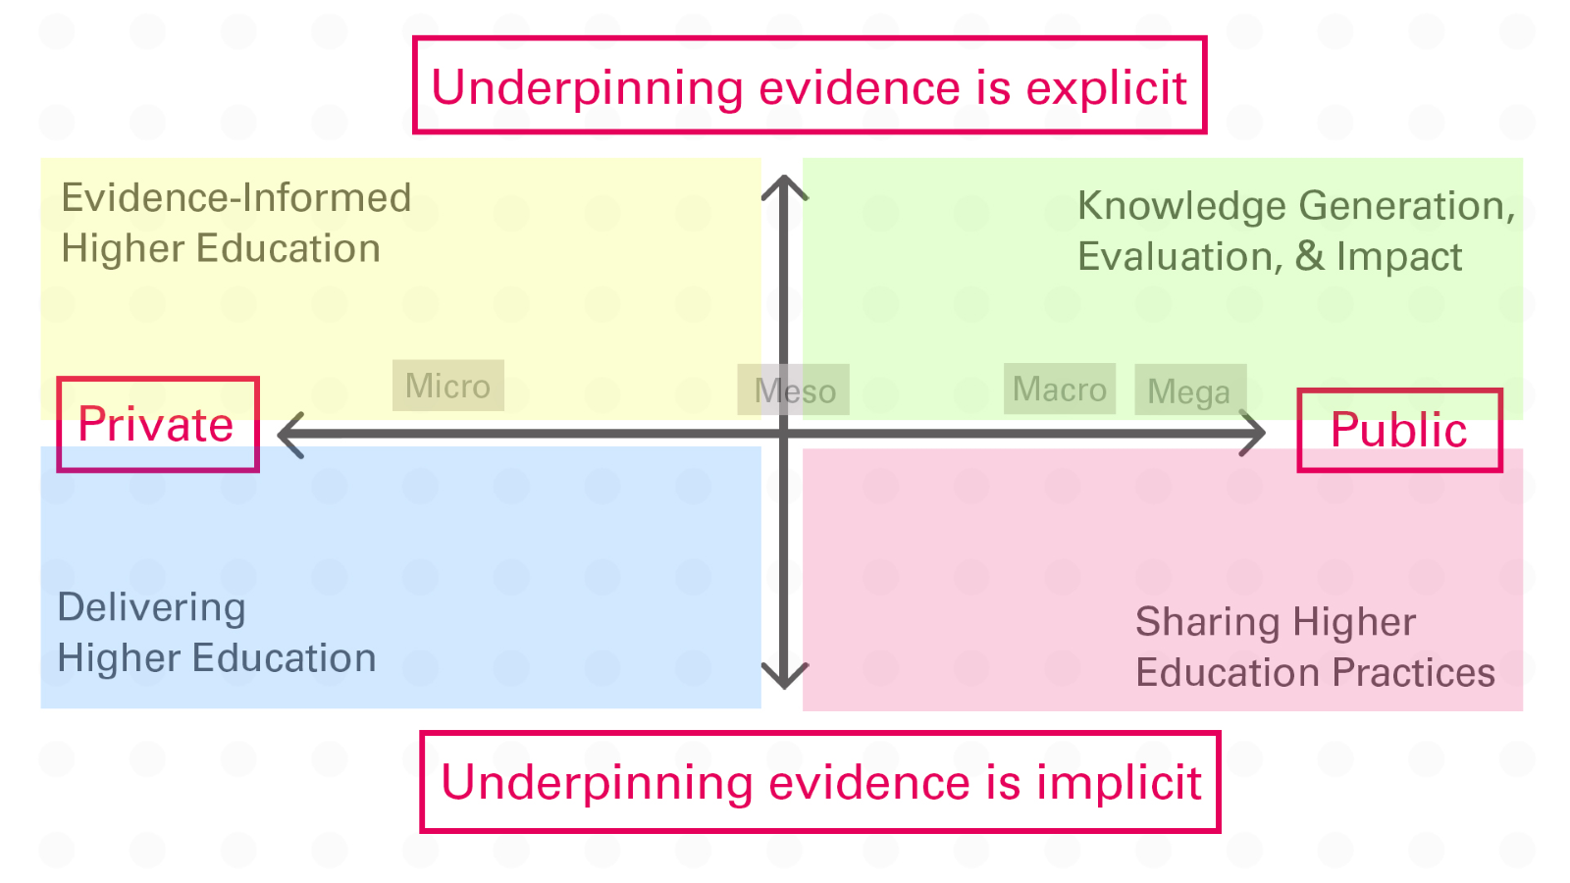

Slide 10
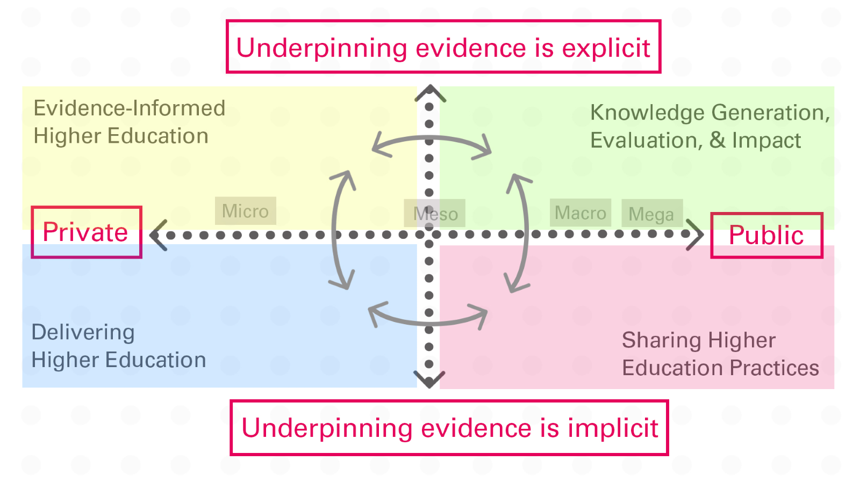

Slide 11
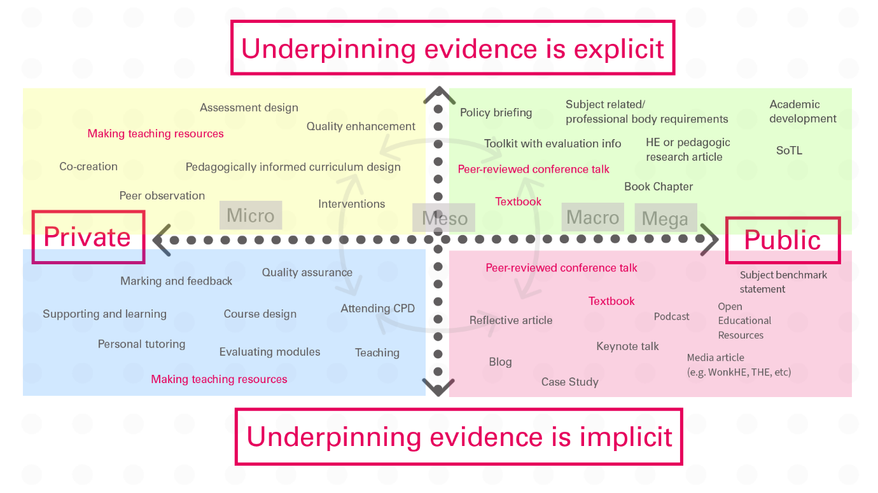

Slide 12
Figure 5.
Underpinning evidence is explicit
Evidence from scholarship literature
Journal articles
Micro
Meso
Macro
Mega
Private
Public
Undergraduate teaching
Subject Benchmark Statement
Conference Presentations
If using, please reference as: Gann, R.J. & Hulme, J.A. (under review). Scholarship reimagined: Creating the DARSHE, an inclusive and flexible model for scholarship in higher education. Higher Education
Underpinning evidence is implicit

Slide 13
Figure 5.
Underpinning evidence is explicit
Evidence from scholarship literature
Journal articles
Micro
Meso
Macro
Mega
Private
Public
Undergraduate teaching
Subject Benchmark Statement
Conference Presentations
If using, please reference as: Gann, R.J. & Hulme, J.A. (under review). Scholarship reimagined: Creating the DARSHE, an inclusive and flexible model for scholarship in higher education. Higher Education
Underpinning evidence is implicit

Slide 14
Figure 5.
Underpinning evidence is explicit
Evidence from scholarship literature
Journal articles
Micro
Meso
Macro
Mega
Private
Public
Undergraduate teaching
Subject Benchmark Statement
Conference Presentations
If using, please reference as: Gann, R.J. & Hulme, J.A. (under review). Scholarship reimagined: Creating the DARSHE, an inclusive and flexible model for scholarship in higher education. Higher Education
Underpinning evidence is implicit

Slide 15
Figure 5.
Underpinning evidence is explicit
Evidence from scholarship literature
Journal articles
Micro
Meso
Macro
Mega
Private
Public
Undergraduate teaching
Subject Benchmark Statement
Conference Presentations
If using, please reference as: Gann, R.J. & Hulme, J.A. (under review). Scholarship reimagined: Creating the DARSHE, an inclusive and flexible model for scholarship in higher education. Higher Education
Underpinning evidence is implicit

Slide 16
Figure 5.
Underpinning evidence is explicit
Evidence from scholarship literature
Journal articles
Micro
Meso
Macro
Mega
Private
Public
Undergraduate teaching
Subject Benchmark Statement
Conference Presentations
If using, please reference as: Gann, R.J. & Hulme, J.A. (under review). Scholarship reimagined: Creating the DARSHE, an inclusive and flexible model for scholarship in higher education. Higher Education
Underpinning evidence is implicit

Slide 17
Your turn!

Slide 18
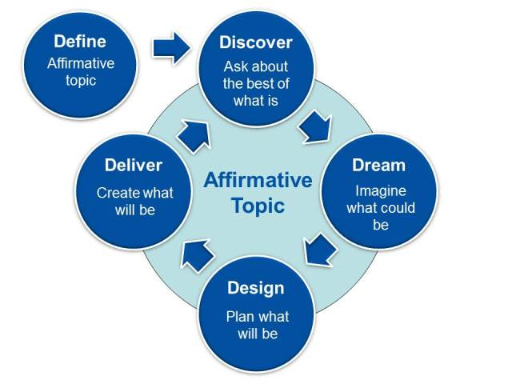
Appreciative enquiry

Slide 19
Activity
Pair up (or trios if we have an odd number) and review your DARSHE scholarship maps.
Take it in turns to use appreciative enquiry to explore where you might each develop next.
While it's fresh in your mind, jot down some notes about actions you will take next.
Be prepared to feedback to the main group – what did you learn from doing this activity? What did you find useful? What was challenging?
How might you use what you learned going forwards?

Slide 20
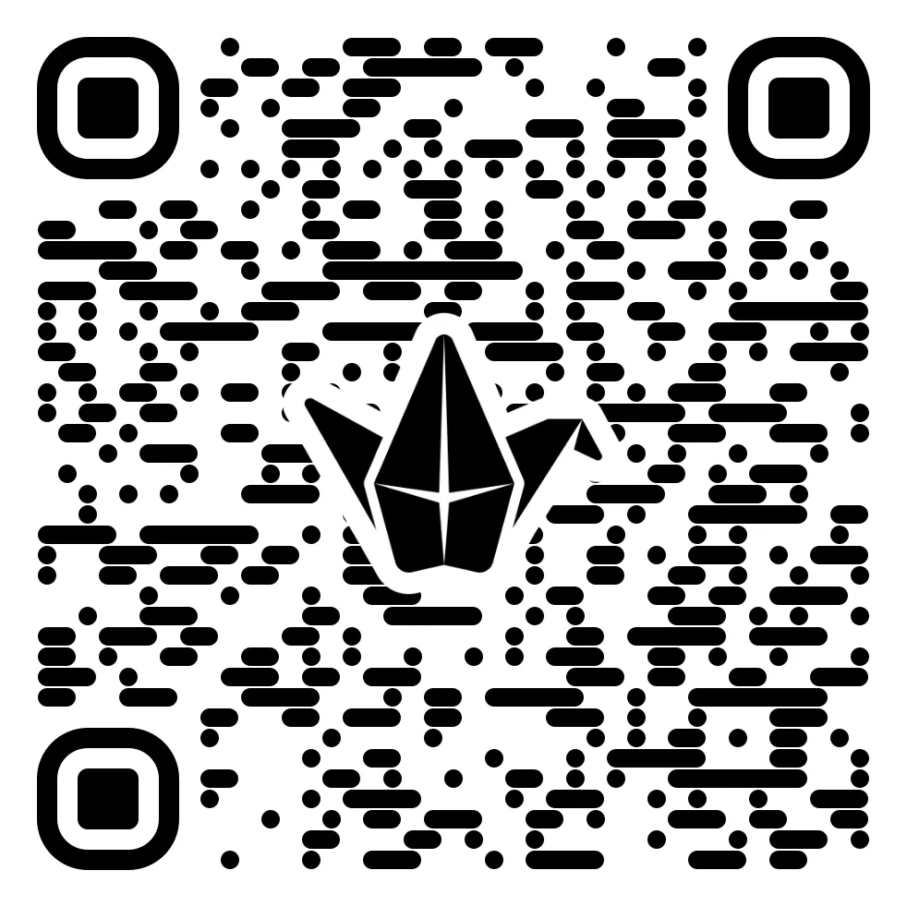
Where and how can you use the DARSHE?
Think about your own development, and how you might use it to support others.
What feedback do you have on the DARSHE model?
What do you still need to know?
http://bit.ly/43RFNlR

Slide 21
What happens next?
We will send you an evaluation form – please do fill it in!
If you haven't already, please add darshe@ntu.ac.uk to your contacts list – or keep an eye on your spam/junk folders.
We would like to follow up with you to:
Send you a copy of the final paper when it is published,
Find out about how you have used the DARSHE in your roles in a few months.
If you would prefer us not to get in touch, please email darshe@ntu.ac.uk by 13th July 2025 to let us know to remove you from our mailing list.
Keep in touch?
Rose.Gann@ntu.ac.uk; Julie.Hulme@ntu.ac.uk
Thank you! For now – networking and refreshments, and/or safe travels!

