Slide 1
How should parents motivate their children prior to high-stakes exams?
Dr. Richard Remedios
Associate Professor of Student Motivation and Engagement
NTU Psychology
Thursday, 26th June, 2025
richard.remedios@ntu.ac.uk

Slide 2
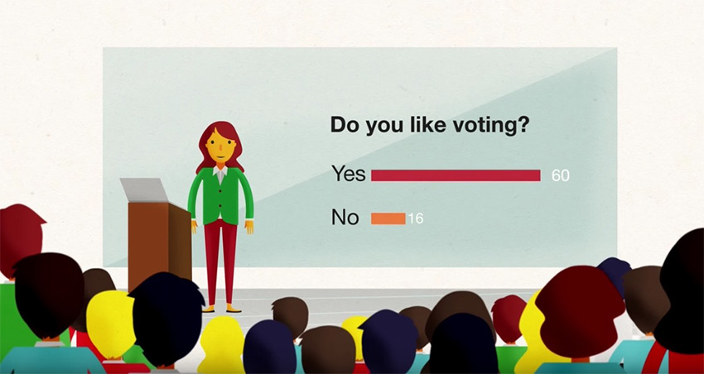
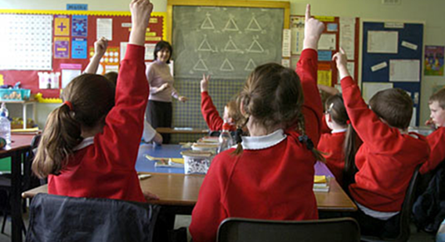
What we will be doing

Slide 3
Audience participation time

Slide 4
Explanation of our research

Slide 5
High-Stakes Exams

Slide 6
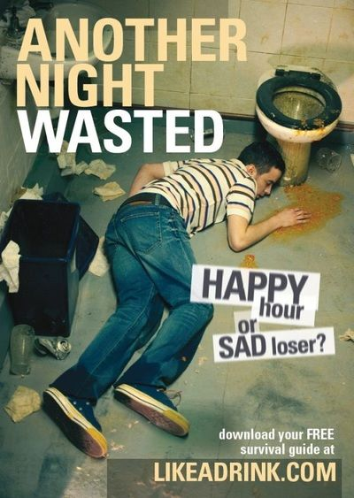
Fear Appeals
Fear Appeals are messages that warn you of the consequences of NOT doing something.
Very common in the health literature.

Slide 7
People who motivate you

Slide 8
Teachers’ use of Fear Appeals
Putwain, D. W., & Roberts, C. M. (2009). The development of an instrument to measure teachers' use of fear appeals in the GCSE classroom. The British journal of Educational Psychology, 79, 4, 643–661. https://doi.org/10.1348/000709909X426130

Slide 9
Interviews with students

Slide 10
Consequence
How often do your TEACHERS tell you that you need good GCSE results help to be able have a good life in the future?
How often do your TEACHERS tell you that you need to get good grades in your GCSEs to get a good job?
How often do your TEACHERS tell you that your GCSE results determine your future?
How often do your TEACHERS tell you that you need to get good grades in your GCSEs to go to college or 6th form or get an apprenticeship?
Putwain, D. W., & Remedios, R. (2014). The Scare Tactic: Do Fear Appeals predict motivation and exam scores? School Psychology Quarterly, 29, 503-516. DOI: 10.1037/spq0000048

Slide 11
Confident student
Experience the message as a “challenge”
Low anxiety
Positive motivation
If you don’t work hard, you won’t get into college
Putwain, D. W, Remedios, R., & Symes, W. (2016). The appraisal of fear appeals as threatening or challenging: Frequency of use, academic self-efficacy and subjective value. Educational Psychology, 36, 6, 1670-1690 DOI: 10.1080/01443410.2014.963028

Slide 12
No so confident student
Experience the message as anxiety provoking
Disengage from task
Negative motivation
If you don’t work hard, you won’t get into college
Putwain, D. W., Symes, W., Laura J. Nicholson, L. J., & Remedios, R. (2021). Teacher motivational messages used prior to examinations: What are they, how are they evaluated, and what are their educational outcomes? In: A.J. Elliot, ed. Advances in Motivation Science, 8, 63-103. https://doi.org/10.1016/bs.adms.2020.01.001.

Slide 13
Tips for teachers: Know your student/child
Messages themselves do NOT predict student experience.
It is how the messages are received/experienced.
If your student/child is NOT confident, avoid fear appeals
If your student/child is confident, fear appeals can be experienced as a challenge.

Slide 14
What about parents?

Slide 15
Interviews with students

Slide 16
Three new constructs
Reassurance
Pride
Changing Behaviour
How often do your parents tell you that GCSE results are not the be all and end all?
How often do your parents tell you they will always be there for you, no matter what your GCSE grades are?
When your parents remind you to revise for upcoming GCSEs exams, does it make you want to stop doing your schoolwork?
When your parents remind you about upcoming GCSEs exams, do you stop listening to them?
Do you want to try hard to do well in your GCSEs so your whole family will be pleased with you?
Do you feel you need to well in your GCSEs so that you do not let your parents down?
Remedios, R. (2023) Worrying or Motivating? Students’ experiences of their parents’ motivational messages. BPS Psychology of Education Section Annual Conference, Oxford, September, 2023.
Remedios, R., Putwain, D. W., & Symes, W. (in prep) Students’ experiences of their parents’ motivational messages: A new instrument.

Slide 17
Parents using Fear Appeals in Education
I wish he wouldn’t use Fear Appeals with our children
If you don’t work hard, you won’t get the grades you need to do well in your SATs.

Slide 18
What did you say compared to what students experience?

Slide 19
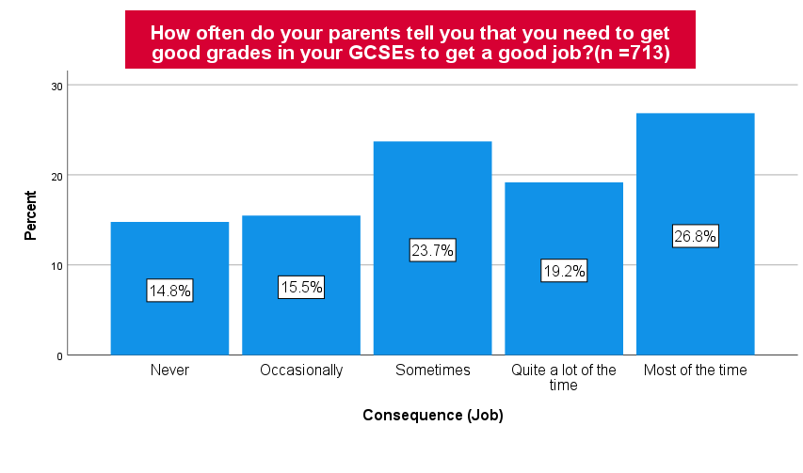

Slide 20
The curious case of PRIDE
Variables | 1 | 2 | 3 | 4 | 5 | 6 | 7 | 8
1. Pride | --
2. Reassurance | .09 | --
3. Changing Behaviour | -.04 | -.08 | --
4. Consequence | .38** | -.30** | .22** | --
5. Self-belief (4 items) | .28** | -.07 | -.28** | .16** | --
6. Persistence (4 items) | .22** | .09 | -32** | .04 | .48** | --
7. Anxiety (4 items) | .19** | .11* | .14* | .06 | -.16* | -.09 | --
8. Learning-Focus (4 items) | .26** | .02 | -.21** | .11* | .56** | .36* | -.02 | --
9. Self-Sabotage (4-items) | -.02 | -.06 | .37** | .05 | -.23** | -.29** | .17** | -.15** | --
Mean | 3.87 | 2.52 | 2.25 | 3.33 | 3.96 | 3.32 | 3.45 | 3.85 | 2.28
Standard Deviation | 1.07 | .98 | .96 | 1.10 | .73 | .79 | .98 | .72 | .88
Cronbach’s α | .88 | .73 | .81 | .87 | .79 | .80 | .80 | .81 | .80
Pride positively related to consequence ad anxiety

Slide 21
The curious case of PRIDE
Variables | 1 | 2 | 3 | 4 | 5 | 6 | 7 | 8
1. Pride | --
2. Reassurance | .09 | --
3. Changing Behaviour | -.04 | -.08 | --
4. Consequence | .38** | -.30** | .22** | --
5. Self-belief (4 items) | .28** | -.07 | -.28** | .16** | --
6. Persistence (4 items) | .22** | .09 | -32** | .04 | .48** | --
7. Anxiety (4 items) | .19** | .11* | .14* | .06 | -.16* | -.09 | --
8. Learning-Focus (4 items) | .26** | .02 | -.21** | .11* | .56** | .36* | -.02 | --
9. Self-Sabotage (4-items) | -.02 | -.06 | .37** | .05 | -.23** | -.29** | .17** | -.15** | --
Mean | 3.87 | 2.52 | 2.25 | 3.33 | 3.96 | 3.32 | 3.45 | 3.85 | 2.28
Standard Deviation | 1.07 | .98 | .96 | 1.10 | .73 | .79 | .98 | .72 | .88
Cronbach’s α | .88 | .73 | .81 | .87 | .79 | .80 | .80 | .81 | .80
BUT: Pride positively related to good things as well

Slide 22
Research quandary
Is it good for students to want to make their parents proud?
Pride seems to be related to the right types of learning elements e.g., persistence, self-belief, and focus on learning.
But is also related to anxiety and consequence?
So, is it good for your children to want to make you proud?

Slide 23
What about when students go into higher education?
Remedios, R., & Baikousi, V. (2023)Out of sight, out of mind: Individual differences in students’ experiences of their parents’ motivational messages in higher education.

Slide 24
Out of sight
If you don’t work hard, you won’t get the degree/job you wanted

Slide 25
Some research questions
What types of motivational messages are students experiencing from their parents when they enter higher education?
How do students experience these messages. For example, are these messages relevant to students?

Slide 26
Questions asked in the interviews (Open)
Have you kept in regular contact with your parent(s)/Carer(s) since leaving home / attending University?
Tell me about the types of things your parents/caregivers say to motivate you at university?
In what ways, if any, are these messages different to the ones you received when you studied for your GCSEs or A-levels?
How do your parents feel about you studying at the university? Why do you think they feel that way?
Do you find getting high grades in your course assignments of high importance for you? Why is that?
Who or what else motivates you at the university? PROMPTS: Peers, lecturers?

Slide 27
Parents messages experienced as stress-relieving
Quotes:
"It's really reassuring to know that If I don't go down a certain path, or if I do almost anything that she should support me and be proud of me, so it's a bit of like relaxing"
"They just make you feel comforted. It makes you feel at ease"

Slide 28
Students less likely to be influenced by parents’ messages if parents did not go to university themselves**
Quotes:
“[…..] is a topic which he doesn't know anything about It's harder for him to do so. I think he doesn't instruct me as much anymore"
"they don't know what a degree is, I believe they don't know the true value of it and the effort that goes into attaining a degree, so I think they can’t, I think they don't have the knowledge and experience to tell me "
" it's not like they would say something by themselves kind of like because they never went through University they don't really know what it entails"

Slide 29
The importance of TRUST
Spray, E., Remedios, R., Freeman, A., & Bradley, T. (2024, 2025 and in prep.) Validation of the five-construct parental motivational messages questionnaire for students in Higher Education.
Example questions: How often do you listen to your parent’s advice regarding your education?, How often do you go to your parents for advice regarding your higher education?
The relationship between TRUST and ANXIETY is ONLY significant for students whose parents have been to university.

Slide 30
Implications
Students likely to appreciate parents stress-related/relieving messages
But less likely to be motivated by messages if their parents have not been to university.

Slide 32
Brief summary
Teachers
Parents of children in High School
Parents of children at University
Be careful about fear appeal messages when they are being delivered to students who are low in confidence.
Students appreciate the stress-relieving messages
Motivational messages less likely to be relevant for first-in-family students.
Students experience consequence messages most of the time.
(Research) Jury is out about whether you want to emphasise the importance of wanting to make your parents/family proud.

Slide 33
Tips for students: Tests are just feedback
Think of tests as a way of finding out where you are in your learning journey, they are NOT judgements of you personally.
We all learn at different rates; just because you do not quite get X today, does not mean you will not get X tomorrow or sometime down the line.
If you get anxious, practice anxiety techniques.

Slide 34
richard.remedios@ntu.ac.uk

Slide 35
What about parents/caregivers?
It does not matter where you live, there is NO difference in the types of parental motivational messages experienced by students [Samples: UK, High School].
The more you want to make your parents proud, the more anxiety you have! [Samples: UK, India, Australia, High School and College].
There are two types of pride, wanting to make your parents proud (positive) and not wanting to let your parents down (negative). [Sample: UK, College]
Once students get to college, they say that parents/caregivers’ motivational messages are only relevant if their parents have also been to college. [Sample: UK, College]

