Slide 1
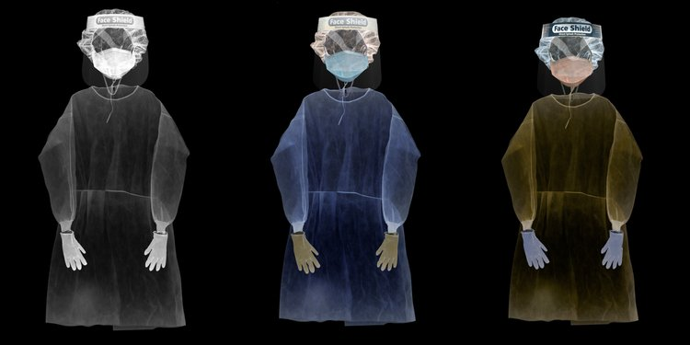
Hidden histories:
reviewing healthcare workers clothing design and its conservation
Image: https://www.sarahcusack.com/work#/ppe-portraits/
Dr Leanne Tonkin, Liverpool John Moores University, UK
Professor Katherine Townsend, Nottingham Trent University, UK

Slide 2
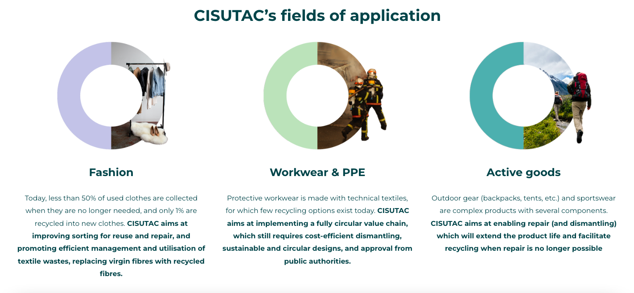

Cultural mapping of workwear and PPE

Slide 3
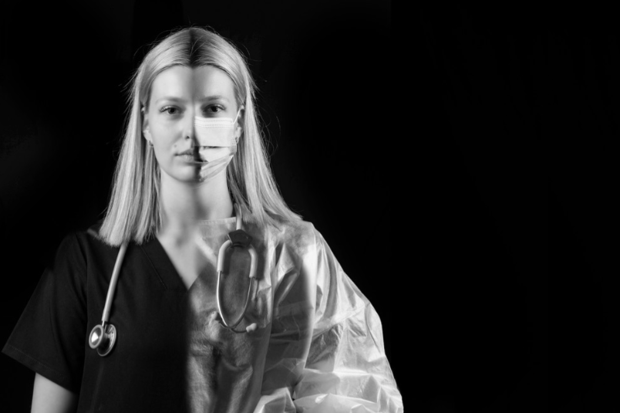
Global Health Workforce:
Total of 65.1 million healthcare workers globally
Projection = 84 million healthcare workers by 2030
(Boniol et al 2022: para 2, 3, pp.1.)
29.1 million nurses
12.7 million medical doctors
3.7 million pharmacists
2.5 million dentists
2.2 million midwives
14.9 additional occupations

Slide 4
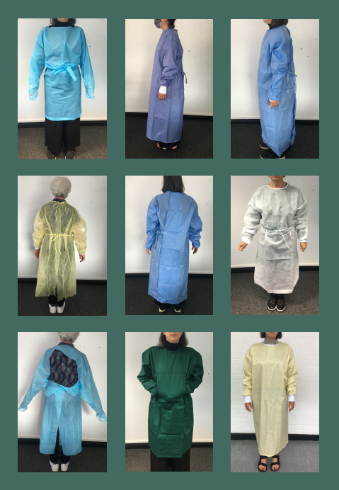
Redesigning PPE
‘The intentional design of the research and product, seeks to connect the practices of making and use by collaborating with all stakeholders and with consideration of the impact on the human and non-human actors from the outset.’ (Townsend et al 2022).
‘The healthcare workers comments tell us directly about the “feeling of wearing” the gowns and provide clear direction for balancing “applicable and protective” qualities in future designs. Functional clothing has “physiological, biomechanical, ergonomic and psychological requirements which must all be considered in the process of design.’ (Townsend et al 2022, pp. 13, 14).
Redesigning PPE: Enhancing the comfort and safety of healthcare workers wearing isolation gowns to treat patients with COVID-19 (AHRC/V015842/1)

Slide 5
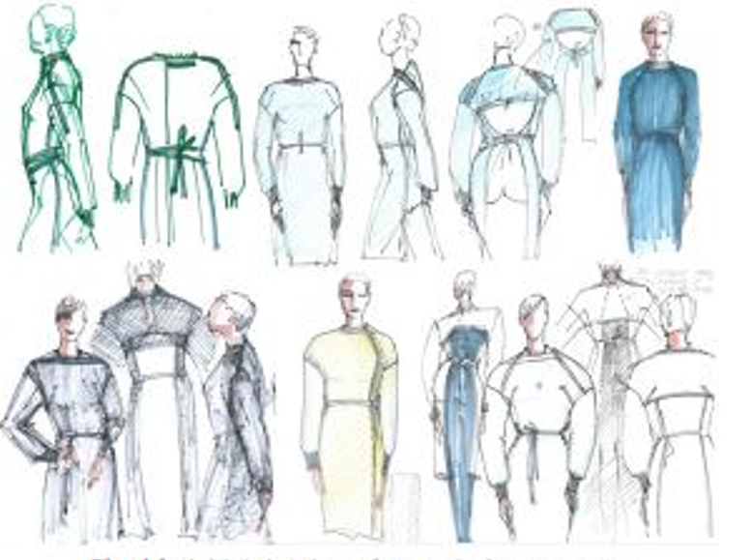
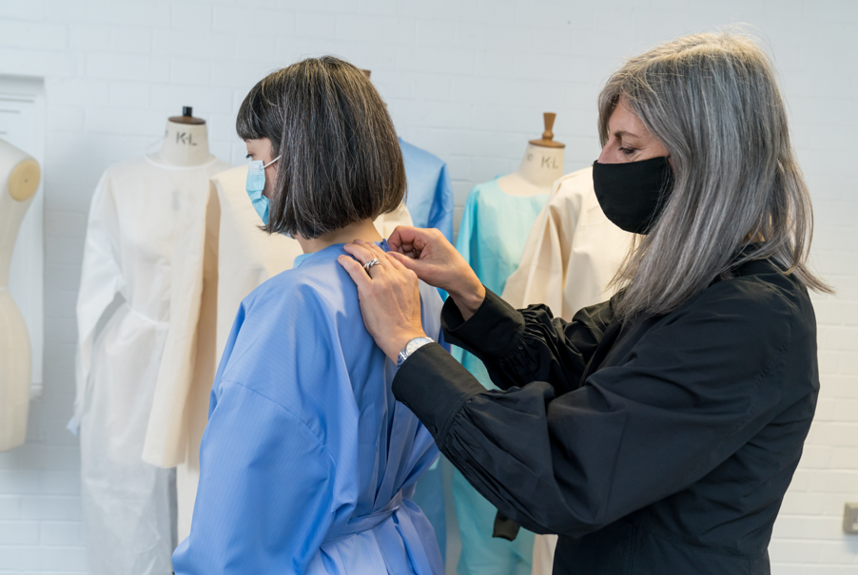
Redesigning PPE
‘As designers, we hope to use this project as a stepping-stone to elevate the isolation gown beyond its current liminal status, as neither garment nor uniform.’ (Townsend et al. 2022, p.14).
PPE sketches by Sonia Sterman

Slide 6
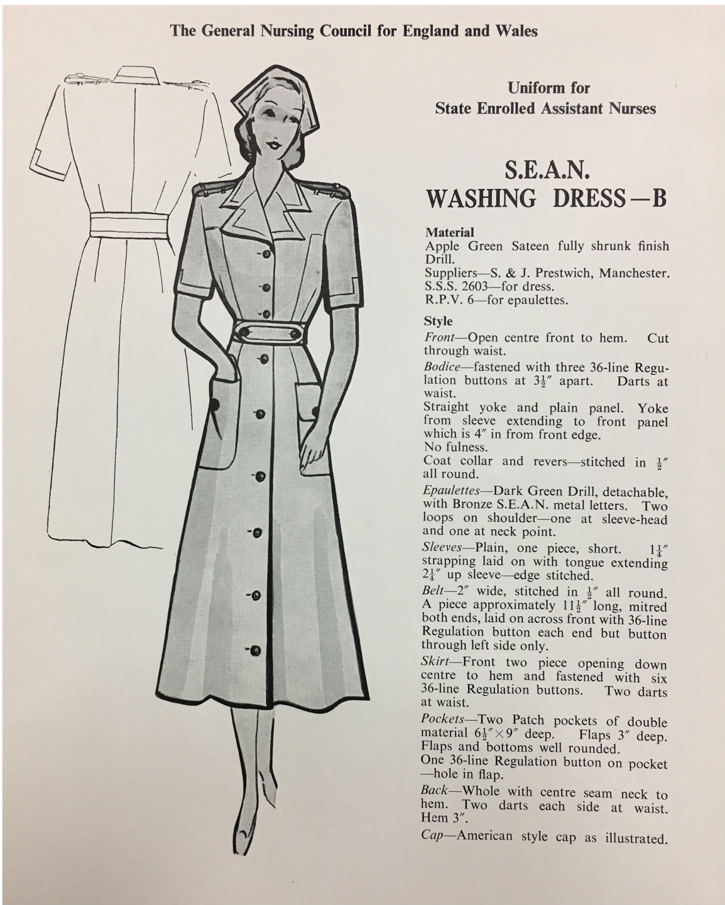
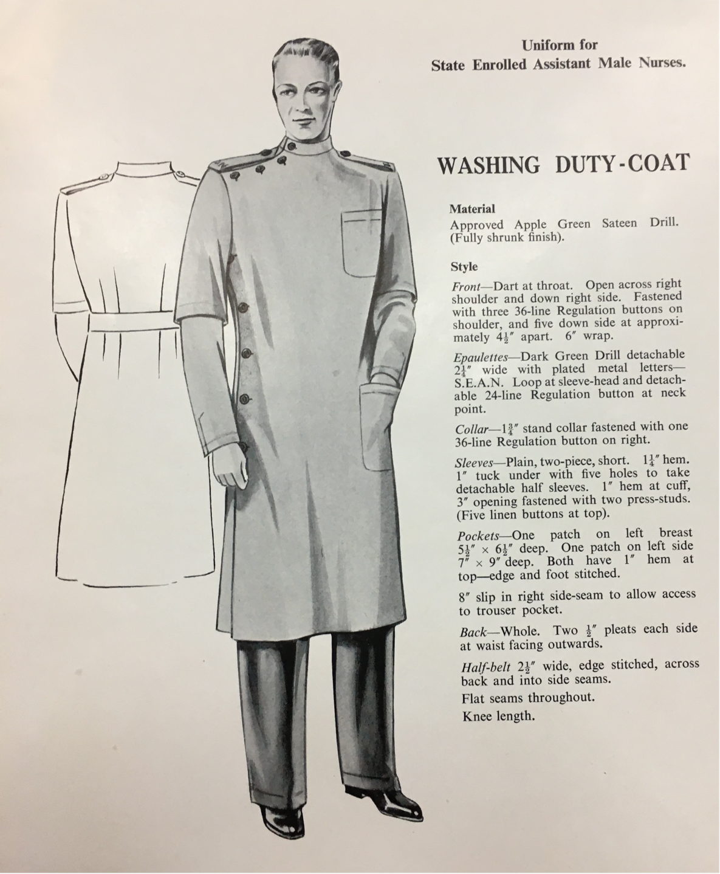
PPE histories
General Nursing Council for England and Wales 1931
(reprinted 1934, 37, 39).
National Archives, London

Slide 7
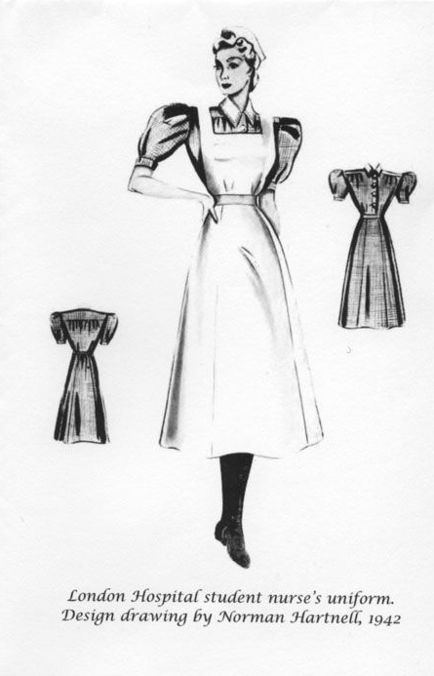
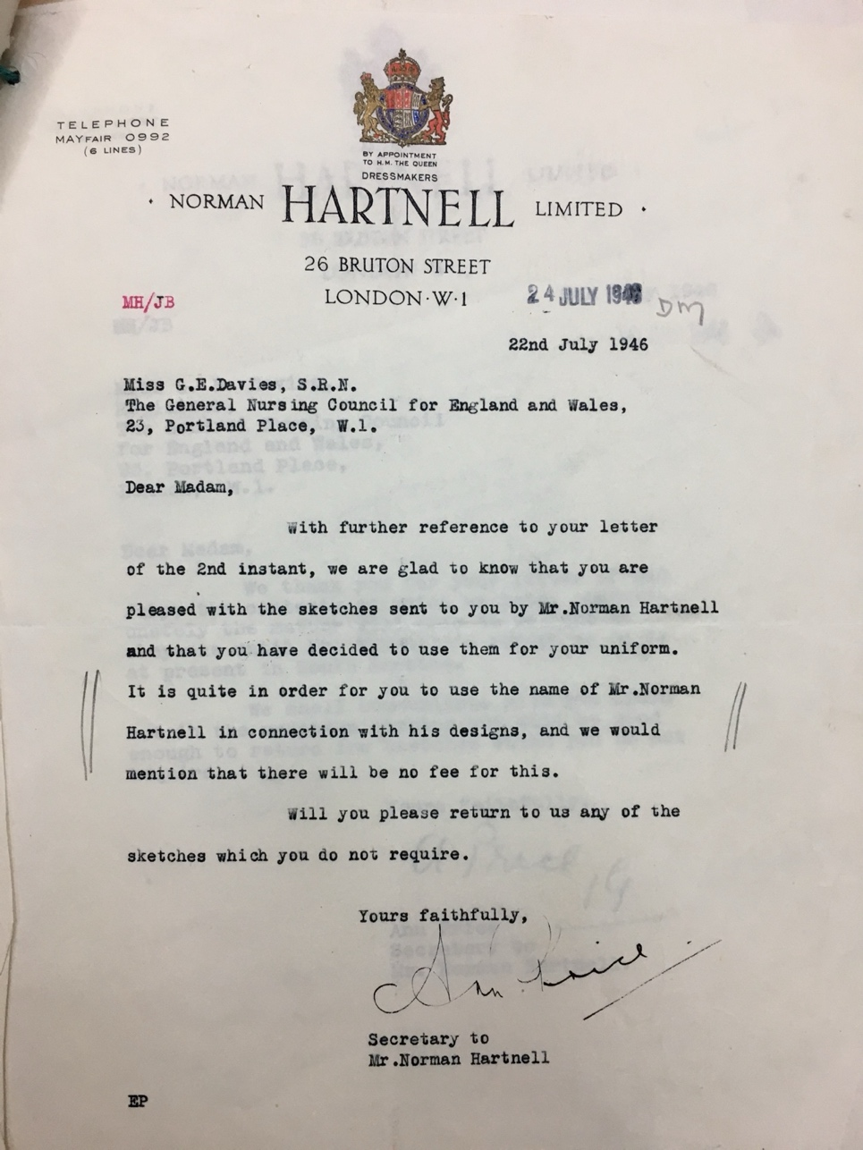
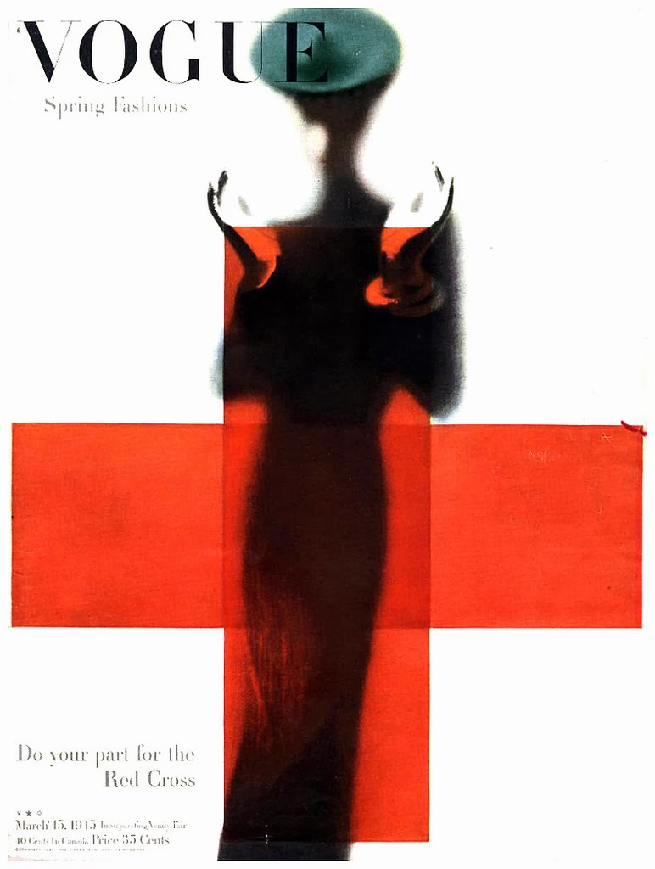
PPE histories
Norman Hartnell letter to General Nursing Council for England and Wales, July 1946. National Archives, London
‘The Red Cross’, 1945. Vogue front cover, Photographer, Erwin Blumenfeld.

Slide 8
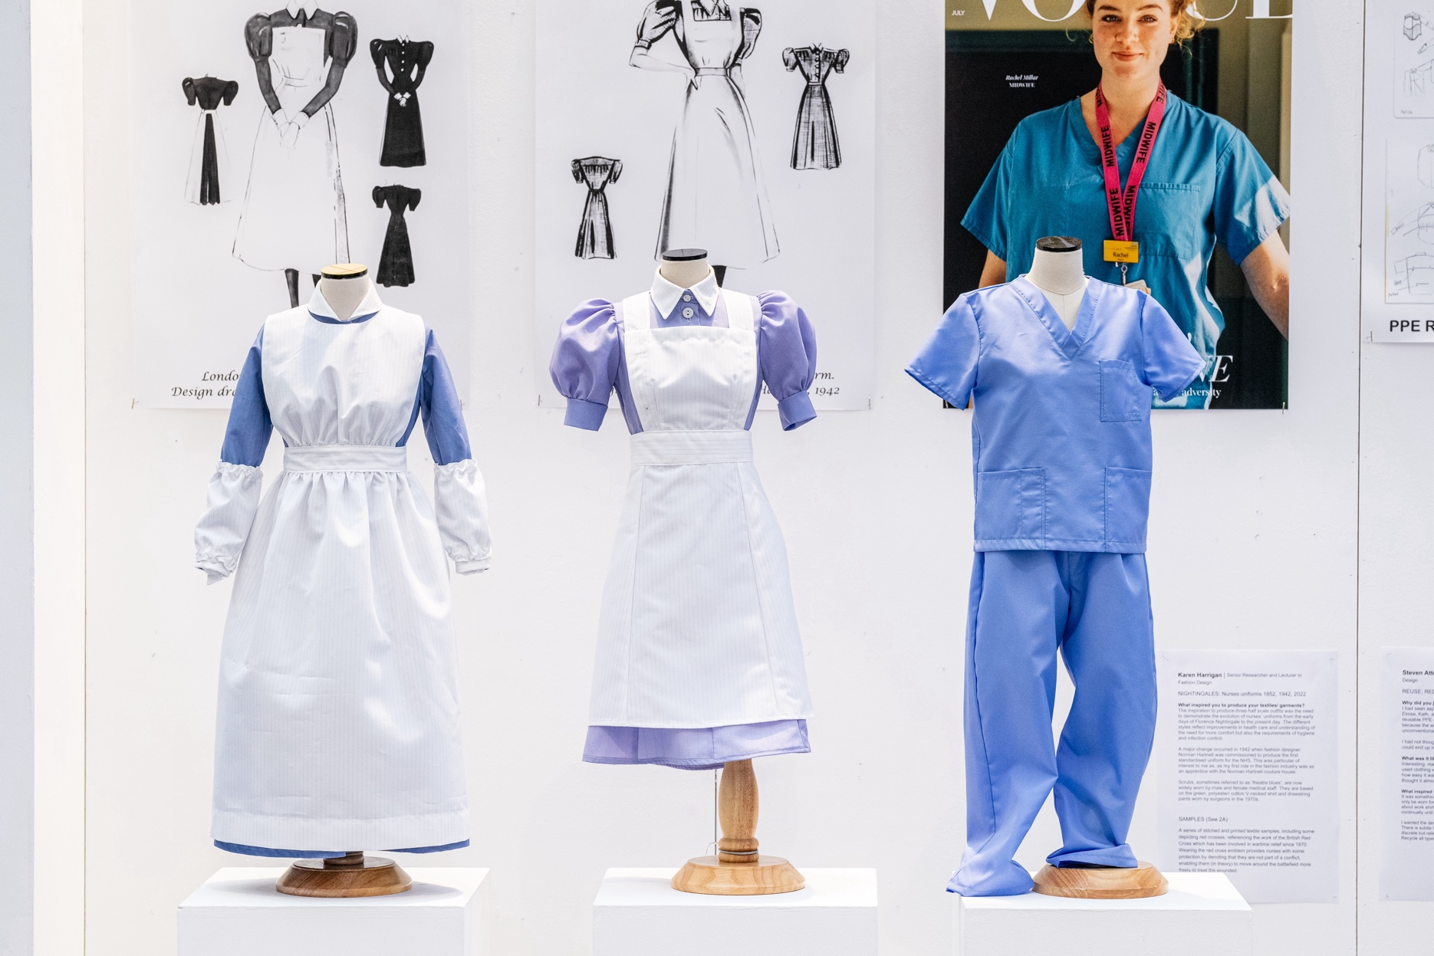
PPE histories
Karen Harrigan: ‘Nightingales: Nurses uniforms 1852, 1942, 2022’, PPE Refashioned (2023).

Slide 9
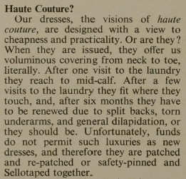
PPE histories
‘I came to [the part of the exhibition] for nursing and there in the display cabinet was a sister’s uniform from the general hospital of about 1890 or something.
And there’s my grey uniform with a note on it [and it] said, “This uniform was made for Miss Marion Reed circa 1960 at the Queen Elizabeth School of Nursing”…
...I thought, golly, there I am in the museum.’
Marion Reed, former nurse, oral history archive, Royal College of Nursing, London.
Gillies, A. "Are Uniforms Necessary?" Nursing Times, vol. 64, no. 2, 12 Jan. 1968, p. 62. Women's Studies Archive,

Slide 10
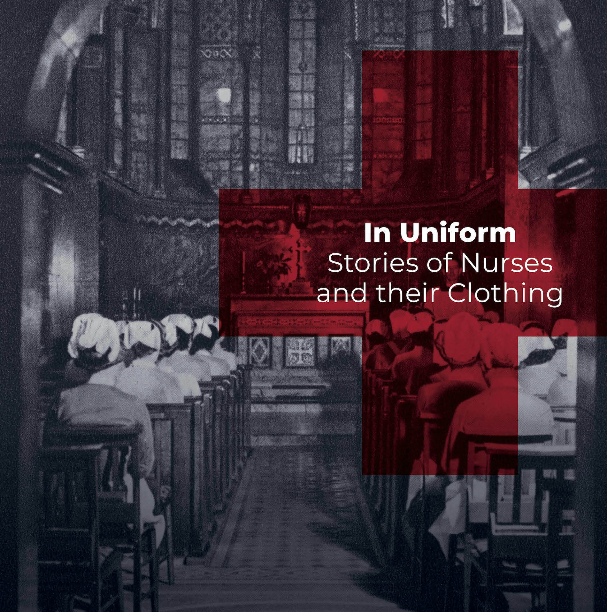
Response:
Cultural expressions
The Fitzrovia Chapel, London
Exhibition runs until 1st December 2024.

Slide 11

Response:
Cultural expressions
‘Through disarray, disruption and disorder my work finds life.’ Pam Hogg (2016)
‘To give more of the obvious, remove barriers of the norm and to break the rules that can stifle and restrict’ Pam Hogg (2016)
Divine Disorder | Pam Hogg | TEDxGlasgow
Pam Hogg ‘Apocalypse’,
S/S 2024

Slide 12
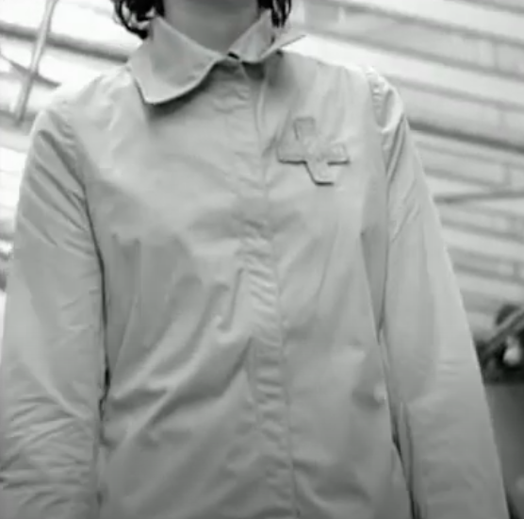
‘When you look carefully, various perspectives of personality re-displayed through the different ways such systemised suiting is worn.
One can immediately see who is creative, who will reveal more and who wants to be covered.
A uniform unifies at first, but it can never fence off or conceal individualism and personality.’
A. F. Vandevorst. Schwartz (2018), p.22.
Still from A. F. Vandevorst S/S 1999

Slide 13
PPE Refashioned exhibition
PPE Redesigned
PPE Repurposed
PPE Refashioned

Slide 14
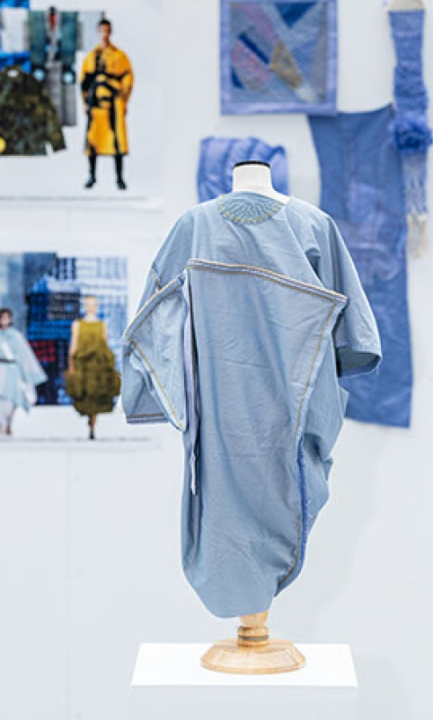
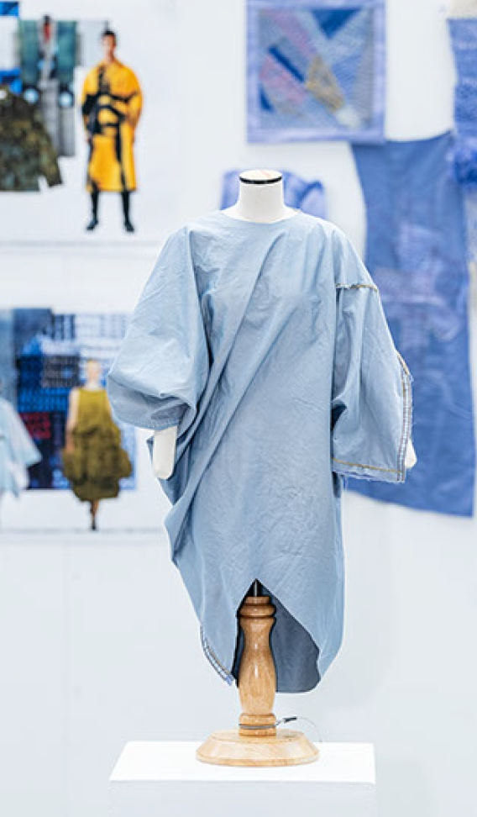
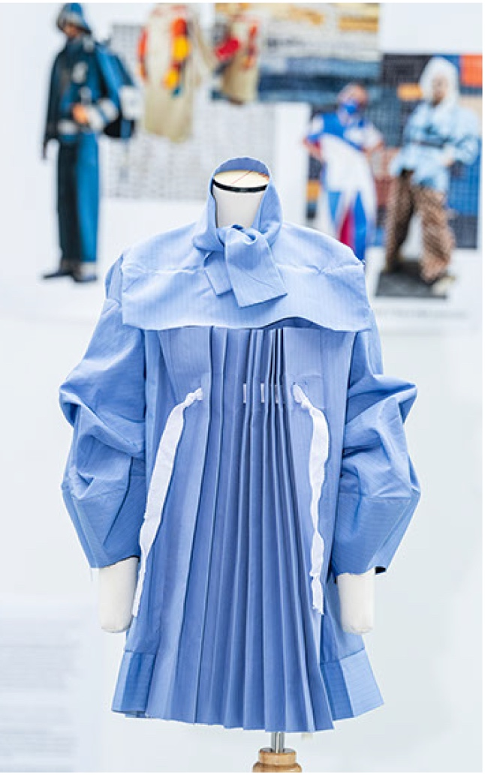
PPE Redesigned
Eloise Salter: Handmade/ embroidered Zero-waste Dress.
Maggie Bushy: Box Dress with pleated apron and pull-up lantern sleeves, inspired by historical nurses’ uniforms.

Slide 15
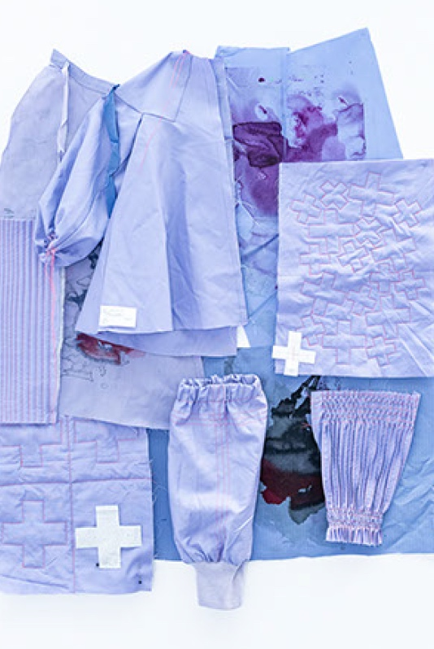
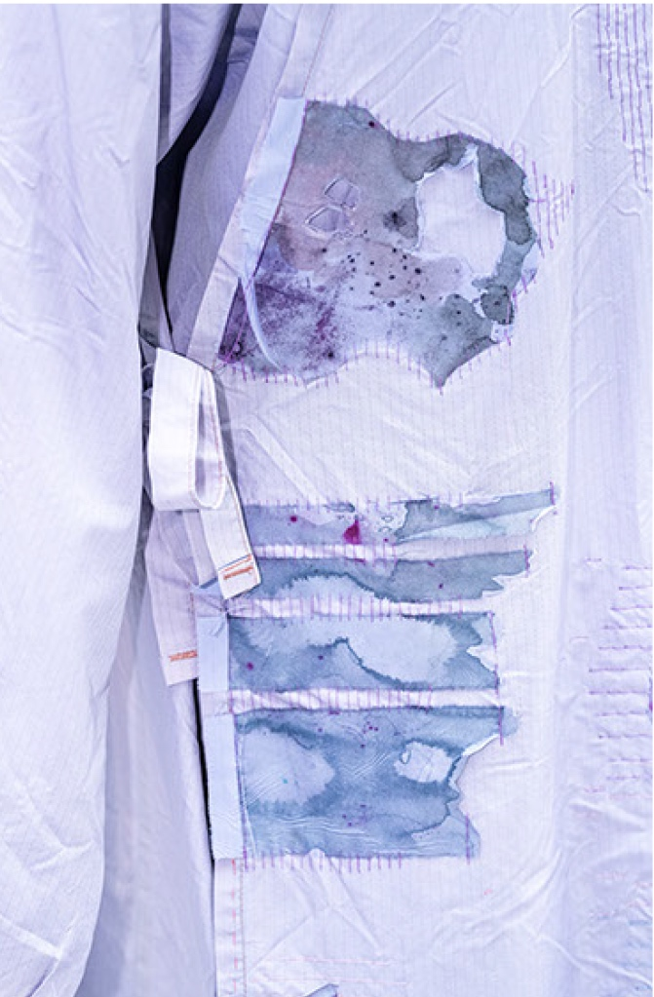
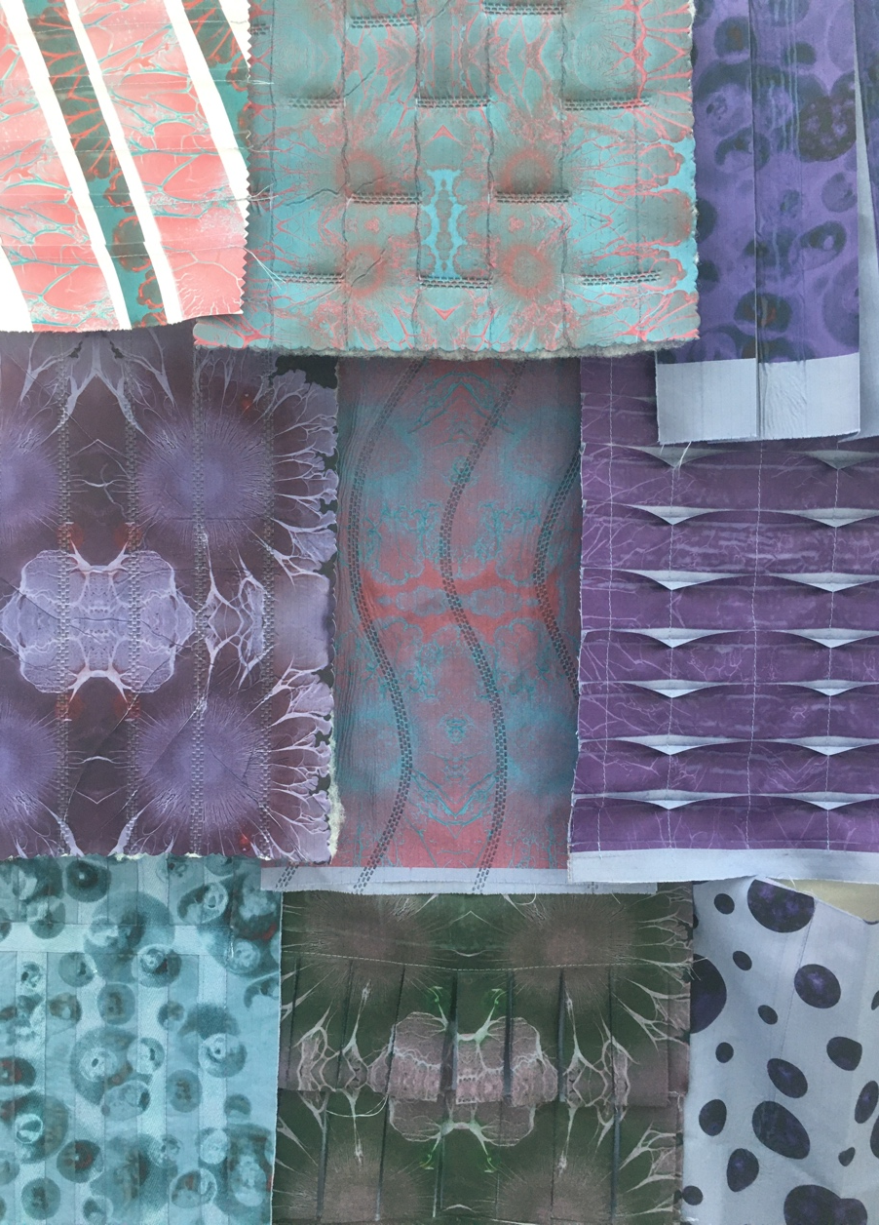
PPE Repurposed
Karen Harrigan & Katherine Townsend: Red Cross; Alison Escott: Biofilms; KT & Leanne Tonkin: Cross Contamination Gown

Slide 16
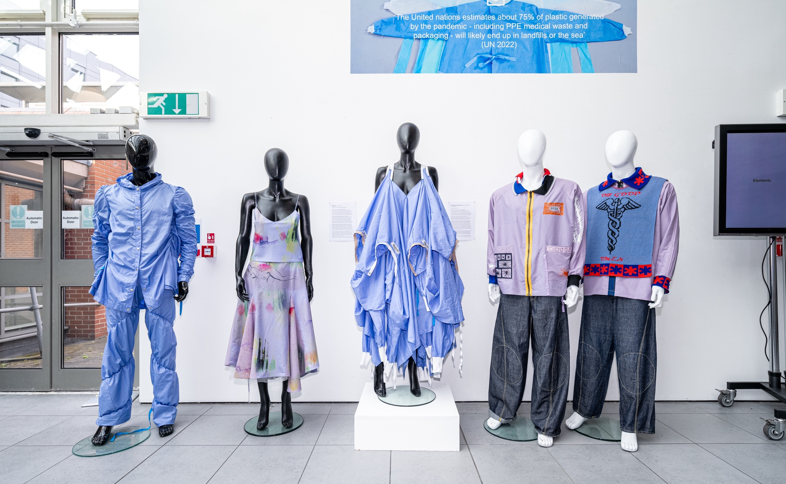
PPE Refashioned
One BC: Spiralized; Klements: Ghosts; Cunnington & Sanderson: Gown of Care; G Force: Of Good Omens

Slide 17

Touring exhibition

Slide 18
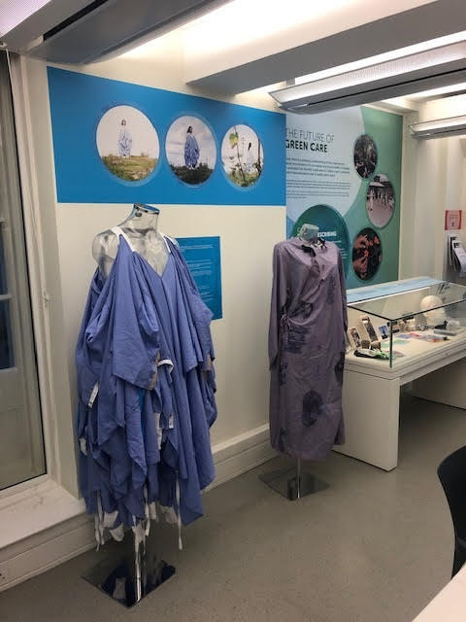
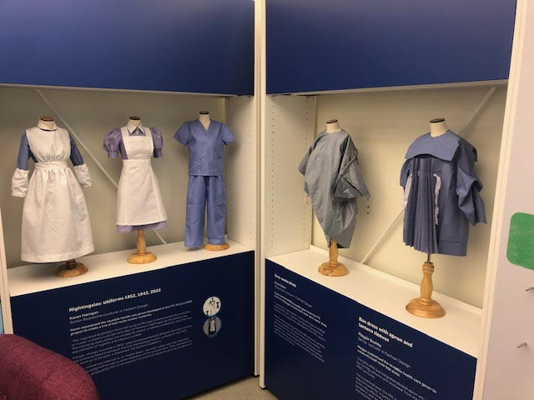
Touring exhibition

Slide 19
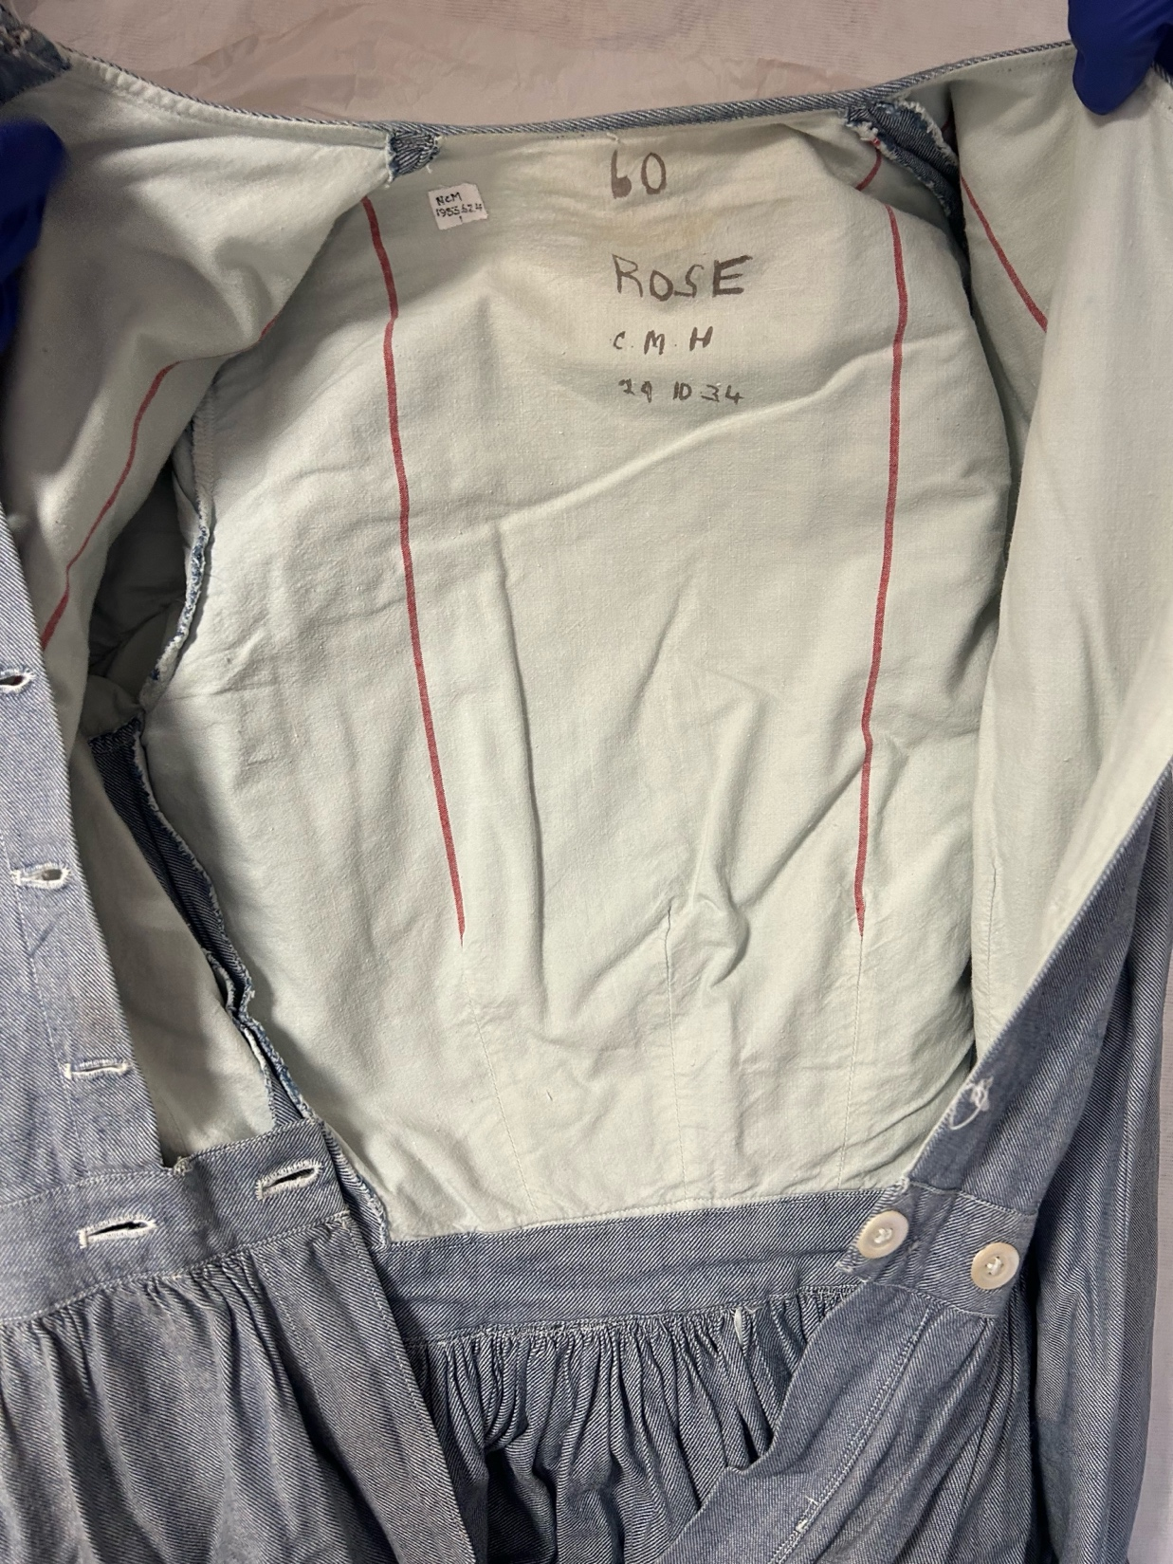
Archiving PPE Objects
‘You were rather like butterflies because you got called a yellow or a short cap yellow, blue or a long cap blue…’ Marion Reed, former nurse, oral history archive, Royal College of Nursing, London.
‘Working with [a] people model….[in] creating identity as a research centre for dress collections, [creates] intimacy, domestic feel to it’. Rosie Gnatiuk, Curator of Costume, Platt Hall, Manchester, UK.

Slide 20
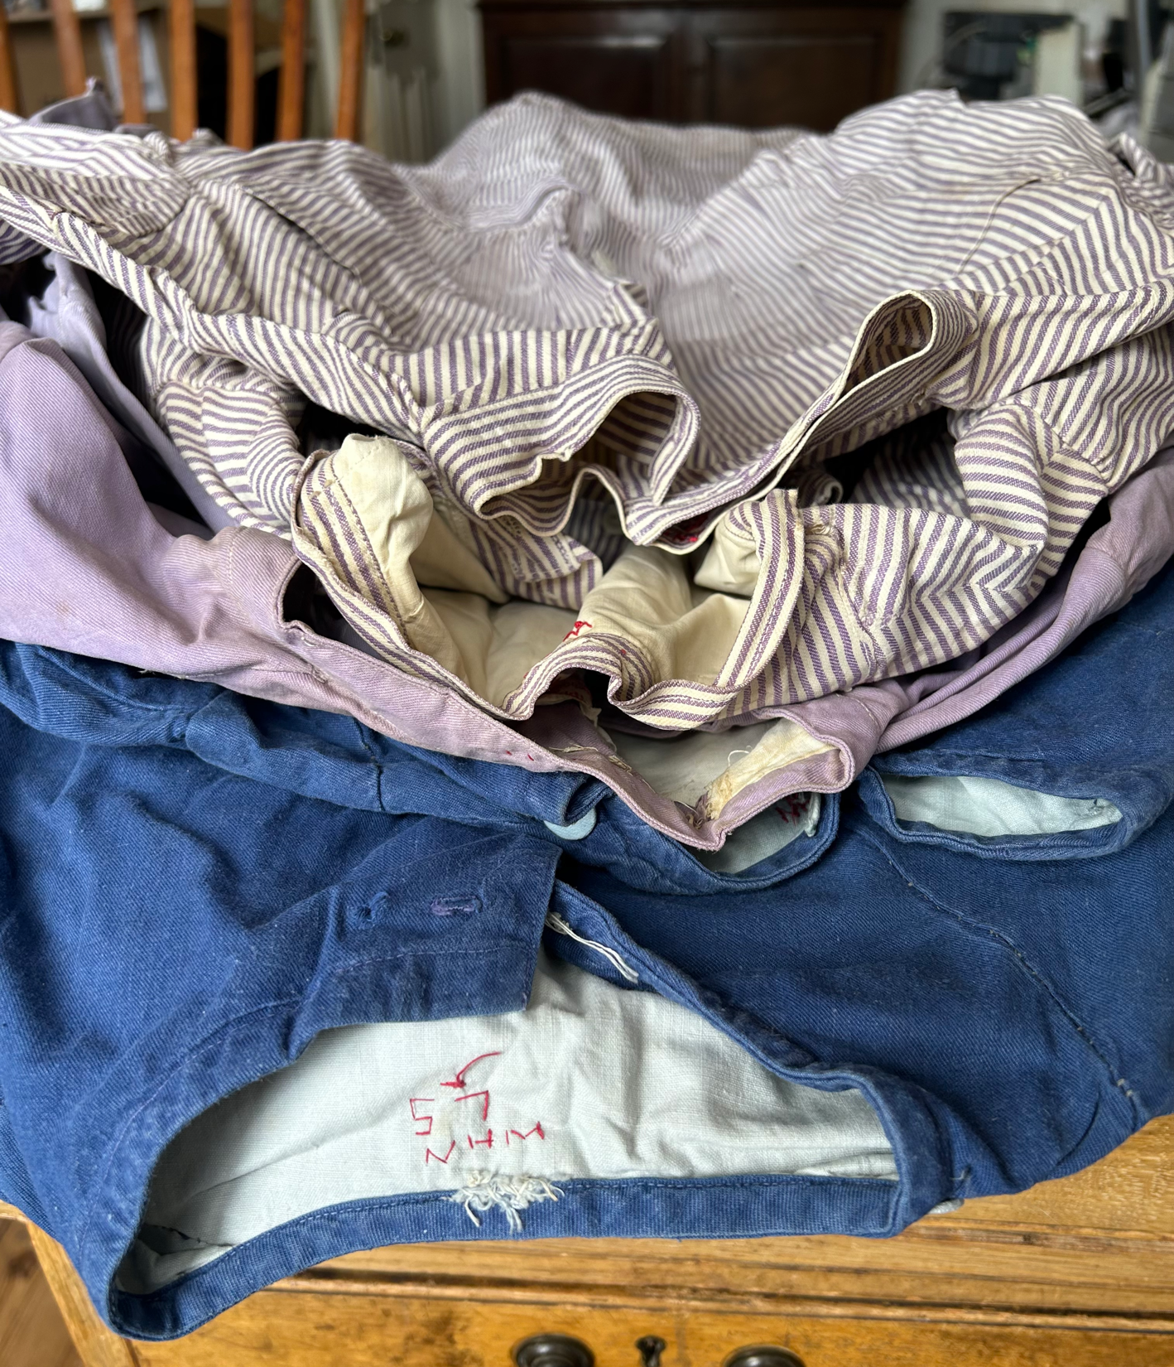
‘When a heritage place maintains its original function and has a connected community, it does not remain static but continues to change/add various tangible and intangible expressions.’
Wijesuriya (2018), p 50.
Nurse uniforms belonging to Ella Doreen Lacey, 1936 - , Newstead Abbey, Nottingham. Image: Leanne Tonkin 2024.

Slide 21
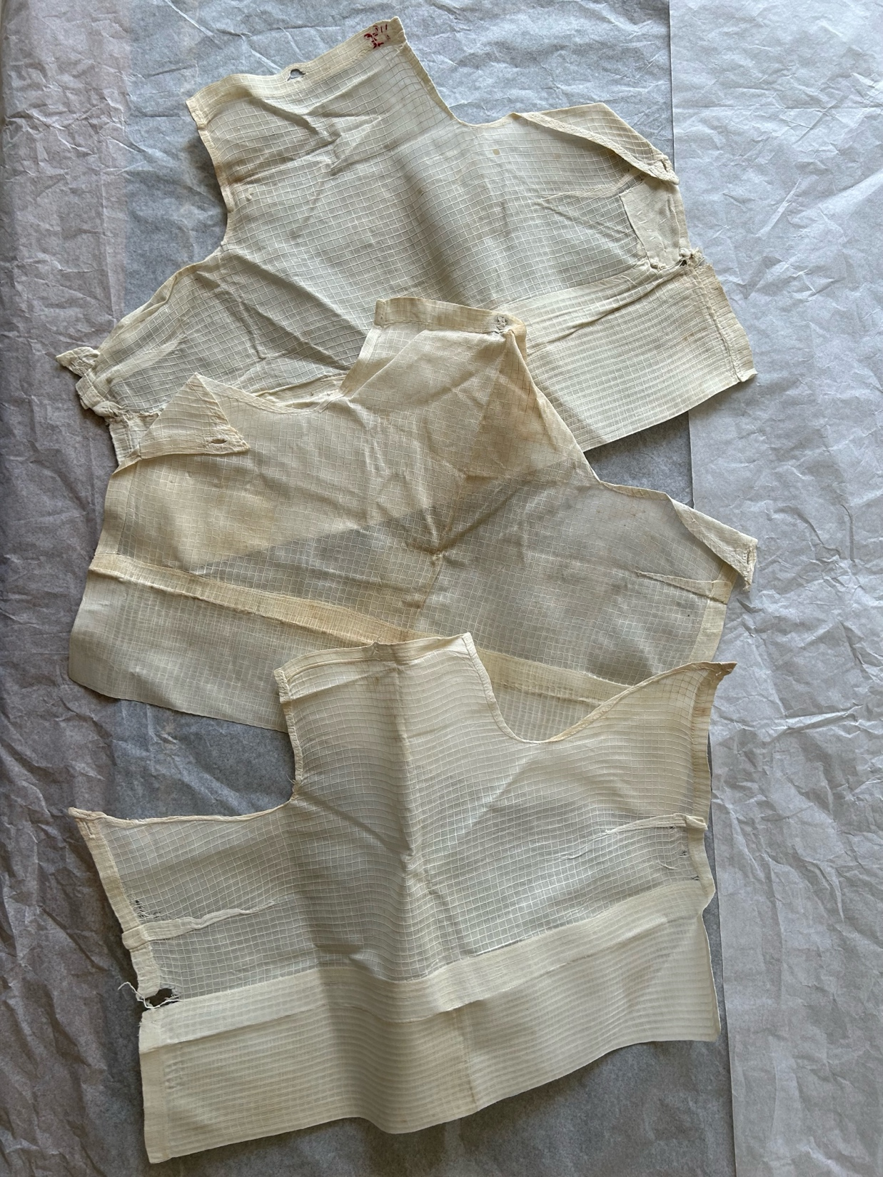
PPE as cultural commodity
‘…continuity is key to characterising living heritage
…continuity is a key element in defining living heritage.’
Continuity is the basis on which to characterise living heritage.’
Wijesuriya (2018), p.45.
Nurses’ caps. Platt Hall, Manchester Art Galleries, Manchester. Image: Leanne Tonkin 2024.

Slide 22
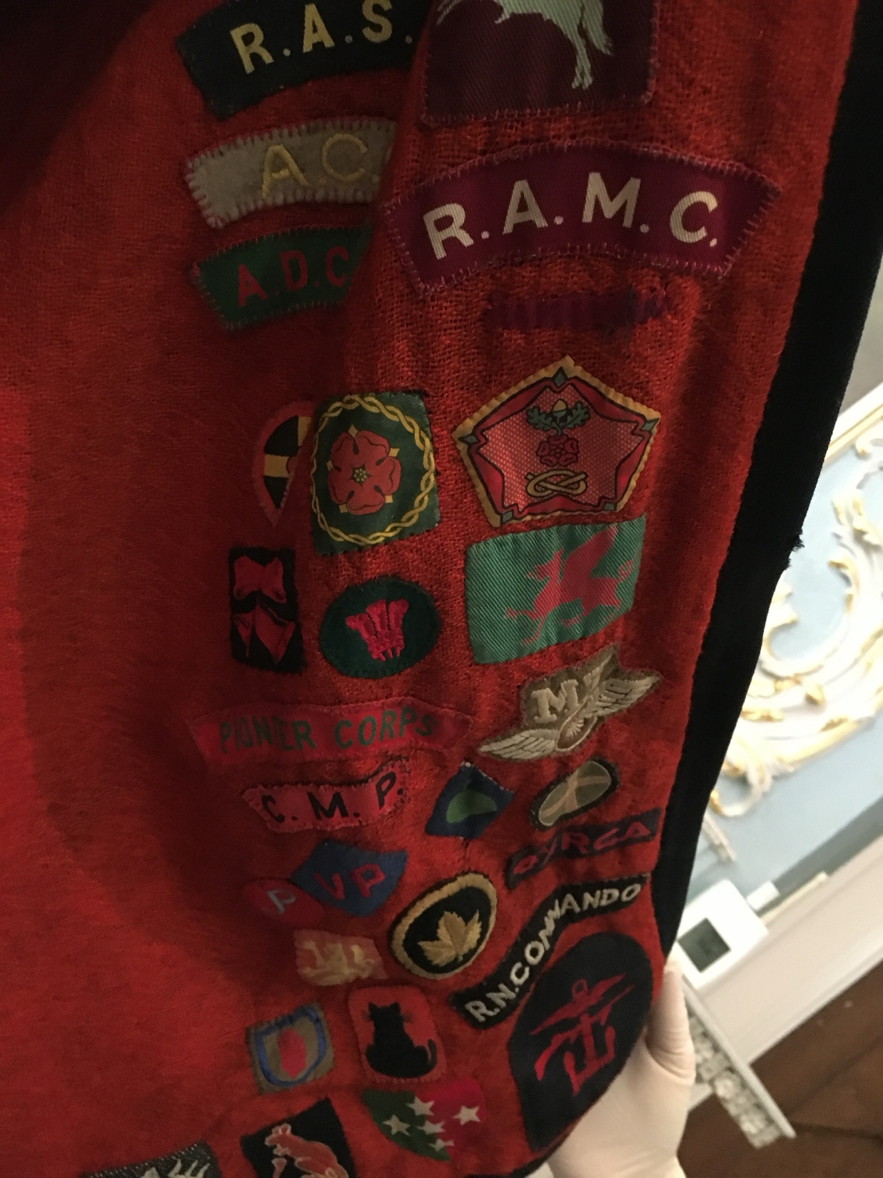
Preserving the production, circulation and exchange of living fashion histories.
VAD cape 1940-45. Accession no. 1971.70.
Platt Hall, Manchester Art Galleries, Manchester.
Image: Leanne Tonkin 2024.

Slide 23
Summary
Bi-directional material relationships are more obvious when conserving PPE
Conserving and exhibiting PPE can showcase everyday artefacts for everyday people
PPE encompasses multiple narratives offering new ways to (re)activate archives
Increasing the visibility of PPE through conservation and exhibition practices could strengthen links intangible heritage and ‘lived experience’.

Slide 24
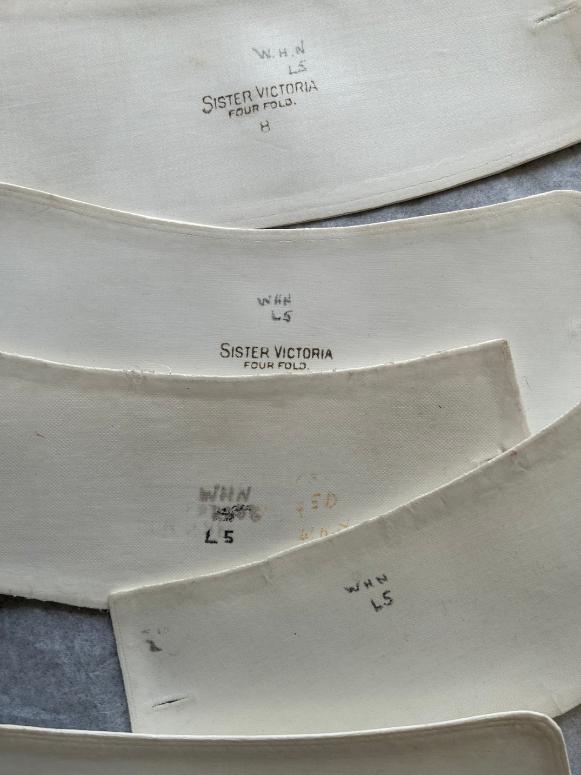
Thanks…
Liverpool John Moores University, School of Art and Design, Research Channel Committee.
Rosie Gnatiuk, Costume Curator, Platt Hall and Manchester art Gallery.
Judith Edgar, Costume Curator, Newstead Abbey, Nottingham City Council.
Archivists at Royal College of Nursing, London

