Slide 1

Shifting epistemes in mental health for culturally appropriate care
Professor Linda Gibson, Nottingham Trent University, UK
14th Culture & International Mental Health Conference
12th December, 2024
University of Manchester

Slide 2
Themes of our global health work at NTU
Inequalities & social justice; gender
Ecological thinking
Moving health systems up stream – health promotion comprehensive primary health care ; social model of health
Working at the boundaries – visible /invisible; formal /informal: Challenging the power structures ; valuing different forms of knowledge
Research with impact; that makes a difference
Partnership leadership investment
www.ntu.ac.uk
Notes:
Impac tjudged so differently

Slide 3
Global Health Networks & Research Themes
Primary health system strengthening;
Community engagement & investment;
NTU Mak Partnership:
Antibiotic stewardship;
Eastern Africa PhD Hub
Transnational mobility (Erasmus Plus ICM)
Pan African Mental Health Group
LIMPRINT: Uganda Framework
SPICES Project
www.ntu.ac.uk
Notes:
I was originally recruited to NTU in 2005 into Environmental Health to develop the School of Social Sciences public health focus and subsequently led the development and implementation of the MA Public Health for which I was Course leader for 10 years (2008-2018). My inspiration for teaching, learning and assessment emerges from my background and experience of understanding health through the lens of my academic training in the social sciences, through the experience of strong comprehensive primary health systems (when I visited Cuba in 2000) and through the need for understanding the structural determinants of health and the call for social justice (as experienced working in communities in Tanzania in 2003 and 2005). This led me to see the need for a course that responded to the call for a 3rd public health revolution in dealing to health challenges in a globalised world. I provided sustained development of the programme ensuring it was an international curriculum and innovatively focused around a social model of health. This meant that the Course has a unique perspective and is very distinctive from traditional MPHs (Masters in Public Health). Consequently the course has attracted largely international cohorts of students both drawn from BAME UK communities and overseas health professionals (doctors, nurses, pharmacists, dentists) and health activists, all drawn to expand their skills in understanding the social model of health as applied to their public and community health workforces globally.
Students have commented that the classroom on our Course is like being at the United Nations and that they value learning from each other immensely. As one full time international student (2015/16) commented in her portfolio: “I believe that the cultural diversity which this course attracts is an important aspect of the MAPH course. When having this large number of international students, one would get the chance to listen and learn about health issues from various countries both developing and developed countries, from different perspectives. In addition to learning from peers’ experiences and become more aware of the wider global health issues that I was unaware of and learn from other countries who have succeeded at solving some of these issues and see how that can be implemented to improve health in my home country”.
We use real world case study approaches and portfolio learning that enable students to emerge who understand where they fit through critical reflection and portfolio development. I led a practice-based learning environment, teaching the real world application of theory and fostering of professional knowledge. I, and the Course team, designed sessions to explore real life scenarios in public health for students to explore and bring professionally active internationally based practitioners and academics to deliver learning and teaching. For example, I facilitated study in the field of humanitarian action through working with a senior protection officer from the UNHCR with distance learning material, online content and face to face interaction from the field (over the years from South Sudan, Central America and Ethiopia) via Skype straight into the classroom. This has an immense impact and immediacy for understanding complex global public health and development issues. I draw extensively on my research and international links to bring those into the course classrooms
My leadership of the Course (2008-2018) made a sustained contribution to the School of Social Sciences, to the University and to international public health. As Course Leader I led its evolution to become a course that was acknowledged as an excellent example of practice at the Public Health Periodic Course Review (2016) as part of NTU’s Curriculum Refresh. The Course was held up at this event as a model for the School and the wider University where my personal leadership in particular was highly commended and the collegial way in which course curriculum has developed drawing on and valuing the strengths of colleagues and their contribution to its success. The Course was also highly commended with respect to ‘sustainability, career development’ and internationalisation. Recognition of the Course was achieved though the attainment of a Commonwealth Shared Scholarship Scheme (2016/17 to 2018/18). This demonstrates the value of the course internationally and has given us global recognition. International applications for MAPH lead on applications within the School’s provision of courses year on year. International students have continued to rise from 2 or 3 (2009/10; 2010/11) to 9 (2015/16) and 32 in 2016/17; 35 2020/21 (NTU MAPH Course Leader Reports) and this trend has continued. Health and Social Care continues to be a feeder course for those wishing to coming through from NTU undergraduate degrees.
I led the continued innovation through attracting increased numbers of international students, both in terms of fees but also from Diaspora communities locally, building a research culture that contributes to the learning and teaching, and developing a pathway that allows students to undertake a three month placement, either locally, nationally or internationally in response to student demand and the NTU strategic plan of ensuring that international students have the support to succeed in their studies and the opportunity to optimise their time in the UK.
My distinctive approach to networking and conducting research with public health colleagues globally is to recognise and value the knowledge that they have and that we can learn from – often enabling a ‘reverse innovation’ of ideas to be applied. This approach offers an inclusive approach with western nations learning with, from and about how nations in the global south tackle public health issues. This approach translates into my teaching by the involvement of colleagues from global HEIs such as MakSPH in Uganda contributing to the course, as well as graduates from the MAPH who are now working in these nations.
These examples of world-wide impact of the course offer rich examples of the international relevance of NTU’s public health provision that I have grown and led. I draw from my research projects in the way I teach research methods to students and support them to undertake research back in their home countries. Several sub-Saharan African graduates (4) from the Course subsequently undertook their doctoral studies with me in the School and two have now completed. Other graduates have now completed their doctoral studies elsewhere (2) whilst others remain studying. Subsequent data on graduate destinations demonstrates that graduates move into health and social care positions, teaching or gain promotion back in their roles in their countries of origin. As course leader I led by having a strong vision, passion and enthusiasm for my topic and strove to develop a strong cohort identity. I have continued to support and nurture alumni in their postgraduate and early career endeavours both formally and informally. I continue to contribute to modules and particularly dissertation supervision to inspire our students to achieve to their best potential. Through the international partnerships that I have developed students have had the opportunity to learn alongside students from other cultures and staff and student exchange between NTU and Makerere University’s School of Public Health has added a richness to the Course. I was instrumental in setting up a full tuition scholarship for students from Makerere University’s School of Public Health in Uganda which is offered bi-ennially,: 2020/21; 2018/19; 2016/17 (we have now had 3 Ugandan students on the Course). Under my Course Leadership we held a Commonwealth Shared Scholarship award for 3 consecutive years (2017-2019) . . External Examiner, Dr Chinouya, commented in her MA PH External Examiners Report (November 2016): I was impressed to see the number of students who, in the four years I have been the external examiner, proceeded to PhD studies. The department is very much connected to key players in global public health and some students have had an opportunity to work as interns in these international health organisations, before proceeding to PhD. Research in the department is growing, thus driving evidence-based teaching’
My particular passion is for supervising Masters and postgraduate researchers (PGR) /students and I recently won the most Outstanding Postgraduate Research Supervisor in the Nottingham Trent Student Union Student Led Awards 2020. One of my international PGR students who nominated me commented: Associate Prof. Linda Gibson first supervised my Master's dissertation on the M.A Public Health in 2015/2016 and recently (2019), she became my Director of Studies (DoS) on the PhD under the Scaling-Up Interventions for Cardiovascular Disease prevention in Select Sites in Europe and Sub-Saharan Africa (SPICES) project. She is passionate about the social model of public health which is the core research area of the department. Her passion is reflected in her ability to coach students and encourage them to analyse and publish on public health issues using the social lens. She is the reason, non-traditional public health professionals like myself from NTU are confident about our multi-disciplinary contributions to traditional public health practice and policy. Her passion has led her to create and lead vital partnerships such as the NTU/Makerere university partnership which has seen over 15 students and faculty members of both institutions share lessons on knowledge and practice through mobility programmes.
I led the development of a Collaborative Online International Learning (COIL) project in a third year undergraduate module, Global Health & Development (2017). A COIL on ‘Comparison of International Healthcare Systems’ was piloted in November 2018 between 3rd year health and social care and public health undergraduate students in NTU and University of Minnesota, Duluth USA. I continue to support staff in delivering this COIL and have now brought in our partners and students from Uganda. A joint paper was presented at the 23rd IUHPE World Conference on Health Promotion in 2019 and a peer reviewed paper in currently in process. A short COIL will run with our international partners from Uganda and Burkina Faso for the virtual NTU Global Summer Schools 2021
.
I also lead on two Erasmus Plus International Credit Mobility Grants as Principle Investigator with NTU Global and Makerere University. We started with public health mobility but have now expanded across Schools (Nursing, Science & Technology and Animal, Rural and Environmental Studies (ARES) ). Over 73 staff (academic and non-academic) and 123 students (UG, PG, PGR) mobilities will participate in an exemplar and innovative research training programme that I designed. The first year was evaluated successfully. Whilst COVID19 has currently disrupted the programme I am currently designing a virtual programme for participation until mobilities can begin again.
Through this work of internationalising curricula, increasing institutional staff and student mobility through transnational education and building international research collaborations I have demonstrated impact in relation to NTU’s Connecting Globally Strategy, the ability to
nurture global citizenship, engage with the international research community, and empower students from around the world. Using the lens of a social model of health has enabled me to influence practice in global multidisciplinary public health in all my teaching and practice.

Slide 4
Social Theories offer Global
Public Health & DEVELOPMENT …
A critique of modernity
Helps understand how people make decisions in their everyday life and the way it affects health (Potvin & McQueen, 2007)
Helps understand systems, risk and uncertainty, agency, subjectivity and participation in public health action/practice (Potvin, et al 2005)
Need for understanding mechanisms of power relations in global knowledge gaps (Gibson et al. 2021)
Notes:
Social theories have led to a society that in its modernity embraces the underlying nature of public health (health, environment and sustainability). We need to ask What is left wanting in a socio-behavioural approach. This provides 3 markers for advancing public health practice
1 Unintended consequences inherent to human activity in complex systems eg widening health inequalities and what complexity theory can offer.
2 critique of bureaucratic or structural planning model or top-down approaches (Weber).
3 Reflexive epistemology to overcome the objectivist/subjectivist dilemma (Bordieu)
We must integrate relevant social theory into the theoretical foundations that inform and potentially transform contemporary public health practice – leads to 2 challenges
First to take into account the social determinants of health and the mobilisation of diverse actors for social change and the prerequisite for this is horizontal relationship networks and democratic participation process – advocating partnership working or developing settings approaches simply isnt enough!
Second to develop an evaluation theory that fosters a reflexive understanding of the integrative ph programmes engaged in social change .
Taken together these critically call into question the bureaucratic/structural model upon which ph practice has been traditionally based which is a decontextualised interpretation of scientific knowledge by experts and a top-down approach to programming and evaluation (Potvin)

Slide 5
Develop research that fosters a reflexive understanding of the integrative programmes engaged in broader social/economic/political change
Taken together these critically call into question the bureaucratic/structural model upon which practice has been traditionally based which is a decontextualised interpretation of scientific knowledge by experts and a top-down approach to programming and evaluation (Potvin 2005)
Whose knowledge, what knowledge is valued?

Slide 6
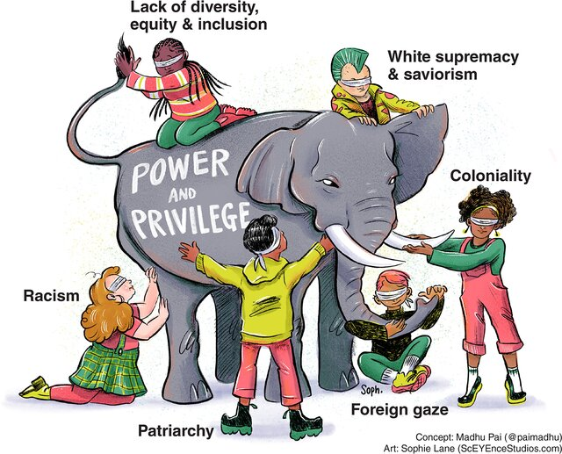
Global Health landscape

Slide 7
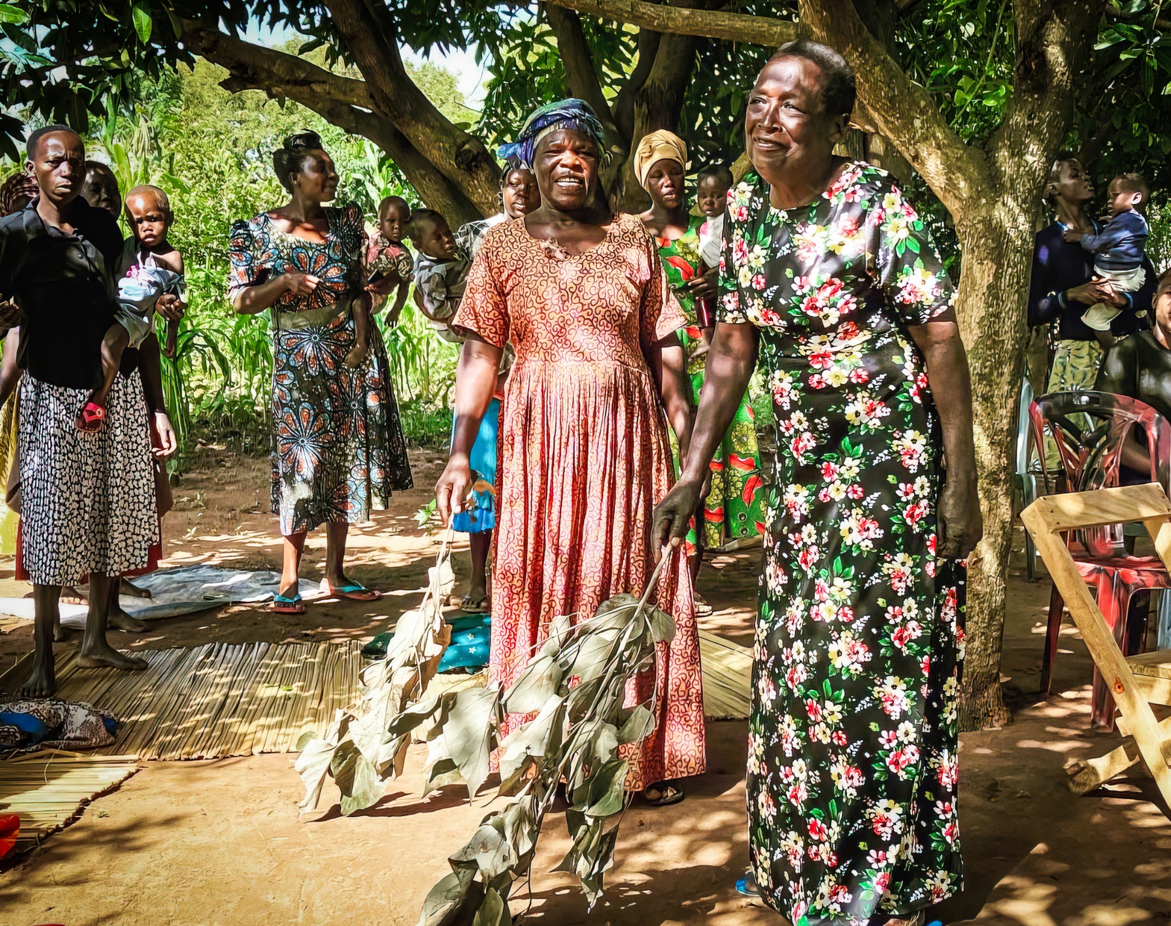
De-colonizing research & practice
“The word itself, ‘research’ is probably one of the dirtiest words in the Indigenous world’s vocabulary. When mentioned in many Indigenous contexts, it stirs up silence, it conjures up bad memories, and it raises a smile that is knowing and distrustful. “ Smith (1999, p.1)
[photo credit: Sally Basford Squires]

Slide 8
#PartnershipMatters!
Landscapes of social (in)justice in global public health
Challenges of the research field & research methods – how we do what we do- often ‘stuck’ (examples) (Bashford Squires, Gibson, L. Nyashanu,
In public health dominated by bio-medicine & scientific model for architecture funding & publishing –hidden power relations
Influences career trajectories and development for academics & ECRs
Publishing models – disadvantages resource poor settings; lack of voices from Global South
Barriers to global engagement for African researchers for collaboration, international travel, publication,& access to global health research networks
Uneven landscape for opportunities for knowledge exchange, professional development, & contributing to scientific discourse (epistemic injustice)

Slide 9
challenging our research practice
Emerging critical voices challenging colonial structures eg Seye Abimbola; Padhur Mai
Need for wider epistemes – valuing different forms of knowings /indigenous/ philosophical eg ‘two eyed seeing’ (Bartlett, Marshall & Marshall 2012) /Ubuntu/wholism / ecological / Afrocentrism /cultural ways of knowing & doing /
Importance of ‘turning the world upside down’; learning from each other;

Slide 10








Principles of Shared Ownership
Investment in people
Trust
Reciprocity
Sustaining activities
Transparency
Global thinking
Cultural appropriateness
Gibson, Musoke, Ikhile, Nyashanu (2021) Health promotion in international settings: the value of a shared ownership approach for north-south partnerships IUHPE Global Handbook on health promotion research Knowledge production and sharing. https://doi.org/10.1007/978-3-031-20401-2
www.ntu.ac.uk
Notes:
These seven shared ownership principles challenge us to

Slide 11

Musoke, D., Nakalawa, S., Brown, M., Lubega, G., Gibson, L. (2024). 'Experiences of Research Coproduction in Uganda; Comment on “Research Coproduction: An Underused Pathway to Impact”', International Journal of Health Policy and Management, (), pp. -. doi: 10.34172/ijhpm.8806

Slide 12
Baseline Research on Collaboration between Biomedical and Traditional Mental Health Service Providers in six African countries and communities of African heritage in the UK.
By
_________________________________
The Pan African Mental Health Research Network (PAMHRN)

Slide 13







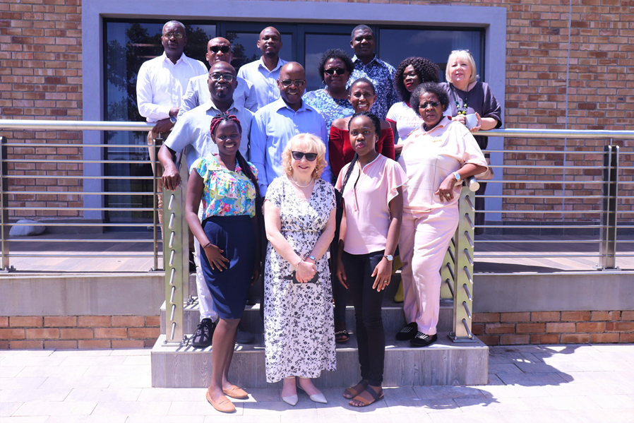
Background: WHAT IS THE Pan African Mental (PAM) Health Network
University of Limpopo | Makerere University | Nottingham Trent Uni | University of Zimbabwe | Thomas Sankara Uni. | University of Jos | University of Ghana
Network objectives:
To work in research partnerships that enable and promote equity in mental health research South-South-North
To establish ways or modalities to help foster collaboration between all mental health stakeholders
To champion collaborative efforts between BHs & THs in mental health care
To develop culturally informed mental health care intervention strategies
To partner with all stakeholders involved in mental health care to increase access to quality mental health care and effective treatments particularly by Africans in Africa and the diaspora
Notes:
Partners will conduct in-country stakeholder mapping and engagement activities to provide baseline data on mental health service delivery as well as the current situation of collaborative efforts between BMS and IKS through
Geo-mapping the biomedical and indigenous knowledge holders’ locations in each context
Assessing availability, accessibility and utilisation of mental health services by communities
Exploring barriers and facilitators to collaboration between
________________________________________________________________________________________
QR GCRF 2019/20 project between 8 multi-country partners (Burkina Faso, Ghana, Nigeria, South Africa, Uganda, Zimbabwe and UK) showed the need to 1] established the need to understand the existing collaboration between Traditional Healers (THs) and Biomedical Healers (BHs) in mental health 2] Formally establish a multidisciplinary network of practitioners and researchers to provide innovative solutions to the gaps in mental health care for Black Africans.
Therefore, this 2020/21 QR GCRF gathered context-specific baseline research on how BHs and THs, can collaborate to improve access to mental health services for Black Africans in the 8 countries listed above. Secondly, this project developed a Terms of Reference for the formal establishment of a Pan-Africa network focusing on mental health research.

Slide 14


The Contribution of Indigenous Knowledge Holders to Mental Health Systems of Care for Black African Communities
Pan African Mental (PAM) Health Network
The Challenge of Change
Virtual Conference
30 November - 2 December 2021
UN75+ 1 Conference

Slide 15
PAMHRN Baseline Research
  Evidence also highlights that Mental Health Care Users (MHCUs) follow two pathways to address their mental health care needs:
  → Biomedical health-care system: for example, psychologists, medical practitioners, psychiatrist & nurses)
  → Traditional health-care system: for example, indigenous healers and spiritualists
  In spite of patient preferences, collaborative efforts between the two stakeholders are met with multi-layered challenges.
  The situation is prevailing despite the WHO & some governments’ call for the two systems of health care to work compliment and/or collaborate towards sustainable solutions
  It is against some of the highlighted issues that we established the Pan-African Network for Mental Health and Society Research to help realise the collaborative imperative (& a need for the present study)

Slide 16
summary
Value of understanding African and Caribbean history
Afrocentric paradigms and research methods: e.g. oral history
Context is crucial
Shift focus to the upstream determinants of MH
Need for collaborative efforts and synergy in mental health care delivery (Sodi, T., Jidong, D.E. and Bailey, D. (2022))
Such synergy is crucial to destigmatize mental health among Black Africans and Afro-Caribbean communities
Need to create awareness of mental health illnesses and MHS collaboration
Engagement with policymakers, policy implementers and other MHS champions
These findings provide research opportunities for the network:
  Evidence generation
  Develop and implement model(s) of collaboration
  Knowledge translation
  Engagement with decision-makers and change-agents

Slide 17
Collaboration benefits between MHS Providers
Reduce the stigma of MHS users
Provide multidimensional MHS
Break the language
barrier & reduce health care complications
Collaboration
helps to…
Raise awareness within disadvantaged communities
Produce culture informed appropriate measures for MHS users

Slide 18


Discussion: Making sense of the study results:
Traditional healing paradigm
Medical healing paradigm
Training & Certification:
Philosophy: Holism
Philosophy: (Post)-Positivism/Empiricism
BioPsychoSocialSpiritual
BioPsychoSocial
Training & Certification:
Spiritual calling
Accredited training institutions: certification
Healing Practice:
Science based or evidence based practice
Evidence based practice
Stringent Regulation Bodies
Healing Practice: ancestral spirits, divination, rituals, herbs/medicines
Mental Health Providers’ Epistemological Schism
Mental Health Users
Notes:
Key issue: Health providers epistemological schism is a major hindrance to collaboration
For MHCs: their worldviews and culture informs their understanding of Mental Health conditions also shaping their health seeking behaviors
MHCs will always use different pathways inspite of the practitioner schism and tug of war:

Slide 19
RECOMMENDATIONS
Academic:
  A need for more studies to help find solutions to this ongoing mental health care challenge
  Need for curriculum revisions
Government:
  Establishment of stakeholder consultative forums
  Establishment of functional THs regulatory bodies
  Policy amendments to support the implementation of collaboration between all involved stakeholders
Practitioners:
  Holistic-mental health care system
  Collaborate for reverse-knowledge transfer

Slide 20
Multi-dimensional projects:
  Defining mental illness across contexts
  Multi-level stakeholder engagements [creating awareness, policy engagements]
  Truly collaborative projects underpinned by equity
Next Steps
Cross-country learning:
  Mutual learning
  Bi-directional knowledge transfer
Capacity building:
  Investment in ECRs
  Student and staff mobility programmes
  Mental health modules/courses from a social lens
  Holistic mental health care training for providers

Slide 21
References
Bashford SquIres, S., Gibson, L. Nyashanu, M. (2022) Mitigating Gender Based Violence through the economic empowerment of women: A case study of Teso Sub Region in Uganda in Mbah, Filho, Ajaps (eds) Indigenous Methodologies, Research & Practices for Sustainable Development Springer International Publishing
Gibson, L.et al 2021 Global Knowledge Gaps in Equitable Delivery of Chronic Edema Care: A political economy cases tidy analysis Lymphat Res Biol. 2021.0063. PMID 34672793
Sodi, T., Abas, M., Abdulaziz, M. et al. A research agenda for mental health in sub-Saharan Africa. Nat Med 30, 616–617 (2024).
Global Challenges Research Fund Project: Baseline research on collaboration between biomedical and traditional mental health service providers. Preliminary findings to be presented at mini partners online conference in May 2023. 2021 UN75+ 1 Virtual Conference “The Challenge of Change”:
Contribution of Traditional Healers to the Burden of Mental Health Conditions in Five African Countries and England: A Situational Analysis (JMHTEP-12-2022-0098) – [Under Review].
Jidong, D.E., Bailey, D., Sodi, T., Gibson, L., Sawadogo, N., Ikhile, D., Musoke, D., Madhombiro, M. and Mbah, M. (2021), "Nigerian cultural beliefs about mental health conditions and traditional healing: a qualitative study", The Journal of Mental Health Training, Education and Practice, Vol. 16 No. 4, pp. 285-299.
Sodi, T., Jidong, D.E. and Bailey, D. (2022), "Guest editorial: indigenous knowledge systems and mental health", The Journal of Mental Health Training, Education and Practice, Vol. 17 No. 2, pp. 89-91.
Sodi, T., Abas, M., Abdulaziz, M., Amos, A., Burgess, R.A., Hanlon, C., Kakunze, A., Kpobi, L., Lund, C., Mwangi, K.J. and Mutiso, V., 2024. A research agenda for mental health in sub-Saharan Africa. Nature Medicine, pp.1-2.
Wadende, P., & Sodi, T. (2023). Mental health literacy: Perspectives from Northern Kenya Turkana adolescents. Global mental health (Cambridge, England), 10, e35. https://doi.org/10.1017/gmh.2023.25

