Slide 1

Happier Healthier Highways: Re-imagining Health Promotion /Ecological Public Health
Dr Linda Gibson
Professor of Global Public Health, NTU
16 October 2024, 09:00-14:00 - Newton Lecture Theatre 5 Nottingham Trent University
Happier, Healthier Highways Conference 2024

Slide 2
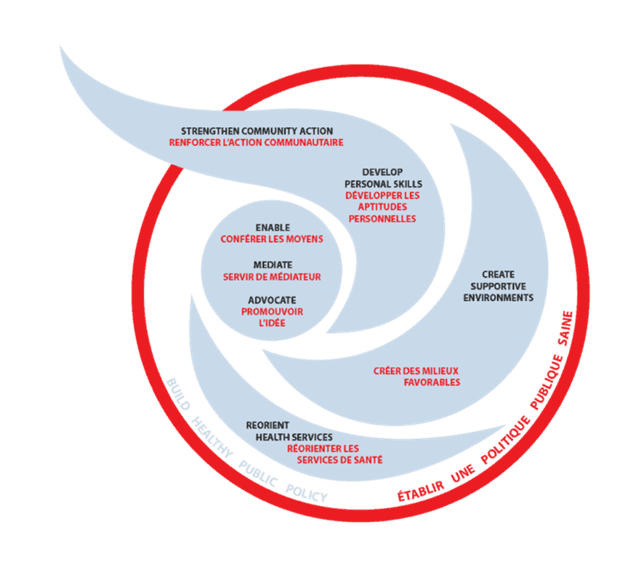
Then… Ottawa Charter for Health 1986
Build Healthy Public Policy
Create Supportive Environments
Strengthen Community Actions
Develop Personal Skills
Reorient Health Services
https://www.who.int/teams/health-promotion/enhanced-wellbeing/first-global-conference
Notes:
Build Healthy Public Policy
Participatory policy making
Transparency in policy making
Speeding up the evidence based policy making process (from research to implementation, from scientists to practitioners to politicians and back again)
Create Supportive Environments
Global and sustainable approach
Public-private sector partnerships and socially responsible marketing that is transparent and regulatory independently evaluated
Healthy urban planning
Strengthen Community Actions
Vertical and horizontal partnerships
Open and transparent communication and funding of local communities
Reversing the current trend of individualisation in all spheres of life
Increasing the level of solidarity and social cohesion
Develop Personal Skills
Improving health literacy
Using information and telecommunication technologies to facilitate social cohesion instead of social isolation
Better implementation of life skills education in basic education
Reorient Health Services
Further integration of health and social services into “wellness” services
Building strong health promotion on national level to facilitate international health promotion network integration
Ensuring universal access to health care

Slide 3
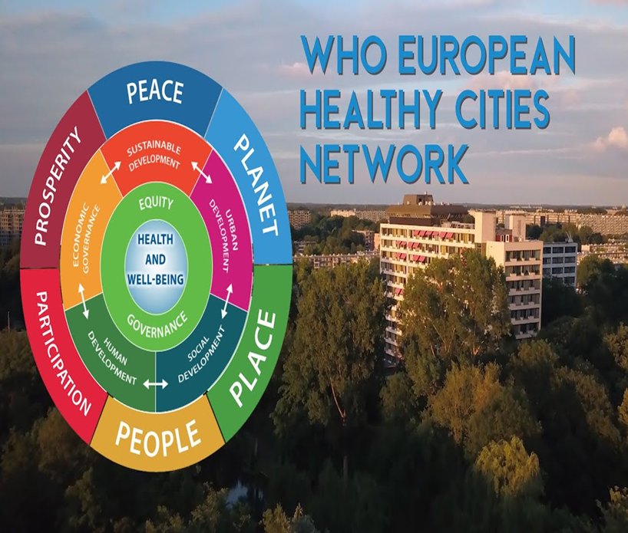
Principles of equity, community participation, empowerment, and intersectoral collaboration
Healthy Cities are places that:
Engage the whole of society
Prioritize public health issues like better housing and sanitation
Encourage better urban planning to improve access to green spaces, safe transportation, and emergency responses
Promote physical activity
Improve air quality
Reduce road traffic deaths
Save lives from disasters
https://www.youtube.com/watch?app=desktop&v=RivmX6CGqXo

Slide 4
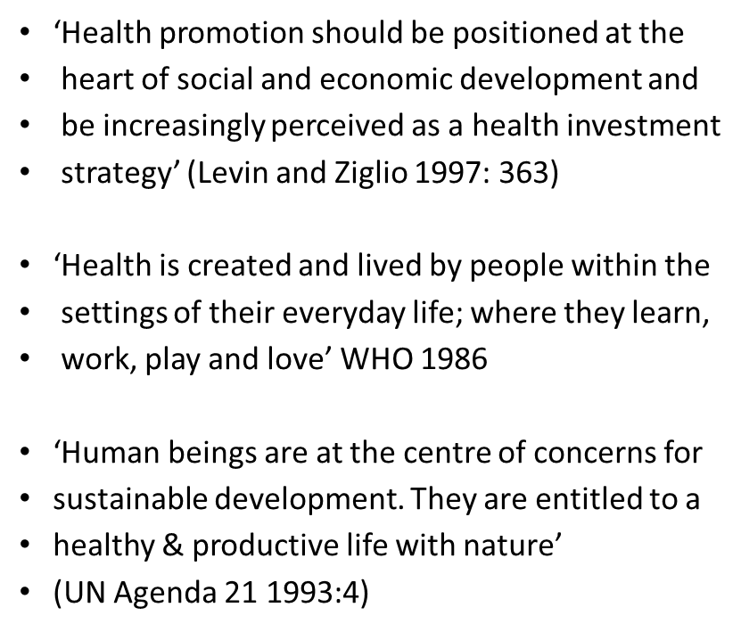

Health Promotion & the Web of Life

Slide 5
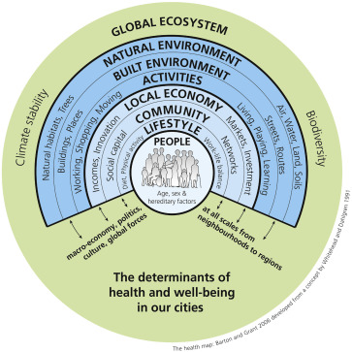
Now… Socio-ecological models of health
Social and structural determinants of health (SSDHs) are the non-medical factors that influence a person's health and well-being:
Social determinants
The conditions in which people live, work, learn, grow, and age. These include education, income, housing, employment, and the physical environment.
Structural determinants
The distribution of power, wealth, social and cultural norms, and economic and political factors.
SSDHs can have a significant impact on health inequities, which are the unfair and avoidable differences in health status between and within countries. Health and illness follows a social gradient, with lower socioeconomic positions associated with worse health.(Marmot, )
Graham, H., and White, P.C.L., 2016. Social determinants and lifestyles: integrating environmental and public health perspectives. Public Health, 141, 270–278.

Slide 6
Happier, Healthier Highways…
Context: Health is deteriorating from cradle to grave
Rising poverty, worsening health
Action on Structural & Social Determinants of Health
Politics of health
Challenging individualism & medicalisation: systems /ecological perspectives
Restore health promotion/ strengthen public health systems
Health is everyone’s business: intersectoral collaboration /community participation /equity/
Notes:
Hiam, L., Klaber, B., Sowemimo, A., & Marmot, M. (2024). NHS and the whole of society must act on social determinants of health for a healthier future. BMJ (Clinical research ed.), 385, e079389. https://doi.org/10.1136/bmj-2024-079389

