Slide 1
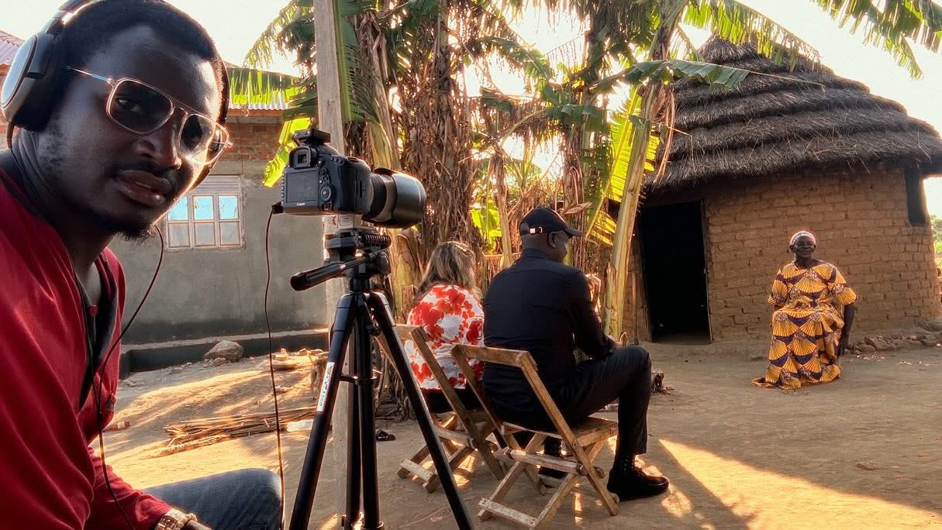
Documentary as a powerful form of research dissemination and impact: a case study
Professor Linda Gibson
Dr Sally Bashford-Squires

Slide 2
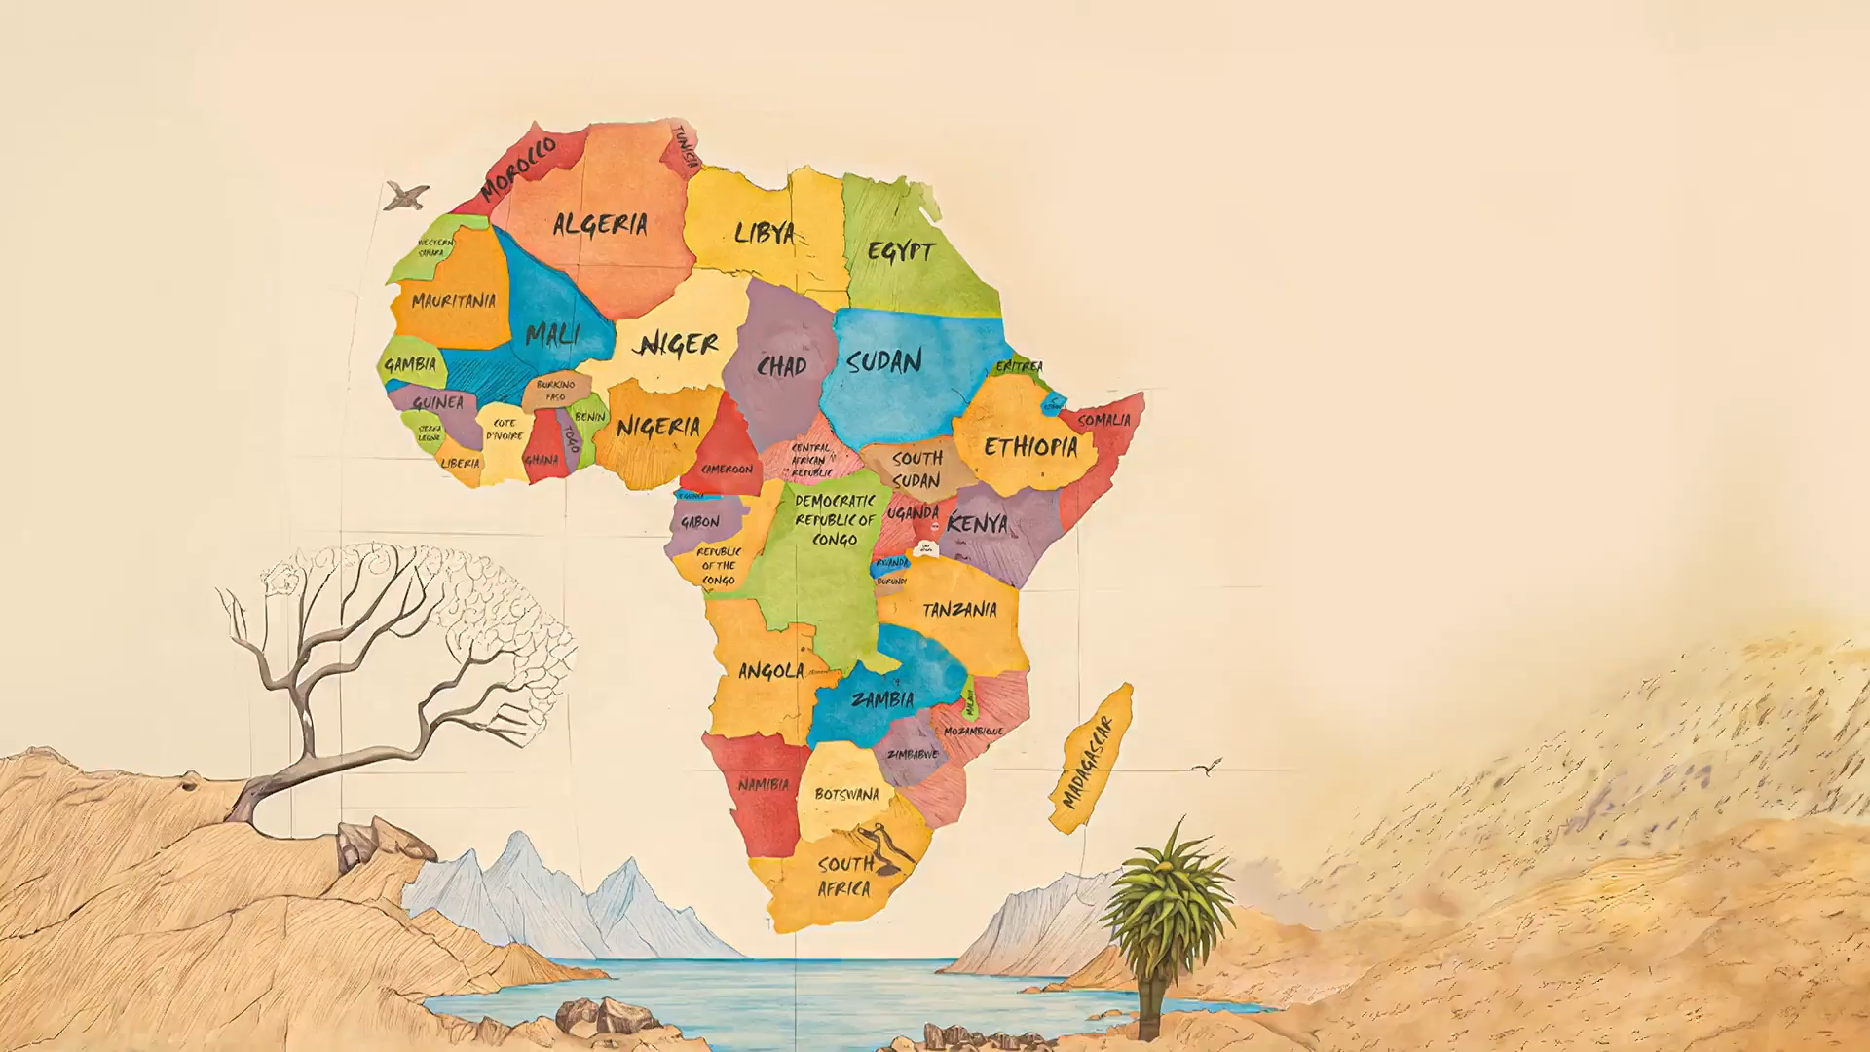
Welcome!

Slide 3
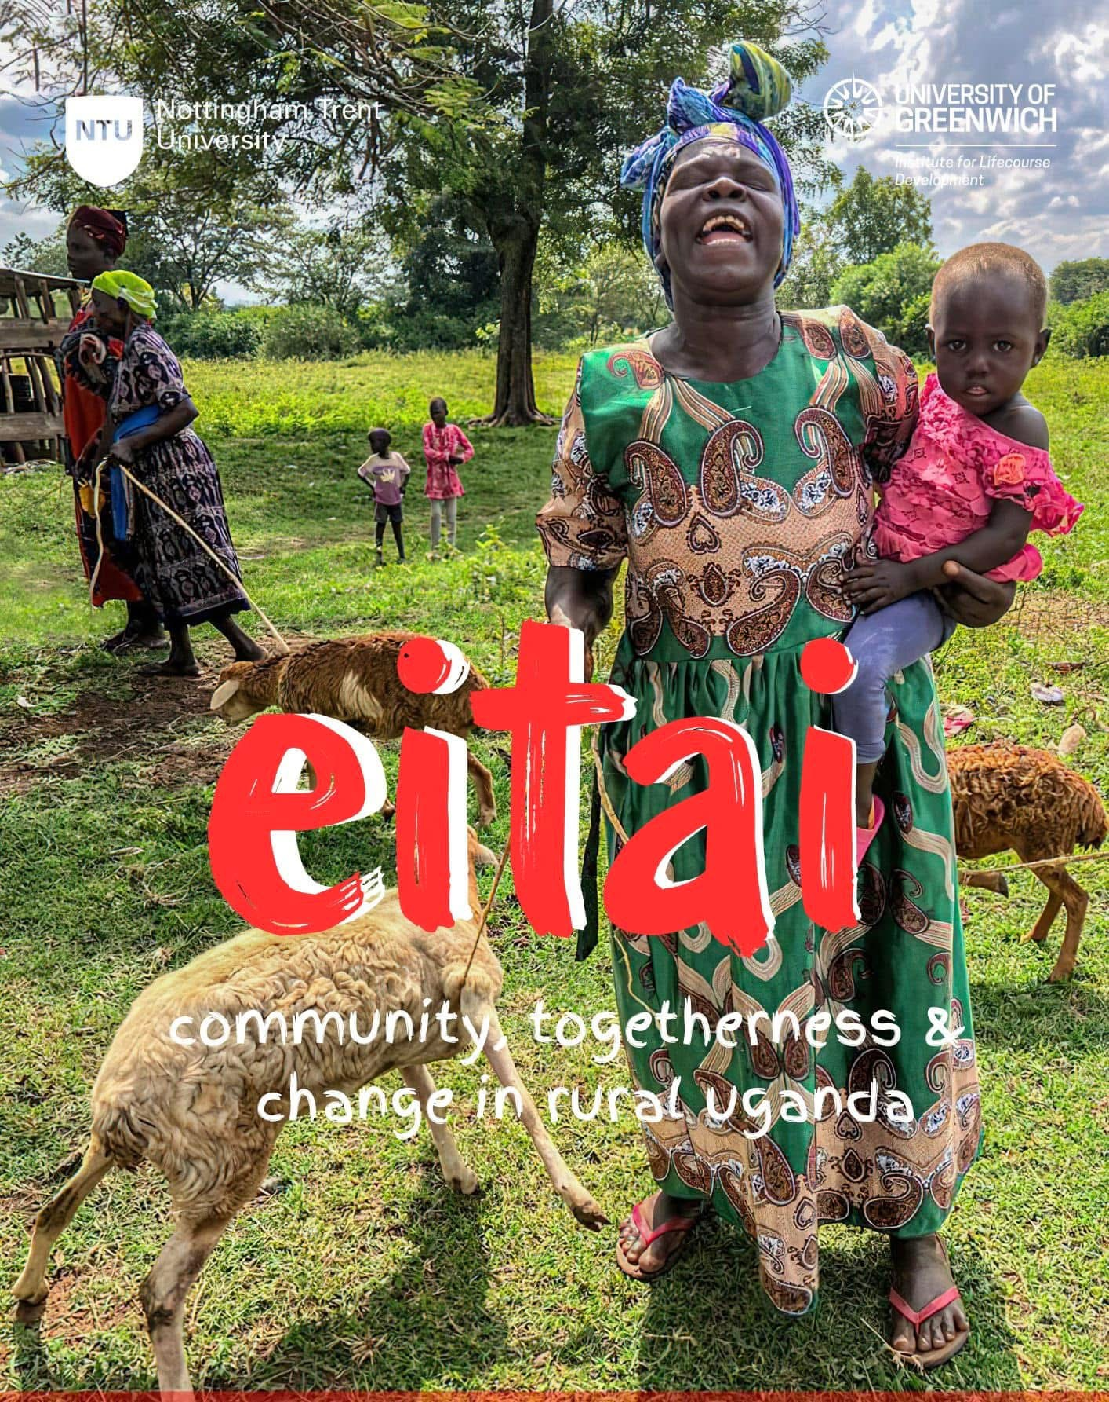
Background
Professor Linda Gibson
Links to Uganda
Dr Sally Bashford-Squires
Links to Uganda
PhD
Dissemination through documentary – NTU QR funding
Eitai – Community togetherness

Slide 4
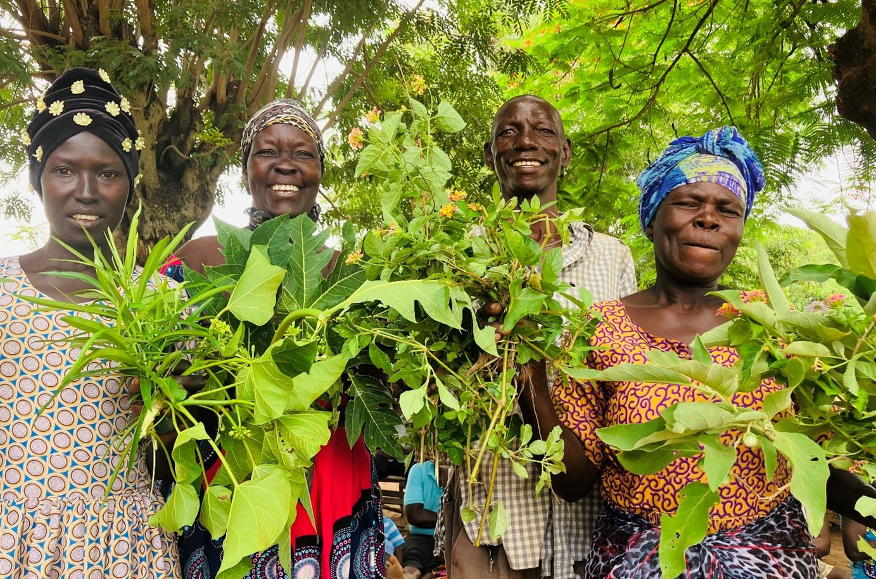
Why a documentary?
Research is primarily disseminated within academic circles. This space is inaccessible to the public and those that might benefit from the research (Petrarca and Hughes, 2014).
Alternative data forms, when treated as art, foster empathy, highlight specifics missed by abstractions, offer insight, and draw attention to complexity (Eisner, 1997).
Documentaries expose social issues by grounding them in real stories. This brings hidden concerns to light, sparking public awareness, dialogue, and potential action (Shyngyssova, 2024).
In the context of this research:
Afrocentric values
Field work – dance, drama, music
Rich tradition of storytelling

Slide 5
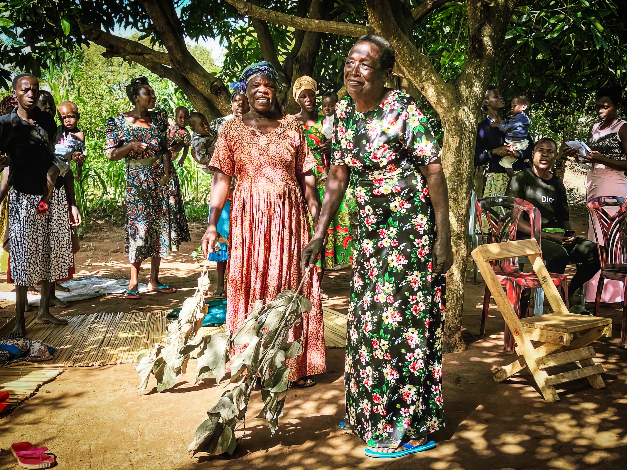
“The word itself, ‘research’ is probably one of the dirtiest words in the Indigenous world’s vocabulary. When mentioned in many Indigenous contexts, it stirs up silence, it conjures up bad memories, and it raises a smile that is knowing and distrustful.”” (Smith, 1999)
Documentary filmmakers must navigate issues of consent, representation, and the responsibility to portray their subjects fairly and honestly (Ruby, 2008).

Slide 6
HIV story

Slide 7
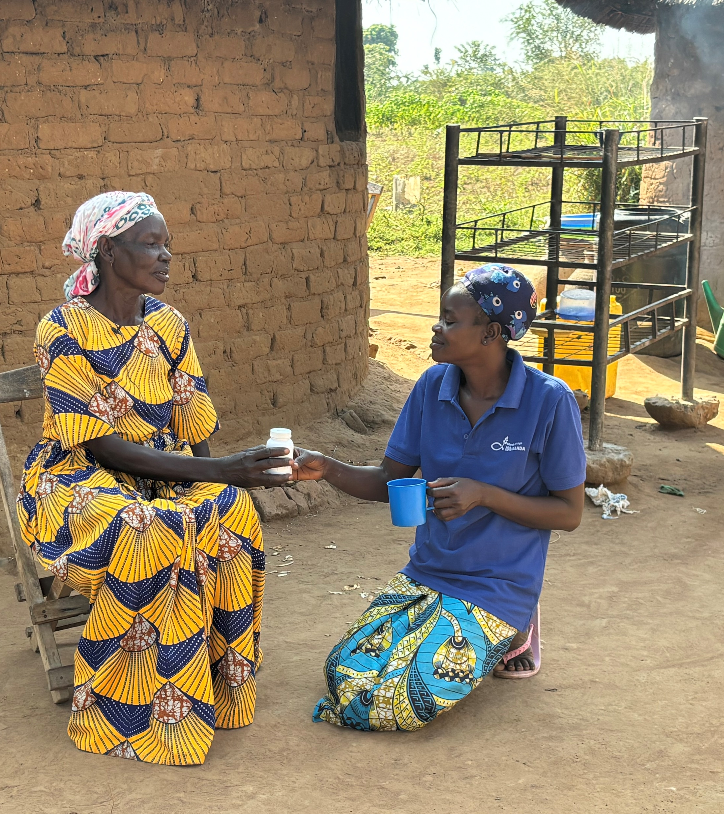
Impact
Shown to over 1000 people across London, Nottingham, and Kampala and rural Uganda via conferences, cinemas, community screenings, and school visits.
Discussed with MP in parliament.
Listed by Springer as one of the 100 most influential global public health films.
Shortlisted out of over 100 films for the International Sociological Association Film festival in Rabat

Slide 8
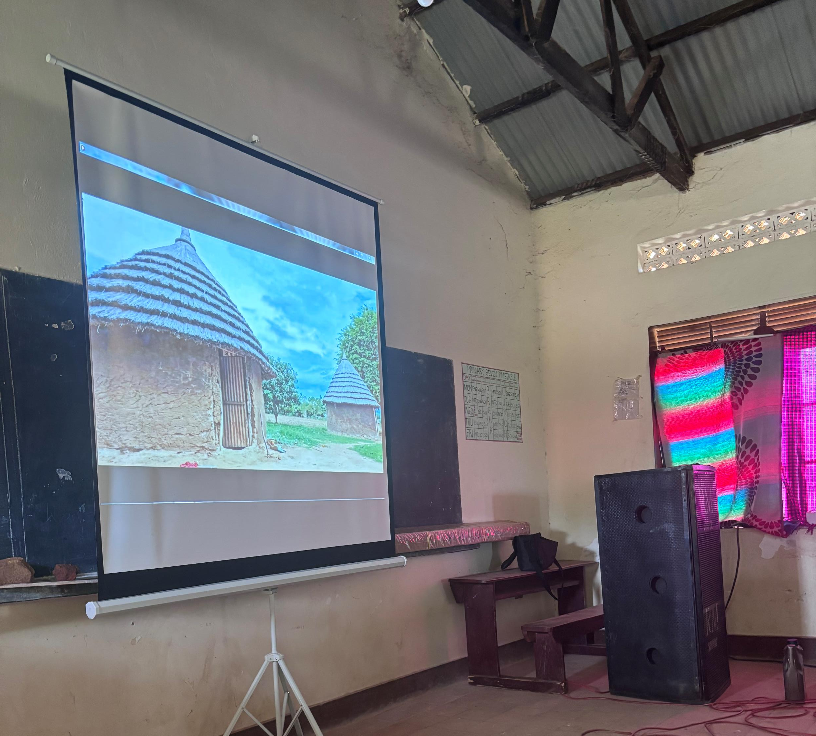
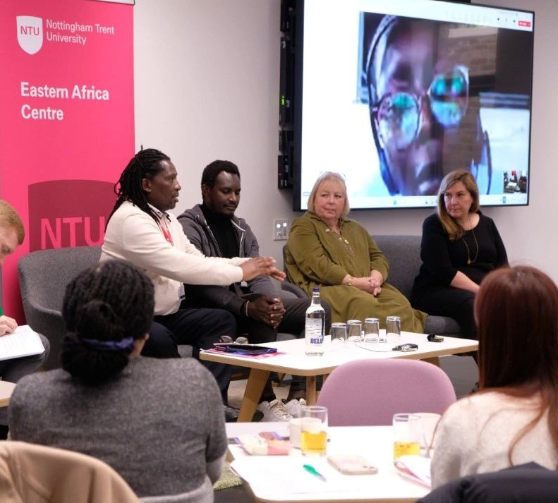
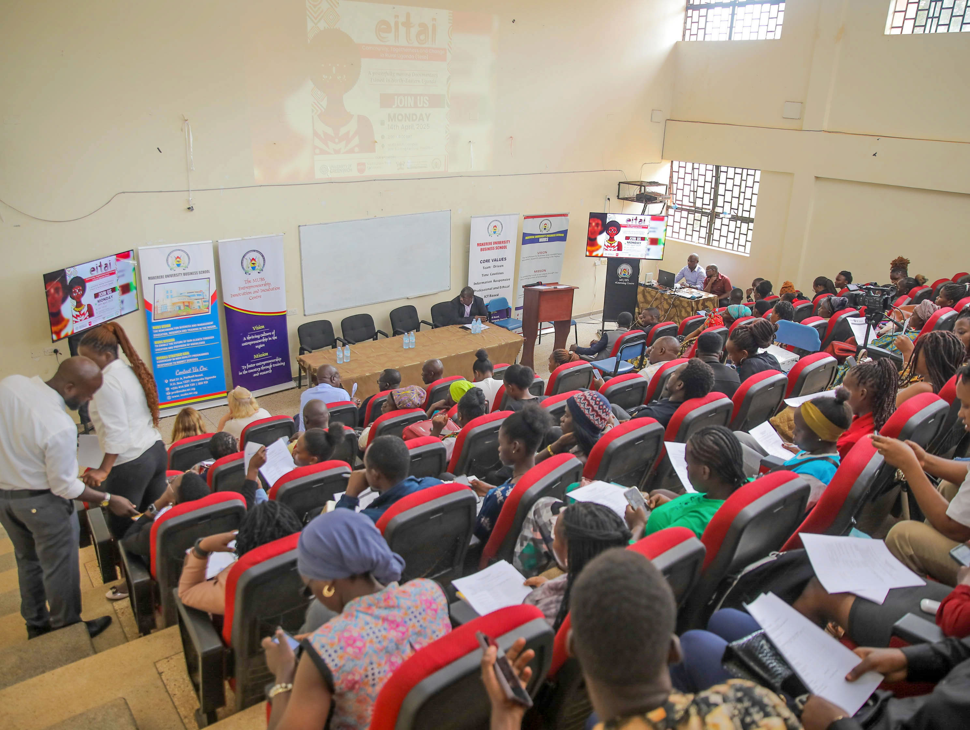
Dissemination
Nottingham Trent University, University of Greenwich, Broadway Cinema, Mammoth Cinema, Makerrere University, TASO, Indigenous Women, Action Aid Women’s Centre, and MIDA, St Peter’s Junior School, Middleton Primary School, University of Nottingham, Klagenfurt University

Slide 9
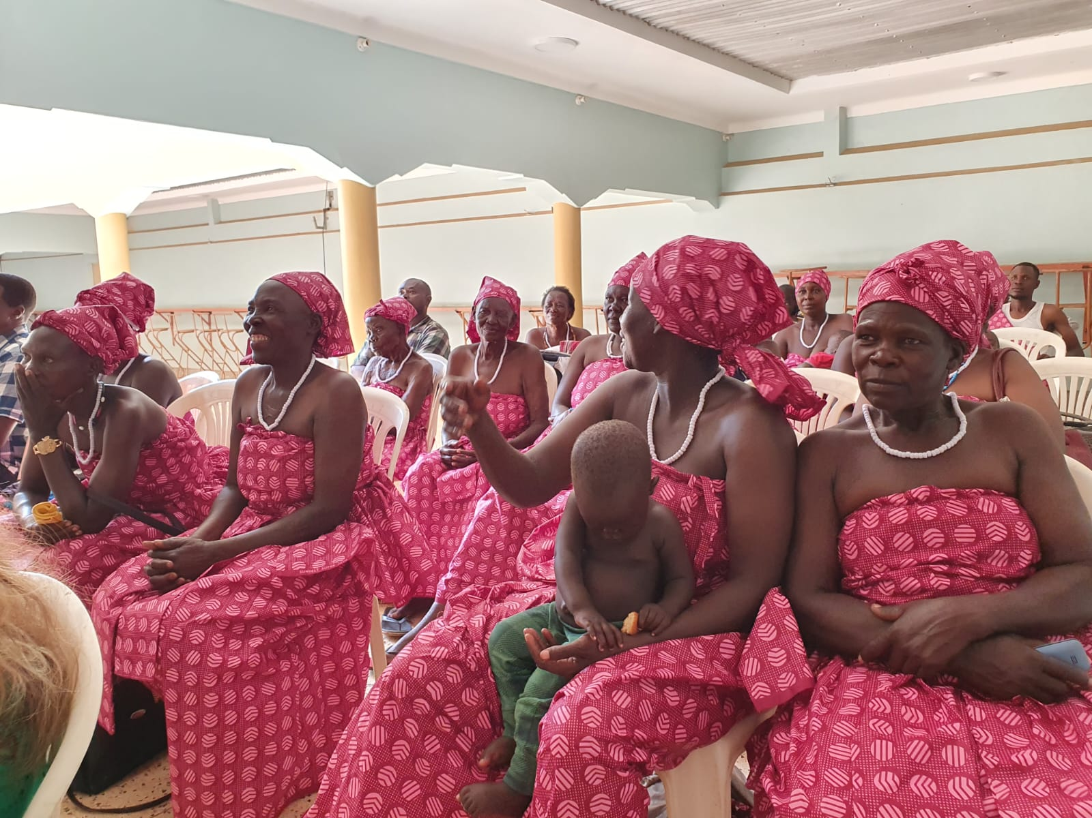
Taking the film back to where it began…
“Created as a more impactful way to share her PhD findings, the film ensures that the wider knowledge is not only disseminated to wider audiences bur also made accessible to the people of Teso, whose stories and resilience it captures…A heartfelt reminder that meaningful change starts with the people and belongs to them.”
Environmental Health Students, Makerere University

Slide 10
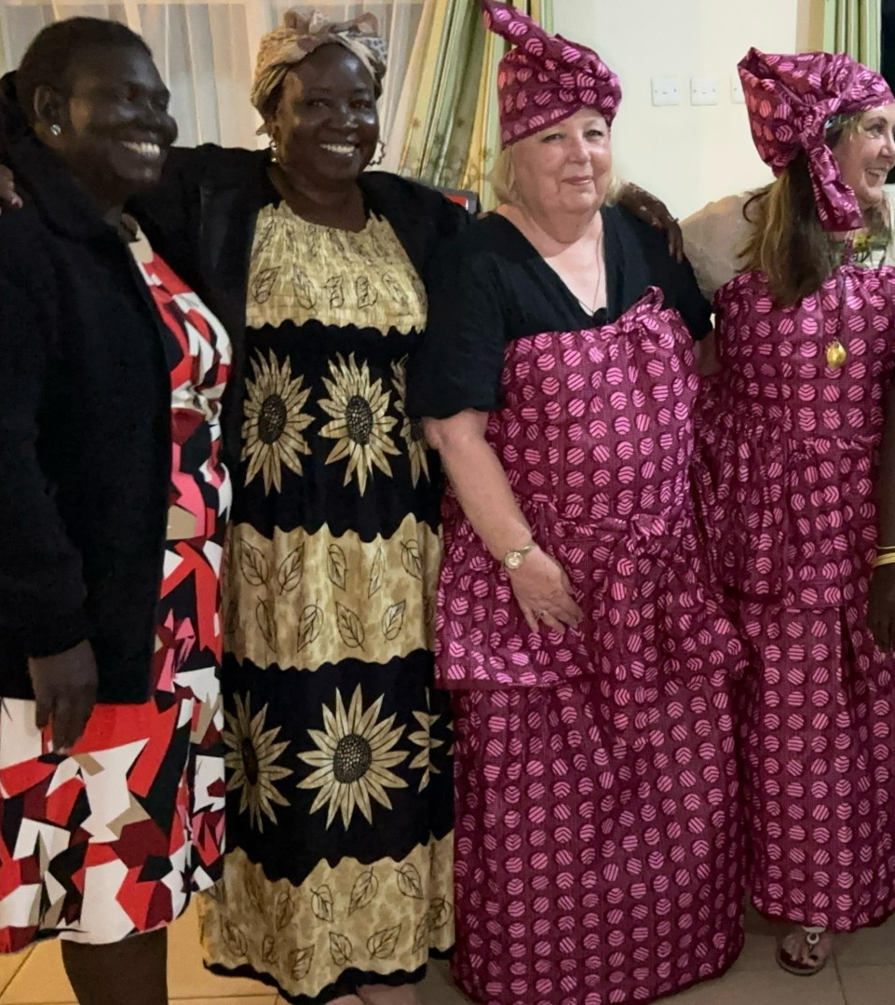
Eitai in action
“Let's see how we can help each other and support each other. What can I borrow from you what can I take from you? The idea coming out from Eitai proves applies to all the groups…How can we realise the little we already have to ensure that it grows into something that moves to the future... You are giving us a push to do better. … we shall build ourselves into a very big tree and other birds will come and perch and take the fruit we have planted. We shall support each other to stand.”
Alice, Action Aid Lead

Slide 11
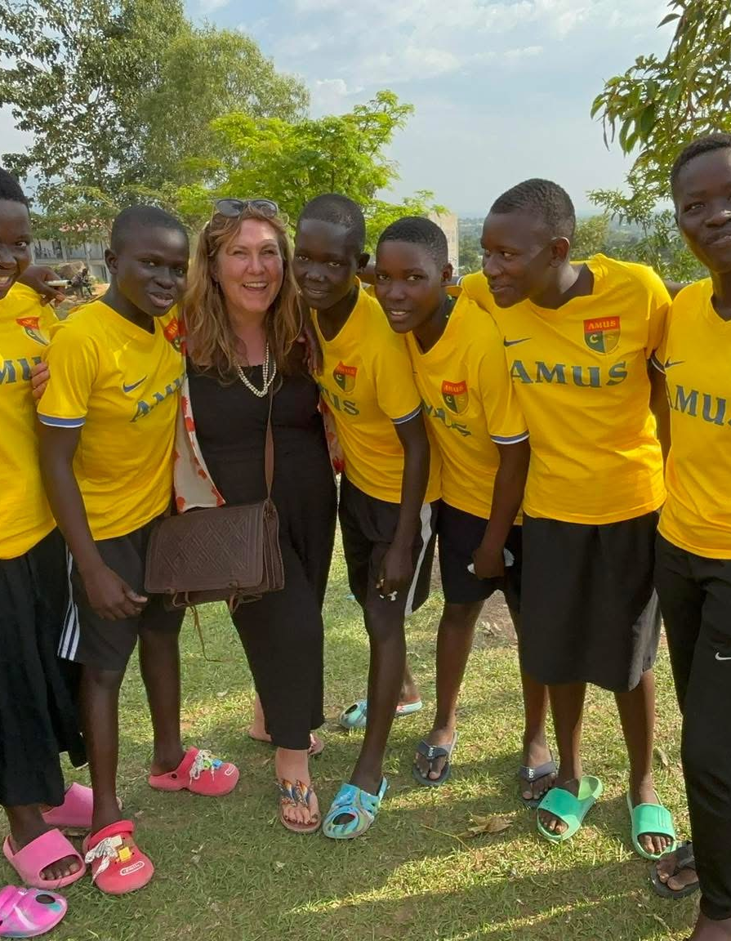
Top Tips!
Budget carefully.
Time—almost as demanding as writing a PhD.
Start with a clear vision: know your goals, identify the footage you need, and define your key messages early.
Atmosphere is crucial, include shots that show daily life and the natural environment. In Eitai, we also recorded local music, which grounded the film both sonically and culturally.
Build trust.
Listen carefully, open-ended questions and silence often lead to the most meaningful stories.

Slide 12
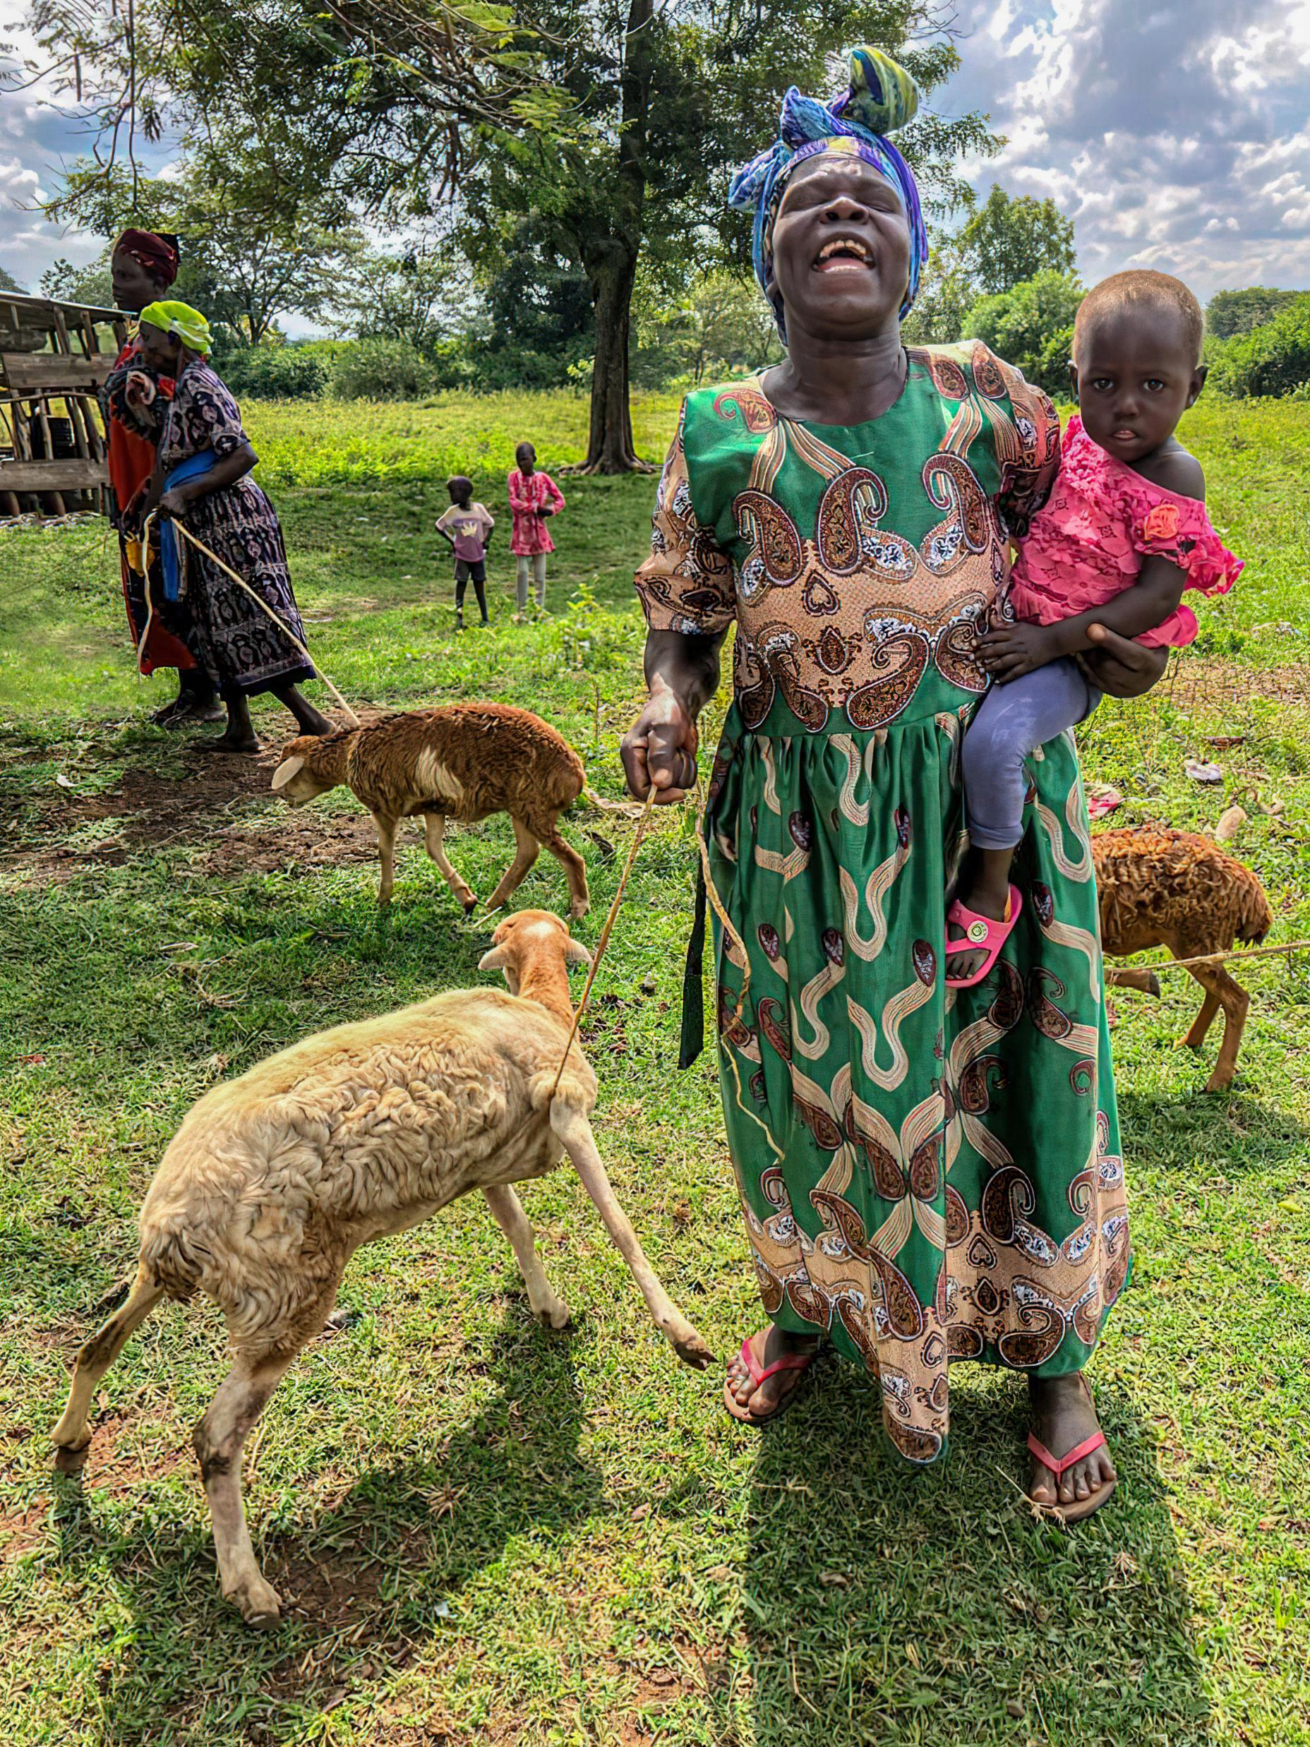
In conclusion…
Documentary film offers an alternative to the written word and can impact a broader audience; enabling researchers to both analyse and present real lives in a more accessible, engaging format.
It can lead to social change and justice, especially when respecting and representing the rights of those involved and building relationality and reciprocity.
What next…
Website – etai.co.uk
Crowd Funding – Football story
Publications
Film Festivals, conferences, and as educational tool

Slide 13
End video

Slide 14
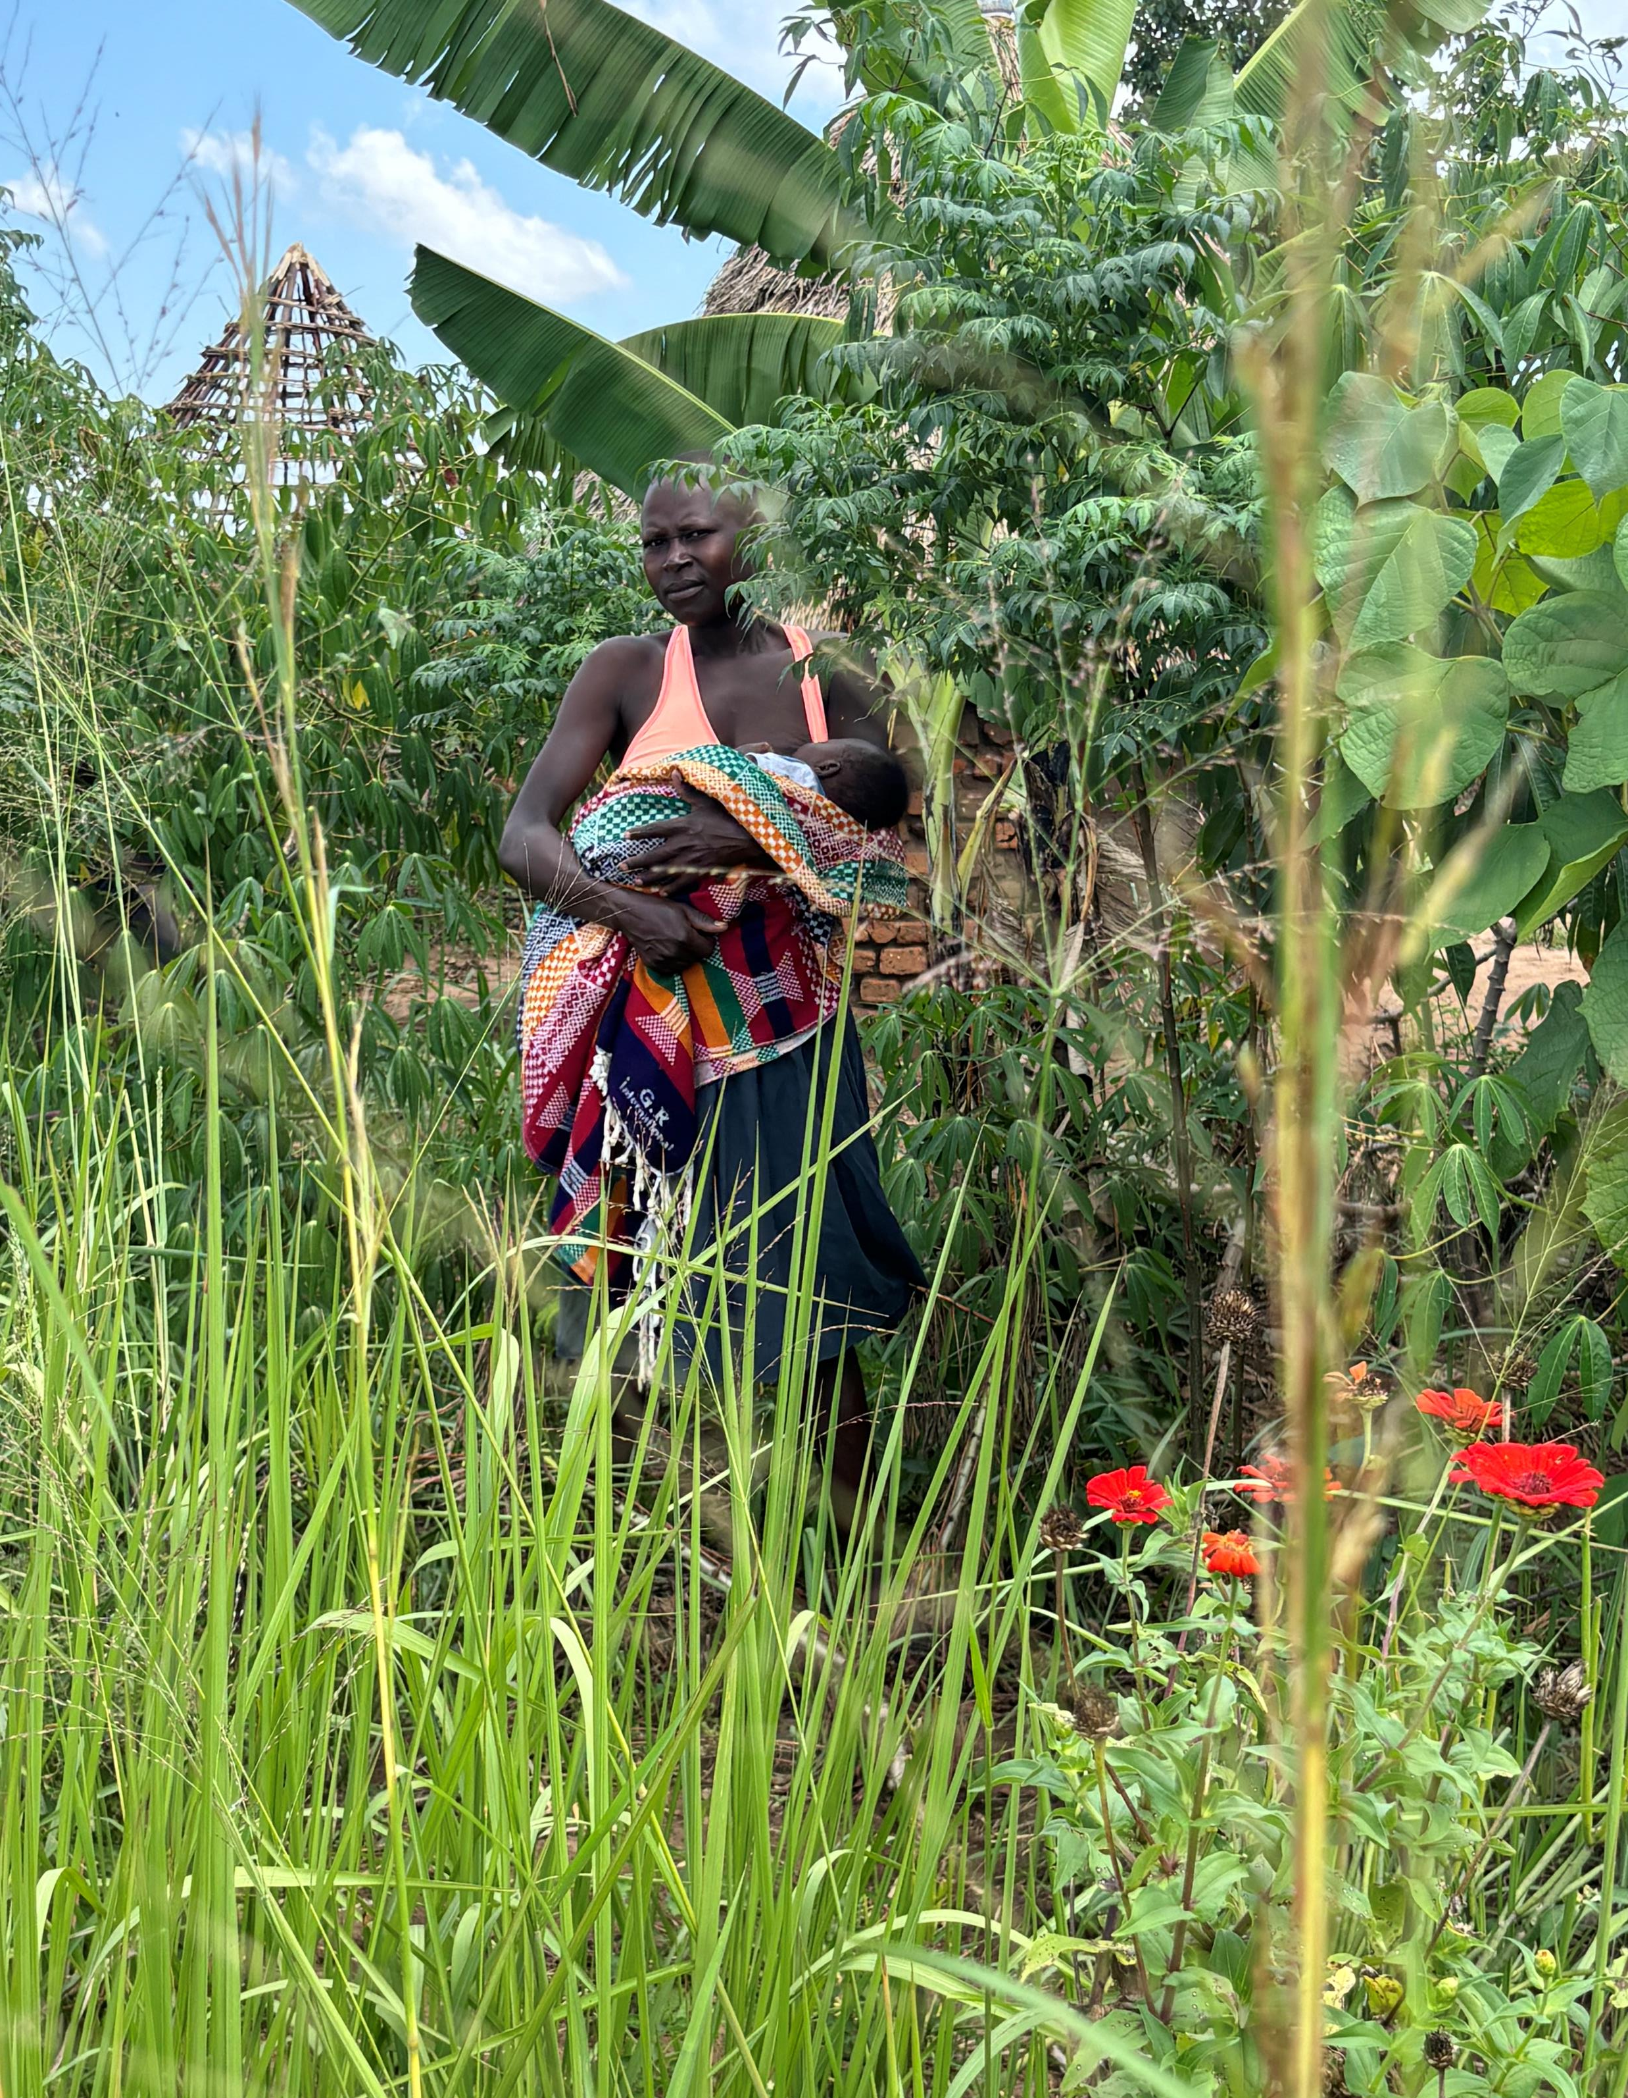
Thank you!
www.etai.co.uk
References
Eisner, E. W. (1997). The promise and perils of alternative forms of data representation. Educational Researcher, 26(6), 4-10.
Petrarca, D.M. and Hughes, J.M., 2014. Mobilizing knowledge via documentary filmmaking—Is the academy ready?. McGill Journal of Education, 49(3), pp.561-582.
Ruby, J. (2008). A future for ethnographic film? Journal of Film and Video, 60(2), 5-14.
Shyngyssova, N., Nurshaikhova, A., Kopbayev, T., Yessenbek, Z., & Yertassova, G. (2024). The impact of documentary films as a form of investigative journalism: analysis of methods, ethics, and public influence. Atlantic Journal of Communication, 33(2), 327–340. https://doi.org/10.1080/15456870.2024.2435940
Smith, L.T., 2021. Decolonizing methodologies: Research and indigenous peoples. Bloomsbury Publishing.

