Slide 1

Welcome to A Nottingham Debate Revisited!
Enjoy a cuppa and a pastry, have a chat and find a seat…
We will be starting at 9:15am.

Slide 2


A Nottingham Debate Revisited post-Brexit and post-pandemic perspectives on graduate retention, belonging and placemaking
Monday, 12th May, 2025 (9:00am – 12:00pm), Nottingham Trent University
A workstream of the NTU “MARKETs” Group

Slide 3
Agenda
9:15: Welcome (Jon Rea/Matt Wheatley, Nottingham City Council)
9:20: Introduction and background (Eva Zemandl, NTU)
9:40: Co-Navigator activity (Kelly Auty, NTU Institute for Knowledge Exchange Practice)
10:30: Coffee break
10:45: Resume activity
11:40: Plenary and next steps
12:00: End

Slide 4

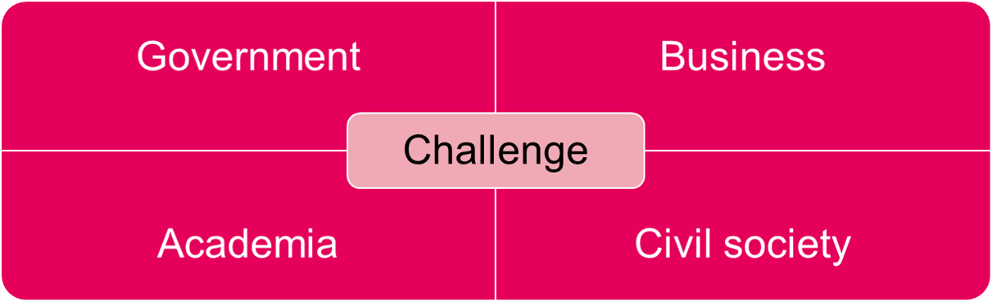
What is the MARKETs approach?
Quadruple helix
Mission oriented
Action oriented
Systems thinking
Deep listening
Relationship facilitation
Policy research
Student engagement/
  empowerment
Notes:
Uses a quadruple helix approach that brings together stakeholders from public, private, civic and academic sectors to interact, exchange and deliberate problems and solutions in a ‘market square’.
MARKETs works on a set of interlocking principles, including deep listening, systems thinking and policy research which involves student –led projects.

Slide 5
MARKETs Group
Project lead: Dr Eva Zemandl (eva.zemandl@ntu.ac.uk)
Associate Prof Peter Eckersley (peter.eckersley@ntu.ac.uk)
Dr Ana Nunes (ana.nunes@ntu.ac.uk)
Dr Elme Vivier (elme.vivier@ntu.ac.uk)
Advisor and collaborator: Jon Rea (jon.rea@nottinghamcity.gov.uk)
Policy Lab and postgraduate students: Benjamin Frimpong Anim, July Myint Aung and Stefani Tieri Georges

Slide 6

Introduction and background

Slide 7
‘The Great Nottingham Debate’
(Lawton 2016)
What can be done to attract and retain graduates, other young people and skilled workers in the short term? What sort of economy should Nottingham aspire to develop in the long term and what are the lessons for Place Marketing?
Nottingham had the lowest rate of graduate retention of the eight Core Cities plus Derby, at 27.7% (DHLE survey, 2012-13)
Of the 11 English regions and UK nations, the East Midlands had the lowest proportion of retained graduates working in the region six months after graduation, at 39.2%.
Notes:
DLHE = ‘Destinations of Leavers of Higher Education’
Manchester had the highest graduate retention, at 48.7%, followed by Birmingham, at 46.3%.
But graduate retention falling over time in most cities and regions except London – “The broadest trend is that graduates are now a little less likely to stay close to the university where they studied and a little more likely to go to London.”

Slide 8
‘The Great Nottingham Debate’
(Lawton 2016)
Students and alumni had very positive views of Nottingham as a place to study
But awareness of what Nottingham’s offer varied:
  Students from London and the South East and the East of England tended to compare Nottingham to London
  Local students and those on highly vocational degree courses had very positive views of Nottingham
  Students on more academic degree courses, those with limited work experience and/or students from London and the South East had more limited awareness of Nottingham’s assets
Nottingham-based alumni an under-utilised resource
Lack of information on employment opportunities and young professional life
‘Over supply’ of student housing vs. housing for young professionals
Student recommendations: dedicated local careers events, engaging students with local people, emphasising Nottingham’s strengths
Emphasis on the important role of place marketing in attracting/retaining talent
Notes:
DLHE = ‘Destinations of Leavers of Higher Education’
Manchester had the highest graduate retention, at 48.7%, followed by Birmingham, at 46.3%.
But graduate retention falling over time in most cities and regions except London – “The broadest trend is that graduates are now a little less likely to stay close to the university where they studied and a little more likely to go to London.”
Place marketing can be more active, i.e., through work experiences and alumni mentoring

Slide 9
Revisiting the debate 2025
To explore factors that may be influencing graduate retention and talent attraction in post-pandemic and post-Brexit era
Taking stock of actions borne out of 2016 debate; policy and economic drivers; approaches in other UK cities
Uncovering student, graduate and stakeholder perceptions of:
  What are (changing) expectations around jobs, lifestyle and place since the pandemic and Brexit?
  What conditions (could) make Nottingham an attractive place to stay, live, work and invest?
  What are the challenges of this post-pandemic, post-Brexit, etc.?
→ And . . . what is this really about?

Slide 10

Graduate retention as a lens…
By starting the conversation with graduate retention, what other questions and problem definitions (re)emerge?

Slide 11

Research support from student projects

Slide 12
Policy Lab Report (postgraduates)
Taking stock of successes, gaps and inspiration from other examples (May – August 2025)
Desk research and literature review
  Global, national and regional drivers (policy and economic)
  Nottingham’s graduate retention and high skills landscape
  ‘Best’ practices from other UK cities
Stakeholder interviews
  What has been the impact of joint actions since the Great Nottingham Debate in 2016?
  What is influence of the post-pandemic, post-Brexit, post-[insert word] landscape? (economic, political/policy, social, cultural), etc.)
July, Stefani and Ben will be immersing themselves in your discussions today. They are grateful for any information and insights you can offer for their policy report.

Slide 13
Summer Research Bursary (second-years)
Uncovering post-Brexit/post-pandemic preferences, choices and decisions (June – September 2025)
Surveys and focus groups with final year students, recent graduates and alumni
  How they see the City in 5, 10 (possibly) 20 years?
  What career opportunities and amenities like a vibrant arts, culture, green spaces, community hubs and sports scene would keep them in Nottingham?
  How do they see themselves contributing to the city's economic life and vibrancy?
  Do they want to stay in Nottingham?
  And for graduates – what influenced their choice to stay or leave the city?

Slide 14

Data to bear in mind

Slide 15
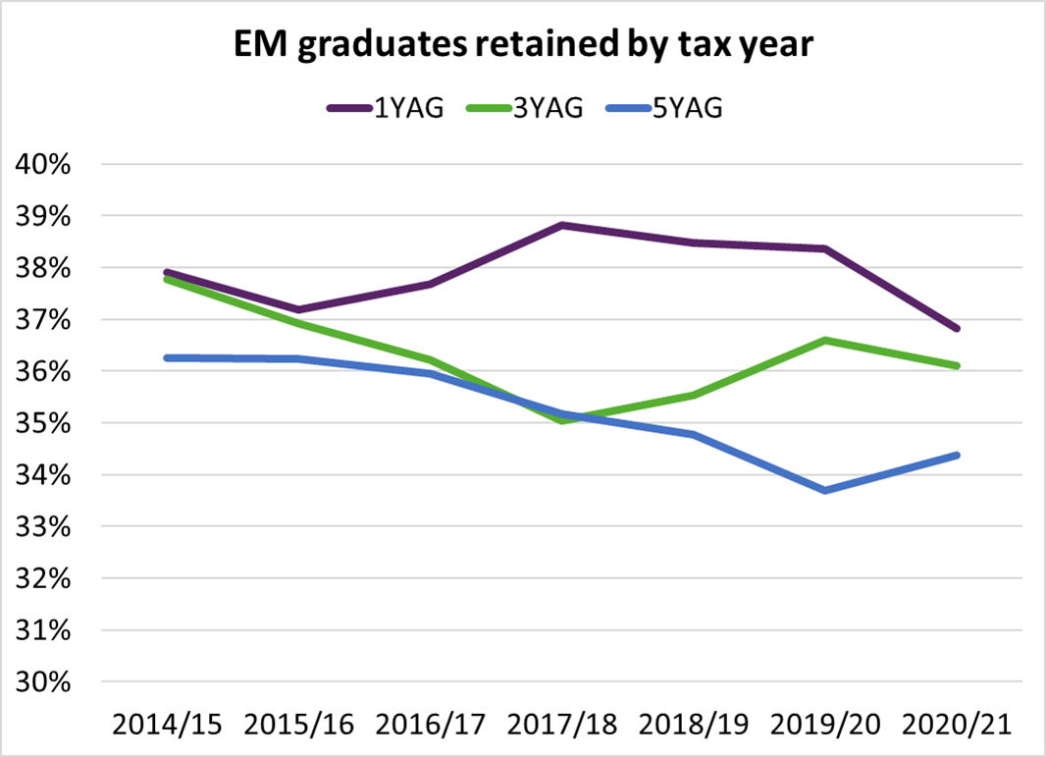
Stability of East Midlands graduate retention

Slide 16
A snapshot of Nottingham’s population (young, diverse, disadvantaged)
Large amount of population ‘churn’ (33,500 people arriving from elsewhere within the UK and 41,800 leaving in the year 2022 – 2023)
International migration and an increase in student numbers are the main reasons for the population growth
Full-time students comprise 1 in 7 of the population
Just under 30% of the population are aged 18 to 29 (City gains young adults; loses families to the suburbs)
42.7% of the population from BME groups (increase from 35% in 2011)
Nottingham has a higher than average rate of people with a limiting long-term illness or disability
Despite large numbers of students, Nottingham has a higher proportion of people of working age with no qualifications, compared with the national average

Slide 17
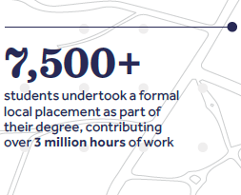
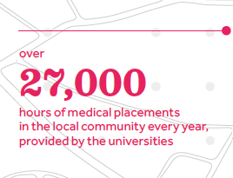
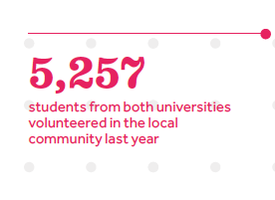
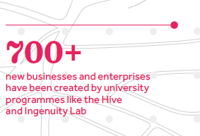
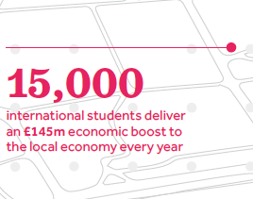
The combined economic, social and cultural impact of
Nottingham Trent University and the University of Nottingham

Slide 18

Co-Navigator Activity

Slide 19

Coffee break

Slide 20

Plenary and next steps

Slide 21
Thank you! Stay in touch
eva.zemandl@ntu.ac.uk
peter.eckersley@ntu.ac.uk
ana.nunes@ntu.ac.uk
elme.vivier@ntu.ac.uk
jon.rea@nottinghamcity.gov.uk
LinkedIn: https://www.linkedin.com/groups/13123226/

