Slide 1

What is happening to Local Public Audit in England? A policy briefing paper
The Future of Public Administration
Pete Murphy and Katarzyna Lakoma
Nottingham Business School, NTU.

Slide 2

Introduction – where we are in the Parliamentary Process
1st reading 10th July 2025: Government published English Devolution and Community Empowerment Bill, Part 4 is devoted to Local Audit.
2nd Reading - debate on general principles, and decision to proceed 2nd September. No debate on its details at second reading.
Committee Stage, MPs selected to form a small committee (approx. 17) examine the bill in detail each line and clause and suggest amendments
Report Stage – whole House considers the changes made at committee stage (then onto third reading in Commons before scrutiny in Lords).

Slide 3
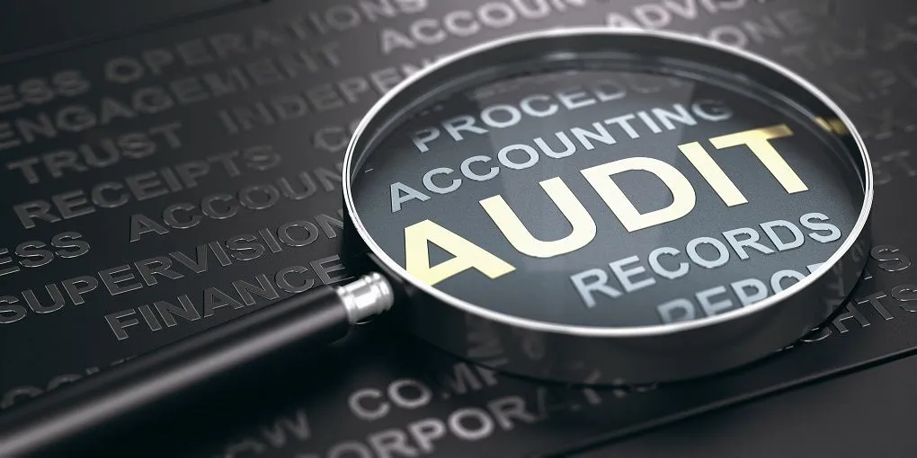
Local Public Audit (LPA)
English Devolution & Community Empowerment Bill, a very contentious Bill that proposes a new framework for devolution of powers to local government and combined authorities in England.
Proposals for Local Audit are probably the least contentious part of the Bill
Why? - The long gestation of the local public audit proposals and the broad agreement of the need for change
Key antecedents date back to the inadequacies of the Audit and Accountability Act 2014

Slide 4

Local Public Audit in England
1844 Local Public Audit system in England was established in the nineteenth century as a wholly public audit system,
1983 Transformed into a mixed audit system after the Audit Commission was established.
2014 reformed into a primarily private audit systems after the Local Audit and Accountability Act 2014.
It is currently proposed to be reformed into a mixed audit system if English Devolution and Community Empowerment Bill becomes law
The models are different in Scotland, Wales and Northern Ireland as devolution meant the auditing of public bodies was a transferred responsibility. A public audit system that covers all public bodies.

Slide 5
Local Audit and Accountability Act 2014
Provided less comprehensive and inadequate audits by poorer qualified staff.
Public oversight deteriorated as the new regime had less accountability, less transparency and weaker public assurance (to government, stakeholders and the public)
A growing ‘accountability gap’ between what the public thought and assumed the system provided and what it actually provided.
Significant backlogs in the publication of statutory reports led the NAO to disclaim the Whole of Government Accounts for 2022/23 and 2023/24
Year | 2014/15 | 2015/16 | 2016/17 | 2017/18 | 2018/19 | 2019/20 | 2020/21 | 2021/22 | 2022/23
Audits | 97% | 97% | 95% | 87% | 57% | 45% | 9% | 12% | 1%

Slide 6
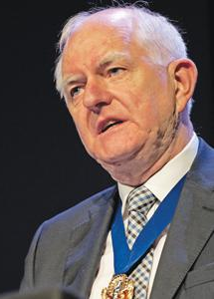
The Redmond Review
An independent review of the oversight of local audit arrangements and the transparency of local authority financial reporting.
Key Findings
Local public audit market was fundamentally flawed
Unprecedented backlogs of incomplete audits had built up
National leadership fragmented and ineffective.
Audit process and its reporting were no longer fit for purpose ( going concern judgement was effectively meaningless)
No real assessment of an organisation’s financial sustainability, financial or organisational resilience, or its vulnerability
Responses had high level of unanimity across the sector.

Slide 7

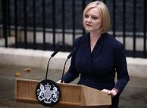

2020-2024 Governments response
From December 2020, they agreed to the 17 recommendations relating to the content and conduct of the local audit but not the 6 system-leadership and management proposals.
March (DBIS) and May (MHCLG) 2021 Proposed an Audit, Reporting and Governance Authority, (ARGA) be established to oversee both public and private auditing.
July 2021 a “technical consultation” and arrangements to extend new system to health police fire etc
May 2022 Announced £45m support in the 2022/23 spending review to tackle audit backlogs
No primary or secondary legislation by election in July 2024.

Slide 8

July 2024-Sept 2025
30 July 2024 - announced 13th December as a statutory backstop date for financial years up to and including 2022/23, and through to 2027/28 (NAO implementation guidance.
18th December 2024 Audit Reform Consultation published. (239 responses).
April 2025 governments response to the consultation published.
10th July 2024 English Devolution and Community Empowerment Bill (Chapter 4 Local Audit). 2 September 2nd Reading

Slide 9
Latest proposals
New Local Audit Office
Assume responsibility for appointing/contracting auditors for LAs,
co-ordinate and manage an oversight framework
clear the audit backlog.
reestablish public provision of local audit and
create a new career pathway in public sector local audit.
Government to
Amend primary legislation; review options for the content and format of accounts and list of bodies to which LAO appoints auditors
work collaboratively with the sector to develop and improve LPA to make it fit for purpose
apply the new local audit approach/regime to locally delivered services/sectors such as the police, FRS, national parks etc,
Work with the sector and Scotland, Wales and Northern Ireland to ensure future accounting practices are consistent across the UK.

Slide 10
We support and welcome
The redefinition of the purpose of audit, and clarity on system leadership (LAO)
Proposals to tackle the dysfunctional audit ‘market’
centralised audit registration and responsibility for fees;
the creation of a new public audit firm,
complementary changes to the internal audit function within local authorities,
The new LPA regime
commitment to working collaboratively with the sector to develop/improve LPA and make it fit for purpose and fit for future purpose
Consistent accounting practices across the UK.
Proposed changes and review of smaller public entities audit regime

Slide 11

Clarifications and assurances
Inherently collaborative areas (public health, community health, preventative health) need a commitment to make the LA and NHS systems as compatible as possible (e.g. Acs Auditors' Local Evaluation for Health and Use or Resources for LAs) as beneficial to future collaborations.
We would like to see more acknowledgement of the importance of forward-looking prospective audit and accountability to complement the traditional backward-looking retrospective audit and accountability
The intentions could be more explicit e.g. list of bodies to which the LAO will appoint auditors
A statement of the relationship the LAO will adopt to IAS and IFRS standards

Slide 12

Thankyou for listening
Questions,
Comments,
Suggestions.
Contact:
Peter.Murphy@ntu.ac.uk
Katarzyna.Lakoma@ntu.ac.uk

