Slide 1

Central Government Interventions in Fire and Rescue Services in England and Wales.
The Future of Public Administration
Pete Murphy and Katarzyna Lakoma
Nottingham Business School, NTU.

Slide 2
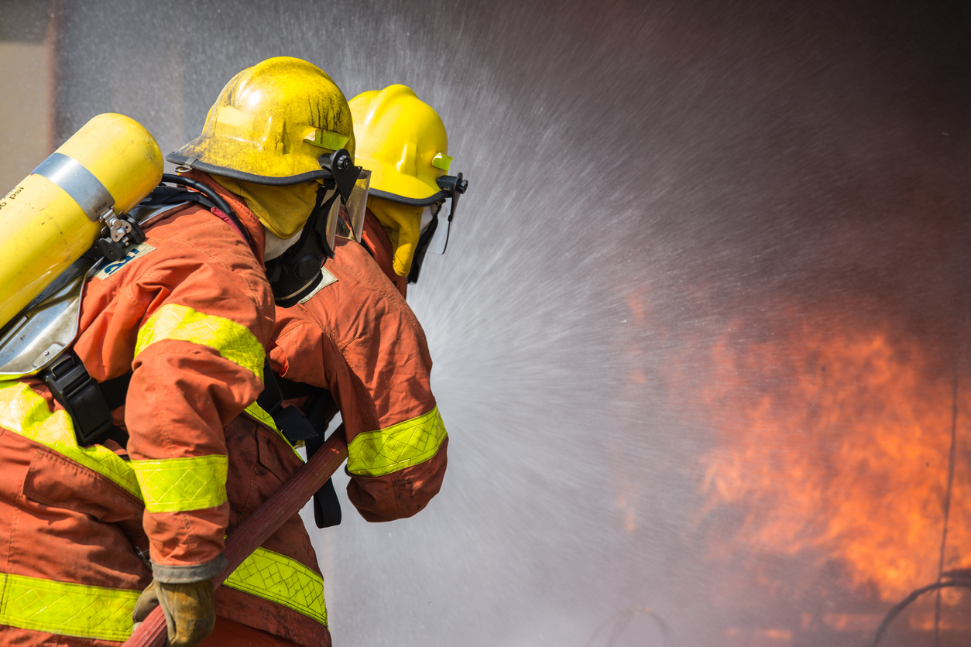
Introduction and background
1947-2001 Under the Home Office - the period of benign neglect.
1947 Fire Services Act returned responsibility to local government and established His Majesty’s Fire Service Inspectorate (HMFSI) with Chief Inspector for England and Wales reporting annually to the Home Office.
HMFSI monitored technical standards and operational performance by providing advice on standards and compliance. It did not hold FRS to account

Slide 3

Methods and some limitations to the study
It had to rely on very different data and information sources for each of the three periods.
Phase 1: National reports by the Audit Commission and other collaborating local inspectorates lodged in the Government Collection of the National Archives (often summaries of unavailable individual reports).
Phase 2: National reports but with some ad hoc individual reports. Fire Peer Challenge and Operational Assessments removed from LGA website from 2015.
Phase 3: Heavily dependent on the individual and national reports from the reconstituted HMICFRS established in 2018, after the Policing and Crime Act 2017. These are lodged on its current website which forms the institutional repository.
However, all data and information is publicly available; no issues of sensitivity or confidentiality and some summary analysis by Audit Commission, the LGA and HMICFRS.

Slide 4



Intervention 2004-2025
All engagements or interventions throughout the study period were predicated on individual authorities’ failure to meet their statutory obligations of procuring Best Value under the Local Government Act 1999.
We look at 3 chronological phases.
Phase 1 2004 to 2010 - CPA/CAA and early versions of the National Frameworks
Phase 2 2010 to 2017 - Sector led improvement/Fire Peer Challenges and Operational Assessments and the 2012 National Framework
Phase 3 2017 to 2025 – HMICFRS, service inspections and 2018 National Framework

Slide 5
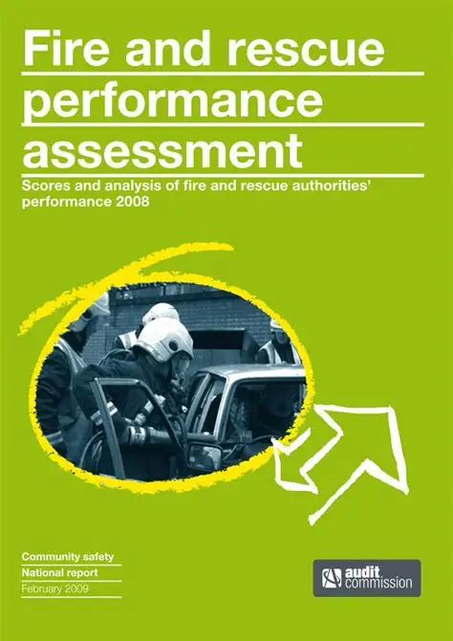
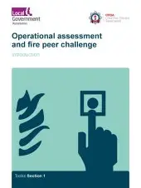

Findings: Phase 1 2004-2010 CPA Inspection
Fire and Rescue Services’ CPA was a comprehensive and corporate assessment not just a service inspection. From 2006/07 they also had annual Use of Resources and Direction of Travel Assessments.
It comprised a self-assessment, a peer challenge, political and officer peers on assessment teams, and key lines of enquiry (KLOE) supported by detailed diagnostics to enable judgements to be made.
Judgements used a rules-based scoring system, with each authority categorised on a five-point scale of ‘poor’, ‘weak’, ‘fair’, ‘good’ and ‘excellent’.

Slide 6
Intervention under CPA
All engagements or interventions throughout the study period were predicated on individual authorities’ failure to meet their statutory obligations of procuring Best Value under the Local Government Act 1999.
ODPM engaged with all weak and poor FRS (8) through Fire & Rescue Improvement Support Team (independent contractors) based on intervention arrangements for Loxal Authorities.
Annual use of Resources and Direction of Travel monitored services performance
4 (Lincs, Northants, Beds and Wiltshire & Swindon) went through CPA recategorizing in 2007, the other 4 released from intervention in 2008 when CAA introduced.

Slide 7

Findings: Phase 2 2010-2017 Fire Peer Challenge and Op A.
Austerity-localism and sector-led improvement meant, FRS were not inspected by an external inspection body,
From 2011, fire peer challenges with an operational assessment and the annual external audit were the basis of the sectors performance management and assurance regime. Services identify their own issues for peers to review which required “honesty, openness and a willingness to learn”.
Initially all reports published but after 2015 there was no website or institutional repository where results from different authorities could be benchmarked and compared.

Slide 8
Interventions during sector-led improvement 2010-2017
There were 2 forms of interventions caused by scandals and disasters that were very high profile in the media.
In Essex FRS the suicides of two serving firefighters, and allegations of bullying and intimidation led to the Lucas cultural review. In Avon FRS the minister commissioned a Best Value inspection of the authority’s governance, accountability and assurance after the Chair and Vice Chairs of the Fire Authority refused to do so.
In Kensington & Chelsea, it was the public inquiries into the Grenfell Tower Disaster and in Manchester the Arena Terroorist Attack that laid bare the serious and systematic inadequacies in governance and leadership of the London Fire Brigade and the Greater Manchester FRS.

Slide 9

Findings: Phase 3 Inspections 2017-2025
July 2017, HMIC became HMICFRS to monitor and report on the efficiency and effectiveness of FRSs
They inspect FRS not FRAs based upon pre-published performance standards and benchmarks brought together in national performance methodologies. Reports and results published on HMICFRS website and in summary reports to government.
There have been 3 rounds since 2018 (with a fourth ongoing). Measure FRS against services effectiveness, efficiency and management of people.
Services were initially graded in 4 and more recently in 5 categories (Outstanding, Good, Adequate, Requires Improvement and Inadequate).
There have also been 3 thematic inspection was the response to COVID-19 in 2020/21, while Values and Culture (2023) and Handling of Misconduct (2024) have followed. These have been desk-top exercises.

Slide 10

Findings: Interventions Phase 3: 2017-2025
HMICFRS have two ‘flags’ for specific operational concerns (cause and accelerated cause for concern) and two categories for different levels for the monitoring and assurance relationship with individual FRS (Scan and Engage) based on the severity and nature of the identified issues.
Statutory Interventions have been preceded by bespoke or Best Value inspections based on significant corporate issues in London, the West Midlands and South Wales.
Throughout this period (and since 2010) academics have consistently called for more comprehensive corporate inspections to include strategic as well as operational issues and the FRA as well as the FRS.

Slide 11
Conclusions
Significant changes have been made in both the form and nature of external inspections in the FRS performance and assurance regimes. However, questions remain about their adequacy as the “evidence” or “justification” for central governments’ interventions in FRS.
Interventions were more coherent and acknowledged to be more successful in the first regime based upon CPA/CAA between 2004-2010.
Sector-led assessments and more recent HMICFRS inspections have been predominantly operationally, and service based despite strategic and corporate issues being manifest in the sector.
HMICFRS have a system for encouraging short-term action on operational inadequacies, but inspections are not sufficiently robust to justify addressing, what are essentially major strategic and corporate challenges, such as organizational culture, and strategic leadership and management inadequacies.

Slide 12
Recommendations
The purpose of intervention should be to turnaround FRSs into sustainably improving organisations operating in the public interest.
Although HMs Chief Inspector suggests the 2025-27 inspections will focus more on leadership and local community engagement, we think that the inspections should go further and be fully comprehensive and strategic.
It also needs an appropriate assessment of the short-, medium- and long-term use of resources, the strategic leadership and performance of the FRA (as well as the FRS), and report on the sustainability and resilience of both organisations.
The government therefore needs to replace the 2018 National Framework, revisit the intervention protocol and ask HMICFRS to further develop its inspection methodology to reflect these issues prior to the next round of inspection post-2007.

Slide 13

Thankyou for listening
Questions/comments/suggestions?
Contact:
Peter.Murphy@ntu.ac.uk
Katarzyna.Lakoma@ntu.ac.uk

