Slide 1
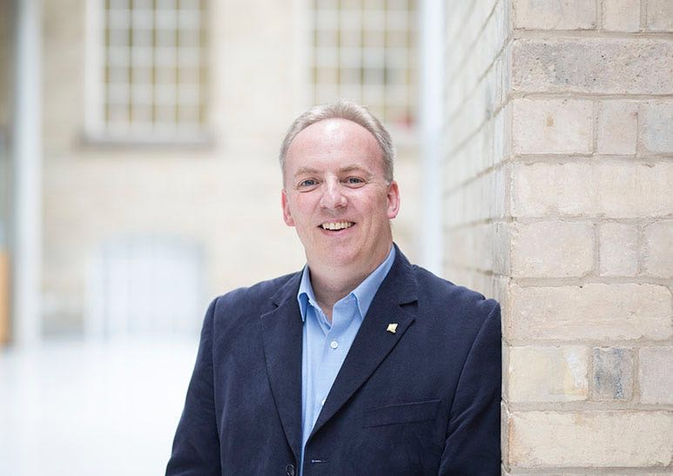
UK politics and green jobs: implications for other countries?
Dr. Douglas W.S. Renwick
Associate Professor in Sustainable Work, Nottingham Business School, UK, and Visiting Faculty, Nova Business School Africa, Ghana. douglas.renwick@ntu.ac.uk

Slide 2


Slide 3
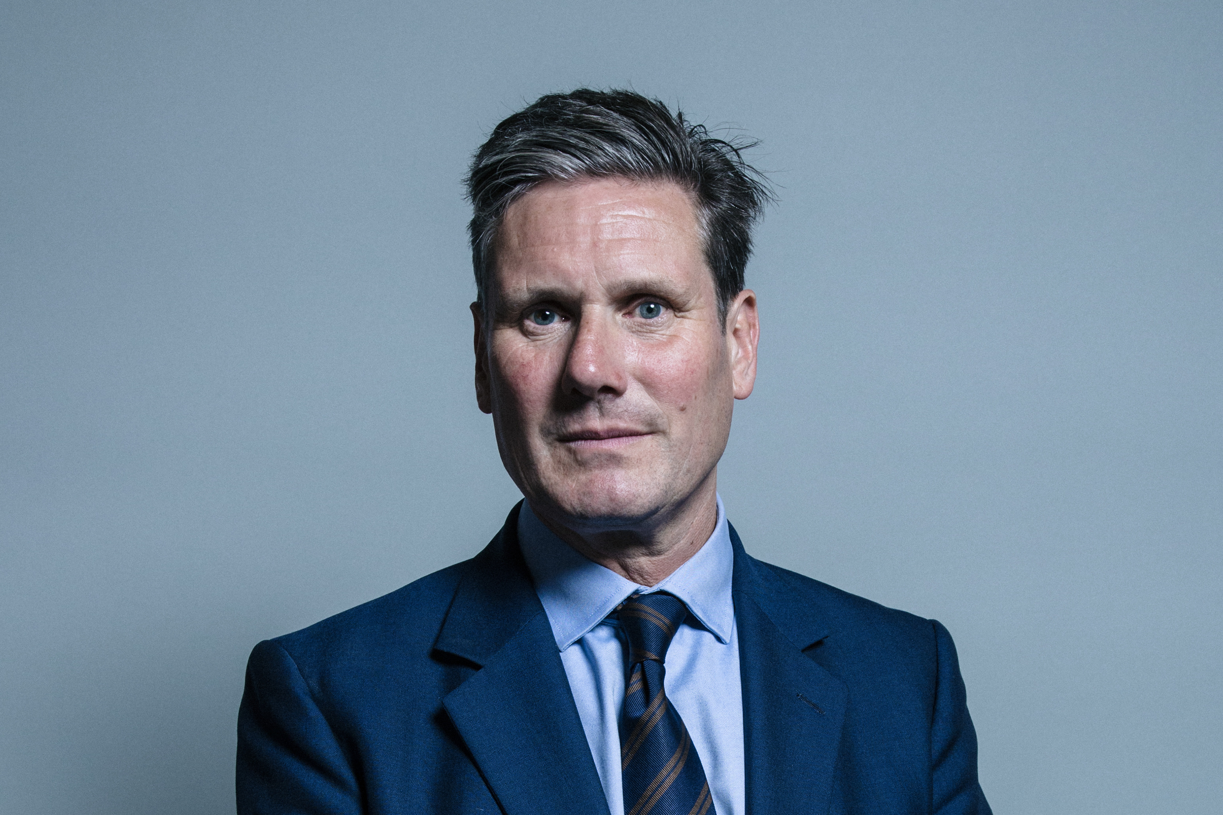

Slide 4
Implications from UK experience for others are?

Slide 5
Your “to do” list is?

Slide 6
Understand UK experience
UK financial prudence – costs of eco-employment
UK private-sector development of renewables
But… China & Europeans = leading examples of big state action (see Renwick, 2024)
China is ahead: £13bn for nuclear power stations – so why listen to UK? Well..
UK’s 142-year history of coal-fired electricity ended - last Ratcliffe-on-Soar plant in Nottinghamshire closed
UK lesson? - no coal can be done
Ratcliffe – coal made up to 80% of UK electricity in early 1980s, plus 40% in 2012 [key figures for China?]

Slide 7
Comprehend some limited UK successes
UK experience – may work elsewhere? Examples…
setting net zero target into law
hosting COP 26 climate summit
backing offshore wind
conceiving Zero Emission Vehicle mandate
Establishing heat pump mandate (Johnstone, 2024, p.6).
Macquarie set to pump £20bn into Britain – Australian infrastructure giant to back energy, waste, transport and water sectors (Gill & Treanor, 2024, p.1).
Nissan sticks to electric car pledge – plans £3bn redevelopment of Sunderland plant including third battery-producing Giga-factory, and will sell only zero emission cars by 2030 (Lea, 2024, p.1).

Slide 8
Acknowledge some UK green growth & strengths
Confederation of British Industry (CBI)
9% growth in UK net zero economy far exceeded GDP growth of circa 0.1% 2023, indicating the need for a clear green plan to attract private investment
government could add up to £57 billion to UK economy from green growth by 2030 (Seabrook, 2024, pp.3-4).
Ed Miliband - UK strengths
1. “An island nation, with our unrivalled potential for offshore wind.
2. The unique geology of the North Sea, which has capacity to store 200 years of our carbon emissions.
3. The rooftops of our great towns, villages and cities to harness the sun.
4. Britain’s considerable nuclear expertise and our skilled workforce… in powering our clean energy future, with a new generation of nuclear, such as Sizewell C and SMRs.
5. And significant opportunities in hydrogen, tidal and other technologies.
6. With Britain’s dynamic businesses, world-leading universities, and our skilled scientists, technicians and engineers” (all in GOV.UK, 2024a, p.8).

Slide 9
Know rationale for UK Carbon Capture
Prime Minister Sir Keir Starmer
“Carbon capture use & storage (CCS/CCUS) is a game-changer in our efforts to fulfil our legal obligations to reach Net Zero by 20250 in a sensible way while supporting jobs and industry” (Starmer, 2024, pp.3-4).
“It sets us apart from our international competitors, attracting business and hard cash from countries around the world” (Starmer, 2024, p.4).
“But this is a third way that brings industry with us on our path to Net Zero – while creating 4,000 jobs, reigniting our industrial heartlands and pumping £5 billion into UK economy every year once CCS is up and running” (Starmer, 2024, pp.6-7).
Industrial Strategy Council
Government support - Labour’s pledge to establish an Industrial Strategy Council is an important first step towards policy stability [?] (Rickard, 2024, pp.3-5).

Slide 10
Note GB Energy & Crown Estate Partnership
GB Energy given £8.3 billion of UK public money over one Parliament to invest in green tech
Ministers are hoping that investment will persuade companies to spend another £60 billion in an attempt to hit the government’s target of decarbonising Britain’s power sector by 2030 (Stacey and Harvey, 2024, p.2).
GB Energy & Crown Estate partnership
The public sector taking on… additional early development work for offshore wind projects… [which] has lower risk for developers… will help boost new technologies such as CCS, hydrogen, wave and tidal energy (Starmer and Miliband, 2024, p.3).
Crown Estate given new borrowing powers to invest in wind projects (Scott, 2024, p.6).

Slide 11
View UK moving into solar power
Solar power
Ed Miliband approved three massive solar farms in east of England that had been blocked by Tory ministers (Helm and McKie, 2024, p.1).
The three sites alone – Gate Burton in Lincolnshire, Sunnica’s energy farm on the Suffolk-Cambridgeshire border, and Mallard Pass on the border between Lincolnshire and Rutland… ministers working with building industry to make it easier to buy new homes with panels installed, or install on existing ones (Helm and McKie, 2024, p.2).
Miliband has promised to triple the amount of solar power in the UK by 2030, as well as double onshore wind and quadruple offshore wind (Helm and McKie, 2024, p.3).
Starmer: made clear his priorities would be to stimulate economic growth – including through a green energy revolution – in order to provide the necessary wealth for improving public services. There will be legislation on setting up a national wealth fund to drive investment into the UK (Helm and McKie, 2024, p.5).

Slide 13
See UK wish for energy self-reliance
Keynote Speech: Energy Minister Ed Miliband Sept 2024
“The lesson for this government is that we must build a new era of greater energy independence on the foundation of clean energy [because] energy markets are in the grip of dictators and petrostates… the energy produced here [UK] is consumed here, and is not subject to the same volatility of international markets… this is a chance [for UK] to create hundreds of thousands of good jobs and drive investment into all parts of the UK” (in GOV.UK, 2024a, pp3-.8).
“government as architect – I appointed Chris Stark (former head of CCC) to head up Mission Control in my department [which] is about a new way of working, bringing together the relevant players across government and industry to plan and deliver” (in GOV.UK, 2024a, p.10).

Slide 14
View UK “government as architect”
Keynote Speech: Energy Minister Ed Miliband Sept 2024
“Our National Wealth Fund will strengthen our supply chains…our North Sea workers have huge talents which can serve us in oil and gas as well as industries like CCUS, renewables and hydrogen… embracing the voice of workers and a role for trade unions as fossil fuel industries have traditionally done… acting together with us to ensure no worker, no community is left behind. People will judge us on whether this transition delivers fairness, and rightly so… our approach [is] working with you and government as architect, driver of dynamism and guarantor of fairness, working in the closest partnership with business to make this transition a success”. Together, we can do great things for our country and our world” (in GOV.UK, 2024a, pp.12-14).

Slide 15
Your “do not do” list?

Slide 16
Be timid like UK green government policy
“calculation behind Rishi Sunak’s changed rhetoric on net zero has not yielded electoral success [despite] successive Conservative governments making bold moves on climate change” (Johnstone, 2024, p.6).
Piers Forster, chair of UK Climate Change Committee (CCC)
“to achieve our 2030 climate targets, the UK government needs to be equally bold to encourage take-up of EVs, heat-pumps & electrification of industry” (Forster, 2024, pp.1-2).
Chancellor Rachel Reeves & Starmer acknowledge that private investment is going to be vital for their plans… to achieve their planned green investment - is going to require an optimistic & confident private sector willing to put up most of the cash… as billions are needed to get major infrastructure and building projects off the ground (Andrews, 2024, pp.1-2).

Slide 17
Ignore existing strengths & role of smaller projects
UK home rental sector & energy efficiency
“with 50 million homes rated EPC D or under in the UK, the government still has a long way to go to ensure that all poorly insulated homes “fit for purpose” (Culbertson, 2024, pp.5-6).
Oil tax threatens to sap green power
“there’ll be a longer-term loss of tax revenues as companies switch off North Sea projects… for a government elected on a growth mandate, what if its calculation that the UK can decarbonise electricity by 2030 turns out to be wishful thinking?
On the industry’s own figures, the UK spent almost £27 billion on imports of crude oil last year… and £21 billion bringing in gas. Can that gap be plugged quickly with clean domestic energy?
In nixing North Sea projects, Labour eviscerates a UK offshore supply chain with the best skills and engineering clout we’ve got for the energy transition. A report from Rystad Energy reckoned that the oil and gas supply had at least a 60% capability overlap with the one for green energy technology (all Osborne, 2024, p.35).

Slide 18
Use state power (arguably!) oddly
GB Energy & Crown Estate partnership
EDF in France & Sweden’s Vattenfall, though it will not have more spending power than new GB Energy has (Stacey and Harvey, 2024, p.2).
GB Energy will invest in carbon capture, tidal power, small nuclear reactors & initial focus is offshore wind (Stacey and Harvey, 2024, p.3).
GB Energy will…
spend money on scoping out the seabed, and connections to the onshore grid
return money to the government, or
invest in further energy projects, or
fund the royal family, which the Crown Estate was set up for (Stacey and Harvey, 2024, p.3). [UK royal family own UK seabed]

Slide 19
Ignore your own country strengths & history
Labour North Sea oil & gas policy attacked
Sharon Graham, General Secretary of UK’s biggest Union said: “until Labour has a concrete plan for replacing North Sea jobs and ensuring energy security, the ban on new oil and gas exploration licences should not go ahead. Labour must not allow oil and gas workers to become this generation’s coal miners” (in King, 2024, p.9).
London School of Economics Grantham Institute response
Mercer: “to crowd in the investment the UK so desperately needs. It’s clear scaling back their original £28 billion pledge will be costly” (Mercer, 2024, p.1).
Mercer: “if the manifesto was serious about tackling climate change, we would have seen a bolder industrial strategy to build up the grid, workforce and innovative businesses of the 21st century” (Mercer, 2024, p.2).

Slide 20
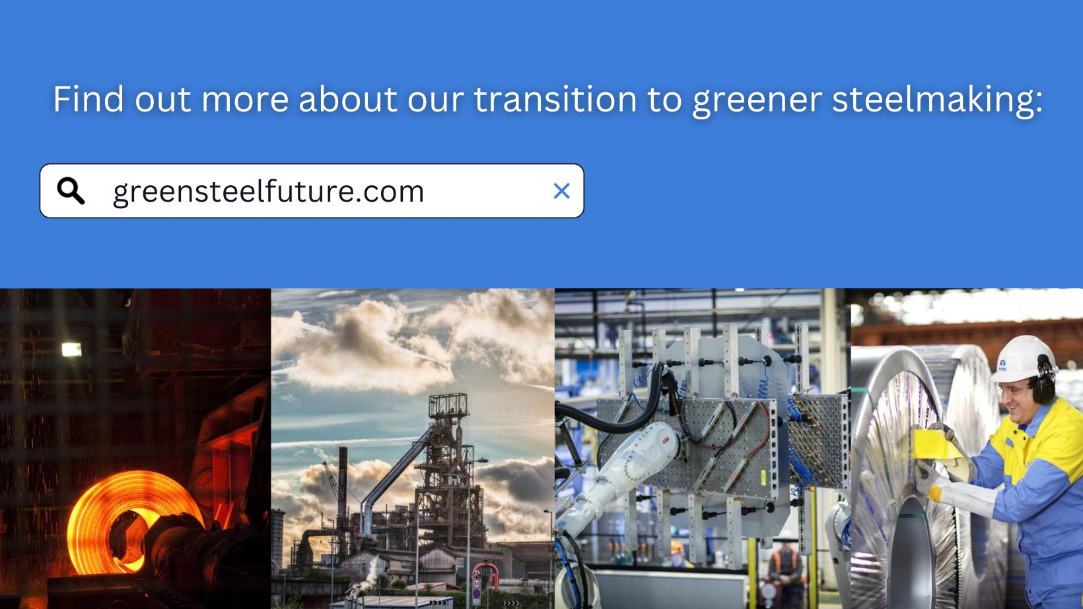
Tata Steel - Port Talbot, Wales, UK

Slide 21
“Silence” worker interests
Future investment – will not save jobs in the short-term. Even Tata Steel’s existing commitment to building an electric arc furnace in 2025 will require far fewer workers (Thomas and Palmer, 2024, p.4).
Resident views…
Grangemouth oil refinery – Scotland, UK
‘Expected to shut in 2025 – but Just Transition Commission warn of a “lack of effective just transition planning to date” (Sky News, 2024b, pp.2, 3).
“steelworks is never going to be a long-term solution”
“it’s going to be empty words”
“there are other jobs”
“more work [is needed] on what are the other options”
“the people need some support”

Slide 22
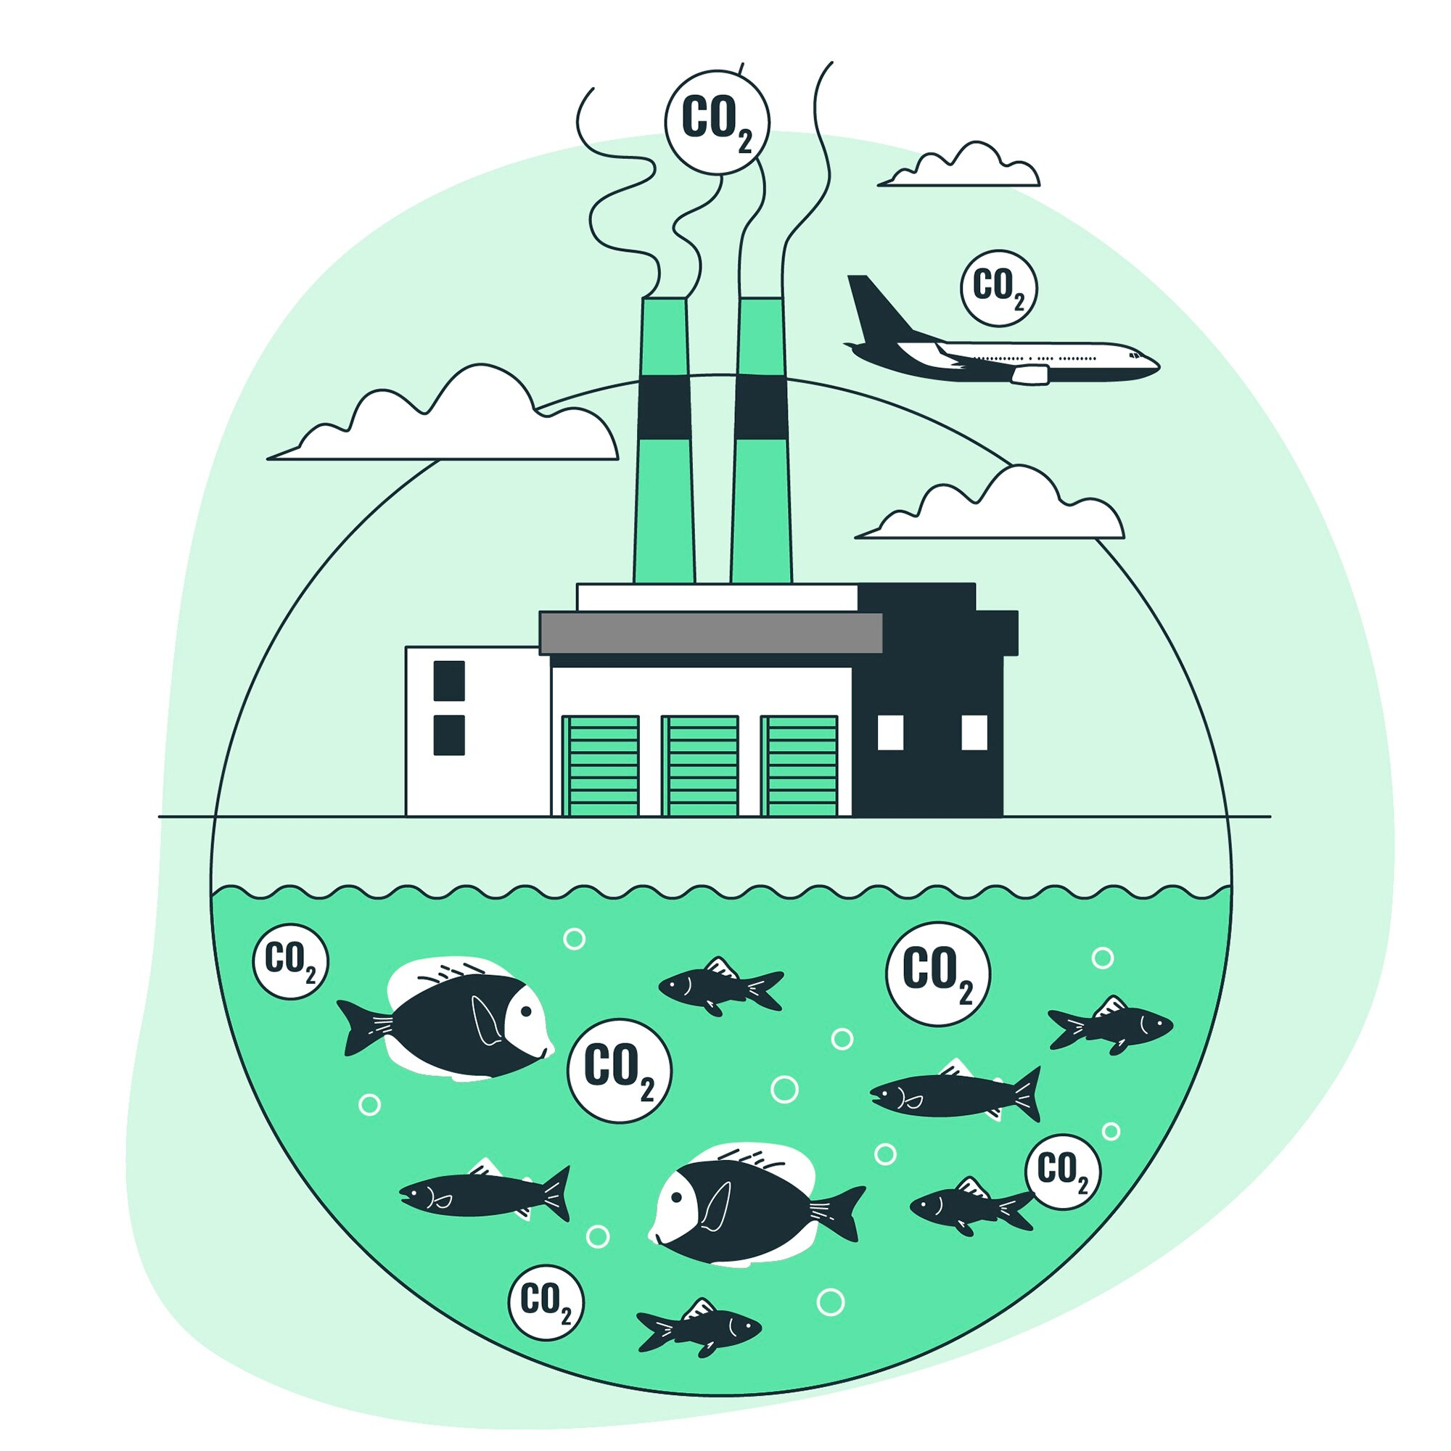
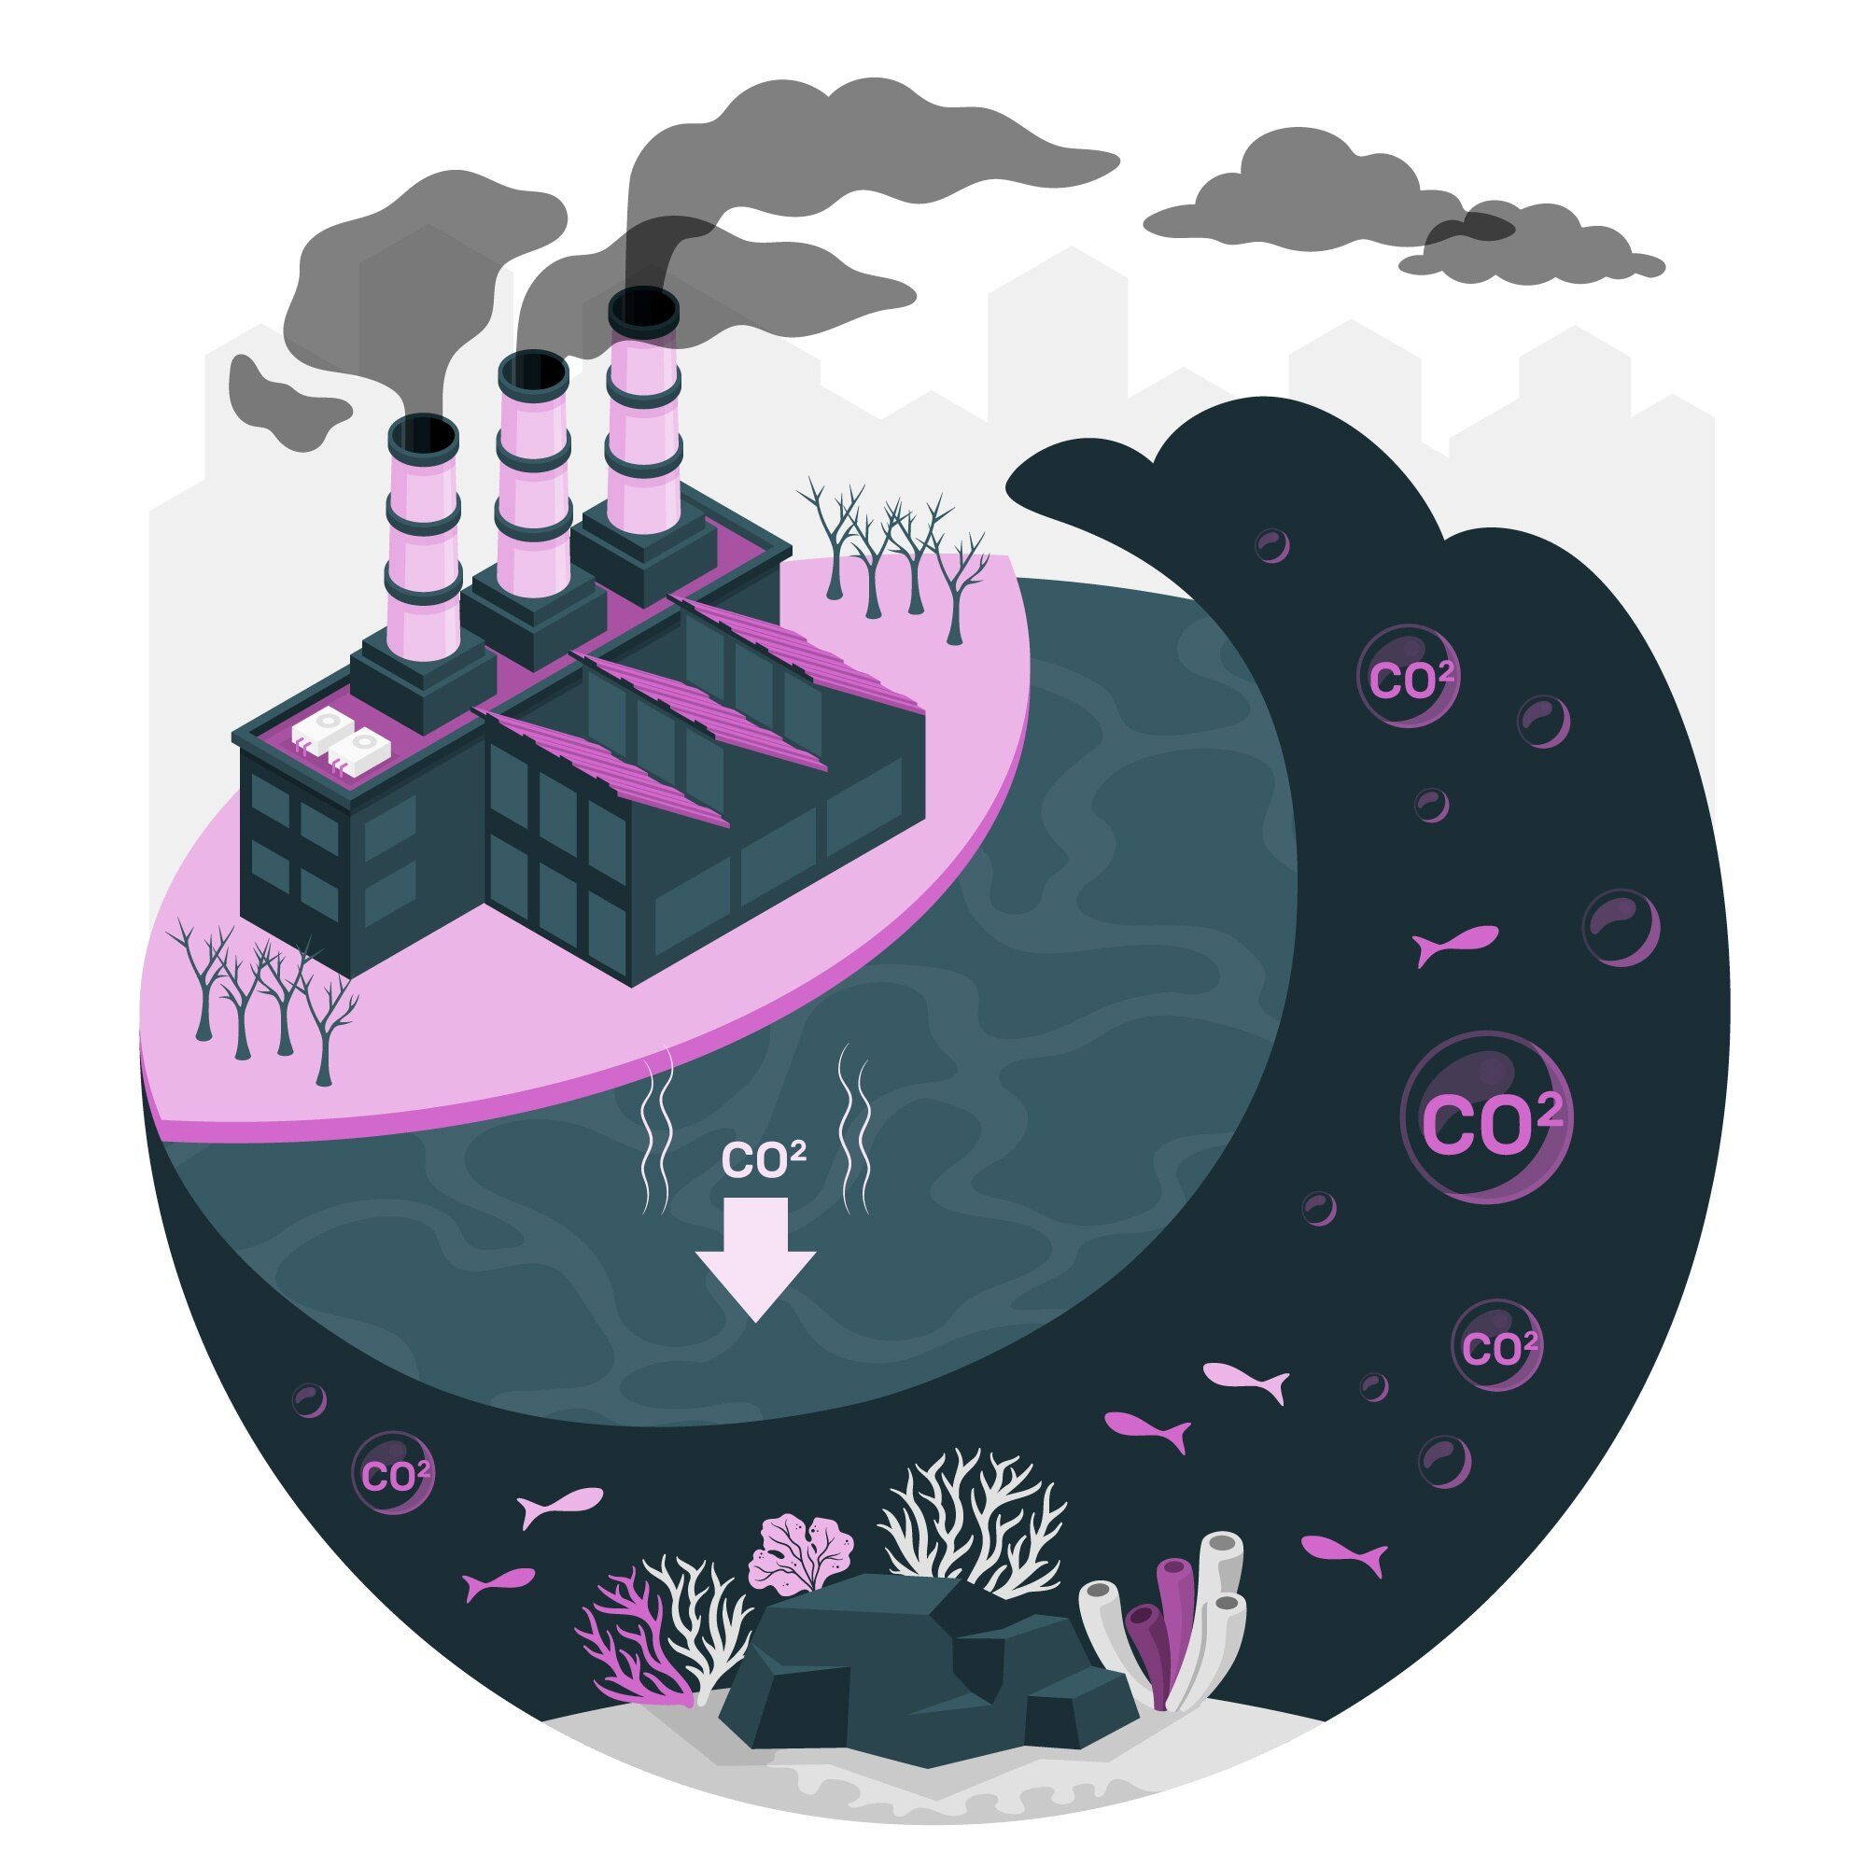
Carbon Capture & Storage - CCS

Slide 23
Overspend on CCS
Definition: carbon capture and storage (CCS) is where CO2 produced from power stations and inkeir dustrial processes is captured at source (Poynting & Rowlatt, 2024, p.1).
“CCS… will be Starmer’s White Elephant: a terrible mistake costing billions… Labour slashed its green prosperity plan from £28bn a year to £15bn, and a sensible and rational programme for insulating 19m homes… the £27.1bn for CCS is for construction only… its likely to be highly optimistic… plus, new government commitment to pay a “premium” for the hydrogen component of CCS for 15 years… Labour say no viable alternatives to CCS – but no such audit has been conducted – what about geopolymeric cement? Green hydrogen to make steel?... estimated cost of this CCS scheme? I suspect no change from £50bn” (Monbiot, 2024, pp.1-3).

Slide 24
Believe too much UK political rhetoric 1
Ed Miliband: “this is a government willing to invest in the future of Britain to create good jobs of the future, as the good jobs used to exist in coal but this is a new era for Britain and a new set of good jobs bringing us energy security. Carbon capture and storage, a new industry, a new generation of good jobs in our industrial heartlands” (in Burnell & Sherlock, 2024, pp.1-3).
Up to £21.7bn will subsidise three CCS projects on Teesside and Merseyside to support development of clusters, including to transport and store carbon in Liverpool Bay and the North Sea.
UK Labour govt. said the move would… directly create 4,000 UK jobs, and supporting 50,000 UK jobs in the longer term
Greenpeace Director Doug Carr: “a lot of money to extend life of planet-heating oil & gas”
UK Friends of the Earth: UK government should be spending the money on insulating people’s homes
Ed Miliband: the alternative is unabated gas” (all in Burnell & Sherlock, 2024, pp.1-4).

Slide 25
Believe too much UK political rhetoric 2
Kier Starmer: Britain must win the “global race” for green jobs – pioneer new technology to sell to the rest of the world… invest or decline.
Risk is that carbon capture proves to be another long, slow, expensive disappointment in Britain’s history of post-war economic planning (all in Heale, 2024, pp.1-2).
Globally - 45 CCS facilities, capture over 50 million tonnes of CO2 per year - but global CO2 emissions from fossil fuels & industry run at 35 billion tonnes per year – so CCS makes very little difference to global CO2
[some] green campaigners say CCS technology is “unproven”. It will be nearly the next election before we see carbon captured at the 2 sites under the £22bn plans (Sky News, 2024a, p.4).

Slide 27
Believe too much UK political rhetoric 3!
UK Prime Minister Sir Kier Starmer
“we have got the skills and the jobs and the potential to get ahead on carbon capture. That is a good thing in its own right” (in Sky News, 2024a, p.5).
today’s investment will create 4,000 jobs & up to to 50,000 jobs in wider supply chain
“I know what we lost when we lost coal all those years ago. But I also know how we can rewrite our story in the ink of the future. I have always believed that clean energy is a golden opportunity for our country, a chance to bring security and hope to working people, to relight the fires of renewal that got hit so hard by deindustrialisation. This is a race, a global race to get ahead… and that will be measured in thousands of jobs for literally decades to come” (in Sky News, 2024a, p.7-8). [conjecture?]

Slide 28
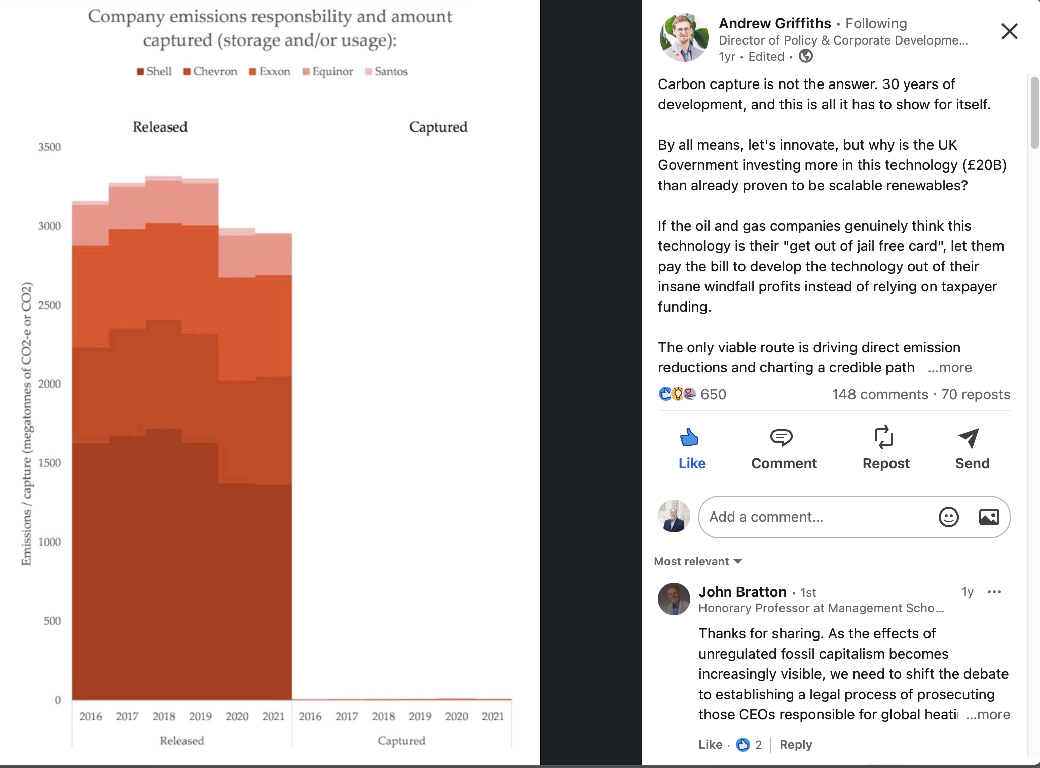
Does Carbon Capture & Storage work? Data says…

Slide 30
Avoid real talk & oddities from UK politicians
Keynote Speech: Energy Minister Ed Miliband Sept 2024
“We need to face facts. Britain is not on course to meet the challenges or maximise the opportunities… Britain has underdelivered on promises of clean energy jobs.
Germany has almost twice as many renewable jobs per capita as Britain.
Sweden almost three times as many.
Denmark almost 4 times as many.
Britain must not be left behind”. (in GOV.UK, 2024a, p.9).
do not to follow all parts of the UK experience – unsafe to assume UK is a leader
- changing any economy to ‘go green’ and achieve green economic growth requires decisive state action

Slide 31
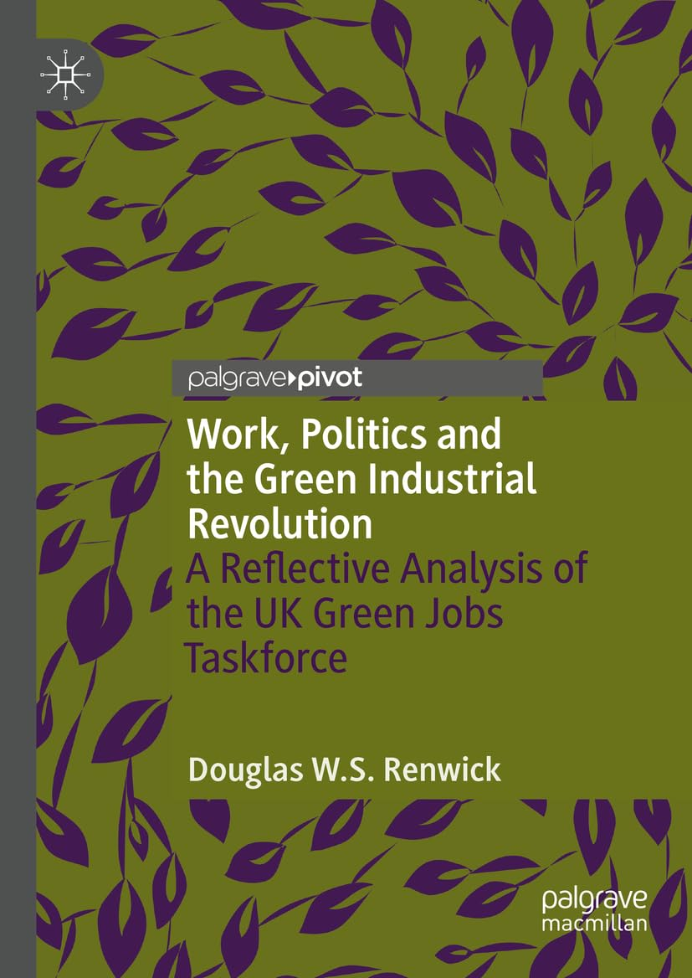


Slide 32
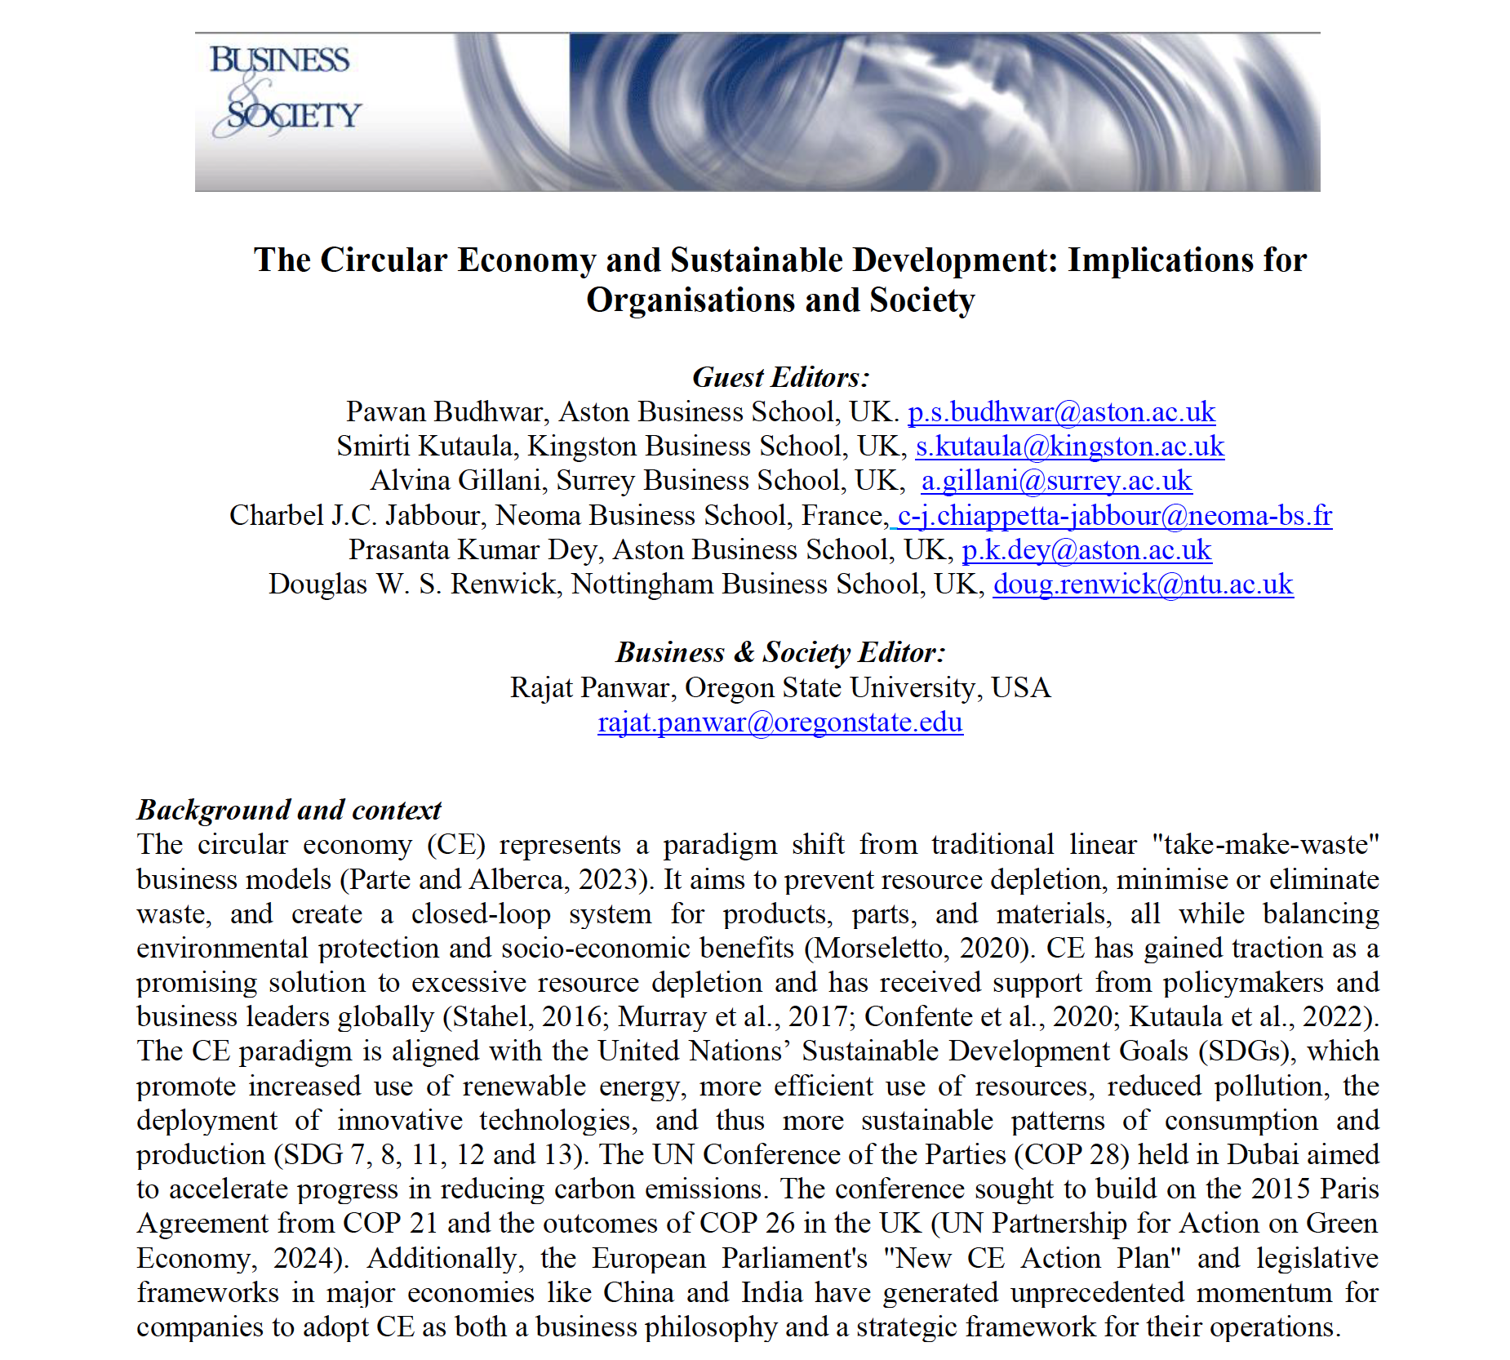
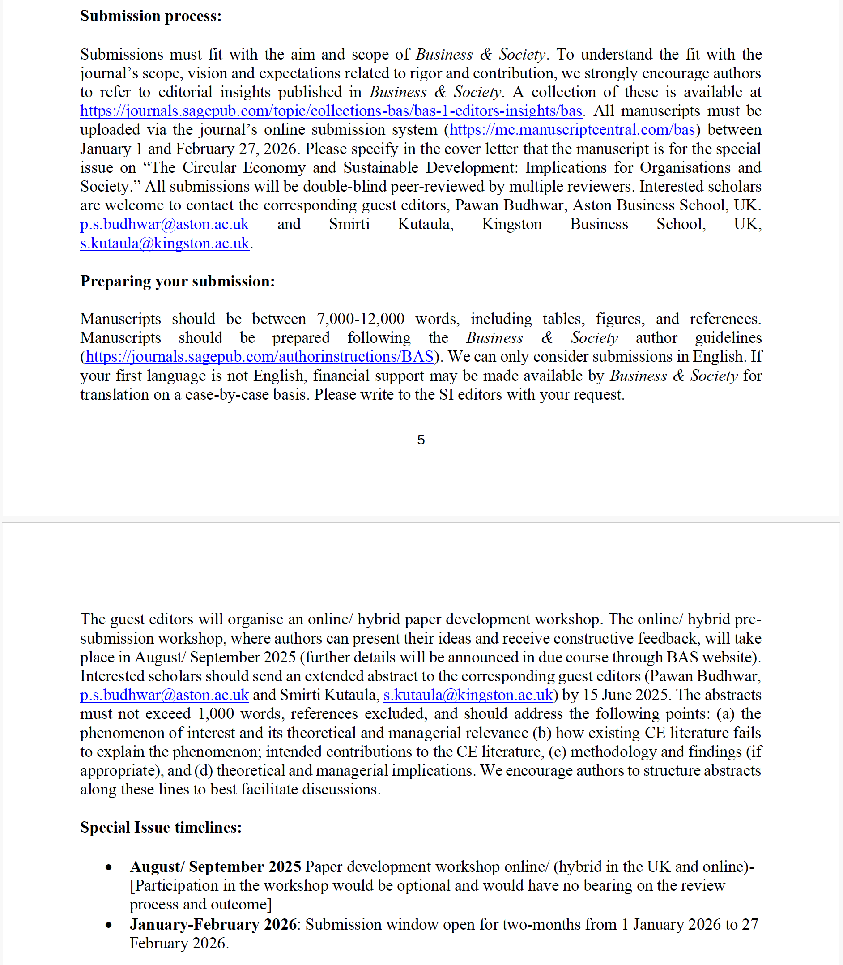

Slide 33


Slide 35
References 1
Ambrose, G. (2024) ‘End of an era as Britain’s last coal-fired power plant shuts down’, The Guardian, Monday 30th September 2024, pp.1-3, published and accessed 30th September 2024, at: https://www.theguardian.com/business/2024/sep/30/end-of-an-era-as-britains-last-coal-fired-power-plant-shuts-down
Andrews, K. (2024) ‘Rachel Reeves goes for growth on house-building’, The Spectator, 8th July 2024, pp.1-3, at: https://www.spectator.co.uk/article/rachel-reeves-goes-for-growth-on-house-building/
Baldry, C. and Hyman, J. (2022) Sustainable Work and the Climate Crisis: the Link Between Labour and Climate Change, Abingdon, Oxon: Routledge, pp.1-277.
Benyon, H. and Hudson, R. (2021) The Shadow Of The Mine: Coal And The End Of Industrial Britain, London: Verso, pp.1-402.
Bet, M., 2021a, “Boris Johnson warned Steve Baker could be biggest 2024 election challenge”, Daily Express, 1-5, published 5th June 2021, accessed 7th June 2021, at: https://www.express.co.uk/news/uk/1444702/boris-johnson-news-steve-baker-election-challenge-gas-boilers-spt
Bet, M., 2021b, “Gas boiler replacement row could spark Tory civil war as Boris Johnson risk coup”, Daily Express, 1-6, published 18th June 2021, accessed 20th June 2021, at: https://www.express.co.uk/news/politics/1451262/gas-boiler-replacement-andrew-neil-boris-johnson-steve-baker-rishi-sunak-spt
Brandl, B., (2014) “Industrial Relations Since The Economic Crisis”, verbal paper presented to the Work, Organisation and Employment Relations Research Centre (WOERRC), Management School, University of Sheffield, UK, 19th November.
Brown, F. (2024) ‘Former Tory minister says he’ll vote Labour and accuses Sunak of ‘siding with climate deniers’, Sky News, Thursday 20th June 2024, pp.1-7, at: https://news.sky.com/story/former-tory-minister-says-hell-vote-labour-and-accuses-sunak-of-siding-with-climate-deniers-13156261
Burke, E. (1969) Reflections on the Revolution in France, London: Penguin, pp.1-192. (edited by C.C. O’Brien).
Burnell, P. and Sherlock, G. (2024) ‘Nearly £22bn pledged for carbon capture projects’, BBC News, 4th October 2024, pp.1-4, published and accesed 4th October 2024, at: https://www.bbc.co.uk/news/articles/cy4301n3771o
Callinicos, A. and Simons, M. (1985) The Great Strike: The Miner’s Strike of 1984-5 And Its Lessons, Socialist Worker: London, pp.1-256.
Clark, R. (2024) ‘Ed Milband’s ‘new era’ for energy policy is anything but’, The Spectator, 4th October 2024, pp.1-2, at: https://www.spectator.co.uk/article/ed-miliband-new-era-for-energy-policy-is-anything-but/
Clarke, T. (2024) ‘Future of new oil and gas projects in UK thrown into doubt after landmark Supreme Court decision’, Sky News, Thursday 20th June 2024, pp.1-9, at: https://news.sky.com/story/future-of-new-oil-and-gas-projects-in-uk-thrown-into-doubt-after-landmark-supreme-court-decision-13155934

Slide 36
References 2
Cooke, F.L., (2017) “PROVOCATION PAPER: Concepts, contexts, and mindsets: Putting human resource management research in perspectives”. Human Resource Management Journal, 28(1): 1-13, at: https://doi.org/10.1111/1748-8583.12163
Culbertson, A. (2024) ‘Ed Miliband promises renters will not have to suffer such cold homes’, Sky News, Monday 23rd September 2024, pp.1-6, published and accessed 23rd September 2024, at: https://news.sky.com/story/ed-miliband-promises-renters-will-not-have-to-suffer-such-cold-homes-13220852
D’Cruz, P., Delannon, N., McCarthy, L., Kourula A., Moon, J., Spence, L.J. and Gond, J.P., (2021) “Human Relations Special Issue Call For Papers: Contesting Social Responsibilities of Business: Experiences in Context”. Human Relations, 1-7, at: https://journals.sagepub.com/page/hum/call-for-papers
Evans, S. (2024) ‘Huge surge of MPs back UK net zero target: up to 94% from 76% before election’, LinkedIn 12th October 2024, p.1, at: https://www.linkedin.com/posts/simon-evans-53091614_theres-been-a-huge-surge-in-share-of-mps-activity-7250478824327376897-UElF/
Fawcett, E. (2020) Conservatism: The Fight for a Tradition, Princeton University Press: Princeton, New Jersey, pp.1-525.
Forster, P. (2024) ‘The end of coal power should be the start of a true electrical age’, LinkedIn, 1st October 2024, at: https://www.linkedin.com/pulse/end-coal-power-should-start-true-electrical-age-piers-forster-pbnre/
Gill, O. and Treanor, J. (2024) ‘Macquarie set to pump £20bn into Britain as Labour woos investors’, The Times, Saturday 12th October, pp.1-3, published and accessed 12th October 2024, at: https://www.thetimes.com/business-money/companies/article/macquarie-pump-20bn-britain-waterways-labour-investment-0msk6r756
Goodwin, B. (2014) Using Political Ideas (Sixth Edition), Chichester: John Wiley & Sons Ltd, pp.1-480.
GOV.UK (2021) Green Jobs Taskforce Terms of Reference, 1st December 2020, pp.1-3, published and accessed 28th July 2021, at: https://www.gov.uk/government/groups/green-jobs-taskforce#background Green Jobs Taskforce (2021) ‘Green Jobs Taskforce: report to Government, Industry and the Skills Sector’, Department for Business, Energy & Industrial Strategy GOV.UK, pp.1-82, published and accessed 14th July 2021, at: https://www.gov.uk/government/publications/green-jobs-taskforce-report
GOV.UK (2024a) ‘Speech Energy UK Conference 2024: keynote speech by Ed Miliband’, Department for Energy Security and Net Zero and the Rt Hon Ed Miliband MP, pp.1-13, published and accessed 17th September 20204, at: https://www.gov.uk/government/speeches/energy-uk-conference-2024-keynote-speech-by-by-ed-miliband
GOV.UK (2024b) ‘Policy paper: Policy statement on onshore wind’, GOV.UK - Ministry of Housing, Communities & Local Government, HRM Treasury, Department for Energy Security & Net Zero, Department for Levelling Up, Housing & Communiites, published and accessed 8th July 2024, pp.1-3, at: https://www.gov.uk/government/publications/policy-statement-on-onshore-wind/policy-statement-on-onshore-wind#:~:text=1.,onshore%20wind%20energy%20by%202030.

Slide 37
References 3
Harvey, F. (2024) ‘Green politics: Labour must ramp up renewable energy to meet 2023 climate vows’, The Guardian, Thursday 18th July 2024, pp.1-8, at: https://www.theguardian.com/environment/article/2024/jul/18/labour-must-ramp-up-renewable-energy-to-meet-2030-climate-vows-says-watchdog
Harrabin, R., 2021a, “Keir Starmer attacks government record on green jobs”. BBC News, 1-7, published 8th August 2021, accessed 12th August 2021, at: https://www.bbc.co.uk/news/uk-politics-58088236
Heale, J. (2024) ‘Can Keir Starmer sell carbon capture?’, The Spectator, 4th October 2024, pp.1-2, at: https://www.spectator.co.uk/article/can-keir-starmer-sell-carbon-capture/
Johnstone, A. (2024) ‘Election survey: what switching voters thought on climate as they went to the polls’, Energy & Climate Intelligence Unit (ECIU), 5th July 2024, p.1-9, at: https://eciu.net/media/press-releases/2024/election-survey-what-switching-voters-thought-on-climate-as-they-went-to-the-polls
Kalleberg, A. (2018) Precarious Lives: Job Insecurity and Well-Being in Rich Democracies (First Edition), Polity: Cambridge, pp.1-248.
King, I. (2024) ‘Labour’s North Sea oil and gas policy under attack from industry and activists’, Sky News, Thursday 27th June 2024, pp.1-11, at: https://news.sky.com/story/labours-north-sea-oil-and-gas-policy-under-attack-from-industry-and-activists-13159925
Kleinman, M. (2024a) ‘Live: Politics latest: Starmer to hail more than £50bn in investment at summit’, Sky News, Sunday 13th October 2024, pp.1-3, published and accessed 13th October 2024, at: https://news.sky.com/story/starmer-to-hail-more-than-50bn-in-investment-at-key-summit-13232860
Kleinman, M. (2024b) ‘Starmer to call on UK regulators to prioritise growth agenda’, Sky News, Friday 11th October 2024, pp.1-5, published and accessed 11th October 2024, at: https://news.sky.com/story/starmer-to-call-on-uk-regulators-to-prioritise-growth-agenda-13231883
Lea, R. (2024) ‘Nissan sticks to electric car pledge despite market woes’, The Times, Friday 11th October 2024, published and accessed Friday 11th October 2024, at: https://www.thetimes.com/business-money/companies/article/nissan-sticks-to-electric-car-pledge-despite-market-woes-57slfcq7r
Letza, S., Smallman, C. and Sun, X. (2004) ‘Reframing privatisation: deconstructing the myth of efficiency’, Policy Sciences, 37, 159-183.
Mercer, L. (2024) ‘LSE Grantham Institute responds to Labour Party manifesto launch’, LSE Grantham Institute Press Release, 13th June 2024, pp.1-3, at: https://www.lse.ac.uk/granthaminstitute/news/institute-respond-to-labour-party-manifesto-launch/
Monbiot, G. (2024) ‘Labour’s carbon-capture scheme [CCS] will be Starmer’s White Elephant: a terrible mistake costing billions’, The Guardian, Friday 11th October 2024, pp.1-3, published and accessed 11th October 2024, at: https://www.theguardian.com/commentisfree/2024/oct/11/labour-carbon-capture-climate-breakdown
Osborne, A. (2024) ‘Oil tax threatens to sap green power’, The Times, Tuesday 3rd September 2024, p.35, published and accessed 3rd September 2024, at: https://www.thetimes.com/business-money/companies/article/oil-tax-threatens-to-sap-green-power-5d5z83cw2#:~:text=Who%20yet%20knows%20if%20Offshore,and%20cutting%20their%20investment%20allowances.

Slide 38
References 4
Paxman, J. (2021) Black Gold: The History Of How Coal Made Britain, London: William Collins, pp.1-392.
Poschen, P. (2015) Decent work, green jobs and the sustainable economy, Sheffield: Greenleaf Publishing Limited/International Labour Organization (ILO), pp.1-182.
Poynting, M. and Rowlatt, J. (2024) ‘Will carbon capture help then UK tackle climate change?’, BBC News, 4th October 2024, pp.1-3, published and accessed 4th October 2024 at: https://www.bbc.co.uk/news/articles/cden6k97n9xo#:~:text=Carbon%20capture%20would%20help%20to,are%20currently%20few%20obvious%20alternatives.
Renwick, D.W.S. (ed) (2020) Contemporary Developments in Green Human Resource Management Research: Towards Sustainability in Action? First Edition (June), Routledge Research in Sustainability and Business Series, Abingdon, Oxfordshire: Routledge, pp.1-199. Paperback: ISBN 978-0-367-37687-1.
Rickard, S. (2024) ‘What Labour’s new industrial strategy needs to succeed’, LSE Blogs, 24th July 2024, pp.1-7, published and accessed 24th Jul 2024, at: https://blogs.lse.ac.uk/politicsandpolicy/what-labours-new-industrial-strategy-needs-to-succeed/
Rodriguez, J.K., Johnstone, S. and Procter, S., (2017) “Regulation of work and employment: advances, tensions and future directions in research in international and comparative HRM”, The International Journal of Human Resource Management, 28(21): 2957-2982, DOI: 10.1080/09585192.2017.1416555
Scott, J. (2024) ‘Starmer says bills will come down with Great British Energy – as he hails ‘game-changer’ Crowne Estate partnership’, Sky News, pp.1-9, Thursday 25th July 2024, pp.1-9, published and accessed 25th July 2024, at: https://news.sky.com/story/great-british-energy-to-team-up-with-crown-estate-to-develop-new-offshore-wind-farms-13184324
Scruton, R., (2017) Conservatism. London: Profile Books Ltd, pp.1-169. ISBN 978-1781257524.
Seabrook, V. (2024) ‘Deafening silence’ on climate change criticised by CBI, which says being pro-growth means being pro-green’, Sky News, Monday 1st July 2024, pp.1-8, at: https://news.sky.com/story/deafening-silence-on-climate-change-criticised-by-cbi-which-says-being-pro-growth-means-being-pro-green-13161740
Seddon, P. (2024) ‘King’s Speech summary: Key points at a glance’, BBC News, 15th July 2024, at: https://www.bbc.co.uk/news/articles/c51y7pqy1v3o
Sky News (2024a) ‘Politics latest: Starmer quizzed over £22bn in climate funding – as questions over freebies continue’, Sky News, Friday 4th October, published and accessed 4th October 2024, pp.1-10, at: https://news.sky.com/story/politics-latest-concern-in-government-over-starmers-willingness-to-accept-gifts-12593360
Sky News (2024b) ‘Intensive work needed to avoid ‘unjust’ transition at Grangemouth oil refinery, report warns’, Sky News, Thursday 18th July, pp.1-8, at: https://news.sky.com/story/intensive-work-needed-to-avoid-unjust-transition-at-grangemouth-oil-refinery-report-warns-13180200
Stacey, K. and Harvey, F. (2024) ‘Offshore wind to power 20 million UK homes within 5 years, Starmer to pledge’, The Guardian, Thursday 25th July 2024, pp.1-6, published and accessed 25th July 2024, at: https://www.theguardian.com/environment/article/2024/jul/25/offshore-wind-to-power-20m-homes-within-five-years-starmer-to-pledge
Starmer, K. (2024) “I will not sacrifice Great British industry to the drum-banging, finger-waving Net Zero extremists”, The Sun, 3rd October 2024, published and accessed 3rd October 2024, pp.1-7, at: https://www.thesun.co.uk/news/30853358/keir-starmer-great-british-industry-net-zero/

Slide 39
References 5
Starmer, K. and Miliband, E. (2024) ‘Press release: New Great British Energy partnership launched to turbocharge energy independence’, GOV.UK, 25th July 2024, published and accessed 25th July 2024, pp.1-7, at: https://www.gov.uk/government/news/new-great-british-energy-partnership-launched-to-turbocharge-energy-independence
Stevis-Gridneff, M. (2024) ‘The Greens Are Dead. Long Live the Greens!’, The New York Times, 16th June 2024, pp.1-3, at: https://www.nytimes.com/2024/06/16/world/europe/eu-elections-green-parties.html
Teeter, P. and Sandberg, J., (2016) “Constraining or Enabling Green Capability Development? How Policy Uncertainty Affects Organizational Responses to Flexible Environmental Regulations”. British Journal of Management, 28(4): 649-665.
Thomas, H. and Palmer, M. (2024) ‘Tata talks under way but no full jobs guarantee - Reynolds’, BBC News, 7th July 2024, pp.1-5, at: https://www.bbc.co.uk/news/articles/c10lm46z54mo#:~:text=The%20UK%20government's%20new%20business,technologies%20would%20employ%20fewer%20people.
Trevelyan, A.M. and Keegan, G. (2021) in ‘Green Jobs Taskforce: report to Government, Industry and the Skills Sector’, Department for Business, Energy & Industrial Strategy GOV.UK, pp.3-4, published and accessed 14th July 2021, at: https://www.gov.uk/government/publications/green-jobs-taskforce-report
Vaughan, A. (2024) ‘Ed Miliband asks CCC for 2035 climate target’, Twitter / X, Thursday 8th August, p.1, at: https://x.com/adamvaughan_uk/status/1821563605948481974
Vincent, S., Bamber, G.J., Delbridge, R., Doellgast, V., Grady, J. and Grugulis, I., (2020) “Special Issue: Situating Human Resource Management Practices in their Political and Economic Context”. Human Resource Management Journal, 30(4): i-iv, 461-623 (November), at: https://onlinelibrary.wiley.com/toc/17488583/2020/30/4
Ward, B. (2024) ‘Rachel Reeves’ mission must be to invest in a sustainable future’, The Guardian, Thursday 26th September, pp.1-2, published and accessed 26th September 2024, at: https://www.theguardian.com/politics/2024/sep/26/rachel-reeves-mission-must-be-to-invest-in-a-sustainable-future
Wilkinson, A., Knoll, M., Mowbray, P.K. and Dundon, T., 2021, “New Trajectories in Worker Voice: Integrating and Applying Contemporary Challenges in the Organization of Work”. British Journal of Management, 32(3): 693-707, at: https://onlinelibrary.wiley.com/doi/10.1111/1467-8551.12528

Slide 40
European Union - EU
The greens tanked: losing one-third of their seats in the European Parliament elections in 2024
But prior EU record: emerged as the world’s most ambitious frontier in fighting climate change – through
setting high targets to cut emissions
preparing to ditch combustion engines
pushing for nature restoration and
curbing the effect of faming on nature
(Stevis-Gridneff, 2024, p.1).

