Slide 1


The Grenfell Tower Fire –
A Case of Proactive and Reactive Accountability in Crisis Management
Dr Katarzyna Lakoma, Prof Peter Murphy, Dr Peter Eckersley

Slide 2
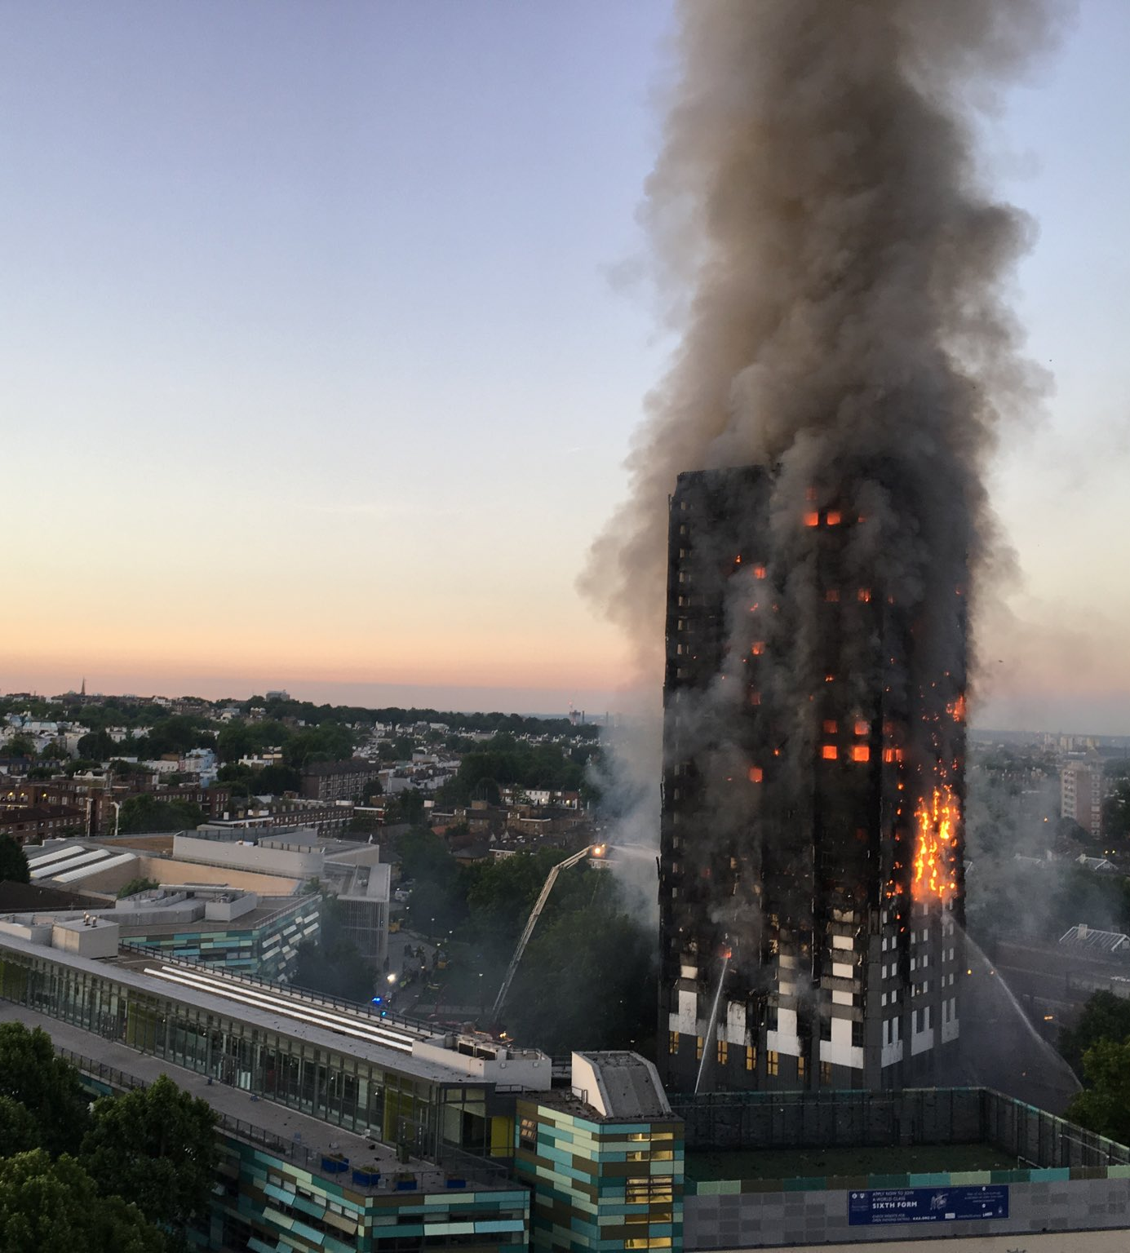
The Grenfell Tower Fire
North Kensington,
London, 14 June 2017
One of the deadliest structural fires in the UK
The fire started by an electrical fault in a fridge on the 4th floor of the 24-storey building
72 people died, 70 injured and 223 escaped

Slide 3
Accountability
Accountability - a principal-agent relationship between the agent and the principal, who can hold the agent to account for its behaviour and activity (Mulgan 2000).
Accountability is normally triggered as a reactive response to a failure (Bovens 2007), where individuals or institutions are expected to be held responsible for their actions.
Accountability as a mechanism and as a virtue (Bovens 2010) :
  Accountability as a mechanism - justifying past actions and decisions (ex-post),
  Accountability as a virtue – a set of normative standards for the evaluations of public officials (ex-ante)
Recent studies in public administration have started to emphasise a more prospective approach to accountability, facilitating learning and improvement (Bovens et al. 2008, Visser 2016, Murphy et al. 2019)

Slide 4

Crises and disasters
Crises and disasters reveal gaps in accountability arrangements and trigger intense scrutiny and demands for greater accountability (Boin et al. 2010, Christensen et al. 2018, Cooper and Lapsley 2021, Ferry et al. 2024).
Crises and disasters are often used interchangeably(Shaluf et al. 2003). Crises, if not addressed timely and effectively, may escalate into disasters (Davies and Walters 1988).
Scholars studying crises have often relied on a well-established framework of the three phases of crisis management: pre-crisis, crisis, and post-crisis (Bundy et al. 2016, Christensen et al. 2016, Coombs and Laufer 2018, Tokakis et al. 2019).

Slide 5
Accountability and crisis management
Knowing that unexpected events can shape accountability (Ferry et al. 2024, Barbera et al. 2025), we would expect accountability to change its nature and role across the three phases of crisis management.
Accountability research primarily focuses on post-crisis evaluations (Romzek and Dubnick 1987, Koppell 2005, Boin et al. 2010, Cooper and Lapsley 2021).
The role of accountability in pre-crisis situations has to date remained relatively underexplored.

Slide 6
Research objective
Table 2. Proactive accountability and reactive accountability in crisis management
(Source: Authors, based on Kearns (1994) and Novelli et al. (2024))
To understand the holistic nature of accountability in the crisis management cycle.
We draw on previous studies that introduce the concepts of proactive and reactive accountability (Kearns 1994, Novelli et al. 2024)
Kearns (1994) argues that proactive accountability improves performance, whereas reactive accountability refers to compliance with codes and evaluations.
Novelli et al. (2024) argue that proactive accountability resembles Bovens’ (2010) accountability as a virtue, as it comes before events, whereas reactive accountability aligns with Bovens’ (2010) accountability as a mechanism, as it comes after events
 | Focus | Timing
Proactive Accountability | Assigning specific responsibilities to actors | Before a crisis
Reactive Accountability | Sanctioning actors for failures | After a crisis
RQ: How do proactive and reactive accountability mechanisms interact across the crisis management cycle?

Slide 7
Methods
A qualitative case study
Three-phases of crisis management (pre-crisis, crisis, and post-crisis)
Public Inquiry reports:
Phase 1 Report - the events of the 14th of June 2017 and includes the causes of the fire, the London Fire Brigade’s response, and how the fire spread through the building.
Phase 2 Report - the causes of the fire, including the building's structural flaws, regulatory failures, and the roles of contractors and regulatory bodies in the refurbishment of the Grenfell Tower.
Understanding how accountability mechanisms (proactive and reactive) played out before (pre-crisis), during (crisis), and after the crisis (post-crisis).

Slide 8
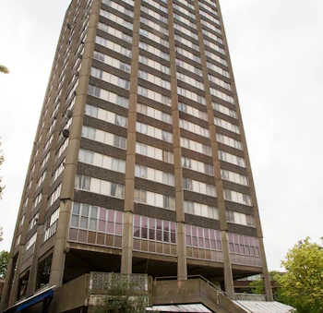

Findings: Pre-crisis
Flammable materials
  Installation of highly flammable cladding (Reynobond 55 PE) and combustible insulation (Celotex RS5000 and Kingspan K15) during Grenfell Tower refurbishment in 2016, approved by Studio E (the architect), and ultimately by the Tenant Management Organisation (TMO), as authorised by the RBKC (local authority).
Outdated and incomplete fire risk assessments failed to account for the changes to the building's design
Residents unaware of the potential fire hazard in their building
Regulators were dishonest in ensuring the safety of the materials used in the construction and alteration of high-rise buildings:
  Local Authority Building Control (LABC), the British Board of Agrément (BBA), the Building Research Establishment (BRE), and the National House Building Council (NHBC)
UK Governments were aware of cladding risks

Slide 9
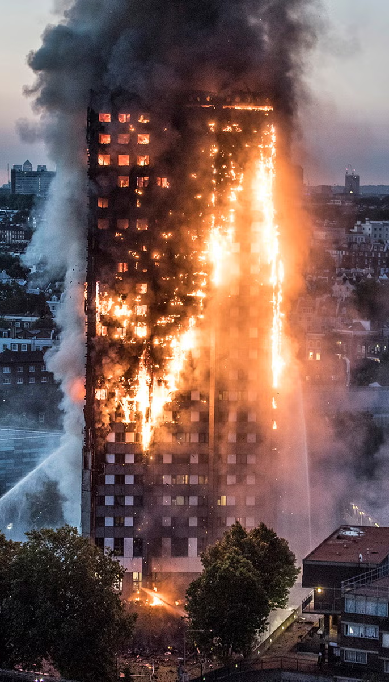
Findings: Crisis – the fire
Initial ‘stay put’ advice allowed the flames to spread rapidly across multiple floors
Chaotic and inadequately coordinated emergency services response
RBKC (the local authority) did not have an effective plan to deal with the displacement of a large number of people from their homes
No effective system in place for communicating with the public, leaving many survivors, residents and relatives unaware of available resources and next steps
Residents of the Grenfell Tower were excluded from the discussions related to support and recovery

Slide 10
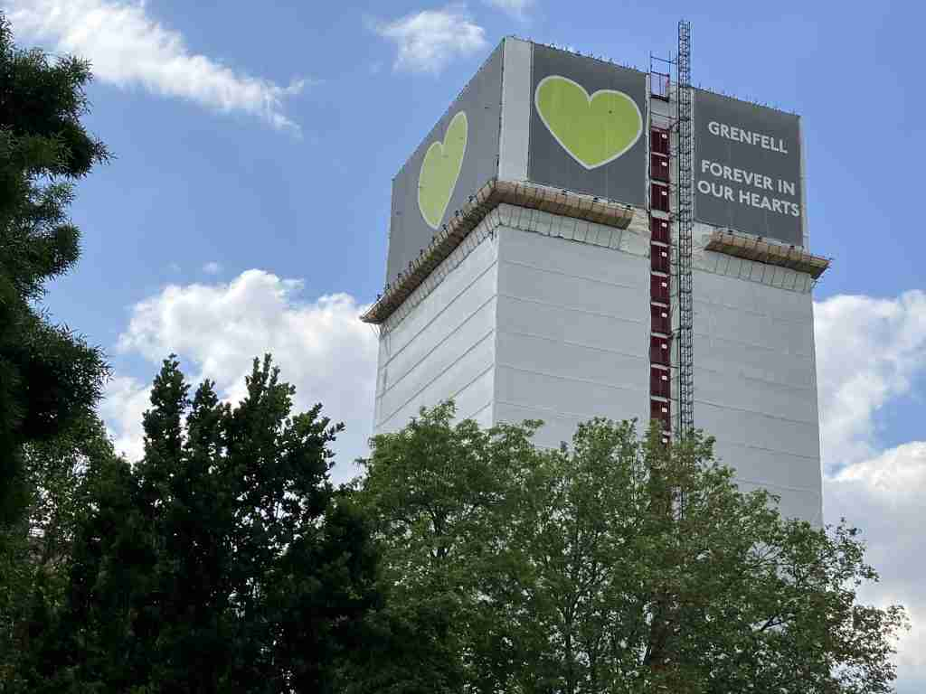
Findings: Post-crisis
A public inquiry to find and ultimately hold responsible individuals or organisations to account.
The UK government has introduced a range of new reforms and regulations intended to prevent future high-rise fires:
  The Building Safety Act 2022 to enhance safety standards.
  Establishing a single construction regulator.
Further recommendations:
  Enhanced training for firefighters, particularly in high-rise buildings, and a review of evacuation strategies in high-rises
  Greater coordination and collaboration between emergency services and local authorities
  A single govt department dealing with all fire safety responsibilities

Slide 11
Pre-crisis
Inadequate risk assessments,
Outdated fire safety procedures,
Lack of resident involvement in contingency planning
Ignored risks or warnings,
Inadequate oversight of building regulations
Crisis
Inadequate contingency plans,
Inadequate emergency response protocols
Inadequate emergency services and local authority response
Post-crisis
Regulatory and policy reforms,
Fire sector changes,
Implementing lessons learned from previous incidents
Public inquiry,
Legal actions,
Criminal prosecutions
Proactive accountability
Reactive accountability

Slide 12
Proactive and Reactive Accountability
Both proactive and reactive accountabilities serve distinctive, yet complementary roles in crisis management.
Proactive accountability is forward-looking as it aims to reduce future risks in the crisis and post-crisis phases, while reactive accountability, by contrast, can work backwards through the crisis and pre-crisis phases to sanction actors for failures.
Table 2. Proactive accountability and reactive accountability in crisis management (Source: Authors)
 | Focus | Timing | Mechanisms | Goal
Proactive accountability | Assigning specific responsibilities to actors | Predominantly before a crisis | Risk assessments, contingency planning, learning from past events | Reducing risks
Reactive accountability | Sanctioning actors for failures | Predominantly after a crisis | Public inquiries, legal actions, evaluations, criminal prosecutions | Ensuring justice

Slide 13
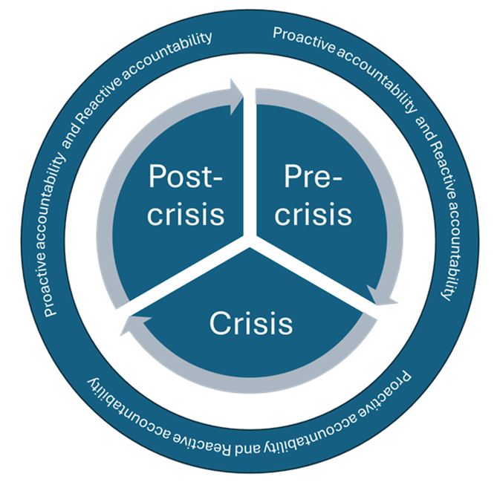
The interplay of proactive and reactive accountability
Both proactive and reactive accountabilities are intertwined throughout the crisis management cycle and failures in one form of accountability may influence the other, and ultimately change the relationship between them.
Proactive accountability mechanisms can prevent the need for extensive reactive accountability measures, and similarly, reactive accountability measures might help identify inadequacies in proactive accountability mechanisms to improve future responses.
Figure 1. The interplay of proactive and reactive accountability mechanisms/processes across the crisis management cycle (Authors’ interpretation).

Slide 14
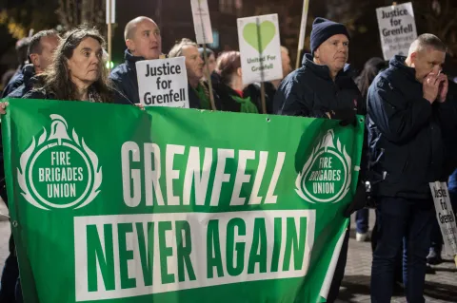
Conclusions
We contribute to the literature on accountability in crisis research, by arguing that accountability in crisis management can act as both proactive and reactive mechanisms (Bovens et al. 2008, Novelli et al. 2024).
Accountability should be understood not only as a reactive tool (which Bovens (2010) calls a mechanism), but also as a proactive mechanism (which Bovens (2010) refers to as a virtue) for crisis prevention.
We hope that our findings will help improve regulatory and policy reforms, support the ongoing pursuit of justice for Grenfell victims, inform future crisis management strategies in similar situations.

Slide 15

Thank you
katarzyna.lakoma@ntu.ac.uk
peter.murphy@ntu.ac.uk
peter.eckersley@ntu.ac.uk

