Slide 1
Leading Governmental Financial Resilience – 23rd July 2025
Professor Pete Murphy
Dr Martin Jones
Dr Bernard Dom

Slide 2



Leading Governmental Financial Resilience
Introductions
Dr Martin Jones, Head of Accounting & Finance
Dr Peter Murphy, Professor of Public Policy and Management
Dr Bernard Dom, Lecturer in Accounting and Finance

Slide 3

Ministry of Economy and Finance Leading Governmental Financial Resilience
The context of public finances
Strategic financial leadership in the public sector
Understanding financial resilience
The financial resilience toolkit

Slide 4
Leading Governmental Financial Resilience The context of public finances and performance management in England
Peter Murphy
BA, MA, PhD, FETC, MRTPI, CISPA, FEAH, FRSA FJUC, FAssSS.
Professor of Public Policy and Management
Nottingham Business School
Visiting Professor Kwansei Gakuin University

Slide 5

Cambodia and the UK
Similarities
Differences
Multi-tiered systems of local government
Decentralisation: UK via ‘devolution deals’ Cambodia via Commune/Sangkat and the Organic Law
Elected local representatives
Central funding to L Gov dominant
Autonomy relatively high in UK limited in Cambodia
Legal framework – UK varies across home nations. Cambodia is by law an indivisible state.
Citizen participation encouraged in UK, growing but constrained in Cambodia

Slide 6
In contrast to Cambodia Since 1979, the UK has seen big radical swings in the strategic objectives and operational reforms of Central and Local Government.
Prior to 1979 UK tended to see more long-term incremental reforms - the UK had a reputation for political and economic, stability - perhaps even reliability?
The 1979-1997 Thatcher/Major administrations replaced traditional forms of direct provision (TPA) with competitive tendering, marketisation and outsourcing to private sector provision (NPM)
The 1997-2010 Blair/Brown introduced Best Value and continuous improvement across all public services with devolution of powers to Scotland, Wales and N Ireland (NPM gradually superseded by emergence of PV and NPG).
2010-2024 (Cameron, May, Johnson, Truss, Sunak) long-term austerity and radical reforms towards smaller state, private sector and hybrid provision (with Brexit, COVID 19 etc exacerbating the swing and LG among the worst affected sectors (return to NPM)
July 2024. Starmer inherits both domestic and international ‘poisoned chalices’ (internal and external threats and challenges) that deserve the description ‘omnishambles’ (return to NPG)

Slide 7

Social and economic issues facing the UK in 1997
Examples of historical highs
Rapidly increasing wealth and health inequality
Falling educational attainment,
Social problems such as rising teenage pregnancies
Prison, overcrowding, offending recidivism,
Rising crime and anti-social behaviour,
Poverty, alienation and discrimination increasing and community cohesion disintegrating,
Record levels of street homelessness.

Slide 8
What happened between 1997-2010?
The quality and quantity of all individual public services delivered continuously improved as collaboration, innovation and co-creation increasingly flourished.
The long-term real costs per capita reduced and the value for money continuously improved.
The major social and economic challenges facing local communities (wicked issues and challenges) such as
wealth and health inequality,
offending recidivism, anti-social behaviour, community cohesion,
Homelessness, teenage pregnancies, educational attainment,
poverty, alienation and discrimination,
were all tackled, while inclusive communities and sustainable development was promoted.

Slide 9
Public Sector Reform: 1997-2010 Blair/Brown Devolution Human Rights N Ireland Agreement Iraq 2007/8 Recession
The mechanics of central government – internal workings and structures - Cabinet Committees and Strategic Units
Money & Modernisation, Comprehensive Public Spending Reviews (Netherlands 1981) and Public Service Agreements
This meant policy implementation and delivery were the civil service’s responsibility - not just policy development - it led to an influx of public practitioners across Whitehall
It also meant an era of collaboration and partnership between Central and Local Government with multiple, several and mutually reinforcing responsibilities across public departments and agencies.
Central and local government ‘owned’ the same social, economic, and environmental problems

Slide 10
Local Government Modernisation and Improvement Lessons fed back to central government reforms and across the public sector in the UK
New legal framework of powers and responsibilities – Best Value; the power of general competence; the power to promote economic, social and environmental wellbeing.
Improved local democracy, citizen engagement community planning and accountability through new political and governance arrangements
Evidence based decision making, improved data and intelligence (input, output and outcomes data) and improved public assurance arrangements, most notably via external inspections
More ‘economic, efficient and effective’ public services through collaborations and partnerships
Improved financial management via budgeting, accounting and financial reporting
Innovation, new technology digital delivery and e-government.

Slide 11

1997-2010: Performance Management Regimes and Integrated financial and non-financial management.
Frameworks or Regimes
Best Value 1999-2002
Comprehensive Performance Assessment 2002-2005
Comprehensive Performance Assessment 2006-2008
Comprehensive Area Assessment 2009
Public Financial Management moved from annual financial reporting to (holistic) Use of Resources Assessments of short, medium and long-term financial resilience and the greater appreciation of risk.

Slide 12
2010-2024 (Cameron, May, Johnson, Truss, Sunak)
Long-term austerity and a smaller ‘state’,
Private sector and hybrid provision with Brexit, COVID 19, wars and immigration etc exacerbating the swing and LG among the worst affected sectors (the return to New Public Management)
Local Government:
Sector Lead Improvement and localism/austerity – the gradual abandonment of collective responsibility by central government and the decline of local government into service failures and financial distress.

Slide 13
In July 2024 the UK was again facing historical highs
Rapidly increasing wealth and health inequality
Falling educational attainment,
Social problems, including poverty, alienation and discrimination and community cohesion,
Record prison populations, overcrowding, offending recidivism,
Rising crime and anti-social behaviour,
A housing crises including street homelessness. AND
A Local Government Finance System and a Local Public Audit that are not fit for purpose or fit for future purpose

Slide 14
July 2024 election (Starmer administration )
The latest approach (somewhat uncoordinated) is starting to emerge
Local Government devolution and re-organisation
Local Government Outcomes Framework
Local Audit, a new Local Audit Office and mixed audit market.
Fair Funding Review (financial support arrangements from Government to local Government)
Learning lessons from 1997-2010 (NPG and PV).

Slide 15


Slide 16
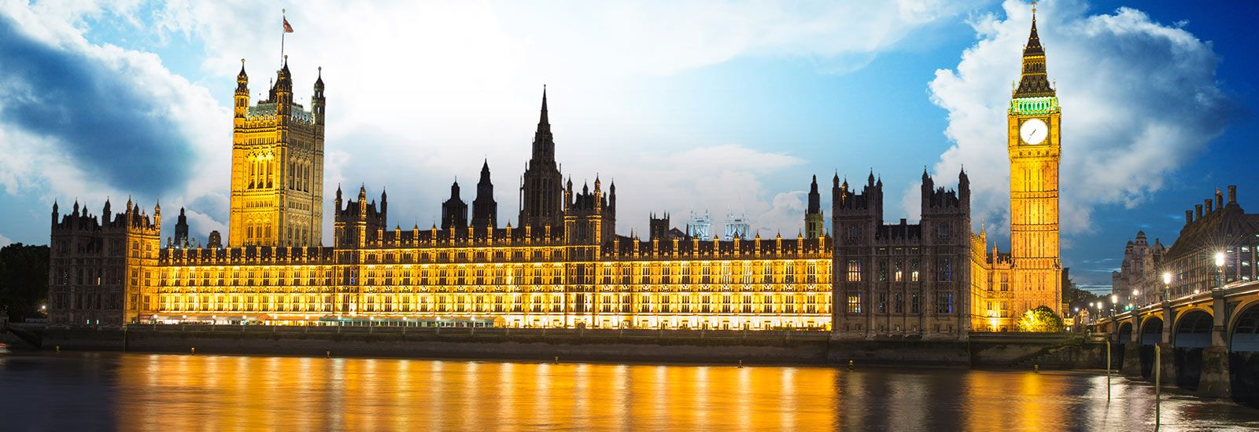
Local Government Finance : An Introduction to Financial Resilience
Finance Workshop
Dr Martin Jones
martin.jones@ntu.ac.uk

Slide 17
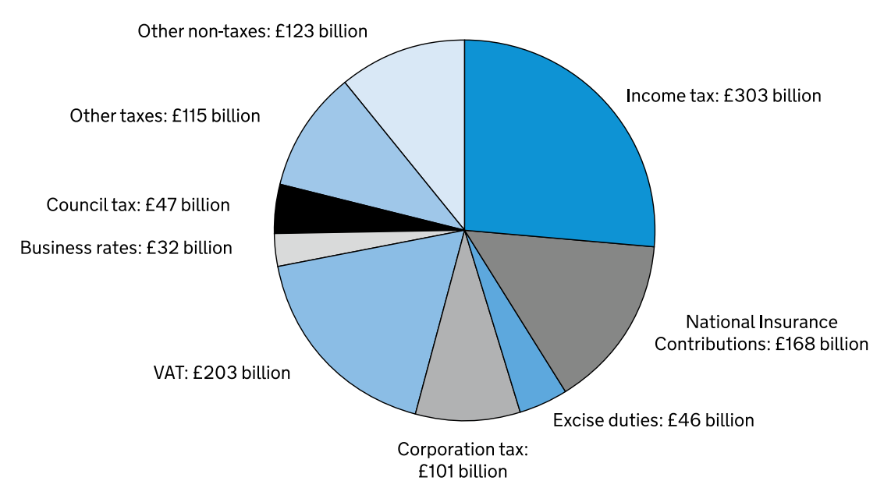
UK Public Sector Receipts 2024/25 £1,139 Billion
Other taxes includes capital taxes, stamp duties, vehicle excise duties, customs duties and other smaller tax receipts.
Other non-taxes includes interest and dividends, gross operating surplus and other smaller non-tax receipts.
Source: Office for Budget Responsibility - Spring Budget (March 2024)

Slide 18

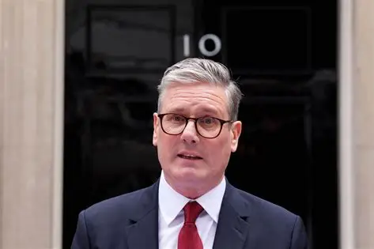
The UK Government: Key Players
Head of State - constitutional and representational duties
Prime Minister – first among equals..
Scrutiny from House of Lords
The Government
Cabinet
Scrutiny from Parliament
Devolved Governments
Central Government Departments
Executive Agencies
Non-Departmental Public Bodies (QUANGOs)
Schools, Academies, FE & HE
Local Authorities
NHS organisations

Slide 19
The UK system of Government
NHS Organisations – NHS organisations in England are accountable to NHS England which is accountable to the UK Department of health. In the devolved regions, NHS organisations are accountable to the respective devolved government.
Non-departmental Public Bodies - A non-departmental public body (NDPB also known as a Quango) is a national or regional public body, working independently of ministers to whom they are nevertheless accountable. They are not staffed by civil servants. Examples include the Arts Council of England, the Environment Agency
Local Authorities – these provide a range of services at the local level. The councils are democratically elected and are accountable to the local population. However, they get much of their money from central government and are accountable to much central control. They have no constitutional protection

Slide 20
The UK system of Government
Government Departments - The main role of government departments is to develop and propagate government policy and to advise ministers. Departments are staffed by politically impartial civil servants and are funded by Parliament.
Devolved Governments – responsible for a wide range of public services in Scotland, Wales and Northern Ireland. Independent of UK government for devolved services. The bulk of finance comes from UK government
Executive Agencies - An executive agency is a public institution that delivers government services for the United Kingdom government, the Scottish Government, the Welsh Assembly Government or the Northern Ireland Executive. An agency does not set the policy required to carry out its functions - these are determined by the department that oversees the agency. For example, Jobcentre Plus is an executive agency and part of the Department for Work and Pensions. DVLA is part of the Department of Transport

Slide 21
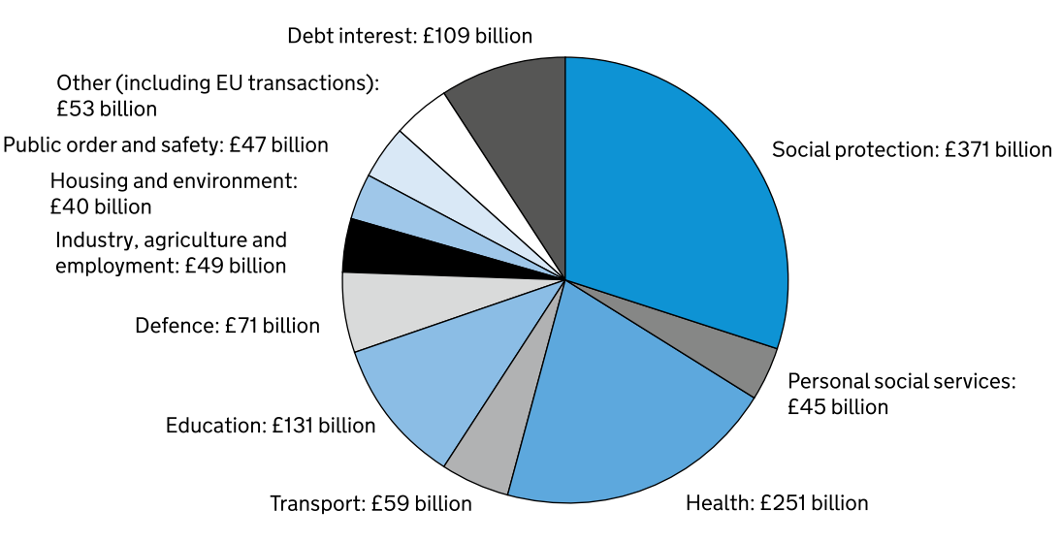
UK Public Sector Expenditure 2024/25 £1,226 Billion
Main areas of spend linked to local government
Figures may not sum due to rounding
Source: Office for Budget Responsibility and HMT - Spring Budget (March 2024)

Slide 22
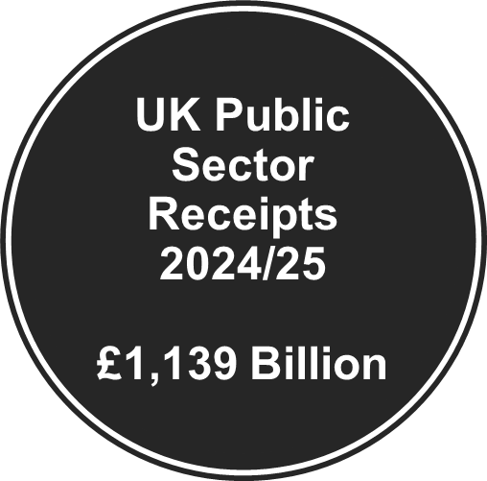
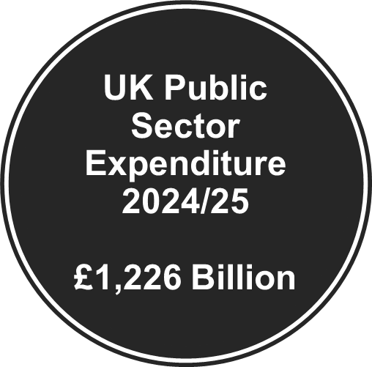
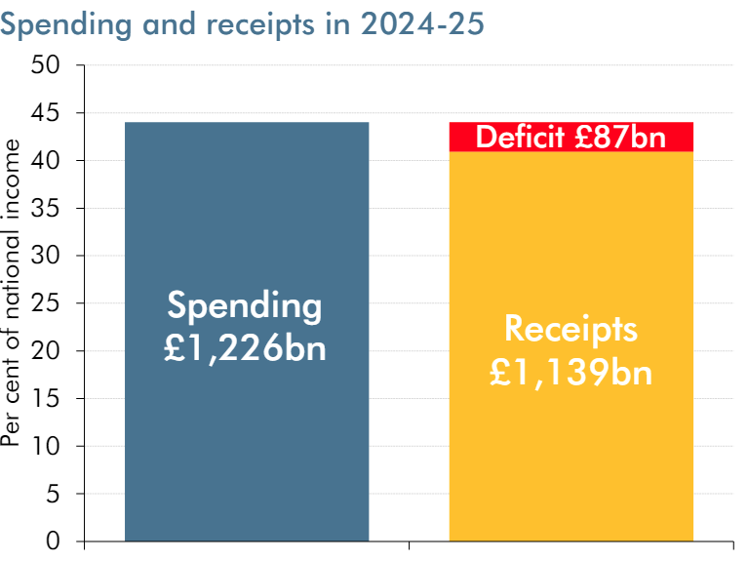
Click chart to follow link - OBR March 2025

Slide 23
Local Government Finance

Slide 24
UK Local Government Characteristics
Politically and Administratively autonomous from Central Government
The unit of government closest to the citizen
Funded from central grants and local taxation
Can borrow money on the open market and has its own bank account
Uses accruals accounting
Financial statements are subject to annual external audit
Legislative requirement to deliver Value for Money and Best Value
Mixed economy of structures and political leadership
Often seen as organisational leaders in their region/area

Slide 25
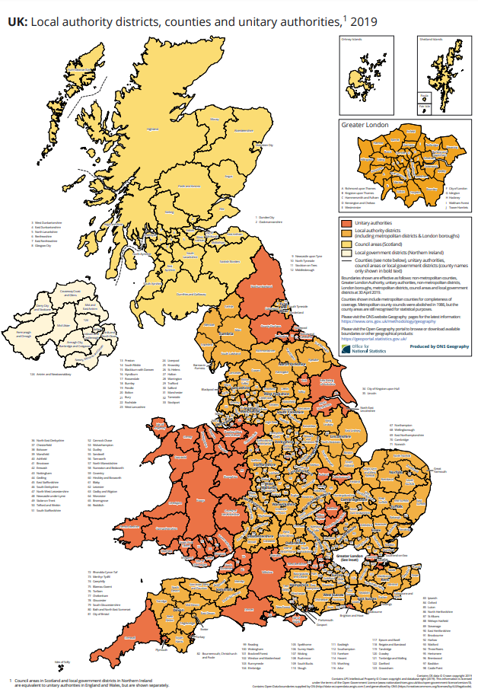
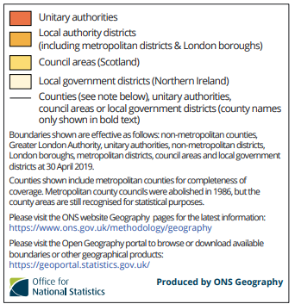
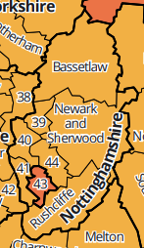
How is English Local Government structured?

Slide 26
UK Local Government by numbers
England – there are 317 councils in England:
21 County Councils (upper-tier)
164 District Councils (lower-tier)
32 London Boroughs (unitary)
36 Metropolitan Boroughs (unitary)
62 Unitary authorities (unitary)
2 Sui Generis authorities – City of London Corporation and Isles of Scilly (unitary)
Wales – 22 Unitary authorities
Scotland – 32 Unitary authorities
Northern Ireland – 11 Unitary authorities

Slide 27
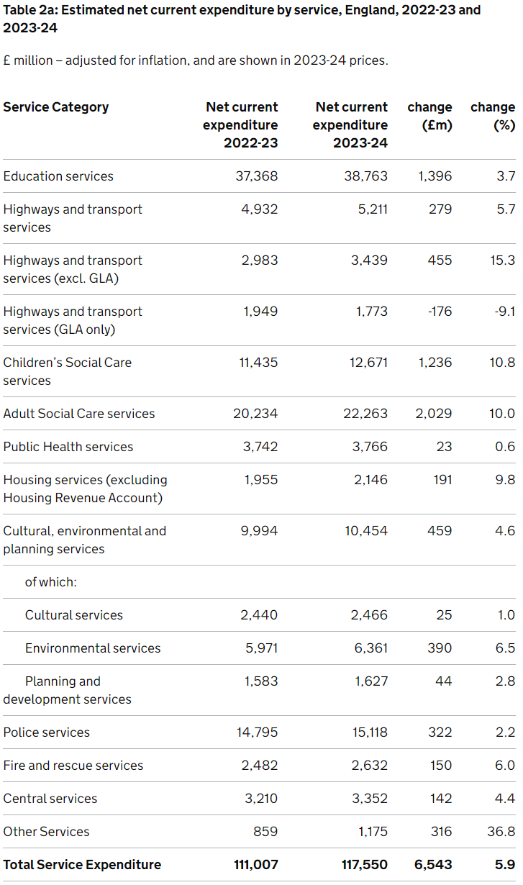
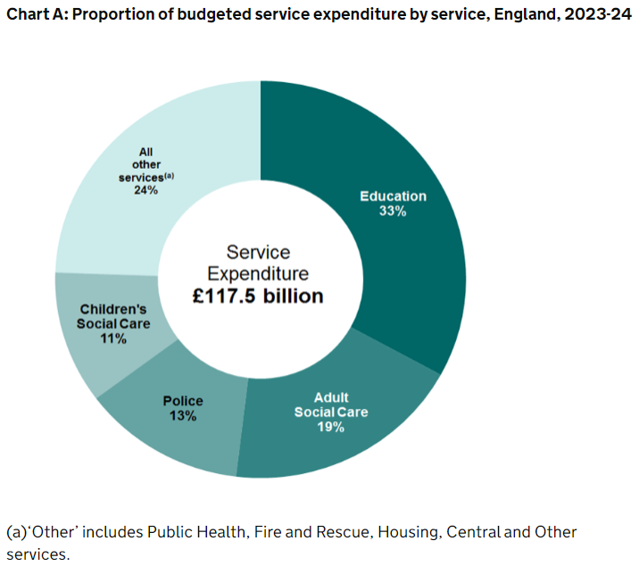
Local Government expenditure 2023/24

Slide 28
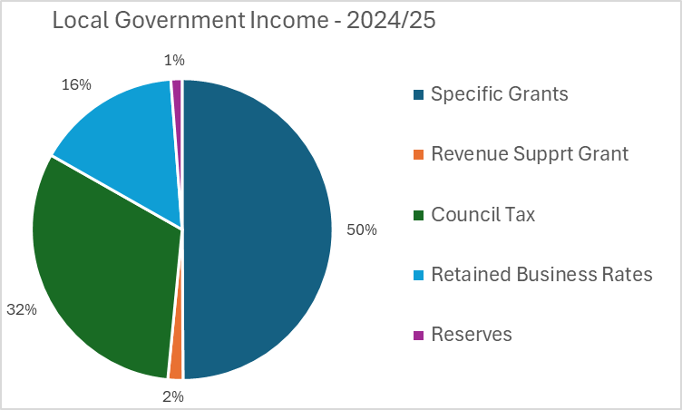
Local Government income 2023/24
Three main sources of income plus reserves

Slide 29
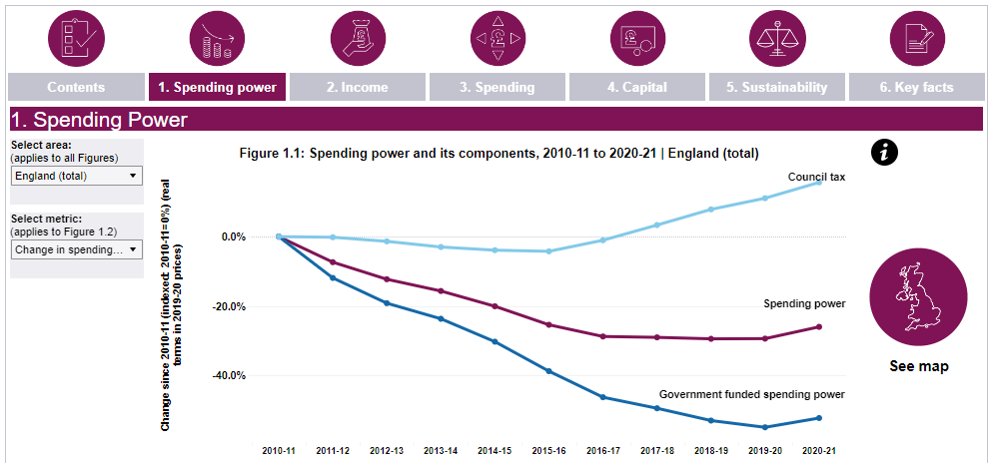
Local Government and Austerity

Slide 30
Nolan Principles of Public Life
Leadership
Selflessness
Integrity
Objectivity
Openness
Accountability
Honesty

Slide 31
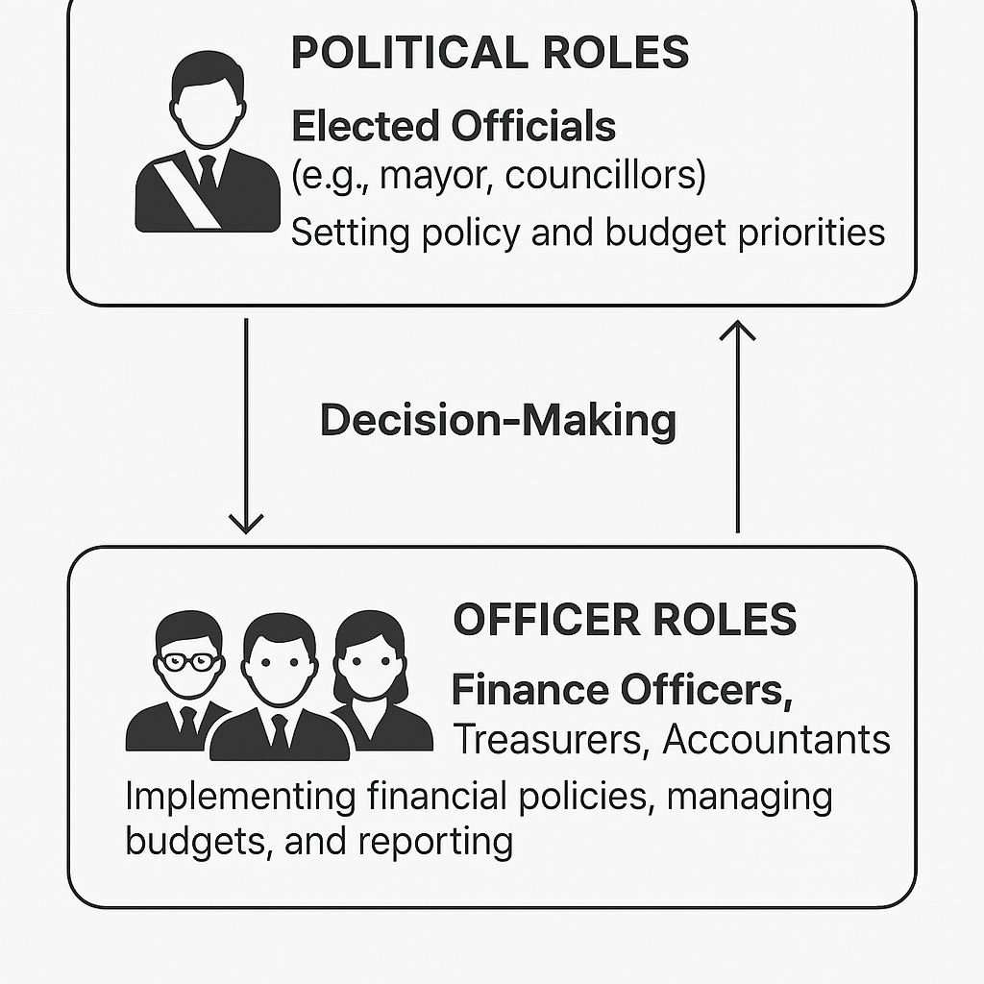
Financial Leadership – who is involved?
Leadership
Selflessness
Integrity
Objectivity
Openness
Accountability
Honesty
Elected Politicians
Officers (Civil service/Admin)
Mayor
/Leader
Chair/Portfolio holder: Finance and Resources
Cabinet and Scrutiny
Head of Paid Service
Chief Finance Officer
(Section 151 Officer)
“Golden Triangle”
Monitoring Officer
Audit Committee
Internal Audit

Slide 32










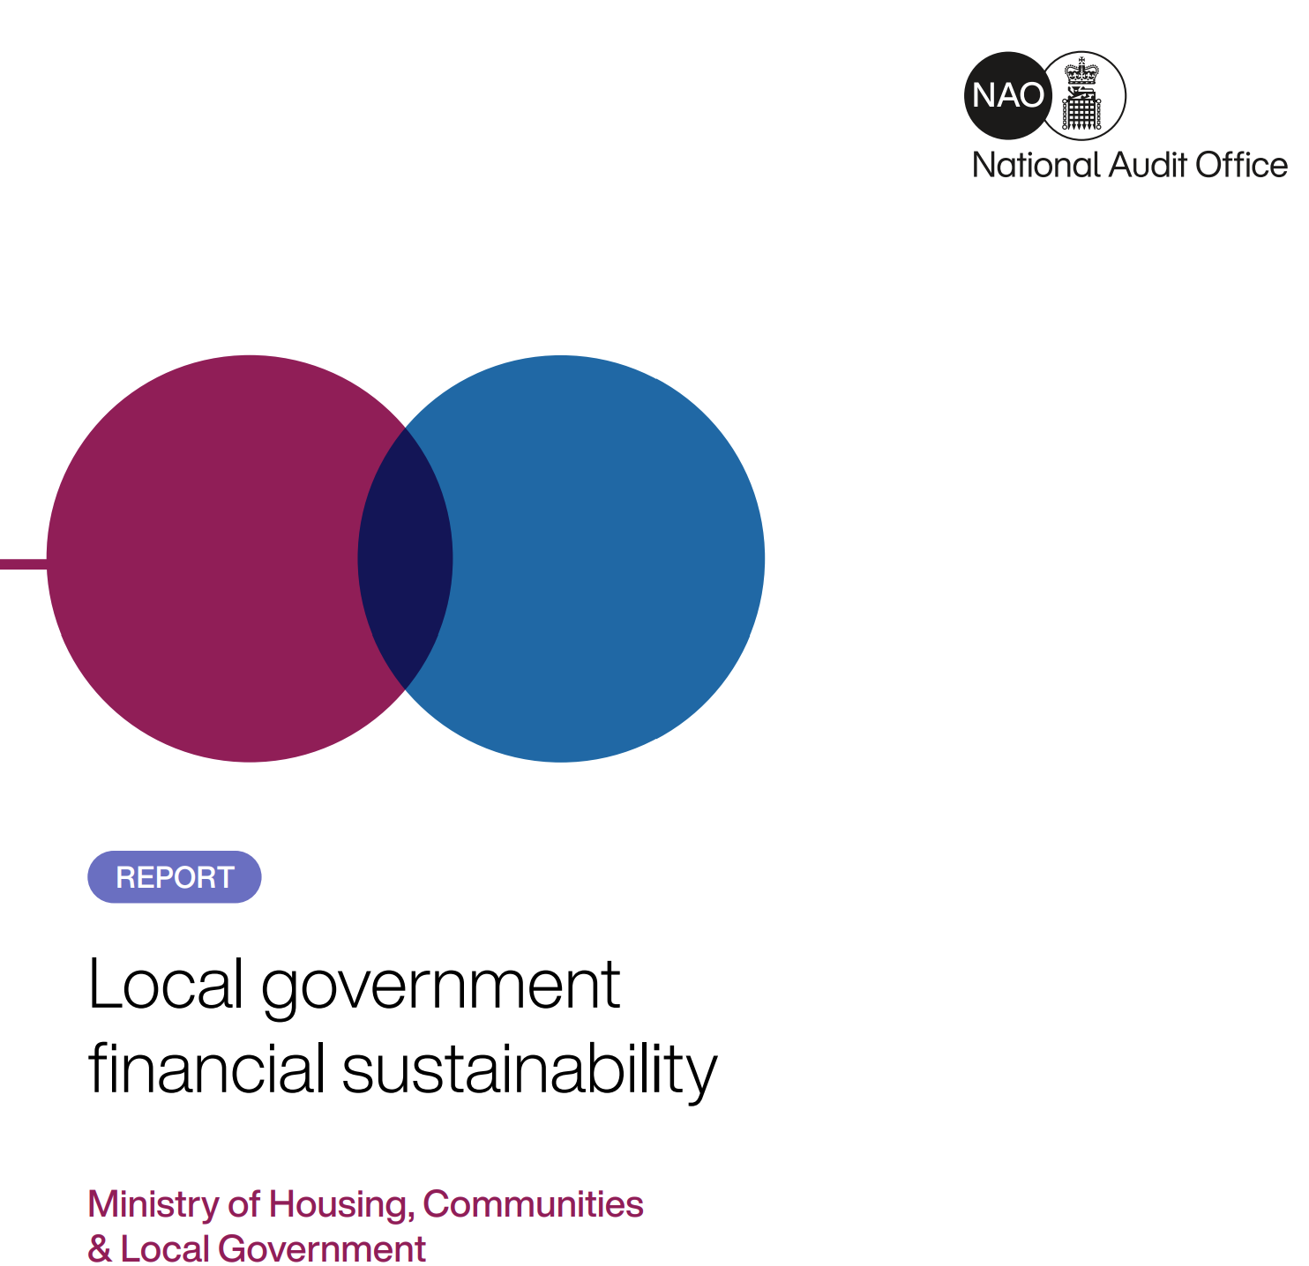

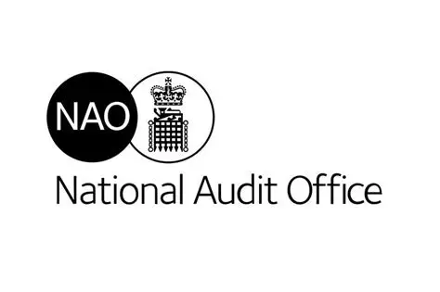

Financial Leadership – who is involved?
Regulation, Oversight and Guidance
Audit and Consultancy
Central Government
Information

Slide 33
Local Government Finance - Overview
Budgeting in very simple terms:
Calculate total spending requirement
Deduct:
Revenue grants
Business rates
Reserves
Fund the balance from Council Tax
But council tax increases are capped…..
So may need to cut costs or use more reserves
Revenue Spending
Day to day costs
Budgeted for annually
Funded mainly from grants and local taxes
Some fees and charges
Capital Spending
On long term assets – eg buildings
Budgets can span financial years
Funded mainly from capital grants, capital receipts and borrowing

Slide 34
Who Audits Public Bodies?
National Audit Office (NAO)
Audits - Central Government Departments, Government Agencies, Non-departmental public bodies and Value for Money Audits
NAO reports to Comptroller and Auditor General who reports to the Public Accounts Committee
NAO is independent of and separate from government
Private firms – Mazars, Grant Thornton, Ernst and Young, Deloitte, BDO
NHS, Local Government, Higher Education
Public Sector Audit Appointments
Public audit backlog – only 1% on time; 95% with audited accounts up to 2022/23
Internal Audit
All types of public body
Also Audit Committees

Slide 35
UK Public Sector Regulation
GAAP
International Accounting Standards Board
Financial Reporting Council
Accounting
Standards
(IFRS)
Legislation by Sector
UK Government
Interpretation
Sector Specific Guidance/ Manuals
CIPFA, CAPE & FRAB
Statements of Recommended Practice (SORPs)

Slide 36
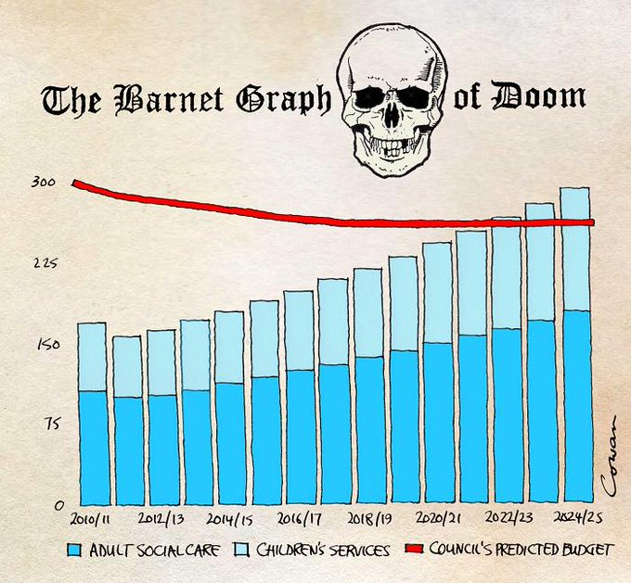
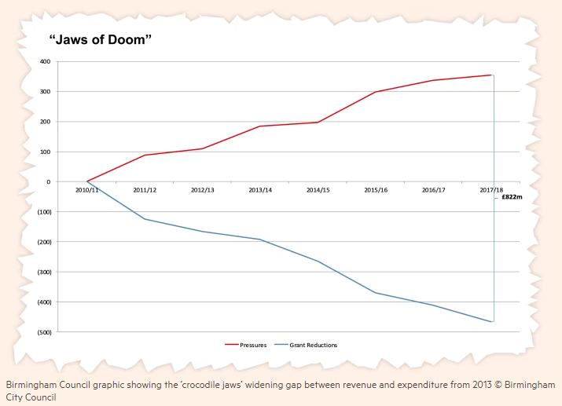
Graphs of Doom………..
Rob Cowan - X (July 2015)
Financial Times (July 2023)

Slide 37
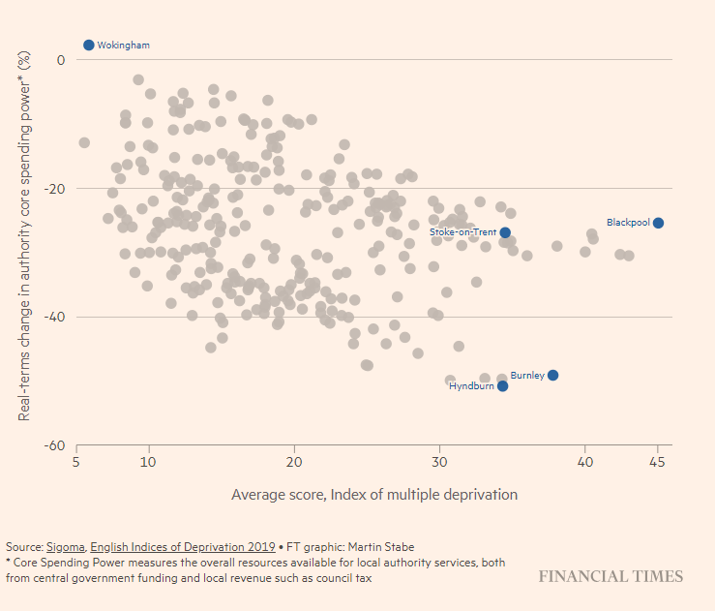
Reductions in councils’ real-terms spending power since 2010 has tended to affect more deprived areas most acutely Financial Times (July 2023)

Slide 38
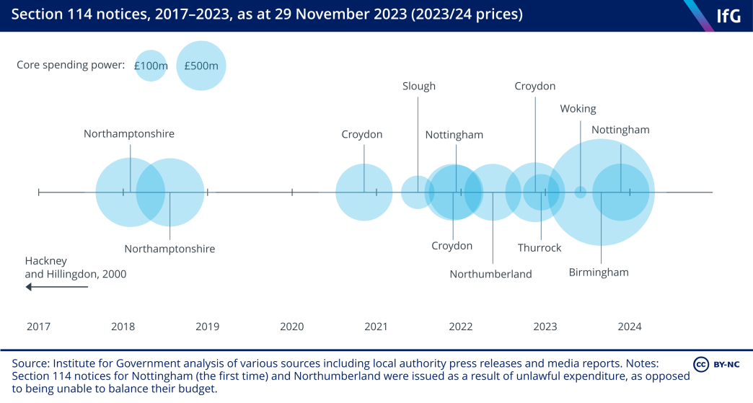
Timeline Section 114 Notices

Slide 39
Some useful resources
There have been a number of reports on the state of local government finance, some links to which are below and in NOW
The next few slides draw some key points from some of these
LGIU-The State of Local Government Finance 2023
NAO - Financial sustainability of local authorities 2018
House of Commons Library - Local Government Finances
National Audit Office - Sustainability Visualisation Dashboards

Slide 40
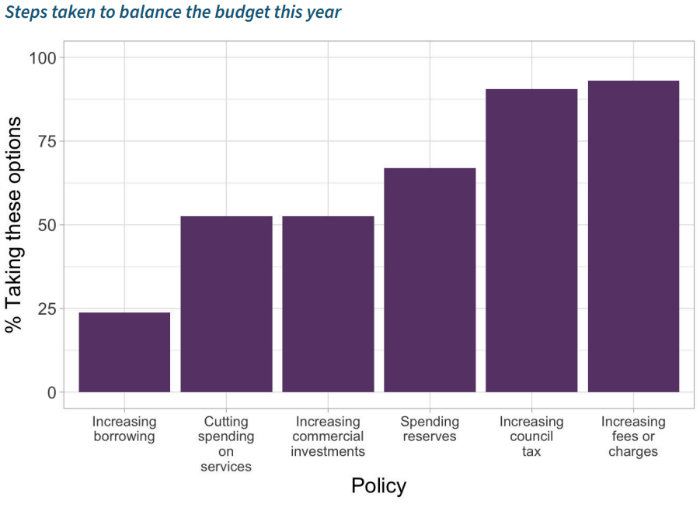
LGiU – State of Local Government 2023
138 Councils

Slide 41
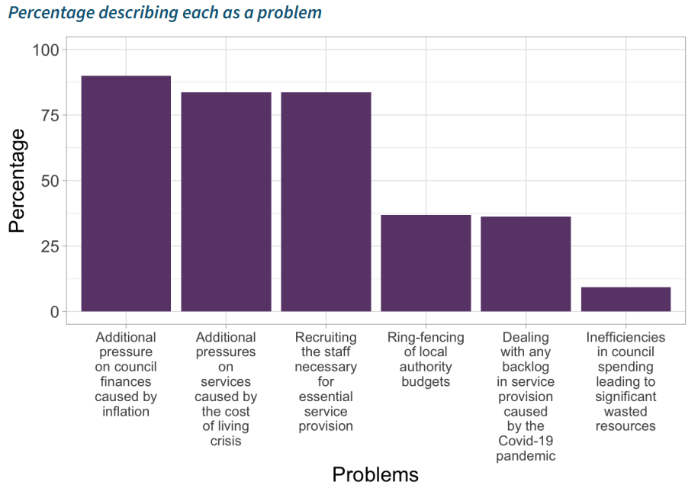
LGiU – State of Local Government 2023

Slide 42
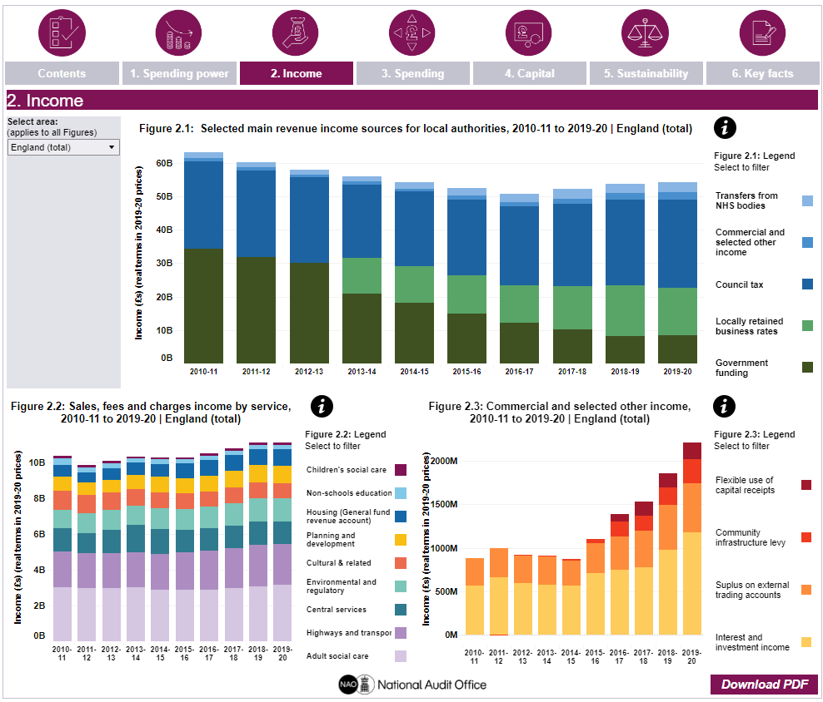
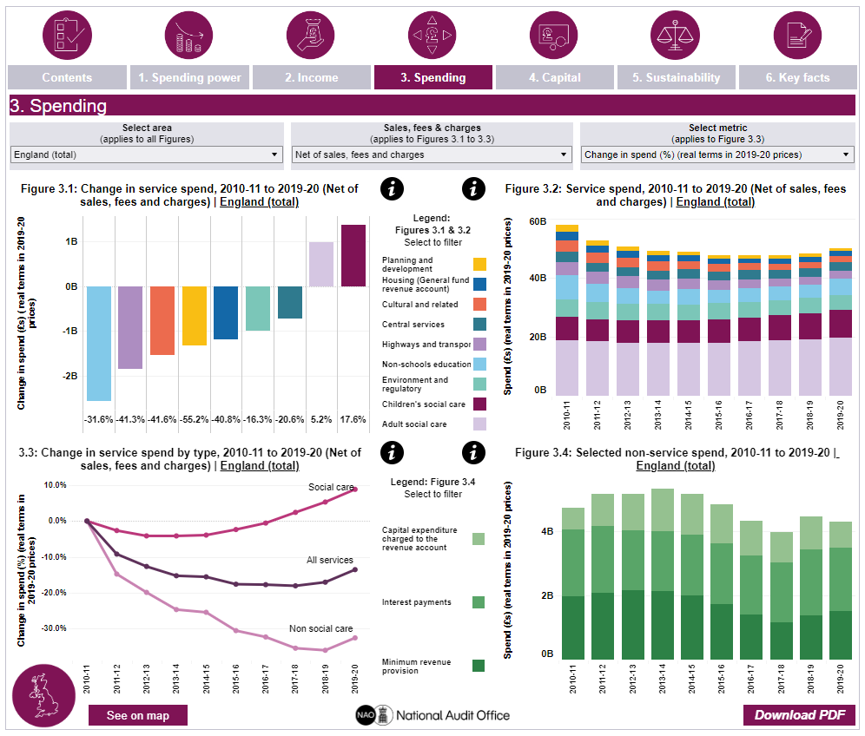
NAO – Financial Sustainability Dashboard

Slide 43
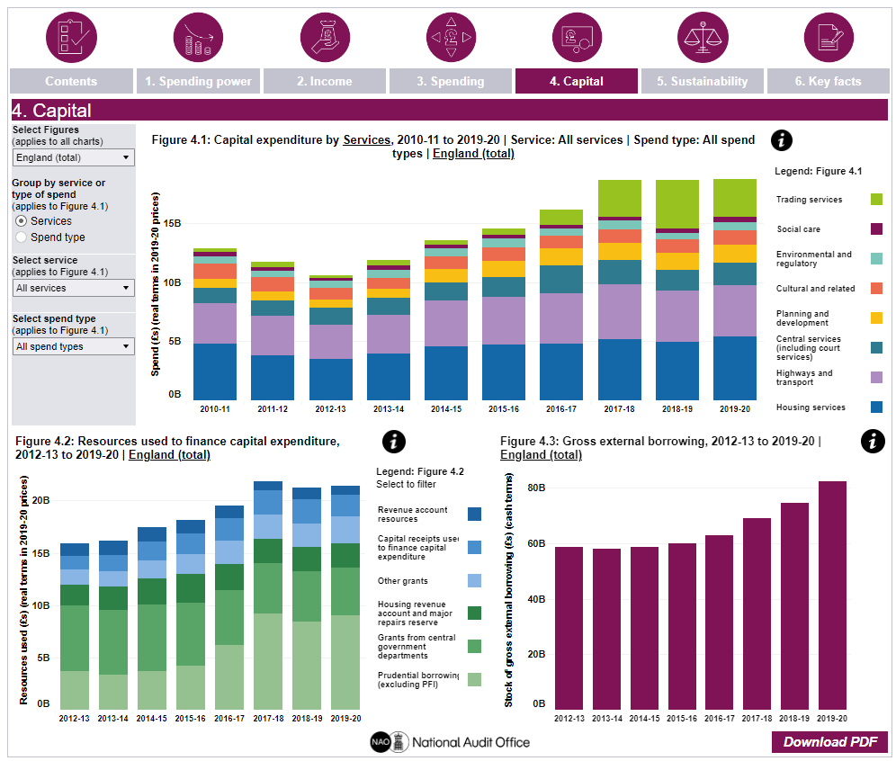
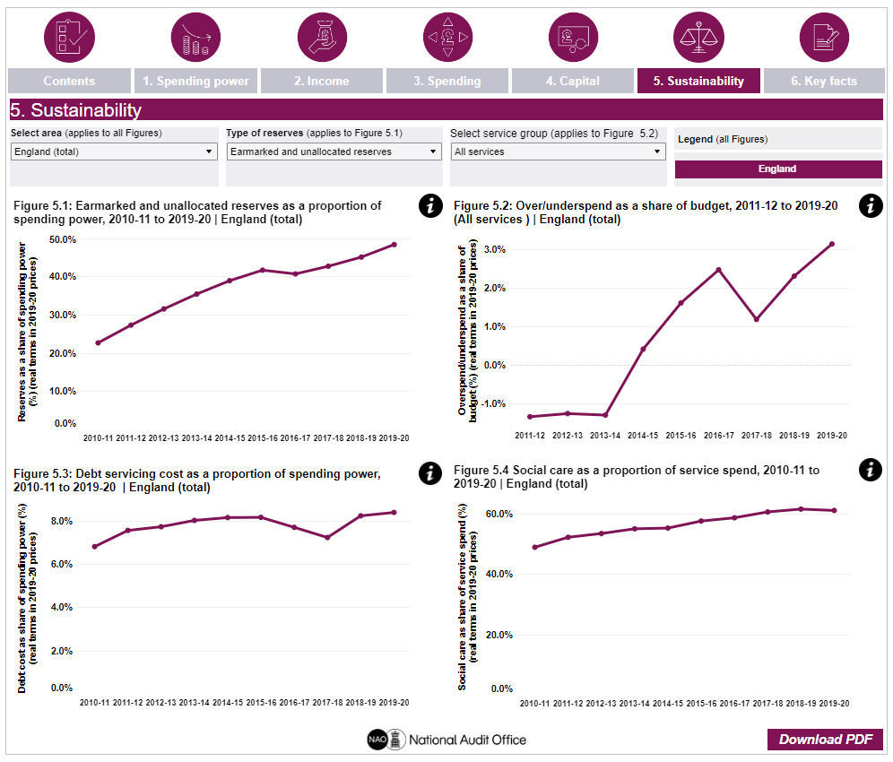
NAO – Financial Sustainability Dashboard

Slide 44
Financial Resilience Tools for Local Authorities

Slide 45
There are two recently developed tools to look at
Both tools look at the financial sustainability but with slightly different perspectives
CIPFA Financial Resilience Index
Current data with some comparators, all LAs, Focuses on 9 key metrics
National Audit Office - Sustainability Visualisation Dashboards
Data between 2010 and 2019, all LAs across 6 Dashboards

Slide 46
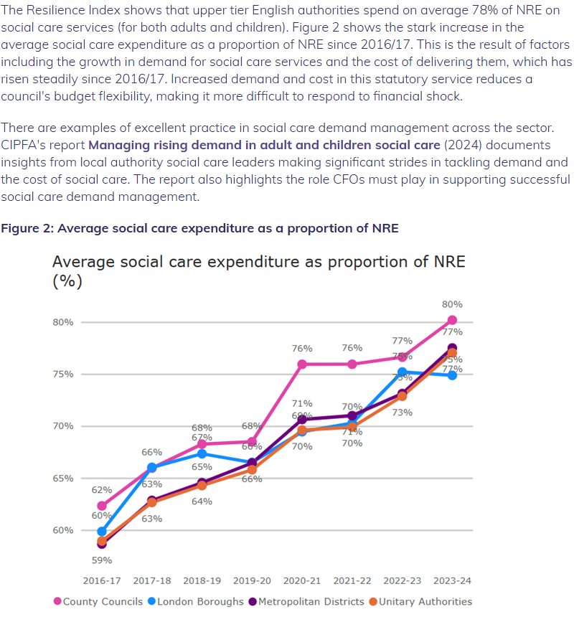

CIPFA Resilience Index (2024)

Slide 47
Specific Issues Relating to Social Care
Challenges:
Demand led services
Growing and Aging population
Multiple presenting problems
Cost of residential care
Inflation/rising care costs
Integration of Health and Social Care
Workforce shortages
Initiatives:
2% additional council tax for social care
Some additional grant funding
Better Care Fund (?)
Pooled budgets
Regional Authorities (?)

Slide 48
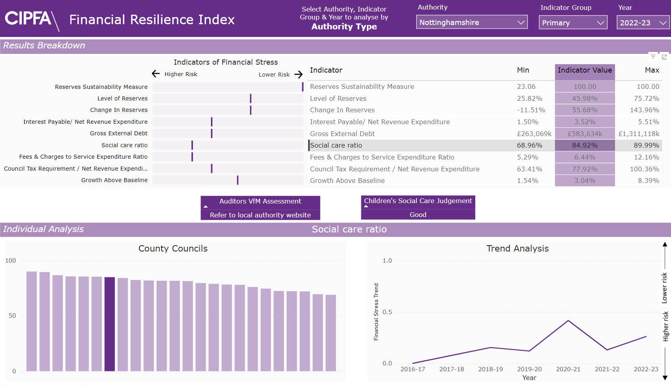
CIPFA Financial Resilience Index

Slide 49
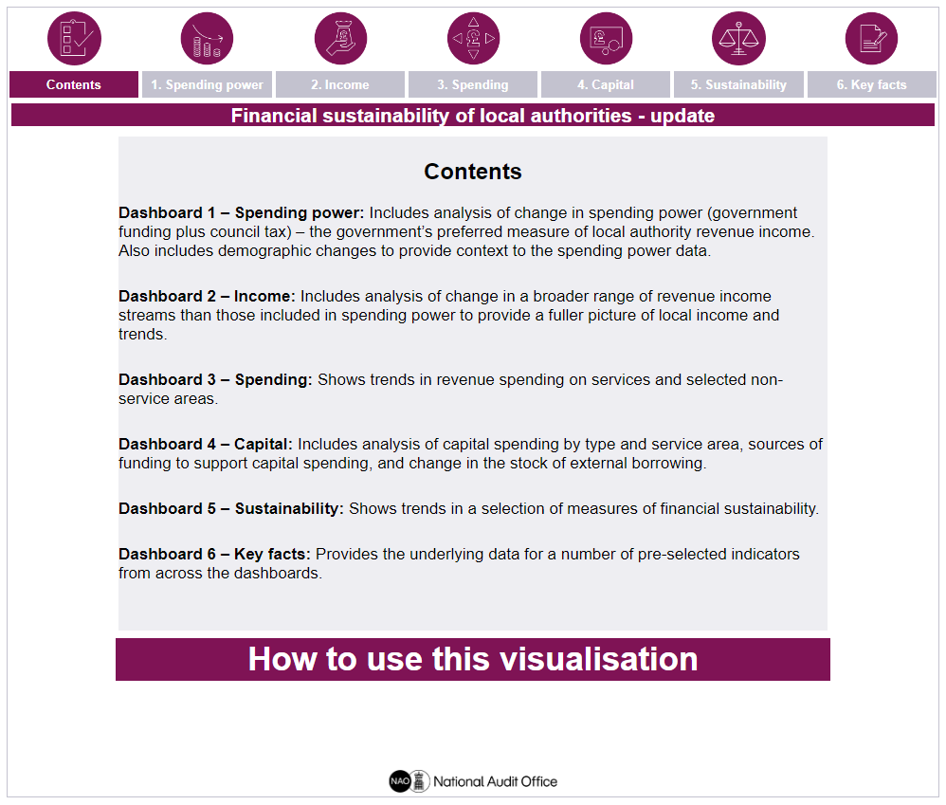
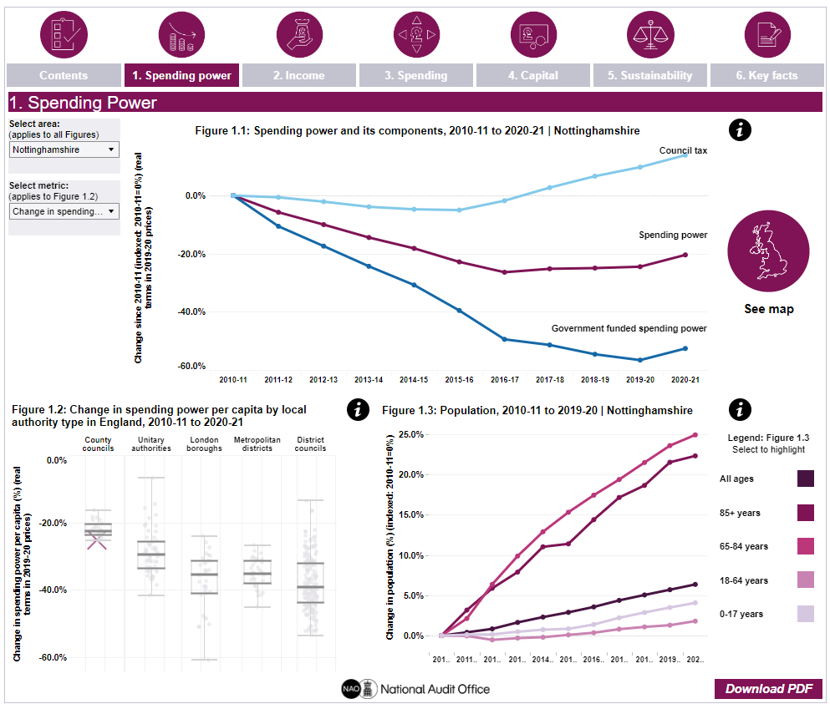
National Audit Office - Financial sustainability of local authorities

Slide 50
Short task – 30 minutes
Follow the links below to look at both scorecards for your own organisations.
Spend 15 minutes looking through the different scorecards and form a view on your organisation
Be prepared to talk about your viewpoint and share your charts
CIPFA Financial Resilience Index – tip – click on the “social care” row in the right-hand table
National Audit Office - Sustainability Visualisation Dashboards

Slide 51


Slide 52
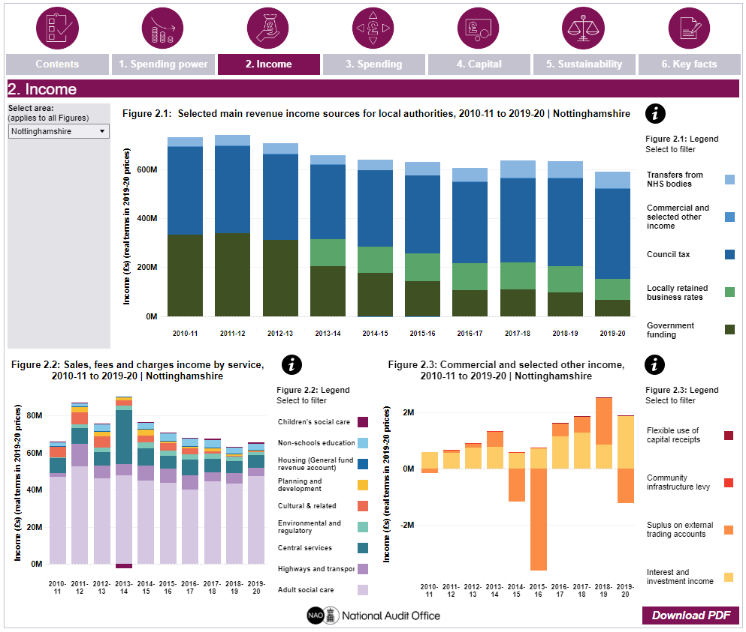
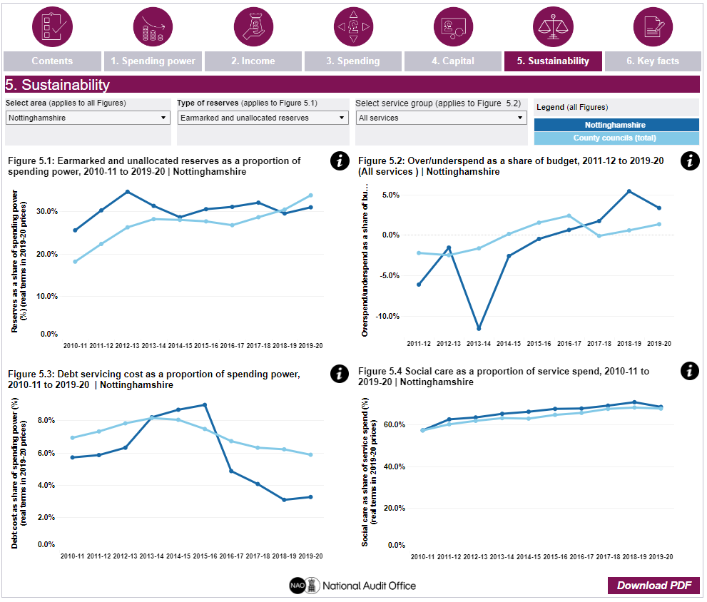
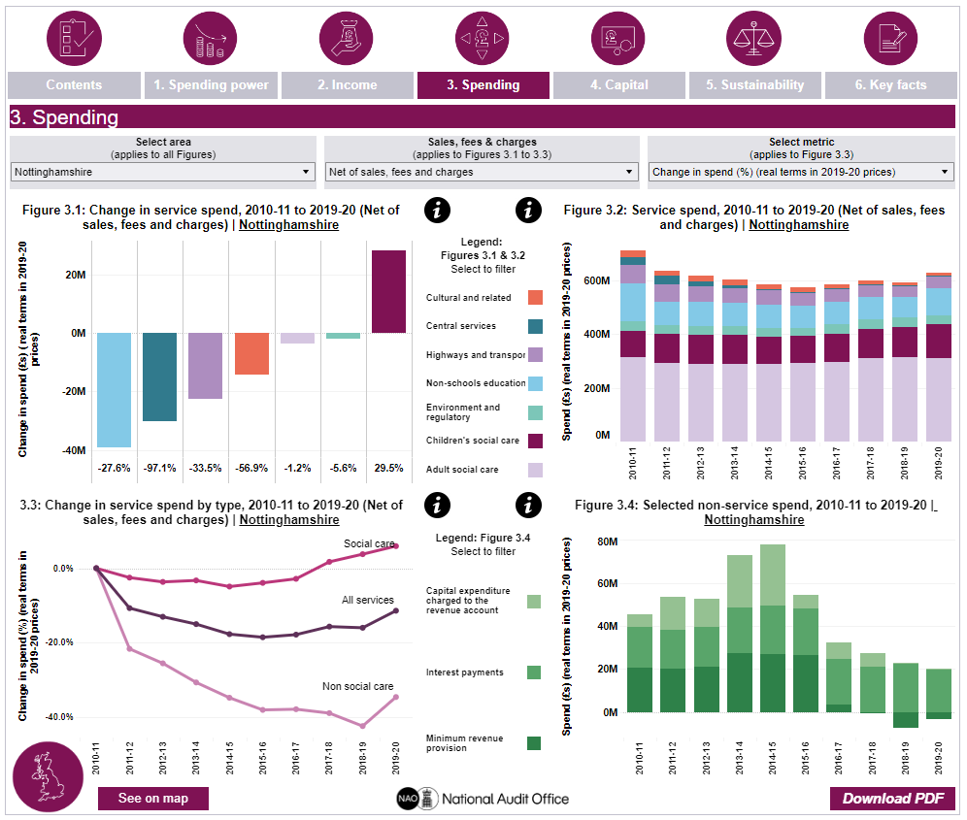
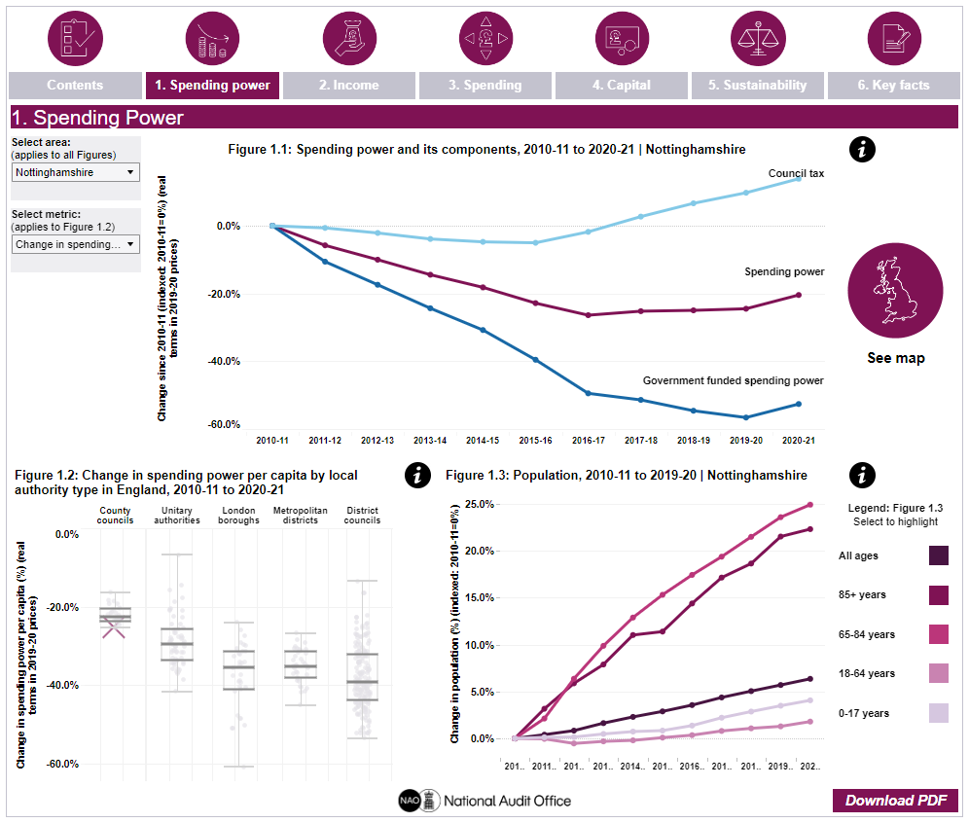
National Audit Office - financial sustainability of local authorities

Slide 53
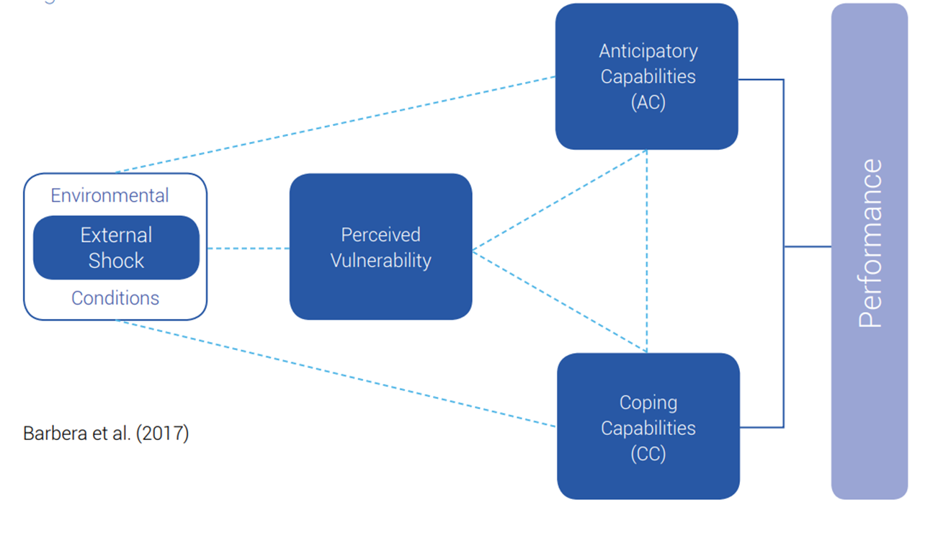
Financial Resilience – An Introduction

Slide 54
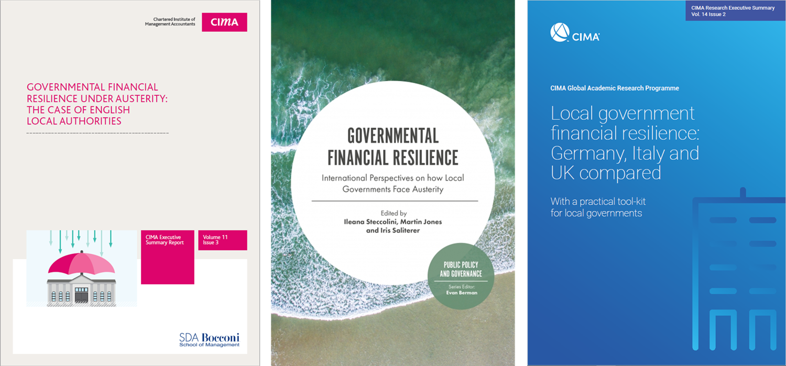
Financial Resilience – Not just about the numbers
These publications have prompted worldwide interest in our work on local government financial resilience.
This in turn has led to the development of a financial resilience tool kit.
This toolkit is intended to be developed in other areas of the public sector eg emergency services, universities, government departments

Slide 55

The Dimensions of Financial Resilience

Slide 56

External Shocks
External shocks disrupt the environmental conditions of local governments, thereby impacting their financial and non-financial conditions.
Natural disasters - earthquakes, floods, pandemics, tsunamis
Artificial disasters - wars, coup d’états
Political - Brexit, immigration
Economic - inflation, high-interest rates, economic recessions, high unemployment levels
Social (e.g. increased and/or ageing population),
Technological - cyber-crimes, internet scams, and terrorist attacks
Environmental - climate change, flooding
Financial - external audit processes
Legal - rapid changes in regulations, or responsibilities for LAs.

Slide 57
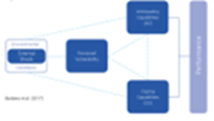
Perceived Vulnerability
Level of perceived exposure to a specific shock
External and internal factors contributing to vulnerability (e.g. dependence on uncertain revenue bases, diversification of income, rigidity of expenditure, uncertain/decreasing transfers)
How does the organisation see its level of vulnerabilty, and is this correct?
More than a specific level of vulnerability - the extent to which there is ‘owning’ or being able to control one’s vulnerability (i.e. being able to manage it and/or influence its sources).
Incorrect perception of vulnerability can lead to poor decisions
Vulnerability informed by Anticipatory and Coping capacities

Slide 58
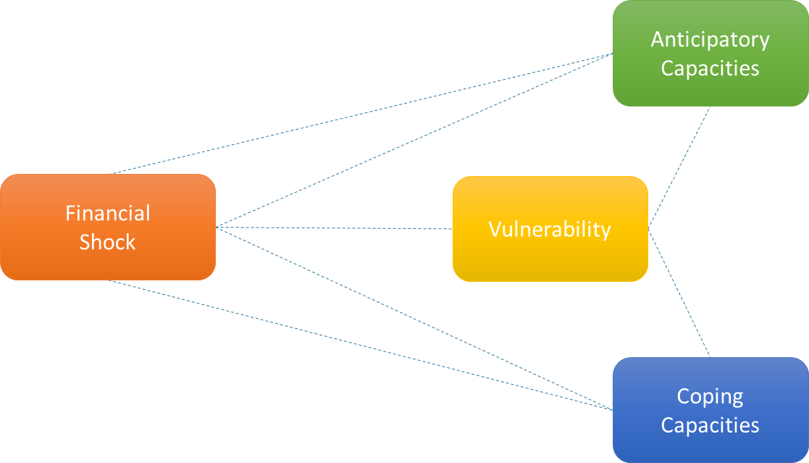
The Financial Resilience Framework
Tools and capabilities to (better) identify and manage vulnerability and to recognize shocks in advance
Tools and capabilities to understand the nature, likelihood, timing, scale and potential impact of shocks
Sensemaking
Scanning (awareness) and interpretation of the crisis (threat, opportunity)
Staff’s emotional reaction and mental framing
Retrospective interpretation (perception of controllability, powerlessness, and dependence on decisions by others)
Prospective interpretation (estimate of the organization’s future condition and possible sources of negative impact)
Perceived level of exposure to external shocks that may affect organizazional finances
External and internal factors contributing to the level of vulnerability
Resources and abilities that enable local governments to face shocks and manage their vulnerabilities
These capacities lie dormant in times of order and become visible in times of disruption (shock) through coping strategies
Three main types of CCs: Buffering, Adapting, Transforming

Slide 59
Coping Capacities
Resources and abilities that allow shocks to be faced and vulnerabilities to be managed
Buffering - Ability to absorb impact without changes in structure or function
Use of reserves, temporary closure of services, delaying capital projects
Adapting - Ability to implement incremental changes to extant structures and functions without changing underlying principles, culture, values.
Restructuring and delayering, use of IT systems
Transforming - The ability to implement radical changes, characterized by new ‘rules of the game’

Slide 60
Coping Capacities
resources and abilities that allow shocks to be faced and vulnerabilities to be managed
Buffering - Ability to absorb impact without changes in structure or function
Adapting - Ability to implement incremental changes to extant structures and functions without changing underlying principles, culture, values.
Transforming - The ability to implement radical changes, characterized by new ‘rules of the game’
“When the crisis came in 2007/2008, we immediately tried to reduce our spending [cost cuts], […] to defer investments or maintenance [defer investment, defer expenditures].” (CFO, A3)
“What we are trying to do is move our budget setting process to being more outcome based [enhancing performance management], and trying to refocus the money left on our most vulnerable within the town, on the services we have to provide for those who can’t provide for themselves.” (CFO, E2)
“I would say our goals have kind have turned around that we are trying to make sure we are generating income and that we are self-sufficient and we can do what we want and carry on providing important services without any requirement of government funding has on us. [financial self-sufficiency]” (CFO, E2)

Slide 61
Anticipatory Capacities
The ability to identify and manage vulnerabilities, to recognize (potential) shocks at an early stage, and to understand their impact
Sharing of Information - the process of transferring relevant information (internally) within an organisation among key stakeholders, such as employees and managers, to enhance empower their ability and capabilities to enable them to withstand pressures from shocks.
Exchange of Information - the conscious effort of engaging with external stakeholders to track and understand the changes in the external environment of an organisation in order to remain aware of critical events and their potential consequences or opportunities and devise ways to minimise such consequences or take advantage of the opportunities.
Monitoring Internal and External Activities - Organisations monitor activities in the external environment by continuously scanning the horizons in their environment and recognising any forthcoming or potential changes in national policies and regulations to meet citizens' demands and ensure value for money.

Slide 62
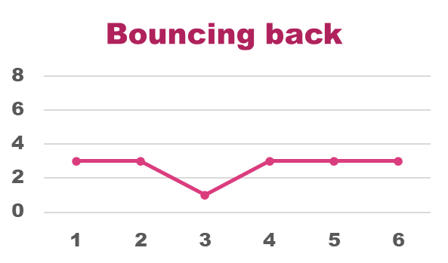
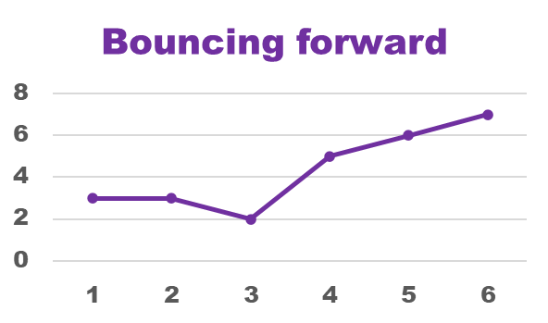
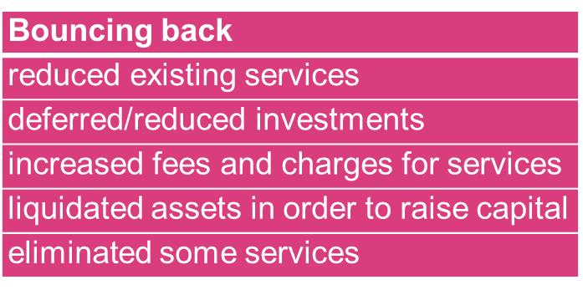
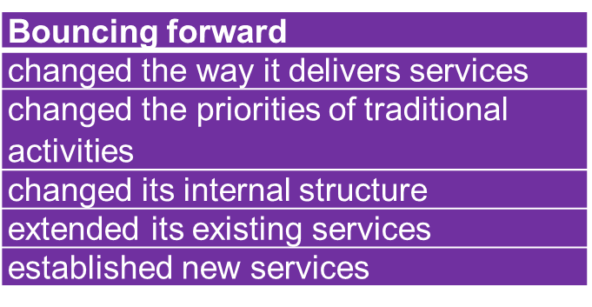
Responding to crises: resilience & capacities
Two types of reactions to shocks

Slide 63
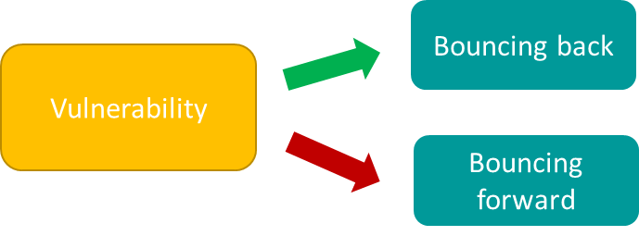
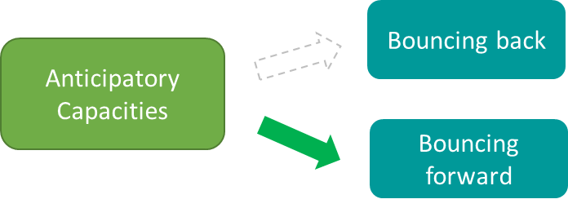
Why Governmental Financial Resilience matters
Higher financial vulnerability encourages bouncing-back strategies and discourages bouncing-forward strategies of reactions to shocks
Anticipatory capacities (especially information exchange) encourage bouncing forward strategies, and have no association with bouncing back strategies.
Barbera et al; 2018; 2019

Slide 64
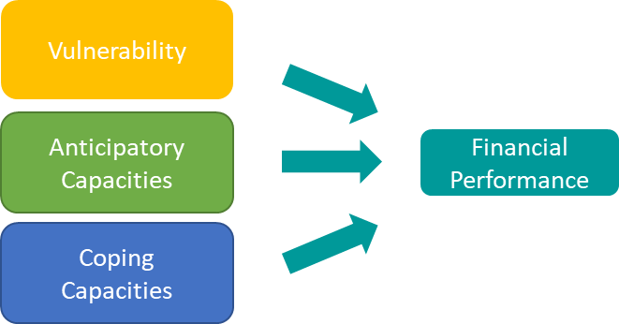
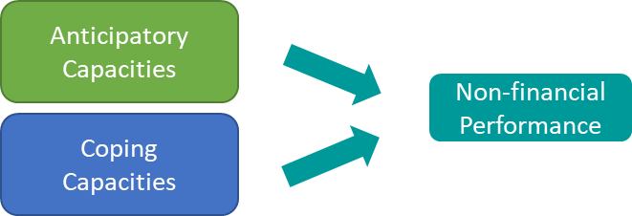
Why Resilience matters to performance
Perceived Financial vulnerability makes a difference in financial performance
Some anticipatory and coping capacities affect financial performance (monitoring, info sharing, rapidity of action)
Anticipatory and coping capacities make a difference for non-financial performance…
Barbera et al; 2018; 2019

Slide 65
Average Local Government Financial Resilience Profile

Slide 66
Financial Resilience Toolkit C. Barbera, C. du Boys; M. Jones; S. Korac; I. Saliterer; I. Steccolini

Slide 67
The Dimensions of Financial Resilience

Slide 68
Dimensions | Definition
Shocks | Shocks and crises are events that have a significant impact on (local) governments' finances and service delivery, varying in their nature, likelihood, timing, scale and potential impacts.
Vulnerability | Vulnerability represents the exposure to (potential) shocks that may affect local government finances and service delivery, as the result of external and internal sources
Anticipatory Capacities | Anticipatory capacities refer to the availability of tools and capabilities that enable local governments (a) to better identify and manage their vulnerabilities and to recognise potential financial shocks before they arise,
Coping Capacities | Coping capacities refer to resources and abilities that enable local governments to face shocks and manage their vulnerabilities. Coping capacities lie dormant in times of order and become visible in times of disruption in the form of actions that are taken and coping strategies that are pursued
(Barbera et al. 2017; Saliterer et al., 2021)

Slide 69
What users have said about the toolkit
Uses of the Toolkit
A powerful internal dialogue tool to help Local Authorities (LAs) better understand capacities and perceptions to recover from shocks
For comparison against peer institutions to identify potential opportunities and threats, and devise strategies for enhanced financial resilience
For performance measurement and internal control
For identifying potential risks, and useful in generating ideas to withstand adversities from such risks
Users of the Toolkit
Its subjective nature allows it to be used by different actors in different ways
Not just for individual assessment, but LAs can make a collective use of the toolkit for better understanding of their state of vulnerability.
Impact of the Toolkit
Enhanced financial resilience when used properly
An external benchmarking tool for reduced perceived vulnerability

Slide 70

QR Code and Link
https://bit.ly/4lZeK05

