Slide 1
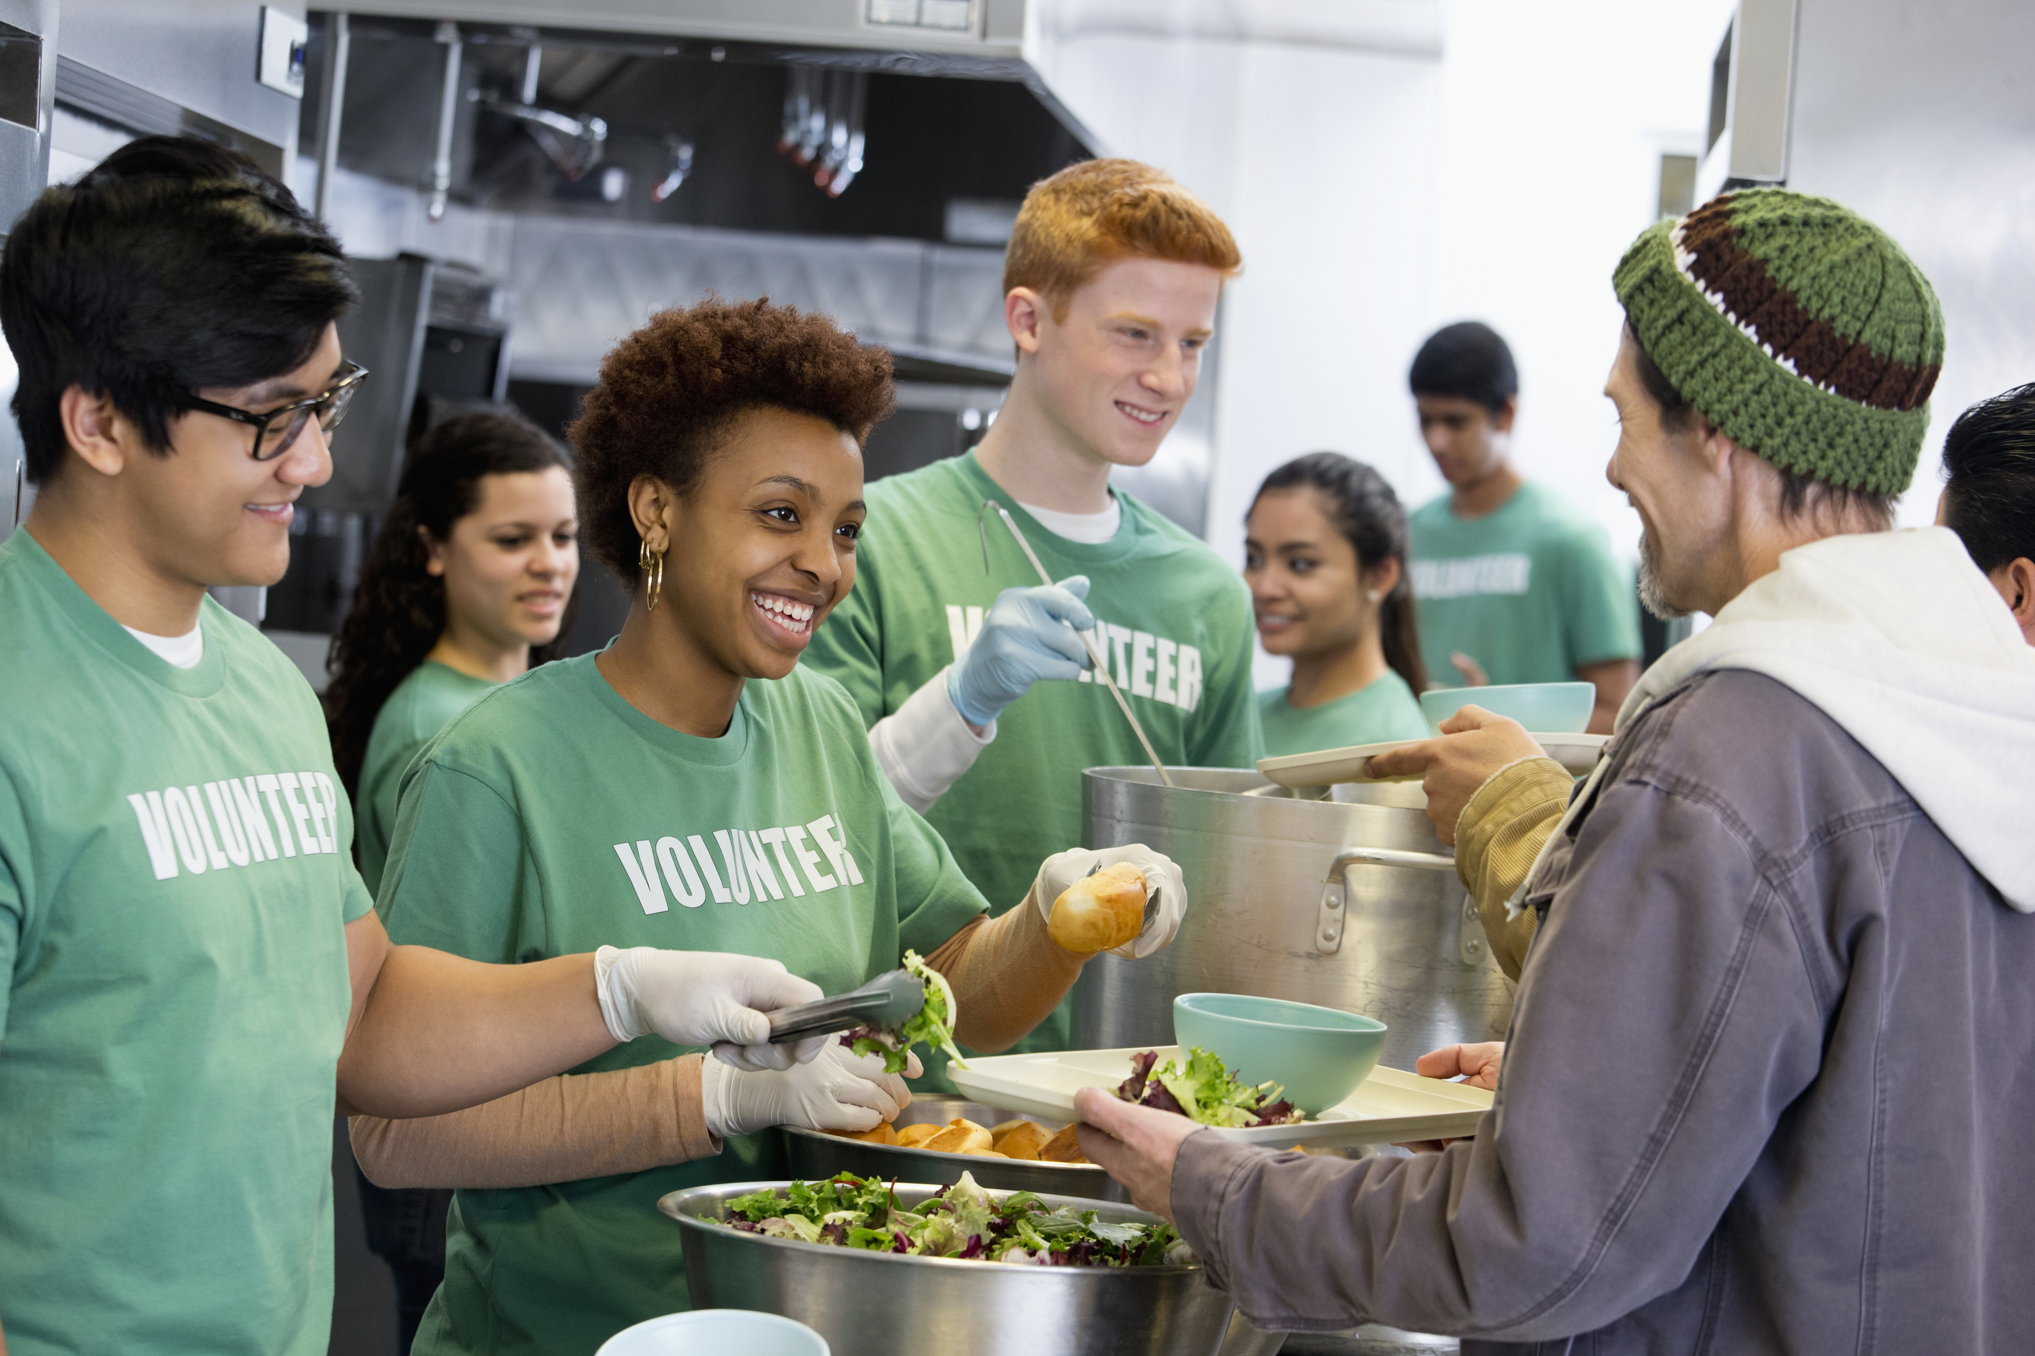
Nottingham City Sustainable Food Partnership (NCSFP) EMGH workshop, Nottingham City Council Delivered by: Eva Zemandl 16 January 2025

Slide 2
Content
Partnership vision and principles
Themes and aims
Structure and interim steering group
EMGH and NCSFP synergies
How to get in touch

Slide 3
We are a multisector partnership formed to create a food secure, financially resilient, enterprising, socially just and green Nottingham.

Slide 4
Our guiding principles
Prioritizing the food insecurity emergency
Working with and learning from Nottingham’s diverse populations to address differing needs, leverage creative approaches and empower citizens and communities
Investing in our young people
Harnessing the potential of local procurement, community gardens and urban agriculture to be part of the solution in addressing food insecurity, poor nutrition as well as promoting healthy lifestyles and social capital
Supporting the development of circular economies, reducing pressure on resources and effectively monitoring, managing and minimising waste
Universities working at the centre of the partnership, as anchor and broker institutions, to ensure that joint actions are turbocharged by impact research and student-community engagement

Slide 5
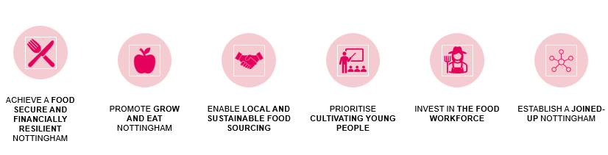
Themes and aims

Slide 6
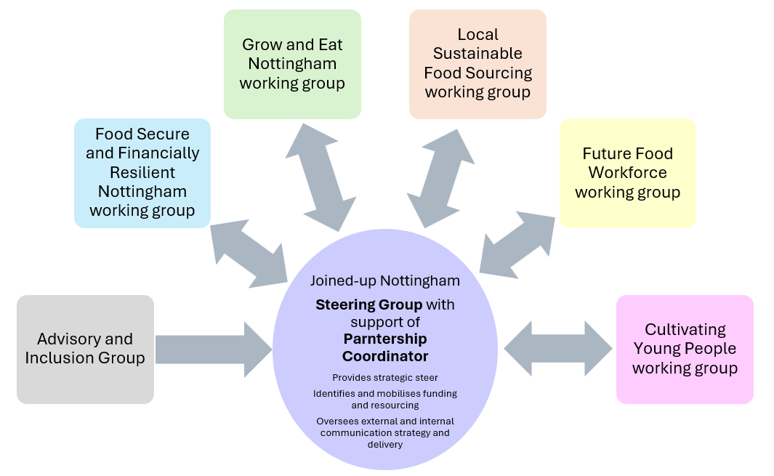
Structure and interim steering group
FareShare Midlands
Himmah
Nottingham City Council
Nottingham Growing Network
Nottingham Financial Resilience Partnership, including the Food Bank Group
Nottingham Social Eating Network
Nottingham Trent University
Urban Agriculture Consortium
University of Nottingham, Food Systems Institute
Trussel Trust (Hope Nottingham and Clifton Food Bank)

Slide 7
EMGH and NCSFP Synergies
EMGH themes | NCSFP themes | Outputs and actions
Commission/create a Nottingham Good Food plan | Joined-up Nottingham: Establishing and coordinating a sustainable food partnership in the city that leverages existing strengths within Nottingham through a whole systems, multisector and ‘more-than-food’ approach. | Explore the creation of a ‘Nottingham Food Chater/Strategy’ as a framework for this partnership and to unify all Nottingham City Council’s policies with a food dimension (with links to the Government Food Strategy
Define a clear governance structure that brings together local partners to monitor the progress of the aims set out in the good food plan To be underpinned by TOR - in progress |  | Nottingham City Sustainable Food Partnership established, with Sustainable Food Places membership/accreditation achieved Establish the NCSFP Steering Group, finalise membership and agree terms of reference

Slide 8
EMGH and NCSFP Synergies
EMGH themes | NCSFP themes | Outputs and actions
Look beyond just crisis food poverty and consider the larger group of people struggling with food insecurity with the aim of preventing crisis point see financial resilience public health strategy | Food Secure and Financially Resilient Nottingham: Working towards a food secure, financially resilient as well as physically and mentally healthy resident population in the city | Intervention and Research Sub-group tasked with identifying and building a bank of potential interventions that are evidence-informed and can be piloted in select LSOAs as part of a significant, funded study. The output would be the development of a comprehensive, multiyear funding bid that would benefit communities on the ground
Creating a local environment that promotes healthy food choices | Grow and Eat Nottingham:Harnessing urban and peri-urban agriculture to play a part in the nutrition, health and (physical and mental) wellbeing of residents. | Pilot CropDrop model in Nottingham to support future planning and distribution of locally grown food to community projects

Slide 9
EMGH and NCSFP Synergies
EMGH themes | NCSFP themes | Outputs and actions
Ensuring all Early Years Settings, Schools and Academies are enabling eating and moving for good health | Cultivating Young People: Connecting young people to healthy and locally grown food and harnessing schools as hubs for supporting healthy food choices for children and their families. | Co-design a pilot project based on knowledge and experience of pioneering teachers and schools; community groups working with schools delivering ‘edible classrooms’ and similar initiatives, and Nottingham City Council’s Healthy Schools Team. This can help develop a local model to ensure children and young people develop a deeper understanding of food and food provenance, as well as healthy and sustainable eating habits.

Slide 10
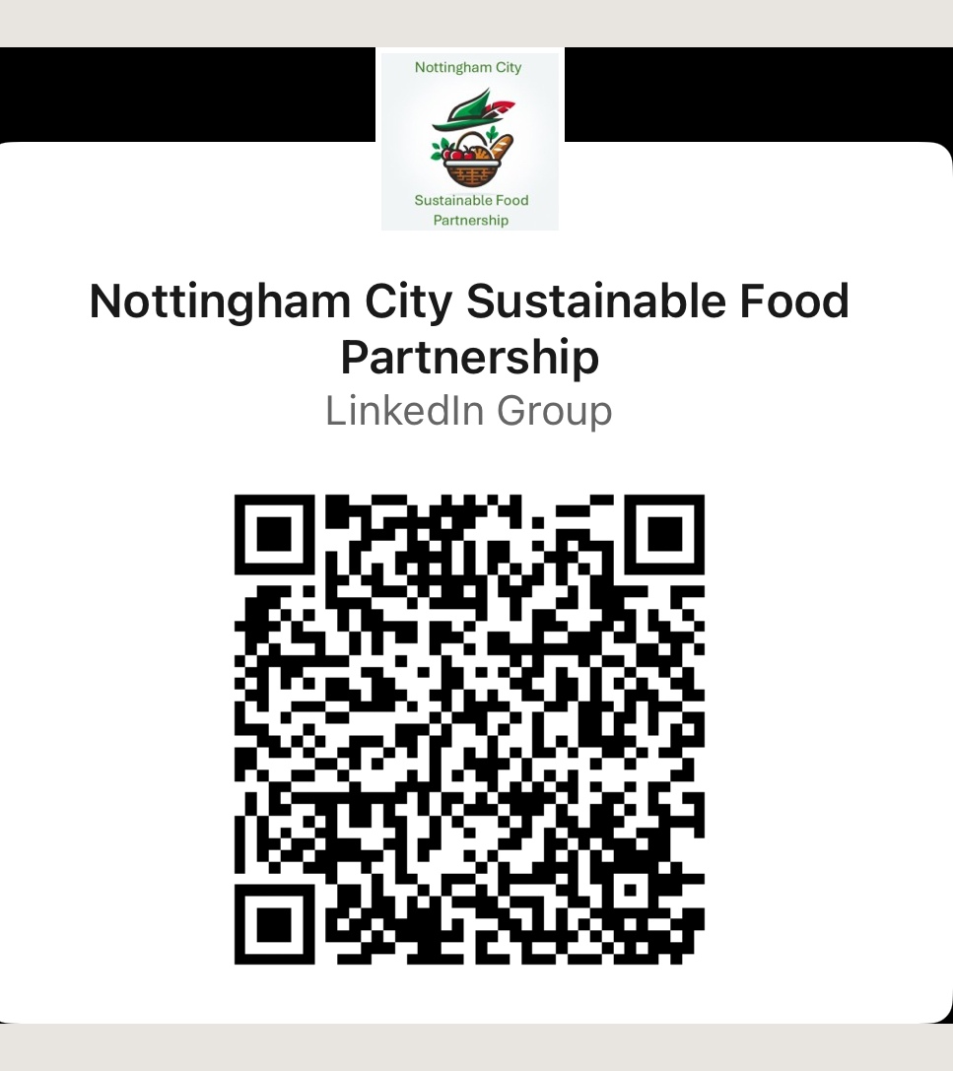

Find us on LinkedIn

Slide 11
Thank You
Dr Eva Zemandl
Interim Partnership Coordinator
MARKETs Group at NTU
eva.zemandl@ntu.ac.uk

